Slide 1
CCLS
Building a Professional Brand and Online Networking
December 2021

Slide 2
Purpose of this session
Provide an overview of online networking and why it is important
Give you some tips on building a professional brand and online presence (focus on LinkedIn)
Outline the career benefits of professional networking, especially informational interviews

Slide 3
Building a Professional Brand and Network on LinkedIn
Image by inlytics on Unsplash

Slide 4
Benefits of using LinkedIn
Make career
decisions
Network
Gain academic
insights
Create
online profile
Research
career paths

Slide 5
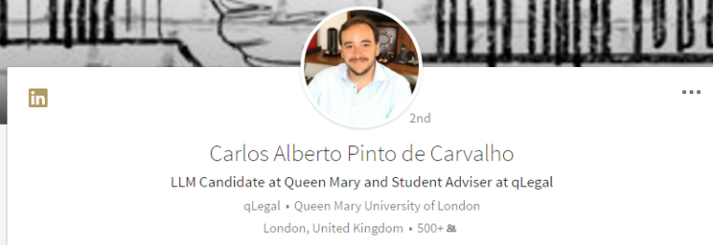
Add professional photo
First impressions – photo and headline
“Spanish qualified lawyer currently completing Regulation and Compliance LLM at Queen Mary University of London and seeking in-house roles in the same area”
What you currently do
Show your value
Use keywords
14x more views with a profile photo
Write attention grabbing headline
1
2
Notes:
Profile Summary
Similar to a CV but with some important differences.
Top 3rd is a profile summary designed to give any reader a quick idea of who you are, what you have accomplished and importantly what you are looking for – like personal statement. It is one of the most important sections in the profile
There are two parts
Headline
Summary
The pencil icons are the edit button. Whenever you see one it means you can edit. So
First element to a good profile is your photo and headline.
Photo – professional, head and shoulder – not glamour or with friends or a beach in the background. Plain background, get a friend to take a head and shoulder photo if you don’t have one.
Background picture – again pencil icon to edit. You can browse other people to get an idea. LinkedIn has a default background if you aren’t sure.
Then the first name and last name
Finally your headline. This is really important to spend time thinking about, as it is what defines whether you would come up in a search someone does (as it trawls headlines for keywords) and it’s what people see when they search, so it tells them who you are

Slide 6
3
First impressions - summary
Example of good LinkedIn summary
information about their studies
includes keywords
includes areas of specialism related to career interest
relevant work experience/project experience
future aims stated
Notes:
Here is an example of a summary that LinkedIn say is a good one.
- states where he is in studies
- states areas of specialism relevant to future career interest
- states relevant work experience
- states future aim
- includes a download of a CV
Have a go at writing your summary.
If you want to do a job totally unrelated to your degree, flag up other ways you have engaged with that career e.g. talks / magazines you subscribe to / blogs you read etc that inform you about that area. Also, if you don’t know what you want to do, then focus on the transferable skills that you have and how you have gained them.

Slide 7
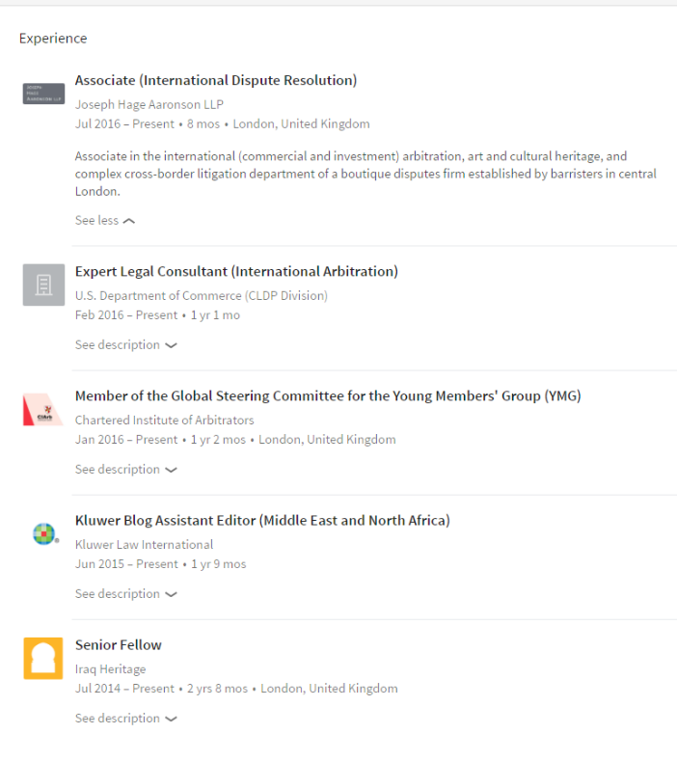
4
Detail your current and past work experience and education
(most recent first)
12x
More profile views than those without

Slide 8
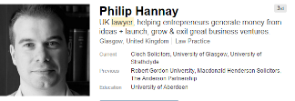
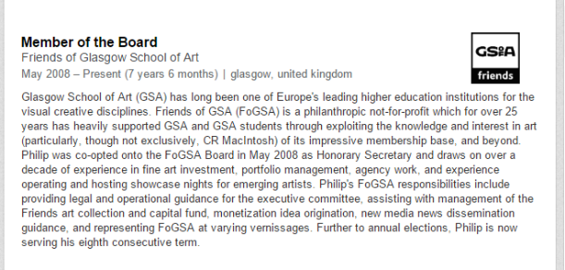
5
Include volunteer experiences & interests
6x
More profile views than those without
On profile page, go to ‘Add profile section’ and select ‘volunteer experience’

Slide 9
6
Add skills and get endorsed for them
Include mix of technical/legal and transferable
Skills and endorsements contribute to elevation in search results…
…so don’t be shy!
Scroll down to bottom of profile page to ‘Skills and endorsements’

Slide 10
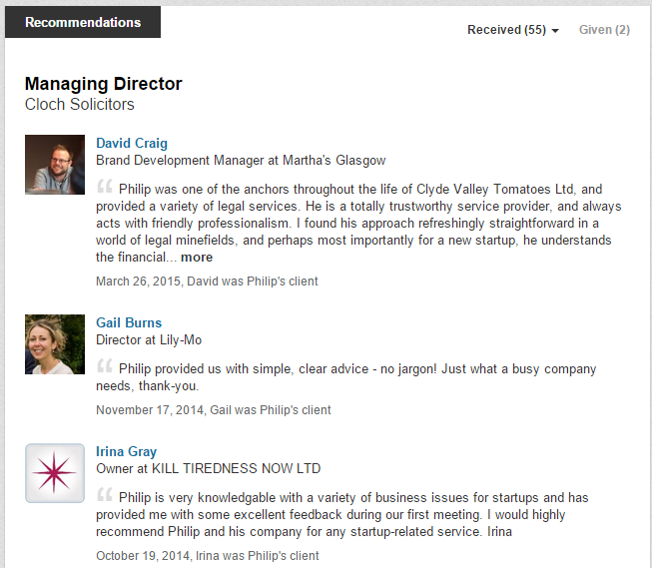
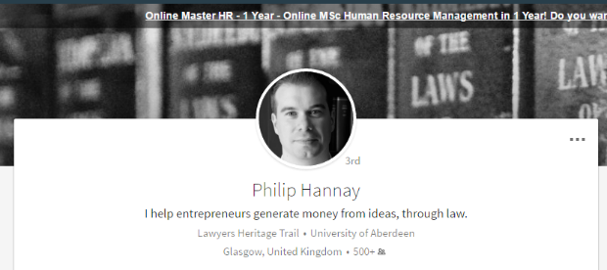
7
Collect valued recommendations
Scroll down to bottom of the profile page to ‘Recommendations’
Notes:
Highly desirable
Unsolicited, Requested, Reciprocated
LinkedIn has special functions for soliciting recommendations (under Recommendations on profile page)
The recommender needs to be a connection
It becomes clear when you write them for yourself so try to get your contact to write them and reciprocate.
Who can recommend you??

Slide 11
8
Join Groups
indicates your interests on your profile
helps you gain more contacts
provides useful information
Use ‘Search’ box at the top of the page
Select ‘Groups’ once highlighted
Type your specific search in the box (e.g. human rights lawyers UK)
You can also check which Groups other people are in by going to the ‘Interests’ section at the bottom of their profile page (select ‘See all’ then ‘Groups’)

Slide 12
Grow your network – make connections
9
When inviting people to connect, always send a short, personalised invitation which lets them know why you want to connect (and where you met if applicable)
TIP: Do not contact the same person too often (no more than 5x’s or you’ll be blocked
Start at the profile to ensure you have the option to create a personal message.
Notes:
Ask to LinkedIn with every relevant
contact you meet
Send them a personal note!!
For graduates looking for jobs LinkedIn is important as a showcase but it also can be a place to network:
LinkedIn can automatically send connection requests to your contact list
You can search for people you know
Class mates and Alumni are a good source
Join Groups
Look for colleagues from previous employment
LinkedIn can be viewed as an address book too!
Can be game of six degrees of separation

Slide 13
Follow companies/organisations to learn
about their work and find out about jobs
10
Chat with connections who work there
Look at their ‘Jobs’ section
Look at other similar/relevant organisations people viewed
Clifford Chance Trainee Tuesdays

Slide 14
Connect with Queen Mary Alumni
Clifford Chance Trainee Tuesdays

Slide 15
Explore other people’s career paths
Review profiles of people doing roles you are interested in (and the companies they work for) to get ideas about career paths and keywords/
language to use on your profile and in your searches
Clifford Chance Trainee Tuesdays

Slide 16
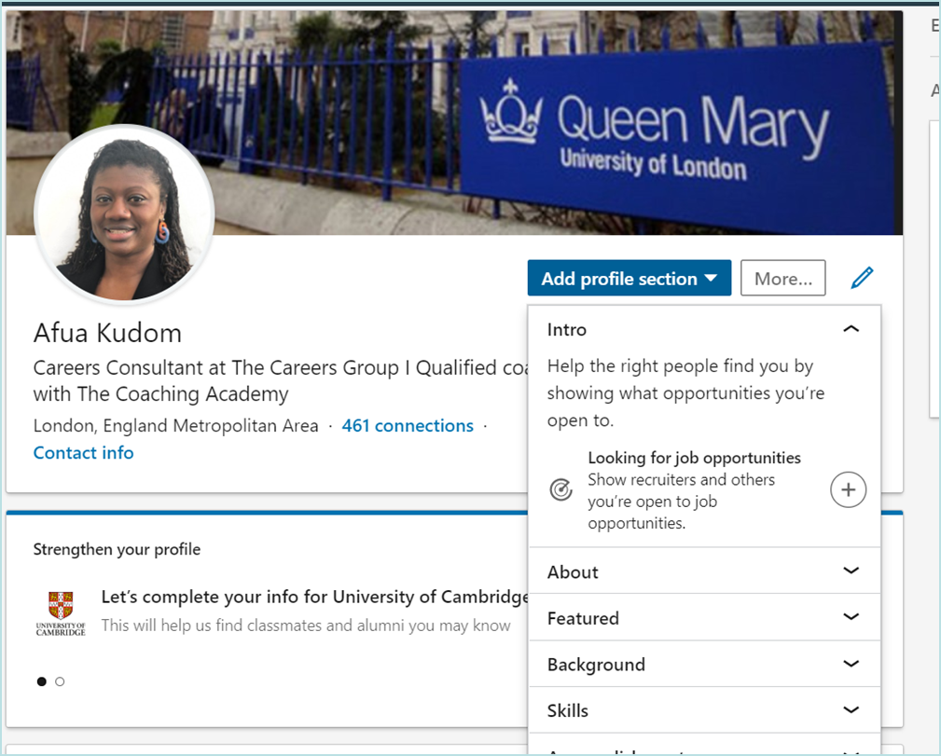
Show recruiters you are open to opportunities
Clifford Chance Trainee Tuesdays

Slide 17
Manage your personal settings
Click on your profile (it says ‘Me’ where your profile picture is )
Select ‘Settings and Privacy’ under ‘Account’
Remember - YOU control your privacy

Slide 18
Informational interviews
Image by David Travis on Unsplash

Slide 19
Informational interviews
Short conversation (ideally 20 – 30 minutes)
With someone in a firm/chambers/organisation you want to work for or someone on your desired career path (e.g. future joiner)
Focus is on gathering information (NOT about getting a job)
Ask intelligent questions (do your research before hand)
Think of what you contribute to the conversation – they are likely to want to know about you too

Slide 20
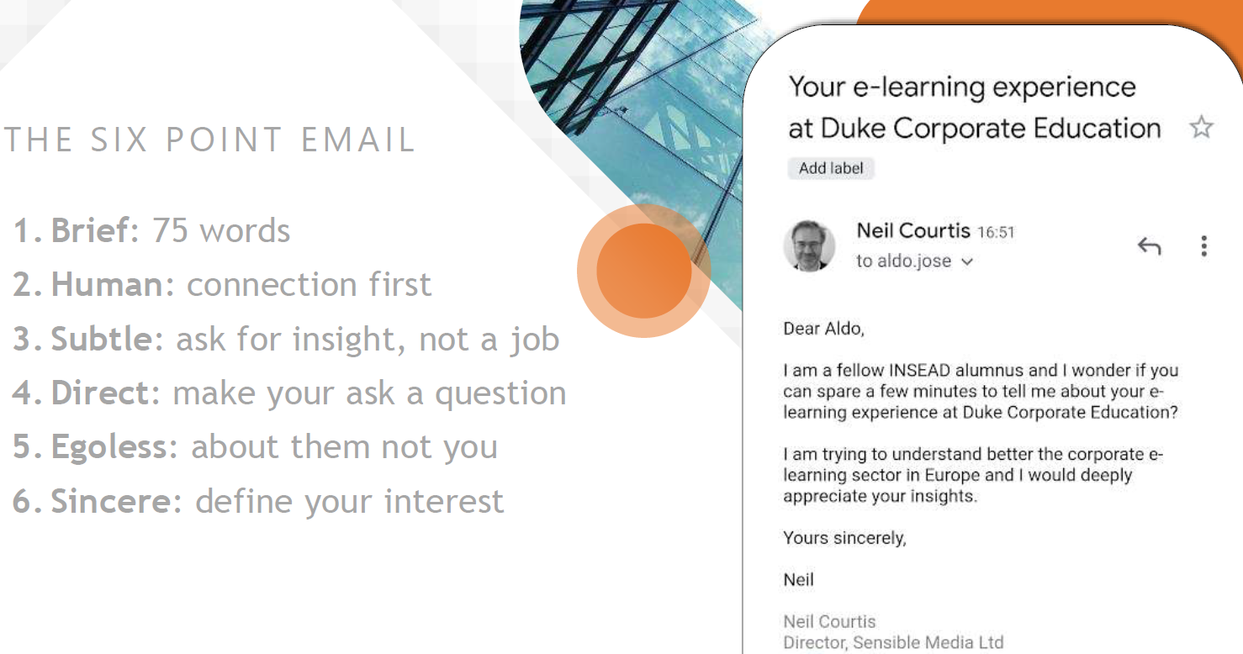
Taken from Steve Dalton’s ‘The 2-hour job search’

Slide 21
Using social media for professional networking
Image by dole777 on Unsplash

Slide 22
The career benefits of using social media
Taken from an article on LawCareers.Net, ‘Aspiring lawyers: a guide to social media’
Develops commercial awareness
learn new ideas, keep up to date with trends, news and updates
engage with content creators and join discussions on issues affecting the sector
provides practical examples for applications and interviews
Creates opportunities
through engagement/collaboration with peers/industry experts
social media ambassador

Slide 23
Online/virtual professional networking
Image by Wes Hicks on Unsplash

Slide 24
Online/virtual professional networking tips
Set clear objectives (e.g. explore career options, gain first-hand insights)
Maximise opportunities to connect with recruiters, alumni and other professionals
Read and implement useful advice and guidance on online/professional networking
Present a professional image (e.g. smart attire, professional profile photo and bio)
Keep your information up to date
Practise, practise, practise…..

Slide 25
The Queen Mary Alumni Network
Global community of almost 180,000 former students, in over 160 countries around the world
Lifelong link to the university
You can join as a current student
Provides access to alumni willing to provide a wide range of support, including e-mentoring and careers advice
A good way to practise your professional networking skills
https://www.qmul.network

Slide 26
Useful resources
EJ Legal
http://www.ejlegal.co.uk/finding-your-next-legal-job-with-social-media
LawCareers.Net
How to network online
Aspiring lawyers: a guide to social media

Slide 27
Final thoughts
You don’t have to do everything all at once …
..but take the first steps, keep working at it and start laying a foundation for your entire career
Image by Dayne Topkin on Unsplash

Slide 28
CCLS
Enjoy building your brand and networking

