Slide 1
COM6006 / FRE6006 Narrative in Theory and Practice: Analysing and Creatively Responding to French Literature Through the Ages
Dr Richard Mason
richard.mason@qmul.ac.uk

Slide 2
Post-Reading Week approach:
Analyzing and creatively responding to literary texts
Why?
Understanding by doing

Slide 3
Assignment 2: 2500-word creative exercise and reflective commentary (60%) due 23:55 on Sunday 9 January 2022
Guidelines
There is no fixed proportion for the lengths of the creative exercise and reflective commentary; neither component, however, should be less than 1000 words. If you were to write a creative piece of 1200 words, for example, you would have 1300 words remaining for the reflective commentary.
FRE6006 students should write their creative exercise in French, but their reflective commentary in English.
Your creative piece should not be inspired by the same text you discussed in your first assignment.
You should approach (and present) the reflective commentary as you would a normal piece of academic writing. The reflective commentary provides you with a space for discussing key narrative features of the primary texts and the ways in which you have responded to these in your creative writing. You might analyse, for example, how focalization is used in the literary work before discussing how you adopted or subverted this narrative approach in your own work.
Your reflective commentary should demonstrate an awareness of relevant secondary literature. It should be accompanied, therefore, by a bibliography detailing the critical works you have used. The bibliography is not included in the word count.

Slide 4
Assignment 2 task based on ‘Un cœur simple’:
3. Based on your reading of Flaubert’s Trois contes (Three Tales), complete one of the following tasks:
a) Rewrite one or more scenes from ‘Un cœur simple’ (‘A Simple Heart’) in order to explore the views, feelings and perceptions of Mme Aubain. Options for scenes to rewrite include the group’s encounter with the bull; the episode in which Félicité becomes acquainted with her nephew Victor and the announcement of his death; Virginie’s illness and death; the arrival of the parrot and Mme Aubain’s perspective on Félicité’s relationship with it. Accompany your piece with a reflective commentary.

Slide 5
Week 8. 6006 Creative session 1 : Flaubert, ‘Un cœur simple’
Objectives:
Discuss narrative technique in the first of Flaubert’s Trois contes (Three Tales)
Undertake a creative exercise inspired by Flaubert’s description of objects and interiors.
Reflect on how such description overlaps with narrative features such as focalization, characterization, time…

Slide 6
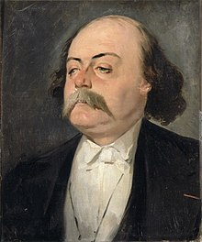
Gustave Flaubert (1821–1880)
‘un homme qui par l’usage entièrement nouveau et personnel qu’il a fait du passé défini, du passé indéfini, du participe présent, de certains pronoms et de certaines prépositions, a renouvelé presque autant notre vision des choses que Kant, avec ses Catégories, les théories de la Connaissance et de la Réalité du monde extérieur.’
‘A man whose entirely original and singular use of the definite and indefinite past tenses, of certain pronouns and prepositions, has upturned our vision of things as much as did Kant with his Categories and his theories of Knowledge and of the Reality of the exterior world.’
Marcel Proust, ‘A propos du style de Flaubert’, 1920

Slide 7
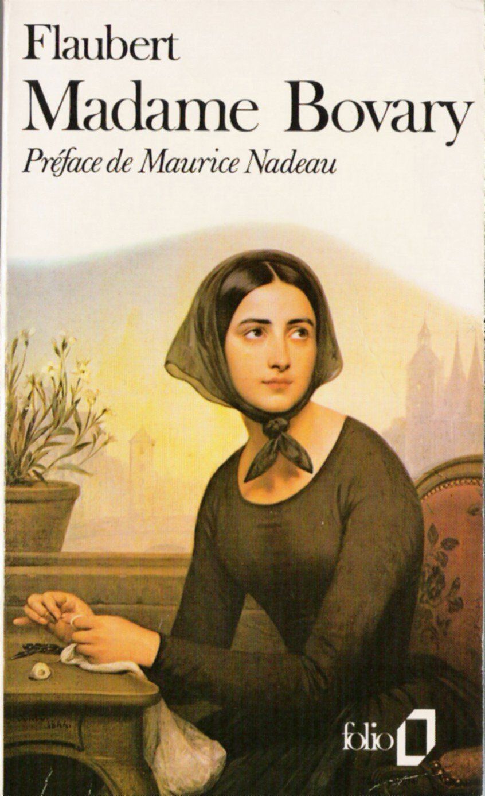
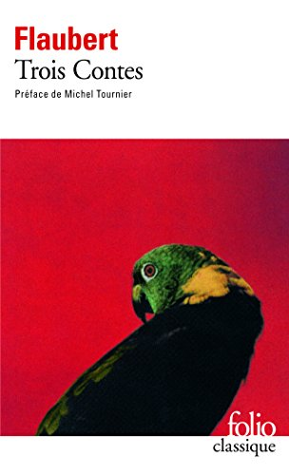
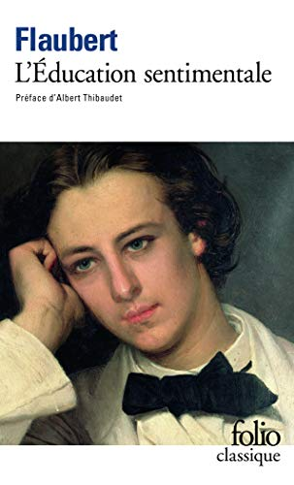
Gustave Flaubert (1821–1880)
Madame Bovary (1856)
Salammbô (1862)
L’Éducation sentimentale (1869)
Trois contes (1877)
Bouvard et Pécuchet (1881)

Slide 8
‘Ce qui me semble beau, ce que je voudrais faire, c’est un livre sur rien, un livre sans attache extérieure, qui se tiendrait de lui-même par la force interne de son style, comme la terre sans être soutenue se tient en l’air, un livre qui n’aurait presque pas de sujet ou du moins où le sujet serait presque invisible, si cela se peut.’
‘What seems beautiful to me, what I should like to write, is a book about nothing, a book dependent on nothing external, which would be held together by the strength of its style, just as the earth, suspended in the void, depends on nothing external for its support; a book which would have almost no subject, or at least in which the subject would be almost invisible, if such a thing is possible.’
Flaubert, Letter to Louise Colet, 1852.

Slide 9
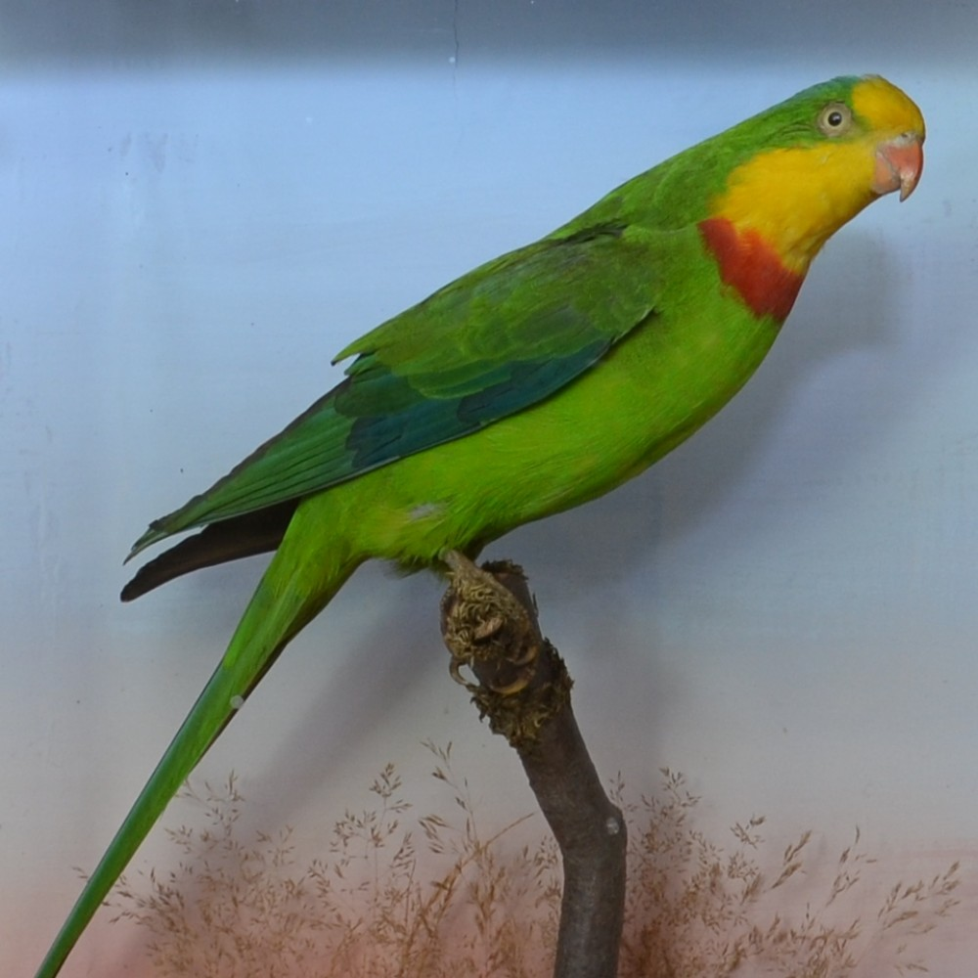
Gustave Flaubert, ‘Un cœur simple’ (‘A Simple Heart’)
‘[‘A Simple Heart’] is quite simply the tale of the obscure life of a poor country girl, devout but not given to mysticism, devoted in a quiet sober way and soft as newly baked bread. One after the other she loves a man, her mistress’s children, a nephew, an old man she nurses, then her parrot; when the parrot dies she has it stuffed, and when she is on her deathbed she takes the parrot for the Holy Ghost. It is in no way ironic (though you might suppose it to be so) but on the contrary very serious and very sad. I want to move my readers to pity, I want to make sensitive souls weep, being one myself.’
Flaubert, cited ‘Introduction’, Three Tales, p. xx.

Slide 10
Gustave Flaubert, ‘Un cœur simple’ (‘A Simple Heart’)
What did you take to be the story’s key events? (discussion)
To which genre would you say the story belonged?
Critical perspectives:
‘The absence of action and incident which rendered the subject unsuitable for a novel would not be a drawback in a much shorter work.’ (Raitt 1991: 13)
‘In general, writers of short stories have preferred to avoid relating the whole life of a character, illuminating it instead by means of a single salient incident. Flaubert on the other hand has chosen to recount a whole life, and a life which has no single incident to act as a focal point. This means that the work is largely lacking in any forward impulse, save what is imparted by the passage of time.’ (Raitt 1991: 29)

Slide 11
Textual analysis: Flaubert, ‘Un cœur simple’ (‘A Simple Heart’)
Description of Mme Aubain’s house (Eng, pp. 3–4, Fre, pp. 11–12)
Description of Félicité’s bedroom (Eng, p. 34, Fre, pp. 49)
Discussion:
In what ways does the description of interiors contribute to characterization in these extracts?
Are there any other narrative features worth noting in these extracts?

Slide 12
Warm up: ‘Places where I have slept’ (after Georges Perec)
Places I have slept outside
Places I have slept in an emergency
Family bedrooms
Places I have slept where it was too cold to sleep
Places where I have slept on the floor
Places where I fell asleep accidentally
Etc.!
Make a list of as many as you can and then write some in the messenger

Slide 13
Creative exercise: write a description of an interior to evoke a character
The task is as follows: using roughly 200 words, describe a room in such a way that it evokes a character who inhabits that room. You should not directly describe the character (who could be yourself if you wish, or anyone that you fancy), but rather, you should use indirect presentation of the room to evoke that person or persons.
Once you have completed your piece of creative writing, you should write a few sentences in answer to the following question: how can descriptions of interiors contribute to characterization?
FRE6006 students are encouraged to write their creative piece in French, as they will be required to do so for the second assignment. Reflective commentaries should be written in English by all students.
Once you have finished, you upload your description to the wiki on Qmplus.

Slide 14
Reflection
How did you find this piece of creative writing? what did you find difficult/stimulating etc.?
After having done this creative task, return to a discussion of Flaubert’s use of indirect presentation.

Slide 15
For next week
Write up description on to the wiki if you have not already done so.
Read ‘Saint Julien’ and ‘Hérodias’

