Slide 1
Queen Mary univ of London Energy Law & Ethics Dr Tibisay Morgandi
WEEKS 2
INTERNATIONAL, EU LEGAL FRAMEWORKS FOR ESG REQUIREMENTS

Slide 2
I. INTERNATIONAL LEGAL FRAMEWORK FOR ESG REQUIREMENTS

Slide 3
UN ‘Protect, Respect and Remedy’ Framework and Guiding Principles (2008)
International framework
State’s duty to protect (+/-) against human rights abuses by third parties (including business) and fulfil (+) human rights and fundamental freedoms
National framework
The corporate responsibility to respect (-) human rights + State’s and corporate responsibility for providing access to remedies

Slide 4
Home States and TNCs
Do obligations of home states arising under human rights treaties typically extend to the acts or impacts of the TNCs in other states?
Is this a rule or rather an exception, eg when the TNC is a state-owned or controlled enterprise?
Do home state have a duty to regulate TNCs abroad, eg by enacting legislation?

Slide 5
II. EU LEGAL FRAMEWORK FOR ESG REQUIREMENTS

Slide 6
Companies & Sectors covered

Slide 7
Key Provisions

Slide 8
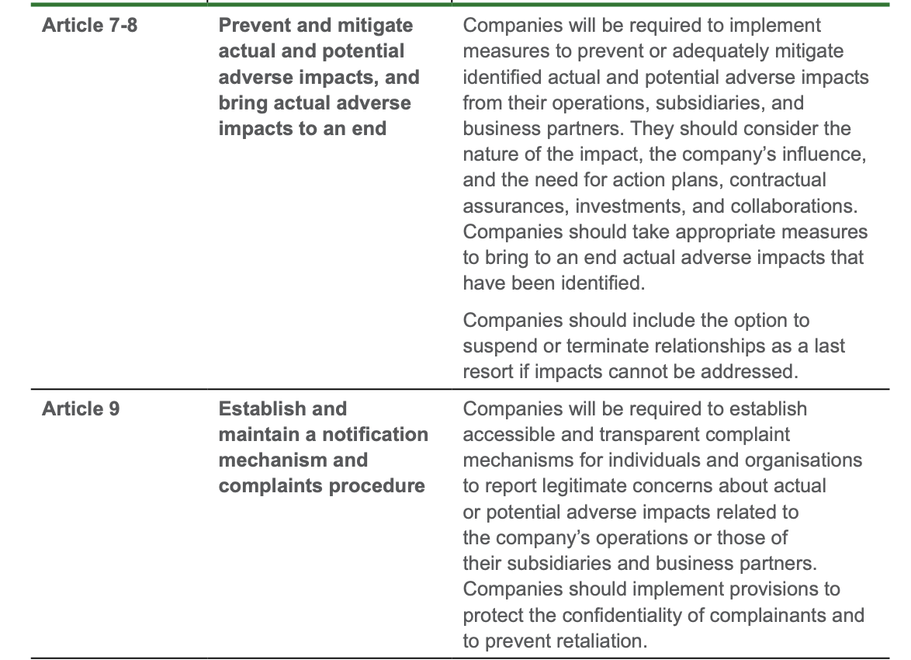
Key Provisions

Slide 9
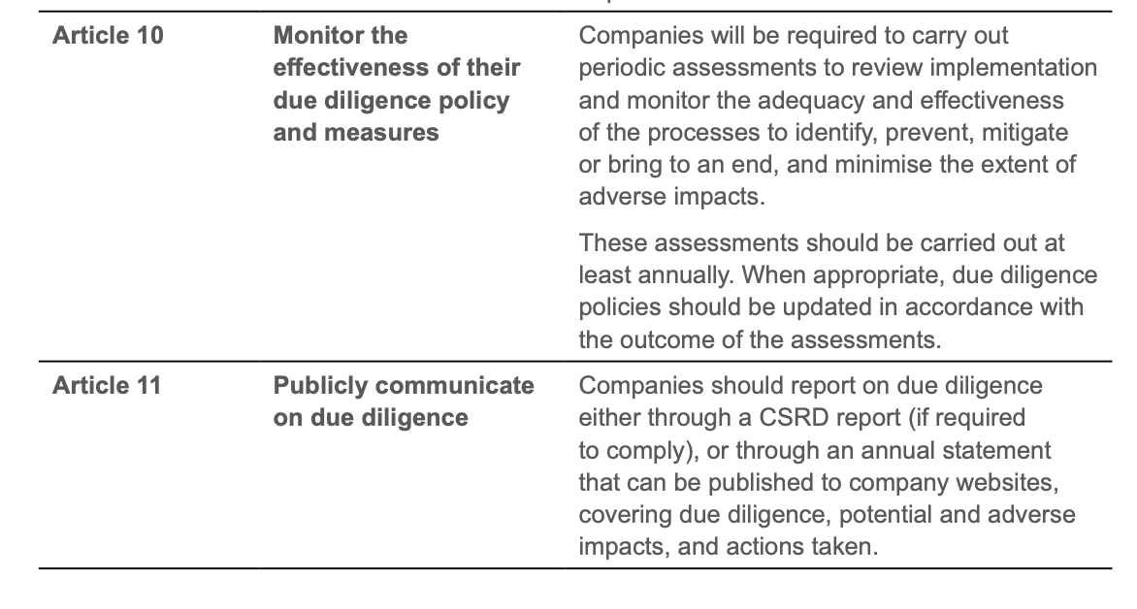
Key Provisions

Slide 10
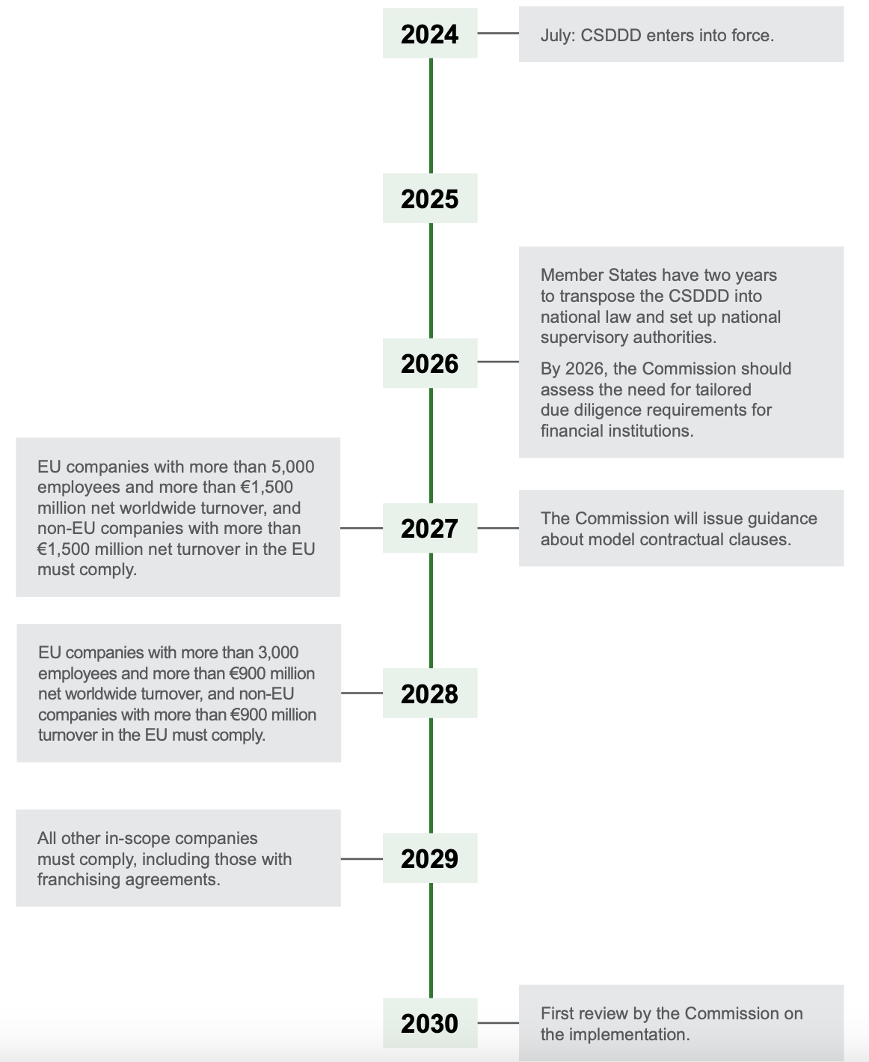
Timeline

Slide 11
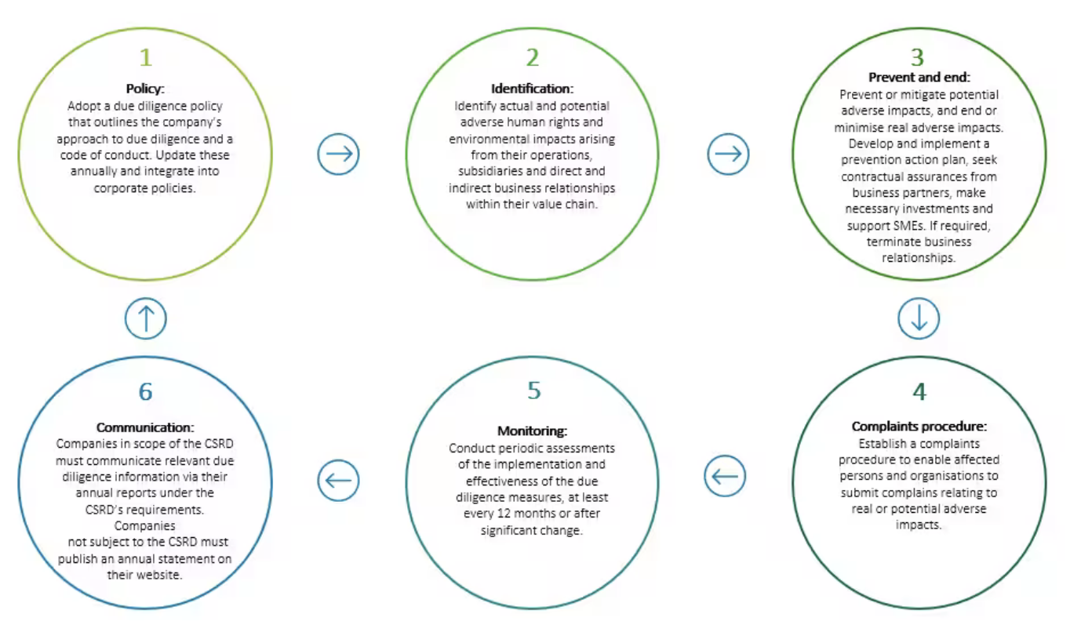
© Deloitte

