Slide 1
COMPANY LAW
LECTURE 1

Slide 2
Personnel
• Lectures Dr Shalini Perera
• E-mail: s.perera@qmul.ac.uk
• Address: Law School, Mile End
• Consultation: By appointment-please email
Seminars/Tutorials 4 SGT - Dr Lilian Moncrieff

Slide 3
Classes
Lectures Mondays 12-3pm
SGT
Tuesdays : You will be allocated into groups after week 1.
SGT start in week3.
Total of 4 (starting week 3)

Slide 4
Lecture Schedule
• Lecture One: Preliminaries and Corporate Management (lecture only)
• Lecture Two: Directors’ Duties (lecture only)
• Lecture Three: Derivative Actions
• Lecture Four: Unfair Prejudice and Winding up on the Just and Equitable Ground
• Lecture Five: Corporate Governance
• Lecture Six: Corporate Finance I
• Lecture Seven: Corporate Finance II
• Lecture Eight: Corporate Finance III
• Lecture Nine: Corporate Insolvency
• Lecture Ten: Corporate Insolvency

Slide 5
Materials
Assigned texts:
D French, Blackstone’s Statutes on Company Law 2023-24 (OUP 2023)
Recommended texts: Please note these texts are available on Law Trove and available to you (FOC) on a QM subscription
Basic: A Dignam and J Lowry, Company Law (12th ed, OUP, 2022)
OR
Intermediate: B Hannigan, Company Law (6th ed, OUP, 2021)
AND
S Worthington, Sealy and Worthington’s Text, Cases and Materials in Company Law (11th ed, OUP, 2016)

Slide 6
Materials
Further useful texts:
Advanced: P Davies and S Worthington, Gower & Davies’ Principles of Modern Company Law (11th ed, Sweet and Maxwell, 2021)
Intermediate: D French et al, Mayson, French and Ryan on Company Law (37th ed, OUP, 2023) available on Law Trove

Slide 7
Reading List
Contains indicative reading; could be added to
Cases and materials can be found in either:
S Worthington, Sealy and Worthington’s Text, Cases and Materials in Company Law (11th ed, OUP, 2016)(‘S&W’)
OR
QMPlus Company Law Lecture Folders
Powerpoints are available before each class and a lecture handout available for some lectures
Use lectures/tutorials as guide to help you frame your essay question

Slide 8
Assessment
Formative assessment
Provision for a formative assessment to assist with final assessment. This will be an outline of your proposed essay. You are expected to submit a paper (a) outlining your proposed essay topic with a brief extract (b) a proposed outline of its structure (c) proposed bibliography.
If space permits you can also submit a paragraph or two of your work for assessment.
The complete paper cannot exceed the maximum word count of 500 words.
Deadline : 18th March 2024 (please note this is changed to a later date)
Submission will be online using the QMplus page.
Final assessment (May)
Independent Research Essay: maximum word limit 5,000 words.
Essay Topic: free choice on any of the topics discussed/ or to be discussed within module or within broad subject area of module.
Deadlines are set by the PG office and this will be mid-May.
All essays must be submitted via QMPlus by the deadline (TBC). Submission points will be set up on QMPlus.

Slide 9
Today
History of the company
Forms of business organization
Why choose the corporate form? …….
Plus Corporate Management

Slide 10
History of the Company

Slide 11
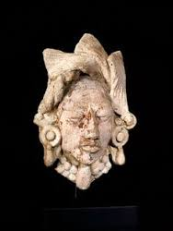
History of the company
600 BC to 100 AD: In Rome associations of persons formed for business purposes. Typically, the societas comprised two persons and engaged in trade.
Variations of the societas (societas publicanorum) had a close relationship with Roman state; these were mechanisms for performing state contracts.
900 AD: In Amalfi and Venice, maritime firms were created to finance and manage single maritime voyages. Funds were contributed by persons who included passive ‘investors’. These arrangements developed to encompass multiple voyages and offer of shares.

Slide 12
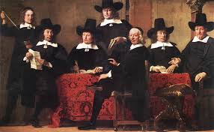
History of the company
1100: In Britain, guilds (associations) formed to advance the interests of tradespersons and local community.
Guilds served quasi-public purposes, regulating aspects of trade – including:
entry and progression from apprentice to journeyman to master
setting of standards of quality for work done
They were recognised and conferred a monopoly within respective boroughs upon payment to Crown of ‘donations’.

Slide 13
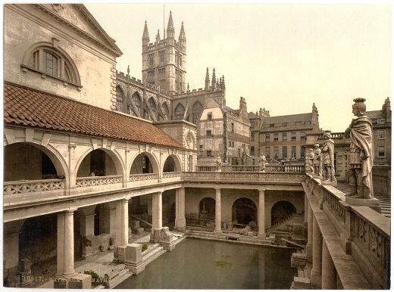
History of the company
1200s: Originally, incorporation was by Royal Charter. Charters were first offered to the Church, cities and university colleges.
Church/city/college was recognised as a legal person, could enter into contracts, hold property, sue and be sued.
Charters were later given to groups of tradespersons as guilds declined.
Royal charter conferred favoured-status and a level of royal protection for group activities; but it also demanded that those given a charter acted for public purposes. The Crown maintained a degree of control.

Slide 14
History of the company
1400s: Crown began to grant charters to those seeking business opportunities overseas. In return for a share in profits, Crown granted the chartered corporation a monopoly on trade in relevant region.
The objects of such grants were to
provide for proper organisation of trade,
develop a new trade, or
assist colonisation
‘The interest of merchants was not in separate legal personality as such so much as the exercise of governmental power and trading privilege’ (Farrar).
Later, chartered corporations began to raise funds through the sale of stock (shares). This allowed for conduct of business ventures on a larger scale. Profits were paid in the form of ‘divisions’ or dividends.

Slide 15
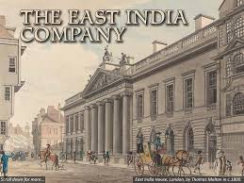
History of the company
In Britain, East India Company was first to combine incorporation by royal charter, overseas trade and joint stock raised from the general public.
It was given a royal charter in 1600 by Queen Elizabeth I and became monopoly trader to the East Indies.
When founded, the company had 125 shareholdesr and raised £72000 for its ventures.
The company was headed by a Governor and had a two-tier structure:
General Court, comprised of all shareholders with voting rights
Court of Directors (24 persons) undertaking day-to-day management

Slide 16
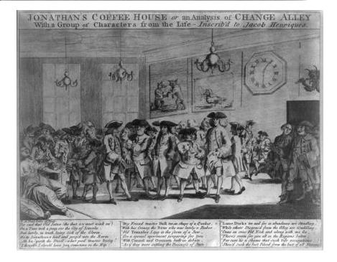
History of the company
Late 1600s: a market had developed in shares of joint stock companies. Shares were traded by ‘stockjobbers’.
Regulation moved from Monarch to Parliament. Parliament attempted a limited regulation of ‘companies’ under Bubble Act 1720 – made it difficult to incorporate without a charter/Act of Parliament. The aim was to prevent persons from speculating in shares.
Bubble Act led to development of deed of settlement company. Business assets were held (not by a corporate body, but) by trustees. The business was managed by directors/other managers. There was an attempt to make beneficiary interests transferable.

Slide 17
History of the company
1844: first modern companies legislation was Joint Stock Companies Registration and Regulation Act 1844. Government wished to encourage investment and business activity and moved from incorporation as a privilege to a right.
Act permitted registration of deed of settlement companies, giving them ‘qualities and incidents’ of incorporation. It divided governance between board of directors and shareholders in general meeting.
There was no formal limited liability for investors.
1855: Limited Liability Act provided deed of settlement companies with limited liability. The idea was to help promote building of railways, canals and docks.

Slide 18
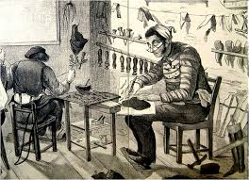
History of the company
1856: Joint Stock Companies Act introduced:
articles of association
memorandum of association – 7 persons were to sign
registration process
need to use designation ‘Ltd’
winding up procedures.
Many new co’s failed.
Eg - boot-maker Aron Salomon, who operated a small company in which he was major shareholder and 6 family members each held one share.
The scene was set for Salomon v Salomon & Co Ltd (1897).

Slide 19
Forms of Business Organisations in the UK

Slide 20
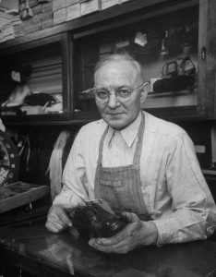
Non-Corporate Forms of Business
Simple forms include:
Sole trader
Partnership
Sole Trader
little formality
a person runs a business and owns its assets personally
trader is personally responsible for contracts/obligations
personal assets are at risk when debts not paid
business income taxed as personal income

Slide 21
Non-Corporate Forms of Business
Partnership
Two or more persons carry ‘on a business in common with a view of profit’: Partnership Act 1890, s 1
Forms by agreement in writing/oral. Few formalities
Agency and contracting: Each partner is principal and agent for other partners: PA 1890, s 5. Each is bound by acts of agents for normal business transactions.
Exception - where counterparty knows that agent has no authority to act.

Slide 22
Non-Corporate Forms of Business
Partnership
Liability: No separate legal entity. Property purchased for business is partnership property: PA 1890, s. 20.
If p/ship fails, its property is used to satisfy debts.
If assets are inadequate, creditors look to personal assets of partners.
Partners share rateably in discharging debts. But if assets of other partners are exhausted, the last solvent partner discharges remaining debts.
Each partner is responsible for own tax affairs; thus, p/ship profits are divided and each partner declares that much of the profit received as personal income.

Slide 23
Non-Corporate Forms of Business
Hybrid organisations
Limited Partnership Act 1907 –
LP must be registered.
Features active and passive partners.
Non-managerial (passive) partners:
cannot bind partnership to external obligations; but
enjoy limited liability
Limited Liability Partnership Act 2000 –
LLP’s main similarity to p/ship is in internal decision-making by partners as equals and in taxation of profits.
Otherwise:
LLP is a body corporate
Partners can limit liability for trading debts (but remain liable for torts they commit).

Slide 24
The Company
Registered Companies
Company Limited by Shares
Private
(Ltd)
Public
(PLC)
Company Limited by Guarantee (private)
Unlimited Company (private)
Unquoted
Quoted

Slide 25
Companies Limited by Guarantee
A company is limited by guarantee if liability of its members is limited to the amount specified in the articles that the members undertake to contribute to the assets of the company in the event of the company being wound up. The guarantee amount is usually a nominal sum (e.g. £5.00).
Issues no shares; these are not necessary because no profits will be distributed to members.
Widely used in charitable organizations- schools, museums, management companies
Resignation of a member from company limited by guarantee, simply-matter of agreement
Limitations on financing. The problem arises in the need for working funds. These might be acquired through a loan; but more typically from subscription fees or fees for services.

Slide 26
Unlimited Companies
‘If there is no limit on the liability of its members, the company is an ‘unlimited company’’; s3(4) Companies Act 2006
Requirements for publication of accounts not necessary for purposes of publicity since creditors rely on credit of shareholders
Privacy and flexibility of structure

Slide 27
Companies Limited by Shares
Shareholders own shares in the company
Their liability is limited to the amount, if any, unpaid on the shares held by them’; s3(2) Companies Act 2006
Companies limited by shares may be public or private companies

Slide 28
Public (PLC) vs. Private Companies (Limited)
Public companies can sell their shares to the public and require a trading certificate authorizing them to sell shares to the public
Private companies cannot sell their shares to the public (CA s.755)

Slide 29
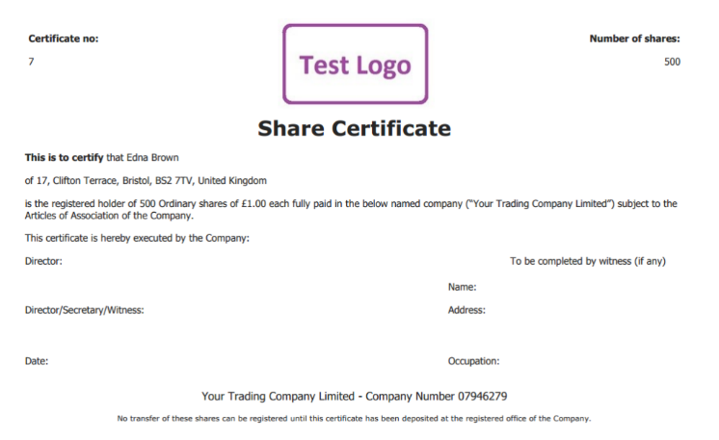
Private Companies
Ownership is via shareholding.
A share is a claim to certain rights regarding the co, usually (but not always) including rights to vote at meetings and to share in dividends of the co.
S/holders appoint directors to oversee running of the co; must be a minimum of 1 director. The director(s) then appoint persons to actually run the co – managers and employees.
The private company has a restricted ability to obtain finance for its operations. It may borrow money from financial institutions; but may not raise money from the public in general. Shares are not offered to the public and thus are not traded on open markets.

Slide 30
Private Companies
The bulk of UK companies
Often restrict membership in articles of association
Often a right of first refusal tied to shares of private companies
Usually smaller than public companies
Often overlap directors, officers, and member hats
Law permits for less formality/requirements
No minimum capital requirement
‘Ltd’ or ‘Limited’ in name

Slide 31
Public Companies
It must be a co limited by shares. It can issue shares/securities to the general public in accordance with Financial Markets and Services Act 2000; subject to regulation by the Financial Conduct Authority (FCA).
There is the potential for public co shares to be traded on a market, such as London Stock Exchange. Such co’s will be subject to FCA’s Listing Rules
LRs give ‘investors an accreditation indicating that those issuers adhere to a range of standards on governance and investor protection’
Even if these steps are not taken, public co is still subject to significant regulation under CA 2006 reporting requirements. These provide protection for various stakeholders – esp. creditors.

Slide 32
Public Companies
Minimum capital requirement of £50,000 (s. 763)
Usually freely transferable shares
Known as a public limited company (plc)
Onerous accounting and audit requirements
Must have at least two directors; requires a company secretary (but 1 member)
Must hold an annual general meeting
Quoted/Listed companies required to fulfill disclosure requirements and other requirements of the Exchange

Slide 33
Incorporation & the Fundamental Attribute of Corporate Personality
Once incorporated the company is a separate legal entity distinct from its shareholders
Members enjoy limited liability and are not required to participate in the management of the company which is a matter for the directors

Slide 34
Advantages and Disadvantages of Incorporation
Advantages | Disadvantages
Limited liability | Burdensome in regulatory requirements
Easier to raise capital | Costly – professional advice needed
Allows for a large number of people to become investors (large and fluctuating) | Shareholders may need to provide guarantees for bank loans for a new business
Enables directors to take more risks and manage (agents/trustees)
Impervious to death
“Ltd” “Plc”signals greater legitimacy and credibility of venture

Slide 35
Think
What is the goal of Company Law?

