Slide 1
INTERNATIONAL FINANCE
INTERNATIONAL FINANCE MARKETS, CRISIS & LAW Professor G A Walker

Slide 2
International Markets, Money & Debt

Slide 3
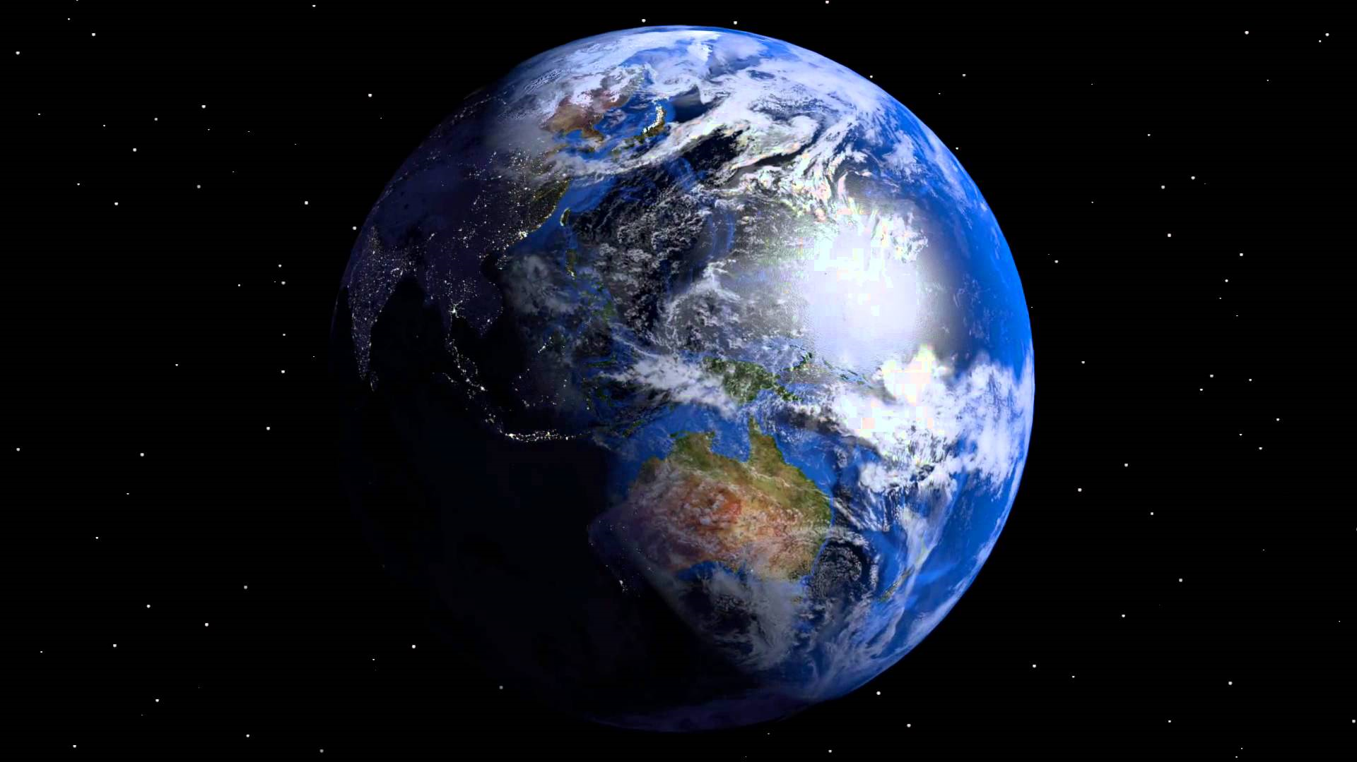
`

Slide 4
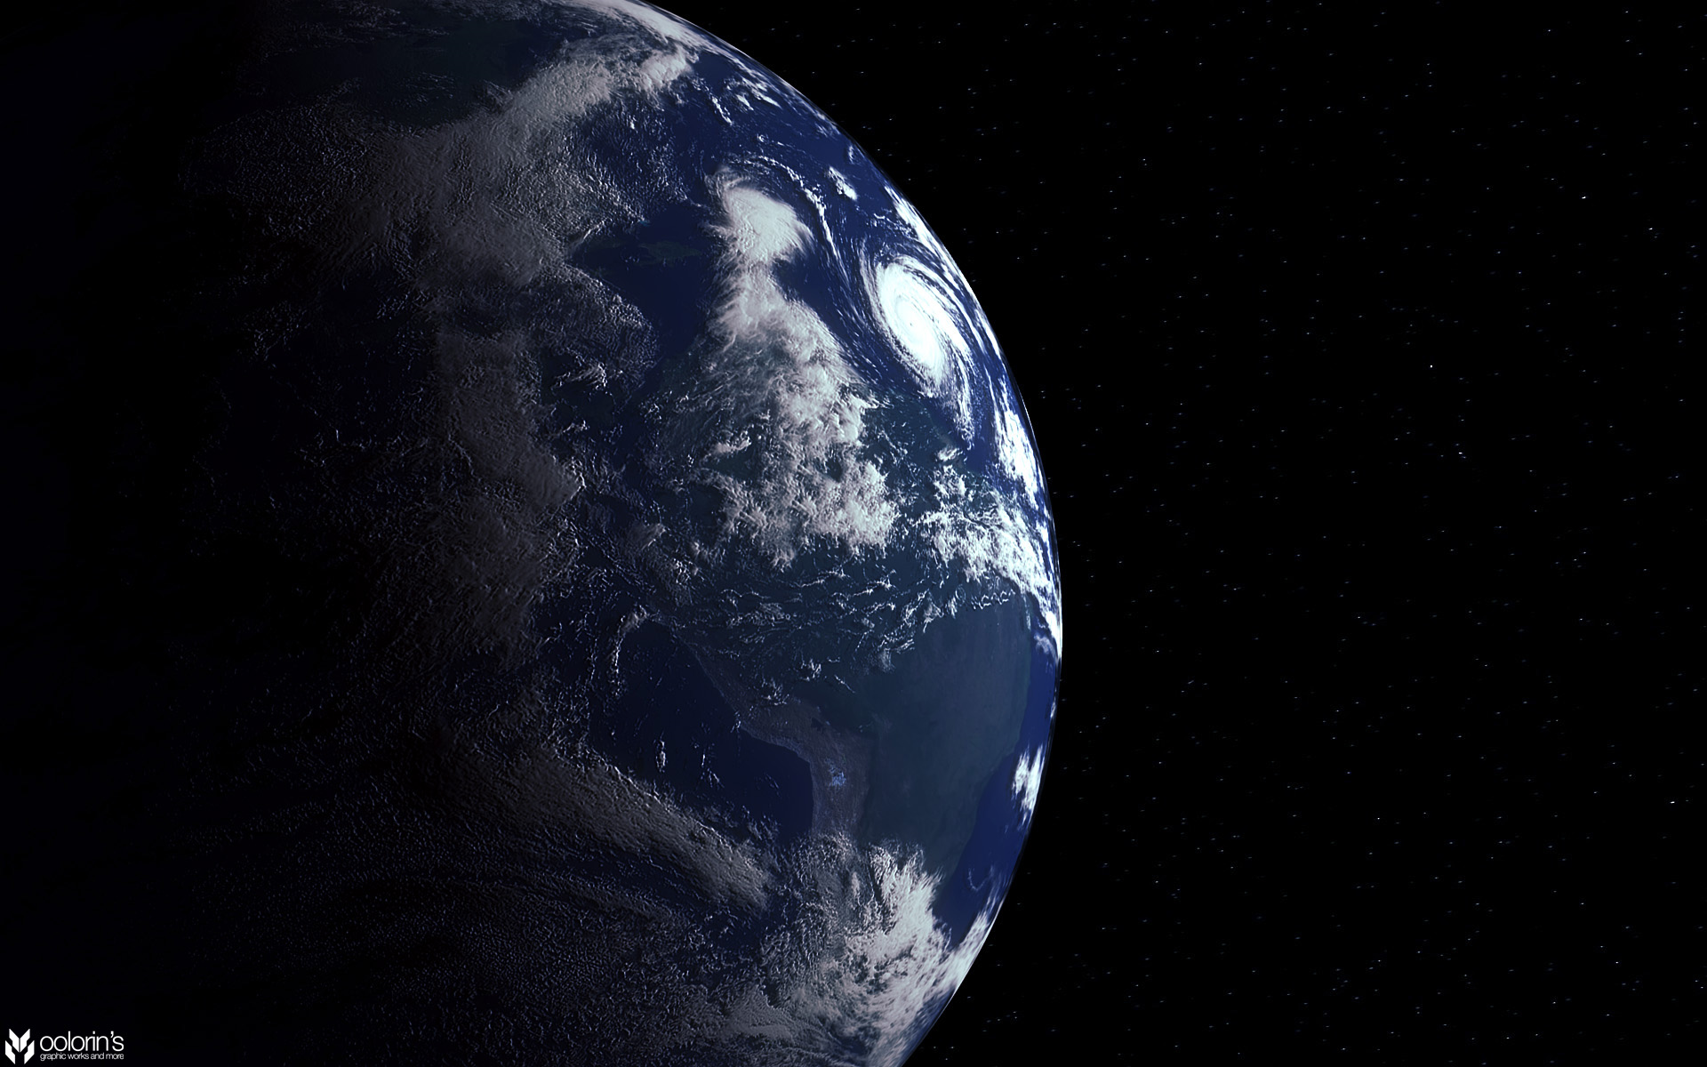

Slide 5
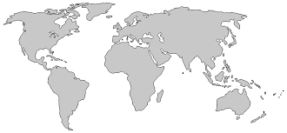
INTERNATIONAL FINANCE & FINANCIAL MARKETS
Two & Three Worlds
Global Financial Economy
Global Mercantile Economy
Digital & Crypto Economy

Slide 6
INTERNATIONAL FINANCIAL MARKETS
CAPITAL MARKETS
BANKING MARKETS
BONDS, NOTES AND PAPER
PRIMARY MONEY MARKETS
EURODOLLAR MARKETS
STRUCTURED FINANCE
FINANCIAL DERIVATIVES
SECONDARY MONEY MARKETS
INSURANCE MARKETS
GOLD

Slide 7
INTERNATIONAL FINANCIAL MARKETS
Coinage & Banknotes 4.687 T (180)
Bonds $ 128.3 T
Banknotes & Accounts $90.4 T
Eurodollar Markets $223 T
Securitisation $1.6 T
Equity Trading $37.7T
Financial Derivatives $ 600 / 15.8 / 3.4 T
Global Stock Market $95/105.8 T
Insurance $5.5 T 2025 $6.4T
Gold $11.12 T
Foreign Exchange $ 6.t T 2019
Shipping Markets $14 T
Silver $5T

Slide 8
GLOBAL FINANCIAL MARKETS VALUE
What is the World Worth
$84.54 / $103.86 Trillion GDP > 2.9%
$1,540 Trillion 2020
$431 Trillion 2020
$545 Trillion 2025
$510 Trillion 2020 NET
$315 Trillion Financial Assets
$250 Trillion Financial Assets
$296 Trillion Real Assets
$235 Trillion Real Assets
$67 Trillion Liabilities
$53 Trillion Liabilities

Slide 9
GLOBAL FINANCIAL MARKET DEBT
$844.54 Trillion GDP
£307 Trillion 2023
What is the Total Global Debt
2000 $198 Trillion
US Debt &75 million > $26.7 Trillion / $30.6 trillion / 2023 32.91 Trillion 2022 $677.6 billion to service
2010 $224 Trillion
US Fed BS $8.447 (1, 2.25, 4) T / $ 9 T BS
2020 $67 - 281 Trillion
China Govt $7 Trillion / 82% GDP / 10 T 2028
End 2021 IMF $226 Trillion
China Total $40 Trillion 303% GDP
$150 (431-281) – $350 Trillion Net / $510 NET

Slide 10
GLOBAL FINANCIAL MARKETS INDECES
Global Crisis Triggers
China Evergrande $310 Billion
Historic High Debt Levels
Complex Causation & Emergence
Inflation & Interest Rates
China Real Estate $52/55 Trillion
Exogenous & Existential Risk
Coronavirus Costs
US Commercial Real Estate 70% Collapse
Climate Costs
China Electricity
Technology Crisis Costs
UK & EU Gas & Energy Costs

Slide 11
GLOBAL FINANCIAL MARKETS
Global Financial Asset Prices
S&P 500 4,350
UK 10 Year Bond 1.00
US 10 Year Bond 1.47%
Japan 10 Year Bond 0.04%
Dow Jones 44,00
Ger 10 Year Bond 0.23%
Dollar Sterling FX 0.74
NASDAQ 100 15,000
Dollar Euro FX 0.86
Dollar Yuan FX 6.45
UK FT100 7,025
Dollar Yen FX 110
CBOE VIX 19.45 / 32.41
Hong Kong Hang Seng 24,000
Oil Brent Crude/NYMEX WTI 78.93 Barrel
Shanghai Composite 3,500
Gold 1,763.29 Troy Ounce
Silver 727 Kilo

Slide 12
GLOBAL FINANCIAL MARKETS 2022
Global Financial Asset Prices 2022
S&P 500 4,350 4,249
UK 10 Year Bond 1.00 1.98
US 10 Year Bond 1.47% 2.83
Dow Jones 33,604 33,617
Japan 10 Year Bond 0.04% 0.189
Ger 10 Year Bond 0.23% 46.2
NASDAQ 100 14,790 23,513
Dollar Sterling FX 1.38 CABLE RATE 1.16
Dollar Euro FX 0.86 0.97
Dollar Yuan FX 6.45 6.74
UK FT100 7,025 7,467
Dollar Yen FX 110 132.63
Natural Gas 4.92 MMBtu 8.38
Hong Kong Hang Seng 24,000 20,082
Oil Brent Crude 78.93 Barrel 92.71
Shanghai Composite 3,500 3,281
Silver 727 Kilo 632
Gold 1,763.29 Troy Ounce 1,464

Slide 13
VIX (VVIX) 31.69 (>3.83%) 18.36
GLOBAL FINANCIAL MARKETS
S&P 500 4,350 4,249 / 3,719 / 4,280
Global Financial Asset Prices Sept 2023
UK 10 Year Bond 1.00 1.98 / 4.14 / 4.37
US 10 Year Bond 1.47% 2.83 / 4.21 / 4.58
Dow Jones 33,604 33,617 / 29,683 / 33,603
Japan 10 Year Bond 0.04% 0.189 / 0.25 / 0.74
Ger 10 Year 0.23% 1.98 / 2.258 / 2.85
Dollar Sterling FX 1.38 CABLE 1.16 / 1.11 (1.035)/ 1.22
NASDAQ 14,790 23,513 /11,051 / 13,122
Dollar Euro Cross FX 0.86 0.97 / 1.03 / 1.0557
Dollar Yuan FX 6.45 6.74 / 7.31
UK FT100 7,025 7,467 / 3,719 / 7,593
Gas 4.92 MMBtu 8.38 / 7.10 / 2.71
Dollar Yen FX 110 132 / 144 / 149
Oil Brent Crude 78.93 Barrel 92.71 / 89.60 / 94.41
HK HS 24,000 20,082 / 17,165 / 17,611
Shangh Composite 3,500 3,281 / 3,107
Gold 1,763.29 Troy Ounce
1,464 / 1,648 / 1,545
Silver 727 632 / 600 / 361

Slide 14
INTERNATIONAL BANKING & FINANCIAL KEY TRENDS
CAPITAL MARKETS ADJUSTMENT -
Securitisation Credit Markets 1970s
Disintermediation Funding Markets 1980s
Product Innovation and Repackaging 1990s
Privitisation Markets (OTC) 1990s/2000s
Deconstruction Risk 2000s
POST-WAR MARKET DEVELOPMENT -
(1) Cross-border Expansion
(2) Computer Hard/Software
(3) Telecommunications
(4) Complex Groups Construction
(5) Legal Deregulation
FINANCIAL MARKET EFFECTS -
Market Consolidation
Market Concentration
Market Innovation
Market Integration
Market Aggregation
POST-CRISIS DEVELOPMENT -
(1) Market Contraction and Restructuring
(2) Market Competition and Profitability ‘QE’/’QT’
(3) Market Criticism and Over Regulation
(4) Market Reaction and Deregulation
(5) Market Innovation, Growth and Evolution

Slide 15
INTERNATIONAL FINANCIAL CRISIS
US MARKET HEGEMONY (70 years)
(1) 60% $ Zone but 23%GDP/12% trade
(2) Investment 39/24% Manage 44/55%
(3) Wild Gyrations $9t US$ global assets
(4) Lack $ Backstop/ GLLR and Hoarding
(5) Regulatory Politicisation & Weapon
IDEAL NEW GLOBAL SOLUTION AND TRANSITION
(1) US triple funding IMF £3T and Surrender Veto
(2) Extend Swap Lines to All Countries with No Caps
(3) Encourage Large Banks to Open New York
(4) Remove Local Political Regulatory Interference
(5) Reform World Bank and WTO Extensions
ALTERNATIVE SOVEREIGN SOLUTIONS
(1) Regional Trade Deals (with over 450)
(2) Assume Global Control $ esp Reserves
(3) Guarantee Liquidity & DLR (Chiang Mai)
(4) Coordinate Regulation and Supervision
(5) Patchwork Management Arrangements
CHINA REFORM (1 in 5 global population)
(1) SDR Basket but also remove controls
(2) Allow Renminbi Appreciation FX markets
(3) Open Public Share Ownership Govt Stock
(4) Avoid Direct Interference Markets
(5) Avoid All Political Systems Distortion

Slide 16
INTERNATIONAL BANKING AND FINANCIAL TRENDS
GLOBAL CORONAVIRUS CRISIS – IMF $12.5 T
COVID -19 caused by SARS- CoV-2 2019
Origin Wuhan China & Huanan Seafood Market
236 Million cases/4.83 Million mortalities 2021
UK Cost £317 Billion / Global $16 Trillion
Future Variants - Alpha (Kent B.1.17), Beta (SA B.1.351), Gamma (Brazil P1) & Delta (India B.1.617.2)
GLOBAL FINANCIAL CRISIS / US $2-4.6/16 T
(1) Bearn Stearns March 2008 $30 Billion
(2) Lehman Closure 15 Sept 2021 ($159.4)
(3) UK £1.162 Trillion but £20.5 Billion
(4) US $8 Markets & $9.8 Trillion Wealth
(5) US $5 Trillion Fed Liquidity
(6) Global Economic Growth $2 Trillion
GLOBAL CLIMATE CRISIS -
140-300B 2030&280-500B 2050
Global Disasters $650B 2016-18
Global GDP 37% Lower Climate
One Estimate $7.9 Trillion 2050
Costs Correction $ 300B - $50 T / $178 Trillion over 50 years
FUTURE EXOGENOUS & EXISTENTIAL RISK -
(1) Biological Pandemics (New Variants)
(2) Natural Planetary Events (Earthquakes)
(3) Climatic Impacts (Floods & Droughts)
(4) Infrastructure Failure (Energy & Internet)
(5) Technological Failure (AI & Robotics)
(6) Warfare (LAWs & Nuclear Proliferation)

Slide 17
New Future, New Opportunity, New Responsibility

