Slide 1
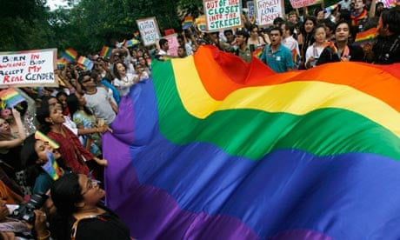
BUTLER AND SEDGWICK
Towards ‘Queer’ and Queer Activism

Slide 2
Poppy Arkell Russell, Charlotte Beatwell, Isabelle Brent | Foucault, Michel, ‘Method’ in The History of Sexuality, Volume 1, trans. Robert Hurley (Harmondsworth: Penguin, 1981), pp.92–98.
Anna Broadbridge, Zoe Cox, Molly Donnelly | Julian Jackson, "Introduction" in Living In Arcadia: Homosexuality, Politics, and Morality In France From the Liberation to AIDS, Chicago, University of Chicago Press, 2009, pp.1–15.
Grace Caddy, Eisha Ghuman, Kenza Rashid | Eve Kosofsky Sedgwick, "Introduction: axiomatic' in Epistemology of the closet(University of California Press, 2008), pp.2 - 11.
Naomi Eden, Mathilda Huscroft, Amy Johnson | David L. Eng, Judith Halberstam, and José Esteban Munoz, “What’s Queer about Queer Studies Now?, special issue, Social Text, 84–85, (2005), pp.1–15.
Nancy Hamer-Nickells, Maisy Larney, Zara Lees | Bourdeau and Capps, Revisting Sites of Rawness, Queerness, and Vulnerability, in Revisiting HIV/AIDS in French Culture (London: Lexington Books, 2022), pp.1–15.
Lucy Lightfood, Katherine Llyod, Anna Lofts | Claire Ernst, ‘Act Up Paris French Politics and Society’, Vol. 15, No. 4 (Fall 1997), pp. 22-31.
Poppy McLean-Inglis, Hannah Salmeron Gough, Elenor Wilson | Bersani, Leo, ‘Is the rectum a grave?’, in Reclaiming Sodom, ed. Jonathan Goldberg (London: Routledge, 1994), pp.249–263.

Slide 3
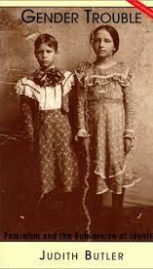
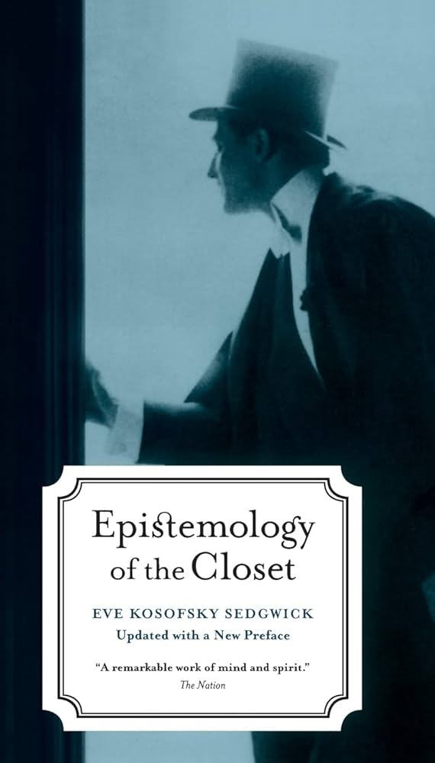
‘People are different from each other’
Eve Kofosky Sedgwick

Slide 4
Objectives of today’s class
Build on Butler’s dismantling of the discursive production of gender
Study ‘Critically Queer’ – the final chapter in Bodies that matter (1994)
Establish several different definitions of ‘queer’
Explore Sedgwick’s argument that monolithic understandings of sexuality seek to disrupt the presumption that sexual identities are static and pinned to a fixed category
Map the relationship between Gay and Lesbian studies and queer studies
Consider the ethical responsibility of Queer thought faced with a public health crisis and with a rise in hate crime
Understand how to collapse what Sedgwick calls the ‘unamity of identity’ (1993: 6).

Slide 5
Lisa Downing: Genealogy
The most politically acute sort of historical method is one that pays attention to structures of thought (both hegemonic and dissident) and the ways in which power is always implicated in them. The term Foucault uses to describe this is genealogy (Foucault, 1971). This term he borrows from Nietzsche, who famously applied it to the alleged universal of morality (Nietzsche, 1887). Foucault, on the other hand, used it to reconceptualize sexuality as a field of power and knowledge rather than as an ahistorical and natural given (Foucault, 1976). Like Nietzsche, Foucault explains the truth content of ideas from an ideological rather than a metaphysical perspective. That is to say that concepts that often appear as hegemonic absolutes are in fact historically contingent. This is one of the defining insights of queer.
Downing, L., & Gillett, R. (2012). Introduction. Sexualities, 15(1), 11-15. https://doi.org/10.1177/1363460711432091

Slide 6
Riki Wilchins, Queer Theory, Gender Theory, p.50
The new concern for sexuality demanded of people new forms of vigilance. It became something one searched out in oneself, something that required rigorous nonstop self-examination. No longer something to be enjoyed, if with discretion and restrain, sex had become something that threatened salvation. Sexuality was transformed into something akin to truth. To know one’s Self increasingly mean to know one’s sexuality. Knowledge of sex had become increasingly disconnected from pleasure. It was focused almost solely on how to prevent sin. Sexuality had emerged, not as a pleasurable appetite that occasionally called forth unruly behavior, but as the central problem of living a moral life […] sexuality and gender have emerged as central foundations for social identity.

Slide 7
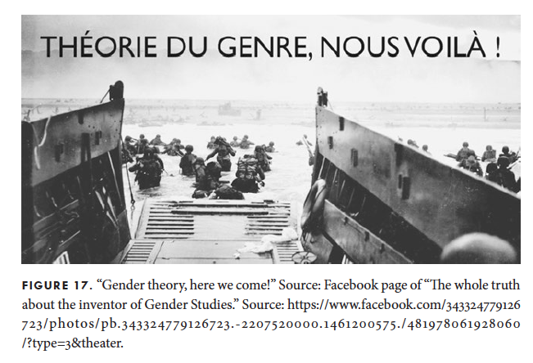
“Gender theory,” an ideology imported from America?
“By gender theory they mean queer theory in general and, more specifically, the work of philosopher Judith Butler, whose publications French opponents of gay marriage, supported by the Vatican, are now attacking school curricula that explore male/female equality, which they claim is further proof of the growing empire of gender theory. They see it as queer propaganda that will not only pervert young people but also destroy the French nation itself. Whether through marriage, parenthood, or school, they dread the possibility that lesbians and gay men may find a way to literally reproduce themselves”, Bruno Perreau, Queer theory in France, p.1.

Slide 8
Butler, ‘Critically Queer’, GLQ 1 (1993), pp.21–22.
“That gender is a choice, or that gender is a role, or that gender is a construction that one puts on, as one puts on clothes in the morning, that there is a ‘one’ who is prior to this gender, a one who goes into the wardrobe of gender and deicdes with deliberation which gender it will be today. This is a voluntaristic account of gender, which presumes a subject, intact, prior to its gendering. The sense of gender performativity that I meant to convey is something quite different”

Slide 9
Kadji Amin: Genealogy of ‘Queer Studies’
List the difficulties in defining the field of ‘Queer studies’ (p.18)
What tensions does Queer Studies explore?
How would you define ‘anti-identitarian’?
To whom do we attribute the inception of Queer Studies and why?
Why is Foucault considered one of queer theory’s ‘main progenitors’?

Slide 10
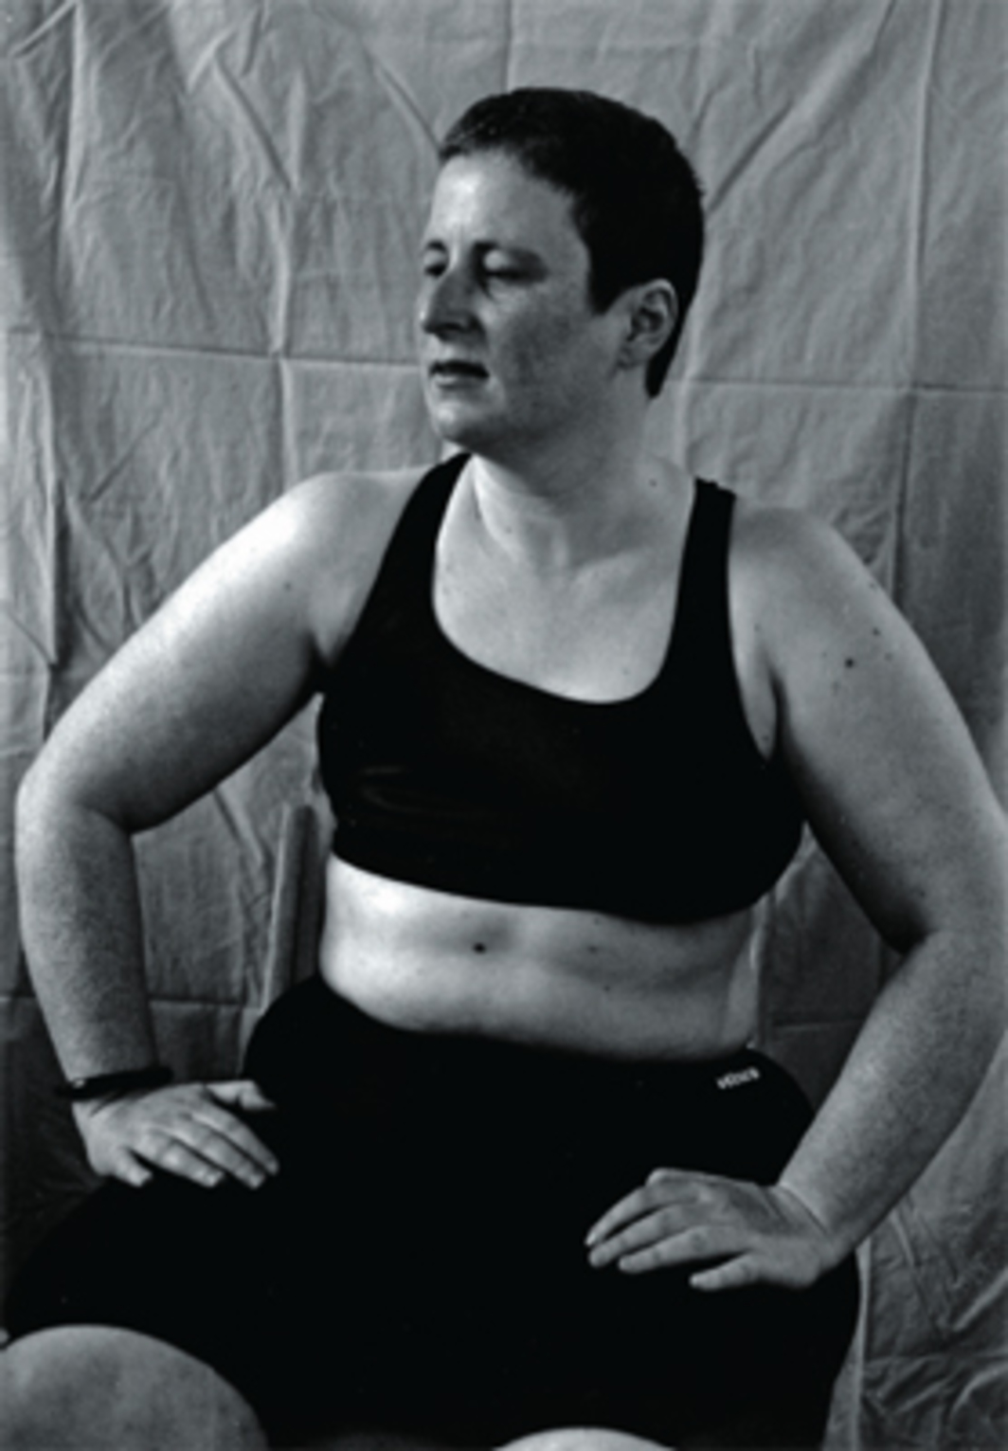
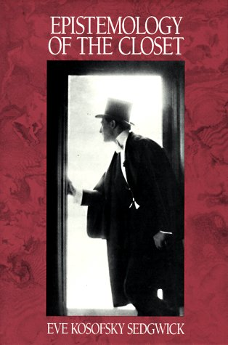
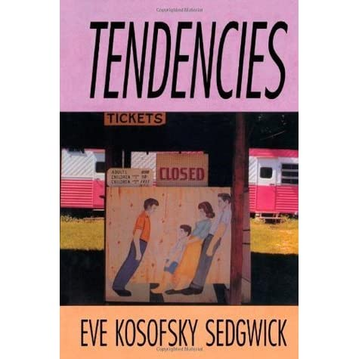
Eve Kosofsky Sedgwick: 1950 - 2009

Slide 11
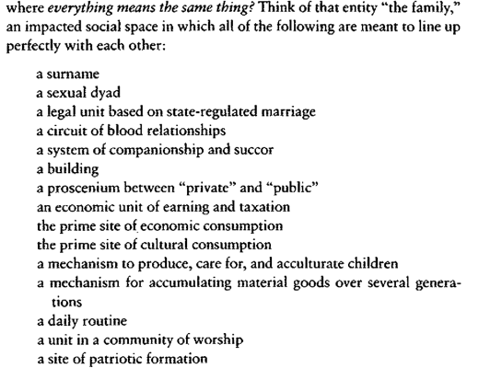
Eve Kofosky Sedgwick: Queer as disarticulation / disidentification (1993: 5)

Slide 12
Sedgwick: Resisting the ‘unanimity’ of family (1993: 6)
Looking at my own life, I see that— probably like most people—I have valued and pursued these various elements of family identity to quite differing degrees (e.g., no use at all for worship, much need of companionship). But what’s been consistent in this particular life is an interest in not letting very many of these dimensions line up directly with each other at one time. I see it’s been a ruling intuition for me that the most productive strategy (intellectually, emotionally) might be, whenever possible, to disarticulate them one from another, to disengage them—the bonds of blood, of law, of habitation, of privacy, of companionship and succour— from the lockstep of their unanimity in the system called “family.”

Slide 13
Sedgwick – the presumptions of identity (1993: 7)
Think of all the elements that are condensed in the notion of sexual identity, something that the common sense of our time presents as a unitary category. Yet, exerting any pressure at all on ‘sexual identity’ you see that its elements include
Your biological (chromosomal) sex, male or female
Your self-perceive gender assignment, male or female (supposed to be the same as your biological sex)
The preponderance of your traits of personality and appearance (masculine or feminine) supposed to correspond to your sex and gender
The biological sex of your preferred partner
The gender assignment of your preferred partner
Your self-perception as gay or straight
Your preferred partner’s self perception as gay or straight (supposed to be the sae as yours)
[…] the people from whom you learn about your own gender and sex (supposed to correspond to yourself in both respects)
Your community of cultural and political identification (supposed to correspond to your own identity)
[…] what is striking is the number and diference of the dimensions that ‘sexual identity’ is supposed to organize into a seamless and univocal whole
And if it doesn’t?

Slide 14
So what is queer?
That’s one of the things that “queer” can refer to: the open mesh of possibilities, gaps, overlaps, dissonances and resonances, lapses and excesses of meaning when the constituent elements of anyone’s gender, of anyone’s sexuality aren’t made (or can’t be made) to signify monolithically. The experimental linguistic, epistemological, representational, political adventures attaching to the very many of us who may at times be moved to describe ourselves as (among many other possibilities) pushy femmes, radical faeries, fantasists, drags, clones, leatherfolk, ladies in tuxedoes, feminist women or feminist men, masturbators, bulldaggers, divas, Snap! queens, butch bottoms, storytellers, transsexuals, aunties, wannabes, lesbian-identified men or lesbians who sleep with men, or…people able to relish, learn from, or identify with such.

Slide 15
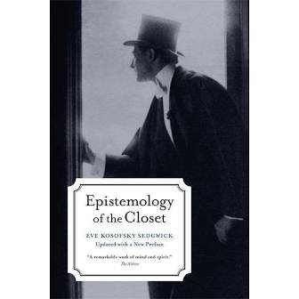
Sedgwick main argument
an understanding of virtually any aspect of Western culture must be, not merely incomplete, but damaged in its central substance to the degree that it does not incorporate a critical analysis of modern homo/heterosexual definition” (1), an operation that “intersects every issue of power and gender” and “transforms the other languages and relations by which we know” (3).

Slide 16
Sedgwick didn’t greatly revise the history of that process of definition from about 1890 to 1990, the period David Halperin has called “one hundred years of homosexuality,” of same-sex sexual attraction conceived, as Michel Foucault had emphasized, as a way of being a person—a species, a human natural kind—in the sociocultural and interpersonal fields of eroticism and sex in which “one particular sexuality was distinctively constituted assecrecy” (73)

