Slide 1
London and its Museums
Seminar Leader: Dr Chloe Ward
Contact: c.ward@qmul.ac.uk

Slide 2
What is a museum?

Slide 3
What is a museum?
‘Museums enable people to explore collections for inspiration, learning, and enjoyment. They are institutions that collect, safeguard and make accessible artefacts and specimens, which they hold in trust for society’.
–The Museums Association

Slide 4
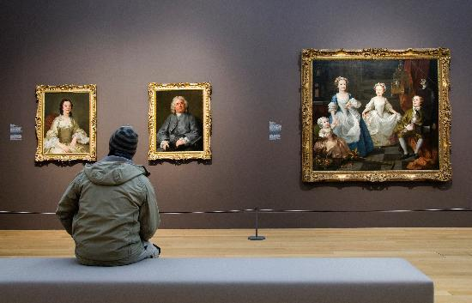
Why study museums?
Their enduring popularity
They are “keepers of collective memory” and help to articulate identity.
They reflect changing cultural, political, social, and economic contexts.

Slide 5
Module overview:
In this module you will:
Visit and evaluate collections in London.
Trace the development of museums historically, analysing how the aims and functions of museums change over time.
Develop a knowledge of collecting processes, curatorial practice, and theories of display.
Deconstruct the cultural narratives and ideological representations in the museums that we visit.

Slide 6
Museum Visits
In each class session, you will visit a different museum.
Do the readings before your seminar.
Bring your notes.
But leave your pen at home.
… And your large backpack.
Wear comfortable shoes for standing for long periods.
Leave time to get there and to find the meeting point.
Check the location of the meeting point the night before your class on QM Plus.

Slide 7
Assessments
In-class presentation:
Throughout module, 20% of mark.
Exhibition Proposal:
Due Monday 22 July, 10am, 80% of mark

Slide 8
Assessments
Group Practice Presentation 1 (3 July):
Bennett—Panella, Lin, Ayodeji, Bjorkman
Haacke—Brown, Kwon, Tonkin, Jones, Oziemkowski
Group Practice Presentation 2 (4 July):
Mcdonald—Brown, Lin, Tonkin, Bjorkman, Oziemkowski
Baudrillard –Panella, Kwon, Ayodeji, Jones
Assessed Presentations:
Benjamin (8 July)—Oziemkowski
Hooper-Greenhill (9 July)—Jones
Anderson (9 July)—Bjorkman
Mitchell (10 July)—Ayodeji
Coombes (10 July)—Tonkin
Supporting Decolonisation (11 July)—Kwon
Duncan (15 July)—Lin
Prior (16 July)—Panella
Crane (17 July)—Brown

Slide 9
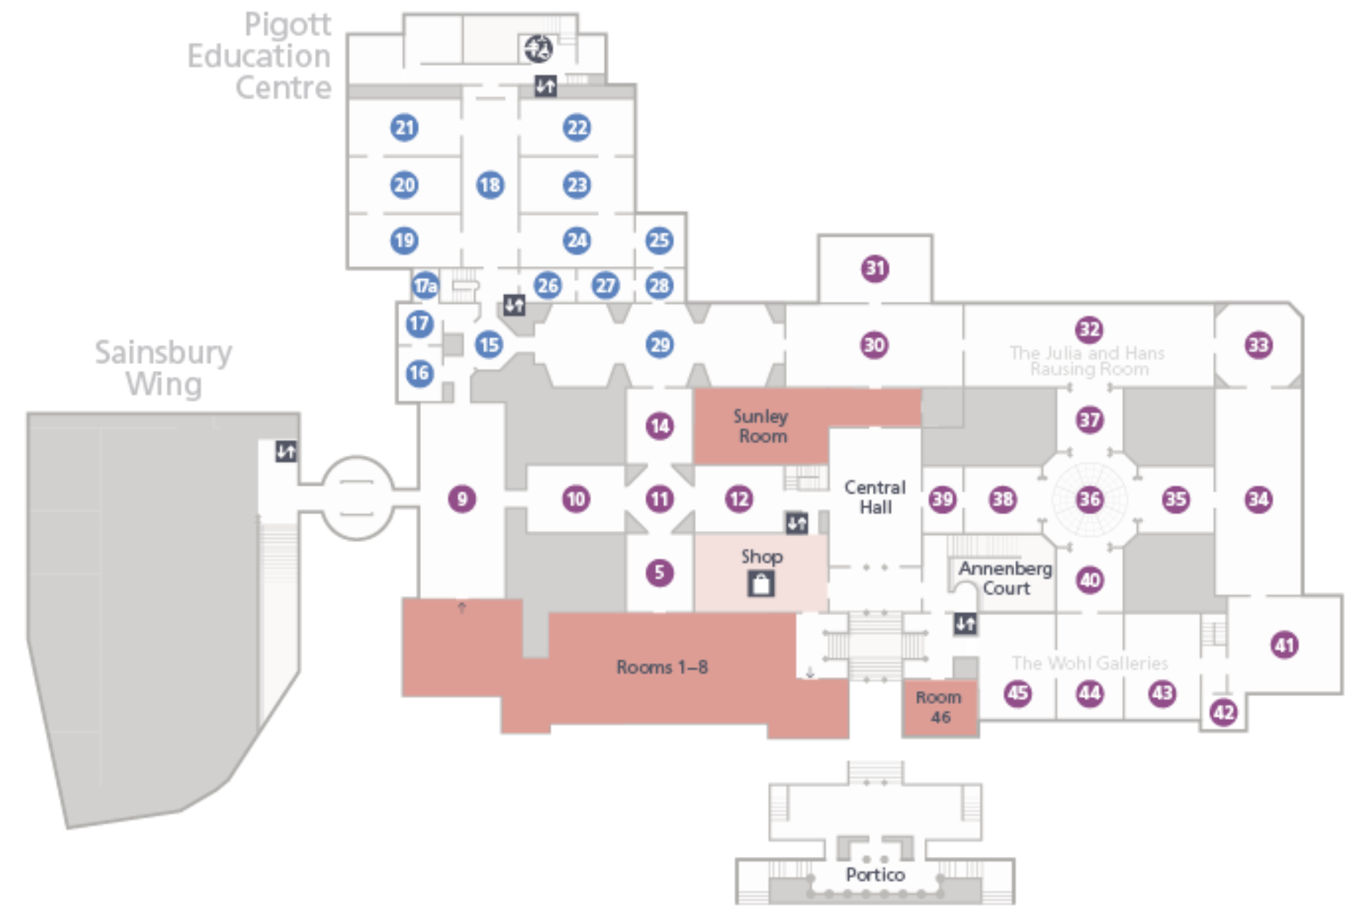
The National Gallery

Slide 10
Readings for next week’s class:
Power, Politics, and the Museum Space
All available on QM Plus
Tony Bennett, ‘The Exhibitionary Complex’
Hans Haacke, ‘Museums, Managers of Consciousness’
Three short articles on the National Gallery’s Sainsbury Wing

Slide 11
London and its Museums:
Main Themes
Structuring Knowledge
Collecting and Display
The Rhetoric of Display
Museums and People
History and the Future

Slide 12
1. Structuring Knowledge
“Musei Wormiani Historia” (1655) , from Museum Wormianum,
showing Ole Worm’s cabinet of curiosities

Slide 13
2. Collecting and Display
Charles Wilson Peale, The Artist in His Museum (1822)

Slide 14
3. The Rhetoric of Display
Hans Haacke, MoMA Poll (1970)

Slide 15
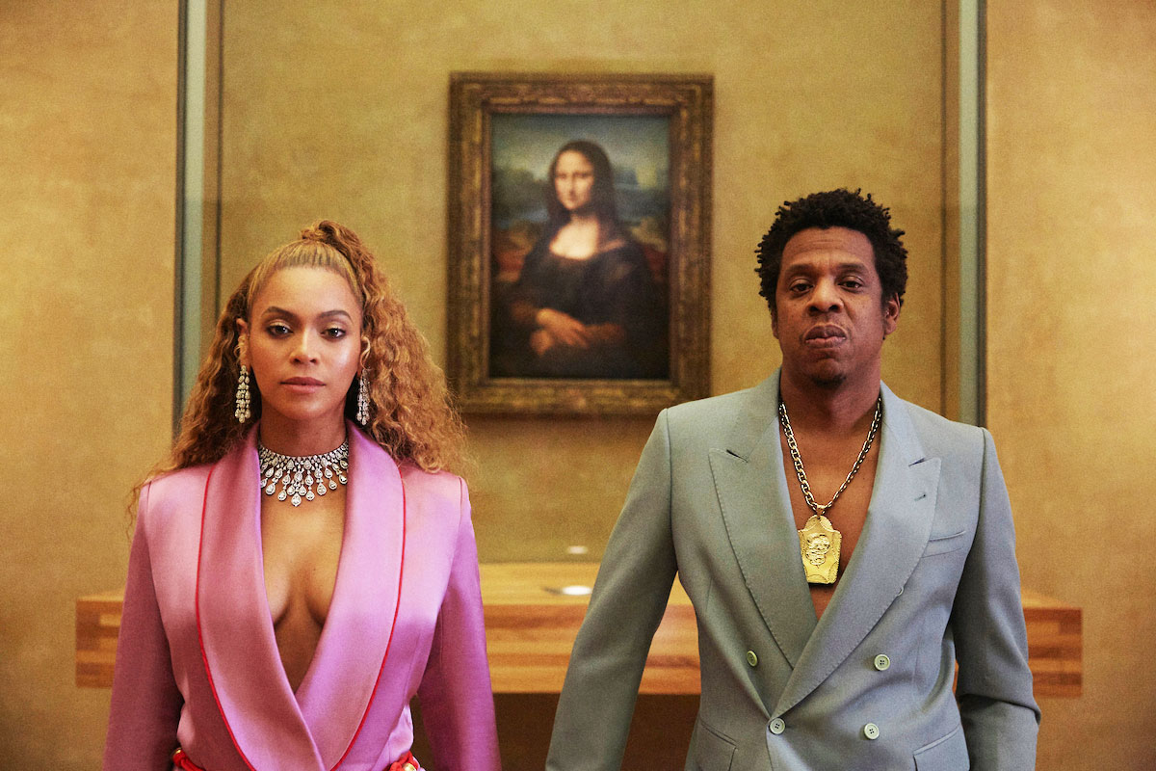
4. Museums and People
Still from the Carters, Apes**t, 2018

Slide 16
5. History and the Future

Slide 17
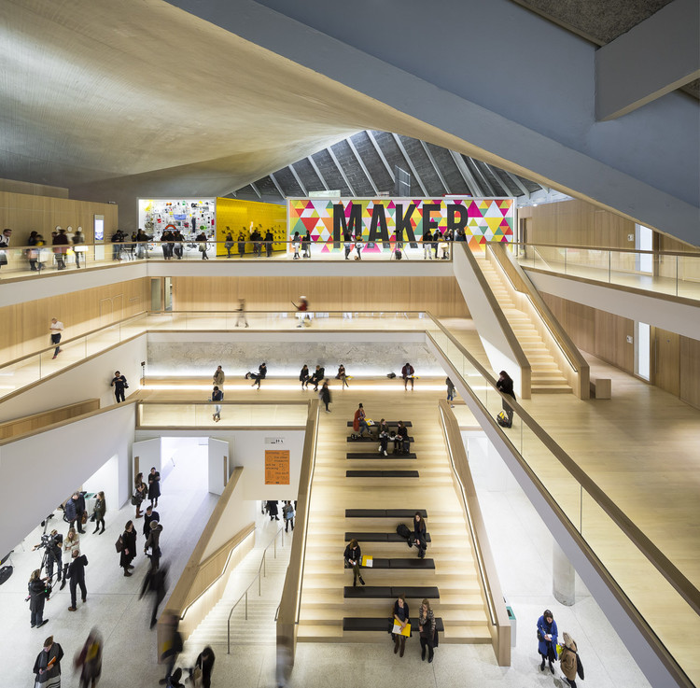
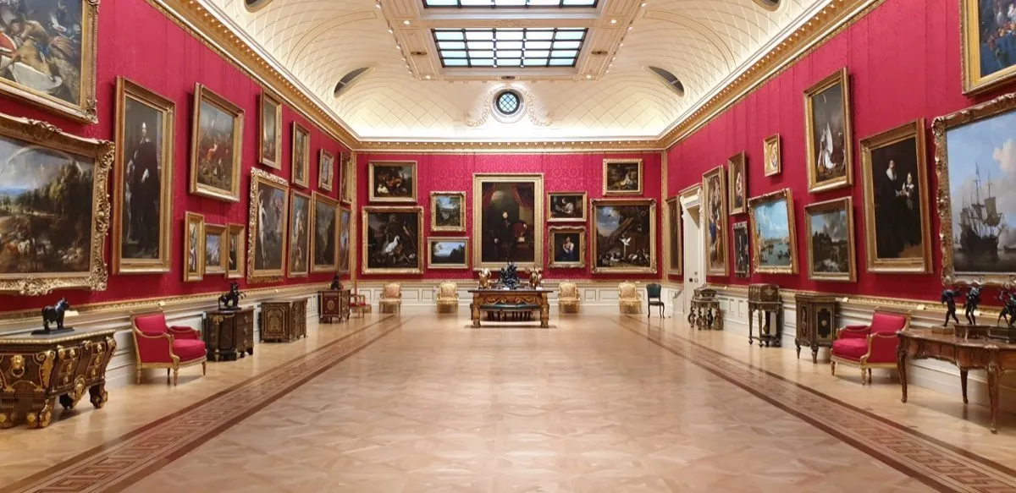
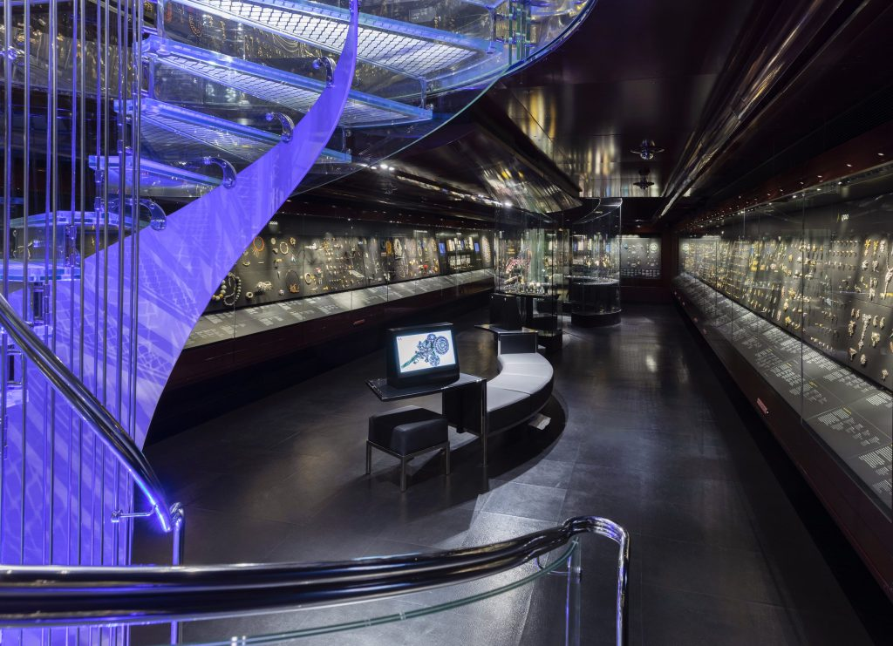
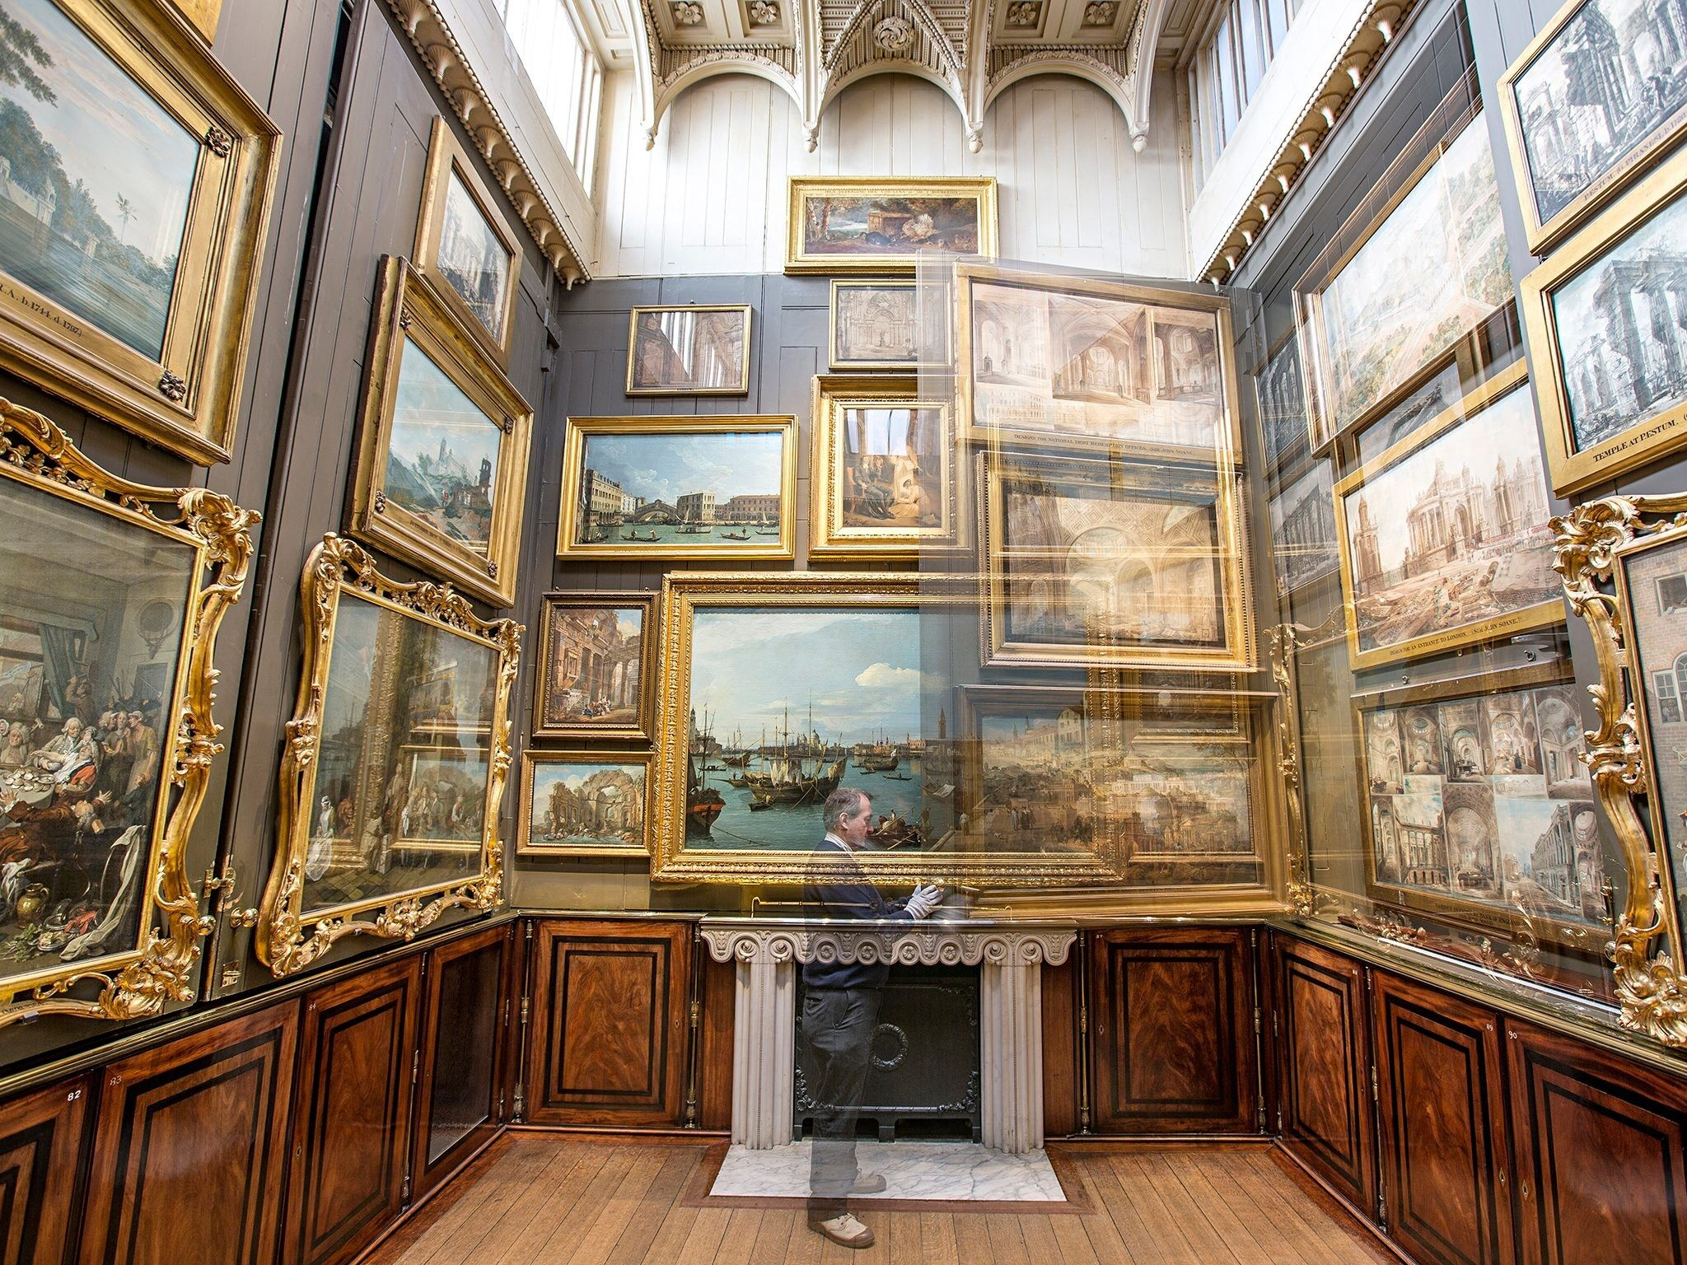
The Design Museum atrium
The Great Gallery, The Wallace Collection
V&A Jewellery Gallery
The Picture Room, John Soane Museum

Slide 18
Questions to ask about
museum spaces
How do you use the space?
How does the space feel?
What messages is the space designed to send?

