Slide 1
Seaford and Morwood Bacchae extracts Week 4
Tragedy COM5207

Slide 3
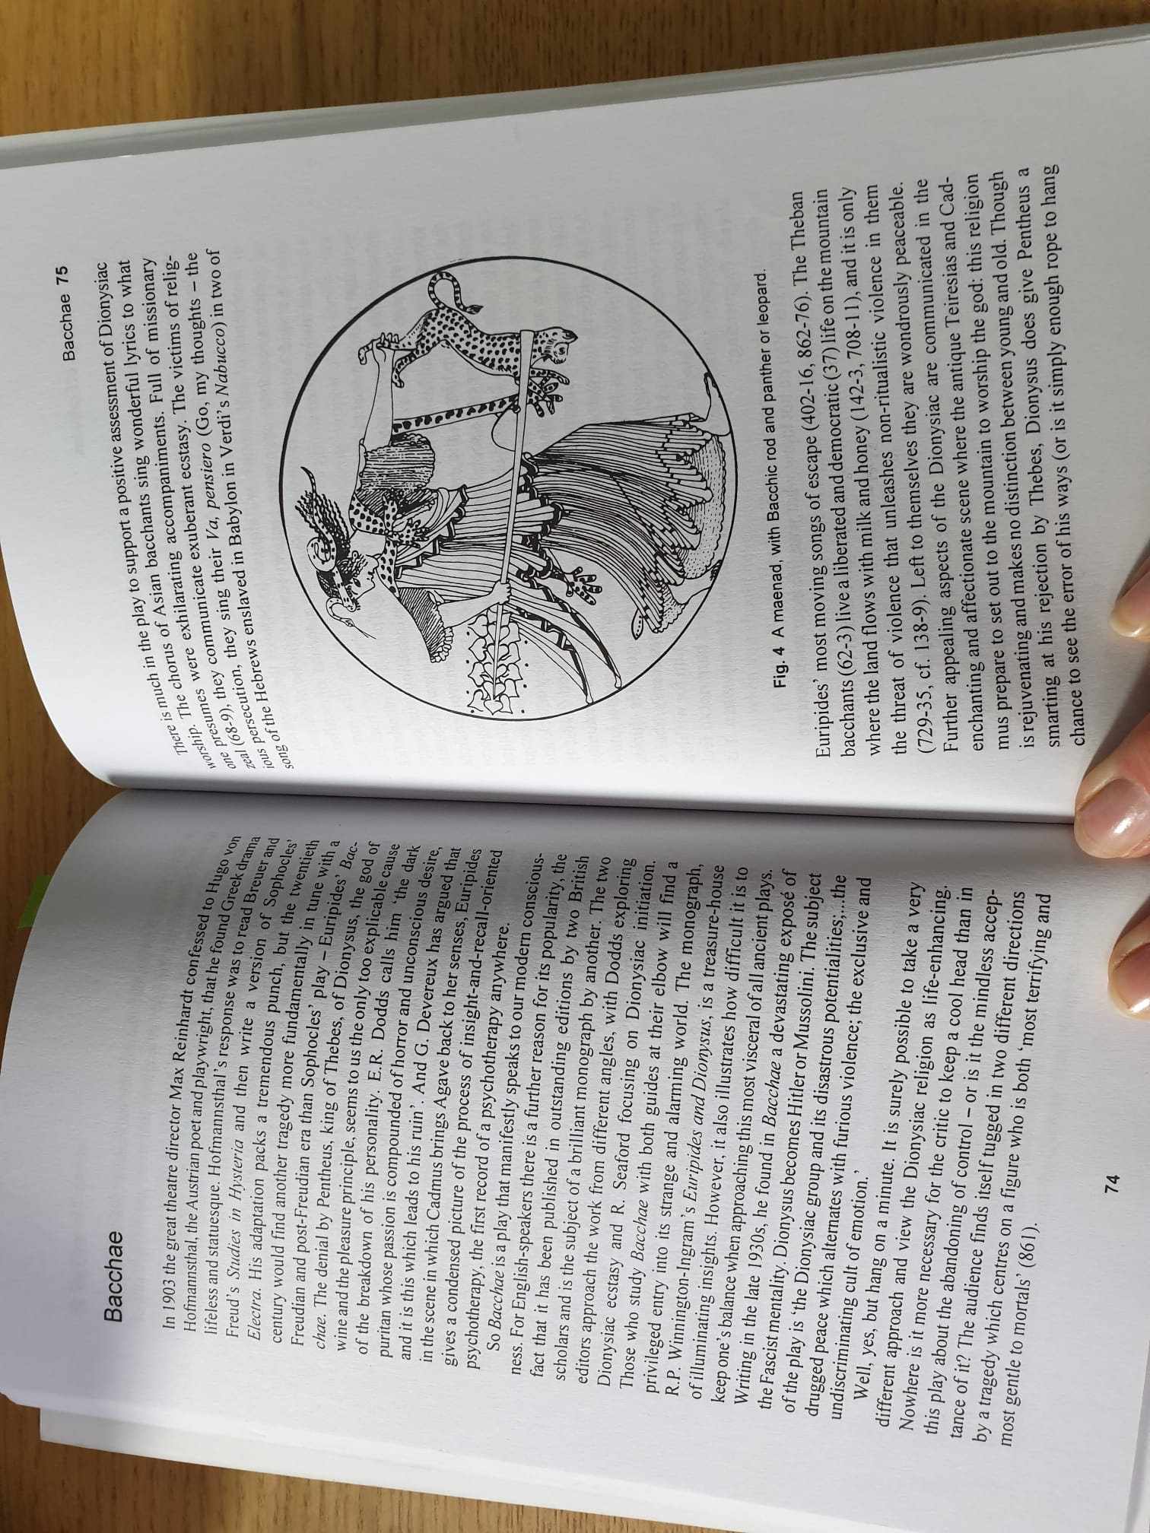

Slide 6
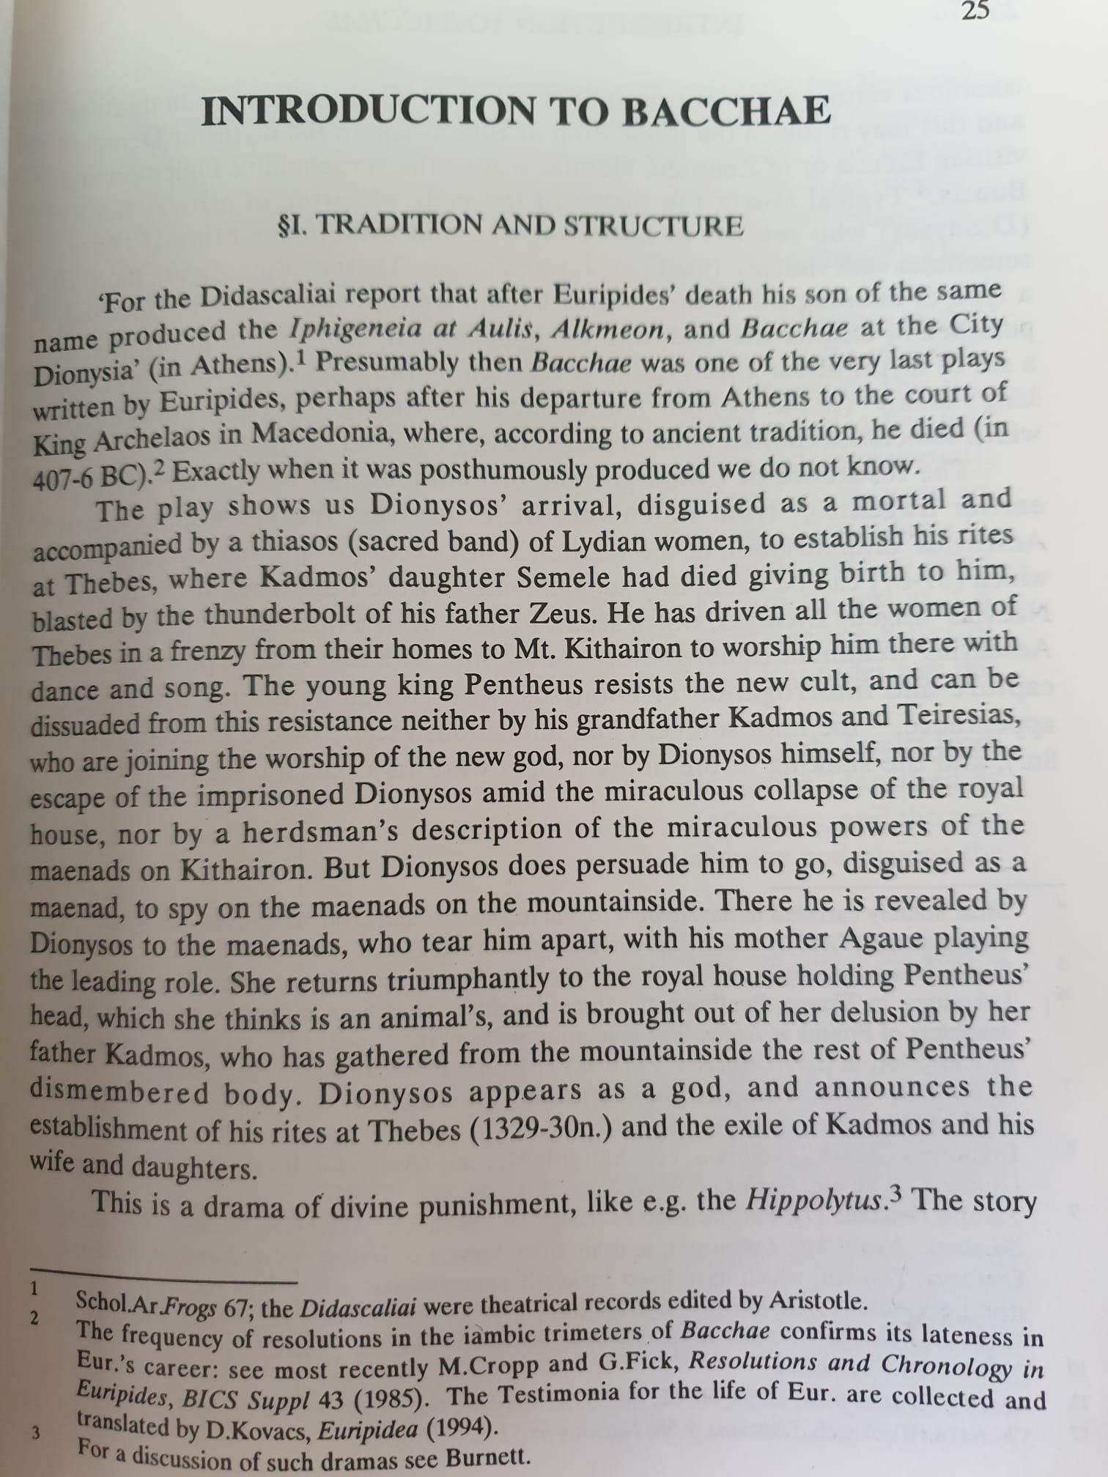
Seaford, Bacchae
From Introduction

Slide 7
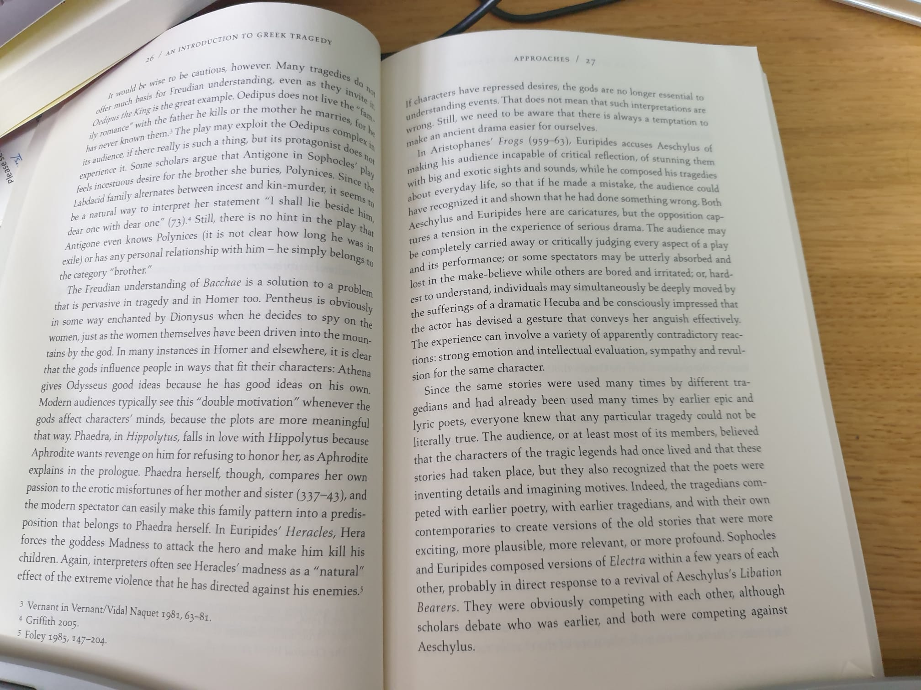

Slide 8
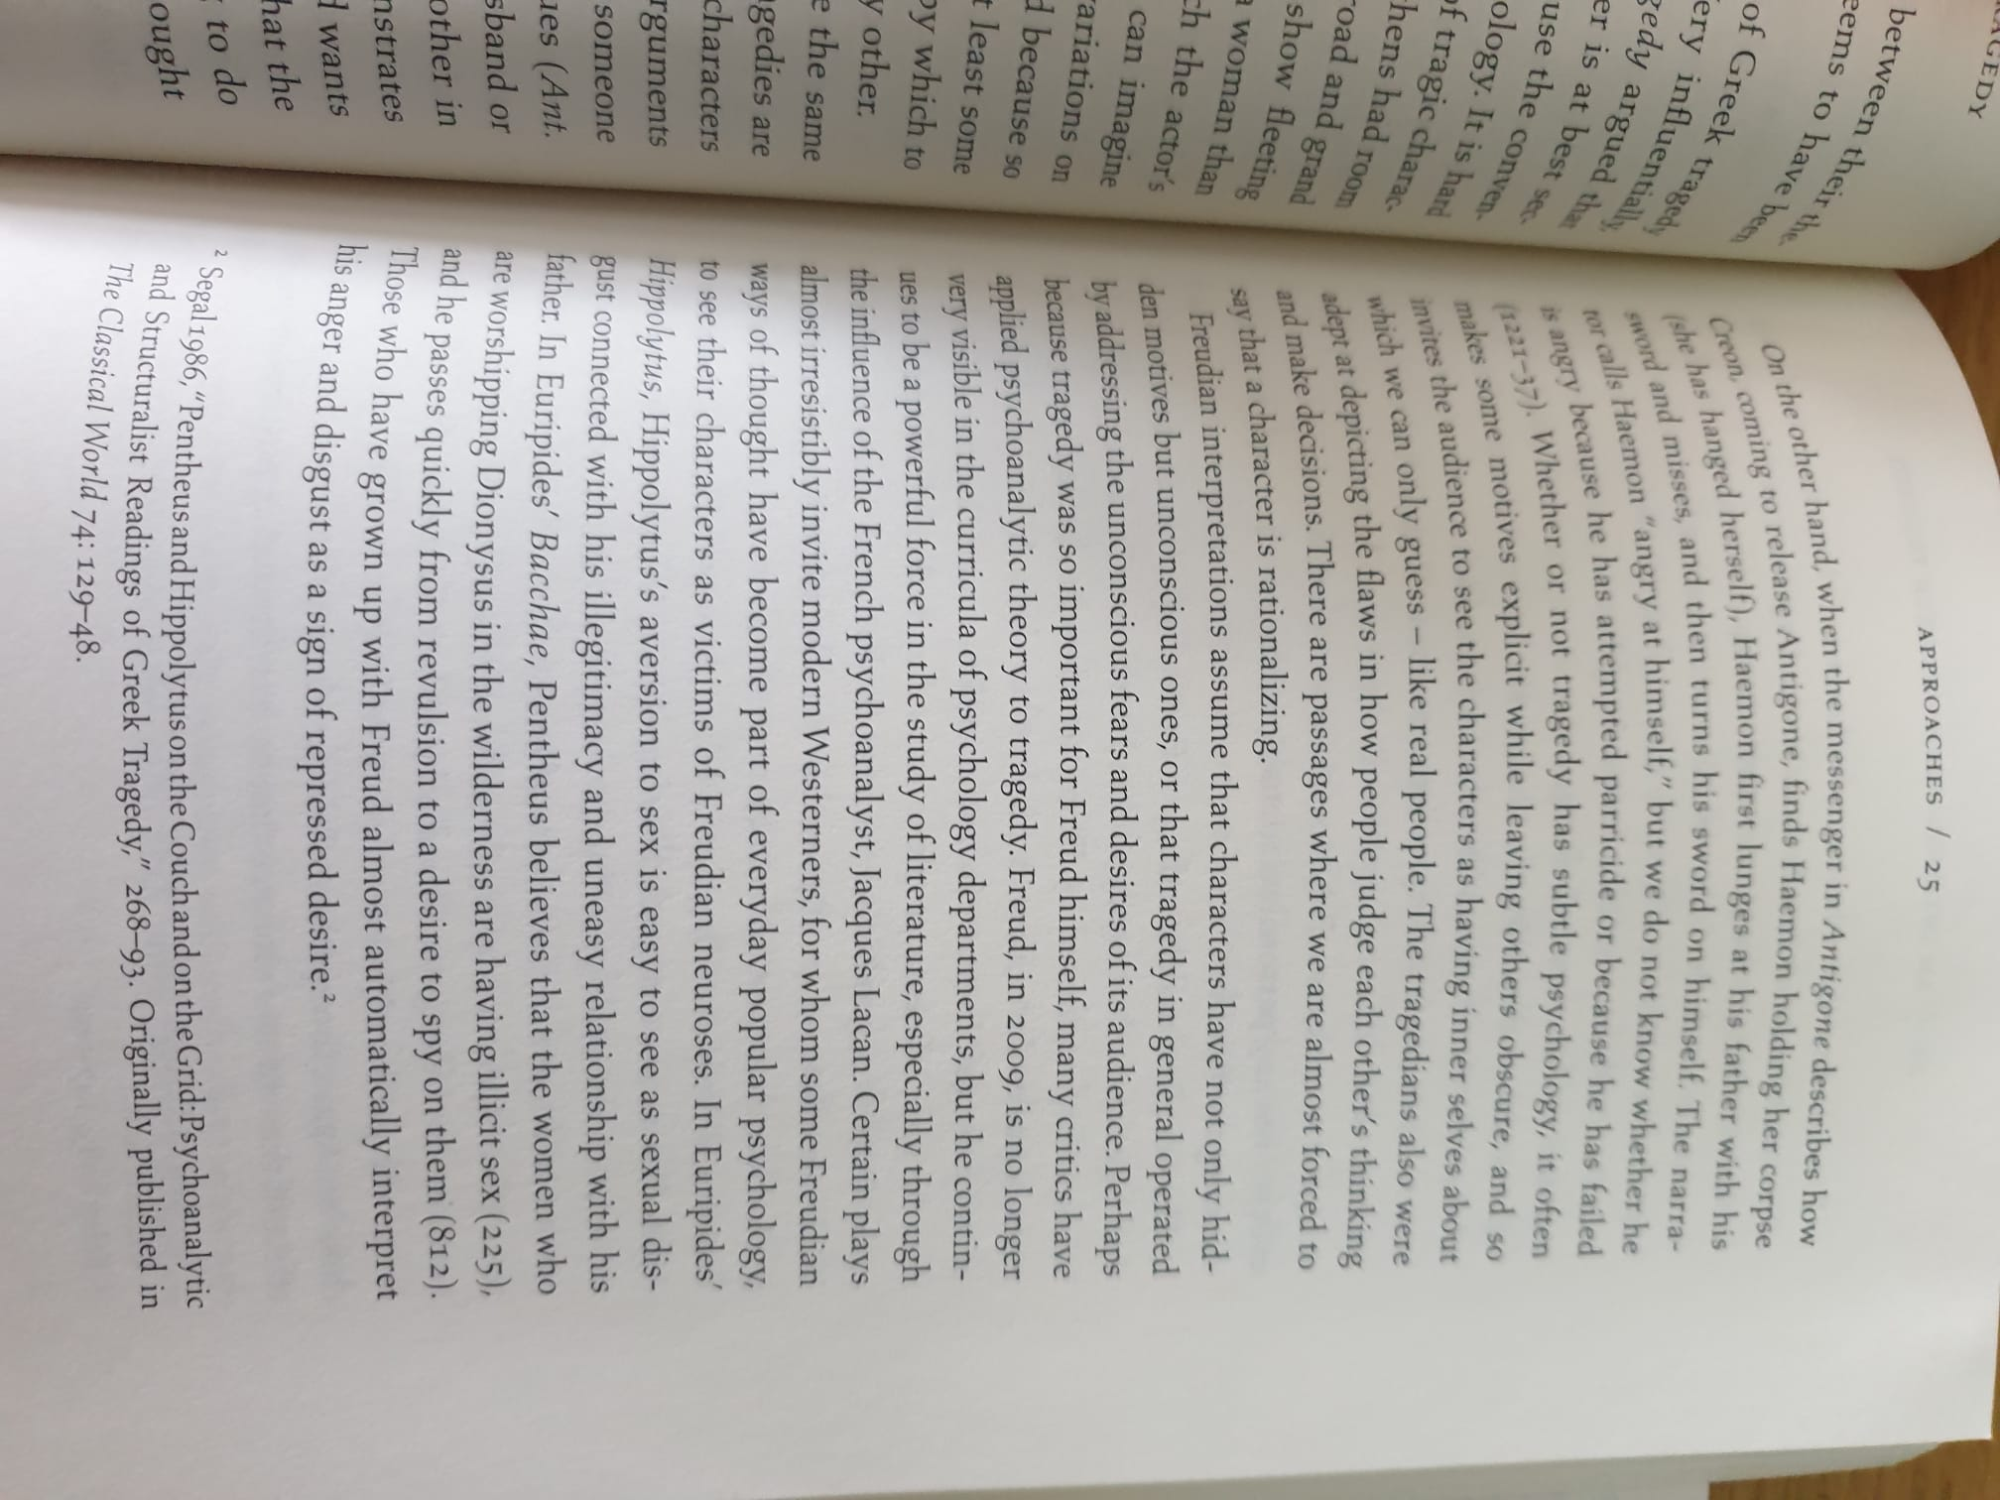

Slide 10
From the end of Winnington-Ingram’s Bacchae preface

