Slide 1
SOLM171 International Refugee Law
Week 4, Refugee Status - Exclusion

Slide 2
What did you think of the readings?
OUTLINE
What is exclusion from refugee status?
Exclusion of ‘terrorists’ from refugee status
Individual responsibility and membership of a ‘terrorist’ organisation
MENTIMETER

Slide 3
Article 1F 1951 Refugee Convention
‘The provisions of this Convention shall not apply to any person with respect to whom there are serious reasons for considering that:
He has committed a crime against peace, a war crime, or a crime against humanity, as defined in the international instruments drawn up to make provision in respect of such crimes;
He has committed a serious non-political crime outside the country of refuge prior to his admission to that country as a refugee;
He has been guilty of acts contrary to the purposes and principles of the United Nations.’
What is the rationale underlying article 1F?
Why was it included in the Refugee Convention?
What does it mean to be ‘excluded’ from refugee status?
Notes:
Refugee status is declaratory, not constitutive; the consequences of this legal status come from formal definition but as soon as you satisfy the criteria you are a refugee

Slide 4
Article 33(2) 1951 Refugee Convention
‘The benefit of the present provision may not, however, be claimed by a refugee whom there are reasonable grounds for regarding as a danger to the security of the country in which he is, or who, having been convicted by a final judgment of a particularly serious crime, constitutes a danger to the community of that country.’
Distinguish from the exception to the non-refoulement principle
Why is this significant?
What is different?
Notes:
Refugee status is declaratory, not constitutive; the consequences of this legal status come from formal definition but as soon as you satisfy the criteria you are a refugee

Slide 5
Article 1F(A) Categories from IHL
Planning, preparation, initiation or waging of a war of aggression (which is illegal under Public International Law)
In principle can only be perpetrated by states
Article 8 Rome Statute
Crime against peace
Grave breaches of the laws or customs of war (under IHL)
Whether international or non-international armed conflict
Can be perpetrated by non-state actors
Tadic Case
War crime
Inhumane treatment of a civilian population in the context of a widespread or systematic attack against it
Applies both during armed conflict and peacetime
Can be perpetrated by non-state actors
Article 7(1) Rome Statute
Crime against humanity

Slide 6
Article 1F(B) Serious Non-Political Crime
AH (Algeria) v SSHD [2012] EWCA Civ 395
Nationality, Immigration and Asylum Act 2002, s 72
‘particularly serious crime’ which attracted or would have attracted custodial sentence of two years or more
1951 Convention ‘being an international convention, it must be given an autonomous meaning. They are ordinary words and should be given their ordinary meaning’ (art 31, VCLT)
‘While terrorism is a grave international threat, merely labelling an offence as a terrorist offence is not sufficient, of itself, to establish that the offence is a serious offence for the purpose of art 1F(b)’
s 38, Nationality and Borders Act
Reduced to a sentence of 12 months or more
Notes:
Refugee status is declaratory, not constitutive; the consequences of this legal status come from formal definition but as soon as you satisfy the criteria you are a refugee

Slide 7
Article 1F(B) Serious Non-Political Crime
T v SSHD [1996] UKHL 8
Crime could be considered non-political in nature when no clear link exists between the crime and its alleged political motive, or when the act in question is disproportionate to the alleged objective
Reaffirmed art 36, Nationality and Borders Act
EU Qualification Directive, Article 12(2)
…a serious non-political crime outside the country of refuge…particularly cruel actions, even if committed with an allegedly political objective, may be classified as serious non-political crimes
Notes:
Refugee status is declaratory, not constitutive; the consequences of this legal status come from formal definition but as soon as you satisfy the criteria you are a refugee

Slide 8
Article 1F(B) Serious Non-Political Crime
T v SSHD [1996] UKHL 8
Political crime satisfied both elements: (i) committed for political purpose, i.e. with object of overthrowing or subverting or changing government of a state or inducing it to change its policy; (ii) sufficiently close and direct link between crime and alleged political purpose
Determining link (Home Office Guidance): means used to achieve political end; whether aim at military or governmental target or civilian targe; involved indiscriminate killing or injuring of members of public
Notes:
Refugee status is declaratory, not constitutive; the consequences of this legal status come from formal definition but as soon as you satisfy the criteria you are a refugee

Slide 9
Article 1F(B) Serious Non-Political Crime
B & D [2010] CJEU C-101/09 (09 November 2010)
‘it is clear that terrorist acts, which are characterised by their violence towards civilian populations, even if committed with a purportedly political objective, fall to be regarded as serious non-political crimes within the meaning of point (b)’
Notes:
Refugee status is declaratory, not constitutive; the consequences of this legal status come from formal definition but as soon as you satisfy the criteria you are a refugee

Slide 10
Article 1F(C) Acts Contrary to the Purposes and Principles of the UN
EU Qualification Directive, article 12(2)
He or she has been guilty of acts contrary to the purposes and principles of the United Nations as set out in the Preamble and arts 1 and 2 of the Charter of the United Nations
UN Charter, art 1 and 2
Purpose: maintain international peace and security; develop friendly relations among nations; achieve international cooperation in solving international problems of an economic, social, cultural, or humanitarian character
Principles: sovereign equality of all its Members; States act in good faith; settle international disputes by peaceful means; States refrain from threat or use of force
Notes:
Refugee status is declaratory, not constitutive; the consequences of this legal status come from formal definition but as soon as you satisfy the criteria you are a refugee

Slide 11
Article 1F(C) Acts Contrary to the Purposes and Principles of the UN
Pushpanathan v Canada (Minister of Citizenship and Immigration) [1998] 1 SCR 982
Acts could be considered contrary to the purposes and principles in cases where:
‘there was a consensus in international law that particular acts constitute sufficiently serious and sustained violations of fundamental human rights as to amount to persecution’
The acts ‘are explicitly recognised as contrary to the purposes and principles of the UN’, such as by UNGA or UNSC Resolutions
High threshold: not every act condemned by the UN could be considered contrary to its purposes and principles
More difficult for non-state actors to reach threshold
Notes:
Refugee status is declaratory, not constitutive; the consequences of this legal status come from formal definition but as soon as you satisfy the criteria you are a refugee

Slide 12
Article 1F(C) Acts Contrary to the Purposes and Principles of the UN
UNHCR (2003)
Triggered only in ‘extreme circumstances by activity which attacks the very basis of the international community’s coexistence’
Crimes capable of affecting international peace and security
Serious and sustained violations of human rights

Slide 13
Article 1F(C) and Terrorism?
UN Security Council Resolution 1373 (28 Sep 2001)
Para 5, ‘Declares that acts, methods, and practices of terrorism are contrary to the purposes and principles of the UN and that knowingly financing, planning and inciting terrorist acts are also contrary to the purposes and principles of the UN’

Slide 14
Article 1F(C) and Terrorism?
EU Qualification Directive 2011 (recast)
Embodied in the UN Resolutions relating to measures combating terrorism
Al-Sirri v SSHD [2012] UKSC 54
‘Article 1F(c) is only triggered in extreme circumstances by activity which attacks the very basis of the international community’s coexistence. Such activity must have an international dimension. Crimes capable of affecting international peace, security and peaceful relations between States, as well as serious and sustained violations of human rights would fall under this category.’
Notes:
Refugee status is declaratory, not constitutive; the consequences of this legal status come from formal definition but as soon as you satisfy the criteria you are a refugee

Slide 15
UN Security Council Resolution 1373 (28 September 2001), para 3
Calls upon all States to:
‘Ensure…that refugee status is not abused by the perpetrators, organisers, or facilitators of terrorist acts’

Slide 16
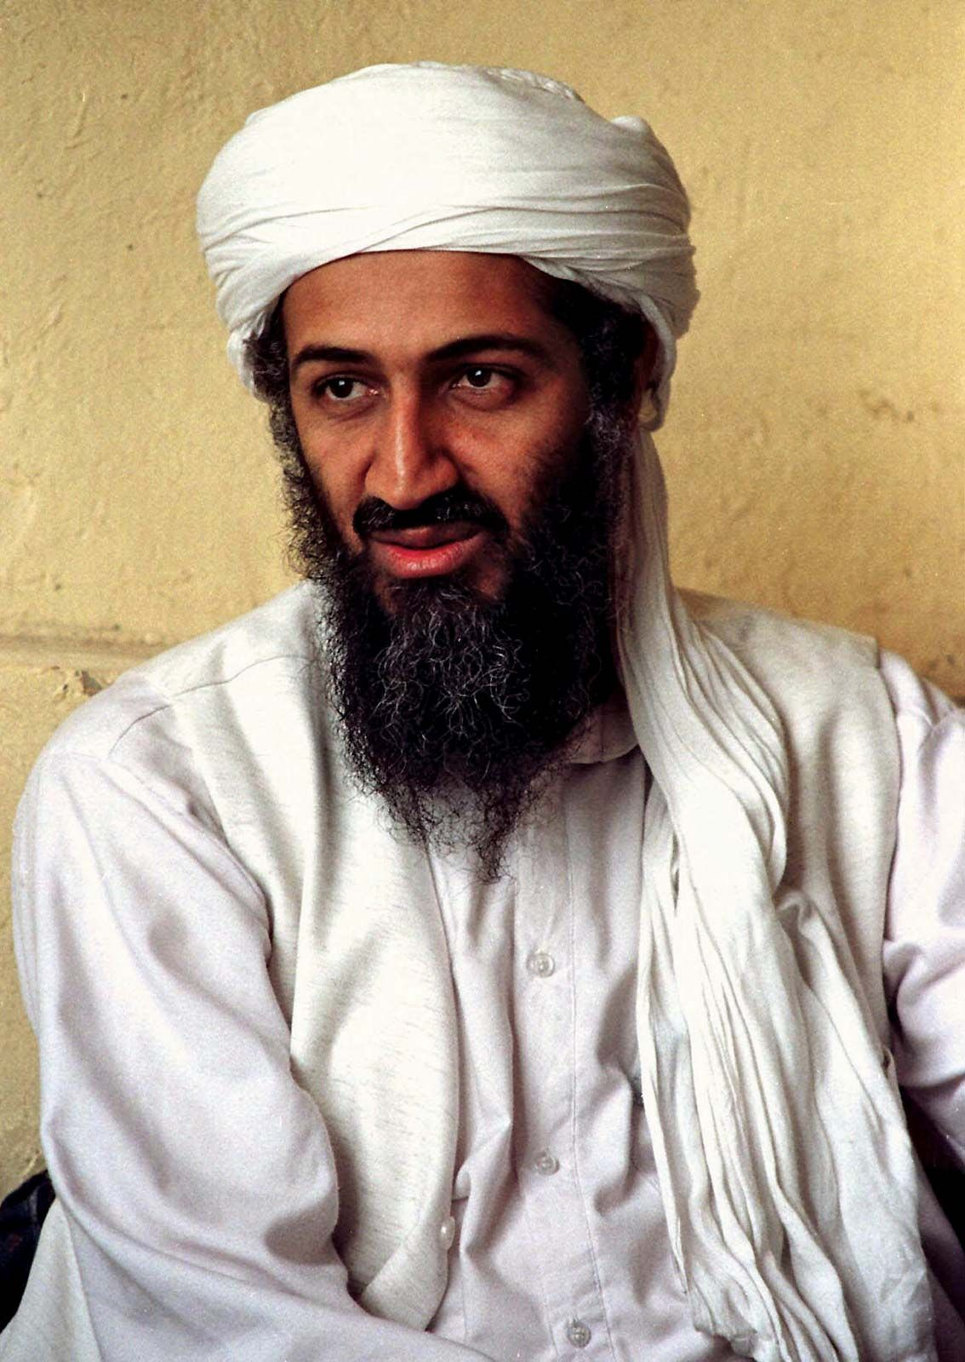
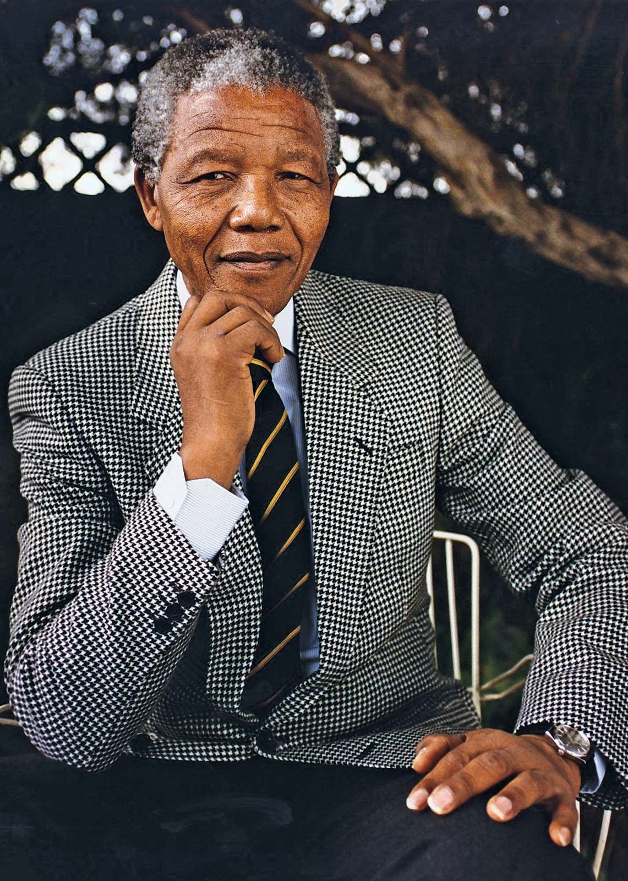
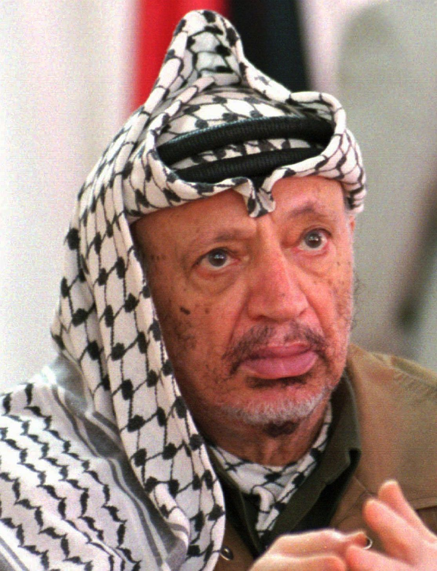
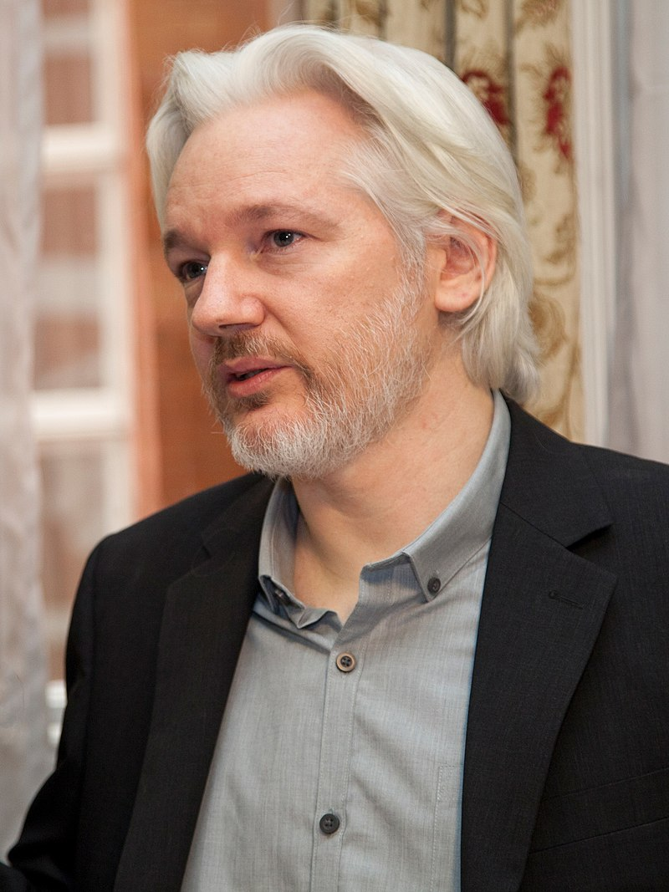
Who is a terrorist?

Slide 17
UN Security Council Resolution 1566 (2004)
‘Criminal acts, including those against civilians, committed with the intent to cause death or serious bodily injury, or taking of hostages, with the purpose to provoke a state of terror in which the general public or in a group of persons or particular persons, intimidate a population or compel a govern or an international organisation to do or to abstain from doing any act, which constitute offences within the scope of and as defined in the international conventions and protocols relating to terrorism, are under no circumstances justifiable by considerations of a political, philosophical, ideological, racial, ethnic, religious or other similar nature.’

Slide 18
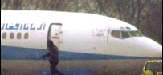
Terrorism or legitimate protest?
The Stansted 15
R v Thacker & Ors [2021] EWCA Crim 97
2000 Stansted Hijacking Case
S and others v SSHD [2006] EWCA Civ 1157
Notes:
Stansted 15: In 2017, locked themselves onto a plane to prevent deporation, convited of terror-related offences of the intentional disruption of services at an aerodrome
2000 Stansted: Hijackers argued they had acted under duress, all members of a youth organisation in Afghanistan, arrested and tortured four of their members

Slide 19
Individual responsibility
Article 1F refers ONLY to those who have committed or found guilty
EU Qualification Directive, article 12(3)
‘…a person who instigates or otherwise participate in the commission of the crimes or acts mentioned therein’
Interpreted as those who shoot the gun and those who give the orders and are responsible under ICL
UNSC Resolution 1377 (2001), preamble para 5
‘the financing, planning and preparation of as well as any other form of support for acts of international terrorism are similarly contrary to the purposes and principles of the Charter of the United Nations.’

Slide 20
Can one be excluded from refugee status for being a member of an organisation classified as terrorist, regardless of actual commission or participation in terrorist acts?

Slide 21
Inclusion on a list?
B & D [2010] CJEU C-101/09 (09 November 2010)
‘…does not automatically constitute a serious reason for exclusion from refugee status considering that that person has committed ‘a serious non-political crime’ or ‘acts contrary to the purposes and principles of the United Nations’
The national asylum judge must undertake an individualised assessment of the specific facts of the case, including both objective and subjective criteria, and assess:
‘the true role played by the person concerned in the perpetration of the acts in question; his position within the organisation; the extent of the knowledge he had, or was deemed to have, of its activities; any pressure to which he was exposed; or other factors likely to have influenced his conduct’
What is the primary concern of legal bodies over-relying on lists?

Slide 22
The JS (Sri Lanka) Approach
JS (Sri Lanka) v SSHD [2010]
‘if there are serious reasons for considering him voluntarily to have contributed in a significant way to the organisation’s ability to pursue its purpose of committing excludable acts, aware that his assistance will in fact further that purpose.’
L Brown Factors:
the nature and the size of the organisation;
Whether and, if so, by whom the organisation was proscribed;
How the asylum-seeker came to be recruited;
The length of time he remained in the organisation and what, if any, opportunities he had to leave it;
His position, rank, standing and influence in the organisation;
His knowledge of the organisation’s war crimes activities; and
His own personal involvement and role in the organisation.
Toulson LJ in CA
The tribunal had ‘rolled up a number of factors which might cause somebody wedded to the ideals of western liberal democracy to take a more or less hostile view of the organisation and to use an assessment of where the organisation stands in relation to those values in deciding whether its armed acts were ‘proportionate’”
Notes:
Gurung approach, voluntary membership of extreme groups, emphasis on nature of organisation, and not on standards of responsibility from international criminal law

Slide 23
Confirmation from Canada
Ezokola v Canada (Citizenship and Immigration), 2013 SCC 40
‘…there must be serious reasons for considering that the claimant has voluntarily made a significant and knowing contribution to the organisation’s crime or criminal purpose.’
Factors:
The size and nature of the organisation
The part of the organisation with which the refugee claimant was most directly concerned;
The refugee claimant’s duties and activities within the organisation;
His position, rank, standing and influence in the organisation;
The length of time he remained in the organisation particularly after acquiring knowledge of the group’s crime or criminal purpose; and
The method by which the refugee claimant was recruited and the refugee claimant’s opportunity to leave the organisation.

Slide 24
KJ (Sri Lanka) [2009]
Liberation Tigers of Tamil Eelam (LTTE) involved in clashes with Sri Lankan army during internal conflict
Did not attack or harm civilians
‘acts of a military nature committed by an independence movement (such as the LTTE) against the military forces of the government are not themselves acts contrary to the purposes and principles of the UN…it is necessary to distinguish between terrorism and such acts.’
KJ was a surveyor for LTTE
Interpretation of art 1F ‘requires the personal guilt of the person…mere membership of an organisation that, among other activities, commits such acts does not suffice to bring the exclusion into play

Slide 25
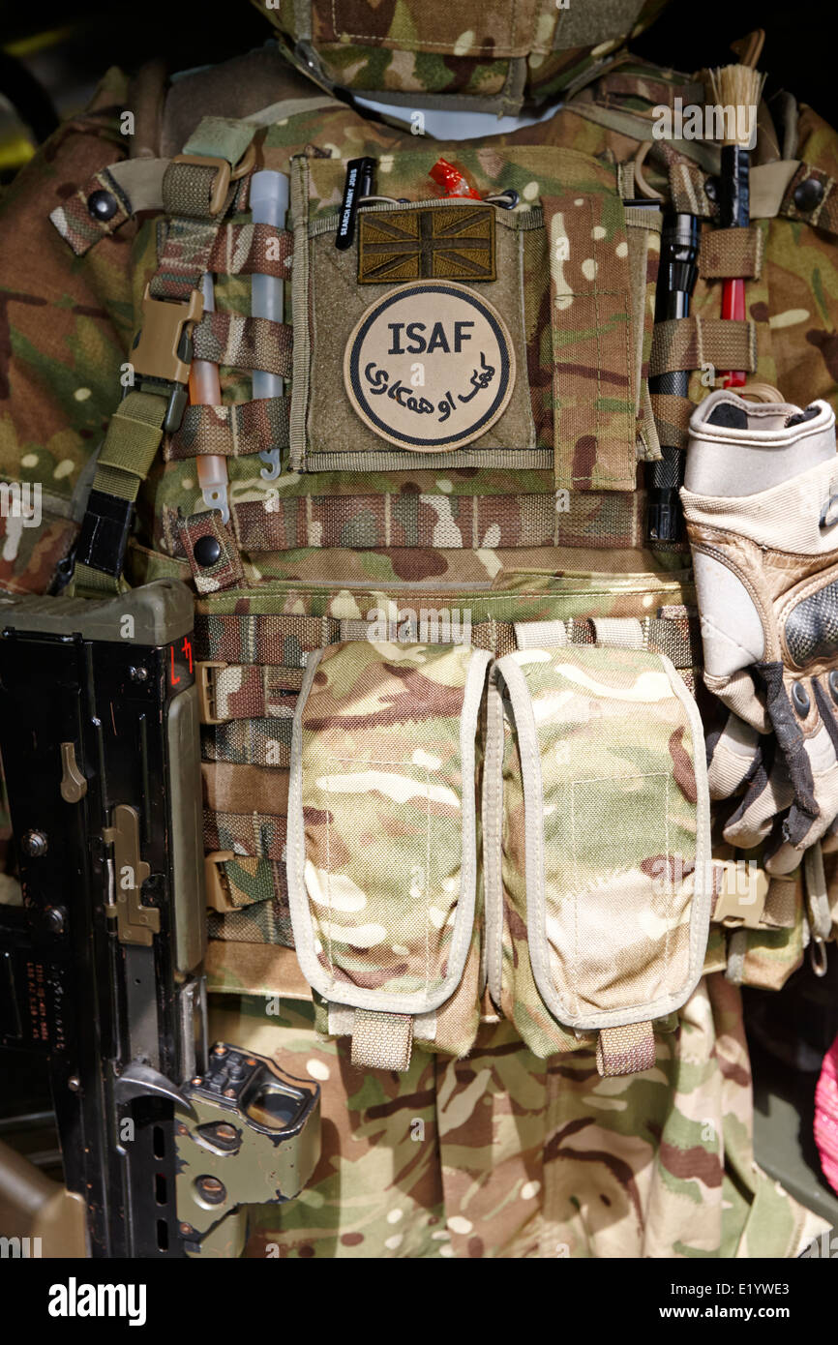
Acts of military nature or terrorism?
DD (Afghanistan) [2012]
Attack on Afghan military forces and UN forces
ISAF mandated to restore peace, attacks on ISAF frustrate that objective
‘an attack against ISAF is, in principle, capable of being an act contrary to the purposes and principles of the United Nations’

Slide 26
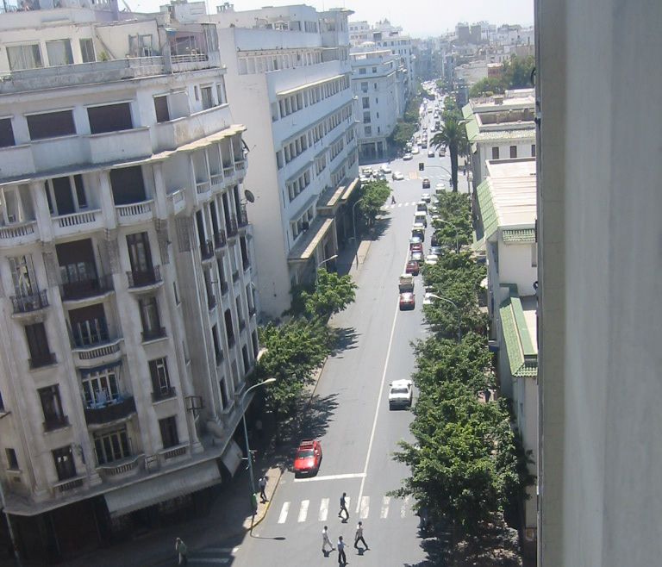
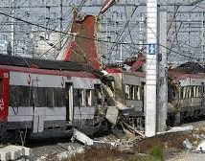
Mere Membership?
Lounani [2017] C-573/15 CJEU
Lounani convicted in Belgium for supporting terrorist group, not for carrying out any terrorist acts as such
Provided logistical support to group, forging passports and assisting volunteers to travel to Iraq as ‘foreign fighters’
Activity banned by UNSC Resolution 2178 (2014)
CJEU interprets exclusion clause broadly, focusing on proscription by UN rather than actual commission of excludable acts, regardless of gravity of individual conduct and actual result ‘whether or not the group had perpetrated any terrorist act’ and whether or not the individual actively participated in such acts
Notes:
Refugee status is declaratory, not constitutive; the consequences of this legal status come from formal definition but as soon as you satisfy the criteria you are a refugee

Slide 27
Tolep’s Case
Facts:
Tolep belongs to ethnic minority, Somas in Ruritania
Systemic persecution by government
Member of Ruritania Liberation Front (RLF)
RLF’s aim to overthrow government, describes themselves as peaceful
RLF proscribed terrorist organisation
Tolep publish leaflets asking to congregate, attend demonstrations and donate
Tolep organise venue for meetings
Individual members RLF assassinated senior government officials
Wanted for two offences:
Member and ‘actively supporting’ RLF
Aggravated robbery
What are the arguments for his exclusion?
What are the arguments against his exclusion?

Slide 28
Next Week, Cessation, Case Analysis
The consolidation activity this week will consist of the analysis of leading international authority on cessation of refugee status, analysing and debating the merits of the CJEU's reasoning on Art 1C of the Refugee Convention in the Abdulla judgement of 2 March 2010 and in the OA judgment of 21 January 2021.

