Slide 1
The Menstrual Cycle
Ccfs 2022
Dr nyree myatt
This Photo by Unknown Author is licensed under CC BY-NC

Slide 2
Lesson objectives
By the end of the lesson, you will be able to:
1. Describe what happens during the menstrual cycle
2. Explain the role of each hormone in the menstrual cycle
3. Describe some conditions related to menstruation
This Photo by Unknown Author is licensed under CC BY-NC

Slide 3
The average menstrual cycle lasts 28 days True
Women have periods when they are pregnant False
Women release eggs from ovaries roughly every 28 days True
The average period lasts 10 days False
Boys go through puberty before girls False
Girls can get pregnant before their first periods True
Oestrogen causes testes to grow larger and growth spurts in boys during puberty False
A period is the body’s way of getting rid of extra blood False
The average period releases two tablespoons of blood True
Men don’t have oestrogen and women don’t have testosterone. False

Slide 4
Let’s start at the beginning with some terms
Menstrual cycle – sequence of natural changes in hormone production together with changes in the ovaries and uterus (21 – 40 days normal range)
Period – part of the menstrual cycle when a woman bleeds from their vagina for a few days (range 2 – 7 days)
Menarche – age at which a girl experiences her first period (range between 10 and 16 years)
Menopause - when a woman stops having periods and is no longer able to get pregnant naturally (normally between 45 – 55 years)
Menorrhagia – abnormal or prolonged bleeding during a period which may interfere with normal life
Dysmenorrhea – severe and frequent menstrual cramps during a period
Oligomenorrhea – infrequent periods (fewer than 6-8 periods per year)

Slide 5
Hormones involved in menstrual cycle
Hypothalamus produces GnRH – gonadotrophin releasing hormone
GnRH tells anterior pituitary gland to produce:
Luteinising hormone (LH) and follicle stimulating hormone (FSH)
FSH acts on the ovary to help with ovum development
LH is produced and leads to ovulation

Slide 6
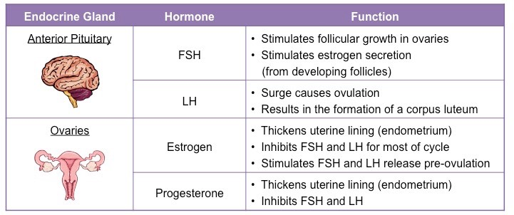

Slide 7
Starting at day 0
Endometrium = uterine lining
Endometrium sheds – period starts
Hypothalamus releases GnRH
GnRH acts on pituitary to cause production of FSH and LH
FSH acts on ovary to help an ovum develop

Slide 8
Days 5 - 14
Period ends
FSH continues to be produced and ovum continues to develop
Endometrium continues to thicken
Oestrogen levels start to increase from the ovary
Peak in oestrogen leads to surge in LH
Surge in LH leads to ovulation around day 14

Slide 9
Days 14 - 28
Corpus luteum develops form ruptured egg follicle
Corpus luteum produces progesterone
LH and FSH start to drop because of negative feedback from oestrogen and progesterone on pituitary and hypothalamus
If no fertilisation and pregnancy happen, progesterone and oestrogen levels start to fall
Endometrium breaks down and is shed - period

Slide 10
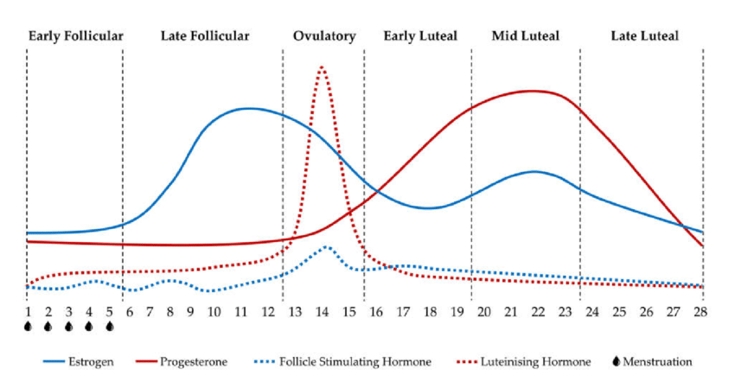
LH
Oestrogen
Progesterone
FSH

Slide 11
In groups of 4-5, look up the following…
Group 1 - Polycystic ovary syndrome (PCOS) (causes, diagnosis, treatment)
Group 2 – Endometriosis (causes, diagnosis, treatment)
Group 3 – Combined oral contraceptives (what they are, mechanism of action, side effects)
Group 4 – HRT (hormone replacement treatment ( what it is, what it is for, how it works, side effects)
Group 5 – Menorrhagia (what it is and treatments)
You have 10-15 mins….And present your findings to the class!!!

Slide 12
Lesson objectives
By the end of the lesson, you will be able to:
1. Describe what happens during the menstrual cycle
2. Explain the role of each hormone in the menstrual cycle
3. Describe some conditions related to menstruation

