Slide 1
Confronting the national identity crisis

Slide 2
French exceptionalism (1)
We have focused on a variety of themes linked to idea of 'French exceptionalism’.
Connected to a specific period: 1989 and after.
Emergence of a consensus around a core set of values.
Blurring of the republican ideas themselves: everyone is a republican.
Re-reading of Revolution as victory of democracy and liberalism.
Tocqueville replaces Marx (continuity vs. rupture)
Prevailing ideology: rights of man / "new individualism"

Slide 3
French exceptionalism (2)
Arrival of a new, less conflictual politics that would work within the parameters of social democracy and liberalism.
Transformations of economy:
Alain Touraine: “post-industrial society”, a society where class conflict was irrelevant – conflict is now in the fields of culture. Post-material demands.
Justified by the emergence of NSM and demise of trade unions.

Slide 4
Bicentennial celebrations (1989)
Chance to display this new reality
For first time it seemed that the commemoration of the Revolution could be celebrated in a spirit of quasi-consensus broadly reflecting the stability of a Constitution that had just survived its first experience of political and institutional cohabitation.
Extravagant parade down the Champs-Elysées (Jean-Paul Goude)
Jessye Norman singing the Marseillaise
Focus on the Declaration of the Rights of Man and the Citizen

Slide 5
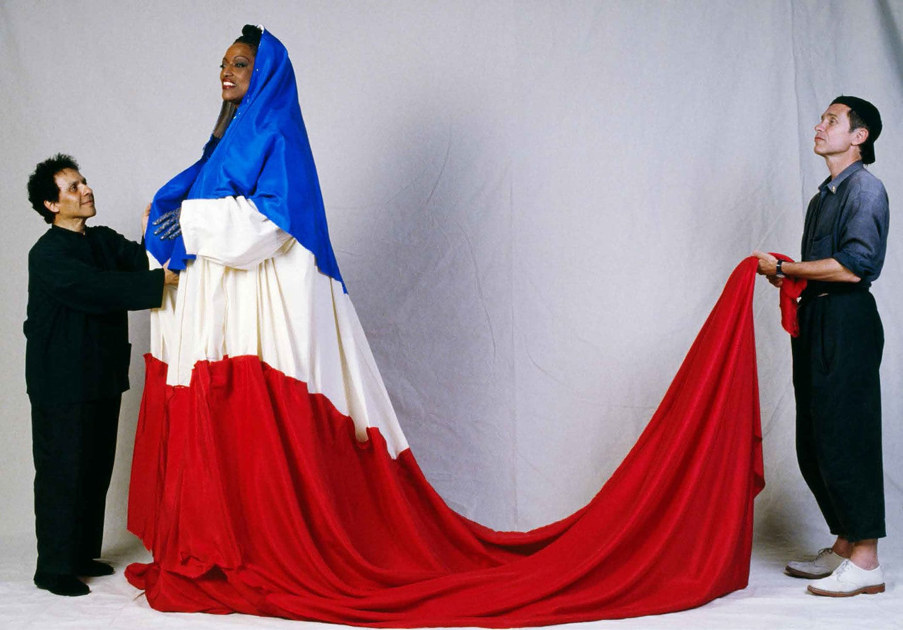

Slide 6
Bicentennial celebrations (1989)
Amongst historians, revisionist François Furet appeared to have won the argument: Dictionnaire critique de la Révolution française (1988, co-directed with Mona Ozouf)
'Revolution is over'
France and the French had, at last, left behind what he termed the 'revolutionary political civilization’.
YET, the End of History (Fukuyama, 1992) and the end of ideology that was associated with it (victory of democracy and liberalism) did not mark an end of social inequality (on the contrary)

Slide 7
1980s/1990s also coincided with a dual crisis
(1) Economic and social crisis: massive rise of unemployment, and social inequalities
Unemployment has risen dramatically: 1981 to 1994: goes from 1.6 to 3.3 million
Hardest hit are employees and workers (ouvriers): 9 out of 10 unemployed
Greater precariousness (short-term contracts, temping) of work (“social exclusion”):
1982 to 1993: number of CDD more than doubled
1993: 70% of new jobs were CDD
Growing poverty
“mobilité sociale descendante”
Working poor: work but do not earn enough to make a descent living
1990s: 8% of the French population (above the EU 15 average)

Slide 8
France and its past (1)
(2) Identity crisis: crisis of Republic/republicanism and therefore national identity
Underlying issue: France and its past.
Invocations of the past (memory) and its impact on French society, politics and culture
French Revolution (Howarth and Varouxakis, 2003)
Events so dramatic, abrupt, and so influential that they imposed their shadow on French society for the next two centuries
Unfinished revolution.
“guerres Franco-françaises” are not over : continuation of past conflicts & new issues.

Slide 9
France and its past (2)
A disproportionately great part of French political debate during the last two centuries has been dedicated either to:
Rehearsing the same battles, arguments, passions, or
Interpreting them, trying to make sense of the revolutionary experience, and trying to make France a country reconciled with itself.
Many political and/or cultural debates = conducted using terms containing direct references or bearing the imprints of the revolutionary experience & debates on Republic/Republicanism.
Thus, an important dimension of French political culture is that it is a historicist political culture.
Pierre Tevanian, Politiques de la Mémoire (2021, Amsterdam)

Slide 10
France and its past (3)
Historical references are at the heart of contemporary French political discourses: The past is not an affair of the past, left to historians to debate, but part of everyday political discourse.
Leads to struggles over history and its interpretation:
Commemorations: Paris Commune, Napoleon 1st, May 68…
Struggle over interpretation of republicanism itself
Republic: "mot voyageur“ (Claude Nicolet, L’Idée Républicaine en France, 1982).
"Republic" used to describe all that is "good“: "Ordre républicain", "police républicaine", "école républicaine"

Slide 11
A threatened republic
Since 1980s, "Republican model" is presented as being under threat
Series of challenges (internal and external)
Multiculturalism
Islam
'Islamo-leftism'
Immigration
‘Wokism’

Slide 12
Globalization
Economic globalization
Cultural globalization / Americanization
Speaking of the values of the Republic, it was argued, only made sense as long as France continued to possess a distinct national identity and voice.
Alain FINKIELKRAUT (La Défaite de la Pensée, 1987): malaise afflicting France had its origin in the internationalization of culture and in the fact that France was becoming ever more hostile to high culture and ever more consumerist and hedonist.
Republic under threat
National specificity had been eroded
Republican political culture had been enfeebled
Role in the world had been diminished

Slide 13
The return of republicanism (1)
Response by growing section of French politicians has been to reassert France’s Republican identity
Acknowledging that the Republic is under threat
Response: Not adapting Republicanism but reaffirming a “defensive” Republicanism.
Pushing idea that the Republican model of integration is in crisis.
Not failure of the Republic BUT failure or/and refusal of certain sections of the population to integrate into it.

Slide 14
The return of republicanism (2)
2004: “l’idée républicaine aujourd’hui” guide
Sent out to schools
Key role of intellectuals:
Many of France’s intellectuals found comfort in what at times amounted to a nostalgic reaffirmation of a golden age of republicanism.
Usually amounted to a straightforward reaffirmation of the principles of republican citizenship filtered through a vision of an idealized past of shared civic identity.
This has tended to blur the Left/Right divide that characterizes most other Western democracies
Supporters of economic liberalism can also invoke the Republic to defend conservative stances in the field of minority rights etc…

Slide 15
The return of republicanism (3)
Régis Debray in Que Vive la République (1989):
"the enemies of the Republic have taken control of society’ and that the old alliance between throne and altar had been replaced by that between ‘money and the image."
Headscarf affair (1989) had to be seen as part of the ‘dissolution’ of the republican idea and the victory of ‘la dictature des particularismes’
Alain Finkielkraut (1988):
"I believe that the fanatics of cultural identity, those who raise collective difference to the level of an absolute, do not proceed differently from racists, even if, to be precise, the determinism in which they enclose individuals is not genetic but historical and traditional. »

Slide 16
The return of republicanism (5)
IMPLICATIONS:
As we have seen, the success of social struggles hinges on their ability to 'republicanize’ themselves.
Problem: Those who are not equiped or unwilling to 'republicanize' their demands fail/are at a disadvantage.
Further placing the 'republic' at the center of public life while simultaneously (paradoxically) widening the gap between it & large sections of French society.

Slide 17
Conclusion
What republicanism for France?
Towards a new 'French exception'?
New approaches
Joël Roman: "pour un multiculturalisme tempéré" "multiculturalisme à la français" (1995)
Cécile Laborde (2009): "républicanisme critique" vs. "républicanisme conservateur" (entre républicanisme traditionnel et théories libérales et multiculturalistes anglo-saxonnes).
Mame-Fatou Niang and Julien Suaudeau (2020): "Antiracist universalism"
"D'un côté, l'universalisme doit s'assouplir pour que tou·tes les Français·es y prennent réellement part. De l'autre, l'antiracisme doit avoir la patience et l'empathie de comprendre l'insécurité culturelle et le dérangement que les mutations postcoloniales engendrent."

