Slide 1
Convention on Biological Diversity (CBD)

Slide 2
species loss
According to WWF, populations of vertebrate animals have decreased by 58% in the past fifty years, driven largely by habitat loss.
A study in Germany found that the country’s insect population has declined by 75% since 1990, posing a serious threat to pollination.
​A paper published by the Proceedings of the National Academy of Sciences USA describes the current trajectory as a “biological annihilation”, and “the Earth’s ongoing sixth major extinction event”. Extinction is occuring at a rate up to 1000 times the prevailing rates over the past 2 million years.
Soil degradation
Globally, 40% of the soil used for agriculture is degraded.
Every year, approximately 24 billion tons of fertile soil is lost, far greater than the average rate of replenishment.
​The loss of fertile soil is already affecting agricultural productivity, presenting a challenge in the face of increasing food demand.
Threats to carbon sinks
3.3 million hectares of the world’s forests are lost annually, limiting their ability to sequester carbon.
Loss of the world’s topsoil also has worrying implications, given it contains three times the amount of carbon as the entire atmosphere.
Loss of fish stocks
Estimates say that 31.4% of global fish stocks are at biologically unsustainable levels.
Coral habitats that act as havens for biodiversity are also under threat. Currently, 27% of the world’s coral reefs have been lost. The 2018 IPCC Special Report said that coral reefs are projected to decline by a further 70–90% at 1.5°C warming (high confidence), with larger losses (>99%) at 2ºC (very high confidence).
https://thefuturescentre.org/trend-card/ecosystems-decline?gclid=EAIaIQobChMImpWppM2I4AIVJRbTCh2kIQB3EAAYASAAEgJek_D_BwE

Slide 3
Biodiversity is of great importance in order to maintain stable ecosystems. An ecosystem is a group of life forms that live together in a balanced and stable community. If there is a sudden change in that community’s environment, the balance of the community may change which may cause it to be destroyed.
The destruction of ecosystems can have a very serious effect both on local and global levels. Rainforests, for example, contribute both to the process of soil formation and help to regulate the climate through photosynthesis – both producing oxygen and absorbing carbon dioxide. Wetlands act as sponge-like reservoirs in dry weather and help to filter and purify water. Coral reefs and mangrove swamps protect the land that they surround by reducing the effects of erosion.
The destruction of rainforest causes erosion, loss of valuable species and changes in climate. http://ypte.org.uk/factsheets/biodiversity/why-do-we-need-to-conserve-biodiversity?gclid=EAIaIQobChMIsM-l9MyI4AIVySnTCh3yHwTUEAAYASAAEgIhHPD_BwE

Slide 4
The Convention was opened for signature on 5 June 1992 at the United Nations Conference on Environment and Development (the Rio "Earth Summit"). It remained open for signature until 4 June 1993, by which time it had received 168 signatures. The Convention entered into force on 29 December 1993, which was 90 days after the 30th ratification. The first session of the Conference of the Parties was scheduled for 28 November – 9 December 1994 in the Bahamas.
The Convention on Biological Diversity was inspired by the world community's growing commitment to sustainable development. It represents a dramatic step forward in the conservation of biological diversity, the sustainable use of its components, and the fair and equitable sharing of benefits arising from the use of genetic resources. https://www.cbd.int/history/

Slide 5
The Convention has two protocols, both of which take into account the needs of, and commit to cooperating with, developing countries and “in particular” those of LDCs and other groups of countries such as SIDS and Parties with Economies in transition:
Nagoya Protocol on Access to Generic Resources and the Fair and Equitable Sharing of Benefits Arising from their Utilization: Parties committed to taking into account the needs of, and cooperating with, developing country Parties and “in particular” LDCs, SIDS and Parties with economies in transition (Article 22 on capacity; Article 23 on technology transfer, collaboration and cooperation; Article 25 on Financial Mechanisms and Resources).
Cartagena Protocol on Biosafety to the Convention on Biological Diversity (governs the movements of living modified organisms – LMOs – resulting from modern biotechnology from one country to another): In regard to the establishment of a Biosafety Clearing-House, Parties committed to ” Assist Parties to implement the Protocol, taking into account the special needs of developing country Parties, in particular the least developed and small island developing States among them, and countries with economies in transition as well as countries that are centres of origin and centres of genetic diversity”(Article 20); in regard to capacity-building, financial resources and access to and transfer of technology and know-how, Parties commit to cooperating in the development and/or strengthening of human resources and institutional capacities in biosafety in developing country Parties, “in particular” the LDCs and SIDS among them, and in Parties with economies in transition (Articles 22 and 28).

Slide 6
Art. 1 Objectives : ‘The objectives of this Convention, to be pursued in accordance with its relevant provisions, are the conservation of biological diversity, the sustainable use of its components and the fair and equitable sharing of the benefits arising out of the utilization of genetic resources, including by appropriate access to genetic resources and by appropriate transfer of relevant technologies, taking into account all rights over those resources and to technologies, and by appropriate’
Art, 2 ‘Ecosystem’ means a dynamic complex of plant, animal and micro-organism communities and their non-living environment interacting as a functional unit’. The ecosystem approach is a strategy for the integrated management of land, water and living resources that promotes conservation and sustainable use in an equitable way. Application of the ecosystem approach will help to reach a balance of the three objectives of the Convention. It is based on the application of appropriate scientific methodologies focused on levels of biological organization which encompass the essential processes, functions and interactions among organisms and their environment. It recognizes that humans, with their cultural diversity, are an integral component of ecosystems. https://www.cbd.int/ecosystem

Slide 7
The CBD is a framework Convention and has three main goals including: the conservation of biological diversity (or biodiversity); the sustainable use of its components; and the fair and equitable sharing of benefits arising from genetic resources. The overall goal of the Biodiversity for Development initiative is to improve the integration of the three objectives of the Convention into development plans and priorities in keeping the spirit of Article 6 (b).
The three inter-related objectives of the initiative are:
To promote the integration of biodiversity considerations into sectoral policies or cross-sectoral strategies (e.g. Poverty Reduction Strategies or Sustainable Development Strategies) as well as ensuring the development dimension in National Biodiversity Strategies and Action Plans (NBSAPs);
To facilitate the exchange of experiences and the dissemination of lessons learned and good practices regarding the integration of biodiversity into development sectors and poverty reduction strategies and programmes;
To strengthen the linkages between CBD Programmes of Work and development / poverty alleviation, and raise awareness of the Parties on this crucial issue.
The basic principle Art. 3 Principle
States have, in accordance with the Charter of the United Nations and the principles of international law, the sovereign right to exploit their own resources pursuant to their own environmental policies, and the responsibility to ensure that activities within their jurisdiction or control do not cause damage to the environment of other States or of areas beyond the limits of national jurisdiction

Slide 8
in-situ & Ex-situ conservation
In-situ conservation is the conservation of ecosystems, natural habitats and species in their natural surroundings. Signatories are required to give emphasis to in-situ conservation through a broad range of actions, including the establishment and management of protected areas; conservation and sustainable use of biological resources within and outside protected areas; promotion of environmentally sound and sustainable development in areas adjacent to protected areas; rehabilitation and restoration of degraded ecosystems; control of alien species and genetically modified organisms; protection of threatened species and populations; and regulation of damaging processes and activities.
While the Convention emphasised the importance of in-situ conservation, it also acknowledges that ex-situ measures also have an important role to play. Ex-situ conservation means conservation outside natural habitats, for example in zoos, botanic gardens and seed banks. Parties are to take ex-situ measures, while ensuring that ecosystems and natural populations of species are not threatened.

Slide 9
Sustainable use
Various measures are to be undertaken by signatories to promote sustainable use of biological diversity. These include integrating consideration of the conservation and sustainable use of biological resources into national decision-making; adopting measures for the use of biological resources which avoid or minimise adverse impacts on biological diversity; supporting local populations to develop and implement remedial action in degraded areas; and encouraging co-operation between governmental authorities and the private sector in developing methods for the sustainable use of biological resources.
Minimising adverse impacts
Signatories must introduce appropriate procedures for environmental impact assessment of projects, programs and policies that are likely to have significant adverse effects on biological diversity. The Convention also provides for the notification of activities which are likely to significantly damage biological diversity and the promotion of emergency response arrangements.

Slide 10
Capacity building
Effective global action requires the expansion of national capacities, particularly in developing countries, for the conservation and sustainable use of biological diversity. In this regard the Convention provides for national and international action on research, training, the exchange of public information, and scientific and technical co-operation with emphasis on building national capabilities through human resource development and institution building. Provisions for encouraging public understanding of the significance of biological diversity and the measures required for its conservation are also included. Technology transfer of this and other pertinent information is an important aspect of ensuring the convention meets its objectives.
Institutional arrangements
The Convention establishes a number of institutional arrangements necessary to ensure effective implementation. The Conference of the Parties is the key decision-making body responsible for monitoring the implementation of the Convention and has a major role in funding matters. Signatories are required to submit reports on measures taken for the implementation of the Convention and their effectiveness in meeting the objectives of the Convention. The Subsidiary Body on Scientific, Technical and Technological Advice is to provide the Conference of the Parties with advice relating to the implementation of the Convention, including the status of biological diversity and the effectiveness of measures taken to give effect to the Convention. It also has a major role in identifying technologies for the conservation and sustainable use of biological diversity suitable for transfer to developing countrieshttp://adlib.everysite.co.uk/adlib/defra/content.aspx?doc=18209&id=18211

Slide 11
Article 8(j) - Traditional Knowledge, Innovations and Practices
Article 8(j) states
Each contracting Party shall, as far as possible and as appropriate:
Subject to national legislation, respect, preserve and maintain knowledge, innovations and practices of indigenous and local communities embodying traditional lifestyles relevant for the conservation and sustainable use of biological diversity and promote their wider application with the approval and involvement of the holders of such knowledge, innovations and practices and encourage the equitable sharing of the benefits arising from the utilization of such knowledge innovations and practices.

Slide 12
Principle CBDR CBD
Article 20(4) Convention on Biological Diversity
The extent to which developing country Parties will effectively implement their
commitments under this Convention will depend on the effective
implementation by developed country Parties of their commitments under this
Convention related to financial resources and transfer of technology and will
take fully into account the fact that economic and social development and
eradication of poverty are the first and overriding priorities of the developing
country Parties.
- Article 21 Convention on Biological Diversity
1. There shall be a mechanism for the provision of financial resources to
developing country Parties for purposes of this Convention on a grant or
concessional basis the essential elements of which are described in this Article.
The mechanism shall function under the authority and guidance of, and be
accountable to, the Conference of the Parties for purposes of this Convention.
The operations of the mechanism shall be carried out by such institutional
structure as may be decided upon by the Conference of the Parties at its first
meeting. For purposes of this Convention, the Conference of the Parties shall
determine the policy, strategy, programme priorities and eligibility criteria
relating to the access to and utilization of such resources. The contributions shall
be such as to take into account the need for predictability, adequacy and timely

Slide 13
flow of funds referred to in Article 20 in accordance with the amount of
resources needed to be decided periodically by the Conference of the Parties and
the importance of burden-sharing among the contributing Parties included in the
list referred to in Article 20, paragraph 2. Voluntary contributions may also be
made by the developed country Parties and by other countries and sources. The
mechanism shall operate within a democratic and transparent system of
governance.
2. Pursuant to the objectives of this Convention, the Conference of the Parties
shall at its first meeting determine the policy, strategy and programme priorities,
as well as detailed criteria and guidelines for eligibility for access to and
utilization of the financial resources including monitoring and evaluation on a
regular basis of such utilization. The Conference of the Parties shall decide on
the arrangements to give effect to paragraph 1 above after consultation with the
institutional structure entrusted with the operation of the financial mechanism.
3. The Conference of the Parties shall review the effectiveness of the mechanism
established under this Article, including the criteria and guidelines referred to in
paragraph 2 above, not less than two years after the entry into force of this
Convention and thereafter on a regular basis. Based on such review, it shall take
appropriate action to improve the effectiveness of the me 4. The Contracting Parties shall consider strengthening existing financial
institutions to provide financial resources for the conservation and sustainable
use of biological diversity.

Slide 14
Strategic Plan for Biodiversity 2011-2020, including Aichi Biodiversity Targets
n decision X/2, the tenth meeting of the Conference of the Parties, held from 18 to 29 October 2010, in Nagoya, Aichi Prefecture, Japan, adopted a revised and updated Strategic Plan for Biodiversity, including the Aichi Biodiversity Targets, for the 2011-2020 period.
This Plan provides an overarching framework on biodiversity, not only for the biodiversity-related conventions, but for the entire United Nations system and all other partners engaged in biodiversity management and policy development. Parties agreed to translate this overarching international framework into revised and updated national biodiversity strategies and action plans within two years. Additionally, in decision X/10, the Conference of the Parties decided that the fifth national reports, due by 31 March 2014, should focus on the implementation of the 2011-2020 Strategic Plan and progress achieved towards the Aichi Biodiversity Targets .
Poor implementation of Aichi Targets . So what next? (post 2020 global biodiversity framework ? )
Negotiations underway on biodiversity convention beyond national jurisdiction.

Slide 15
December 2022 COP adopts “Kunming-Montreal Global Biodiversity Framework” (GBF), including four goals and 23 targets for achievement by 2030.
By 2030: Protect 30% of Earth’s lands, oceans, coastal areas, inland waters;
Reduce by $500 billion annual harmful government subsidies;
Cut food waste in half.

Slide 16
GOAL A
The integrity, connectivity and resilience of all ecosystems are maintained,
enhanced, or restored, substantially increasing the area of natural
ecosystems by 2050;
Human induced extinction of known threatened species is halted, and, by
2050, extinction rate and risk of all species are reduced tenfold, and the
abundance of native wild species is increased to healthy and resilient levels;
The genetic diversity within populations of wild and domesticated species,
is maintained, safeguarding their adaptive potential.
GOAL B
Biodiversity is sustainably used and managed and nature’s contributions to
people, including ecosystem functions and services, are valued, maintain

Slide 17
and enhanced, with those currently in decline being restored, supporting the achievement of sustainable development, for the benefit of present and future generations by 2050.
GOAL C
The monetary and non-monetary benefits from the utilization of genetic resources, and digital sequence information on genetic resources, and of traditional knowledge associated with genetic resources, as applicable, are shared fairly and equitably, including, as appropriate with indigenous peoples and local communities, and substantially increased by 2050, while ensuring traditional knowledge associated with genetic resources is appropriately protected, thereby contributing to the conservation andsustainable use of biodiversity, in accordance with internationally agreed access and benefit-sharing instruments.

Slide 18
GOAL D
Adequate means of implementation, including financial resources, capacity building, technical and scientific cooperation, and access to and transfer of technology to fully implement the Kunming-Montreal global biodiversity framework are secured and equitably accessible to all Parties, especially developing countries, in particular the least developed countries and small island developing States, as well as countries with economies in transition, progressively closing the biodiversity finance gap of $700 billion per year, and aligning financial flows with the Kunming-Montreal Global Biodiversity Framework and the 2050 Vision for Biodiversity

Slide 19
Cartagena Protocol on Biosafety It was adopted on 29 January 2000 and entered into force on 11 September 2003.
The Cartagena Protocol on Biosafety to the Convention on Biological Diversity is an international treaty governing the movements of living modified organisms (LMOs) resulting from modern biotechnology from one country to another. The Protocol seeks to protect biological diversity from the potential risks posed by living modified organisms resulting from modern biotechnology. It establishes an advance informed agreement (AIA) procedure for ensuring that countries are provided with the information necessary to make informed decisions before agreeing to the import of such organisms into their territory. The Protocol contains reference to a precautionary approach and reaffirms the precaution language in Principle 15 of the Rio Declaration on Environment and Development. The Protocol also establishes a Biosafety Clearing-House to facilitate the exchange of information on living modified organisms and to assist countries in the implementation of the Protocol.

Slide 20
The Biosafety Protocol requires Parties to make decisions on import of LMOs for intentional introduction into the environment in accordance with scientifically sound risk assessments (Article 15). It sets out, in Annex III general principles, methodological steps, and points to consider in the conduct of risk assessment.
The general principles include, among others, the following concepts: Risk assessment should be carried out in a scientifically sound and transparent manner; Lack of scientific knowledge or scientific consensus should not necessarily be interpreted as indicating a particular level of risk, an absence of risk, or an acceptable risk; Risks should be considered in the context of risks posed by the non-modified recipients or parental organisms; and that Risks should be assessed on a case-by-base basis.
The methodology described in Annex III of the Protocol follows the conventional risk assessment paradigm, beginning with identification of a potential hazard, such as characteristics of an LMO, which may have an adverse effect on biodiversity. Risks are then characterized based on combined evaluation of the likelihood of adverse effects, and the consequences should those effects be realized.

Slide 21
Article 1 of the Protocol states that it aims to “contribute to ensuring an adequate level of protection in the field of the safe transfer, handling and use of living modified organisms resulting from modern biotechnology that may have adverse effects on the conservation and sustainable use of biological diversity, taking also into account risks to human health, and specifically focusing on transboundary movements”. In short, it seeks to protect biodiversity from the potential risks of living modified organisms (LMOs) resulting from modern biotechnology.

Slide 22
Advanced Informed Agreement (AIA)
The Protocol’s main mechanism is its Advanced Informed Agreement (AIA) requirement. It is a procedure that must be followed before the first intentional transboundary movement of an LMO into the environment of the importing country. The exporter must provide a notification to the importing country containing detailed information about the LMO, previous risk assessments of the LMO and its regulatory status in the exporting country. The importing country must acknowledge receiving the information within 90 days and whether the notifier should proceed under a domestic regulatory system or under the Protocol procedure. In either case, the importing country must decide whether to allow the import, with or without conditions or deny it within 270 days.

Slide 23
The Protocol covers the “transboundary movement, transit, handling and use of all living modified organisms that may have adverse effects on the conservation and sustainable use of biological diversity, taking into account risks to human health”.
It does not cover:
Products derived from LMOs (e.g. paper from GM trees)
LMOs, which are pharmaceuticals for humans that are addressed by other relevant international agreements or organizations

Slide 24
Article 18 of the Cartagena Protocol addresses the issue of the handling, transport, packaging and identification of living modified organisms (LMOs).
Paragraph 1 of the Article concerns the safe handling, transport and packaging of LMOs Each Party to the Protocol has the obligation to take necessary measures to require that LMOs be handled, packaged and transported under conditions of safety, taking into consideration relevant international rules and standards.
Paragraph 2 sets out obligations on each Party to take measures to require the identification of LMOs in accompanying documentation. These identification requirements vary depending on the intended use of the LMOs. Accordingly there are different requirements for: LMOs intended for direct use as food or feed, or for processing (LMOs-FFP) (subparagraph (a)),
LMOs destined for contained use (subparagraph (b)), and
LMOs for intentional introduction into the environment (subparagraph (c)).

Slide 25
What does the Biosafety Protocol do?
It assists developing countries in building their capacity for managing modern biotechnology
It creates an advanced informed agreement (AIA) procedure that requires exporters to seek consent from importing countries before the first shipment of LMOs meant to be introduced into the environment (e.g. seeds for planting, fish for release, and microorganisms for bioremediation)
It establishes an internet-based “Biosafety Clearing-House” to help countries exchange scientific, technical, environmental and legal information about LMOs.
It requires bulk shipments of LMO commodities, such as corn or soybeans that are intended to be used as food, feed or for processing, to be accompanied by documentation stating that such shipments “may contain” LMOs and are “not intended for intentional introduction into the environment”.
The Protocol includes a clause that makes clear the Parties’ intent that the agreement does not alter the rights and obligations of governments under the World Trade Organization (WTO) or other existing international agreements.

Slide 26
What does the Biosafety Protocol Not do?
The Protocol does not address food safety issues. This is addressed by experts in other international fora.
The Protocol does not require segregation of bulk shipments of commodities that may contain living modified organisms.
It does not require consumer product labeling.
It does not subject shipments of bulk commodities to the Protocol’s AIA procedure.

Slide 27
Article 23. Public Awareness and Participation 1. The Parties shall: (a) Promote and facilitate public awareness, education and participation concerning the safe transfer, handling and use of living modified organisms in relation to the conservation and sustainable use of biological diversity, taking also into account risks to human health. In doing so, the Parties shall cooperate, as appropriate, with other States and international bodies; (b) Endeavour to ensure that public awareness and education encompass access to information on living modified organisms identified in accordance with this Protocol that may be imported. 2. The Parties shall, in accordance with their respective laws and regulations, consult the public in the decision-making process regarding living modified organisms and shall make the results of such decisions available to the public, while respecting confidential information in accordance with Article 21. 3. Each Party shall endeavour to inform its public about the means of public access to the Biosafety Clearing-House.

Slide 28
The Nagoya Protocol on Access to Genetic Resources and the Fair and Equitable Sharing of Benefits Arising from their Utilization to the Convention on Biological Diversity, is a supplementary agreement to the 1992 Convention on Biological Diversity

Slide 29
It provides a transparent legal framework for the effective implementation of one of the three objectives of the CBD: the fair and equitable sharing of benefits arising out of the utilization of genetic resources. The Nagoya Protocol on ABS was adopted on 29 October 2010 in Nagoya, Japan and entered into force on 12 October 2014, 90 days after the deposit of the fiftieth instrument of ratification. Its objective is the fair and equitable sharing of benefits arising from the utilization of genetic resources, thereby contributing to the conservation and sustainable use of biodiversity.

Slide 30
The Nagoya Protocol creates greater legal certainty and transparency for both providers and users of genetic resources by: Establishing more predictable conditions for access to genetic resources.
Helpis to ensure benefit-sharing when genetic resources leave the country providing the genetic resources
By helping to ensure benefit-sharing, the Nagoya Protocol creates incentives to conserve and sustainably use genetic resources, and therefore enhances the contribution of biodiversity to development and human well-being.

Slide 31
The Nagoya Protocol sets out core obligations for its contracting Parties to take measures in relation to access to genetic resources, benefit-sharing and compliance.
Access obligations
Domestic-level access measures are to: Create legal certainty, clarity and transparency
Provide fair and non-arbitrary rules and procedures
Establish clear rules and procedures for prior informed consent and mutually agreed terms
Provide for issuance of a permit or equivalent when access is granted
Create conditions to promote and encourage research contributing to biodiversity conservation and sustainable use
Pay due regard to cases of present or imminent emergencies that threaten human, animal or plant health
Consider the importance of genetic resources for food and agriculture for food security

Slide 32
Benefit-sharing obligations
Domestic-level benefit-sharing measures are to provide for the fair and equitable sharing of benefits arising from the utilization of genetic resources with the contracting party providing genetic resources. Utilization includes research and development on the genetic or biochemical composition of genetic resources, as well as subsequent applications and commercialization. Sharing is subject to mutually agreed terms. Benefits may be monetary or non-monetary such as royalties and the sharing of research results.
Compliance obligations
Specific obligations to support compliance with the domestic legislation or regulatory requirements of the contracting party providing genetic resources, and contractual obligations reflected in mutually agreed terms, are a significant innovation of the Nagoya Protocol. Contracting Parties are to:
Take measures providing that genetic resources utilized within their jurisdiction have been accessed in accordance with prior informed consent, and that mutually agreed terms have been established, as required by another contracting party
Cooperate in cases of alleged violation of another contracting party’s requirements
Encourage contractual provisions on dispute resolution in mutually agreed terms
Ensure an opportunity is available to seek recourse under their legal systems when disputes arise from mutually agreed terms
Take measures regarding access to justice
Take measures to monitor the utilization of genetic resources after they leave a country including by designating effective checkpoints at any stage of the value-chain: research, development, innovation, pre-commercialization or commercialization
https://www.cbd.int/abs/about/

Slide 33
Preparations for the Post-2020 Biodiversity Framework
Third meeting of the Open-ended Working Group on the Post-2020 Global Biodiversity Framework
The Open-Ended Working Group on the Post-2020 Biodiversity Framework is tasked with advancing preparations for the development of the post-2020 global biodiversity framework. This process is expected to lead to the adoption of a post-2020 global biodiversity framework during the second phase of the UN Biodiversity Conference in May 2022, in Kunming, China.
The first part of the Working Group meeting was held online from 23 August to 3 September 2021. The report of the meeting is now available (CBD/WG2020/3/5).

Slide 34
Species threatened with extinction

Slide 35
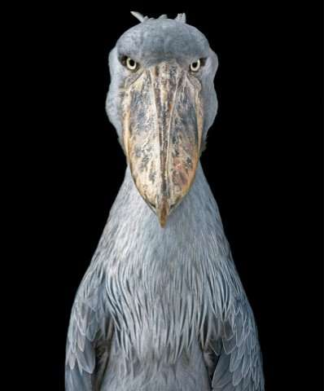

Slide 36
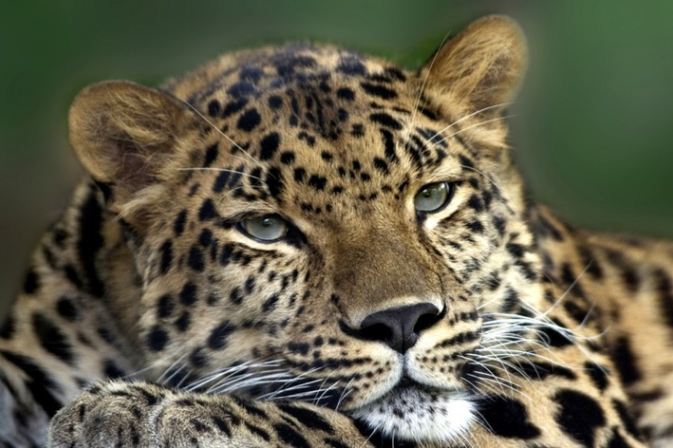

Slide 37
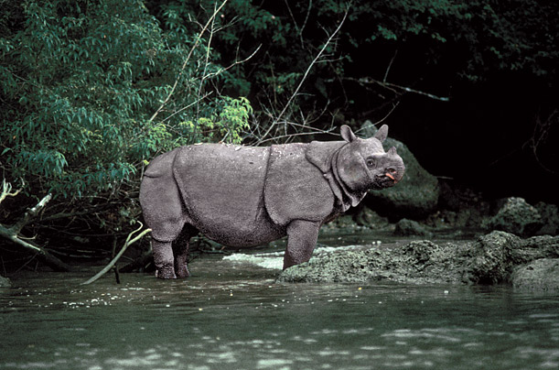

Slide 38
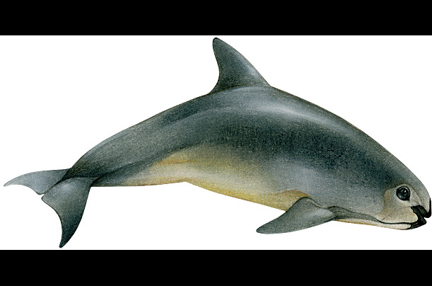

Slide 39
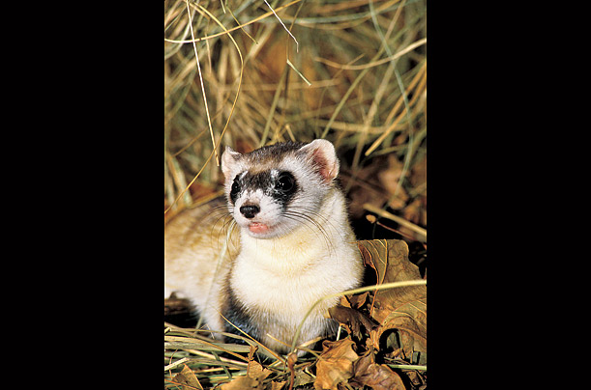

Slide 40
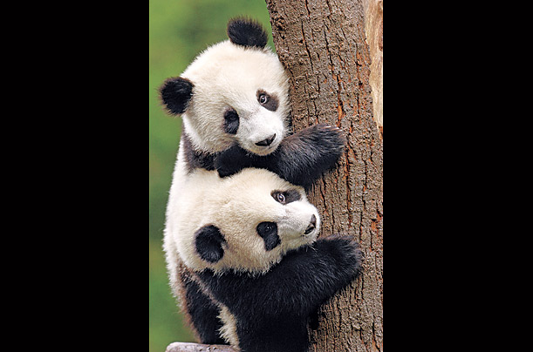

Slide 41
