Slide 1
SOLM171 International Refugee Law
Week 5, Cessation

Slide 2
What did you think of the readings?
OUTLINE
What is cessation & why does refugee status cease
What brings about cessation
Exemption from cessation
Consolidation Activity
Research Question guidance
MENTIMETER

Slide 3
What is the purpose of refugee protection?
Surrogate protection pending resumption or establishment of meaningful national protection
Restore membership of a national community

Slide 4
Distinguishing between loss and denial of status
Individual’s voluntary act, arts 1C(1),(2),(3),(4)
Changes of circumstances in country of origin, arts 1C(5),(6)
Cessation
Once protection has been granted the protected person ‘has the assurance of a secure future in the host country and a legitimate expectation that he will not henceforth be stripped of this status, save for demonstrably good and sufficient reason’
R (Hoxha) v Special Adjudicator [2005] UKHL 19, para 65
Exclusion
Protection elsewhere, states and international agencies, arts 1D, 1E
Undeserving cases, art 1F

Slide 5
When does status cease?
Voluntary acts 1C (1,2,4)
Voluntary Acts 1C (3)
Change of circumstances 1C (5,6)
Re-Availment of protection of country of nationality
Voluntary re-acquisition of nationality
Voluntary re-establishment in country which generated fear of persecution
Acquisition of new nationality & enjoyment of protection of such country
Assessment by asylum state that conditions in country where persecution was feared have improved
There is: (i) no longer any well-founded fear of being persecuted, and (ii) meaningful protection is available

Slide 6
Re-Availment, art 1C(1)
Has voluntarily re-availed himself of the protection of the country of his nationality
Scenario 1.
Rose, a Liliputian national with refugee status in Wonderland has been told she needs to renew her Liliputian passport if she is to be issued with a residence permit in Wonderland.
Scenario 2.
Charles also has refugee status in Wonderland. He has secured a job as a bus driver and now needs to provide a valid driving licence from his country of nationality Narnia before he can start working. He intendeds to call the Narnian Embassy to enquire whether they can issue him a renewed driving licence.
not re-availment, required for residence permit, UNHCR Guidelines para 6-11, requires voluntariness, intent and actual re-availment
not re-availment, required for employment, M.H., French La Cour nationale du droit d’aisle (2eme section, 2eme chambre) no: 16029914 (14.09.18)
Notes:
Formal request for intervention or representation by the authorities, signalled intention to be protected by country of origin

Slide 7
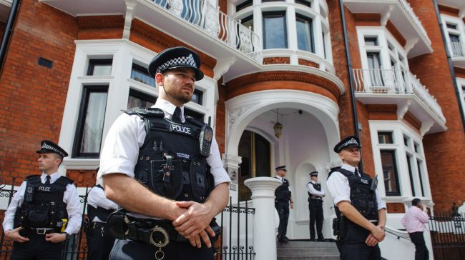
Re-Availment, art 1C(1)
Formalistic understanding of protection
Actions by refugee to indicate establishment of normal relations with authorities of country of origin:
Registering at consulates
Applying for or renewing passport/nationality certificates
Does approaching consulate indicate fear of return?
What about administrative requirements?
Does it indicate awareness of implications?

Slide 8
Re-Availment, art 1C(1)
Voluntary
Specific Intent
Act must have been carried out intentionally
Consummation
Protection must be effectively obtained
Notes:
Most diplomatic contact out of practical necessity

Slide 9
Re-Availment, art 1C(1)
Presumption that applying/renewing passport demonstrates specific intent
UNHCR Handbook: ‘If a refugee applies for and obtains a national passport or its renewal, it will, in the absence of proof to the contrary, be presumed that he intends to avail himself of the protection of the country of his nationality (para 121)’
UNHCR Cessation Guidelines: ‘This implication may…be rebutted by the refugee. The key issue is the purpose or reason for which the passport was obtained or renewed (para 10)’
Voluntary re-availment is conflated with physical return
Does this meet volition, specific intent & consummation requirements?

Slide 10
Re-Acquisition, art 1C(2)
Volition + Actual Acquisition
More straightforward indicator of decision to relinquish entitlement of refugee protection
Only refers to re-acquisition of nationality of the country in relation to which refugee status was established (country of origin) [not a third country]
What is different from 1C(1)?
Notes:
Example of how this may not happen voluntarily?

Slide 11
Re-Establishment, art 1C(4)
He has voluntarily re-established himself in the country which he left or outside which he remained to fear of persecution

Slide 12
Re-Establishment, art 1C(4)
Voluntary
Not coerced
Coercion can subsist if access to rights in host country is severely restricted
What about voluntary return initiatives?
Ex. Australia offered £5000 Afghans in 2000s to return, but only 28 days to accept offer and warned that those not recognised would be returned without compensation.
Not mere physical presence/return
Not temporary: commitment to remain
Settlement on permanent basis with no evident intent to leave
Durable: more than visit or mere presence
Evidence of substantive
Indicative of normalisation of relationship with state of origin
Notes:
Why is more than mere physical presence important? What are some examples of why someone would return to their country of origin without the intention of re-establishing themselves
How do you show normalisation?

Slide 13
New Nationality, art 1C(3)
He has acquired a new nationality, and enjoys the protection of the country of his new nationality

Slide 14
New Nationality, art 1C(3)
Convention foresees naturalisation of refugees as solution
States Parties required to give consideration to assimilation and naturalisation of refugees, art 34
No need for surrogate protection
‘Effective’ Nationality
Recognised by state, accessible in practice, delivers rights & benefits of nationality & effective in practice, i.e. right of return and residence
Voluntary act?
Can country of asylum ask refugee to acquire nationality of STC?

Slide 15
Access to national protection = no need for surrogate protection = cessation
Voluntary acts 1C (1,2,4)
Voluntary Acts 1C (3)
Chance of circumstances 1C (5,6)
Re-Availment of protection of country of nationality
Voluntary re-acquisition of nationality
Voluntary re-establishment in country which generated fear of persecution
Acquisition of new nationality & enjoyment of protection of such country
Assessment by asylum state that conditions in country where persecution was feared have improved
There is: (i) no longer any well-founded fear of being persecuted, and (ii) meaningful protection is available
Personal Circumstances

Slide 16
Change of Circumstances,
art 1C(5) & (6)
He can no longer, because the circumstances in connection with which he has been recognised as a refugee have ceased to exist, continue to refuse to avail himself of the protection of the country of his nationality
(6) Applies to stateless persons and their country of habitual residence

Slide 17
Change of Circumstances
(i) Ceased to exist
(ii) Protection
He can no longer, because the circumstances in connection with which he has been recognised as a refugee have ceased to exist…
Facts upon which refugee status
Fundamental transition that renders the state willing and able to ensure protection
…continue to refuse to avail himself of the protection of the country of his nationality
Change of circumstances prompts inquiry
If change restores refugee to national protection = no continued need for surrogate protection
Contingent on restoration of effective protection / return in case of stateless persons
Notes:
Not that there is merely an absence of negative relationship w/ protection
UNHCR guidelines, ‘need not be exemplary’

Slide 18
Change of Circumstances
(i) Ceased to exist
(ii) Protection
A demanding standard and not simply absence of well-founded fear
Evidence of access to relationship with home country
Balance between fairness to asylum countries and commitment to avoid uncertainty for refugees if their status was subject to ongoing reassessment
Need for security / legal certainty: only a change of real significance will suffice to question need for ongoing status & evidence that protection is available
Need for change that is ‘fundamental, stable and durable’
Focus on political transformation
Notes:
Example of woman who refused to agree to forced marriage. She is now married.
Durability – will conflict take longer or shorter period of time to show durability?
Cole argues that ‘significant improvement’ now geographically and historically contingent idea, not an objective standard

Slide 19
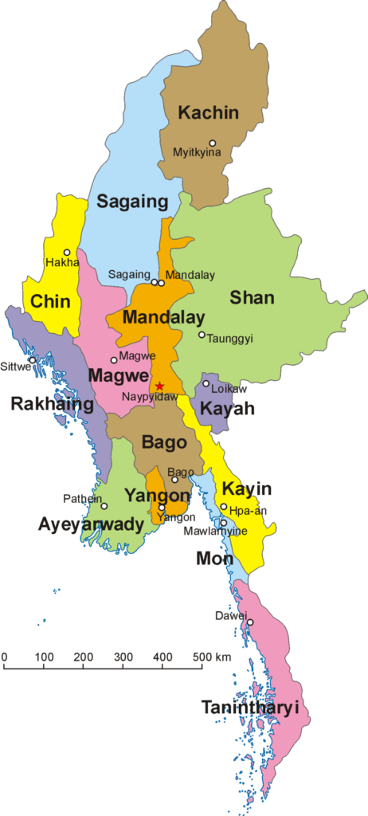
Change of Circumstances – Chin people in Myanmar
Largely Christian ethnic group in Myanmar, estimated 1.5 million people
During former military rule, abused and targeted by military political and religious discrimination
Many fled to Malaysia, India, Thailand (27,580 in Malaysia alone, UNHCR 2024)
Nov 2015 – NLD landslide victory
Aug 2017 – Myanmar military targets Rohingya
June 2018 – UNHCR announces Cessation from 31 Dec 2019
March 2019 – UNHCR abandons implementation

Slide 20
Exemption from cessation of status,
Art 1C (5),(6)
Provided that this paragraph shall not apply to a refugee falling under section A (I) of this article who is able to invoke compelling reasons arising out of previous persecution for refusing to avail himself of the protection of the country of nationality / to return to the country of his former habitual residence

Slide 21
Provided that this paragraph shall not apply to a refugee falling under section A (I)…
Article 1A(2) 1951 Refugee Convention [as modified by the 1967 Protocol]
‘A person who…owing to well-founded fear of being persecuted for reasons of race, religion, nationality, membership of a particular social group or political opinion, is outside the country of his nationality and is unable or, owing to such fear, is unwilling to avail himself of the protection of that country; or who, not having a nationality and being outside the country of his former habitual residence as a result of such events, is unable or, owing to such fear is unwilling to return to it’
Article 1A(1) 1951 Refugee Convention [as modified by the 1967 Protocol]
‘Has been considered a refugee under the Arrangements of 12 May 1926 and 30 June 1928 or under the Conventions of 28 October 1933 and 10 February 1938, the Protocol of 14 September 1939 or the Constitution of the International Refugee Organisation’
Exemption from cessation of status,
Art 1C (5),(6)

Slide 22
Exemption from cessation of status,
Art 1C (5),(6)
‘Compelling reasons’ exception limited to pre-1951 Refugees
B (FC)(Appellant)(2002) R v Special Adjudicator (Respondent) ex parte Hoxha (FX) Appellant [2005] UKHL 19
‘there is no getting away from the plain words of the proviso’ (16)
Evidence did not establish clear & widespread state practice to overcome textual limitations
Application of exception to ‘contemporary refugees’
Reasoning by analogy
Refugee Status Appeals Authority, Refugee Appeal no. 135/92, re: RS (New Zealand)
Explicit amendment of legislation
Qualification Regulation (EU) 2024/1347, art 11(1)

Slide 23
Exemption from cessation of status,
Art 1C (5),(6)
Qualification Regulation (EU) 2024/1347
art 11(1)
‘[Cessation of refugee status on the basis of changing circumstances] shall not apply to a refugee who his able to invoke compelling reasons arising out of previous persecution for refusing to avail himself or herself of the protection of the country of nationality or, being a stateless person, of the country of former habitual residence.’
UK Home Office Guidance
‘Application of the “compelling reasons” exception is interpreted to extend beyond the actual words of the provision to apply to Article 1A(2) refugees and reflects a general humanitarian principle’

Slide 24
Why should exemption apply?
Breakdown in trust with local government / populations following egregious persecution and likely ongoing discrimination
Ongoing psychological distress following ill-treatment: severe & continuing nature of the injuries suffered by persecution [pre-flight]
Acquired rights: strong economic, family, social links in country of refuge [post-flight]

Slide 25
Links between cessation & repatriation
What, if any, are the links between cessation of refugee status and repatriation of former refugees?
“UNHCR may bring about the [forced] return [or expulsion / removal / repatriation] of the person to the country of origin and may thus break ties to family, social networks and employment in the community in which the refugee has become established”
UNHCR Guidelines, 2003, para 7

Slide 26
Consolidation Activity & Change of Circumstances, art 1C(5) & (6)
He can no longer, because the circumstances in connection with which he has been recognised as a refugee have ceased to exist, continue to refuse to avail himself of the protection of the country of his nationality
Relevant EU law standards
Qualification Regulation (EU) 2024/1347
Article 11(1)(e-f), (1)(2)
Article 9
Article 7
Article 3 (2 in QD)
CJEU case law
Joined Cases C-175/09, C-176/08, C-178/08 and C-179/08 Salahadin Abdulla and Others, 2 March 2010
Case C-255/19, SSHD v OA, 21 January 2021

Slide 27
Abdulla, CJEU (02 March 2010)
Pre-2002, Five applicants from Iraq granted refugee status in Germany, WFF persecuted political opinion, fear of Saddam Hussein’s regime
2003 Iraq Invasion
2004, Circumstances in Iraq considered to have changed & Iraqi refugees recognised pre-2002 status reviewed by German authorities based on changes post-2004
Is Article 1C(5) the ‘mirror image’ of article 1A(2) qualification?
What kind of change in circumstances is required?
What must protection look like?
Notes:
What did L Brown mean by ‘mirror image’ – what was he referring to?

Slide 28
OA, CJEU (21 January 2021)
2003, Somali national granted refugee status, as a member of minority group, WFF being persecuted by a majority group
2016 status revoked, non-temporary change in circumstances, minority group no longer persecuted and available effective protection
Family and community members could provide support
Is Article 1C(5) the ‘mirror image’ of article 1A(2) qualification?
Does social / financial support provided by private actors count as protection? Is it relevant?

Slide 29
Do you agree with the reasoning of the CJEU in the case Salahadin Abdulla and Others regarding when refugee status ceases to apply?
Para 76, ‘refugee status ceases to exist when, having regard to a change of circumstances of a significant and non-temporary nature in the third country concerned, the circumstances which justified the person’s fear of persecution for one of the reasons referred to in Article 2(c) of the Directive, on the basis of which refugee status was granted, no longer exist and that person has no other reason to fear being ‘persecuted’ within the meaning of Article 2(c) of the Directive’
Para 66, ‘a causal connection between the change in circumstances and the impossibility for the person concerned to continue to refuse and thus to retain his refugee status, in that his original fear of persecution no longer appears to be well founded.’

Slide 30
When should “the circumstances in connection with which he has been recognised as a refugee [be considered] to have ceased to exit”?

Slide 31
What are the conditions to consider that there has been a sufficient change of circumstances? What requirements must be met by the protection on offer in the proposed country of return?
Para 70, ‘reasonable steps to prevent persecution’, effective legal system for detecting, prosecuting, punishing acts of persecution
Para 71, consider laws and regulations of country, manner applied, extent HR guaranteed
Para 72-73, ‘significant and non-temporary nature, factors which formed the basis of the refugee’s fear of persecution regarded as permanently eradicated
Para 74-75, may be met by non-state actors, including multinational force
With what exception?

Slide 32
What is the role of social and financial support that can be provided by family members to those who are returned to their countries of origin following the cessation of refugee status, in determining effective protection upon return?
Para 64, OA, ‘any social and financial support provided by private actors, such as the family or the clan of a third country national concerned, falls short of what is required under those provisions to constitute protection and is, therefore, of no relevance either to the assessment of the effectiveness or availability of the protection provided by the State’

Slide 33
When should the exemption from cessation of refugee status, on the basis of 'compelling reasons arising out of previous persecution' be deemed applicable?

Slide 34
Formative Submission 08 November
Abstract
Detailed Structure
Bibliography
250 words approx.
Main RQ, SRQ
‘Real world’ problem
Brief literature review
Table of contents
Headings and sub-headings
Core titles
Academic texts
Key source material

Slide 35
Drafting a Research Question
What question needs to be asked in order to address the problem?
Justification.
Frame the research and connect to preceding or existing scholarship.
Flow from the research problem. Precise. Specific. Focused.
‘Why’ research questions as causation questions, try instead ‘How can we understand…’
1. Identify the research problem.
Empirical, theoretical, doctrinal
2. What is the nature or background to the problem? Why is it important?

Slide 36
Families of RQ according to Lieblich (‘How to do research in international law? A basic guide for beginners’, 2021)
Descriptive ‘state of things as they are’ | Positivist. Looks into legal sources as autonomous bodies of knowledge, describing what law ‘is’. Ex. ‘Was the Saudi intervention in Yemen lawful?’ Law and society questions. Looking at laws relationship and interaction with society. How law gains meaning in society. How law becomes effective. Ex. ‘Is law truly international?’
Normative ‘what ought to be the state of things’ | Requires external parameters for assessing law. Morality. As handed down by God or exposed to ‘reason’. Ethics. Thomas Franck legitimacy in law, deriving from clarity and coherence. Utilitarian. What law should be in terms of ability to bring good policy.
Critical ‘exposing relations between law and power’ | Critical Legal Studies. Feminist legal studies. TWAIL. Ex. ‘How colonialism shaped international refugee law regime?’ Marxian. Ntina Tzouvala Ex. ‘Whether and how 19th century standards of civilisation in international law line on international system through capitalist underpinnings?’

