Slide 1
Knowledge Diplomacy- Cities as actors for global climate change The Case of Arctic
Eda Ayaydin
Teaching Fellow
ULIP

Slide 2
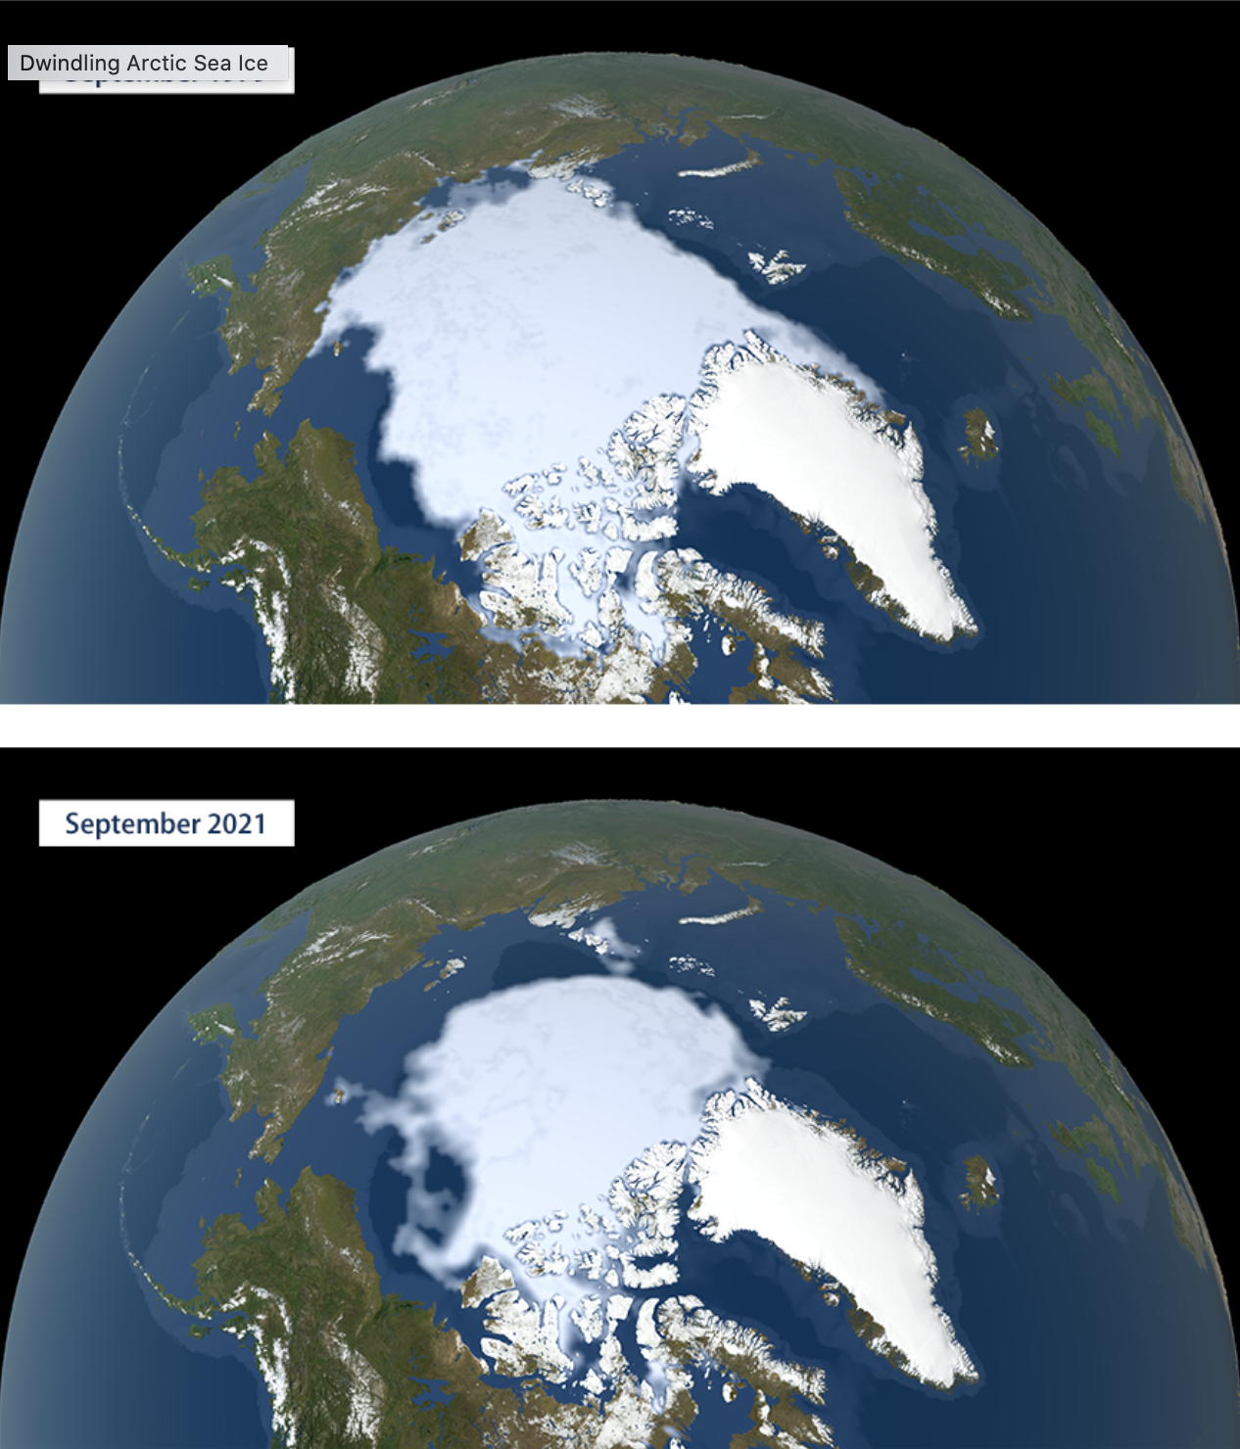
Why Arctic is important in projects on the climate change ?
Arctic amplification
Arctic is warming up to 4 times more than the rest of the planet
Changes in the Arctic affect the World

Slide 3
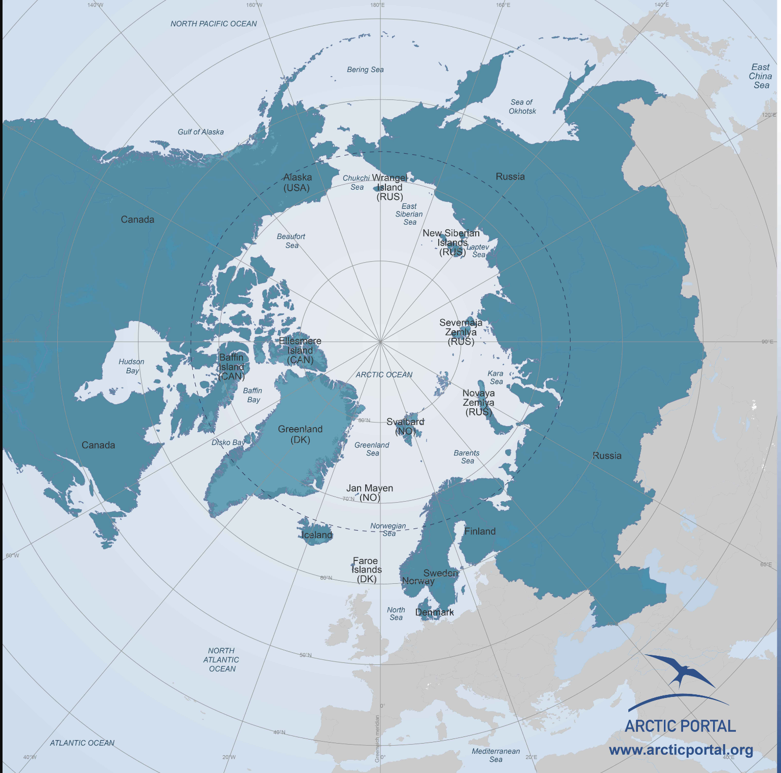
Arctic Council
Permanent members
Non-Arctic states
6 Scientific working groups

Slide 4
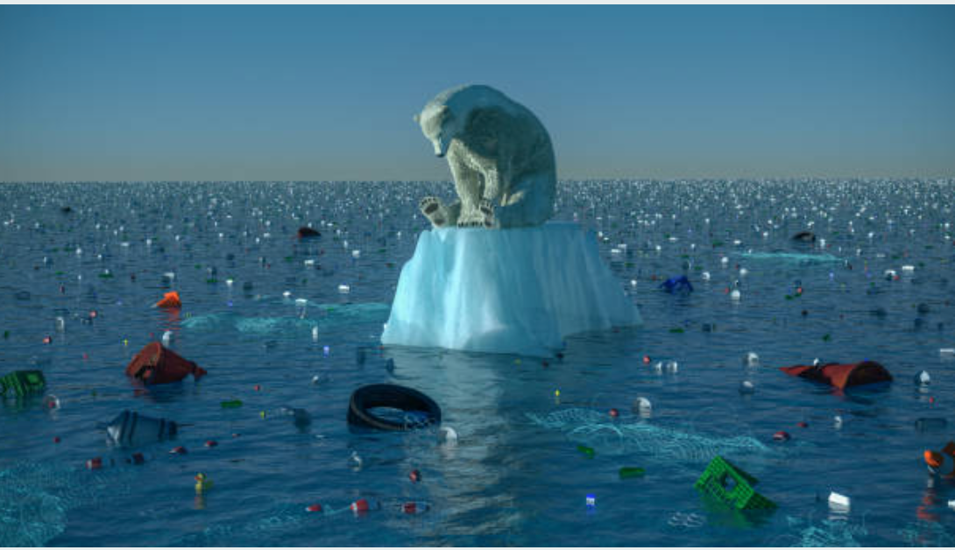
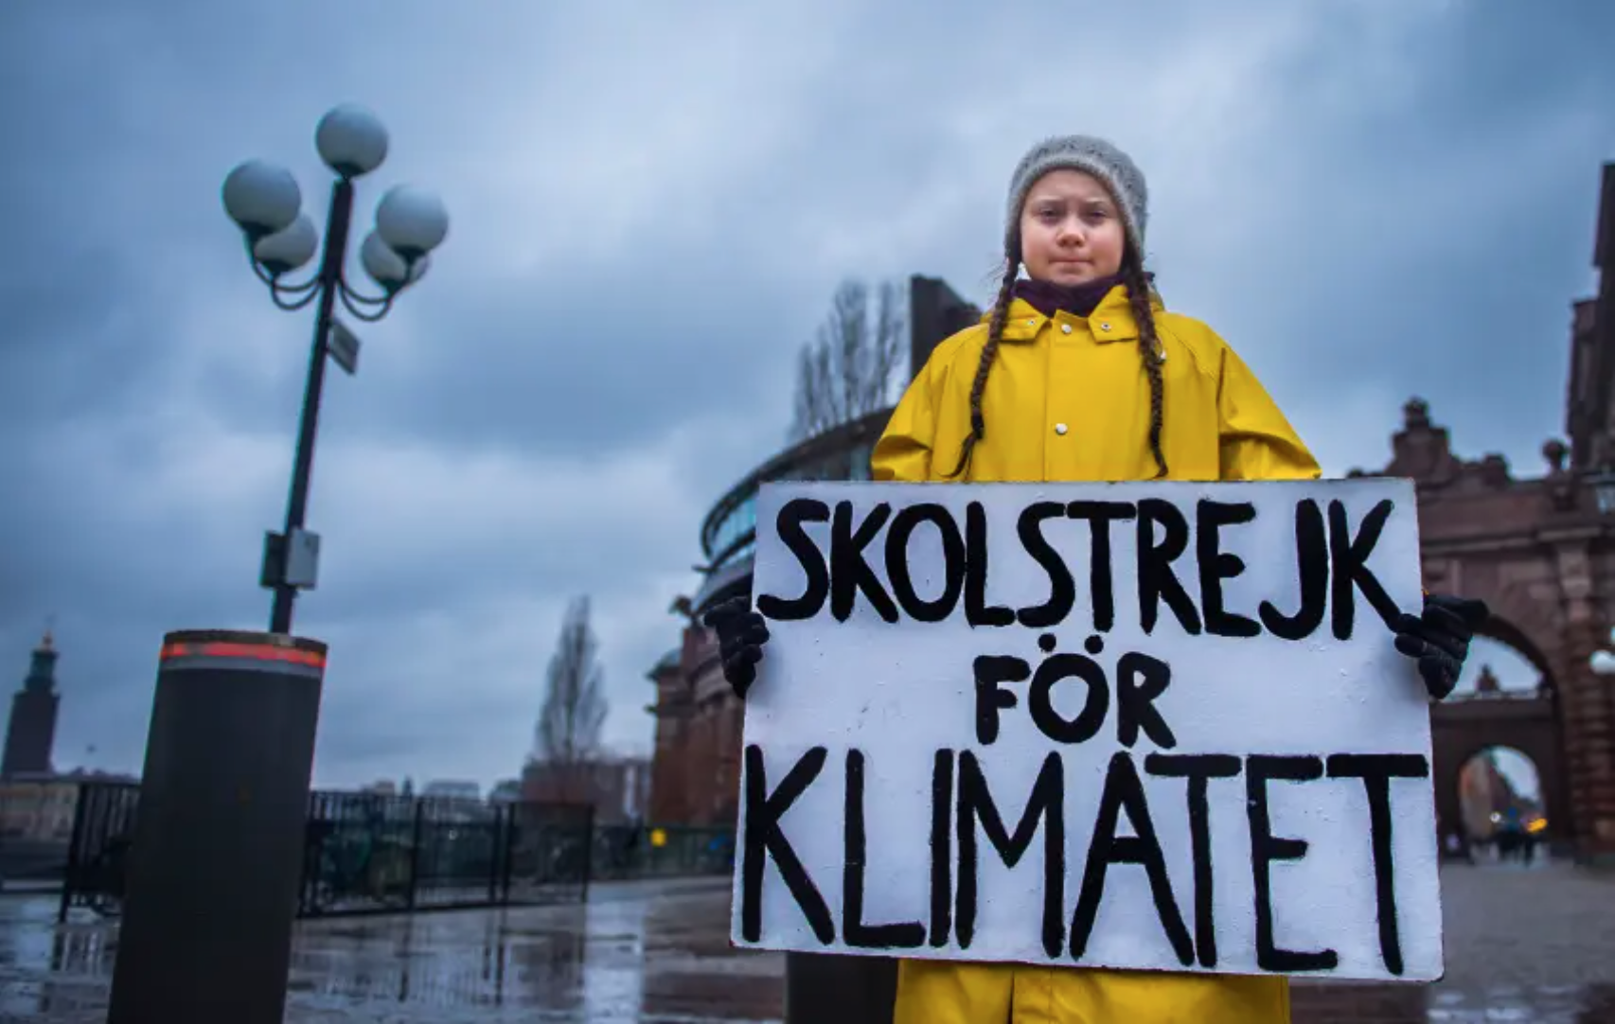
Scientists as actors
Arctic imagineries
For public opinion
For decision-making
For bringing several stakeholders together

Slide 5
Arctic cities & recognized organizations for climate change
Arctic Frontiers- 2006- Tromsø
Arctic Circle Assembly- 2013- Reykjavik
High North Dialogue- 2007- Bodø
EU & National Projects

Slide 6
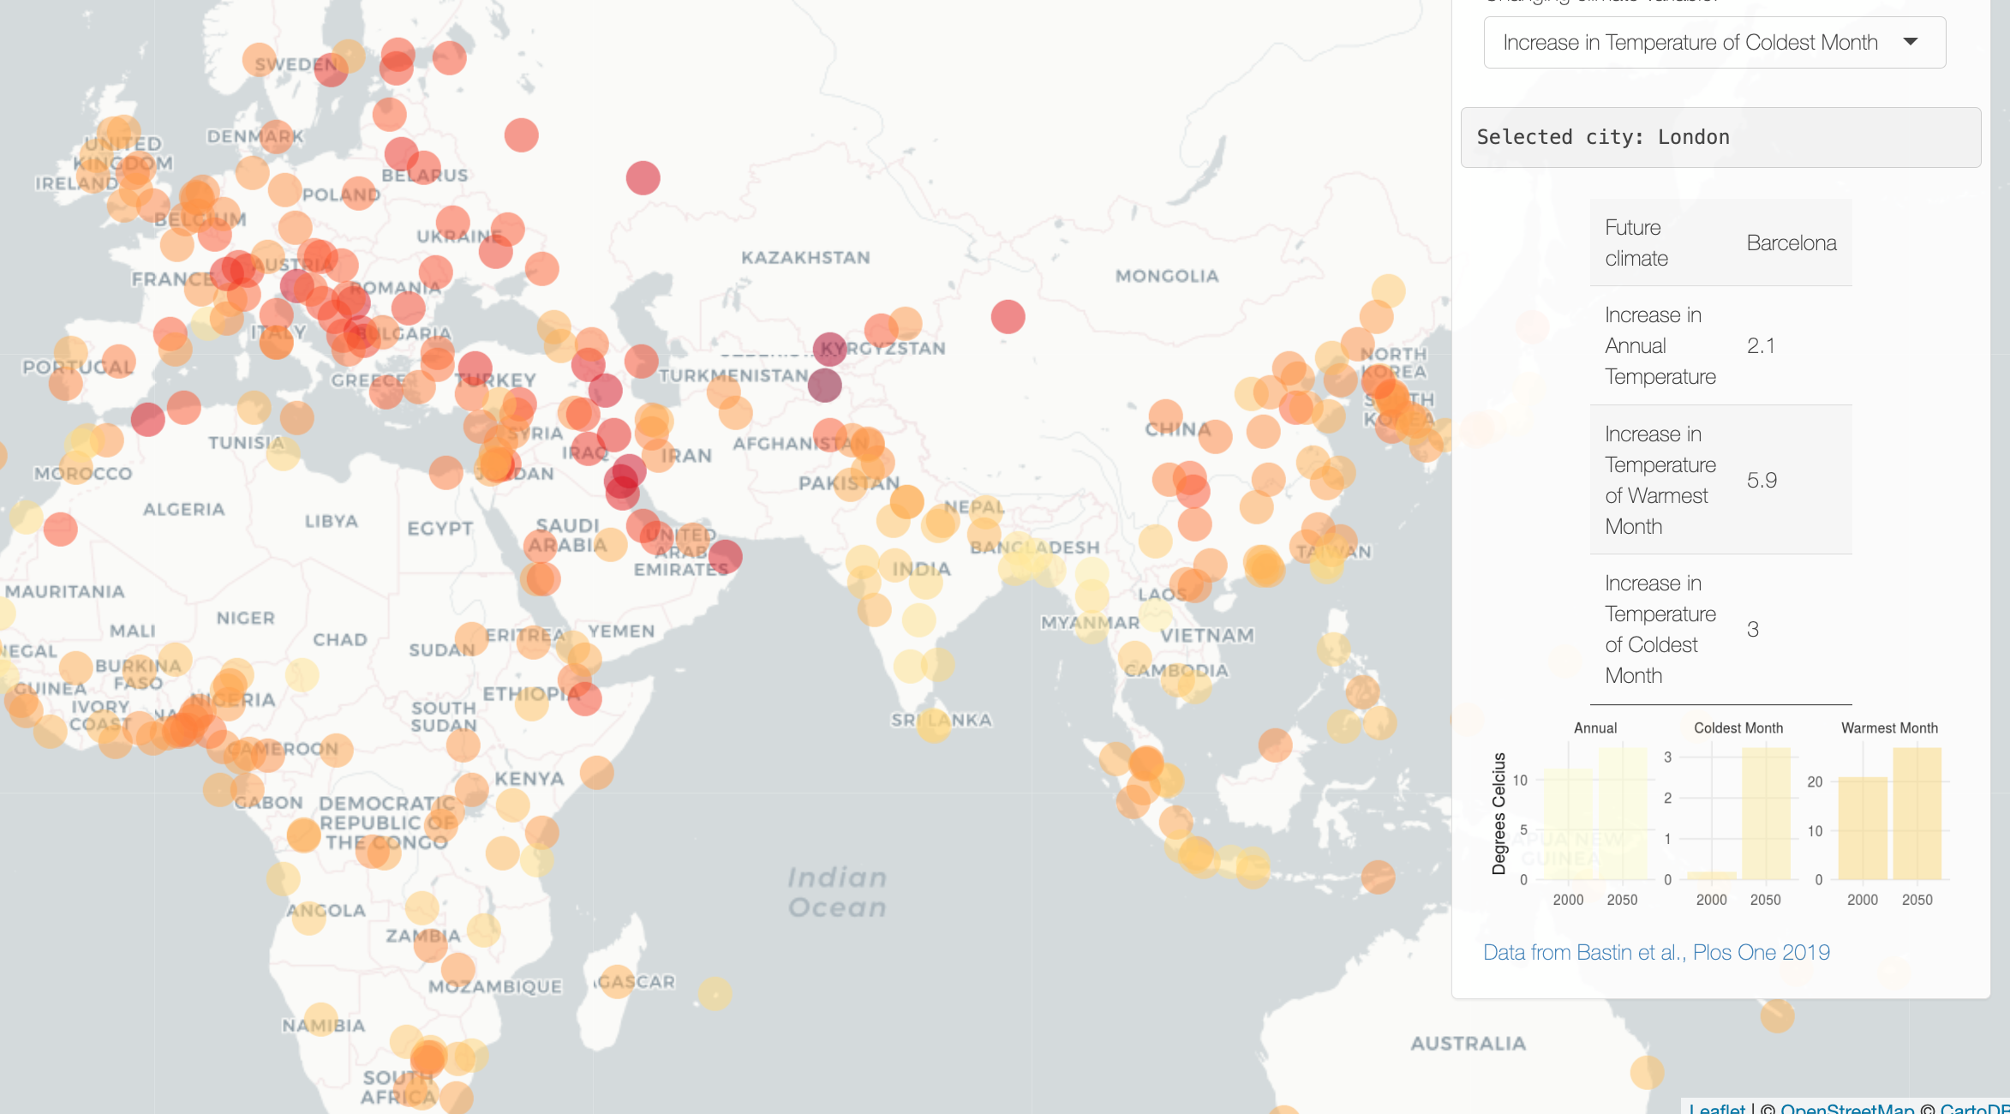
Twin climate cities
Cities are responsible for 75 % of global CO2 (UNEP)
Twin climate cities project helps with decision making process
Has potential for identifying future vulnerabilities
Method: matching the future climate of a city with the current climate of another city.
Important model for raising awareness, strengthen educational ties

Slide 7
Cities
Cities are actors as the most responsible for climate change so have important role in tackling it.
Cooperation in mini-club model as well as in big scale projects is vital.
Engagement with higher education and research institutions is necessary.
Greenwashing!
The target is resilience.
Science based policies?

