Slide 1
Bone structure

Slide 2
Learning objectives
“Students should understand the basic structure and composition of bones and the cells found in them. Students should have a basic understanding of how joints are classified and the six types of synovial joint.”

Slide 3
Lesson aims
By the end of the lesson, students should be able to:
1. describe the composition of bone
2. describe how joints may be classified
3. outline the 6 types of synovial joint
4. outline the basic anatomy of teeth

Slide 4
The skeleton
Composed of:
Bones
Cartilage – firm but bendy. Contains collagen. Produced by chondrocytes. No nerves, blood or lymph vessels
Tendons – connect muscle to bone
Ligaments – connect bone to bone

Slide 5
Bones
A type of connective tissue
Contain blood vessels, cells, proteins, fats, minerals and vitamins
At birth – around 300 bones.
Adults – 206 bones - why are there fewer bones in adults? What happens to them?
Functions:
Provide structural support and enables movement
Protect vital organs
Contains bone marrow to produce blood cells
Storage for minerals (which minerals?)

Slide 6
Bones
Composed of two types of tissue:
External layer called cortical or compact bone which is strong, hard and tough
An internal, spongy layer called trabecular or cancellous bone which is less dense than compact bone
Marrow – yellow and red marrow. Red marrow - blood cell production
Outer covering = periosteum
Inner covering = endosteum
Long part of bone (shaft) = diaphysis
Spongy head = epiphysis

Slide 7
Bones
Bone also contains:
Osteoblasts– cells which make bone
Osteocytes - derived from osteoblasts, carry out bone remodelling
Osteoclasts – large cell which can be involved in maintenance, remodelling and repair of bone
Nonmineral matrix – collagen and proteins
Inorganic mineral salts in matrix

Slide 8
Composition of bone
Osteon – basic functional unit of compact bone
Made of concentric layers (lamellae) of compact bone tissue surrounding a central canal (haversian canal)
Haversian canal contains the blood supply
Osteocytes live in a lacuna (small space)
Lacuna are connected to small canals (canaliculi) and exchanges of nutrients and waste take place here
Osteons are connected to other osteons via Volkmann’s canals

Slide 9
Bone problems
What is osteoporosis? (Groups 1 and 3)
What are the symptoms?
What causes it?
Who is most at risk? Treatment options?
What is osteosarcoma? (groups 2 and 4)
What are the symptoms?
Which groups are most likely to be affected?
What are the treatment options?

Slide 10
Questions
How many bones does and adult have and why is his different to the number of bones we are born with?
What is the difference between tendons and ligaments?
What two types of tissue make up bone?
What are the three types of cell found in bone and what do they do?

Slide 11
Joints
Put simply, a joint is where two or more bones meet and without them, we would not be able to move
Also known as articulations
Joints can be classified in a number of ways:
By function – how much movement they allow
By structure – what they are made from
By type – e.g. ball and socket, hinge, gliding, saddle

Slide 12
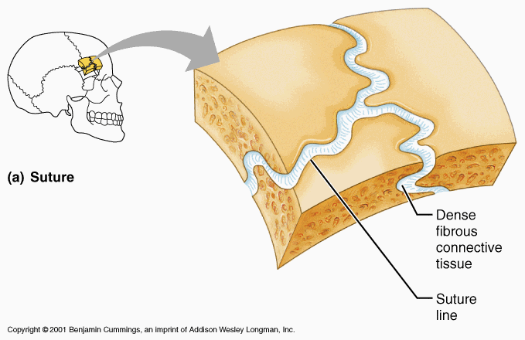
Function - how much movement allowed
Some joints do not allow any movement – synarthrosis
Examples include skull bones that have knitted together and teeth in the jaw bones

Slide 13
Function - how much movement allowed
Some joints allow a little bit of movement –
e.g. discs between vertebrae of spine
Some joints allow pretty much free movement –
e.g. elbow, knee, shoulder or wrist

Slide 14
Classification based on material in joint
Fibrous joints – made of collagen fibres. E.g. sutures holding skull bones together and joint holding radius and ulna together
Cartilaginous joints – bones are held together by band of cartilage. E.g. intervertebral discs of spine

Slide 15
Classification based on material in joint
Synovial joints – most common. Have a fluid-filled space separating bones which have a cartilage pad over them
Outer layer of capsule may extend to become ligaments
Synovial membrane secretes synovial fluid to lubricate joint
What is rheumatoid arthritis?
What is gout?

Slide 16
Synovial joints
Gliding joints where flat surfaces meet
Hinge joints limit movement in one direction
Saddle joints allow 360 degree motion
Ball and socket joint – allow largest range of movement but more susceptible to dislocation
Pivot joint – allow rotation
Ellipsoid joint – less movement than ball and socket, similar to gliding joint

Slide 17
Teeth
Teeth help us to break down food so we can digest it properly
Humans have different types of teeth for breaking down different types of food
Front teeth – incisors – chop food into chunks
Sharp, pointed teeth - canines – tear food like meat
Molars and pre-molars crush and grind food
20 “baby” teeth (deciduous teeth) and 32 adult teeth

Slide 18
Tooth structure
Enamel – hard, calcified outer covering. Made from hydroxyapatite
Dentine – dense bony tissue making up most of the tooth. Not as tough as enamel and can be
Pulp – contains blood vessels and nerves.
Cement – bone-like tissue attaching the tooth to periodontal ligaments to keep the tooth in the jaw
What is gingivitis?
What is the connection to heart valves?

Slide 19
Summary
Bone is a type of connective tissue comprising osteoblasts, osteocytes and osteoclasts
Provides support, protection, blood cell production and storage of some ions and fat
Basic functional unit is the osteon
Joints can be classified by function, structure and type
6 types of synovial joint
Different types of teeth for different roles

Slide 20
Questions
What is a joint?
How can joints be classified?
What are the 6 types of synovial joint?
What is orthodontics?

Slide 21
Lesson aims
By the end of the lesson, students should be able to:
1. describe the composition of bone
2. describe how joints may be classified
3. outline the 6 types of synovial joint
4. outline the basic anatomy of teeth

Slide 22
Key terms
Flex: When muscles contract to bend joints
Extend: When muscles relax to straighten joints
Flexor: A muscle that contracts to flex a muscle e.g. hamstrings (knee)
Extensor: A muscle that contracts to extend a muscle e.g. quadriceps (knee)
Joint: Where muscles bring about movement
Antagonistic: A pair of muscles that work together that pull to extend or flex a joint
Synovial joints: Bones of a joint separated by a cavity of synovial fluid
Synovial fluid: A fluid that enables joints to move freely, acting like a lubricant
Ligaments: Joins bones to bones, they are strong and flexible
Tendons: Joins muscle to bone
Cartilage: Protects bones at joints, absorbs synovial fluid and acts as a shock absorber
Muscle fibre: Bundles of muscle fibres make up muscles and each is a single muscle cell
Multinucleate: Many nuclei to control the metabolism of the cell
Myofibrils: Are made up of a series of contractible sarcomere units

