Slide 1
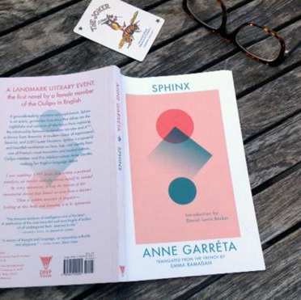
Anne Garréta 2
By Sarah Gerard December 11, 2017
AT WORK
Queer of colour critique

Slide 2
Recap
Turing constraint as the absence of any linguistic gender marker
Protagonists both perfomers – dramatizing the performative nature of identity? A*** and the narrator – fatal downfall
Monique Wittig: Ontological farce that consists of trying to divide a being in language by imposing a mark on her […] It is necessary to destroy gender entirely. This endeavour can be entirely accomplished through the use of language.
Garréta (2000): ‘to experience the contingency of gender, but also its inanity and insignificance as a category’
Butler “The taken-for-granted world of sexual categorization as a constructed one, indeed, as one that might be constructed differently” (1990: 1990, p.149).
Garréta: ‘What I was feeling for A*** needed its own embodiment’
Garréta’s novelistic experiment in indeterminability: Sphinx evokes this indeterminacy by referencing the impossibility of knowing

Slide 3
José Esteban Muñoz (Disidentifications: Queers of Color and the Performance of Politics, 1999)

Slide 4
Key tenets – ‘Dissing identity’
Fiction of identity is easily accessible for majoritarian or ‘normative’ subjects (p.5)
BUT: identity is a site of struggle where fixed dispositions clash against socially constituted definitions (p.6)
How to represent racially predicated and deviantly gendered identities ? (p.6)
Minoritarian identifications are often neglectful or antagonistic to other ninoritiarian postionalities (p.8)
‘To disidentify is to read oneself and one’s own life narrative in a moment, object, or subject that is not culturally coded to ‘connect’ with the disidentifying subject’ (p.12)
To 'disidentify’ in Muñoz's terms is a political act that not only resists dominant ideology but also embodies "a disempowered politics or positionality that has been rendered unthinkable by the dominant culture" (p.31).

Slide 5
Read pp.10-12 and answer the following questions:
Based on the Marlon Riggs example, what does Muñoz mean by ‘queer culture’s whiteness’?
Muñoz states that ‘a soft multicultural inclusion of race and ethnicity does not, on its own, lead to a progressive identity discourse […] when race is discussed by most white queer theorists, it is usually a contained reading of an artist of color that does not factor questions of race into the entirety of their project’ (p.10). Can you think of an example in what we have studied?
What does Muñoz mean by resisting the ‘dominant ideology’? (pp.11–12)
Does queer theory treat race as an addendum? What about in Sphinx?

Slide 6
Doubling difference
In Sphinx, A***’s black body signals both racial difference and cultural difference. A*** is not simply given a black body as a black iteration of the French citizen. The character is not French or Francophone but foreign, which, in this context, means American. A*** and the narrator therefore have different languages as well as different skin tones, and they come from different places (Kim, 2017: 9)

Slide 7
Racial markers
I learned that black skin like A***’s demands makeup of a completely different hue and variety than white skin (p.9)
‘You’re foolishly running after that attractive animal there [gesturing towards A***]. You know what they say to me/ That it could never work between whites and blacks… And that, furthermore, you two aren’t compatible… That one’s always dancing, you’re always hitting the books. They come to me desperately seeking an explanation’ (p.38, Ruggero)
Does Garréta perpetuate stereotypes of racial alterity?
Or does she parody facile caricatures, rather than reproduce them uncritically?
Are we stuck in an essentialized difference?

Slide 8
‘I felt at home there, so much did they make me feel like a part of their family, effortlessly forgetting our differences in race, color, culture, class—everything that one might cite as possible traits of alterity. It was as if the language they were speaking and the food they were cooking had always been familiar to me. And the old black mommas laughed with delight to see that I had such an appetite. A***, who was used to seeing me bored or indifferent when faced with earthly sustenance, was astonished and overjoyed. It seemed that I was forgetting to waste away, that I was finally tasting life, that I was biting into it without words getting in the way, those tableside conversations that, in Europe generally and France in particular, constitute the essential substance of meals’ (p.63)
How does Garréta tie racial difference to cultural difference?

Slide 9
‘My English still bears the stigmata from the time spent among an almost exclusively balkc community. Imperceptibly, the epxressions and characterisitc improprieties of their speech slipped into the tissue of the academic English I had been taught in high schoool. The language I speak is a monstrous hybrid, mingling Oxford and Harlem, Byron and gospel. To the point of caricature, I pronounce these African American utterances with a rather British accent, and sometimes swallow up to half of the syllables of a too perfectly constructed sentence’

Slide 10
Sexed encounter: removal of sexual AND racial difference?
Pp.54-55?
I have in my mouth, still, the taste of skin, of the sweat on that skin; against my hands, the tactile impression of skin and the shape of that flesh. . . . I don’t know how to recount precisely what happened, or how to describe or even attest to what I did, what was done to me. Crotches crossed, I no longer knew how to tell anything apart.

Slide 11
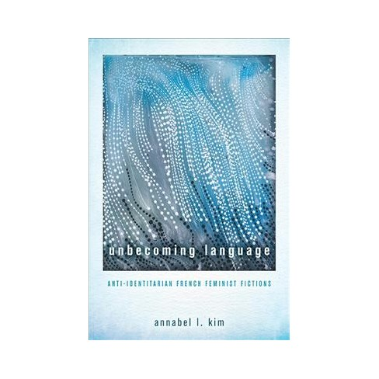
Annabel Kim, Unbecoming language, (Ohio: Ohio University Press, 2018)
Why must we insist on transforming our bodies into linguistic signs?
Do we achieve a greater equality when we realise that bodies are not simply meant to be read or identified so much as to be lived in?

Slide 12
Annabel Kim
The sexed nature of bodies in sexual encounters is occluded by treating the body as unspecific skin, flesh, and sweat, and by disregarding genital specificity to articulate instead the confused nature of the coupling. Illegible in terms of its sex, the indeterminate and protean body can reflect whatever the reader desires it to be. The title Sphinx evokes this indeterminacy by referencing the impossibility of knowing, or in this case, the impossibility of figuring (out) the body and giving it an identity. Falling into an identitarian trap, reviewers have tended to read the relationship in Sphinx as heterosexual or homosexual depending on their own sensibilities. Finding it difficult to suspend certainty and commit to indeterminacy, they have assumed there must be some form of sexual difference (or identity) that Garréta had intended to write into being.

Slide 13
Essay: 17/04; 2000 words

Slide 15
Céline Sciamma
"C'est le regard de l'autre qui décide de ce qu'on est", commente la réalisatrice.
L'humiliation ne passe que par le regard d'autrui, l'incompréhension renvoyée comme un reflet déformant, mettant en marche une mécanique jusqu'alors insoupçonnée d'auto-dépréciation, là où une toute jeune fille est confrontée à la violence de l'indicible.

Slide 16
CS: Also I had—also it’s about pleasure. We don’t talk—that’s also why I wanted to talk about desire in that when I meet students in screenwriting I tell them ‘ you should be excited, it’s not about if it’s good, am I working enough? It’s also about libido.’ Writing, I mean, it should really be about—it should be fun. You should trust your sensations and it shouldn’t be that serious. Also I think I got more humorous with this whole thing and feel less pressured, weirdly, and felt more free. And also found that—because Tomboy for me was going to be a radical thing, about a young girl performing being a boy and in France regarding gender studies which we partly invented but all the women, the lesbian feminists who invented this were in the US, we’re not into gender studies at all. When Tomboy was released and there was the debate around gay weddings and people were protesting with pictures of the film, the film was in schools and parents were taking their kids out of schools because they didn’t want their kids to see the film. So there were strikes, you know, it was something.

