Slide 1
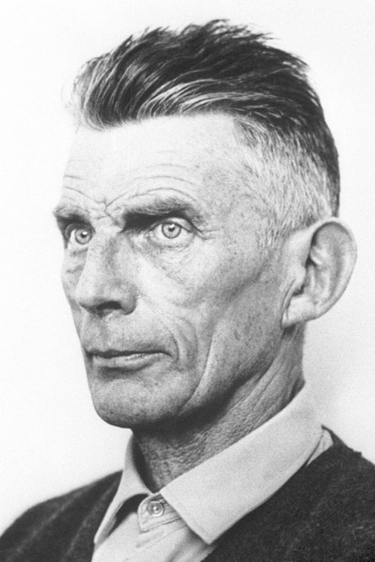
COM507 European Tragedy
Week 11: Beckett, Endgame and Classical Tragedy (2)
Dr Richard Mason
Richard.mason@qmul.ac.uk
Why read the play as a ‘tragedy’?

Slide 2
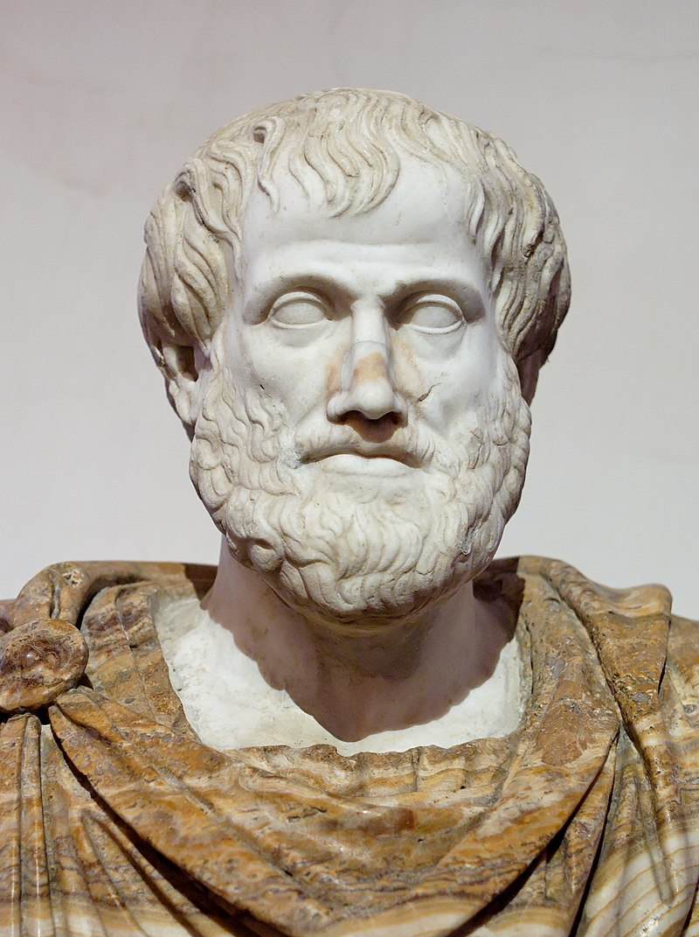
Plot: the source and as it were the soul of tragedy
The plot is, for Aristotle, ‘the source and (as it were) the soul of tragedy’ (Aristotle 1996: 11–12)
CLOV: The end is terrific!
HAMM: I prefer the middle.
*
HAMM: ‘The end is in the beginning and yet you go on’
*
HAMM: [Anguished] What’s happening? What’s happening? CLOV: Something is taking its course.’
*
HAMM: What’s happening? CLOV: Something is taking its course.’
*
HAMM: What time is it?
CLOV: The same as usual.

Slide 3
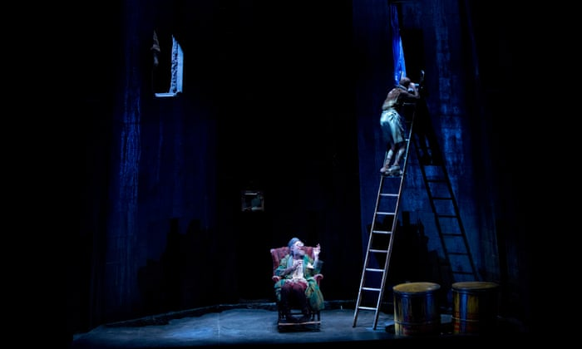
Tragedy, grandeur and social status
HAMM: Can there be misery – [he yawns] — loftier than mine? No doubt. Formerly. But now? [Pause] My father? [Pause] My mother? [Pause] My…dog?
*
HAMM: Accursed progenitor! [….] Accursed fornicator!

Slide 4
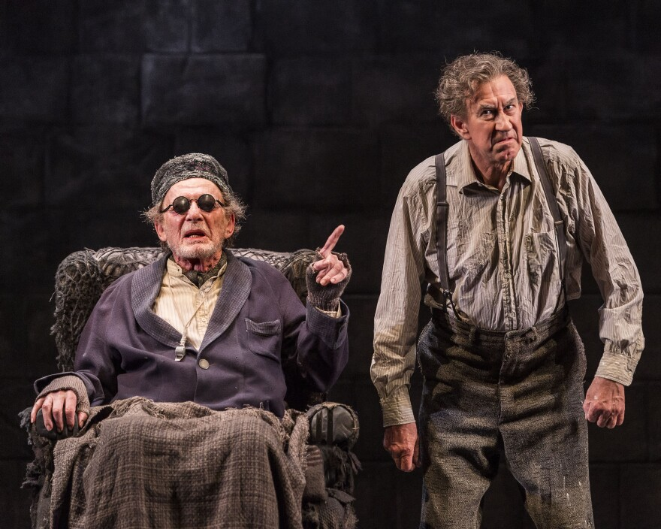
Student presentations
Ela: ‘endings’
Corrina: ‘time’
Navampreet: ‘suffering’

Slide 5
Questions for small group discussion. Find supporting evidence for your answers.
Is Endgame a tragedy, in your opinion? Why? Which other genres might the play suggest?
Can Endgame be said to have a ‘plot’?
What role does character play in the play? Comment briefly on the presentation of Hamm, Clov, Nagg and Nell. Do these feel like ‘tragic protagonists’?
Find and discuss one example where Beckett’s use of dramatic form shapes the play’s effects (e.g. stage directions, setting, dialogue).
Could the play be said to be cathartic? How might one analyse the notion of catharsis in relation to Endgame?
Viewing/close reading of the final section of the play: what sense of ‘endings’ do you get from the play (and from this particular performance)? (1.08-end)
How might Endgame lend itself to comparison to other plays studied for this module?

Slide 7
Task for next week
Find an idea/quote from secondary literature (start with the general guides, perhaps) and explain how it allows for a comparative perspective on two plays
E.g.
Hammond
Poole,
Wallace
You should prepare notes for a very short presentation (c. 3 minutes)

