Slide 1
Getting Started with QMPlus
QMPlus
Manoj Singh
E-Learning Unit

Slide 2
What is QMplus?
An Online Learning Environment (OLE) run by QMUL
Gives you access to your course contents and tools relevant to your modules, courses or areas of interest
Accessible through an internet connection

Slide 3
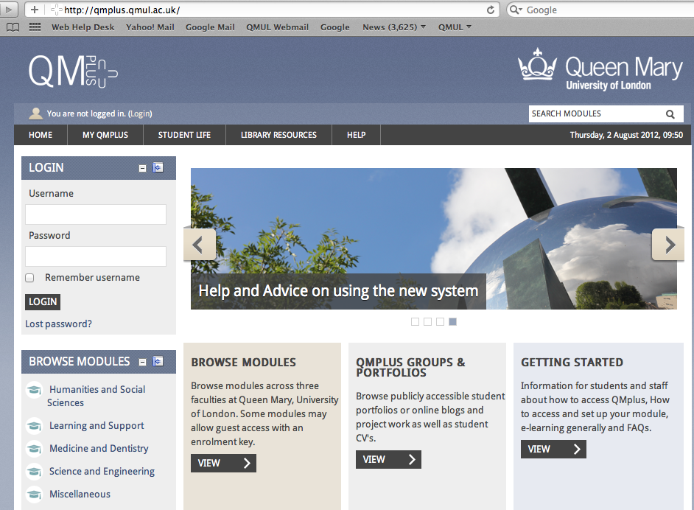
Where to log in
Go to
qmplus.qmul.ac.uk
2. Click on Log in and type your username and password in the next screen

Slide 4
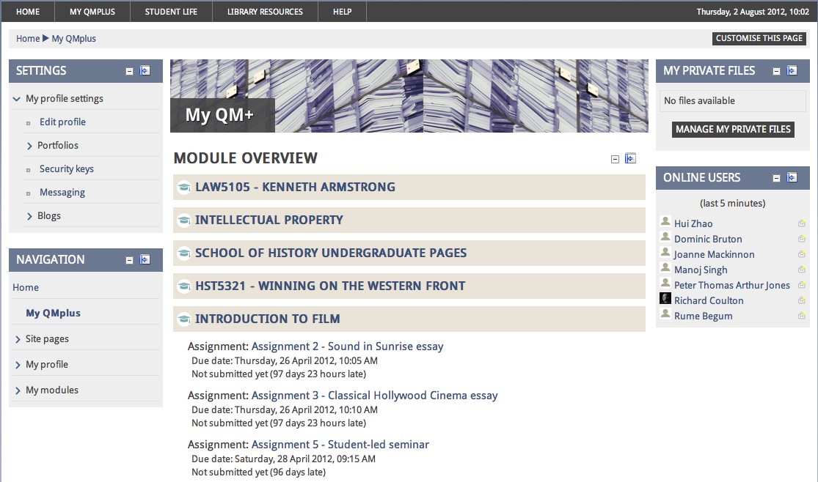
Your MyQmplus page will look something like -
You can Edit your profile
You will see a list of modules you are enrolled in and also the deadlines for the assignments.

Slide 5
How will I use it?
This largely depends on lecturers, but students may use QMPlus to:
access lecture slides
access online resources (further readings, useful web links and other course materials)
read announcements
discuss topics in groups
submit coursework
Notes:
Talk about the underlined terms
Tools – we’ll look at shortly
Non-technical staff – it is easy. You don’t need to be a programmer or a web designer to create a course in a VLE
E-learning: the endless question. Basically is providing an enhancement or opportunity for learning using technology (or the internet)‏
Over the internet: this means you can access it from anywhere that has a decent web connection.

Slide 6
Other Problems
Can’t see your course in the course list
Can’t log in
Links not working
Missing materials
Come to us
http://www.learninginstitute.qmul.ac.uk/elearning/support

Slide 7
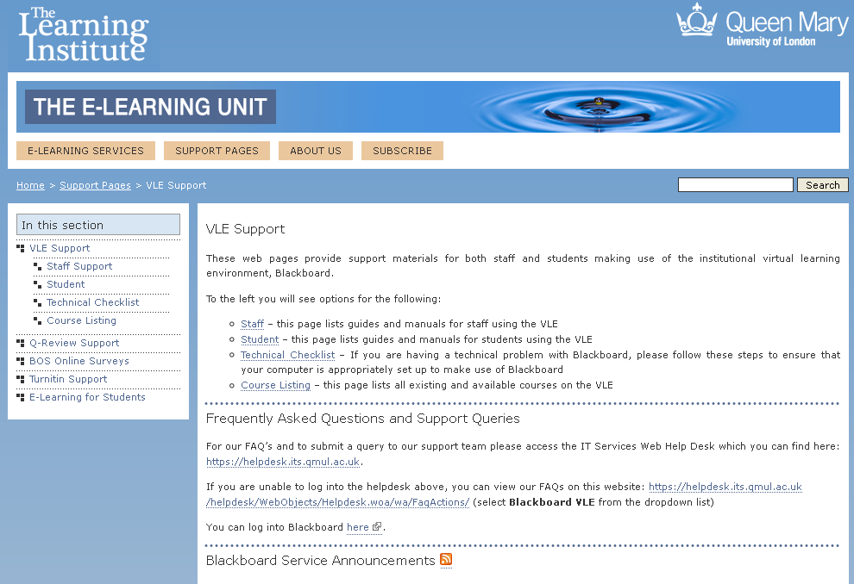
Help and information
http://www.learninginstitute.qmul.ac.uk/elearning/support/vle
Various help topics and more information
Link to the helpdesk https://helpdesk.its.qmul.ac.uk

Slide 8
Don’t forget to see our video tutorials
Notes:
When feeding back, rest of group think of one good point, and consider any alarm bells or worries.
We’ll discuss how these may be dealt with as a group

