Slide 1
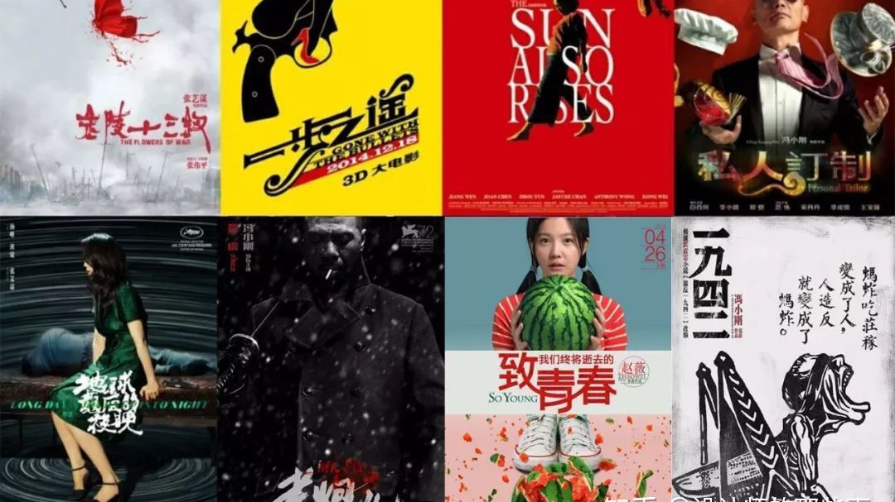
Cinemas in Contemporary China | Week One
Dr Kiki Tianqi Yu Senior Lecturer in Film

Slide 2
Key concepts
National cinema, world cinema (the problematics)
global auteurs (international festivals)
generational cinema (waves)
independent cinema (independent from what?)
women’s cinema and minority cinema
Transnational and transregional
localized genres and aesthetics in ‘non-Western’ cinema

Slide 3
Your encounter with Chinese cinema(s)

Slide 4
Revisiting ‘national cinema’
To describe films produced within a nation state.
Chinese cinema’s’ – sinophone cinema (mainland, HK, Taiwan, Singapore, Chinese language films in SEA, diaspora cinema), (different political commitments, commercial/mainstream, art cinema).

Slide 5
Andrew Higson, “the concept of National Cinema”:
“To identify a national cinema is first of all to specify a coherence and a unity; it is to proclaim a unique identity and a stable set of meanings. The process of identification is thus invariably a hegemonising, mythologising process, involving both the production and assignation of a particular set of meanings, and the attempt to contain, or prevent the potential proliferation of other meanings. At the same time, the concept of a national cinema has almost invariably been mobilised as a strategy of cultural (and economic) resistance; a means of asserting national autonomy in the face of (usually) Hollywood's international domination.”
(Higson, 1989:37)

Slide 6
Andrew Higson, “the concept of National Cinema”:
Economic terms – domestic film industry
Text-based approach – common style, worldview, national characters, constructing nationhood in these films.
Exhibition led approach – consumption of cinema within one country
Criticism led approach – quality art cinema, high-cultural, modernist heritage of a particular nation state.
in Screen, Vol 30:4, Autumn 1989, Pp 36–47

Slide 7
‘Cinemas in PRC’ through the lens of National cinema
As an industry – policies, censorship
Text-based – how is it different from cinema in TW and HK?
Criticism-led – overlooking the mainstream cinema, a major part of domestic reception
Exhibition led – a unique field, limited number of films from Hollywood, censorship for theatrical release and online platforms

Slide 8
World cinema
“World Cinema typically refers to cinemas of peripheries, cinematic production of ‘developing’ or Third World countries or non-Hollywood. Moreover, it does not encompass everything which is produced in the peripheries, but only that part, which lends itself to the gaze of (broadly understood) western scholars. Inevitably, such gaze privileges ‘canonical works’, which have already received national recognition and which due to their subjects, forms or ideologies, align themselves with the production in the centre.” (Mazierska, 2020)

Slide 9
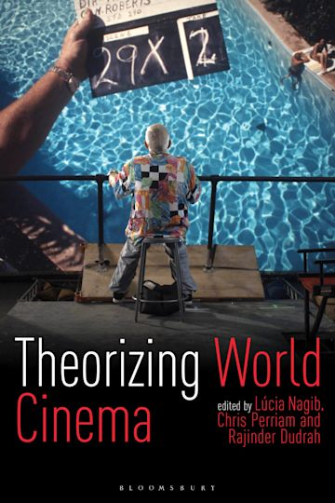
Lúcia Nagib’s manifesto:
“World cinema is simply the cinema of the world. It has no centre. It is not the other, but it is us. It has no beginning and no end, but is a global process. World cinema, as the world itself, is circulation.
World cinema is not a discipline, but a method, a way of cutting across film history according to waves of relevant films and movements, thus creating flexible geographies.
As a positive, inclusive, democratic concept, world cinema allows all sorts of theoretical approaches, provided they are not based on the binary perspective.” (2006:31).
Nagib, L. (2006) Towards a positive definition of World Cinema. In: Dennison, S. and Lim, S. H. (eds.) Remapping world cinema: identity, culture and politics in film. Wallflower Press, London, pp. 30-37.

Slide 10
‘Third cinema’ by Fernando Solanas and Octavio Getino, 1969
A postcolonial approach
an overtly political cinema, whose purpose is liberation of the masses from political and economic oppression, chiefly caused by colonialism.
based on the rejection of the cinema produced in the ‘centre’ (First Cinema),which “serves the political goals of the ruling classes (transnational monopoly capital) and lulls the audience into passivity through its attractive surface”
and also distrusts the auteur cinema (Second cinema), arguing that it expresses the aspirations of the middle layers, the petit bourgeoisie, being often nihilist, pessimist and mystifactory (Chanan 1997:7).
From the mid 1990s, ”Third Cinema dead”
focused on cultural difference
focused on the past, rather than ‘here and now’.
- (Mazierska, 2020)

Slide 11
In what context should we understand Chinese cinema’, or ‘cinemas in China’?
World cinema ?
Cinema outside Chinese cinema and the Hollywood
Third cinema ?
A short period of semi-colonization
Less about political resistance more about building its own identity

Slide 12
Weekly Outline, or key themes
Week 2: Generational filmmakers, world cinema and global auteurs 1: the 5th Generation
Week 3: Generational filmmakers, world cinema and global auteurs 2: the 6th Generation
Week 4: Local blockbusters, national sentiments and identities
Week 5: Independent Documentary 1: alternative spaces and personal filmmaking
Week 6: Independent Documentary 2: modes of productions
Week 7: Studying week
Week 8: Women’s cinema
Week 9: Transnational Chinese cinema and co-productions
Week 10: minority cinemas
Week 11: Conclusion: Artist moving image in gallery spaces
Notes:
Local blockbusters in the mainstream cinema, how they create affect among the wide audience through using national sentiments, such as sino-Japan war, the cultural revolution, ancient Chinese stories, the feeling of nostalgia and lost of a whole generation.

Slide 13
brief histories of Chinese cinemas
Early cinema
The rise and fall of Shanghai film industry (1920-1940s)
The rise of Hong Kong cinema
Cinema in Mao’s China (1949-1976)

Slide 14
Histories – early Chinese cinema
the early history of Chinese cinema is predominantly a history of film screenings, not production. Local consumption habit of cinema.
native filmmaking did not begin until a decade after cinema was introduced in 1897.

Slide 15
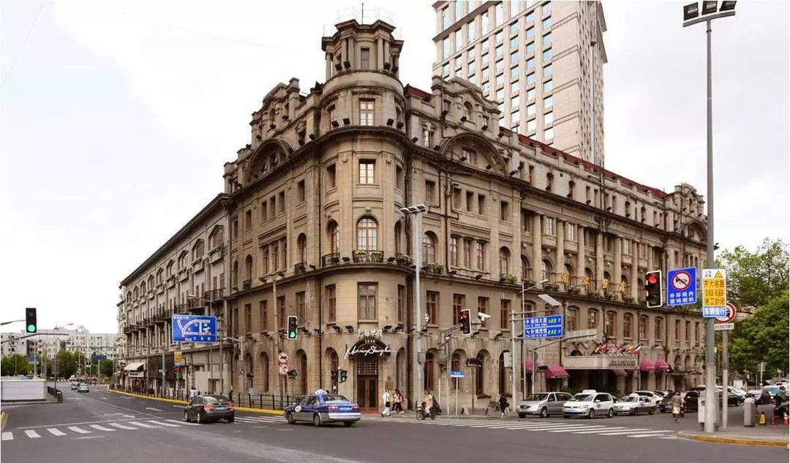
The first cinema screening (of Edison company’s films) in China was on 22 May 1897 at The Astor House Hotel in Shanghai – one of the most luxurious hotel.

Slide 16
Teahouse is a convincing venue for public cinema screening, given its status of popular culture and gather venues among the vernacular.
The urban architectural environment is “essential to the film experiences— the theaters, the amusement halls, teahouses, parks...” – Zhen Zhang

Slide 17
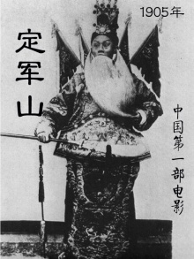
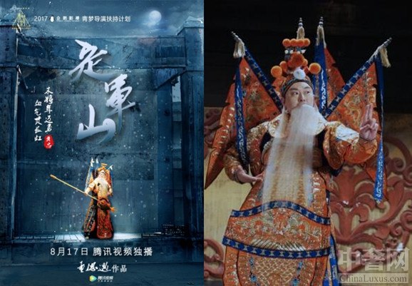
First Chinese film
The Battle of Dingjunshan (1905) - a documentation of a Beijing opera performance.
To celebrate the Centenary
https://www.bilibili.com/video/av34939262/?spm_id_from=333.788.videocard.0

Slide 18
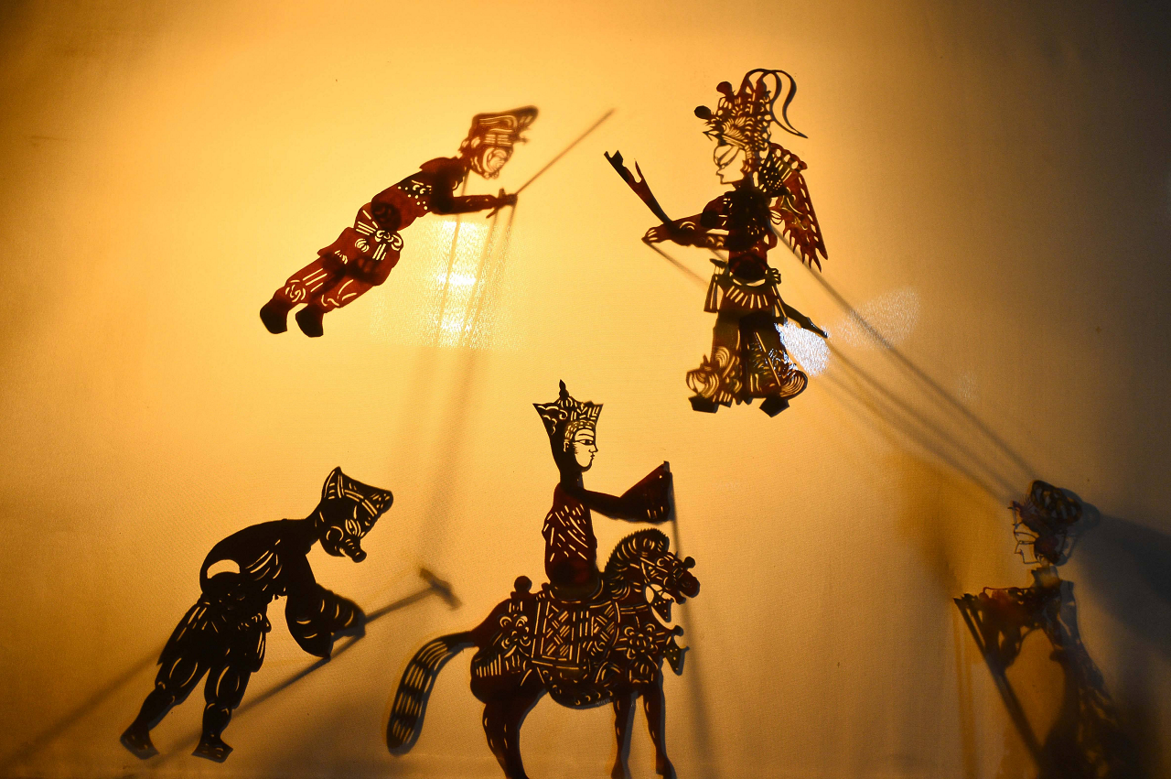
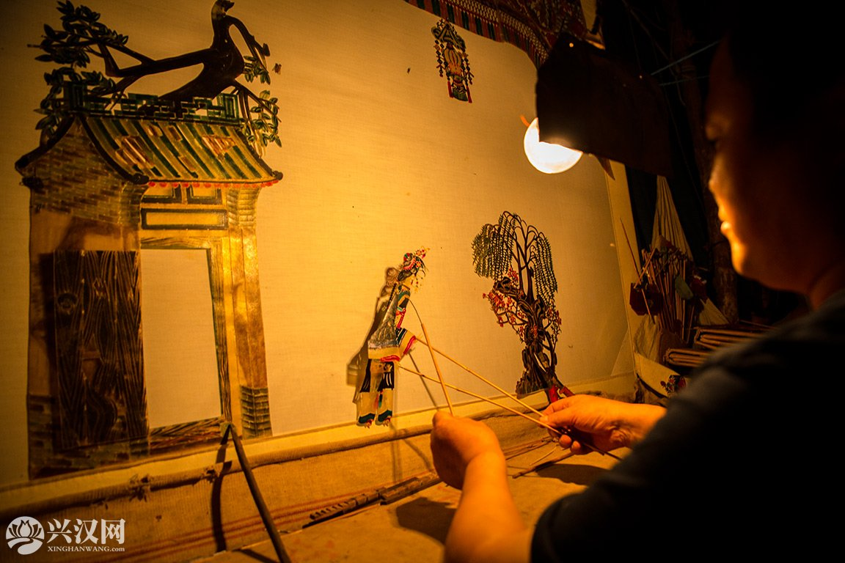
Cinema: electric shadowplay
cinema in Chinese was called ‘electric shadowplay’ (dianguan yingxi 电光影戏), or ‘shadowplay’ (ying xi 影戏)’ before the first sound film was made in China in 1931.
The term gradually changed to ‘electric shadows’ （dian ying 电影）, indicating its umbilical tie to the puppet show and other theatrical arts.
camera is called ‘xiyang jing’- western mirror, or western lens.

Slide 19
Transnational cinema
Flow of capital and films, 1910s - the rise of Chinese Fiction cinema
the Asia Film Company, established by Russian-American Benjiamin Brosky in Shanghai in 1909:
Produced the first Chinese fiction film The Difficult Couple, directed by Zheng Zhengqiu, 1913.
The first fiction film made in HK, Zhuangzi Tests His Wife , directed by Li Minwei.
Global circulation of cinema
Zhuangzi Tests His Wife was never screened in Hong Kong. Brosky brought the film to the US, and it became the first Chinese film to be shown abroad.

Slide 20
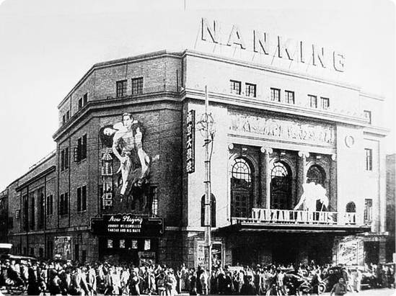
Shanghai Film Industry 1920s-1940s – the rise and the fall
One of the most exciting periods of Chinese film history – commercial success, political commitment and artistic experimentations.
Establishment of China’s own production companies
Network of film talents and capital
Leftwing filmmakers & nationalist cinema

Slide 21
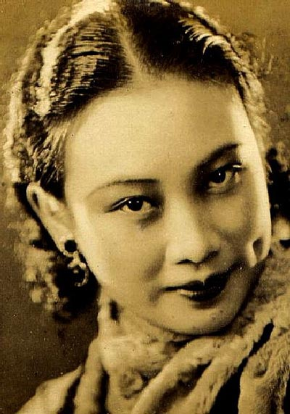
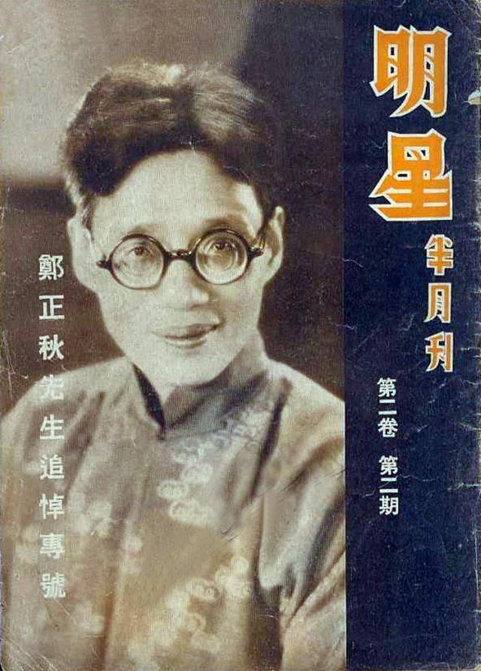
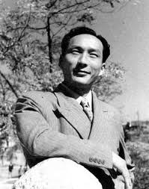
Shanghai film Stars
Ruan Lingyu
Hu Die
Zheng Zhengqiu
Zheng Junli

Slide 22
1930s Nationalist cinema
Japanese invasion of China.
progressive and modernist
Socialist-oriented filmmakers – dictating the ideological climates of the 1930s
leftwing cinema movement
Many films expressed strong patriotic sentiments
Notes:
Along with the success of commercial cinema

Slide 23
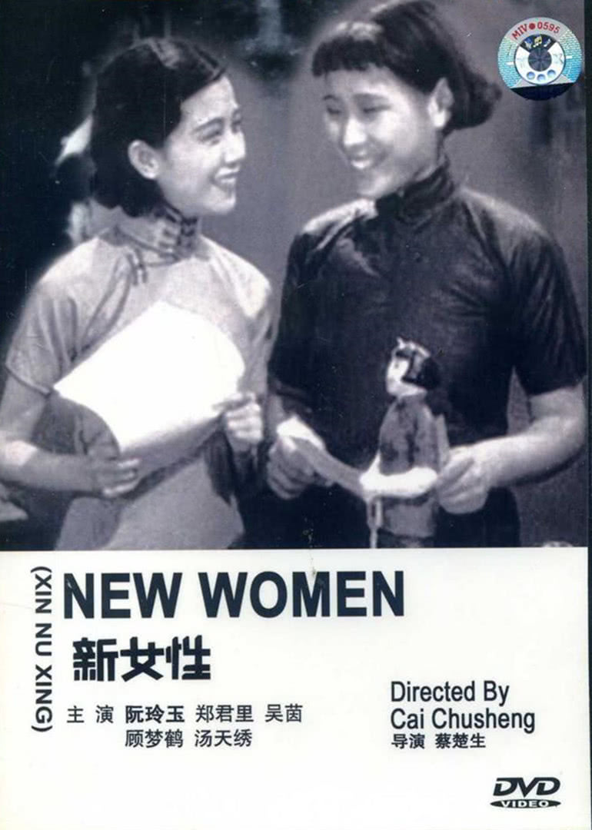
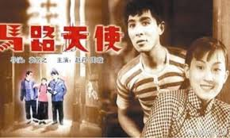
https://www.youtube.com/watch?v=9Q4zhLxCBro

Slide 24
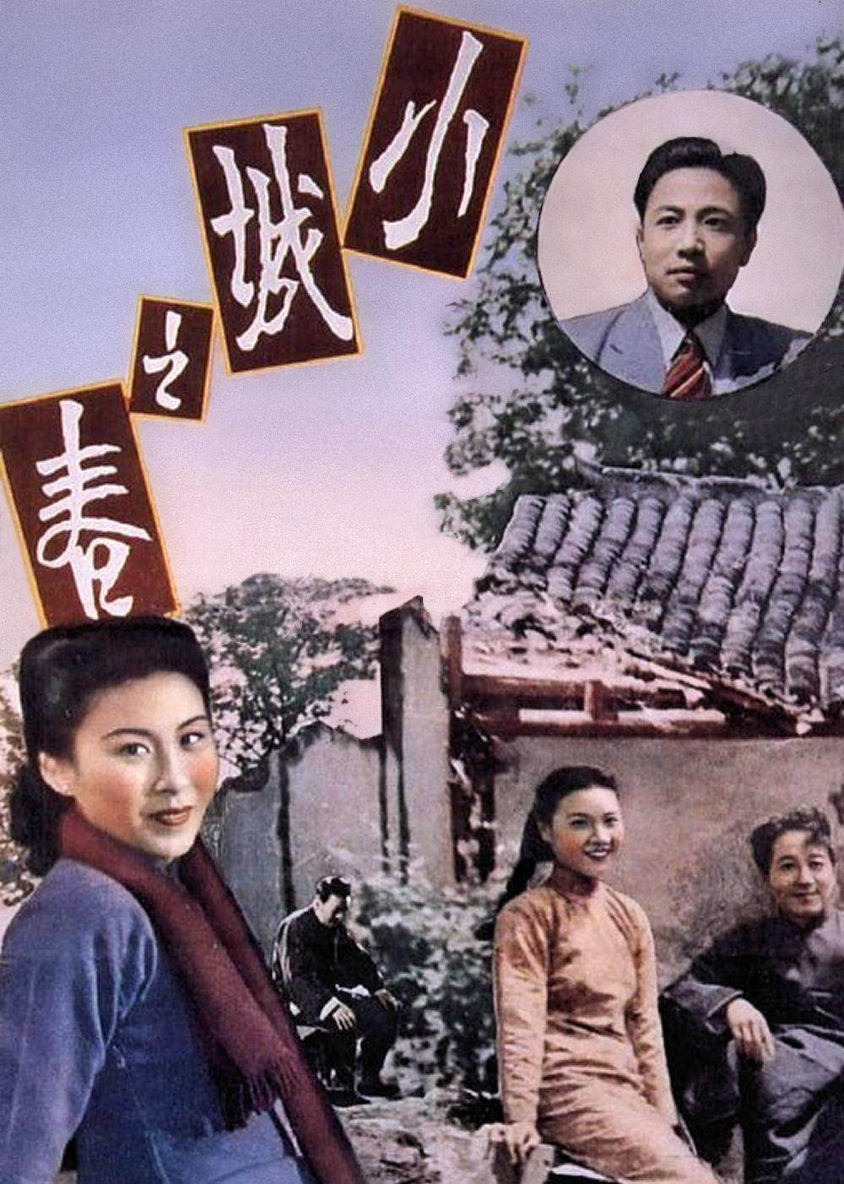
soft films – cosmopolitan sensation and consumerist culture, lack of political grounding by Communist party.
hard films – disseminate progressive political ideologies
Spring in a Small Town, dir. Fei Mu, 1948
https://www.youtube.com/watch?v=LiFkrKUbBd0

Slide 25
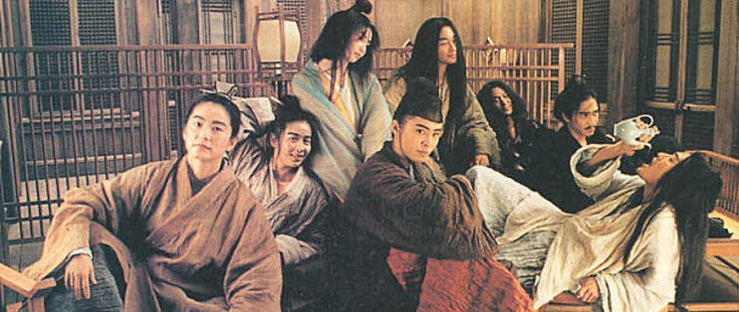
Hong Kong cinema (1950s – 1980s)
The outbreak of WW2 in China ceased most film production.
Film talents and capitals moved from SH to HK
Locally specific Hong Kong cinema - expanded into regional networks across East and SEA, and diasporas.
Local studios, moguls, stars, fans, auteurs, genres (wuxia)
vertical integration, technical innovations, institutional styles…
Cultivated a generation of local moviegoers.
Dialect cinema - Cantonese cinema.
https://www.youtube.com/watch?v=87rnMLRueIc
Notes:
This was the period when what we know the popular HK cinema began to take shape.

Slide 26
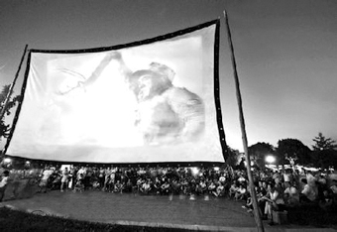
Cinema in Mao’s China (1949-1976)
Aesthetics: Soviet-style socialist realism, strong class consciousness, against federal system, against Japanese invasion, against capitalism
low production number, rely on importing films from socialist states
Exhibition: mobile projection units to meet the largest possible audience. (100 in 1949, 4400 in 1956) – special cultural phenomenon
Filmmakers studying cinema in Soviet Union
Beijing Film Academy – 1956, closed 1966-1976
Notes:
While cinema in hk gained its commercial success and developed mature film industry, cinema in the PRC was solely used as propaganda tool. Communist projection unit workers travel village to village, to show films in the open space, often the village public space, to the local audience. Special cultural experience, collective film viewing experience.

Slide 27
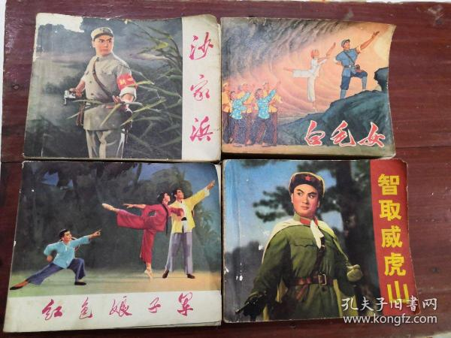
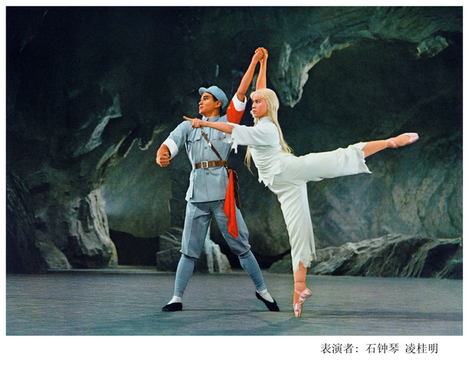
Yang ban xi – Revolutionary Opera
Classic revolutionary stories
The only available theatrical entertainment (8 revolutionary operas) for 800 million people.
Not for the elite, but for the mass - a popular political art.
Started with the White Haired Girl (1950) – set as standards for depicting heroes and villains, and the adaptation of existing works.
Notes:
A unique socialist cultural product in China.
Totally 8, well known stories that show class consciousness
In the form of opera, traditional Chinese opera singing aesthetics, with modern ballet performance, and socialist clothing.
Film of live performance – cut into film.
On radio, book and film
Cultural memory

Slide 28
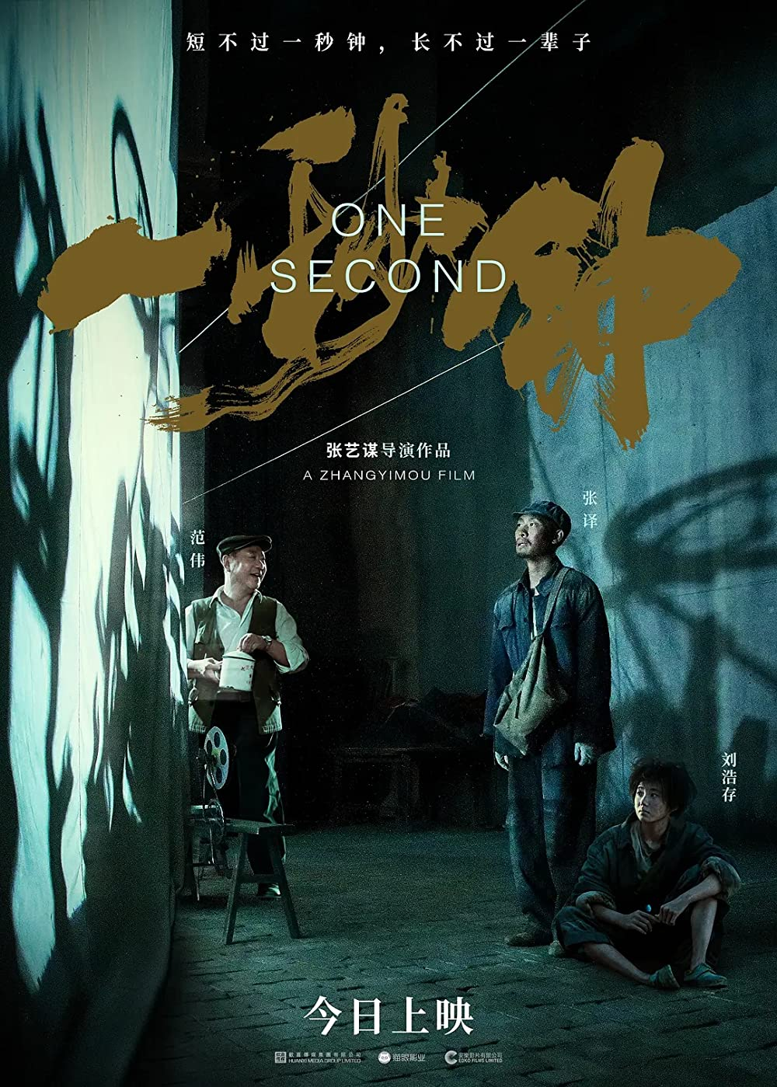
One Second, dir. ZHANG Yimou, 2022
https://www.youtube.com/watch?v=jguQmpDCoZ8

Slide 29
How do these historical moments of Chinese cinema contribute to cinemas in contemporary China today?
Transnational, transregional flows of capital and collaborations
Cultural and aesthetic linkage to other art forms – shadowplay, Chinese painting, opera, martial art
Political – reflecting the turbulent histories of the Greater China throughout the 20th century
Socialism – current film censorship
Localised genres and aesthetics – wuxia, comedy, poetics,slowness, sentiments

Slide 30
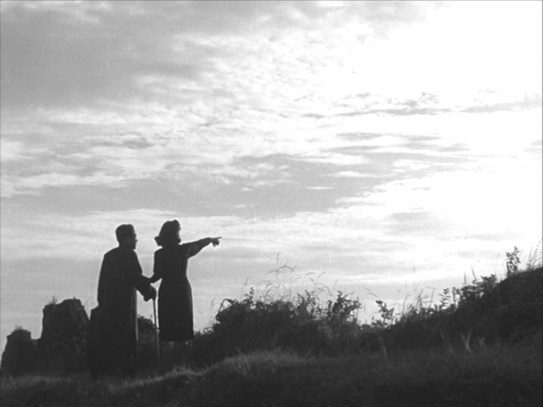
“I have tried my best to avoid the formation of “dramatic climax,” in favor of under-statement. This may well be a loss from the perspective of theatre, but we can afford to ignore this loss from the new perspective of film.”14
Fei Mu, “On the ruction of narratage and flashback”, in Huang Ailing, ed. Shiren daoyen Fei Mu, 25.

Slide 31
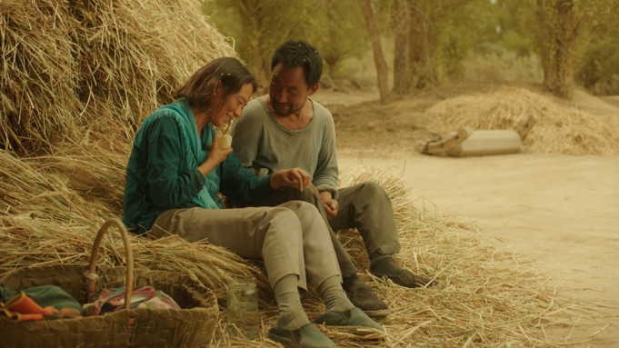
Aesthetic
Narrative
Production
Exhibition

Slide 32
ASSESSMENTS
Group project 25%:
2 or 3 students work in a team to curate a film festival programme on a specific theme (discuss with the lecturer). Write a 1000 words programme note and design a poster. The programme note must include: What is the theme about? Why do you choose it? What is your selection of films? How will they be presented: how many days/sections？ideal venue? Are you planning to organise extra activities to further engage the audience? If so, what are they?

Slide 33
Individual essay (3000 words) 75%:
You are asked to analyse one film/production screened in class. You must choose one of the themes covered in the module as the framework and engage with a couple of key notions discussed in class. It is to demonstrate your skills of research, detailed textual and contextual analysis, and scholarly argumentation.

