Slide 1
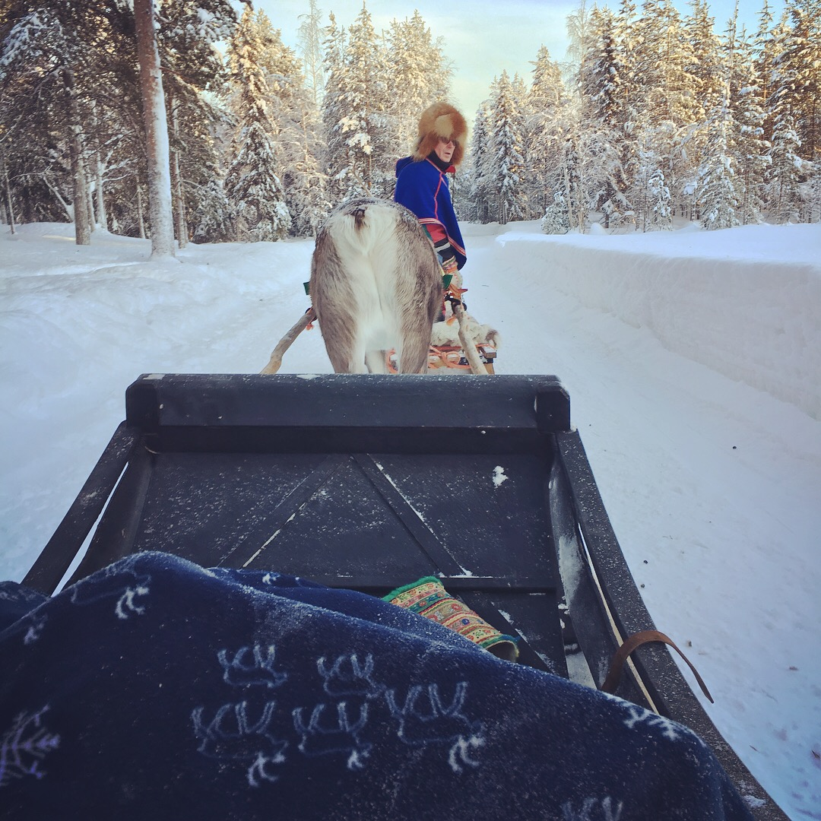
Indıgenous Governance ın the Arctıc
EDA AYAYDIN
Photo Eda Ayaydin

Slide 2
Demography of Indıgenous Peoples based on language groups Indıgenous populatıon ıs the 10% of the Arctıc Populatıon

Slide 3
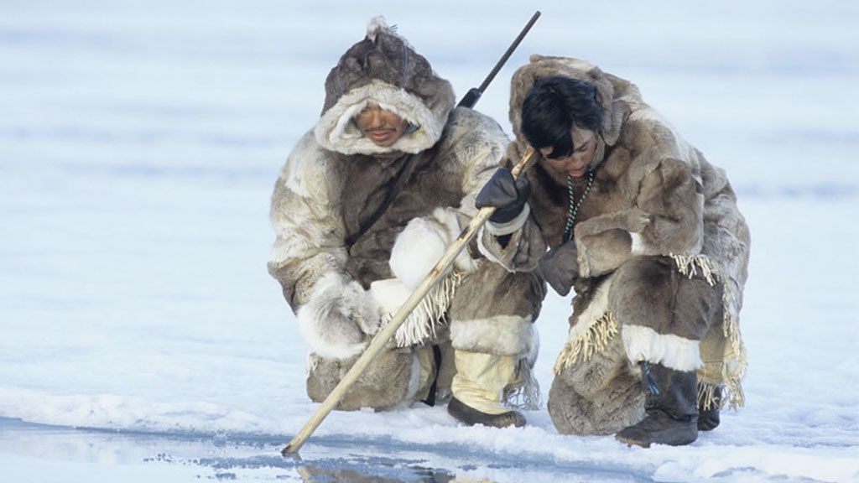
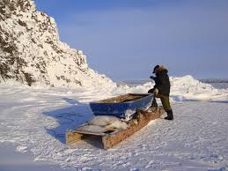
Specıfıc connectıon of ındıgenous peoples’ to the land
«Traditional knowledge»
Transmission of traditional knowledge
Preservation of indigenous languages
https://iite.unesco.org/news/639164/

Slide 4
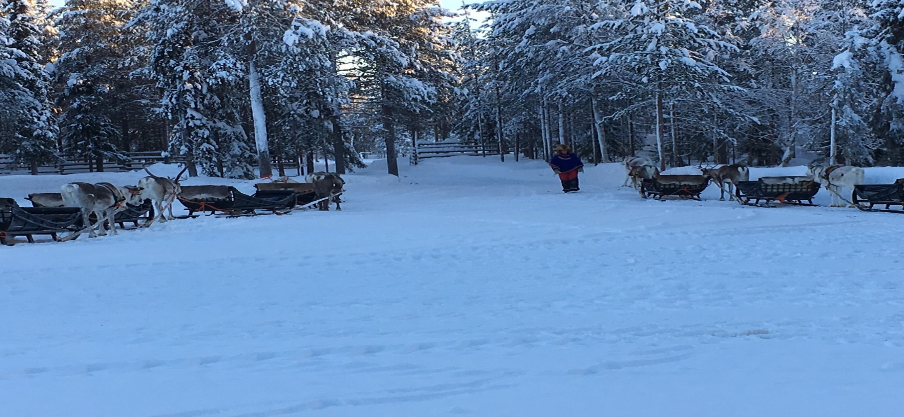
Saamı People
Demographic distribution of Saami
Language policies on Saami language
Economic resources of Saami people
Photo Eda Ayaydin

Slide 5
Saamı
Norway: app. 50.000
Sweden: app. 30.000
Finland: app. 10.000
Russia: app. 1500
ILO Convention (International Labor Organization)
Norway, ratified
Sweden, not yet
Finland, not yet
Russia, not yet

Slide 6
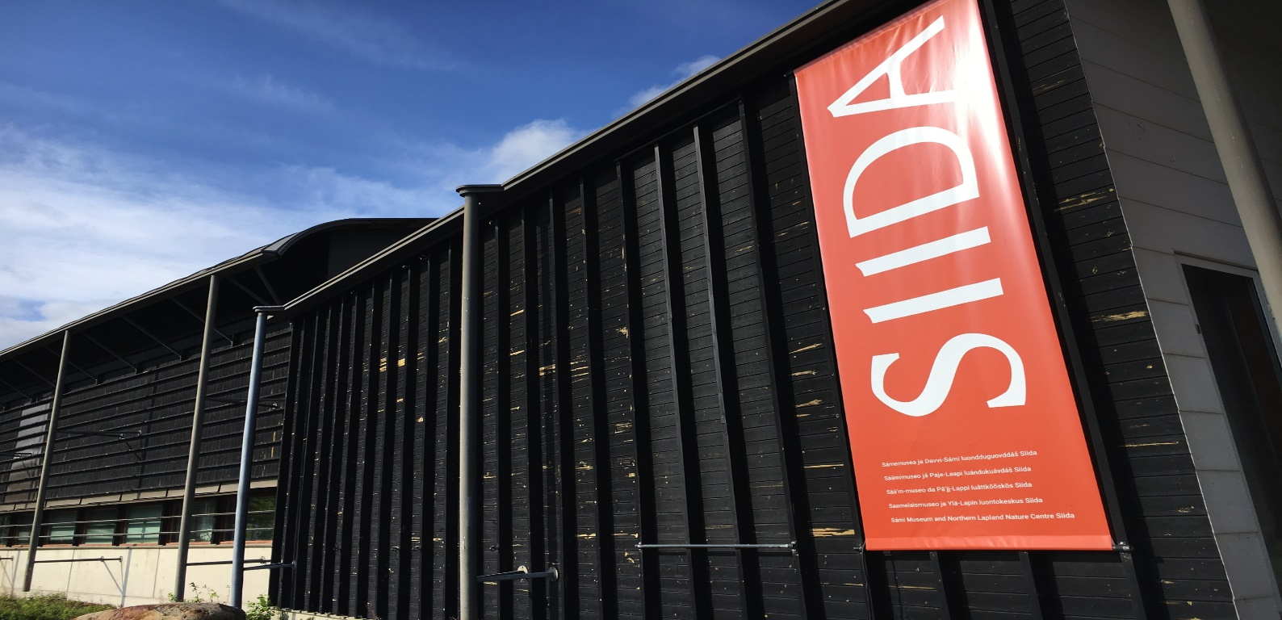
SIIDA SYSTem
Communism by 12th century: Sharing goods, places, seasonal settlements.
Village elders are the leaders in Siida system.
BUT by the expansion of Nordic states, Saami started to experience livind under several sovereigns.
Photo Eda Ayaydin

Slide 7
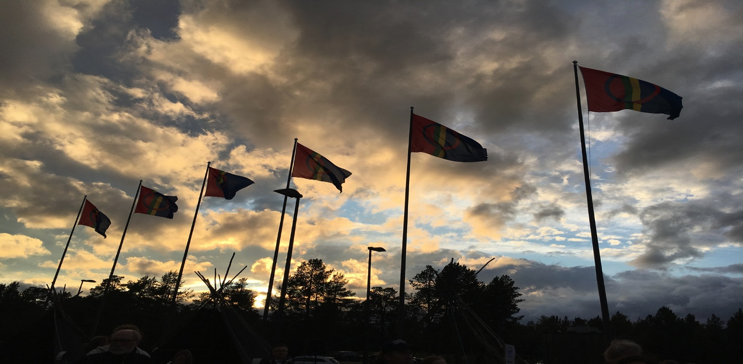
SAAMı COUNCIL & SAAMI PARLIAMENT
Saami council, 1956
Non-governmental
Including Finland, Norway, Sweden and Russia.
Permanent member of Arctic Council
Dealing with promoting Saami rights
(recognition) & consolidating
Saami rights (political,cultural
economic).
Photo Eda Ayaydin

Slide 8
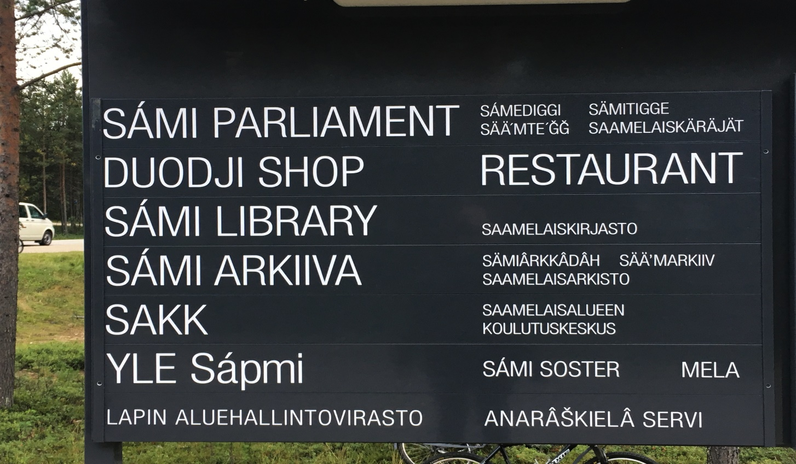
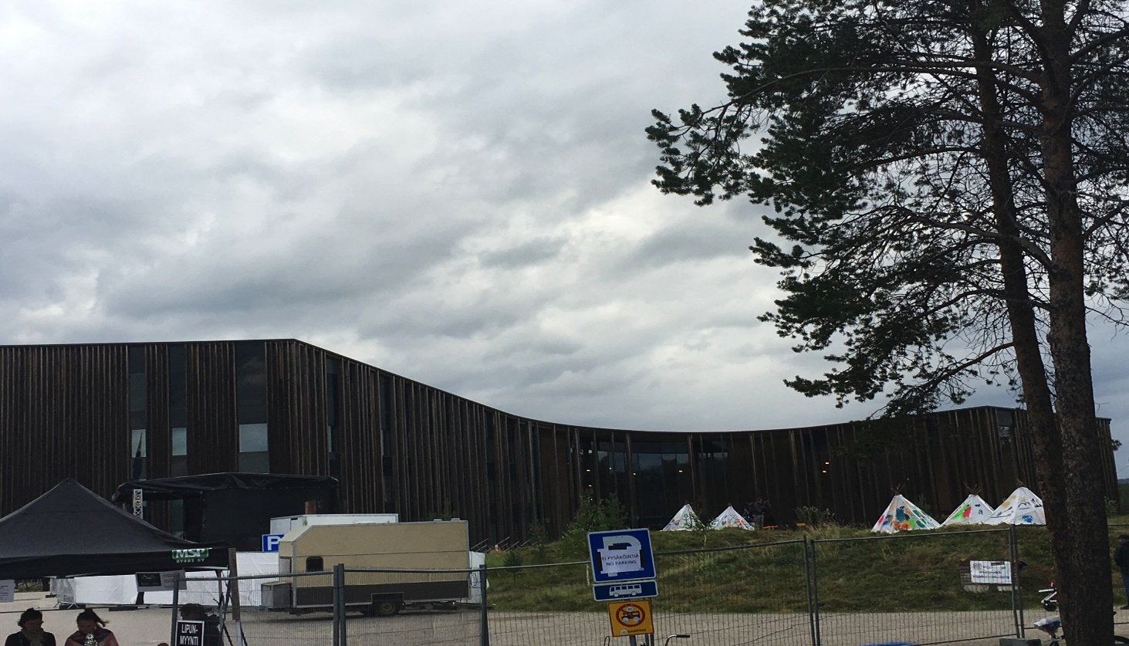
SAAMI PARLIAMENT
Finland, Norway and Sweden have Saami Parliament, not in Russia.
Saami Conference is organized regularly and Saami representatives from Russia are included.
Photo Eda Ayaydin

Slide 9
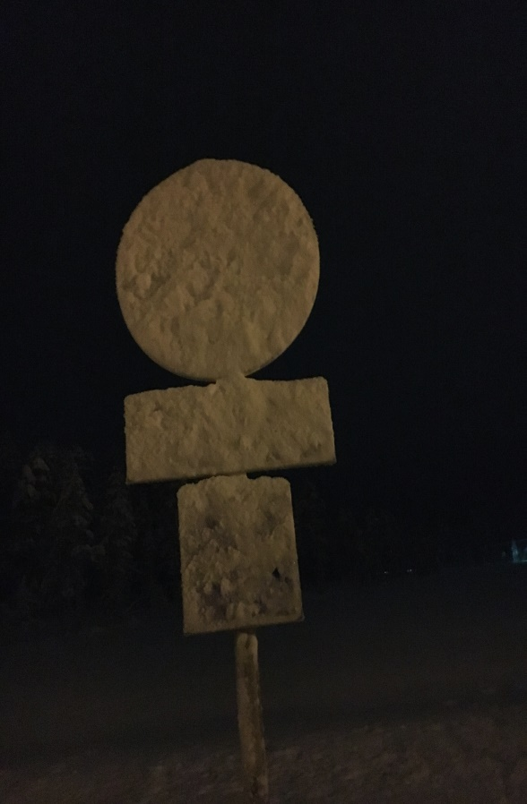
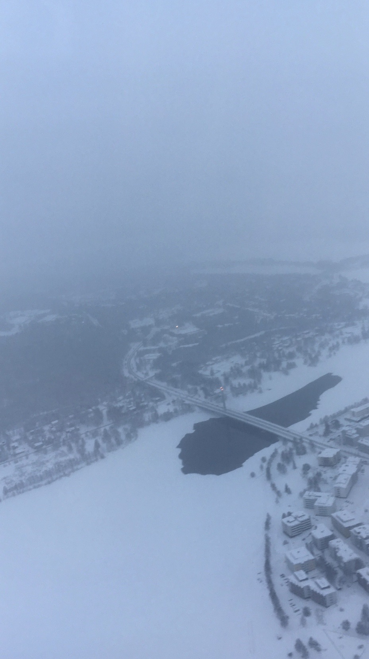
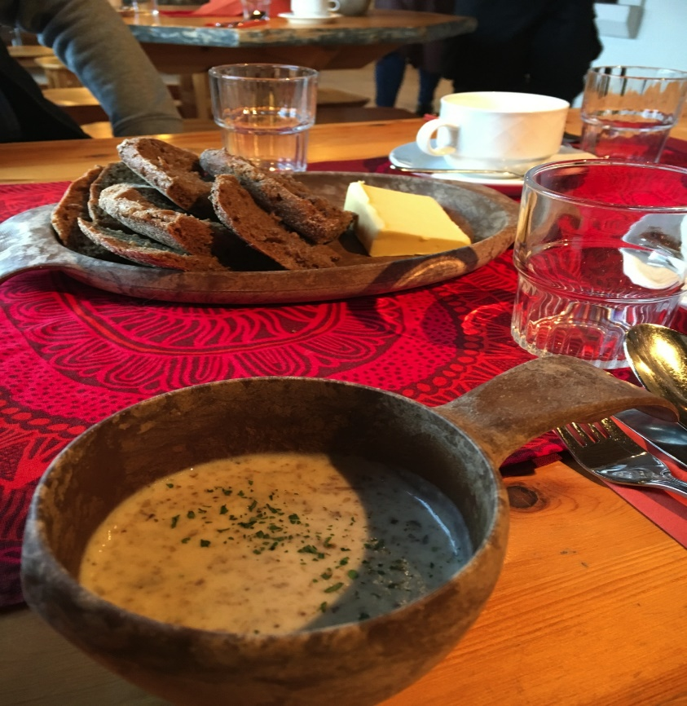
SAAMI ECONOMICS
Reindeer herding; just in Finland is not an exclusivity of Sámi people.
Fishing: Deatnu (Tana) River Problem?
Forestry
Gathering
Photo Eda Ayaydin

Slide 10
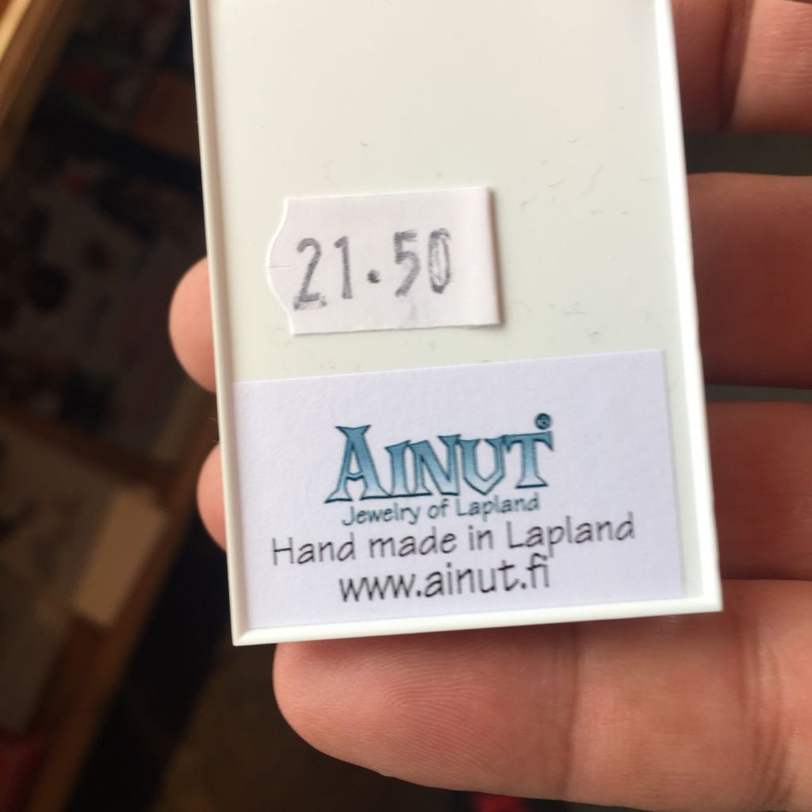
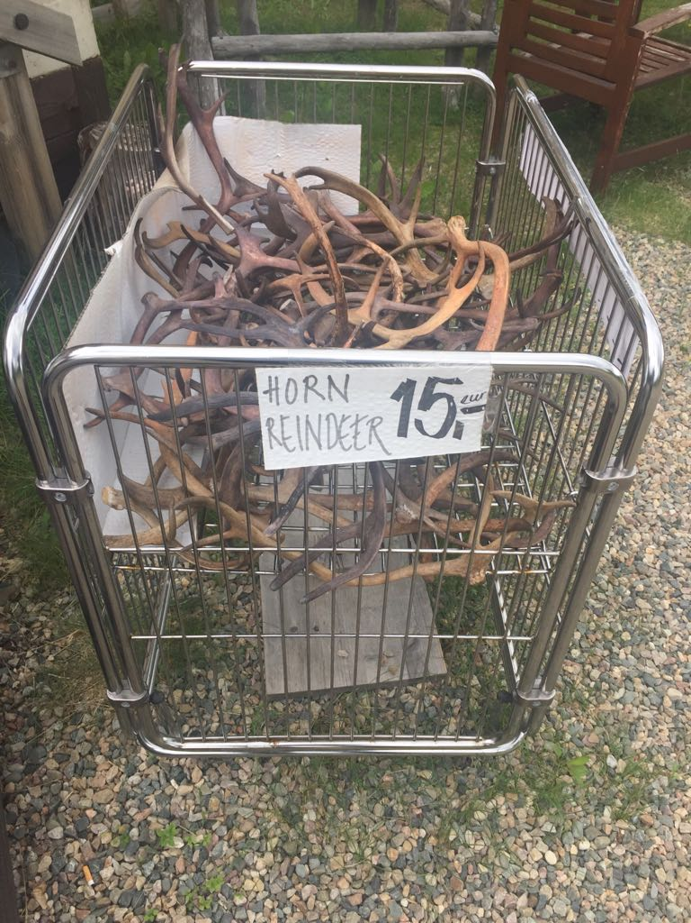
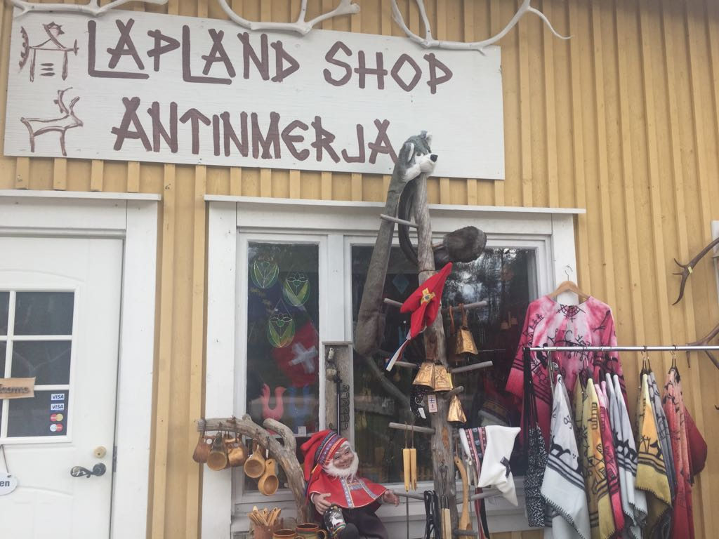
TOURISM
Preservation of culture or authenticity?
Saami is the reason of the tourism or complementary point?
Photo Eda Ayaydin

Slide 11
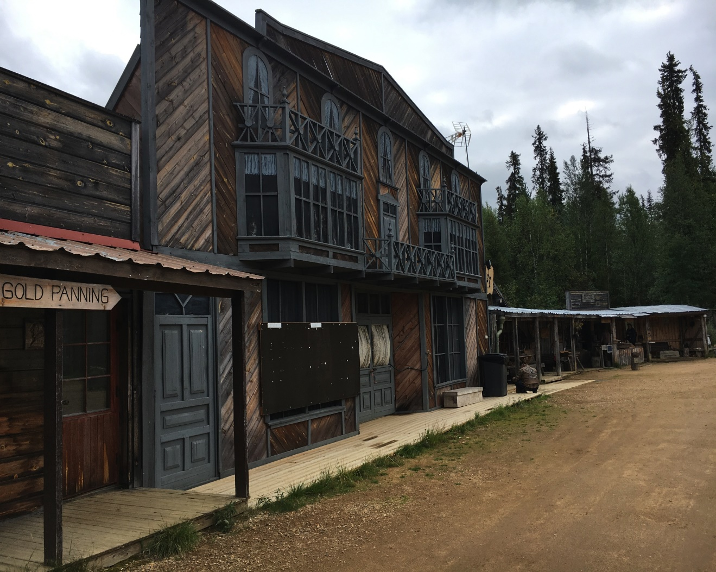
Some cultural features
Photo Eda Ayaydin

Slide 12
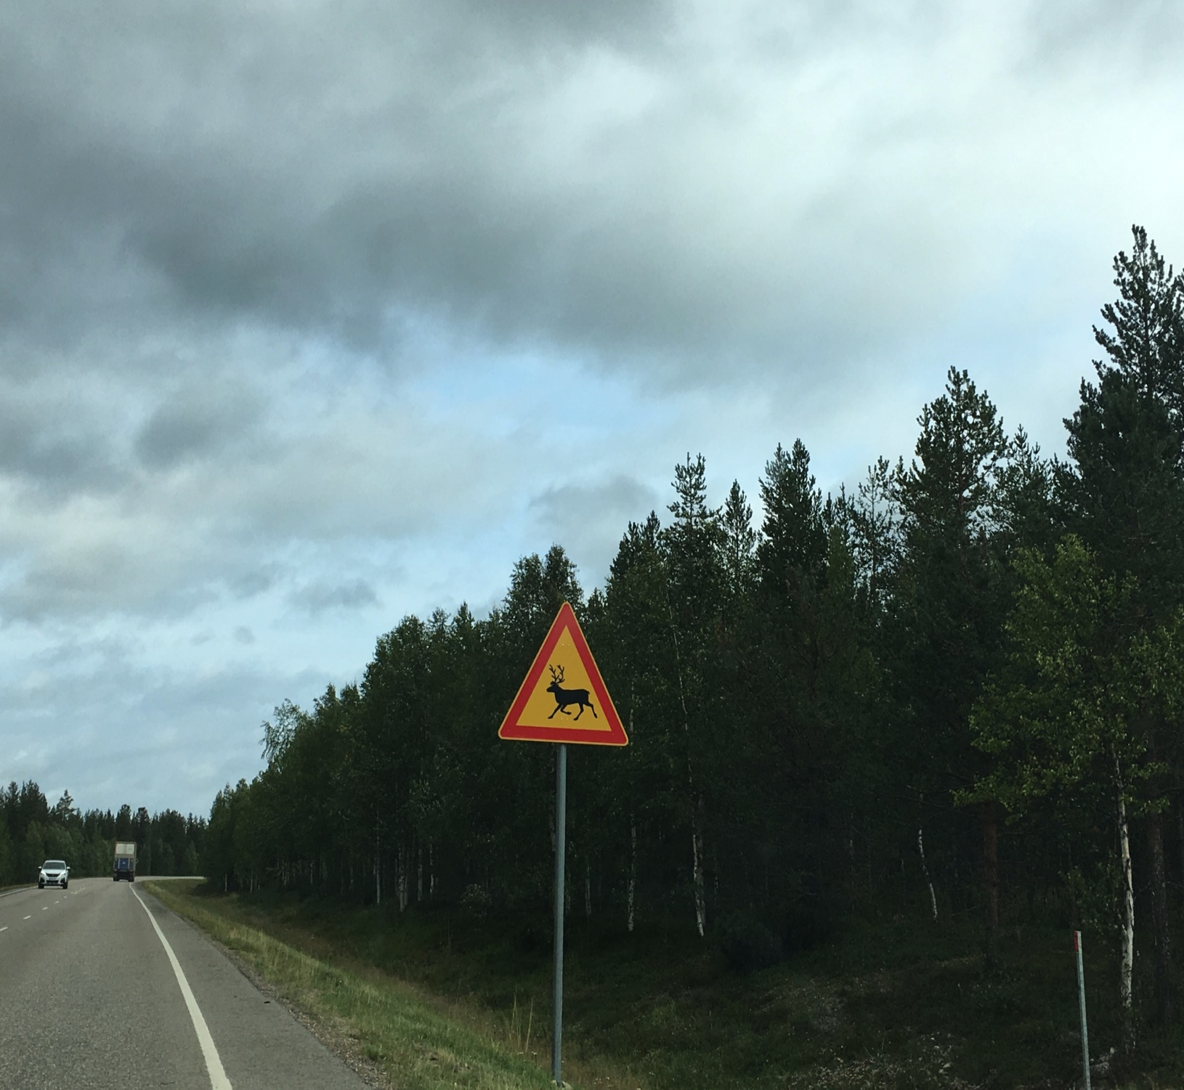
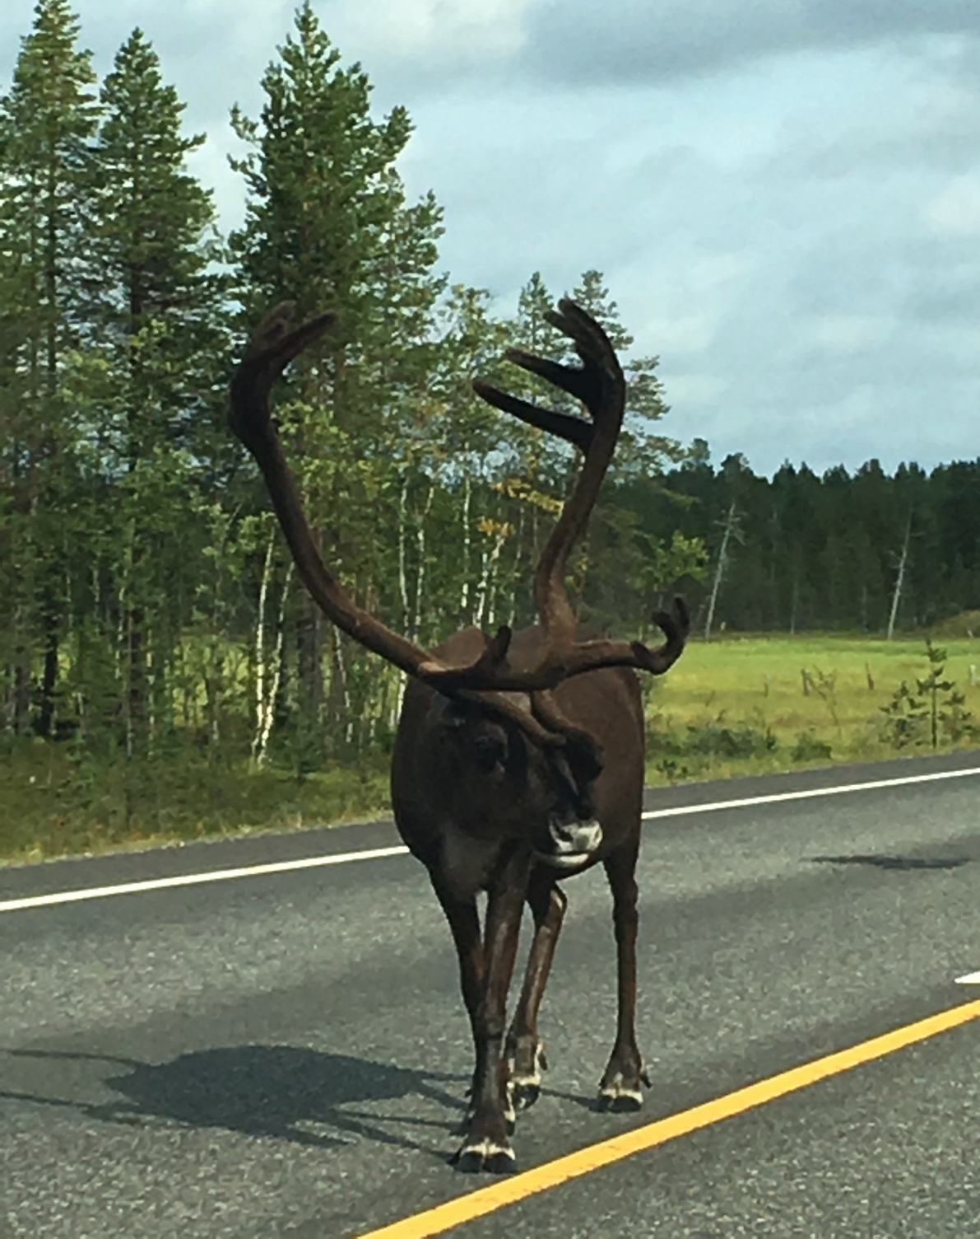
Photo Eda Ayaydin

Slide 13
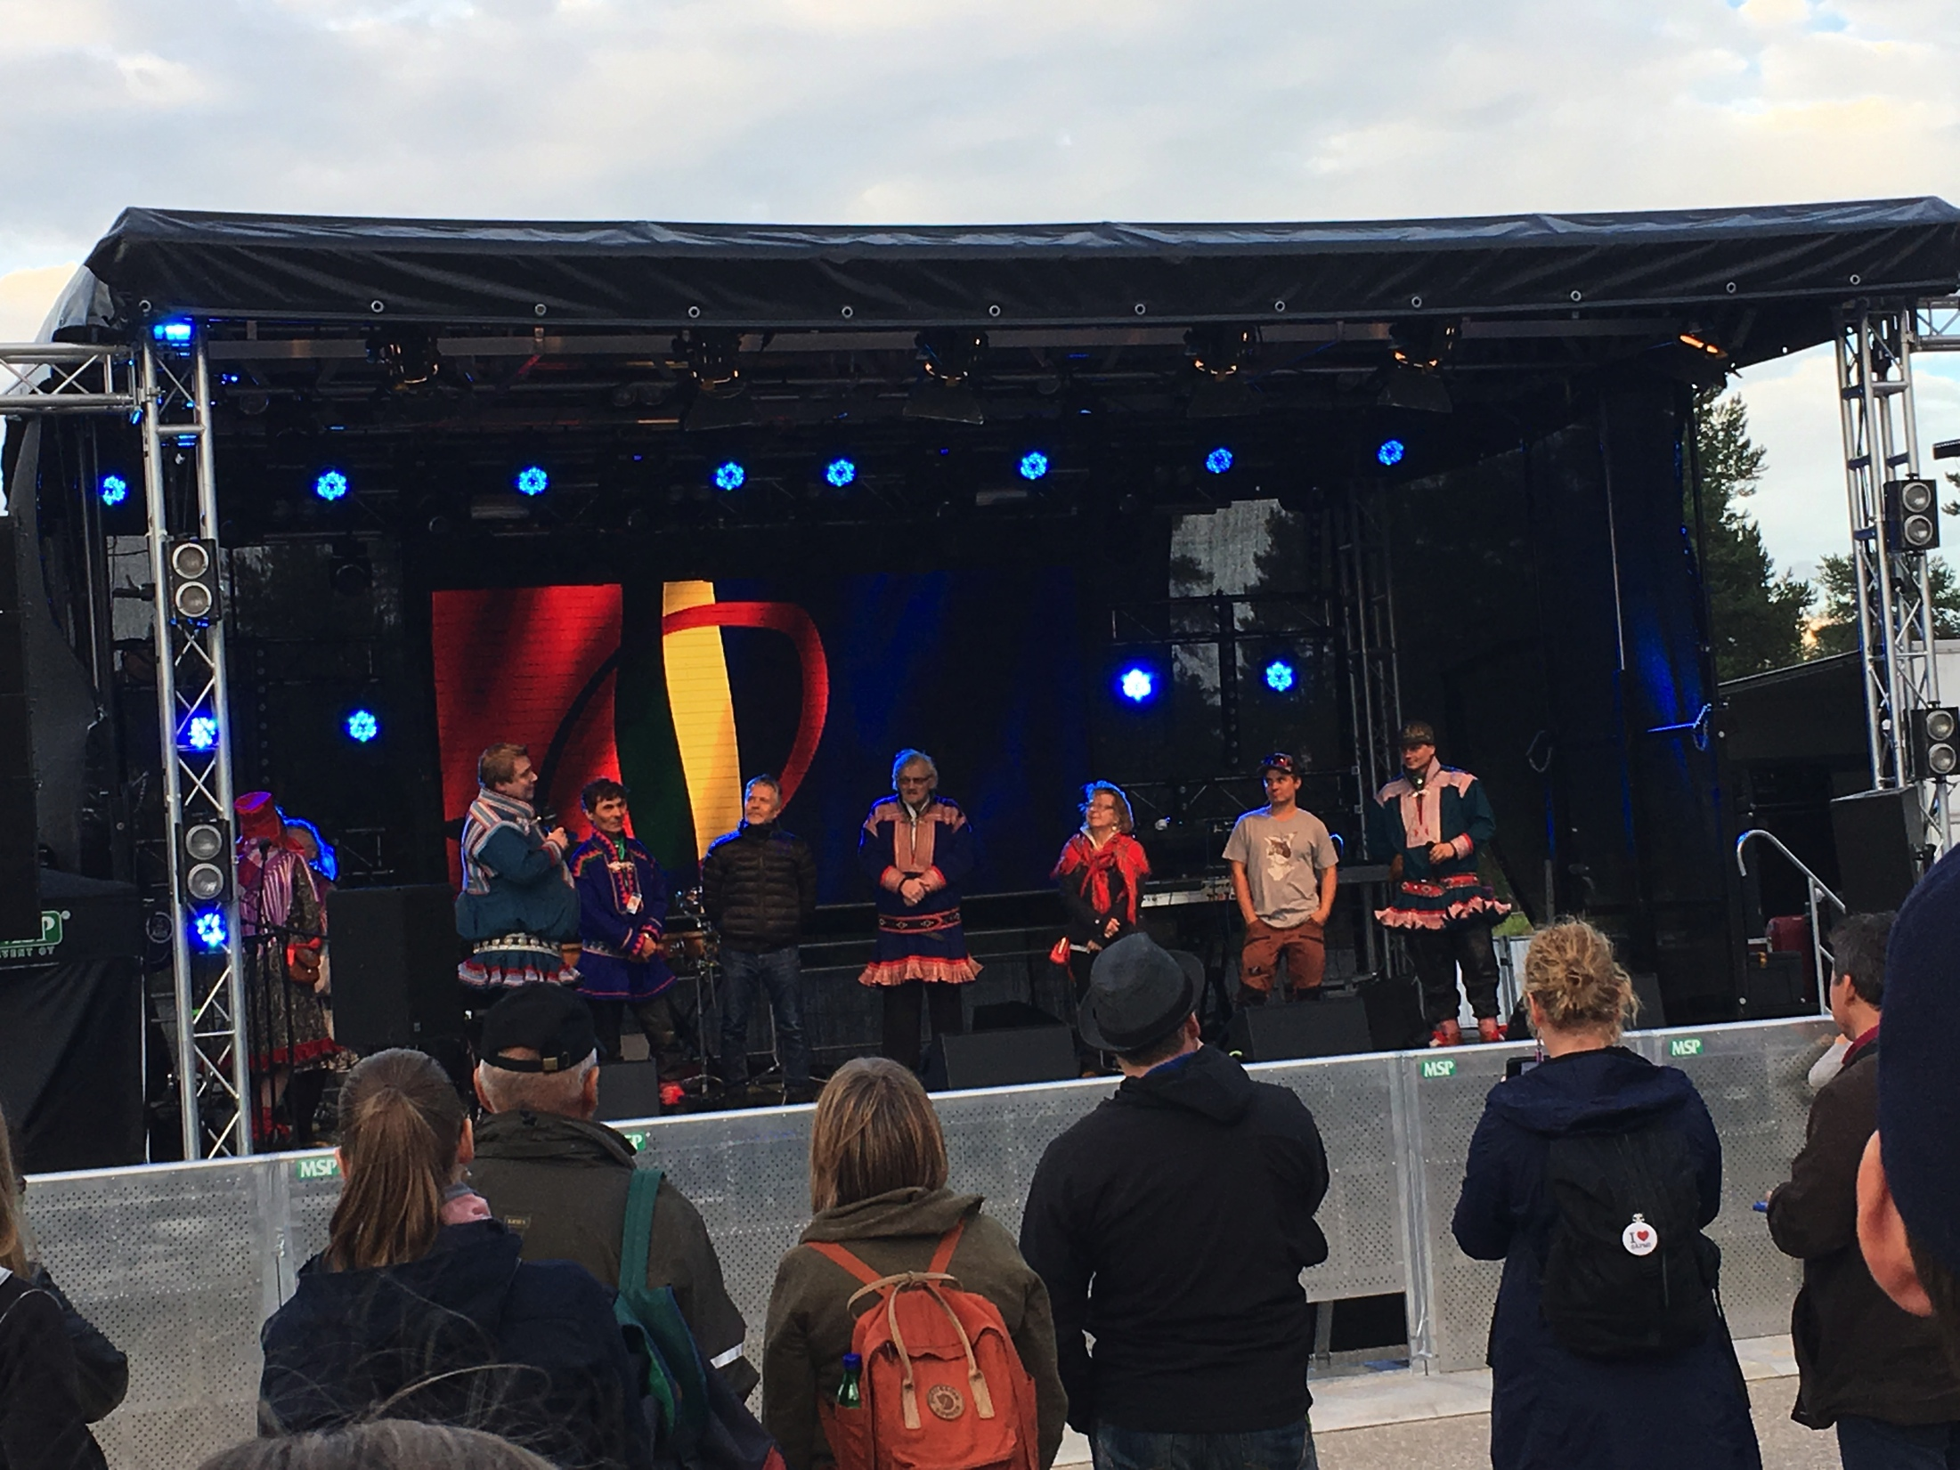
Saami Music Festival in Inari
Photo Eda Ayaydin

Slide 15
INUIT GOVERNANCE
Greenland
The Inuit govern the region
The biggest island in the World
Population is 57000, 88 % is Inuit
15 % of Greenland cost is inhabitable
Rich in terms of cold, copper, iron, uranium, zinc, oil and gas.
Main and only economic industry is fishing, 80% total export.

Slide 16
Inuıt governance
1945-1953 Denmark lost WWII and the USA got the control of defense of Greenland
1953- Denmark adopted new constitution, colonization ended and Greenlanders started to have same rights with Danes.
Maybe colonization ended up but economical neocolonization started.
1950-1970 Danes started to migrated to Greenland, the numbers increased from 4,5% to 20%.
1970, Greenland became export oriented fishing economy.
Greenland started to become mor independent to Denmark by institutions.

Slide 17
INUIT GOVERNANCE
Between 1960-1970, Greenlanders educated in Denmark started to protest Danish rule in Greenland.
60s, protests by music and poems against closure of mining in Qullisat and relocation of inhabitants (1200).
Danish government gave oil and gas drilling rights of Western Greenland between 1973 -77.
Memorandum for EU in 1972, 70% Greenlanders were against, BUT forced to join.
1973- Home rule comitteee founded.
1975- Home rule committee submitted a proposal,
1979- Memorandum and home rule is accepted.

Slide 18
INUIT GOVERNANCE
Greeenland gained some juridictional authority within some areas:
Domestic affairs, taxation, fisheries, planning of trade, church affairs, education, cultural affairs, health, transport…
Denmark and Greenland established a comission for Greater Self Governance.
2008, Referendum in Greenland, 75% Greenlanders voted for self governance and home rule replaced by self governance in 2009.
Denmark retained control from courts, foreign affair, police, minerals, constitution, defence…

Slide 19
AFTER 2008 REFERENDUM
Multi-party system,
Dominant social party is Siumut; suppoted by hunters, fishermen, workers in rural.
Still economic dependency on Denmark, (50% of economy)
Self governance is important as governing an area inhabited by Inuit for Inuit.

