Slide 1
The Student Guide to using IT Services
IT Services – 2022/23

Slide 2
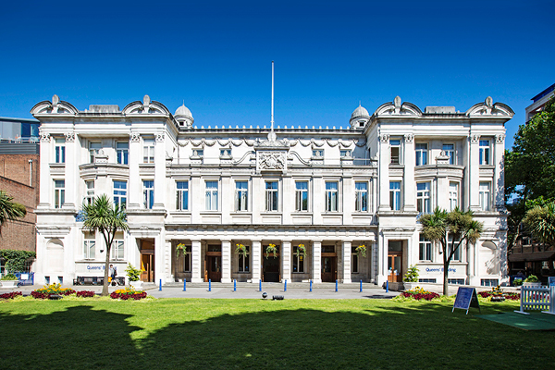
About QMUL IT Services
IT Services provides IT support and equipment to ensure QMUL students can fulfil their potential.
Our services support students and colleagues; these range from email and internet access, to state-of-the-art teaching and learning facilities, business application software and high-performance computing in support of research.
Photo of the Queens Building, Mile End Campus

Slide 3
Username and Password
Your username will look a little like this:
ab12345@qmul.ac.uk
(your short username is just the prefix: ab12345)
When you start you will receive an email with your temporary password. Please, change this as soon as possible to something of your own choosing.
Most networked IT services, including QMplus and email, use the same QMUL username and password. Therefore, when you change your password for one of these services, your password will automatically change for all the others.
You are responsible for protecting your password. Don’t let other people use it, no matter how good a reason they give you.

Slide 4
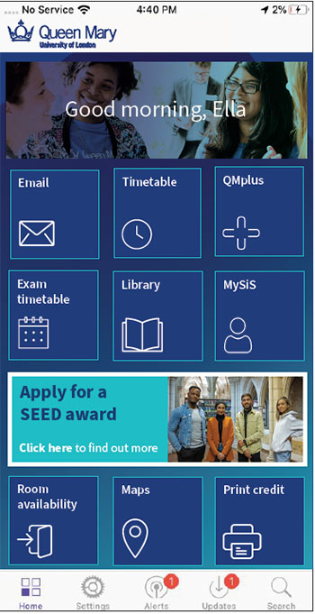
The QMUL App
Queen Mary's mobile app 'QMUL' is available as an app for Android (version 2.3.3 or higher) and iOS (version 6.0 and above) devices. Just search for 'QMUL' in your app store. You can also use the web app for other mobile devices, laptops, desktop PCs and Macs via most browsers. You can access the web app at qmul.ombiel.co.uk
QMPlus • Students’ Union • Timetable
Email • Campus Map • PC/Study Space Booking
Library • TFL • Problem Reporting
iPay • Pocket Guide • MySIS
Newsfeed • IT Status • Alumni Services
Social Media • Exam Timetable • Alerts and Notifications
QMUL Portal • QMNetwork
More information: https://www.its.qmul.ac.uk/services/students/mobile-app/

Slide 5
Email:
We supply all students with a QMUL email address during their time here. Our email service is provided by Microsoft Office 365, which offers 50GB of mail storage, QMUL-wide shared calendaring system, and access from mobile devices.
Official QMUL communications to students are sent to QMUL email accounts, so it is important you check it regularly. You should also use your QMUL email to correspond with your department and the central services.
How to sign in
To check your email online, go to: https://mail.qmul.ac.uk
Enter your username (ab12345@qmul.ac.uk) and password.

Slide 6
Office 365
Students at Queen Mary can download the Microsoft Office Suite free. You can install it on up to five personal devices, both PC and Mac OS X.
Office 365 includes the latest versions of Microsoft Word, Excel, PowerPoint, OneNote, Access, Publisher, Outlook and One Drive for Business
For instructions on how to get Microsoft 365 for free,
visit youtube.com/watch?v=58FIAelSoO4
How to sign in
To check your email online, go to: https://mail.qmul.ac.uk
Enter your username (ab12345@qmul.ac.uk) and password.

Slide 7
Wifi
The wireless network that you should use to connect laptops, tablets and phones is ‘eduroam’.
The JANET eduroam service provides internet access not only in QMUL but in academic institutions across the UK and in many countries around the world with the same QMUL username and password. For information about eduroam, visit: www.eduroam.org
Apple (iPhones, iPads, MacBooks), Windows 8, 8.1 and 10 and latest Android devices
Select the ‘eduroam’ network in your Wi-Fi settings. This will prompt you for your QMUL username and password. You will need to enter your username in the format ab12345@qmul.ac.uk (please note that this is NOT your email address).
You will then be asked to accept a certificate, details of this and how to connect to other devices can be found on the ITS webpages: https://www.its.qmul.ac.uk/services/students/wifi/

Slide 8
AppsAnywhere
Our new ‘appsanywhere’ service allows you to access some of Queen Mary’s specialised apps when away from your department or off campus.
This service is available to both staff and students. All you need for access to these apps are:
Computer – A laptop, Smartphone or any compatible device with a Wi-Fi connection.
Multi Factor Authentication – *A one-time set-up on the QMUL multi factor authentication (MFA) service.
VMWare Horizon - Install the client OR through the web
For more details, please see the ITS help pages: https://www.its.qmul.ac.uk/services/students/appsanywhere/

Slide 9
Using the PCs on Site
There are a number of rooms around the campus that contain computers which students can use. You can sign in using your QMUL username and password.
Some of these are also timetabled for teaching, but if there isn’t a class in the room the computers can be used by anyone however, we ask that you vacate the room 10 minutes before any teaching is scheduled (unless you are part of the class for which it is scheduled, of course).
There are a large number of computers in the Library that are never timetabled for teaching.
How to find an available PC on campus
We have a big campus and computer rooms can be especially busy as deadlines approach. We publish an interactive map showing which rooms have empty seats. This is available here - http://availability.stu.qmul.ac.uk/ - and also on screens around the campus.
The opening hours of some rooms vary and may be shorter during the vacation periods, further details can be found on Teaching Room Facilities website.

Slide 10
Printing, Copy and Scanning
There are printers located across all campuses for use by students, will all devices offering both copying and scanning facilities alongside printing.
If you print a document you have 24 hours to collect it at any printer. You choose the printer, swipe your student ID card at the terminal, and release the jobs you’d like to print from your personal queue.
The cost of printing and photocopying is automatically linked to you iPay account, which is linked to your student ID card. Scanning is free but you will need a USB memory stick on which to save your scanned documents and images. For instructions on scanning, please visit the Library website.
For large print runs, binding and finishing, and professional print jobs, the CopyShop at our Mile End campus offers a range of fast and student-friendly solutions.
https://www.its.qmul.ac.uk/services/students/printing/

Slide 11
Student Handbook
While you are studying at Queen Mary you will use a number of IT services and applications. Please see our Welcome Guide for QM students to find out more information.
If you cannot find the information you are looking for, please contact the IT Service Desk by ITS Live Chat system or you can raise a ticket with us using our Self Service Portal. Alternatively, you can call us on 020 7882 8888. This number is staffed 24/7, 365 days a year.

Slide 12
Service Desk is the 1st point of contact for all ITS related enquiries
Live Chat | Telephone | Ticket System | Email
its.qmul.ac.uk | 020 7882 8888 | servicedesk.qmul.ac.uk | servicedesk@qmul.ac.uk
Best for: Asking questions Reporting problems | Best for: Reporting a Problem – something isn’t working, forgotten password, lost files, slow Wi-Fi etc. | Best for: Requesting a Service – request for new hardware/software, setting up a new account issuing and account amendments | Best for: When a response or support is not required straight away Where you want to support a query with visual evidence, e.g., screen grab
Why? We can ask questions Remote access to your PC We can agree next steps straight away if further support is required | Why? Multi-skilled team Over 65% issues resolved during first call We can ask questions We could agree next steps with you straight away | Why? You have a record of your enquiry You can track progress You can provide detail | Why? We can ask questions Remote access to your PC We can agree next steps straight away if further support is required

Slide 13
Thank you slide

Slide 14
End Slide

