Slide 2
Case studies

Slide 3
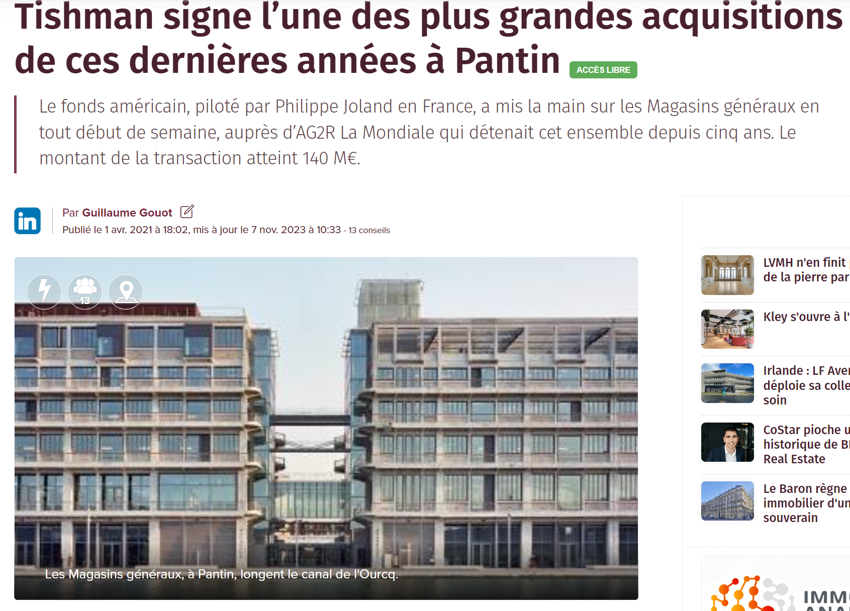
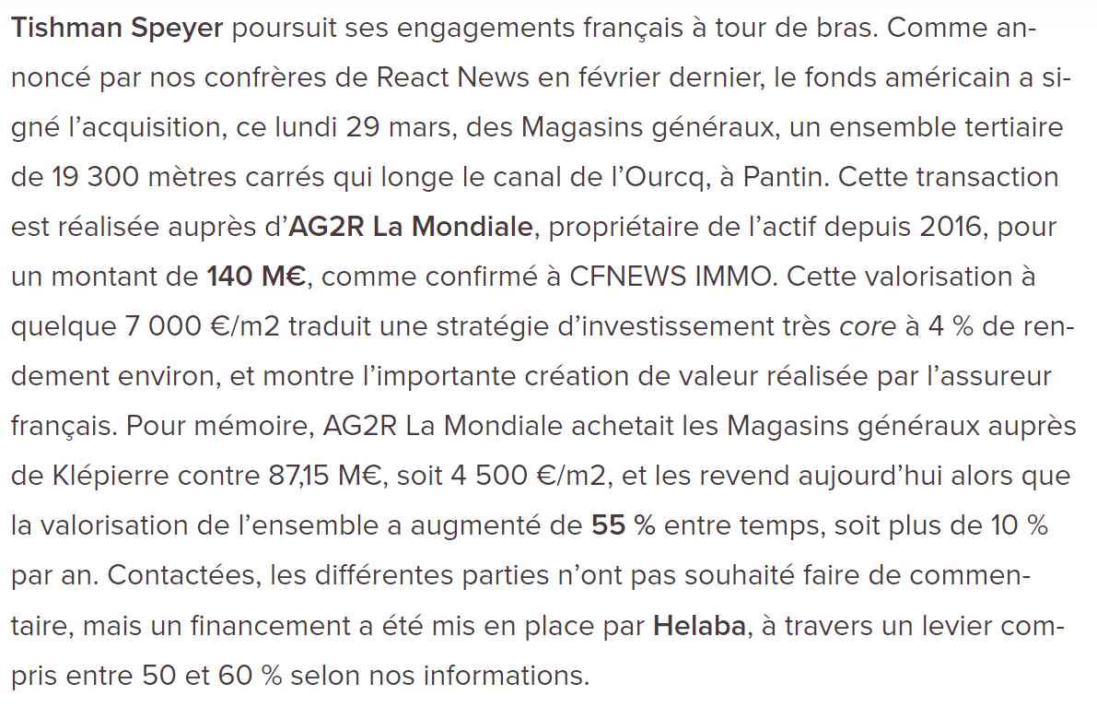
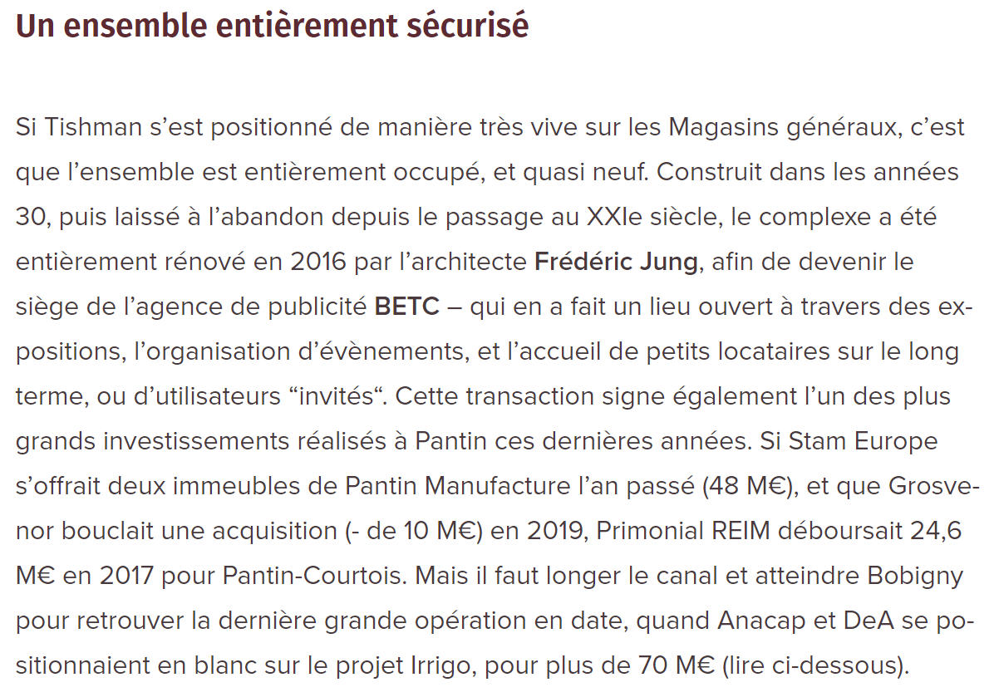
https://www.cfnewsimmo.net/L-actualite/Transactions/Tishman-signe-l-une-des-plus-grandes-acquisitions-de-ces-dernieres-annees-a-Pantin-428939

Slide 4
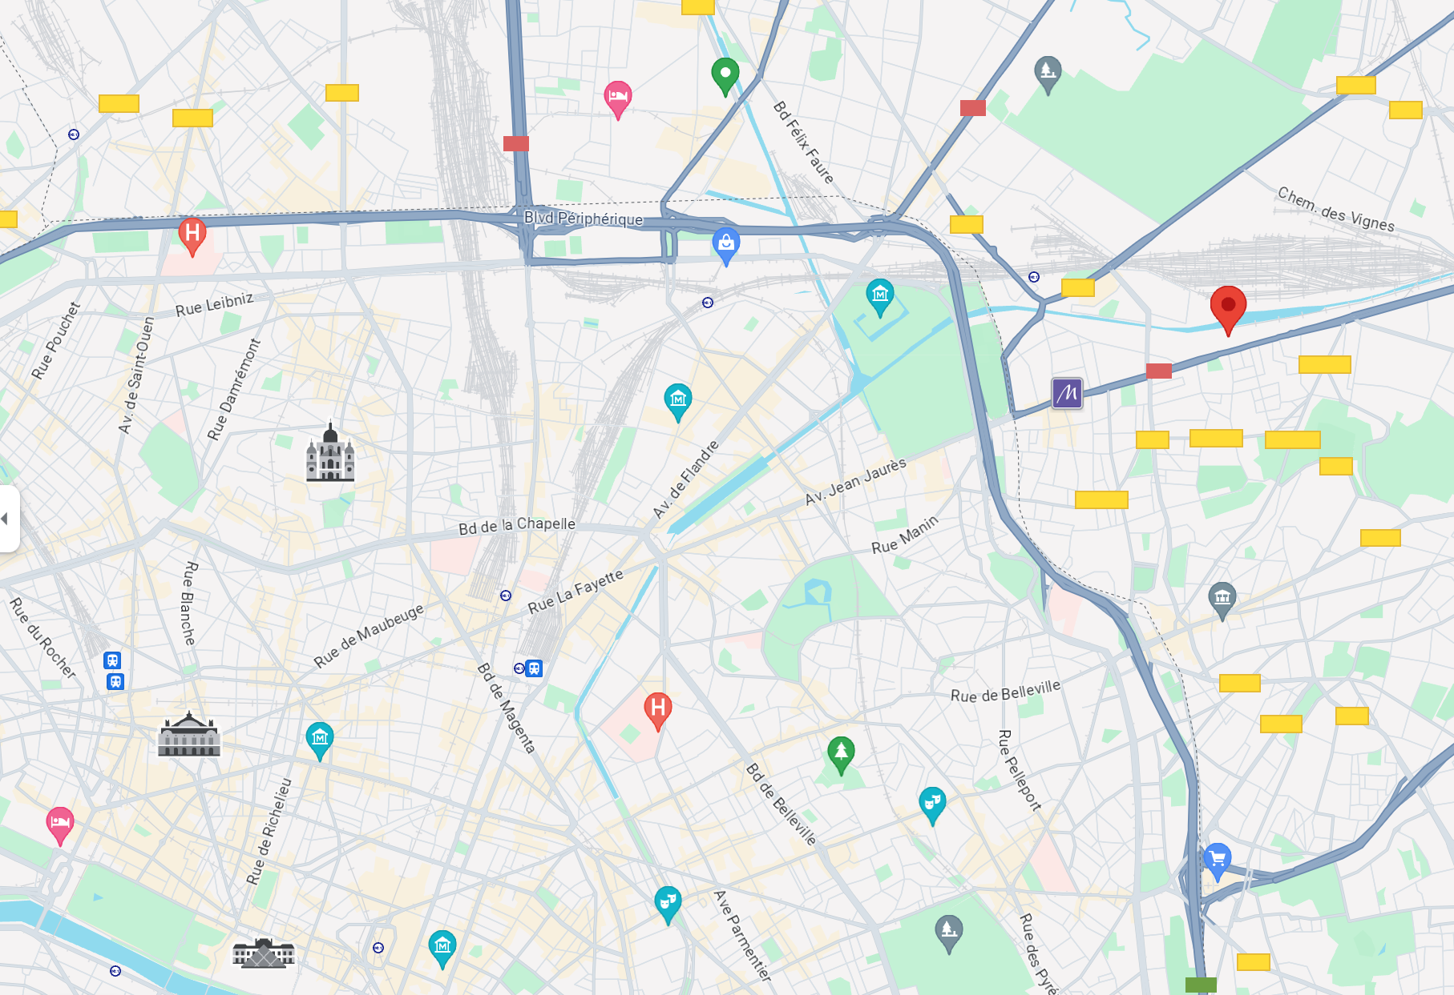

Slide 5
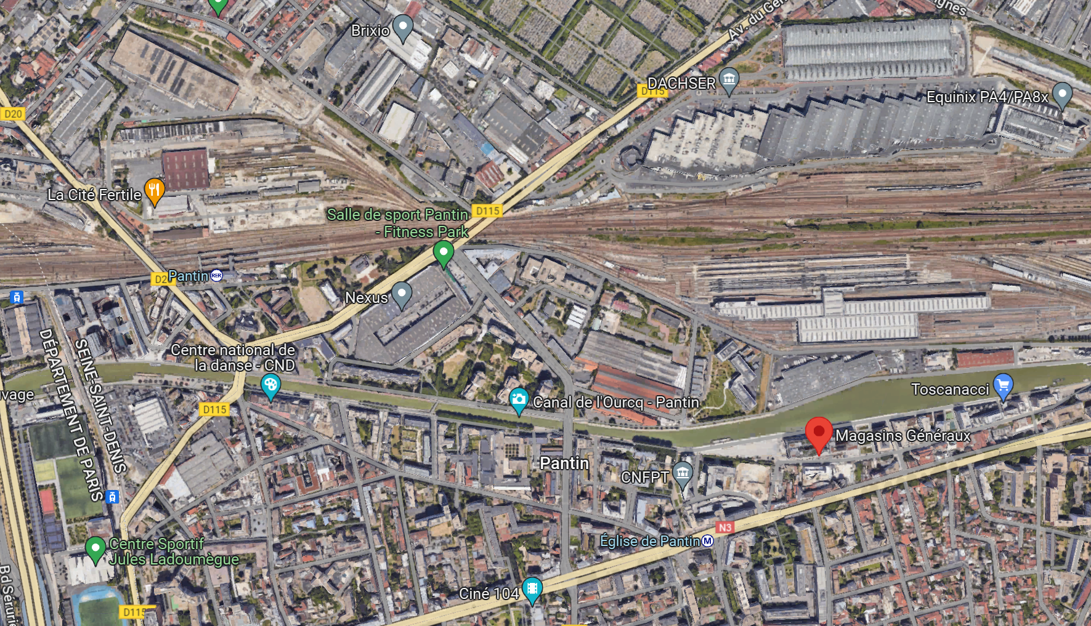

Slide 6
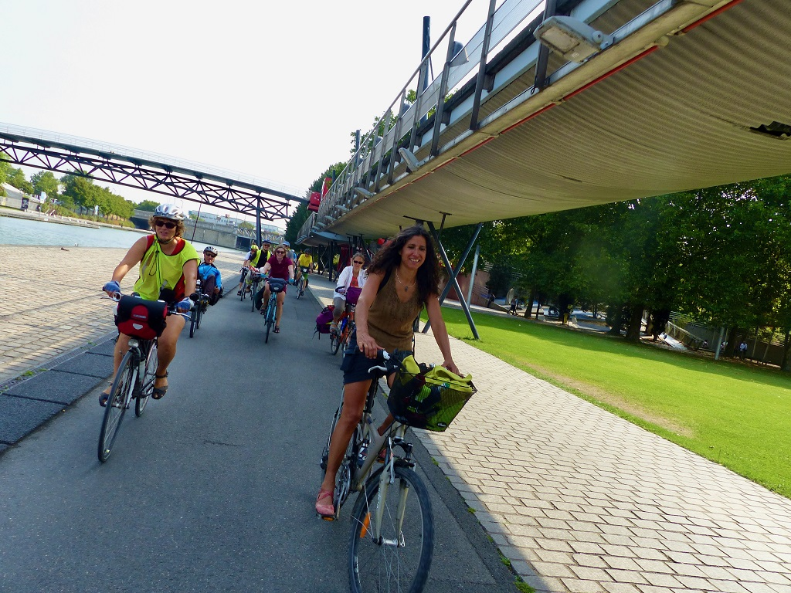

Slide 7
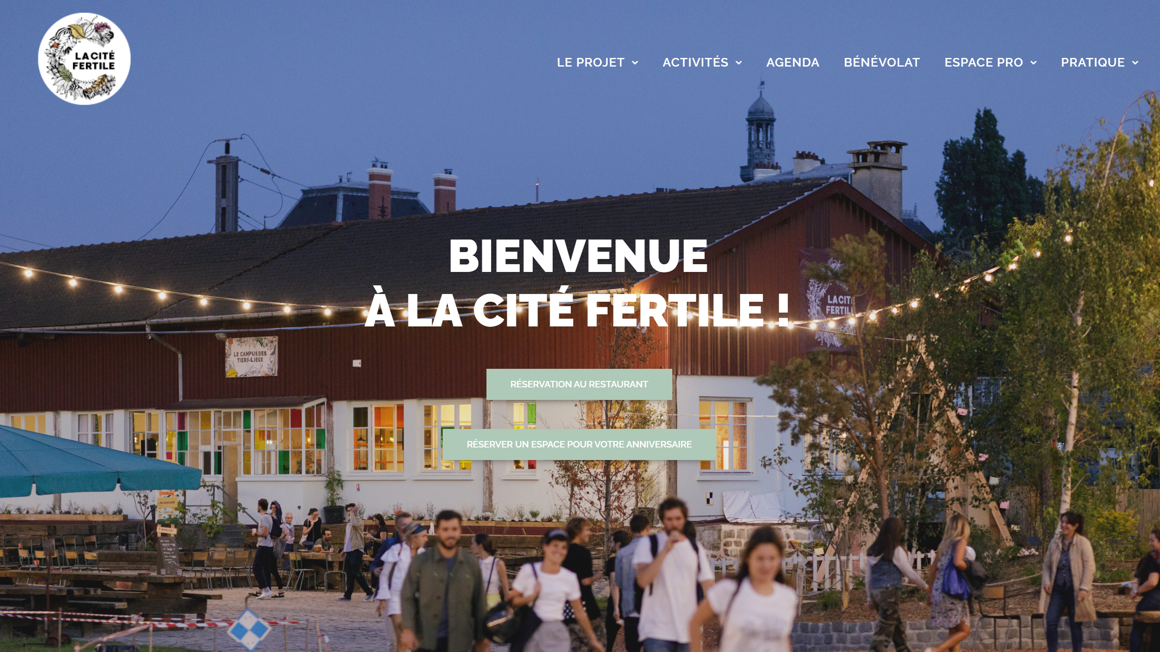

Slide 8
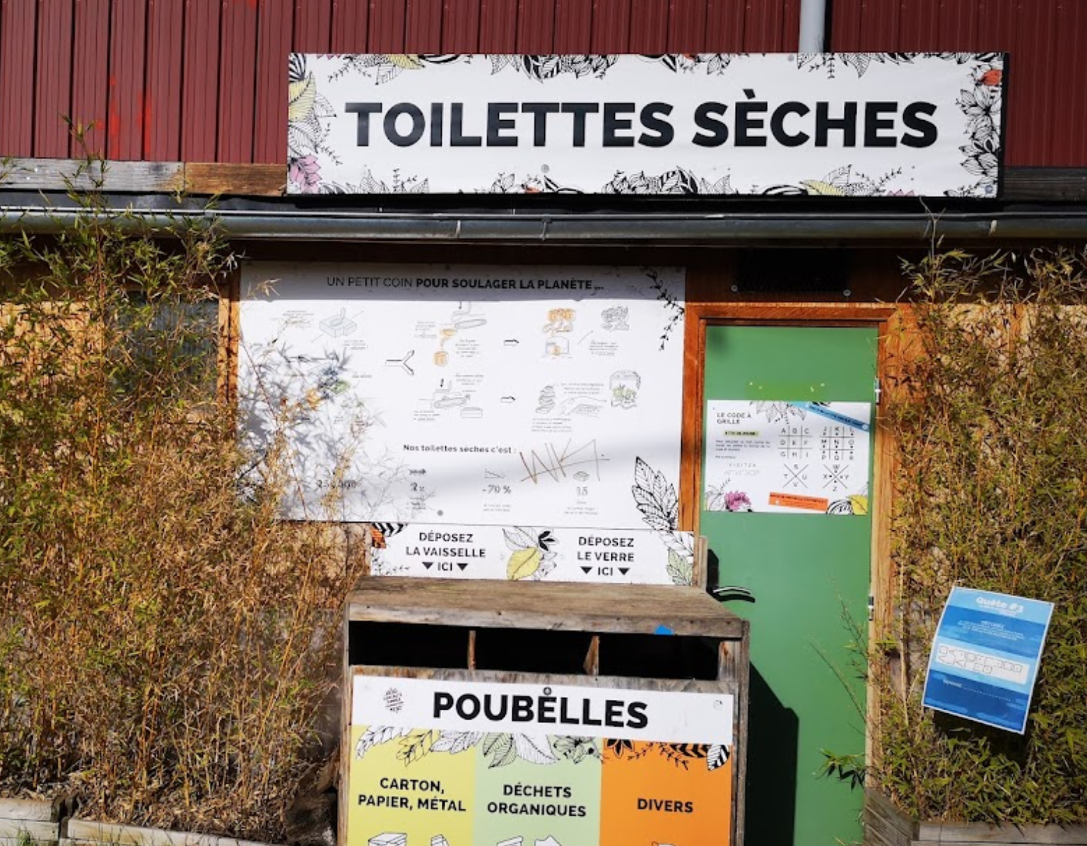
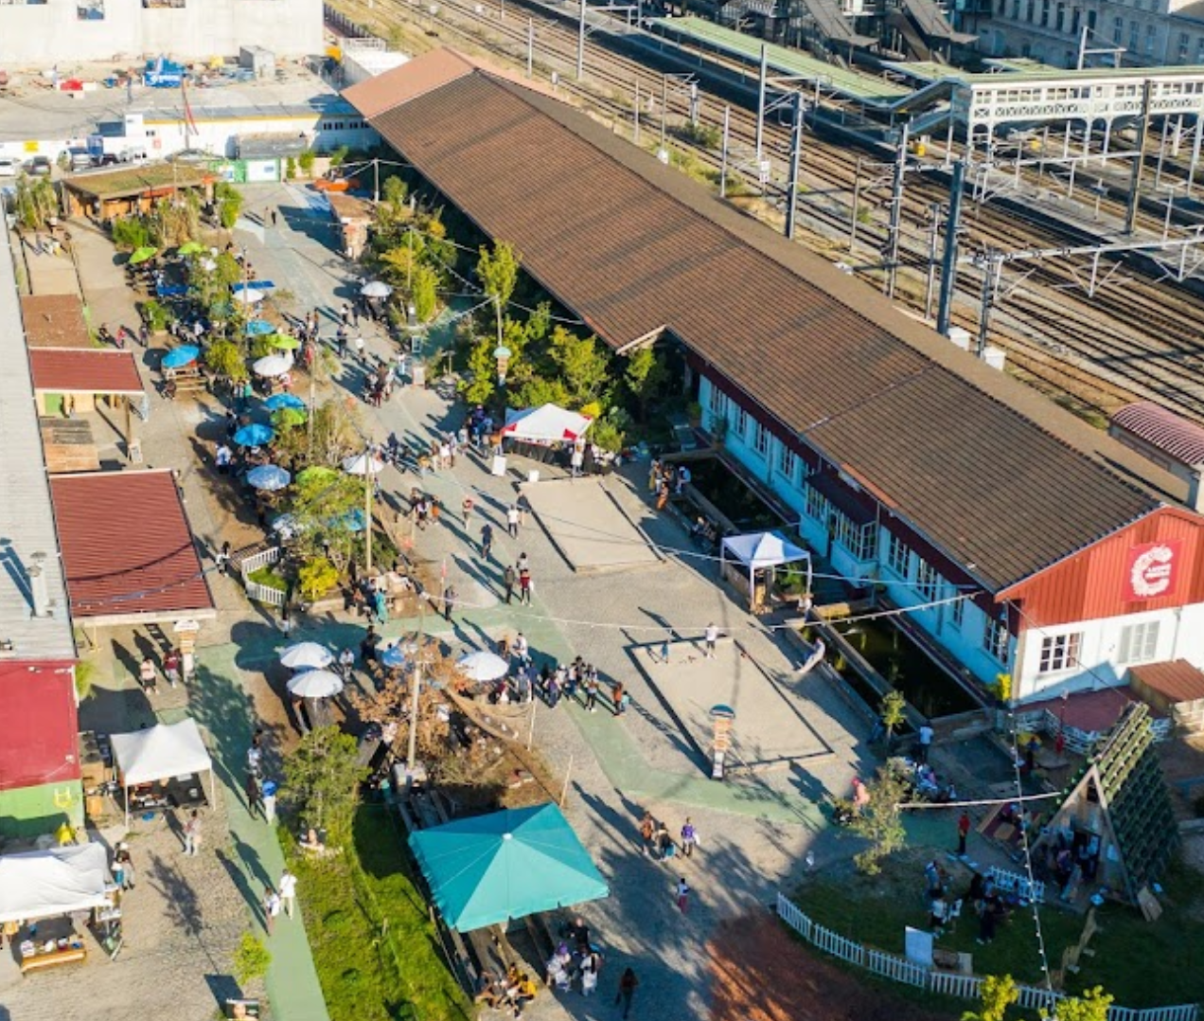
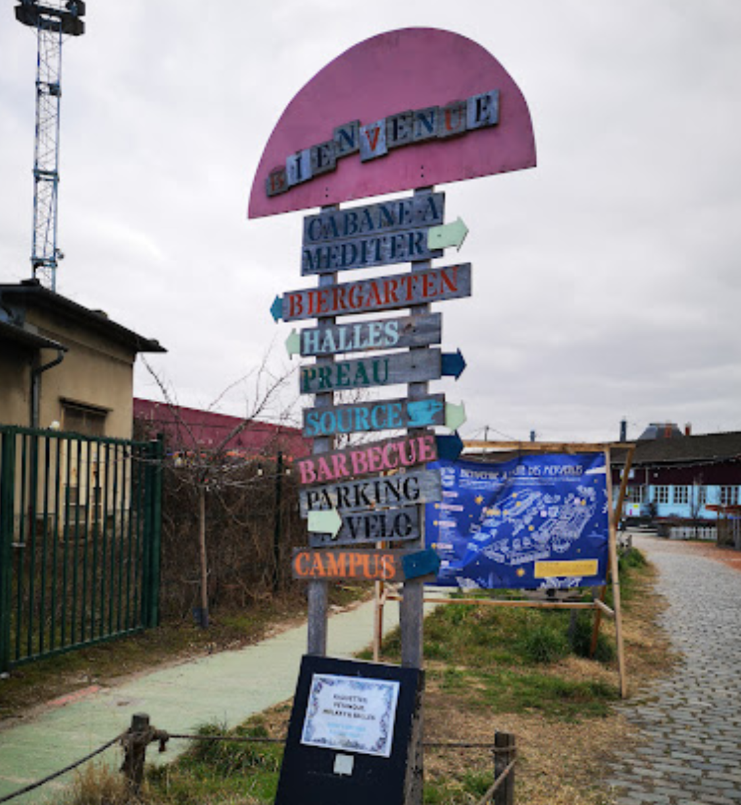
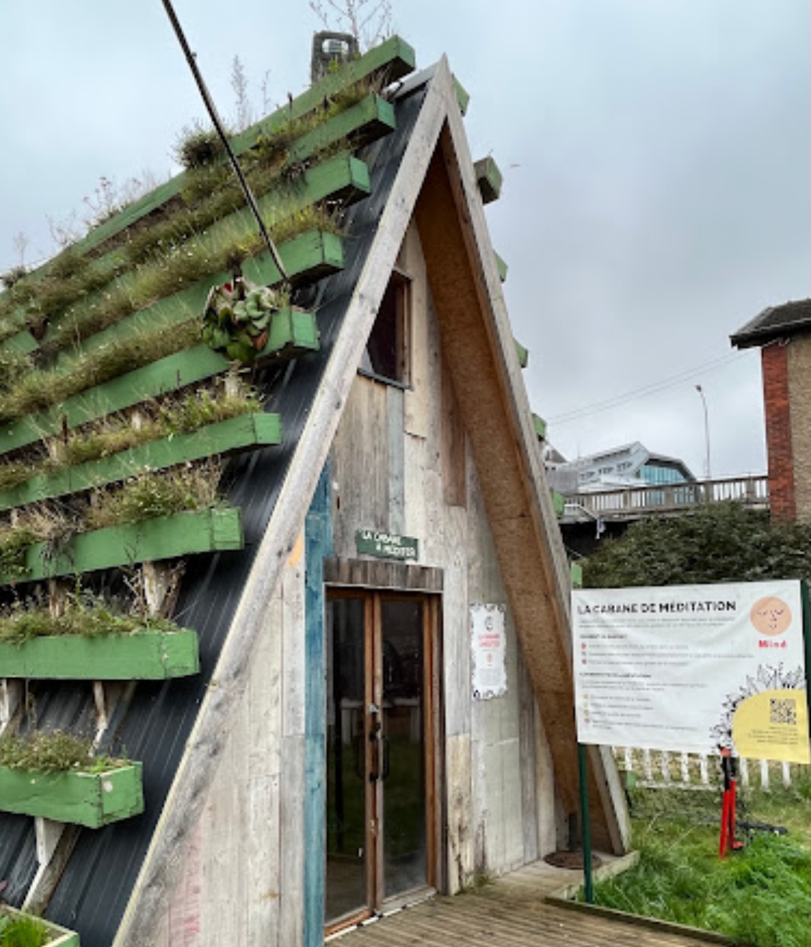
Notes:
SINNY&OOKO Cultural engineering company → TIERS LIEUX
Cité fertile: Owned by SNCF IMMOBILIER also Ground control,
est une agence d’ingénierie culturelle, spécialisée dans la conception et l’animation de tiers-lieux de vie. Depuis 1992, SINNY&OOKO s’acharne à faire revivre des lieux d’exception en imaginant de nouvelles façons de consommer, se divertir, partager.
À l’origine de leur conception, SINNY&OOKO exploite actuellement La REcyclerie, Le Pavillon des Canaux, la Machine du Moulin Rouge et son Bar à Bulles), et prochainement d’autres lieux en régions et dans le Grand Paris, dont la Cité Fertile à Pantin.
SINNY&OOKO met son expérience et son expertise au service de ses partenaires, pour réinvestir un territoire et en révéler le potentiel, de manière à la fois innovante et responsable. À travers un modèle économique privé et viable, et un positionnement unique pour chaque tiers-lieu, SINNY&OOKO s’emploie à opérer la transition en faveur de la cohésion sociale et le dynamisme local, autant que la sensibilisation aux enjeux de demain, et toujours sur un mode festif.
developpement@sinnyooko.com urbanisme transitoire / Transitory urbanism
www.sinnyooko.com

Slide 9
Cité fertile
Run by Sinny & Ooko: « Cultural engineering » business
Specialized in creating and managin « tiers lieux »
Other Parisian « Tiers lieux » managed by Sinny & Ooko: La Recyclerie, Le Pavillon des Canaux, the Bar à Bulles at the Machine du Moulin Rouge.
Owned by SNCF IMMOBILIER (also owner of Ground Control in 12th arrondissement)
« urbanisme transitoire »: « Transitional urban planning aims to breathe new life into unused SNCF railway land (unoccupied land, empty buildings), by creating new places for sharing and living while awaiting their future reconversion. The occupation of a site foreshadows new uses which meet the needs of the territory and thus contribute to the enrichment of future urban planning. These ephemeral, temporary or transitional projects share an experimental, partnership and social dimension, consistent with the social responsibility (CSR) of the SNCF Group. » (SNCF website)

Slide 10
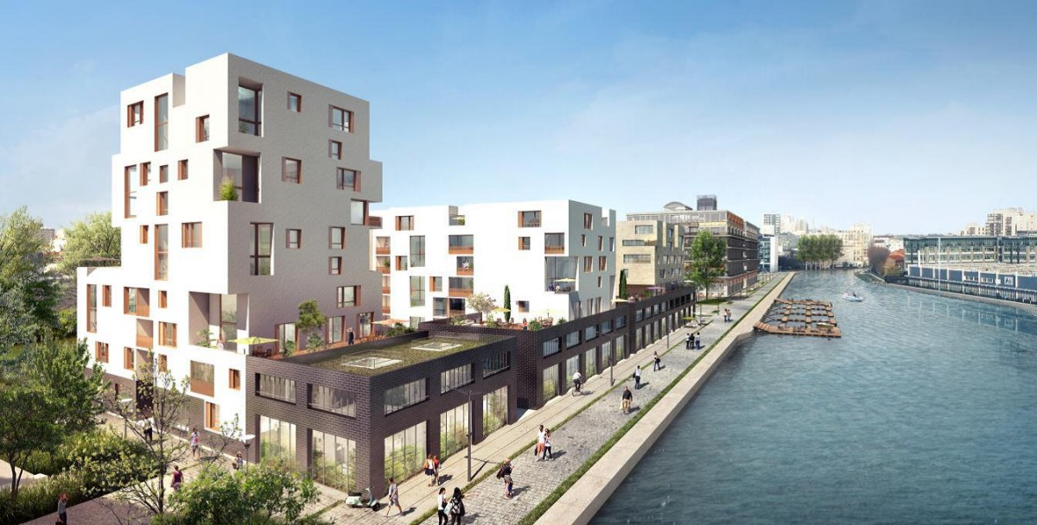
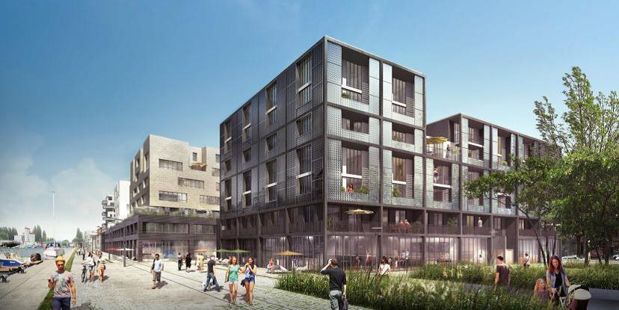
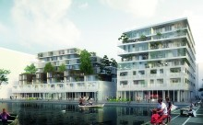
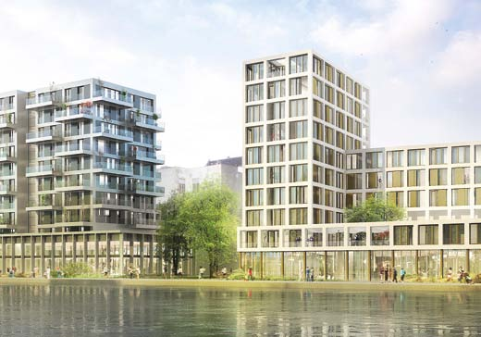
ZAC du Port de Pantin
Zone d’Aménagement Concerté
Notes:
opération publique d'aménagement de l'espace urbain

Slide 11
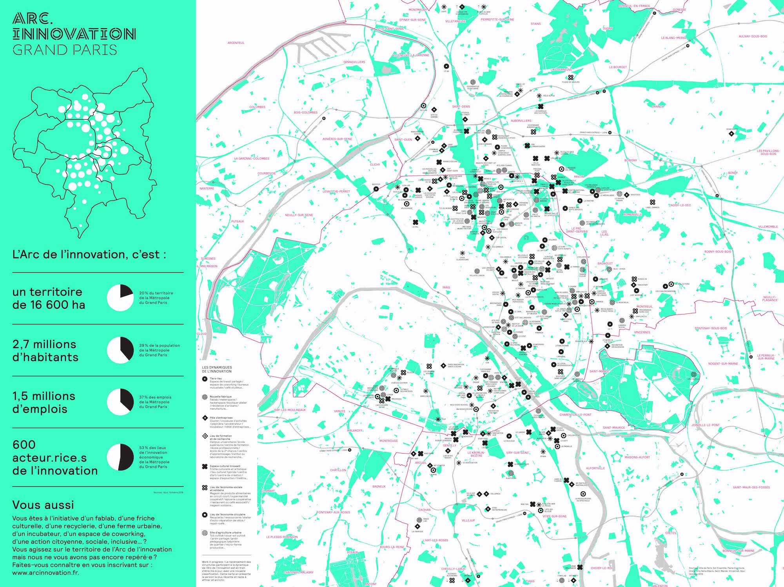

Slide 12
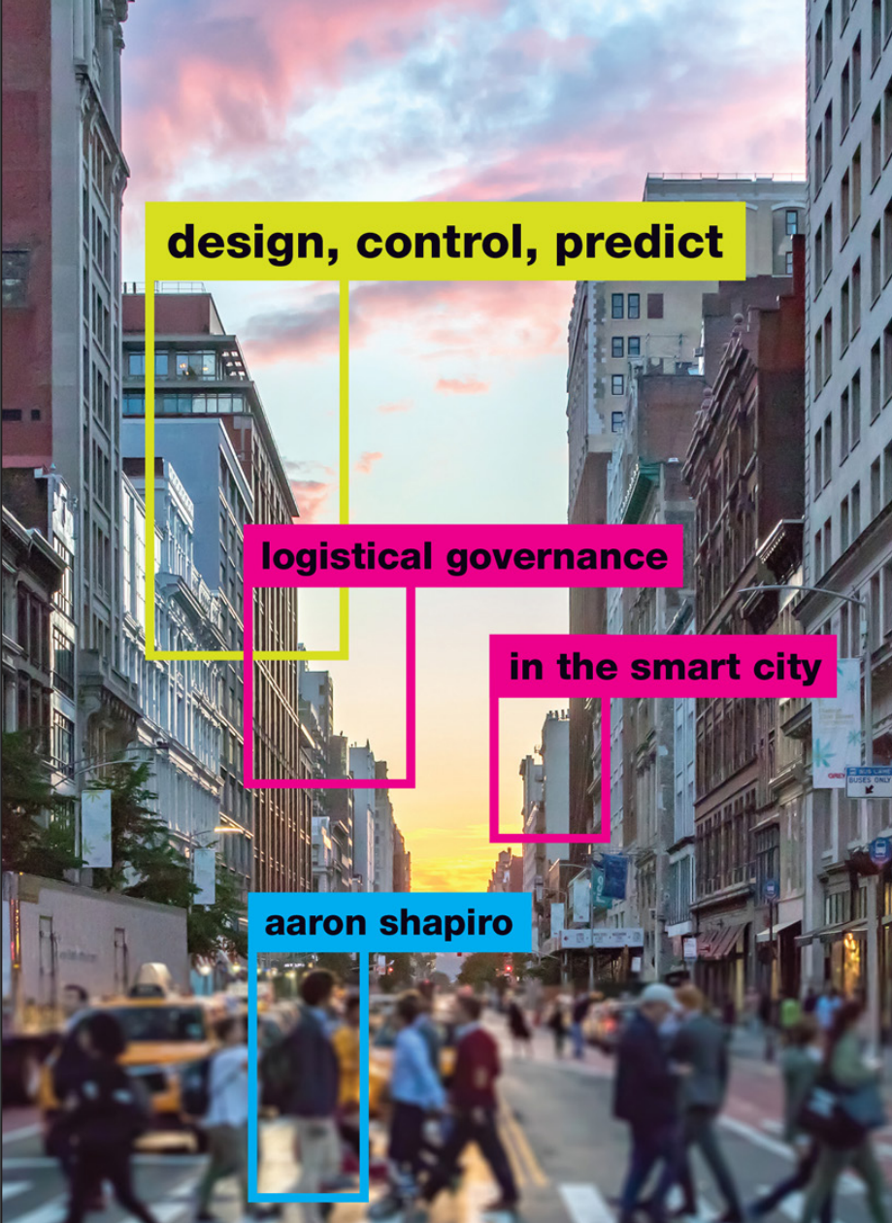
The rise of the ‘entrepreneurial’ & ‘smart’ city
Rise of tech
Smart city:
Use of technology to deal with rapid urban growth + other challenges (including environmental)
Treat city like a system
Data-driven analytics to develop software to improve decision making
Smart cities as efficient cities
Attract tech entrepreneurs/innovators + venture capital

Slide 13
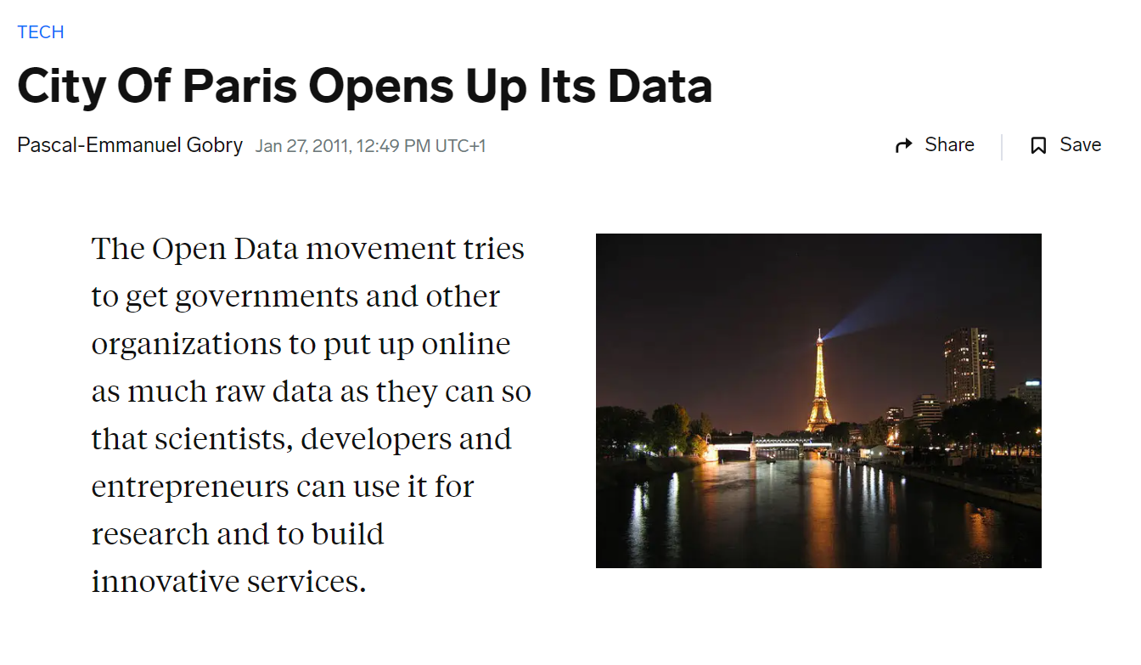
https://www.businessinsider.com/city-of-paris-opens-up-its-data-2011-1?r=US&IR=T

Slide 14
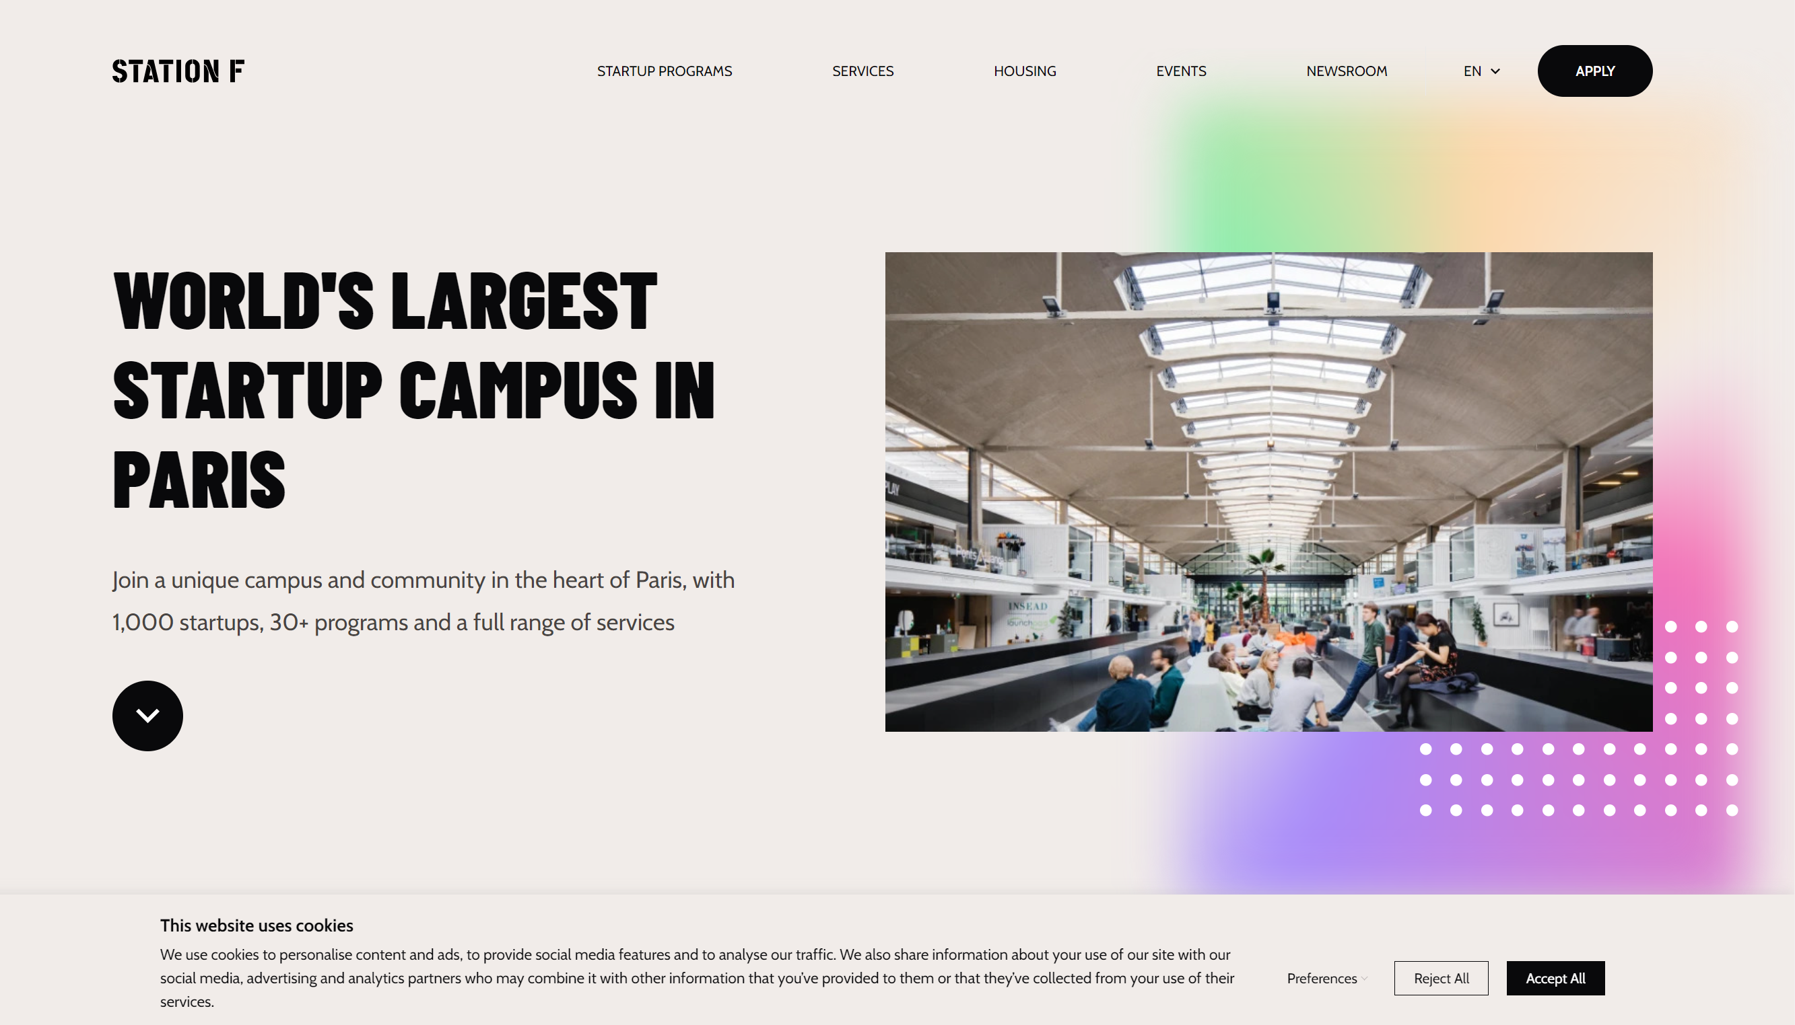

Slide 15
Green spaces

Slide 17
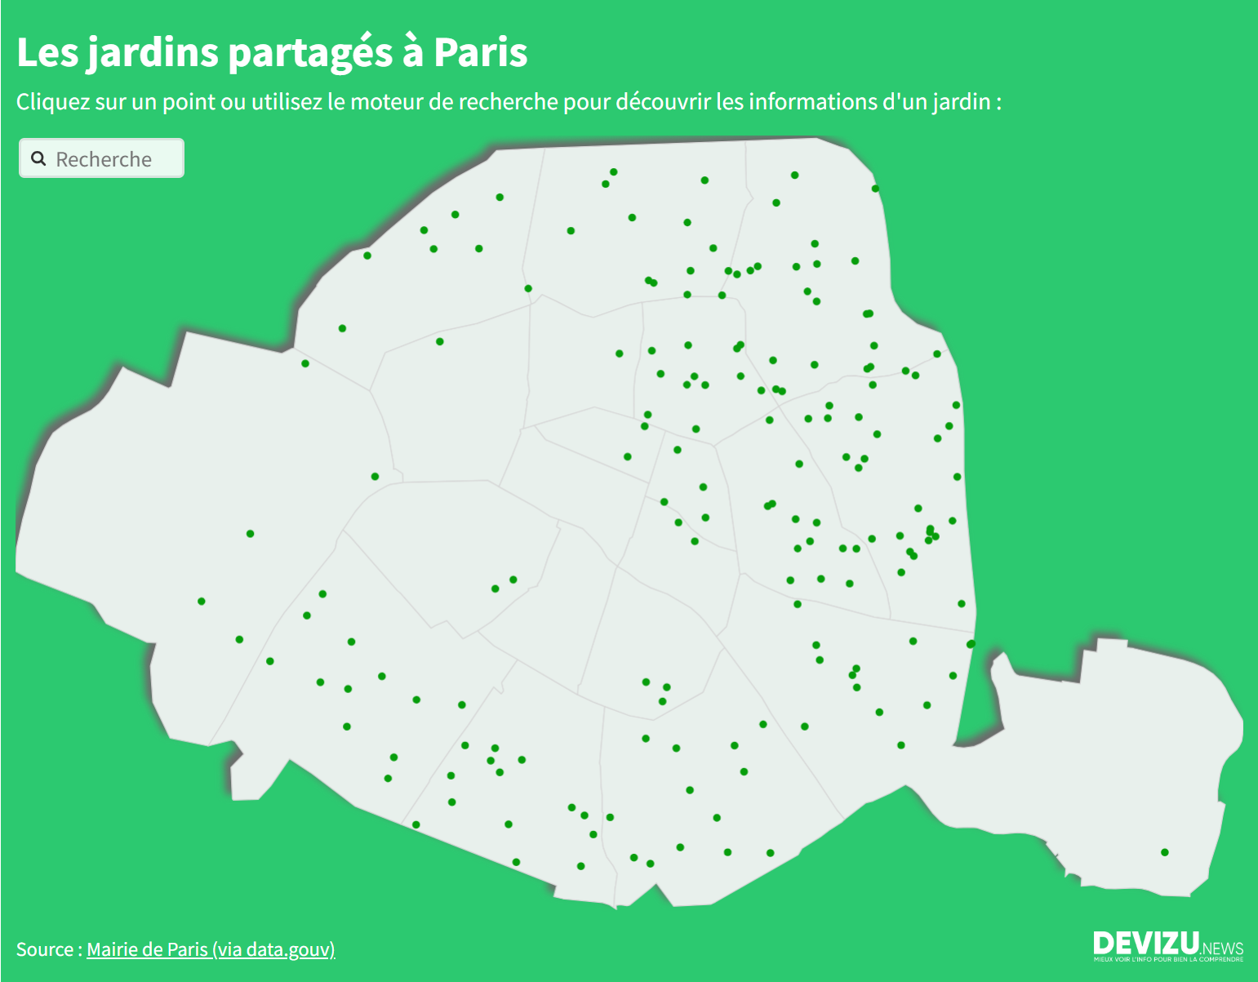
https://www.devizu.news/jardin-paris/

Slide 18
The Jardins d’Eole
18th arrondissement

Slide 19
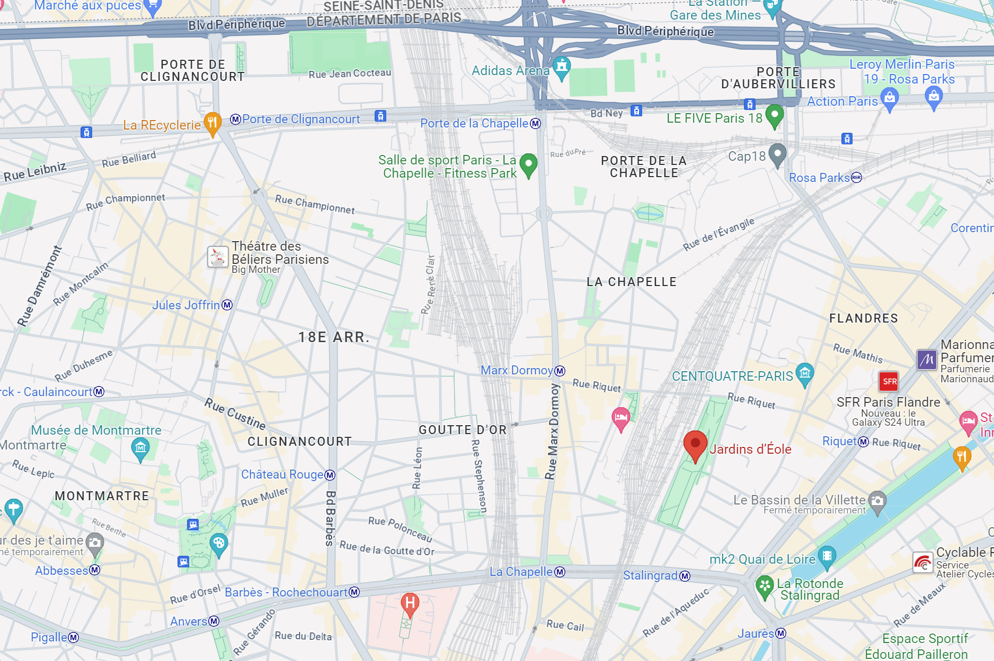

Slide 20
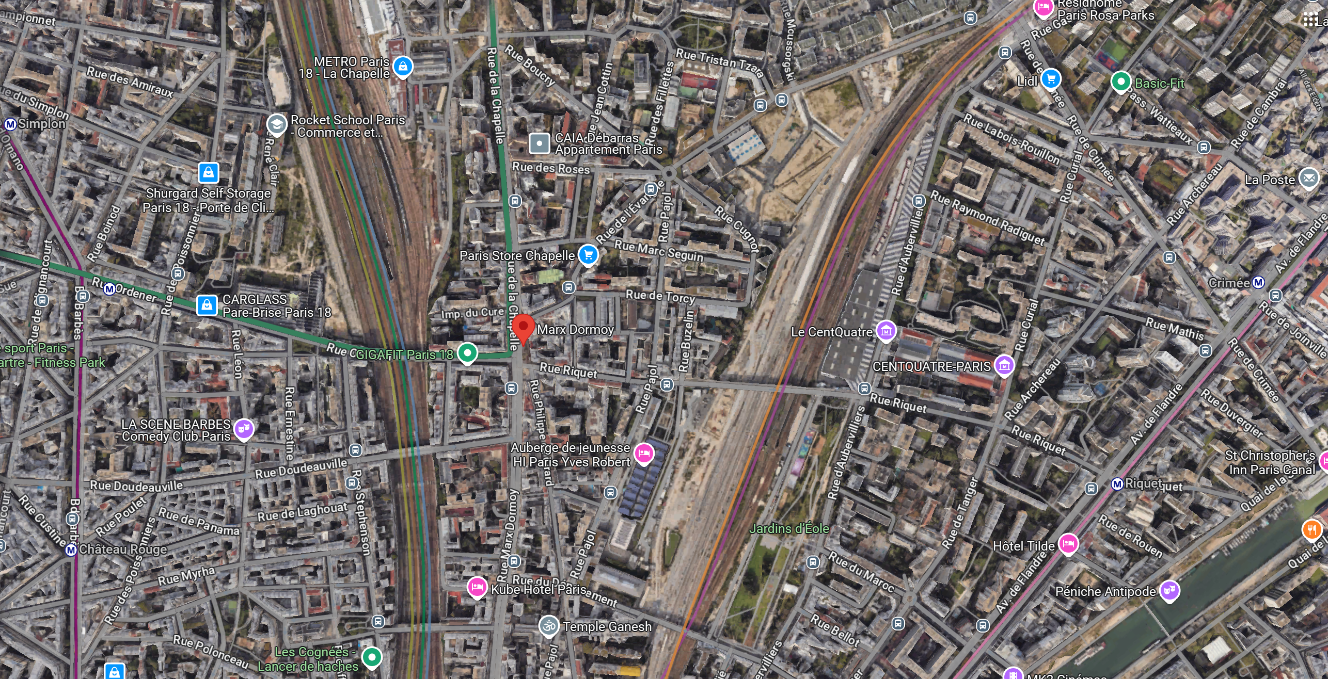
HOW WOULD YOU CHARACTERIZE THIS NEIGHBORHOOD?

Slide 21
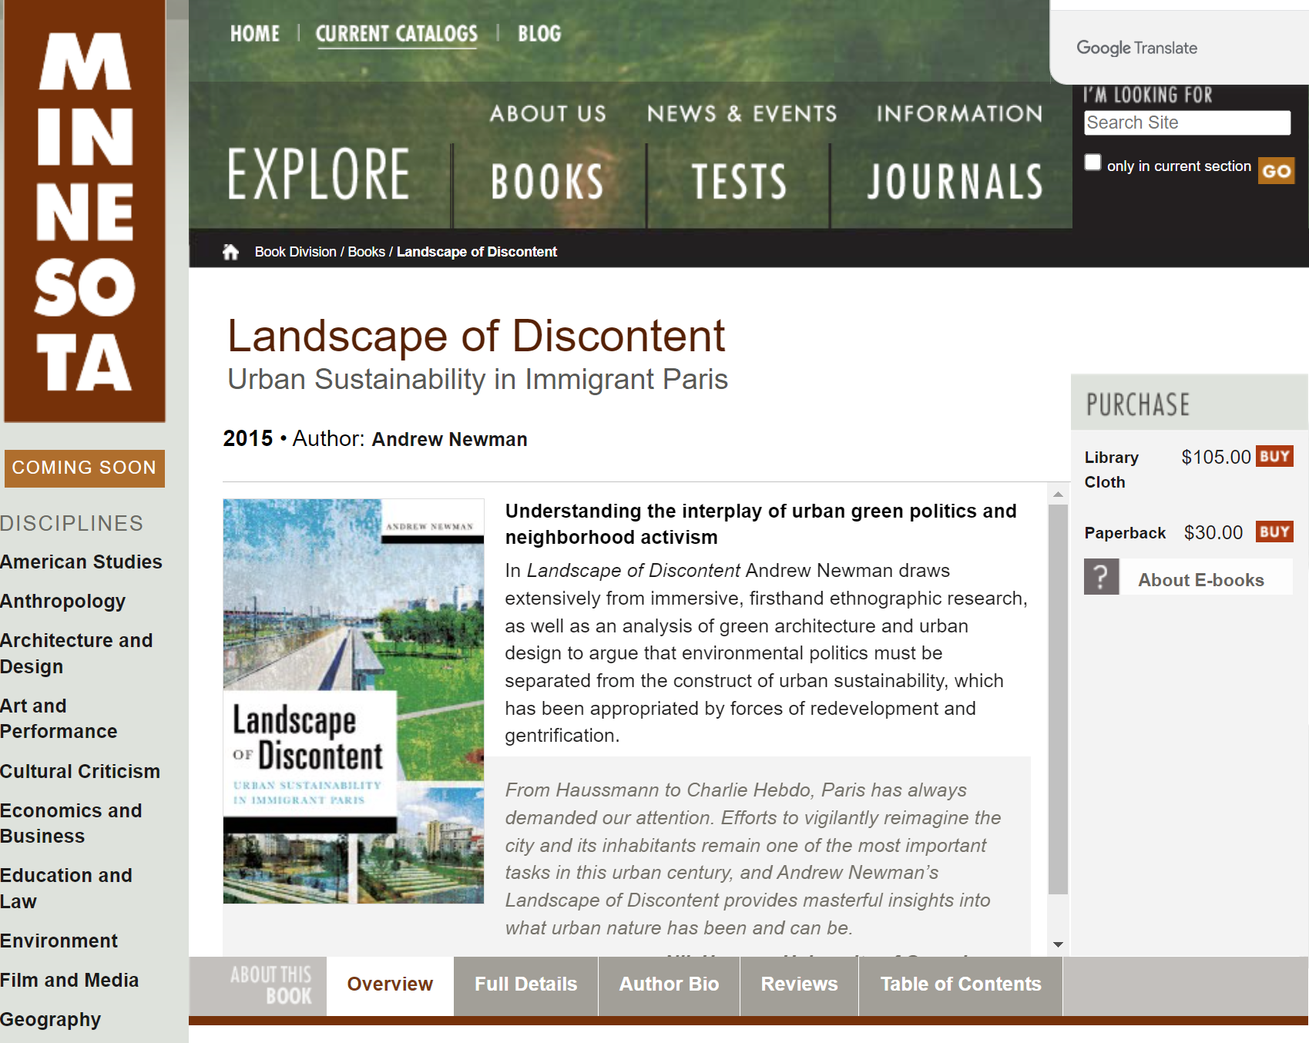

Slide 22
Chapter 1: Poets and locomotives
“The history of northeast Paris is one of urbanization defined by the struggle over the right to the city: that is, conflict between and among varying groups of city dwellers (as well as large institutions, landowners, and political elites) to control the rich economic, social, cultural, and imaginative value of urban space.” (4)
“In sum, I see the urban landscape as a complex assemblage that combines power and political struggle with the city’s built environment and infrastructure, as well as the biophysical processes of ecology and geomorphology (and even meteorological patterns, as we shall see).” (4-5)
“Implicitly or explicitly, ecological injustice has long been a – if not the – defining feature of this area throughout its history of urbanization.” (5)
Greening the city as a way of controlling it and policing it.
Example of the Jardins d’Eole (2007).

Slide 23
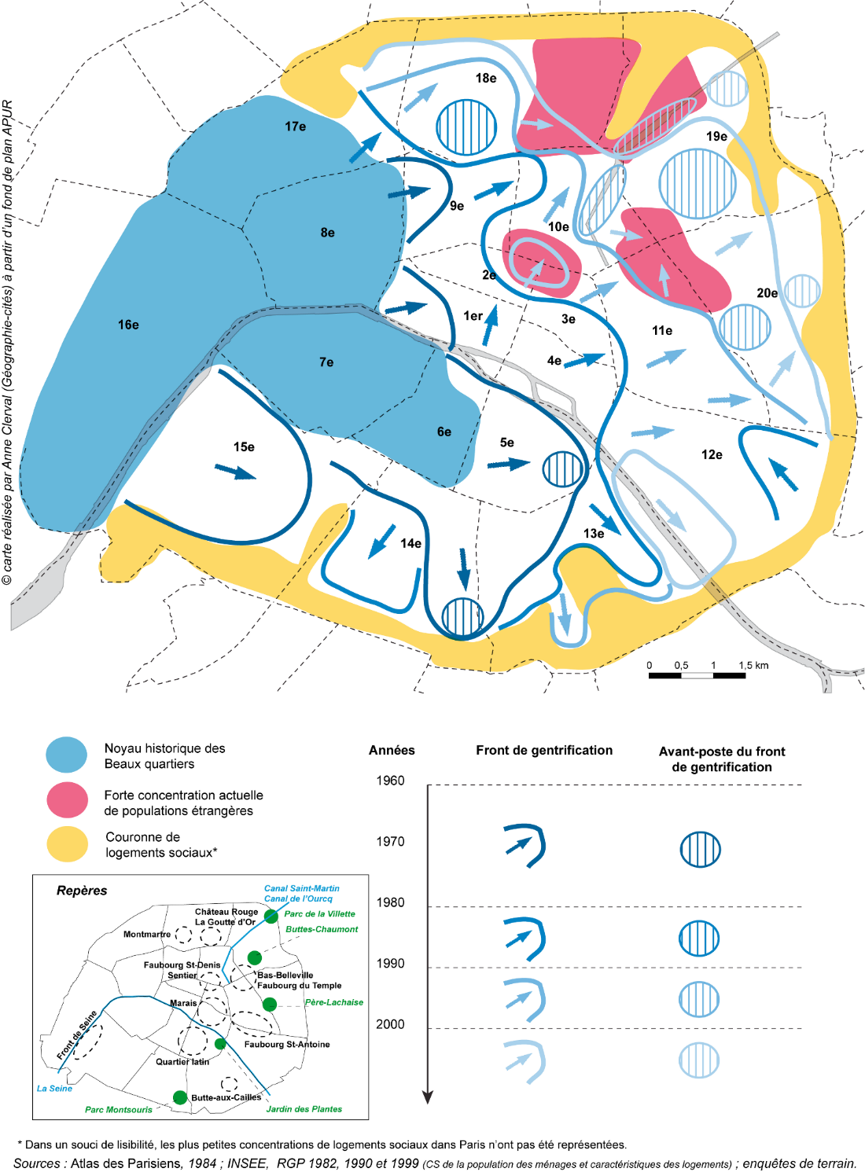

Slide 24
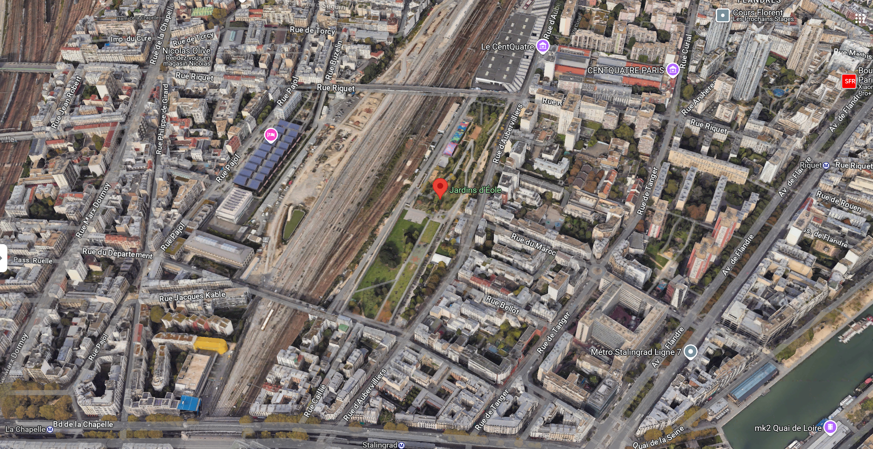

Slide 25
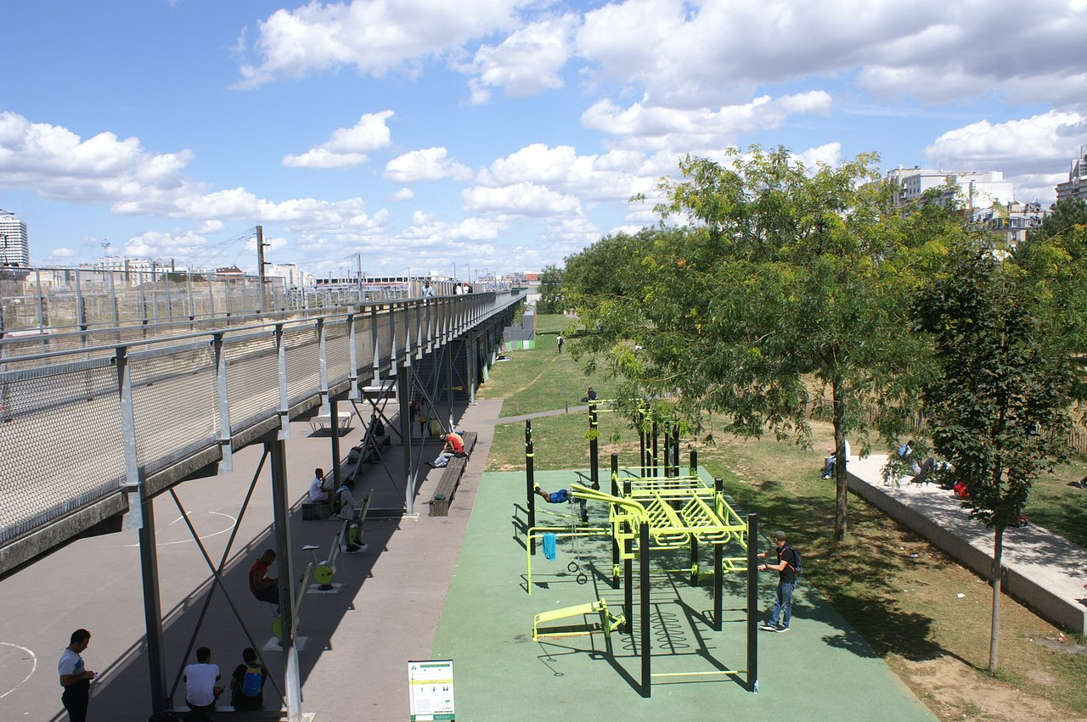
Jardins d’Eole (2007)

Slide 26
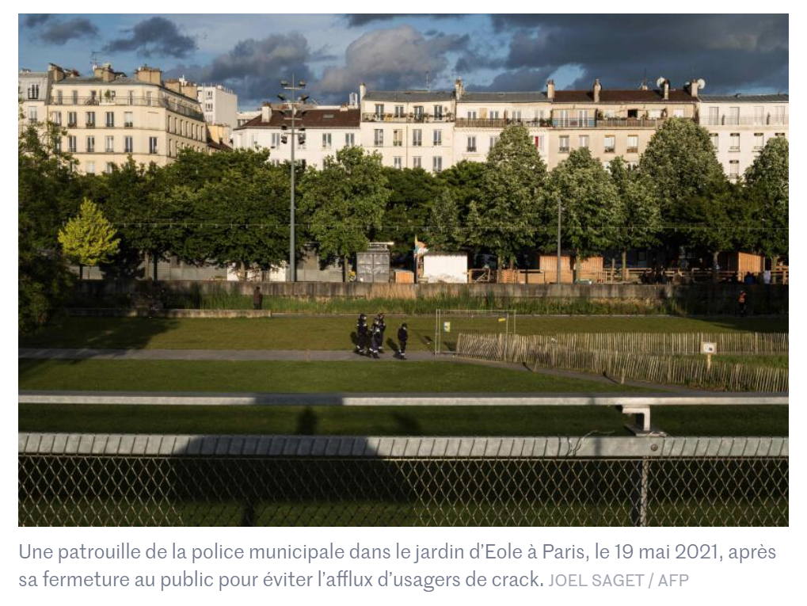

Slide 27
The petite ceinture

Slide 29
Vacant but not uninhabited
“Ecological prospects of urban vacancy” (Foster, 2014).
“Socio-cultural opportunities that vacancy enables and illuminates the contradictions of both managing vacant lands in the name of biodiversity and accommodating public access in the name of nature appreciation” (Foster, 2014).
Petite ceinture “enables forms of inhabitation that disrupt the dominant logic of urban development” (Foster, 2014).
Contested spaces in terms of their current uses and possible futures

Slide 30
Social value of terrain vague (1)
Complexity: open and closed, forbidden yet transgressed
Terrain vagues vs. Dominant logic of urban development
Unproductive
Places where alternative social assemblages are possible
Where sub-proletariat and homeless people find material subsistence
Green spaces: not encompassed within urban beautification programs, not associated with identifiable designers
« They disturb the dominant scenic or picturesque aesthetics of western parks, and convey no moral lessons through their design. Rather, these are places primarily shaped spontaneously by the independent agency of nature, wehre surface faults are exploited, old machinery and buildings ferment, and water pools at will. This is to say, they provide pockets of self-sustaining vegetation, range for wildlife, and connections to other habitat. » (Foster, 2014:3)

Slide 31
Social value of terrain vague (2)
“Recognizing the values of vacant land not as uninhabited, but rather as terrain vague, with rich possibilities that do not necessarily require intensively coordinated planning and design strategies – as land that is already making vital and creative contributions to ecological and social resilience and vibrancy – is critical to progressive interprétations of urban sustainability.” (3)
Ecological value: flora and fauna refuges, urban biodiversity, carbon sequestration, heat island effect...
Environmental justice value: Reduce inequities relating to access to nature
Social dimensions: value of “vacancies” for activities that might not conform with conventional greenspace preferences. Allowing less regulation and reduced surveillance, creative expression, shelter and home building, sexual activity, illicit substance use (Foster, 2014:4).
“Ecological self-determination” vs. Planners/designers

Slide 33
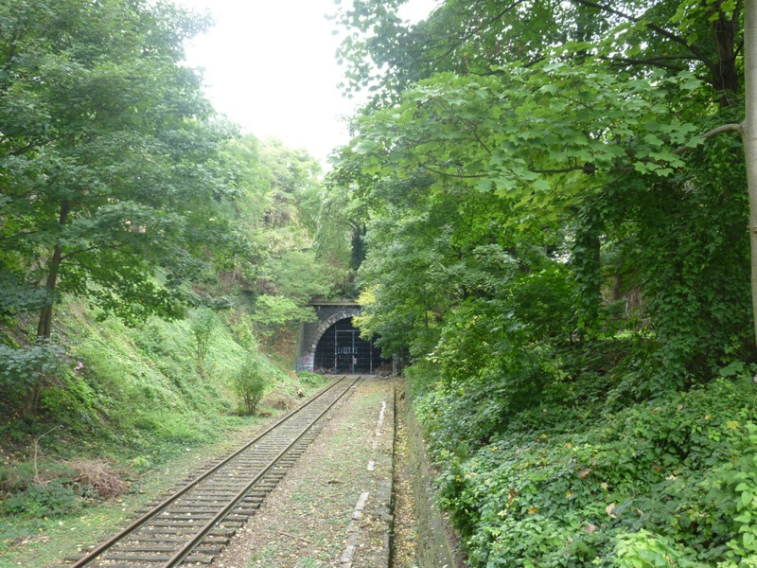
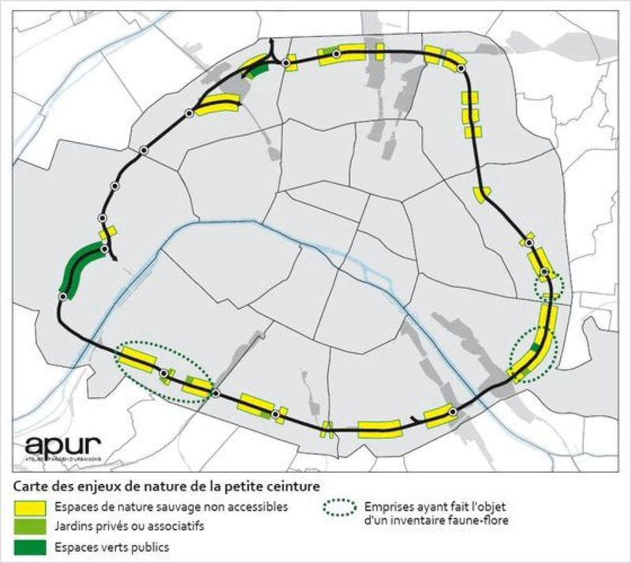

Slide 34
Green/carbon gentrification
Green gentrification: “The premiums placed on neighbourhood amenities – such as walkability, public transport and the proximity of parks, farmers’ markets and ‘greenways’ such as hiking trails and bike paths – by residents who can afford to pursue them raise the cost of living.” (Wachsmuth, Aldana Cohen & Angelo, 2016: 392).
“Middle- and upper-income residents’ preference for neighborhoods that offer the opportunity to walk, bike and ride transit in a mixed-use, dense urban environment, as a means to lower their carbon footprint, which are often, but not always, centrally located in urban areas, leading to a rise in housing prices for those areas.” (Rice, Long, Aldana Cohen & Jurjevich, 2019:6)
“The idea that by biking to work, walking to dinner and living in a dense urban environment, urban residents can ‘do their part’ in the fight against climate change, may also mean that these actions are driving up housing values in neighborhoods perceived as being low-carbon.” (Rice, Long, Aldana Cohen & Jurjevich, 2019:6).
Parks, cycle lanes, etc… can contribute to the gentrification process.

