Slide 1
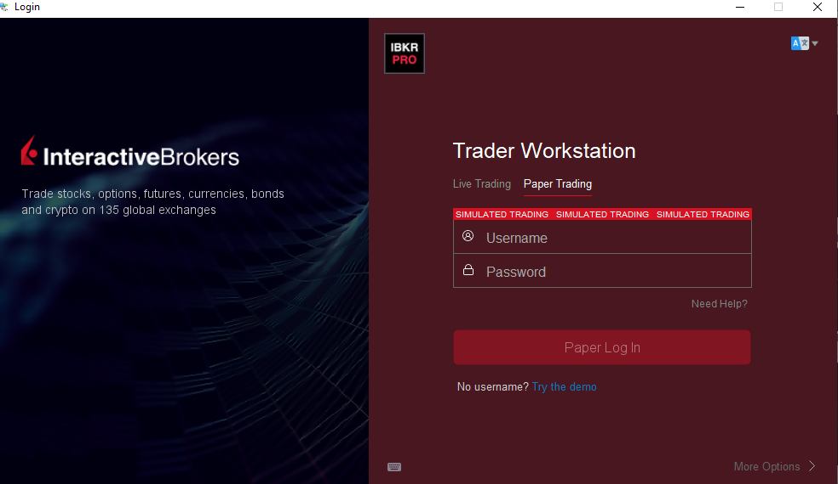

Slide 2
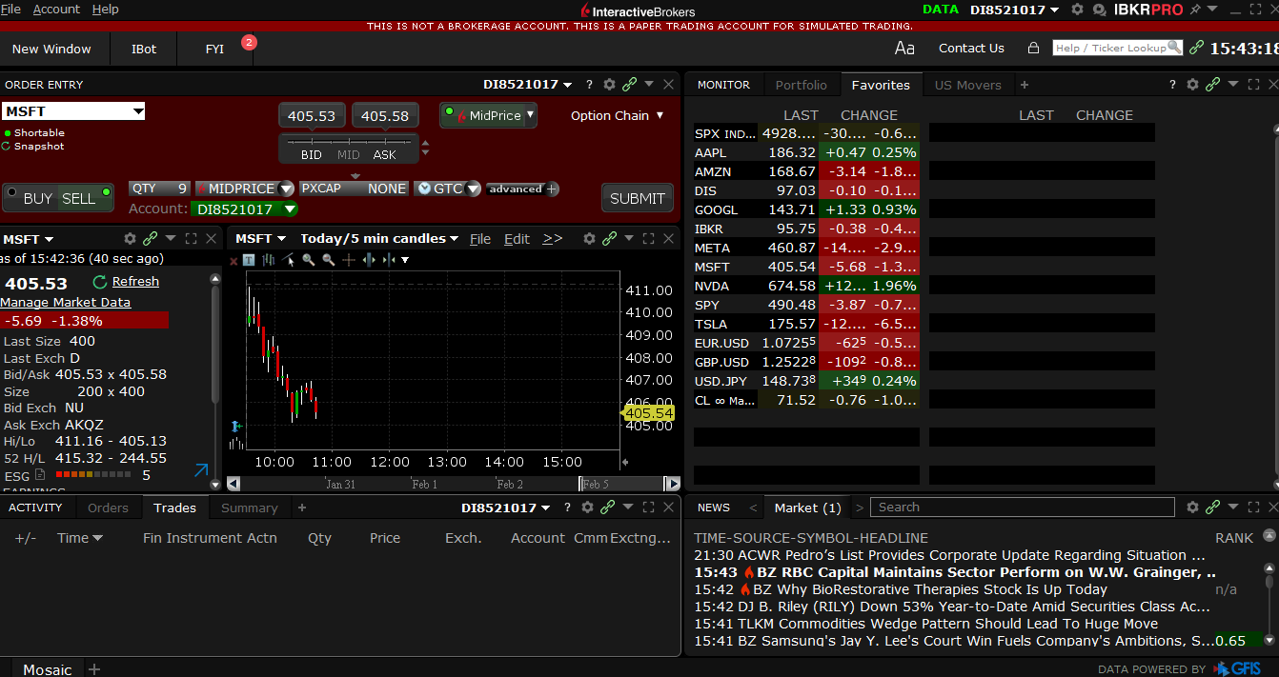

Slide 3
Some terminology
Market order: immediately at the best price available
Limit order: at a specified price
Buy – or take a long position
Sell – take a short position
Bid and ask price:
Bid price – highest price offered for a stock/security on the market
Ask price – lowest price a seller is willing to accept
Bid-Ask Spread
The cheapest order to sell is always higher than the highest order to buy.

Slide 4
Some terminology
What is traded on financial markets ?
Equity: stocks/shares of a public company
Fixed Income: Bonds (secured, unsecured; personal, commercial, governmental)
Foreign currencies (FX)
Derivatives: Options, Futures, Swaps, e.g. Contracts for Difference (CFD)
Crypto

