Slide 1
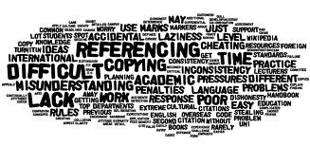
Understanding academic integrity and generative AI
Chenée Psaros, Rosella D’Alesio
Senior Academic Skills Advisers

Slide 2
Session outline
Recognise what we mean by academic integrity
Differentiate between different types of academic misconduct
Appreciate why academic integrity is important
Practical steps to avoid collusion and plagiarism
Recognise good academic practice?
- Quoting, summarising, paraphrasing
Generative AI and tools to help develop your writing

Slide 3
QUIZ in Mentimeter

Slide 4
What is academic integrity?

Slide 5
What is academic integrity?
student’s responsibility

Slide 6
What is academic integrity?
student’s responsibility
comply with the university’s standards and requirements

Slide 7
What is academic integrity?
student’s responsibility
comply with the university’s standards and requirements
avoid undermining the fundamental values of the academic community

Slide 8
What is academic integrity?
student’s responsibility
comply with the university’s standards and requirements
avoid undermining the fundamental values of the academic community
variety of resources
Academic Misconduct Policy 22/23

Slide 9
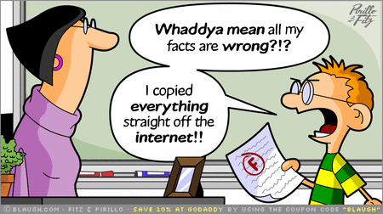
Consequences
Difference between poor academic practice vs serious misconduct…

Slide 10
Consequences
Difference between poor academic practice vs serious misconduct…
intentionality

Slide 11
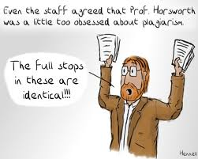
Consequences
But we aren’t out to get you!
Being at university is about learning beyond the content of your course.

Slide 12
Consequences
But we aren’t out to get you!
Being at university is about learning beyond the content of your course.

Slide 13
Types of misconduct
Academic misconduct at QMUL is categorised into these areas:
cheating through deception
cheating by fraud (contract cheating)
collusion
plagiarism

Slide 14
Which of the following examples are contract cheating?
purchasing or commissioning an assessment from a professional writing service or third party and presenting it as your own
using a third party to share solutions to equations, coding and formulas
commissioning a third party to translate an assessment from one language to another
using Google translate
the use of a professional proofreading service to check spelling and grammar and edit changes
giving your university credentials to companies who claim to support you in an exam
asking a friend to edit your work
Write the numbers in the chat

Slide 15
Which of the following examples are contract cheating?
purchasing or commissioning an assessment from a professional writing service or third party and presenting it as your own
using a third party to share solutions to equations, coding and formulas
commissioning a third party to translate an assessment from one language to another
using Google translate
the use of a professional proofreading service to check spelling and grammar and edit changes
giving your university credentials to companies who claim to support you in an exam
asking a friend to edit your work
Notes:
1,2, 3, 5, 6. INTENTIONAL and involves MONEY. “Includes purchasing or commissioning an assessment from a professional writing service or third party and presenting it as your own and commissioning a third party to translate an assessment from one language to another. It also includes the use of a professional writing service or third party to edit an assessment or parts of it to cause changes to the structure or content.

Slide 16
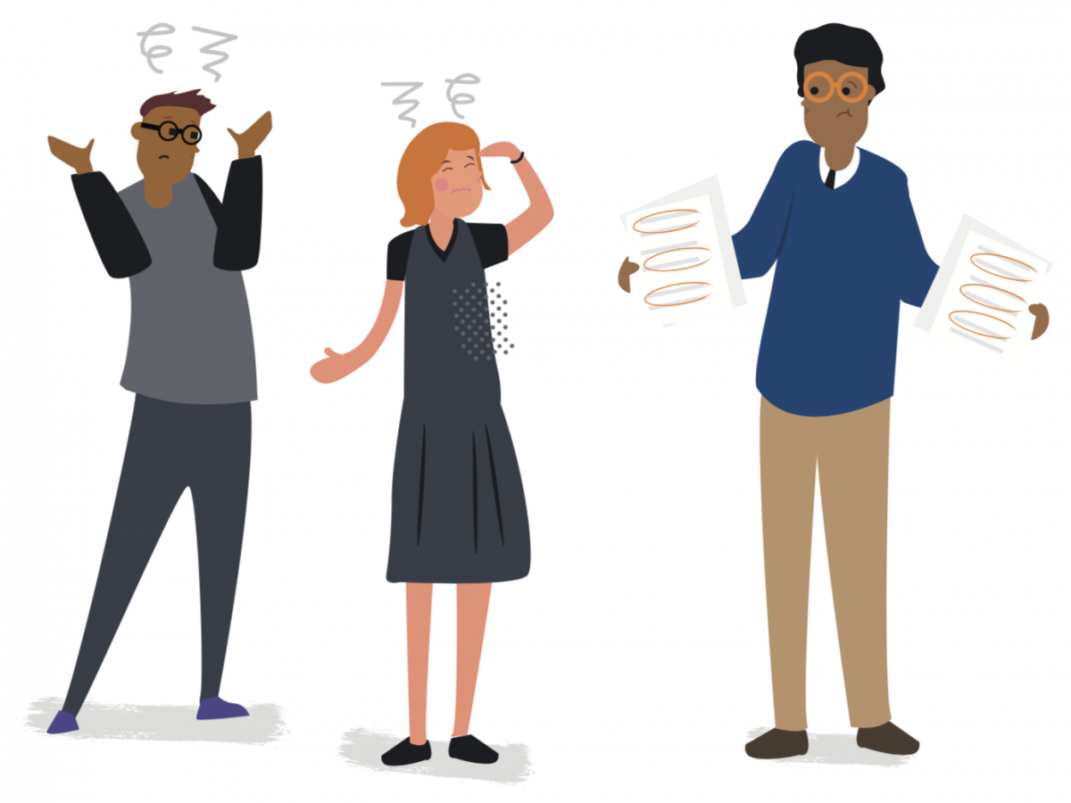
Queen Mary’s definition of collusion
Queen Mary defines ‘collusion’ as any illegitimate cooperation between students in the preparation or production of submitted work, irrespective of intention. Unless such joint work is explicitly permitted by the relevant assessment guidance, students are obliged to ensure that any work submitted for individual assessment is entirely their own. Legitimate academic cooperation between students, such as study groups, is not considered to be collusion
Academic Misconduct Policy 22/23

Slide 17
QUIZ in Menti
Is it collusion if….
You ask your friend to correct your spelling and grammar?
Post an exam paper on a website?
Work with a friend, share notes, discuss structure and arguments and then write up separately?

Slide 18
Collusion | Cooperation
Planning a response together; copying a plan for an individual assessment. | Analysing the assessment question together (for an assignment not an exam)
Paraphrasing someone else's assignment and submitting it as your own. | Practising paraphrasing skills together and sharing tips.
Relying on some group members to do all the work. | Sharing work evenly among group members.
Getting someone else to edit your assessment task. | Getting help from a tutor

Slide 19
Queen Mary’s definition of plagiarism
Queen Mary defines ‘plagiarism’ as presenting someone else’s work as one’s own, irrespective of intention. Close paraphrasing; copying from the work of another person, including another student; using the ideas of another person without proper acknowledgement; and repeating work that you have previously submitted – at Queen Mary or at another institution – without properly referencing yourself (known as ‘self-plagiarism’) also constitute plagiarism.
Academic Misconduct Policy 22/23

Slide 20
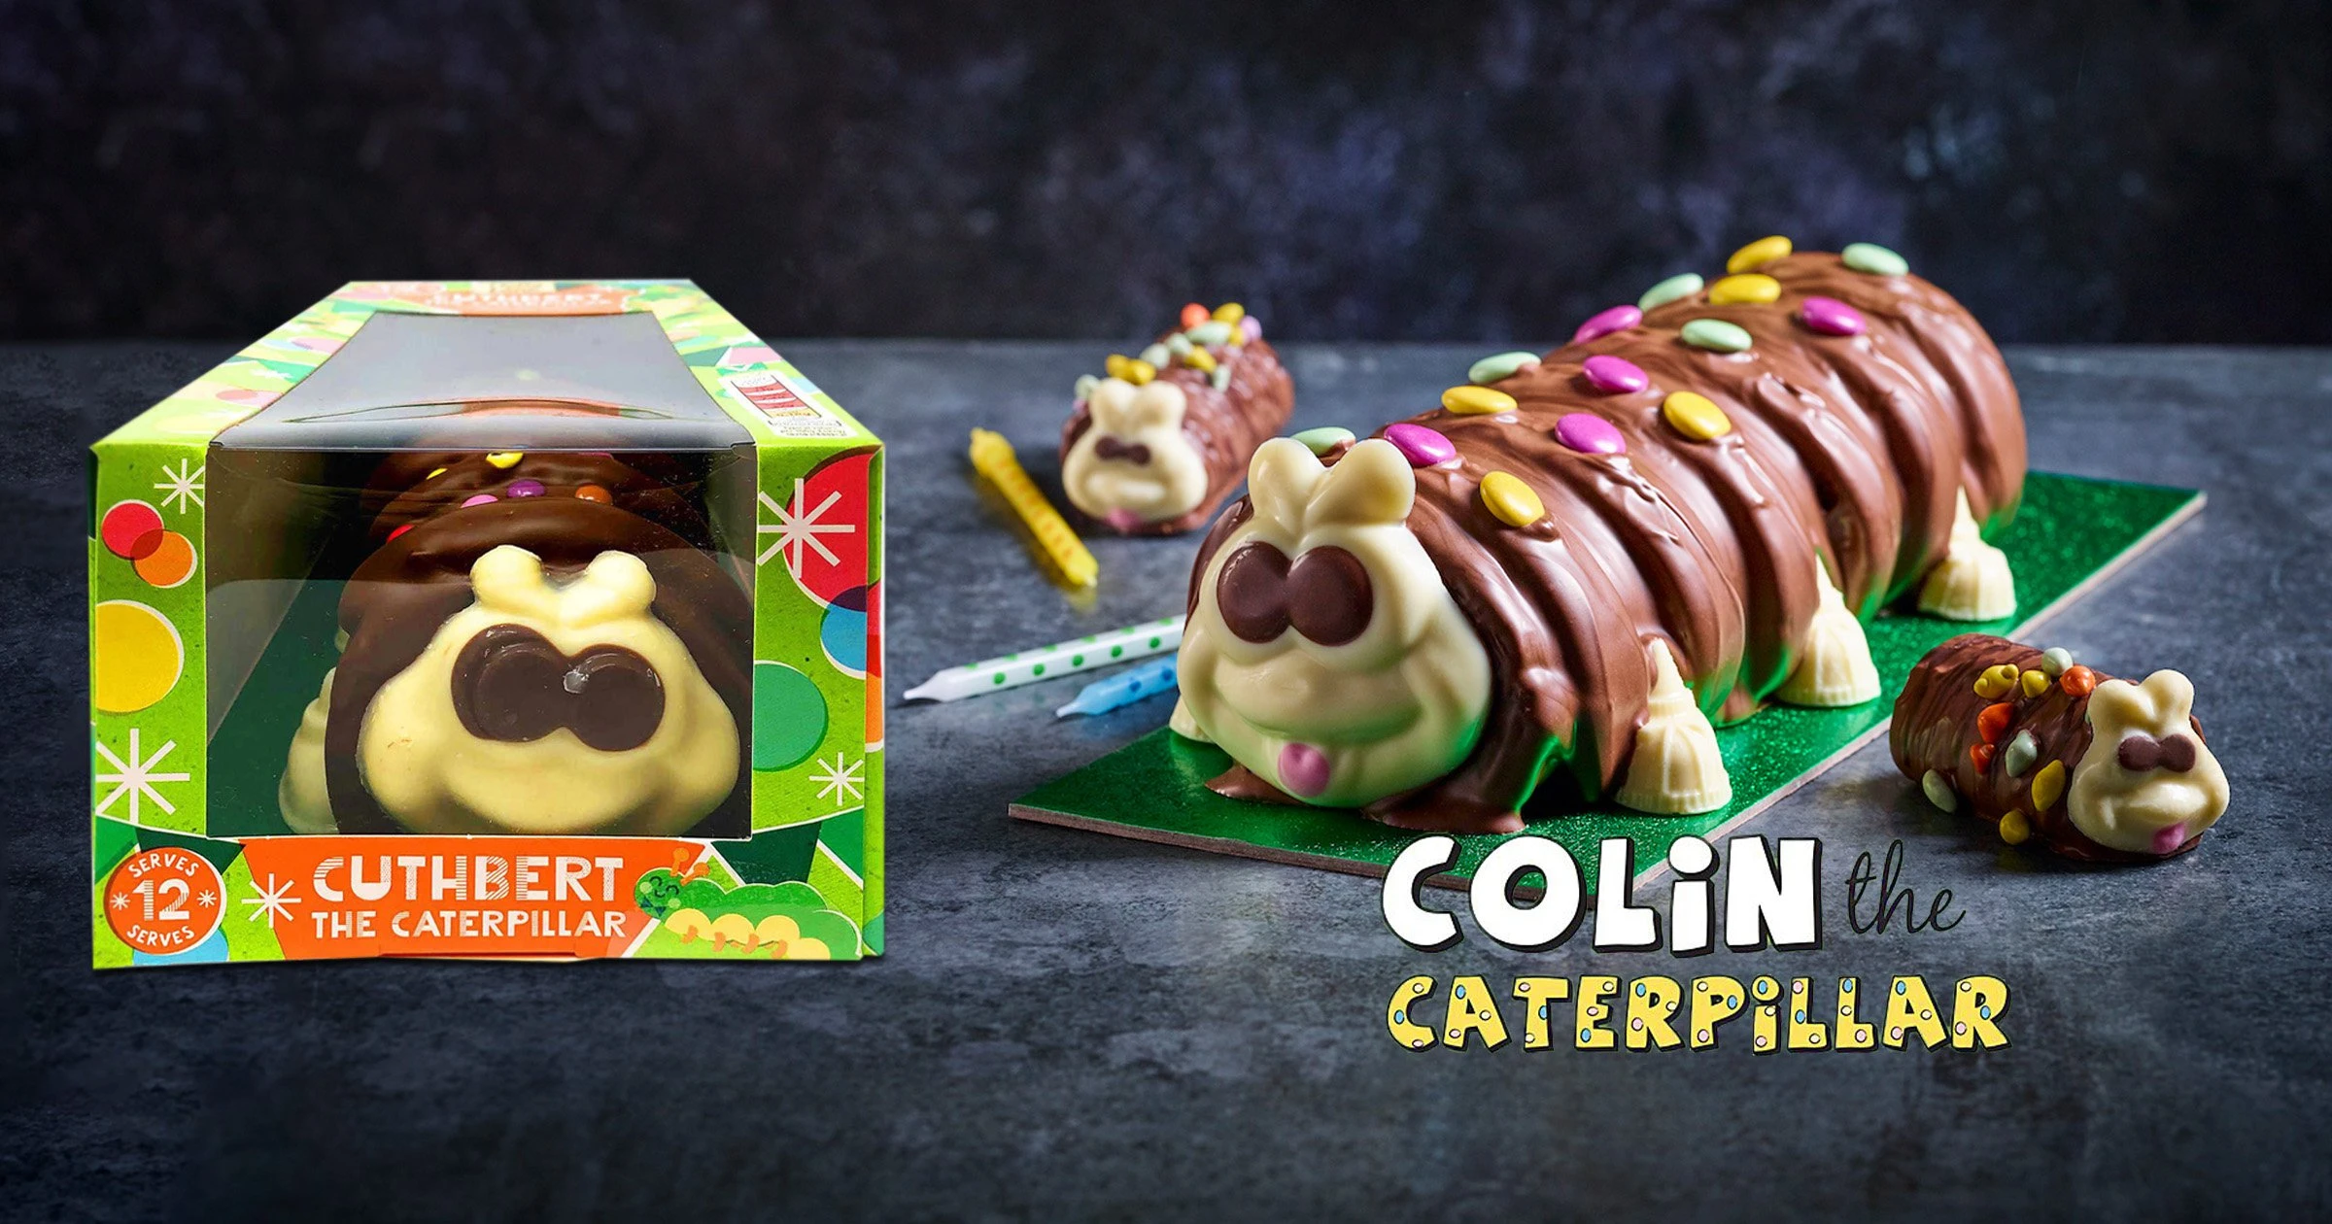
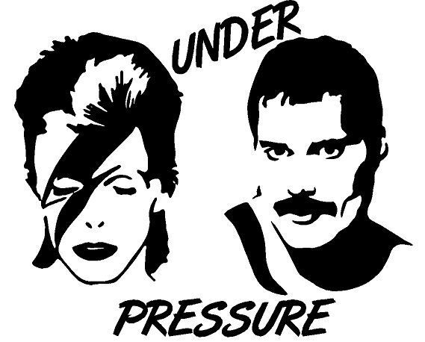
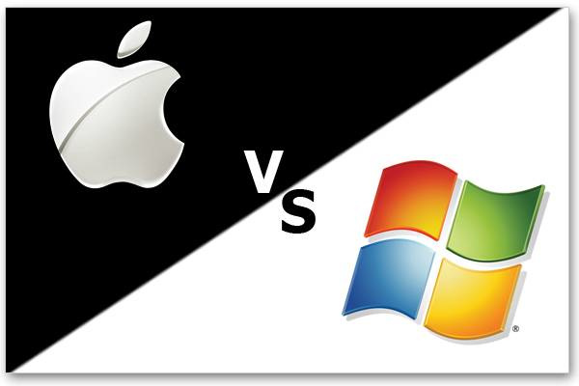
Colin The Caterpillar (2021) M&S took Aldi to court for selling Cuthbert the caterpillar, ongoing.
Why plagiarism matters beyond university
Hoover had to remove product from sale (2000)
Apple And Microsoft IP War (1997), $100 Million in damages to Apple
Estates of Queen And David Bowie (2019), had to pay John Deacon $5m
Notes:
https://consumeradvisory.co.uk/famous-copyright-cases/

Slide 21
QUIZ Menti
Have you ever plagiarised by accident
Have you ever plagiarised on purpose
Are you confident you’ll be able to avoid plagiarism

Slide 22
Which of the following would be considered as plagiarism?
Not providing a reference when you have used somebody’s idea because you could not remember where you read it.
Copying a paragraph, replacing a few words with synonyms, and giving a reference.
Not giving a reference when you use ‘common knowledge’
DNA carries genetic information and has a double helix structure
Joe Biden is the 46th President of the United States but only the 45th person to hold the position
Using an essay you wrote previously but changing some of it to make it fit the topic.
A large percentage of your essay consists of quotation from the same source, correctly formatted and referenced.
Write the numbers in the chat

Slide 23
Which of the following would be considered as plagiarism?
Not providing a reference when you have used somebody’s idea because you could not remember where you read it.
Copying a paragraph, replacing a few words with synonyms, and giving a reference.
Not giving a reference when you use ‘common knowledge’
DNA carries genetic information and has a double helix structure
Joe Biden is the 46th President of the United States but only the 45th person to hold the position
Using an essay you wrote previously but changing some of it to make it fit the topic.
A large percentage of your essay consists of quotation from the same source, correctly formatted and referenced.

Slide 24
How and why do you think academic misconduct happens?
Write your answers in the chat

Slide 25
Why might people cheat?
Possible reasons include:
Time pressure or poor planning, e.g. rushing to meet a deadline might cause one to cut corners.
Not understanding own notes or taking poor notes, e.g. mixing up own ideas with notes taken from other sources.
Lack of subject knowledge or understanding may make an assignment seem overwhelming.
Ignorance of citation (referencing) rules – this is treated just as severely as deliberate plagiarism.
Not being able to express another author's ideas in one's own words.
The unacknowledged use of material prepared by several persons working together (collusion).
Laziness

Slide 26
Quoting, paraphrasing and summarising
Quoting
Paraphrasing
Summarising

Slide 27
Quoting, paraphrasing and summarising
Quoting
Paraphrasing
Summarising
‘…involves using the exact words of a writer and beginning and ending the section text with quotation marks.’

Slide 28
Quoting, paraphrasing and summarising
Quoting
Paraphrasing
Summarising
‘…involves using the exact words of a writer and beginning and ending the section text with quotation marks.’
…involves changing a text so that it is different in terms of vocabulary and sentence structure, while retaining the meaning.

Slide 29
Quoting, paraphrasing and summarising
Quoting
Paraphrasing
Summarising
‘…involves using the exact words of a writer and beginning and ending the section text with quotation marks.’
…involves changing a text so that it is different in terms of vocabulary and sentence structure, while retaining the meaning.
...involves outlining key points of a longer piece of work.

Slide 30
Paraphrasing
The following text represents the original source
Source: Extracted from Renaud, J., Russell, J. J., and Myhr, G. (2014). Predicting who benefits most from cognitive-behavioral therapy for anxiety and depression. Journal of Clinical Psychology 70(10).
Although the effectiveness of cognitive-behavioral therapy (CBT) for depression and anxiety disorders is no longer a matter of debate, the struggle to account for variability in patient outcomes continues. Despite efforts to identify putative factors associated with treatment outcomes, few studies have been designed to explicitly investigate the role of pretreatment patient factors in predicting CBT outcomes. The present study aims to address this gap in the literature by examining the role of a broad range of suitability characteristics to determine for whom CBT is more beneficial.
Is this plagiarism?
The effectiveness of cognitive-behavioral therapy (CBT) for anxiety and depression is no longer debated but variability in patient outcomes is difficult to establish (Renaud et al, 2014).

Slide 31
Paraphrasing
The following text represents the original source
Source: Extracted from Renaud, J., Russell, J. J., and Myhr, G. (2014). Predicting who benefits most from cognitive-behavioral therapy for anxiety and depression. Journal of Clinical Psychology 70(10).
Although the effectiveness of cognitive-behavioral therapy (CBT) for depression and anxiety disorders is no longer a matter of debate, the struggle to account for variability in patient outcomes continues. Despite efforts to identify putative factors associated with treatment outcomes, few studies have been designed to explicitly investigate the role of pretreatment patient factors in predicting CBT outcomes. The present study aims to address this gap in the literature by examining the role of a broad range of suitability characteristics to determine for whom CBT is more beneficial.
Is this plagiarism?
The effectiveness of cognitive-behavioral therapy (CBT) for anxiety and depression is no longer debated but variability in patient outcomes is difficult to establish (Renaud et al, 2014).

Slide 32
Paraphrasing
The following text represents the original source
Source: Extracted from Renaud, J., Russell, J. J., and Myhr, G. (2014). Predicting who benefits most from cognitive-behavioral therapy for anxiety and depression. Journal of Clinical Psychology 70(10).
Although the effectiveness of cognitive-behavioral therapy (CBT) for depression and anxiety disorders is no longer a matter of debate, the struggle to account for variability in patient outcomes continues. Despite efforts to identify putative factors associated with treatment outcomes, few studies have been designed to explicitly investigate the role of pretreatment patient factors in predicting CBT outcomes. The present study aims to address this gap in the literature by examining the role of a broad range of suitability characteristics to determine for whom CBT is more beneficial.
Is this plagiarism?
Outcomes for the treatment of depression and anxiety using cognitive-behavioral therapy (CBT) are inconsistent. In the study, patient pre-treatment characteristics are explored, how they are likely to influence outcomes of CBT, and whether it is useful.

Slide 33
Paraphrasing
The following text represents the original source
Source: Extracted from Renaud, J., Russell, J. J., and Myhr, G. (2014). Predicting who benefits most from cognitive-behavioral therapy for anxiety and depression. Journal of Clinical Psychology 70(10).
Although the effectiveness of cognitive-behavioral therapy (CBT) for depression and anxiety disorders is no longer a matter of debate, the struggle to account for variability in patient outcomes continues. Despite efforts to identify putative factors associated with treatment outcomes, few studies have been designed to explicitly investigate the role of pretreatment patient factors in predicting CBT outcomes. The present study aims to address this gap in the literature by examining the role of a broad range of suitability characteristics to determine for whom CBT is more beneficial.
Is this plagiarism?
Outcomes for the treatment of depression and anxiety using cognitive-behavioral therapy (CBT) are inconsistent. In the study, patient pre-treatment characteristics are explored, how they are likely to influence outcomes of CBT, and whether it is useful.

Slide 34
Paraphrasing
The following text represents the original source
Source: Extracted from Renaud, J., Russell, J. J., and Myhr, G. (2014). Predicting who benefits most from cognitive-behavioral therapy for anxiety and depression. Journal of Clinical Psychology 70(10).
Although the effectiveness of cognitive-behavioral therapy (CBT) for depression and anxiety disorders is no longer a matter of debate, the struggle to account for variability in patient outcomes continues. Despite efforts to identify putative factors associated with treatment outcomes, few studies have been designed to explicitly investigate the role of pretreatment patient factors in predicting CBT outcomes. The present study aims to address this gap in the literature by examining the role of a broad range of suitability characteristics to determine for whom CBT is more beneficial.
Is this plagiarism?
For patients suffering from anxiety and depression cognitive-behavioral therapy (CBT) can be an effective form of treatment. These patients should be assessed before treatment to ensure that they demonstrate the Capacity for Participation and have Attitudes Relevant to the CBT Process (Renaud et al, 2014).

Slide 35
Paraphrasing
The following text represents the original source
Source: Extracted from Renaud, J., Russell, J. J., and Myhr, G. (2014). Predicting who benefits most from cognitive-behavioral therapy for anxiety and depression. Journal of Clinical Psychology 70(10).
Although the effectiveness of cognitive-behavioral therapy (CBT) for depression and anxiety disorders is no longer a matter of debate, the struggle to account for variability in patient outcomes continues. Despite efforts to identify putative factors associated with treatment outcomes, few studies have been designed to explicitly investigate the role of pretreatment patient factors in predicting CBT outcomes. The present study aims to address this gap in the literature by examining the role of a broad range of suitability characteristics to determine for whom CBT is more beneficial.
Is this plagiarism?
For patients suffering from anxiety and depression cognitive-behavioral therapy (CBT) can be an effective form of treatment. These patients should be assessed before treatment to ensure that they demonstrate the Capacity for Participation and have Attitudes Relevant to the CBT Process (Renaud et al, 2014).

Slide 36
So how do you avoid plagiarism?
Good academic practice
Using appropriate sources to support your own work
Taking notes and making a record of the sources used
Paraphrasing and summarising properly
Referencing correctly
Using available resources to help you check your own work

Slide 37
Have you used any of these services to help you write your assignments?
Quillbot
Grammarly
ChatGPT or Bard
Google Translate

Slide 38
Discussion: How can you use artificial intelligence in your studies? (5 minutes)

Slide 39
How you CAN use artificial intelligence in your studies?
As an assistive technology – for example text to speech
For exams and revision – summarising notes, exploring general ideas
To generate text examples – critique text that has been generated
For helping you think more critically
To help you plan your time/processes
Practicing ‘prompt engineering’

Slide 40
How you CAN use artificial intelligence in your studies?
As an assistive technology – for example text to speech
For exams and revision – summarising notes, exploring general ideas
To generate text examples – critique text that has been generated
For helping you think more critically
To help you plan your time/processes
Practicing ‘prompt engineering’
Remember, everything you submit must be your own work!

Slide 41
Discussion: What are the limitations (at the moment) of using artificial intelligence? (5 minutes)

Slide 42
What CAN I do with Generative AI?
Generative AI can help you with:
Understanding a topic
Can give explanations in plain wording and provide more examples
Inspiration or exploring general ideas for a topic
Planning and structuring logic of your work
Generating summaries of your notes for revision
Although note that this means that your notes will become the intellectual property of the genAI programme
Helping you think critically as you evaluate the information provided by generative AI

Slide 43
What do I do if I use Generative AI?
You MUST cite Generative AI appropriately (see https://apastyle.apa.org/blog/how-to-cite-chatgpt)
You MUST include a copy of the full-text response provided by Gen Ai as an appendix.
Appendix will not count towards your word count

Slide 44
Why must I include a copy of full-text output response of genAI output?
To demonstrate that you used GenAI in your coursework
Not citing GenAI and including the source material would be considered academic misconduct.
To demonstrate how you used GenAI in your coursework
How you translated the output into your own thoughts and provided valid academic sources for the information.

Slide 45
Discussion: What are the limitations (at the moment) of using artificial intelligence?
Not up to date
AI tools cannot “understand" the prompts given
Artificial Intelligence hallucination: generate content that is not based on any real-world data
Limited access to data
Not capable of original thinking
Limited critical evaluation
Potential biases
Ethics

Slide 46
What can I NOT do with Generative AI
Like Wikipedia and Google, Generative AI is not an appropriate scientific source: it is not peer reviewed/evaluated for accuracy
You MUST find valid, reputable source of information provided
You cannot copy large pieces of text from any source, including AI
You MUST rewrite in your own words and cite the source (Gen AI and scientific source)

Slide 47
What happens if I use generative AI but do not acknowledge/use it appropriately?
It is academic misconduct
to submit coursework or exam answers that are not the product of your own words and thoughts.
This includes the use generative AI without appropriate citation/acknowledgement.
Please see QMUL Academic Misconduct Policy: https://arcs.qmul.ac.uk/students/student-appeals/academic-misconduct/

Slide 48
What happens if I use generative AI but do not acknowledge/use it appropriately?
Possible academic misconduct associated with unauthorized generative AI use includes (but not limited to):
Plagiarism -
Fraudulent reporting of source material
Eg) cite a source, but the source is actually generative AI
Eg) the source GenAI gave you is incorrect/does not exist
Ghost-writing
Concerns about a student’s unauthorized GenAI use will lead to an oral examination of their assessment

Slide 49
What happens if I use generative AI but do not acknowledge/use it appropriately?
If proven, potential consequences include:
Failing the assessment
with or without a chance to resubmit for the lowest passing mark
Failing the entire module
with or without chance to resit for the lowest passing mark
Capping all modules in the year to the lowest passing mark
Please see QMUL Academic Misconduct Policy for more detail on these consequences. The most likely outcome is failing the entire module.

Slide 50
Summary on maintaining academic integrity: make sure you…
record bibliographic details before making any notes
are able to distinguish between your ideas and those of others (and those presented by generative AI)
use paraphrasing/summarising and reserve quotations for when the wording itself is important
use APA, cite and provide references for all sources that you use
demonstrate how you used AI and include outputs in your appendix
seek clarification from tutors if you are unsure
consult online information (Google it!!!)

Slide 51
Questions?
Unmute or write them in the chat

