Slide 1
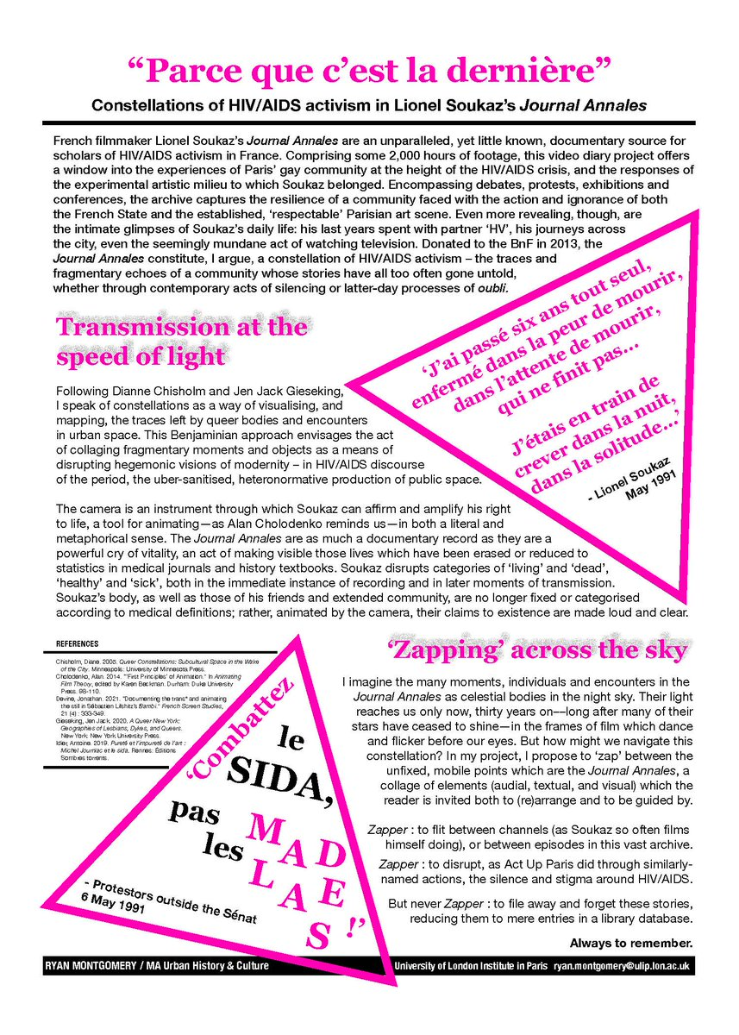
Ry Montgomery PhD at University of Cambridge
Research on Lionel Soukaz
‘Parce que c’est la dernière’

Slide 2
Elliott Evans, The body in French queer thought from Wittig to Preciado (London :Routledge, 2020), pp.2 – 6.
The works of Guibert emphasize the necessity of presenting the material body in all its vulnerability or recognizing the vulnerability of particular bodies - as vital to queer politics and thought. The French context, I will argue – through its literary, artistic and philosophical expression – is particular well-placed to reassess the direction of queer thought on the body.
Despite queer theory’s association with the material body through its roots in the AIDS crisis, it has since been criticized for failing to take account of this materiality. Leo Bersani’s Homos (1996) highlights the elision of sex in the work of Judith Butler, and raises the concern that ‘when we speak of gay rights, we are speaking of the rights for men whose primary erotic pleasure is taken from the bodies of other men, and for women whose primary erotic pleasure is taken from the bodies of other women (58)’
With regards to HIV / AIDS, work by Douglas Crimp, Susan Sontag, Simon Watney, and Leo Bersani elucidated the metaphors, discourses, and ideologies surrounding the illness. Sontag’s attempts, however, to abstain from or try to retire metaphors surrounding the body – a desire to strip the body of metaphor – contradict her much more persuasive assertion of the very same page that ‘one cannot think without metaphors’ (2002: 91)

Slide 3
Hervé Guibert, 1955 – 1991 AIDS, social identity and queer time

Slide 4
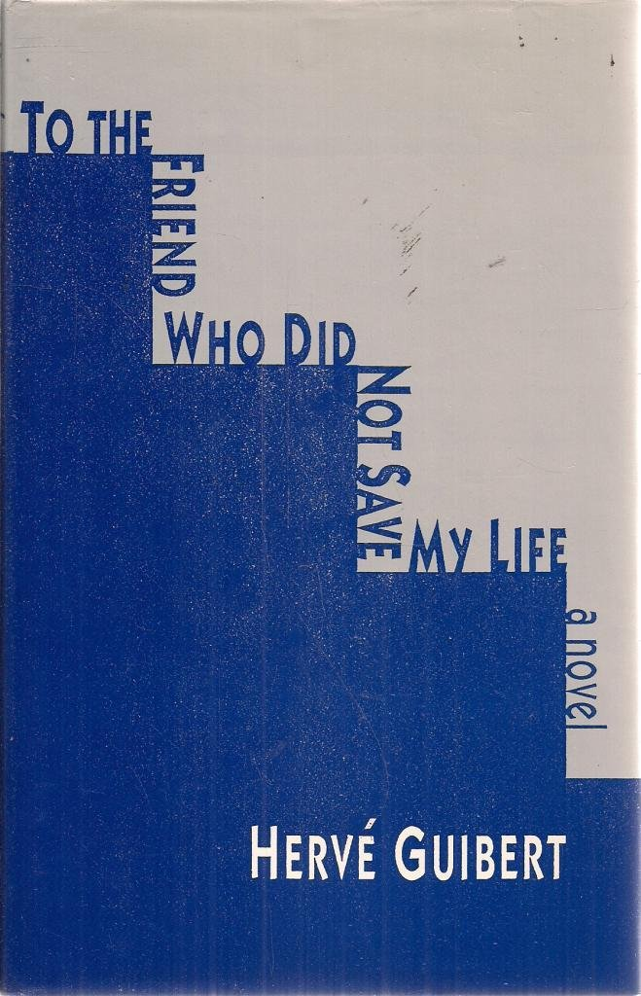

Slide 5
Perhaps part of what was so gripping about To the Friend Who Did Not Save My Life for its first readers was the visceral sense, not just of illness, but of a social identity undergoing such a brutal reconstruction. The newly inhabited social identity of being seropositive would involve an intimate experience of a particular relationship to power that people such as Guibert might never have experienced previously. Foucault’s elaboration of the form of power that he calls biopolitical is now well known. Guibert’s novels implicitly offer an account of what it means abruptly to become a subject of that regime of power […] What does it mean to be addressed not as an individual body, but as a global mass caught up in a process of illness? Guibert traces this experience in the way he describes himself, his body, as a container for blood, blood in which the medical establishment has a certain kind of interest that is separate from any interest it might have in Guibert.
Michael Lucey, Someone: the pragmatics of misfits (Chicago: the University of Chicago Press, 2019), pp.211- 212.

Slide 6
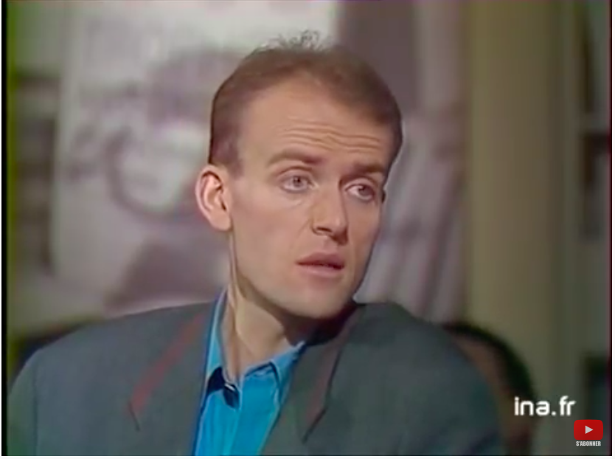
Apostrophes: Bernard Pivot, March 16 1990
After writing To the Friend Who Did Not Save My Life, Guibert made an appearance on Bernard Pivot’s television program, Apostrophes. The interview was broadcast on March 16, 1990. In the course of the interview, Guibert, quite ill, announced that he didn’t expect to write any more books. The result was that he began receiving a large number of letters from people who had seen the interview and/or had read To the Friend and who begged him to keep writing.
He meets readers while riding the bus. Readers send him cassettes, records, cashmere sweaters, perfume, books, and endless letters. “People were encouraging me to keep writing. The fervor of these strangers was beautiful” (154).
Notes:
https://www.youtube.com/watch?v=en9OWEvf_Cw&t=106s

Slide 7
New kinship structures?
Guibert’s success arrived in the moment between the publication of To the Friend Who Did Not Save My Life and that of The Compassion Protocol. “Now he had to face the thorny question of his relationship with a mainstream audience,” David Caron notes. “Was a kind of community possible with them at all?” It will come as no surprise that The Compassion Protocol has as a central concern Guibert’s newfound public and his way of being in touch— corresponding— with them.
What kind of commonality or intimacy could there be between them and him?
How would idiosyncrasy and unconventionality figure in this new situation?

Slide 8
Themes to discuss in today’s session
Serostatus as a ritually produced social identity (new kinship structures)
The visibility of the body
Narcissism
Salvation narratives
Betrayal – this is an act of textual revenge on Bill, the American business man whose laboratory promised to provide a drug that did not ultimately save his life

Slide 9
AIDS WRITING and survival through narrative
The impetus behind witnessing narrative is the desire to live to tell the tale. But witnessing also implies a second kind of faith in survival: that of the tale itself, beyond the personal death of its teller. This is a social survival, transcending the personal lifespan of the narrative's author. In the case of AIDS witness in the autobiographical mode, in which living to tell the tale implies telling the tale of one's dying, these two forms of sur- vival become melded into a single preoccupation, since surviving to tell the story makes sense only to the extent that it is predicated on the sur- vival of the story, whose narrating instance will give a social future to the deceased author. The writing thus tends to have the temporal structure of the future perfect tense (even more appropriately called "futur antérieur" in French): the personal survival of the author, however limited in time that survival may be, will have been a token of textual survival that the survival of the text, after its author's death, will retrospectively validate.

Slide 10
1. How does seropositivity become a form of social identity? (Chapter 49)

Slide 11
1. How does seropositivity become a form of social identity? Chapter 45

Slide 12
1. Kinship structures / new forms of ‘blood relatives’

Slide 13
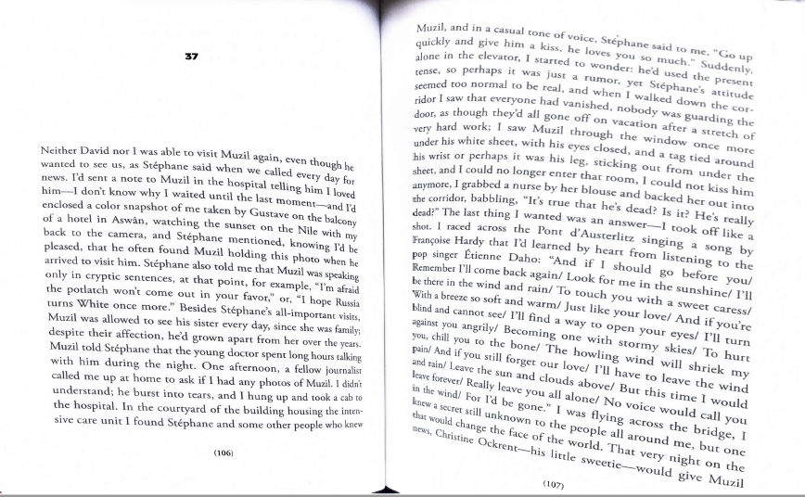

Slide 14
Analysis
The two friends find themselves both united and divided by the slow process of being assigned to this new social category
Fatalism
They are separated as they submit to this experience, undergoing a symmetrical ritual experience that seems to threaten to divide them as much as to bring them together.

Slide 15
2. The visibility of the body Circulation of the blood / social body (chapter 4)

Slide 16
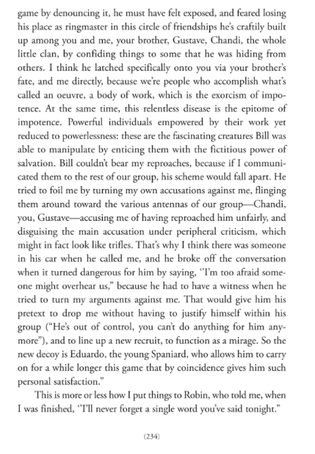
2. The visibility of the body (chapter 89)

Slide 17
2. The visibility of the body
“humiliated, lying naked for more than an hour . . . on a chilly metal table under a skylight where I could be seen by some workmen up on the roof, unable to call anyone because they’d forgotten all about me” (46, chapter 15)
“I’d hurled my body into something that seemed to strip it of a will of its own” (187, chapter 67)

Slide 18
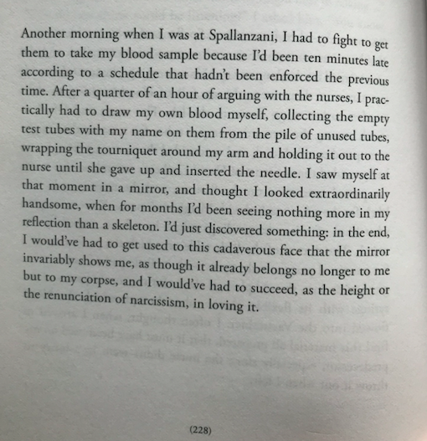
2/3. The visibility of the body / Narcissim (chapter 86)

Slide 19
Analysis - narcissim
As an alternative practice, Lee Edelman proposes “to reinvent ourselves and our social relations, insofar as that can be done, by trying to imagine new subjectivities whose pleasure and politics no longer require conceptualization through antithesis” (34). Based on the scene in A l’ami in which Guibert recognizes his own beauty in the mirror, Edelman stresses “the need to love, not leave, the mirror, by rediscovering the luxury of narcissism from within an experience constructed on every side as a rupture in narcissism itself” (33).

Slide 20
4. Salvation narratives
So it is no accident that, in Guibert, the issue of obtaining drugs — AZT in A l'ami, ddl in Le Protocole compassionnel – is both narratively foregrounded and specifically linked to the author's ability to survive in order to write, and to write about his experience of living with AIDS. So as to tell the story of the friend who did not save his life (by promising, but failing, to deliver an allegedly miraculous vaccine), Guibert's narrator, whom we are invited to identify with the author, has to put moral pressure on his doctor in order to obtain AZT […] it is by threatening suicide (A l'ami, 60, 215) that he blackmails Dr. Chandri into fudging the protocol so that he can obtain AZT; so suicide is set up as the alternative to survival and to writing (the conditions of witness), at the same time as threatening suicide without actually com- mitting it becomes linked to survival and writing, as the means whereby they are made possible […] The gamble represented by Guibert's extraordinary experiment with suicide is, then, about the ultimate value of the witnessing project: is it worth undergoing the pain of living with AIDS (when one might commit suicide immediately) for the aleatory chance of a textual survival that would transcend one's personal death?
‘The Suicide Experiment: Hervé Guibert's AIDS Video, La Pudeur ou l'impudeur’, Ross Chambers, L'Esprit Créateur, Volume 37, Number 3, Fall 1997, pp. 72-82, p.78.

Slide 21
4. Salvation narratives / writing as companion
If it hadn’t been AIDS, it would have been another disease in old age or any other confrontation with death. This is my thirteenth book, and if it hadn’t existed, I would have had a feeling of incompletion. This book is not a testament, but it provides keys to understanding what was in all the other books and that sometimes I couldn’t understand myself. AIDS has allowed me to further radicalize certain narrative systems.

Slide 22
4. Salvation narratives (chapter 11)

Slide 23
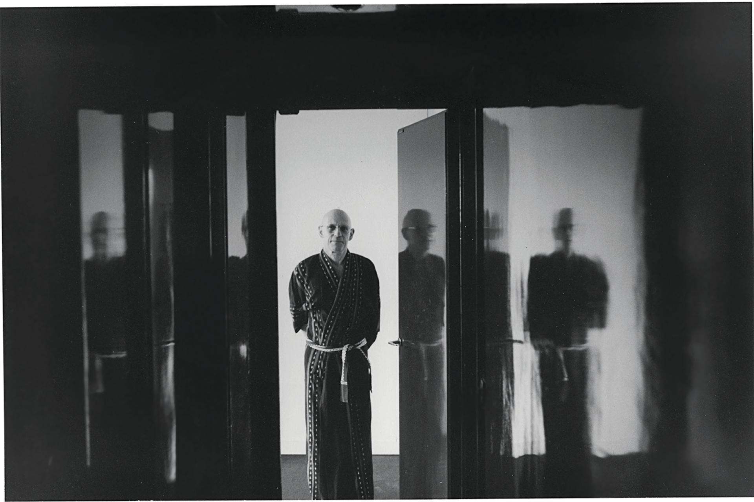
5. Betrayal (chapter 34)

Slide 24
5. Betrayal (chapter 44)
The rumors about Marine have gotten worse and everyone’s spreading the: now she’s got AIDS – my masseur tells me this, and he heard it from his boss at the clinic. One day the hot tip is that she caught it shooting up with her brother, who’s a little junkie, but the next day someone else swears she got it from a blood transfusion and a third opinion has her catching it from her useless Yank, who’s a first class bisexual orgiast, and so on. Marine’s AIDS (which – I should now admit – made me happy, not as a rumor but as the truth, and not so much from sadism as from this fantasy that there was an indissoluble bond between us, that we who’d been called brother and sister by some people were now linked by a common fate) wound up in the newspapers, the radio announced she'd been hospitalized […] She didn’t waste time: with her lawyer at her side, she appeared on the eight o’clock news to dispel the rumors, declaring that she’d had a medical exam and been pronounced perfectly fit, but that she was distressed to eb betraying those who were sick, to have to place herself publicly like that among the ranks of the healthy.

Slide 25
I was writing reports of everything like a spy, like an adversary, all those degrading little things . . . he would have liked to erase around the periphery of his life, to leave only the well-polished bare bones enclosing the black diamond—gleaming and impenetrable, closely guarding its secrets—that seemed destined to form his biography, a real conundrum chock-full of errors from end to end.

Slide 26
Intimate publics, Lauren Berlant
For Berlant, intimate publics are “laboratories for imagining and cobbling together alternative construals about how life has appeared and how legitimately it could be better shaped not merely in small modifications of normativity.”45 In her book The Female Complaint, she notes that “an intimate public is an achievement. Whether linked to women or other nondominant people, it flourishes as a porous, affective scene of identification among strangers that promises a certain experience of belonging and provides a complex of consolation, confirmation, discipline, and discussion about how to live as an x.”46

Slide 27
Queer time – or the death drive
Lee Edelman ‘No Future’ (2005)
‘Queerness figures […] the place of the social order’s death drive [...] it stands outside of the consensus of reproductive futurism’.
Leo Bersani, ‘Is the rectum a grave?’ (1994)
Hans Georg et Thierry à Montecatini, 1983, 1983 6 1/2 x 10 inches

