Slide 1
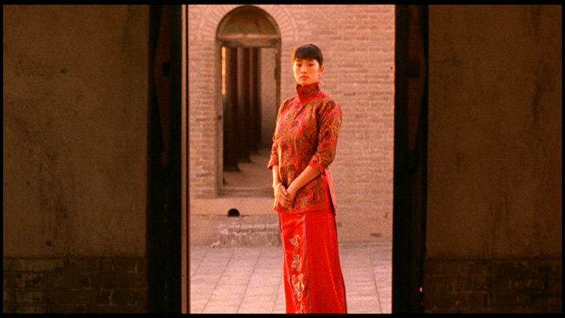
Week 2 Generational filmmakers, world cinema and global auteurs ---The 5th Generation
Dr. Kiki Tianqi Yu

Slide 2
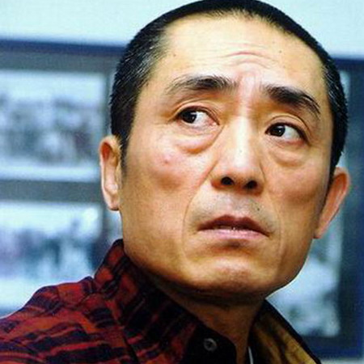
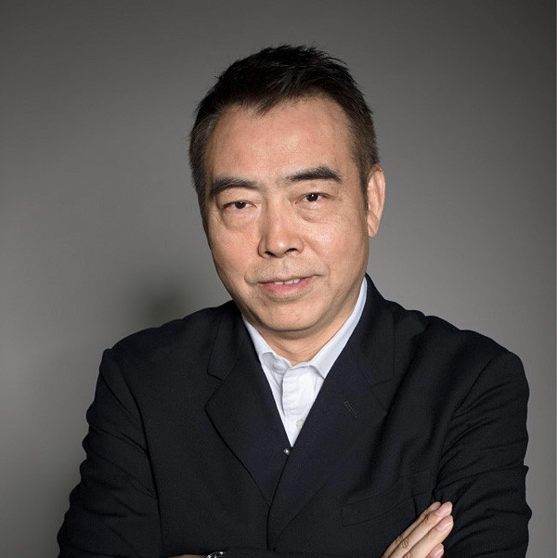
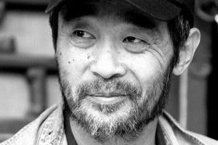
Who are the 5th Generation filmmakers?
Born between 1950-1960, the first cohort(1978-82) that entered Beijing Film Academy after the Cultural Revolution (1966-76).
Major filmmakers
Zhang Yimou, trio red films: Red Sorghum (1987), Ju Dou (1990), and Raise the Red Lantern (1991).
Chen Kaige, Yellow Earth (1984), Farewell My Concubine (1994)
Tian Zhuangzhuang, Zhang Junzhao, Peng Xiaolian, Huan Jianxin, Zhao Xiaowen

Slide 3
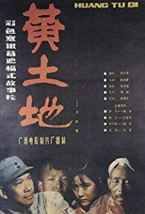
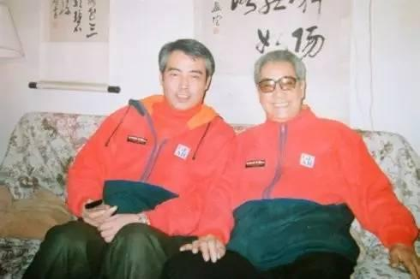
Why group filmmakers into different generations?
Not a historical tradition.
Only started from the 5th Generation.
Screening of Chen Kaige’s film together with Chen’s father’s film made critics and filmmakers realise the generational differences.
Tracing back to group the first, second, third and fourth generation.
Yellow Earth, dir. Chen Kaige, 1984

Slide 4
The cultural background of the 5th G:
Growing up in the most radical social upheaval, the ten-year Cultural Revolution led by the Red Guards
Some were intellectual youth being sent to the rural countryside. Zhang Yimou
1980s China – cultural fever, intellectual debates, searching root, and modernization
the public’s cry for a new modern cinema
Zhang and Chen also worked in remoted Shanxi xi’ an film studio.
the rebirth of Chinese national cinema:
Early films represent “an evolution from socialism to a time when commercialisation, urbanisation and capitalism took firmer cultural hold” (Larson, 2011: 113).

Slide 5
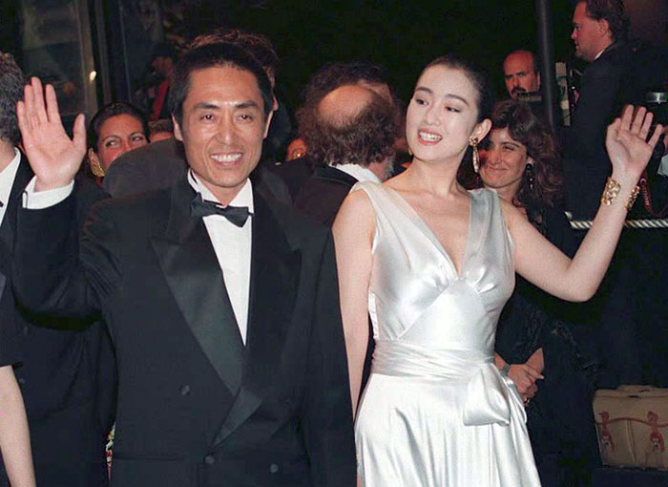
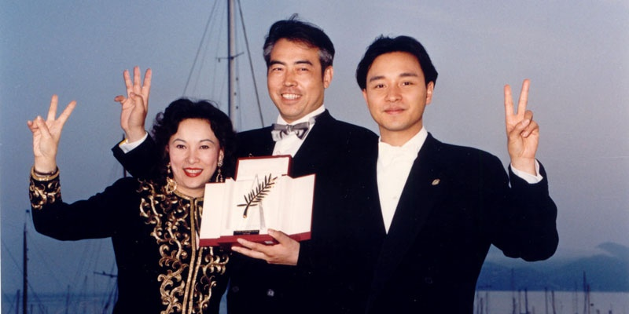
The 5TH Generation directors as auteurs
Auteur as a construct
“the auteur is the only universally recognized currency, yet this currency is stamped and certified at very few of the world’s many festivals.” (Elsaesser 2016:24)
Chen Kaige
Yellow Earth, premiere at Hong Kong International Film Festival 1985
…
…
Farewell My Concubine, Palme d’Or Winner, 1993, Cannes Film Festival

Slide 6
Zhang Yimou’s Filmography

Slide 7
Transnational
Early films mainly co-productions with foreign investment. The directors gained sources from the western producers and many of their films were distributed outside China.
Received a large art house audience in the western world, but negative criticism by the home audience.

Slide 8
“The greatest irony of contemporary Chinese cinema seems to be that some films achieve a transnational status precisely because they are seen as possessing an authentically “national,” “Chinese,” “Oriental” flavour by Western audiences. In the meantime, the domestic Chinese audience dismisses the same films and characterizes them as “misrepresentations” and “mystifications” of China (Lu, 1997: 12).
WHY?

Slide 9
Themes and aesthetics
Themes with a strong cultural and political implication - search-for-root
large allegorical structures, vast and harsh northern landscapes, peasant characters
methods of traditional Chinese painting applied as a visual language, the symbolic meanings in characterisation, and a strong ambiguity in narrative structures questioning traditional Chinese culture.

Slide 10
Yellow Earth, dir. Chen Kaige
https://www.youtube.com/watch?v=sEqfyZGYVrM

Slide 12
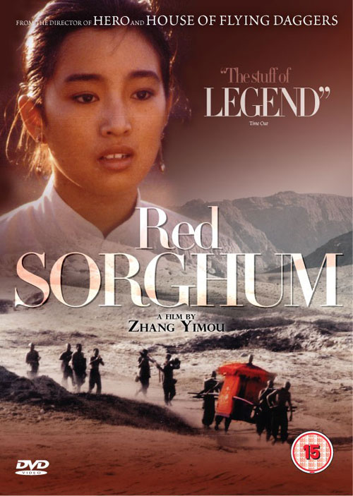
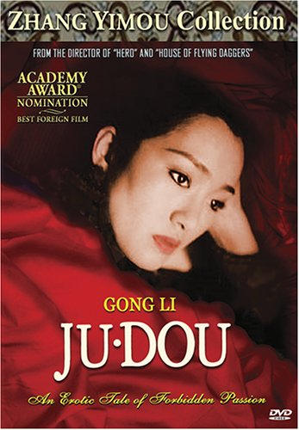
Zhang Yimou’s trio red films: Red Sorghum (1987), Ju Dou (1990), and Raise the Red Lantern (1991)

Slide 13
Women’s subjectivity in Zhang’s films
“What I want to express is that Chinese people’s oppression and confinement, which has been going on for thousands of years. Women express this more clearly on their bodies because they bear a heavier burden than men.”
– Zhang (quoted by Yang, 1993:300)

Slide 14
Female subjectivity is used for exploration of Chinese history and values.
The conflict between women and the patriarchal system
The conflict among the wife and concubines
The subjective conflict within Songlian herself
Raise the Red Lantern (1991).
https://www.youtube.com/watch?v=qWtAK_YCrTw

Slide 15
However, one can also argue that by displaying women Zhang tries to display a ‘China’ with unique traits of orientation to the western world.
The lack of a male point-of-view provides the spectators in the western capitalist society with the very position of the “male”, who gazes at the oriental traditional culture embodied as a female beauty (Jinghua Dai: 2001).
What do you think?

Slide 16
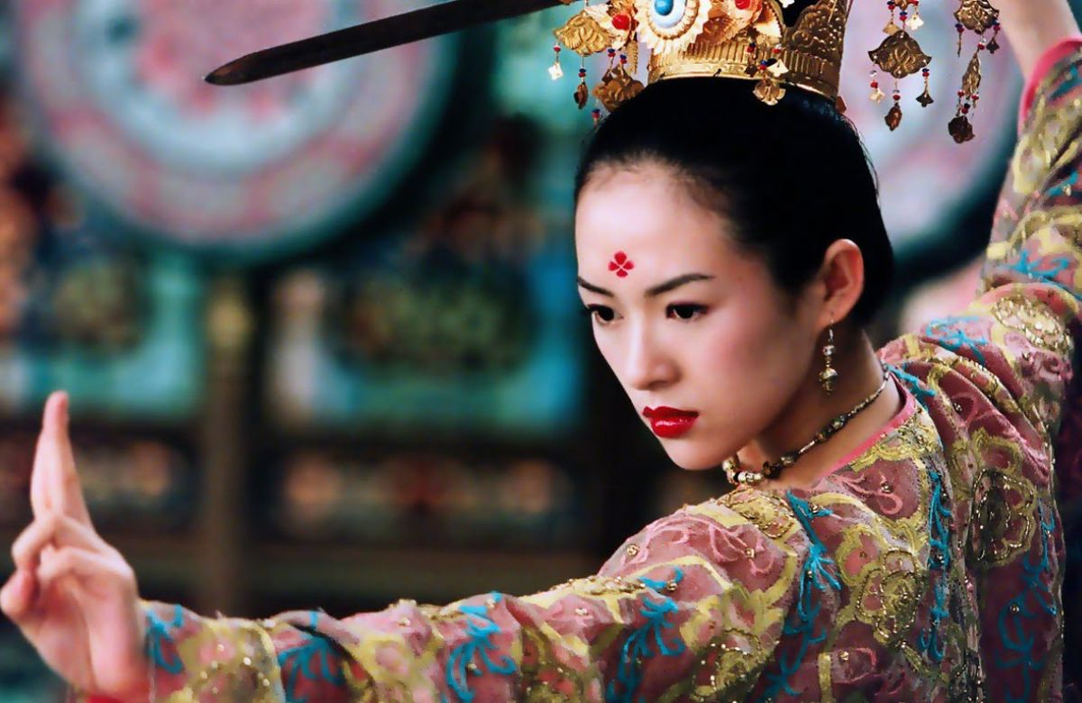
Marked the point when China’s film industry made significant inroads into global film distribution and elite film culture – art house cinema, receive scholarly study;
formalising a more pronounced ‘star’ system;
instigating debate on the self-orientalising of Chinese culture.

Slide 17
“Not only have they successfully ‘demolished’ the socialist-realist tradition by providing ‘superior” visual quality to the world; sailing smoothly into the global market. They seem to have acquired a certain advantage vis-à-vis other possibilities circulating in the same cultural-ideological space. Catering a truly international audience, these films are among the best from the People’s Republic in terms of professionalism in production”. (Zhang, 1997: 204)

Slide 18
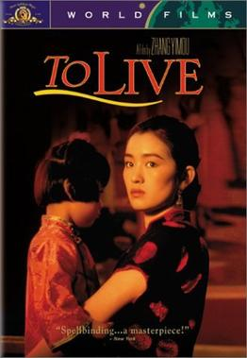
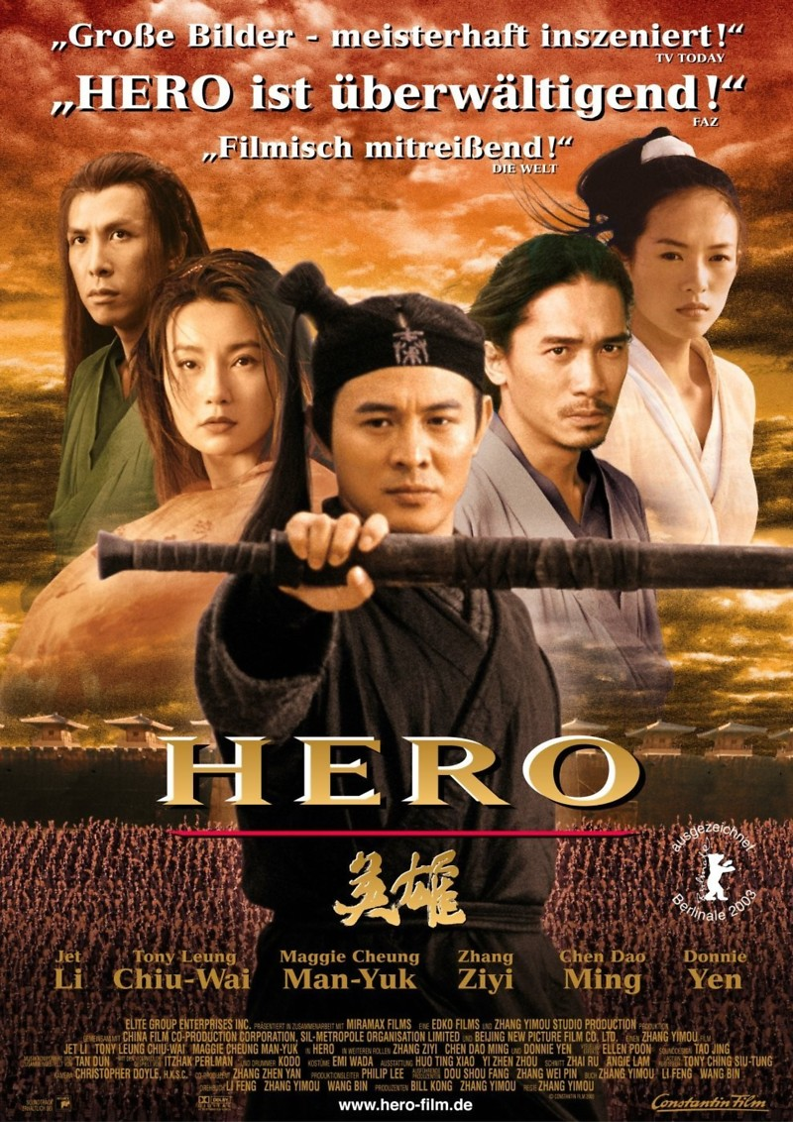
To Live, 1994 (Banned in China)
https://www.youtube.com/watch?v=MgsddFEe9Oc

