Slide 1
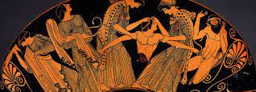
Tragedy COM5207 Week 3 Rachel Bryant Davies
Euripides: The Bacchae

Slide 2
This week: Introduction to Euripides’ Bacchae with reference to Aristotle and in translation (ie. the basics) aka ‘nothing to excess’?
Next week: Analysis of Euripides’ Bacchae and its afterlives as tragic theatre
(ie. themes; analysis)
Aka. ‘know yourself’?

Slide 3
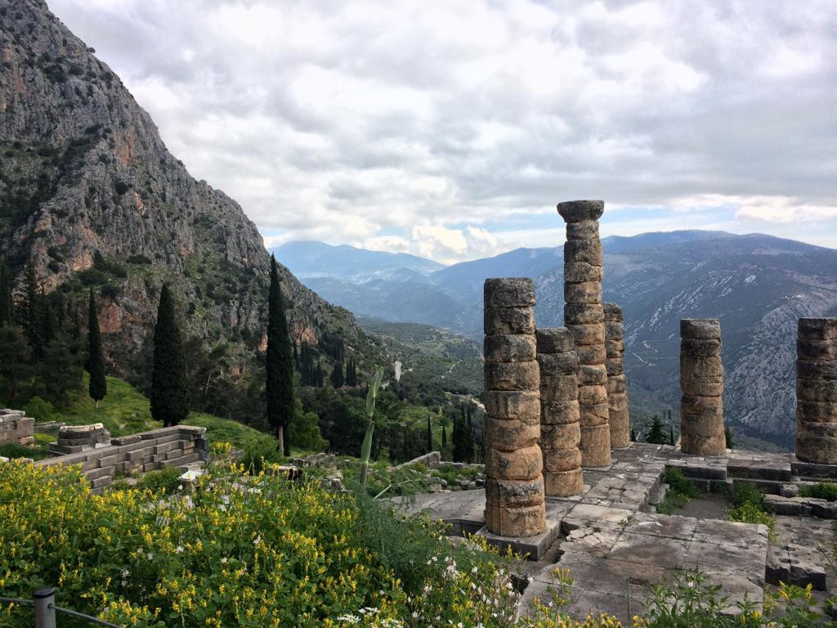
‘nothing to excess’ & ‘know yourself’ Where are these quotes from?
γνῶθι σ(ε)αυτόν (“know thyself”) μηδὲν ἄγαν (“nothing in excess”)
maxims inscribed on the temple of Apollo at Delphi
anonymous philosopher cited by Photius:“seems to be the easiest thing of all, and yet it is the hardest”
Gregory of Nissa (Christian Church Father)): “If you want to know God, you must first know yourself.”
In fact, Apollo only ‘in residence’ at Delphi for 9 months of the year; for 3 months in the winter he visits elsewhere (ancient writer Plutarch records this): priests left the temple to choose next year’s prophetess, while Dionsyiac festivals and rituals took over! (we don’t know much about these – poss agricultural link)

Slide 4
From your reading so far…
What do you make of Euripides? And of Bacchae? What about the characters?
How do you think Bacchae fits with Aristotle’s theory of tragedy from the Poetics (last week’s class)?
Did last week’s class/ reading Aristotle change your assumptions/ideas about ancient Athens & tragedy?
What about reading Euripides’ Bacchae…?

Slide 5
What would you say Bacchae is ‘about’? (not nec. same as what happens in it)
mentioned last week that Euripides has more non-aristocratic/’other’ characters: Bacchae also has more thematic and structural unity than many of Euripides’ other plays…
Suggestions (not complete: we’ll return to themes next week…)
Gods: nature, power; relationship with humans, worship
Human authority/pragmatics vs religious belief/faith
Identity; self-knowledge
Disguise / recognition
Madness / inspiration
Agency / coercion
Family ties
Concepts of civilisation / communities

Slide 6
Bacchae basic context
‘Bacchae, although one of the very latest of extant tragedies, may nevertheless be, as the only extant tragedy about Dionysos, in a sense closest to the beginnings of the genre.’ (Richard Seaford, 1996: 28)
First performed in Athens, Theatre of Dionysus, at the City Dionysia (political/religious festival) c. 406-5 BCE
This was a year after Euripides died (posthumously performed)
Tragedy originate in cult worship of Dionysus; seems likely god took central role (as here)
Importance of divinely-inspired self-destruction of royal family in tragedy derives from Dionysiac myth?
Basic subject = myth of Dionysus’ arrival in Greece
Enacts the establishment of the cult of Dionysus: everyone must join without distinctions of gender, rank, age

Slide 7
Dionysus/ Dionysos: God/cult characterised as arriving from Thrace/ Phrygia
‘a spirit of vegetation, of the fertility of nature and the excitement attendant upon it; wine was one of his gifts, but his sphere was wider than that of a mere god of wine. His worship included wild rites, devoted to the production of ecstasy by music and dancing, by bloody sacrifice, by the sheer intoxication of being one of a band of worshippers, a thiasos. For as Dionysus was pictured as attended by a group of followers, divine or human…Maenads or Bacchanals, so the worshippers felt him among them and within them, till they became themselves Bakchoi or Bakchai, incarnations of the god. Such a religion, so novel, so attractive, and so obviously dangerous, could not but meet with opposition when it attempted to proselytise a land which had already obtained a sober habit of worship. The gods of Greece lived a life upon Olympus…they knew their place and kept their distance: the religion of Dionysus blurred the distinctions between god and man.’ (Winnington-Ingram, p.1)

Slide 8
Reading in translation
NB. Virginia Woolf, ‘On Not Knowing Greek’ (1925): she does ‘know’ Greek enough to criticise translations. Point about privilege/status/gender/ educational opportunities. But really talking about inability to know how ancient Greeks heard the text, power and resonance. (Also talks about antiquity as pure/fresh/innocent: late 19th/early 20thC view)
What is a translation?
What other words could you use?
What differences do these words imply?
1906 Gilbert Murray, The Bacchae of Euripides, translated into English Rhyming Verse with explanatory notes.
1973: Wole Soyinka, The Bacchae of Euripides: A Communion Rite [there’s a useful study guide at https://www.umass.edu/theater/sites/default/files/assets/theater/the_bacchae_study_guide.pdf]
1996: Richard Seaford’s very literal translation (from a ‘parallel text’ intended to help students read original Greek text)
1999: James Morwood’s translation for Oxford World’s Classics series (mixes prose for episodes and verse for choruses)
2015: Anne Carson, Bakkhai. Euripides. A New Version.
We’ll look at these in more detail next week!

Slide 9
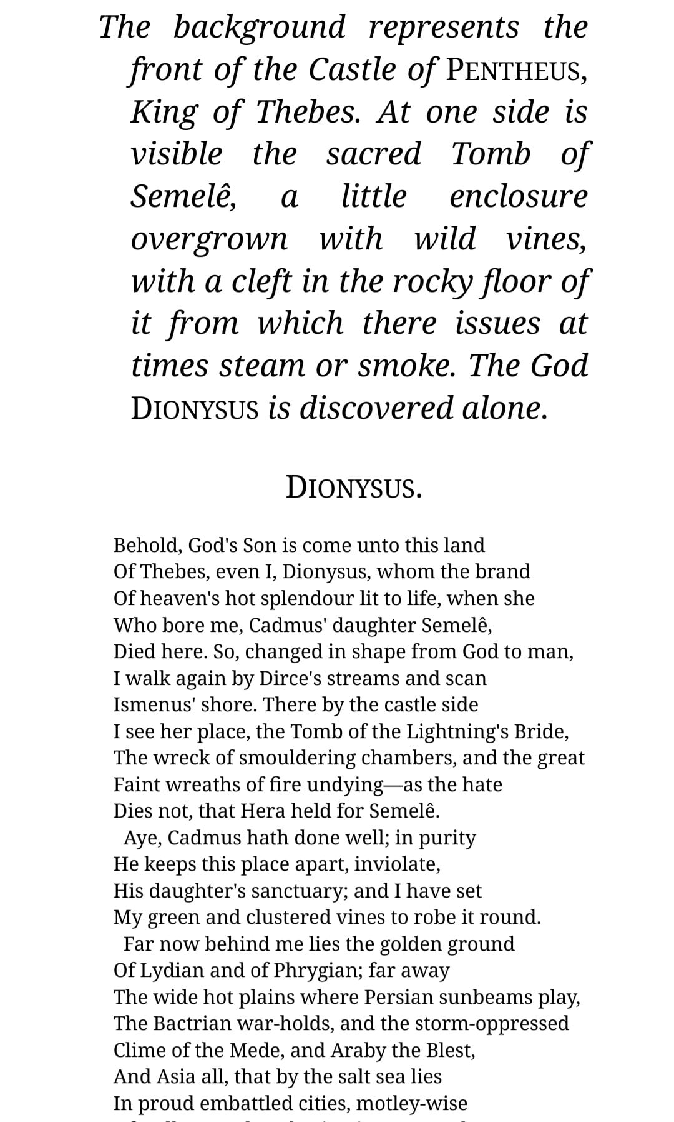
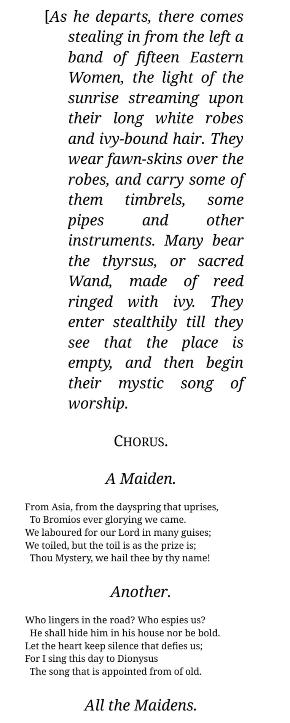
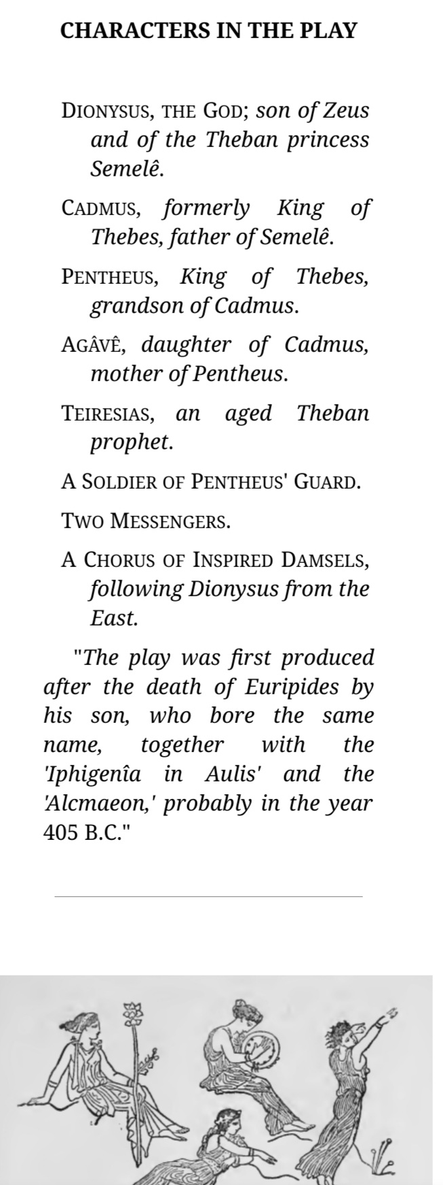
1906 Gilbert Murray, The Bacchae of Euripides, translated into English Rhyming Verse with explanatory notes.

Slide 10
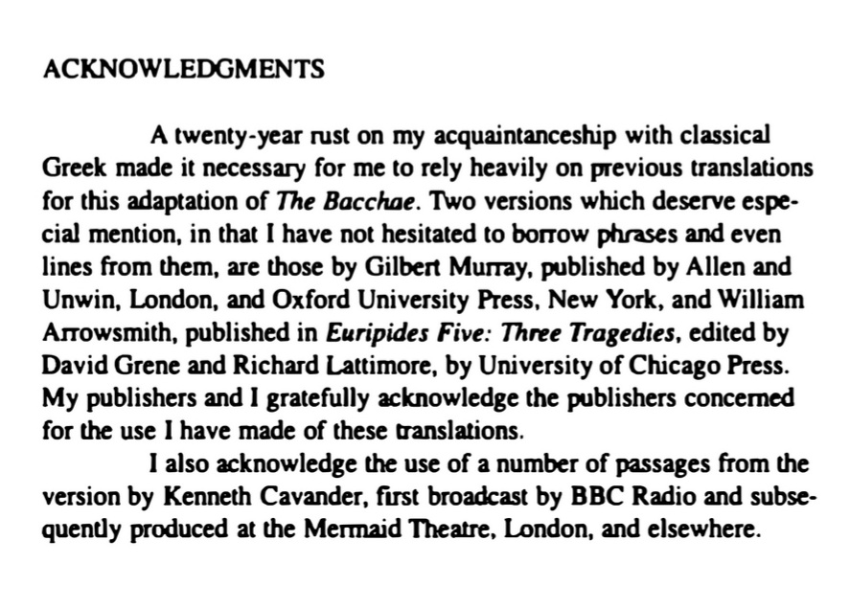
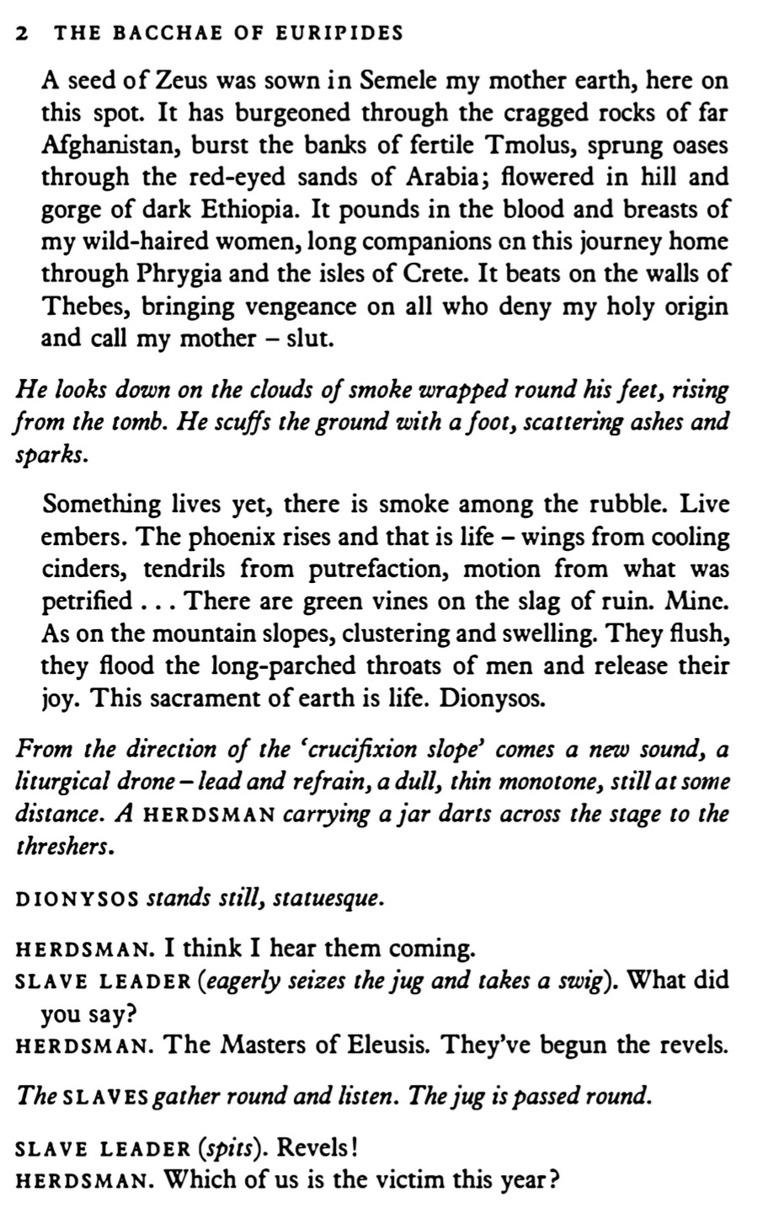
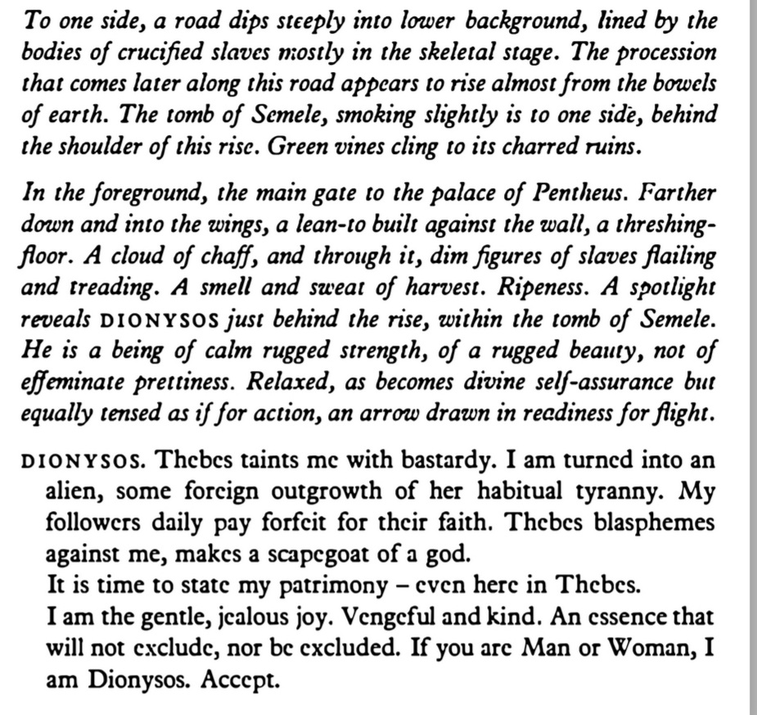
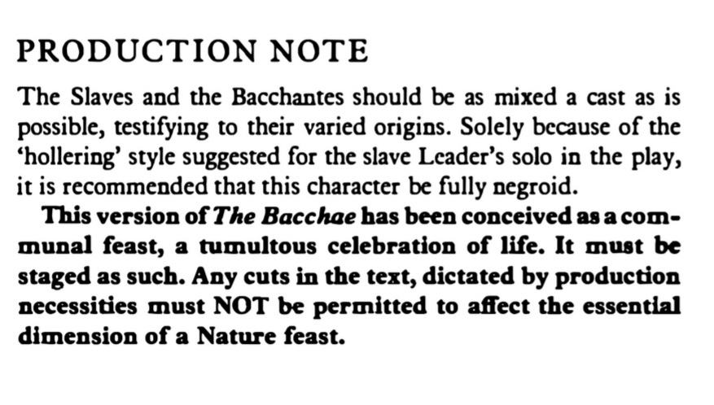
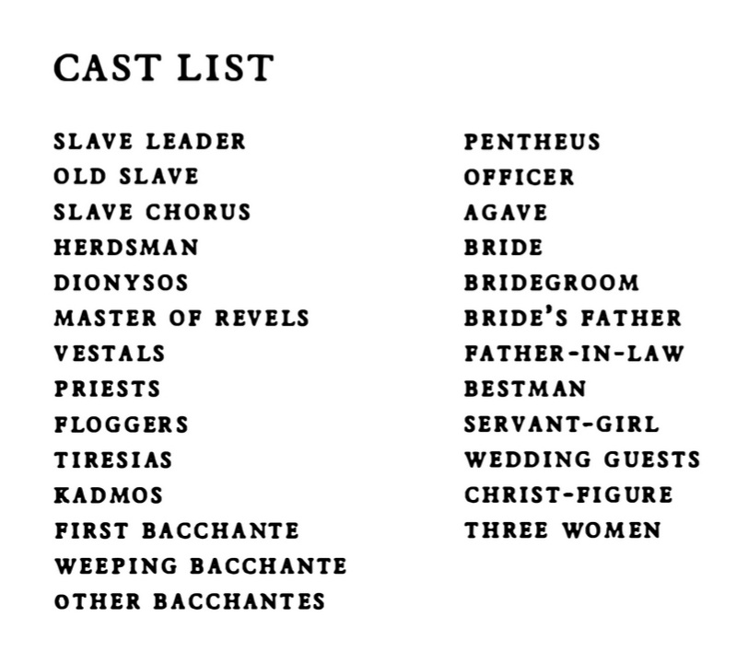
1973: Wole Soyinka, The Bacchae of Euripides: A Communion Rite [there’s a useful study guide at https://www.umass.edu/theater/sites/default/files/assets/theater/the_bacchae_study_guide.pdf]

Slide 11
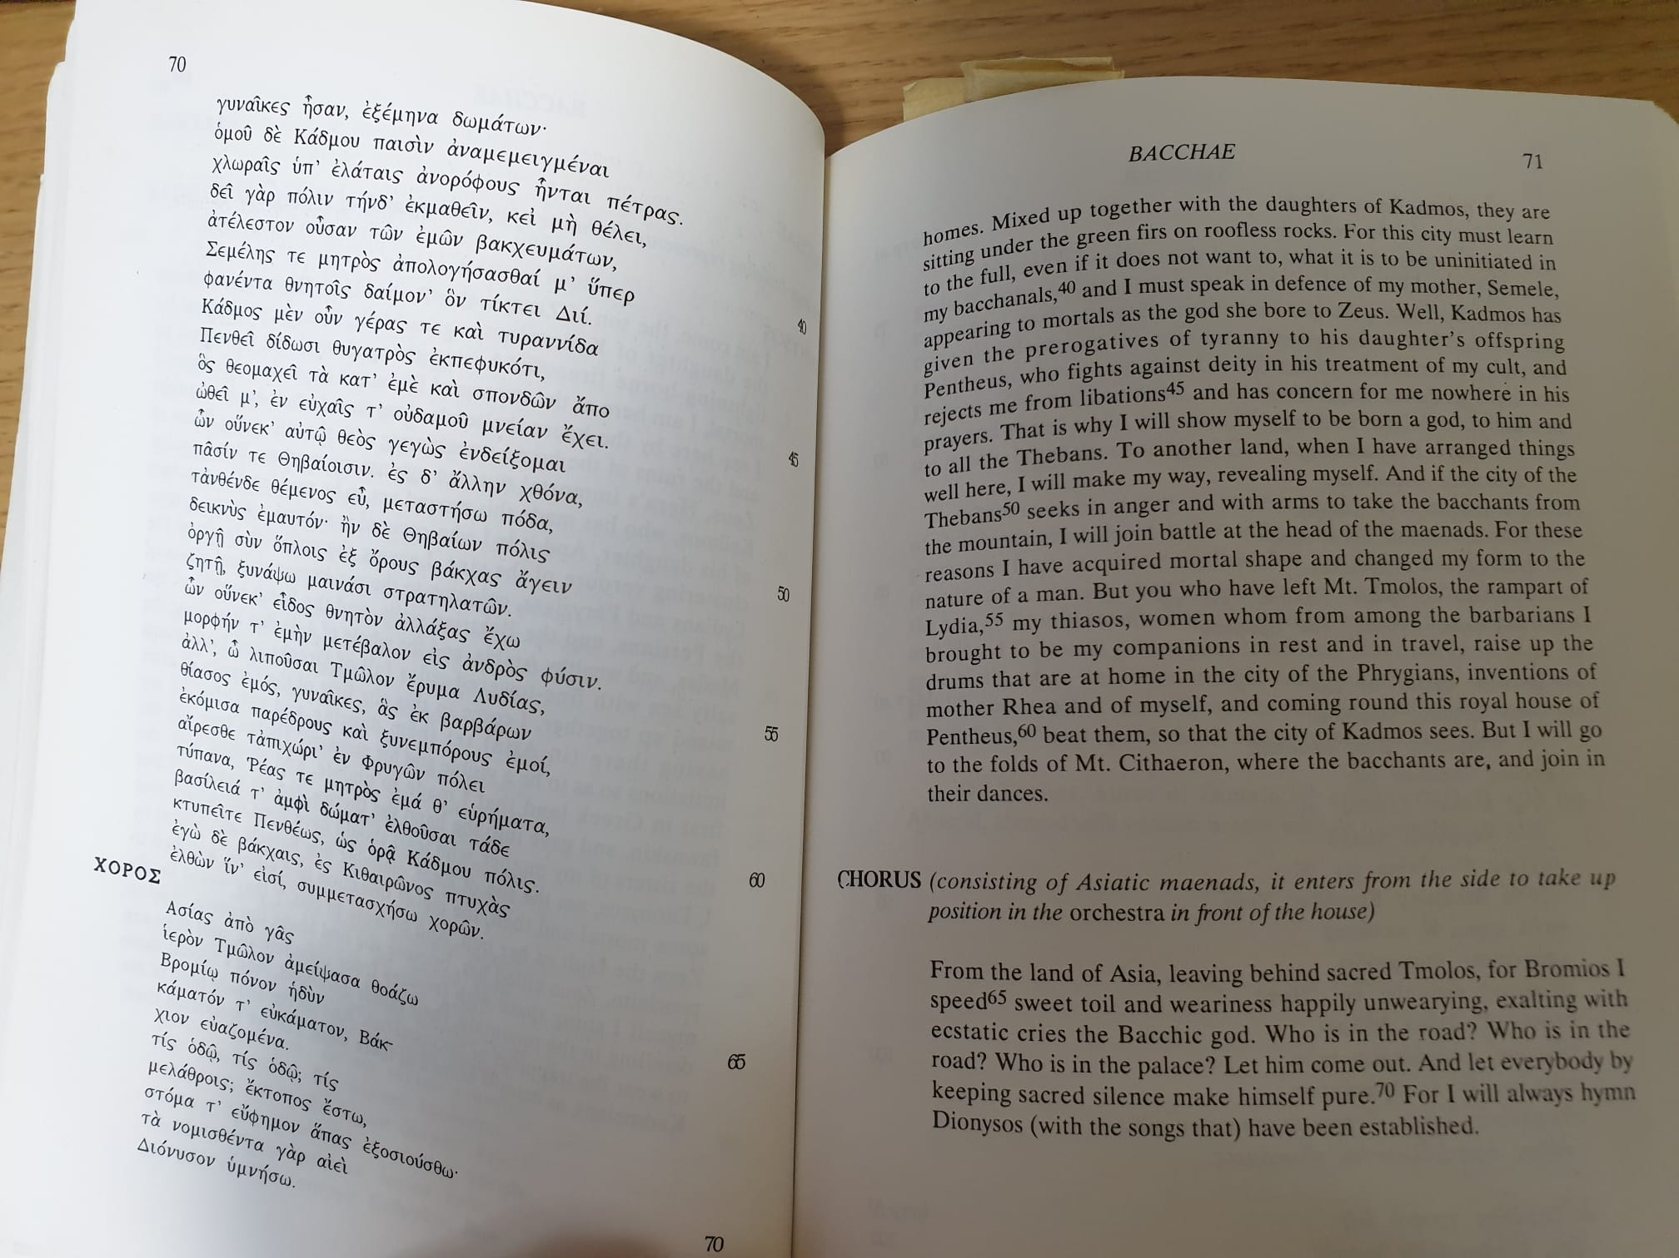
1996: Richard Seaford’s very literal translation (from a ‘parallel text’ intended to help students read original Greek text)

Slide 12
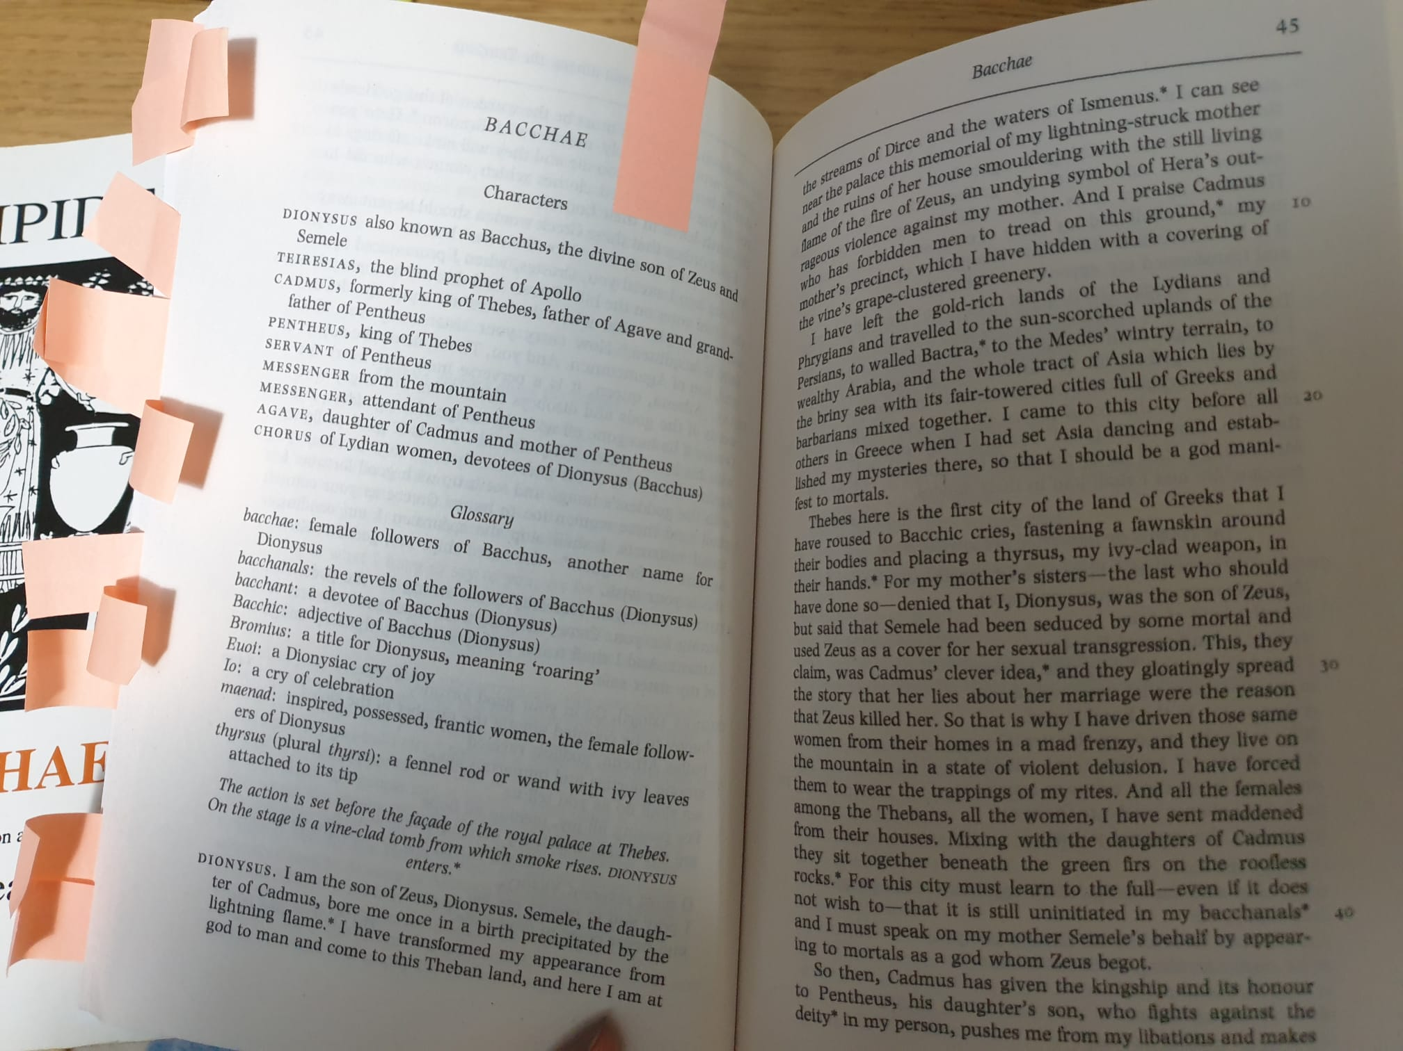
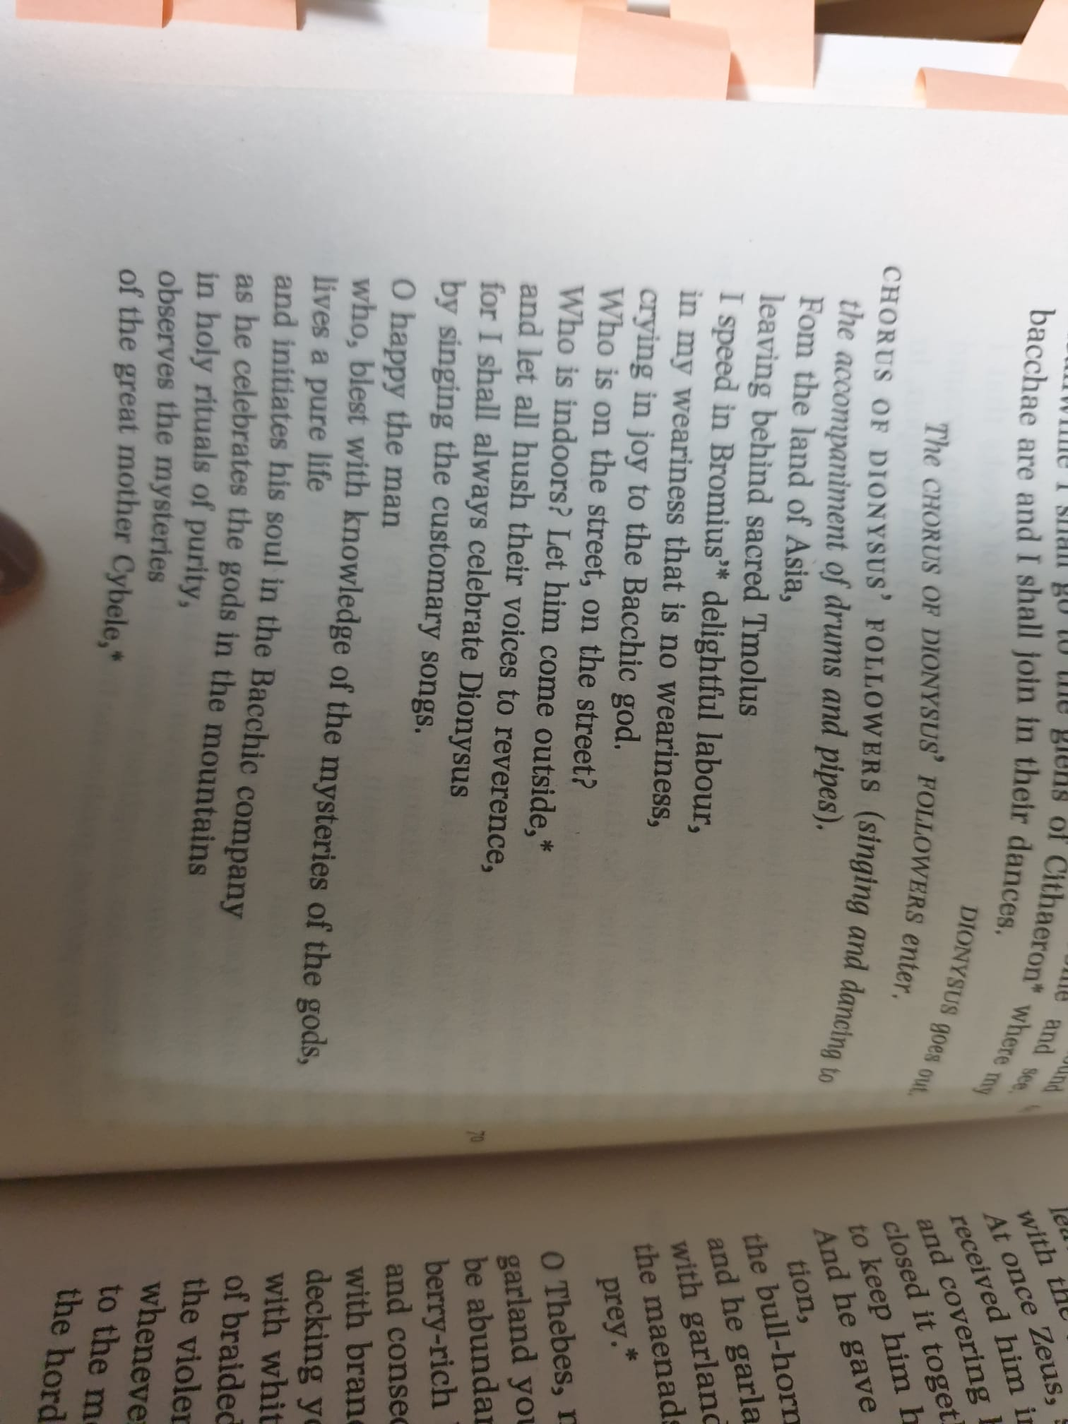
1999: James Morwood’s translation for Oxford World’s Classics series (mixes prose for episodes and verse for choruses)

Slide 13
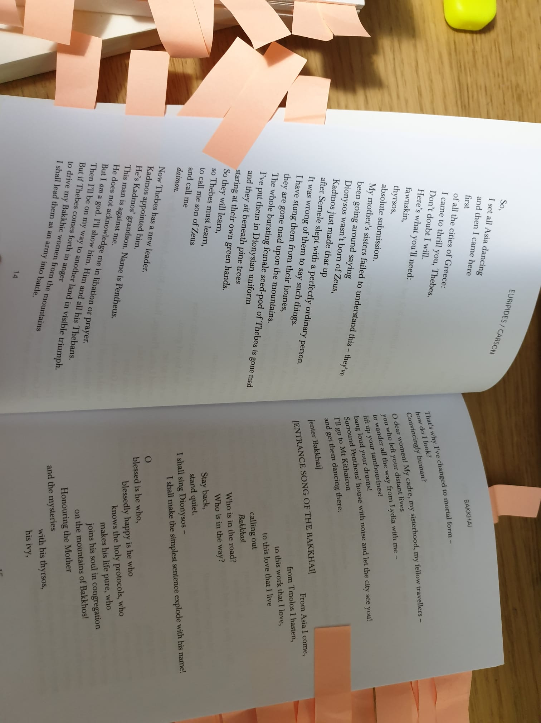
2015: Anne Carson, Bakkhai. Euripides. A New Version.

Slide 14
What happens in Bacchae? (a whistle-stop tour based on Seaford’s commentary: please read the play yourself!)
Greek: lines 1-63 Prologue: Dionysus (p. 45, Gibbons ebook)
Lines 64-169 Parados (entry song): Chorus (p. 47)
Lines 170-369 1st Episode: Tiresias, Cadmus, Pentheus (p. 50)
Lines 370-433 1st Stasimon: Chorus (p. 57)
Lines 434-518 2nd Episode: servant, Pentheus, Dionysus (p. 59)
Lines 519-575 2nd Stasimon: Chorus (p. 63)
Lines 576-861 3rd Episode: Dionysus, Pentheus, 1st Messenger (p. 65)
Lines 862-911 3rd Stasimon: Chorus (p. 76)
Lines 912-976 4th Episode: Dionysus and Pentheus (p. 78)
Lines 977-1023 4th Stasimon: Chorus (p. 81)
Lines 1024-1152 5th Episode: 2nd Messenger (p. 82)
Lines 1152-1164 5th Stasimon: Chorus (p. 87)
Lines 1165-1392 Exodus (exit song/lament): Chorus, Agave, Cadmus, Dionysus (p. 87-99)

Slide 15
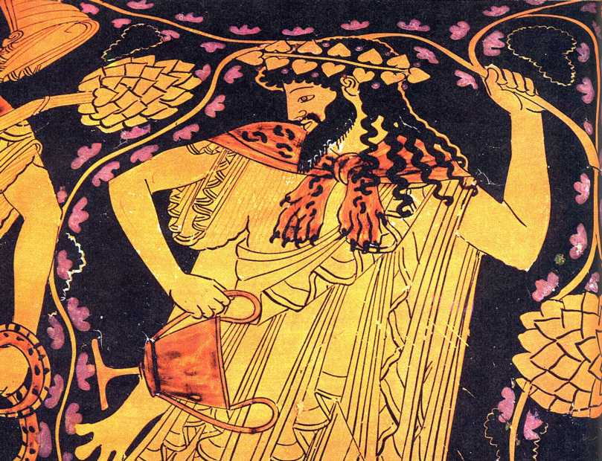
Prologue: Dionysus (p.45 Gibbons)
Lines 1-63 (outside palace)
Opening monologue sets the scene (common Euripidean strategy; often delivered by deity)
Only here is the main participant also a deity (in disguise)
Introduces Dionysus & disguise
Gives back-story/myth (explains why Thebes)
Info about cult worship – in Asia and now in Thebes…
Costume & speech: dual identity (barbarian/Greek; stranger/native; human/god; may be wearing ‘female’ clothes; also smiling mask (unusual for tragedy but characteristic of Dionysus)
As we go through the play, think about how Aristotle’s analysis fits (or not)…

Slide 16
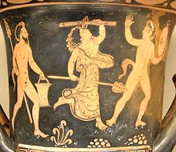
Parados (entry song): Chorus (p. 47 Gibbons)
Lines 64-169 (outside palace)
Probably 15 maenads who followed D from Asia appear from side
Accompanied by pipe music; holding tympanon
Probably dressed in/holding the cult equipment they sing of (thyrsus; ivy crown; ?snakes; branches; fawnskins; wool
6 verses (strophes and antistrophes – dance in opp directions?)
Seems to be a typical worship/cult song
Each strophe starts praising cult then specific encouragement to join
Each antistrophe celebrates a myth than explains the equipment (aetiological myth)

Slide 17
1st Episode: Tiresias, Cadmus, Pentheus
(Page 50 Gibbons)
Lines 170-369, still outside palace
Tiresias = blind prophet/wise man
myth that spent years female – in myth, punishment by Hera for hitting snakes; became priestess and had children- see Ovid…
Myths about blindness: various punishments– but gift of foresight/augury
Tiresias’ religious authority associated with Apollo (esp. Sophocles Antigone and Oedipus); Delphic oracle prescribed D. cult??
Cadmus: Semele & Agave’s father; Pentheus’ grandfather
Comic or festive…?

Slide 18
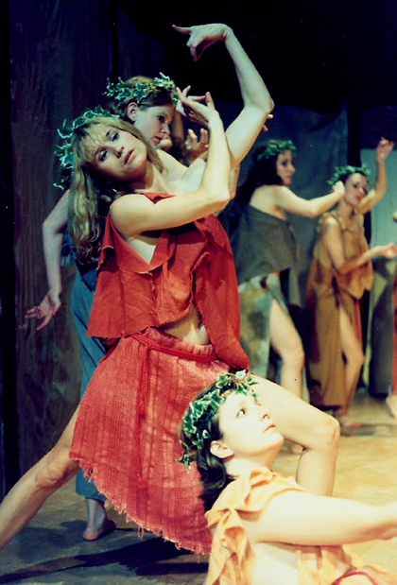
1st stasimon: Chorus (P. 57 Gibbons)
Lines 370-433 (outside palace)
Same (15) maenads as Parados
Prayer/ hymn in very complicated metre; more relaxed than before
Contrasts with Parados: that was about ecstatic mystic ritual
This shows calm well-being of mass participation

Slide 19
2nd Episode: servant/guard, Pentheus, Dionysus (as ‘Stranger’)
Page 59 Gibbons
Lines 434-518, still outside palace; short
Servant explains maenads escaped prison (shackles fell off); guards found “Stranger” & brought to Pentheus
Mostly dialogue between 2 individuals (agon), each perceiving a different reality, and each both weak and strong in diff ways
Dialogue largely in short single lines each (stichomythia)
Pentheus interrogating stranger as ruler; but also implies interest in rituals
Dionysus’ answers /riddles may use language used to confuse mystic initiands?

Slide 20
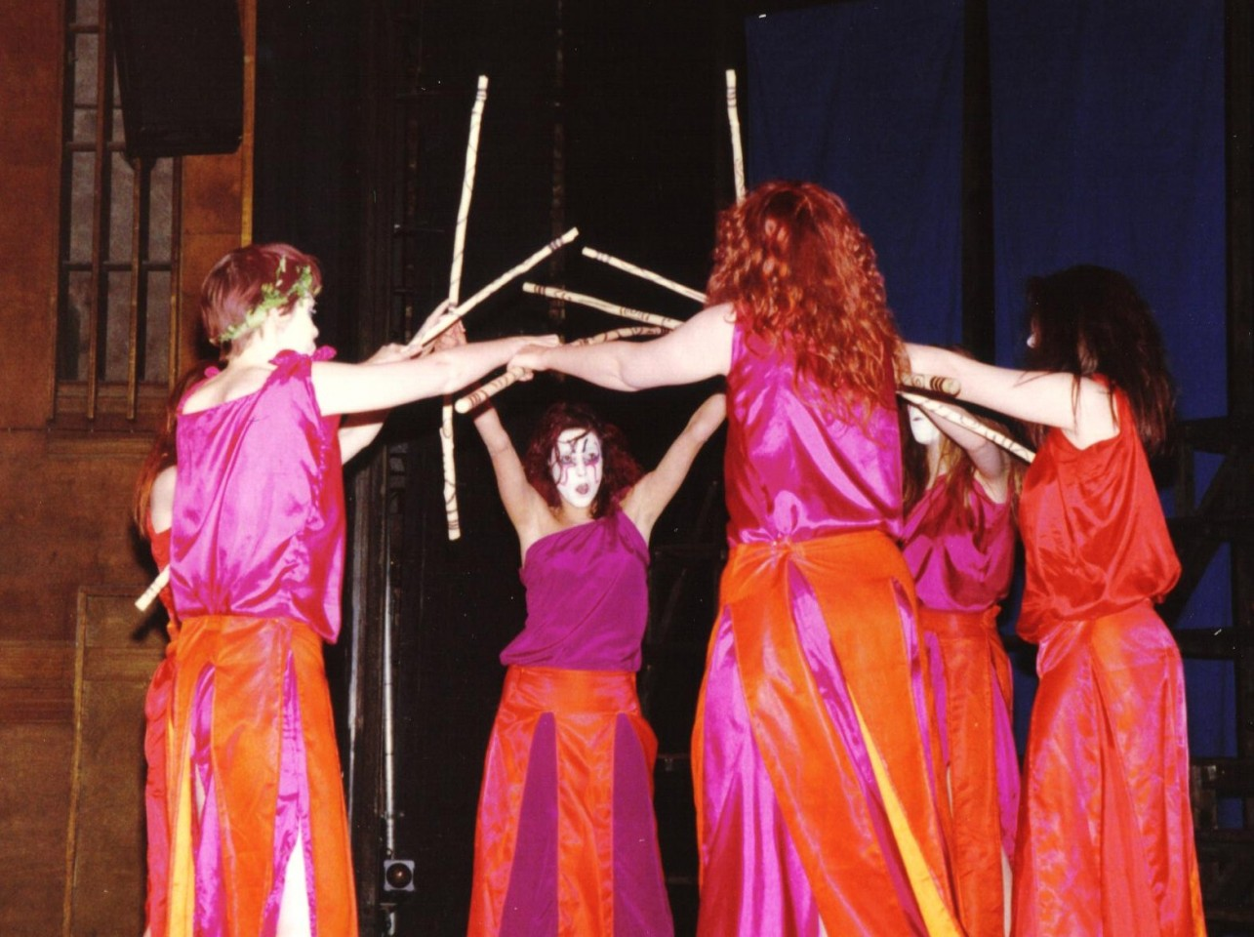
2nd stasimon: Chorus
Page 63 Gibbons
Lines 370-433 (outside palace)
Same (15) maenads as Parados
Prayer/ hymn in very complicated metre; more relaxed than before
Contrasts with Parados: that was about ecstatic mystic ritual
Here: calm well-being of mass participation…?

Slide 21
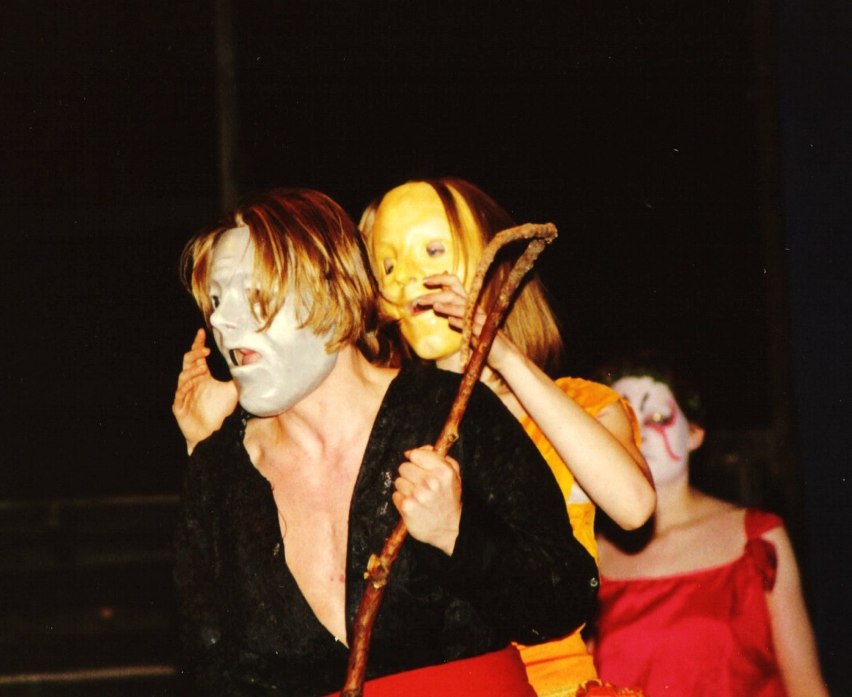
3rd episode: Dionysus, Pentheus, Messenger
Page 65 Gibbons
Lines 434-518, still outside palace; short
Mostly dialogue between 2 individuals (agon), each perceiving a different reality, and each both weak and strong in diff ways
Dialogue largely in short single lines each (stichomythia)
Pentheus interrogating stranger as ruler; but also implies interest in rituals
Dionysus’ answers /riddles may use language used to confuse mystic initiands?

Slide 22
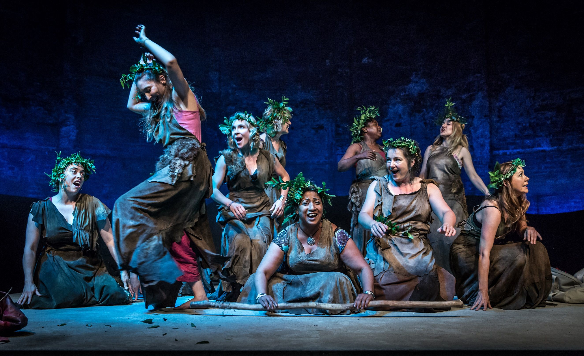
3rd stasimon: Chorus (Page 76 Gibbons)
Lines 862-911 (outside palace)
Same (15) maenads
Compare escape from persecutor (Pentheus) to fawn escaping hunter
Explain mystic initiation brings permanent happiness that’s preferable to temporary power over enemies; further asserts gods punish those who dishonour them

Slide 23
4th episode: Dionysus and Pentheus
Page 78 Gibbons
Lines 912-976, still outside palace
Balances/reverses the 2nd episode
P reverses his aggressive treatment of D
“Transvestism was practised in the Dionysiac ritual and although it is never explicitly connected with mystic initiation, it’s widespread occurrence […] suggests that it did occur in the Dionysiac mysteries as a means of detaching the initiand from his previous identity. Certainly it seems to complete P’s reversal of personality here as one of a series of P’s experiences that reflect mystic initiation. This theatricality of the mysteries was probably a factor in the genesis of tragedy, in which men regularly dressed as women.” (Seaford, p. 222)
P’s linen dress is also his funerary dress

Slide 24
4th episode: Dionysus and Pentheus, CONT.
https://www.theguardian.com/books/2007/sep/08/classics.edinburghfestival2007
“At last Pentheus enters, dressed like a princess, with the plaintive, eager line: "How do I look?"
Pentheus - dressed as a woman - is being humiliated on his way to a horrible denouement, all because he refuses to lose himself in the dance. How many of those 15,000 men would see themselves in Pentheus? How many would feel uneasy about seeing this parody of masculinity and femininity played out in front of them, blurring boundaries?
This moment, for me, holds the key to the contemporary meaning of The Bacchae. […] Throughout, Euripides shows that the values associated with masculinity - rationality, logic, control and articulacy - do not cancel out the "female" Dionysian forces of emotion, instinct and physicality. Pentheus constantly associates Dionysian attributes with women and foreigners. […] The chorus warn him: "Intellect must always submit to the power of the scream." Pentheus cannot defeat the Dionysian because it is already within him. Euripides shows that if you do not recognise the Dionysian spirit within yourself, or in your society, then it will surely return and destroy you in ways more horrible than you can imagine.”

Slide 25
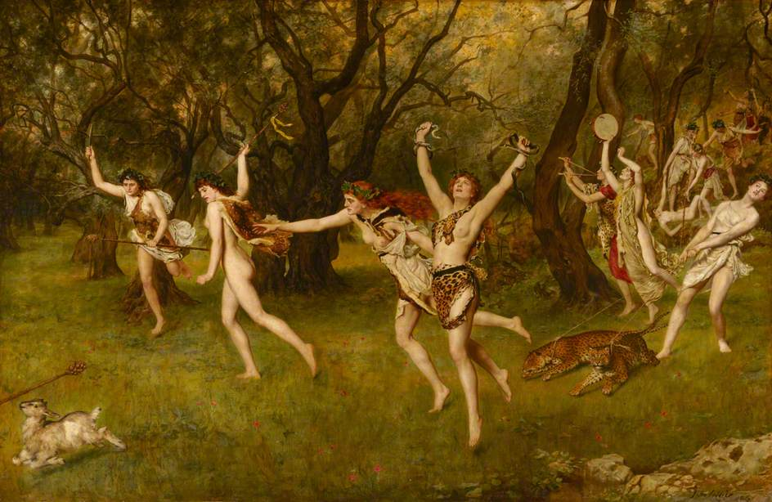
4th stasimon (Page 81 Gibbons)
Lines 977-1023
Imagined to cover time of P’s journey to Mount Kithairon (about 10 miles by foot), plus his death and the messenger’s return to Thebes (=several hours)
Imagine how Agave might react (inaccurate prediction!)
Ends with invocation to Dionysus to appear as a bull or lion or snake (seems to have been actual cult practice – ancient hymn

Slide 26
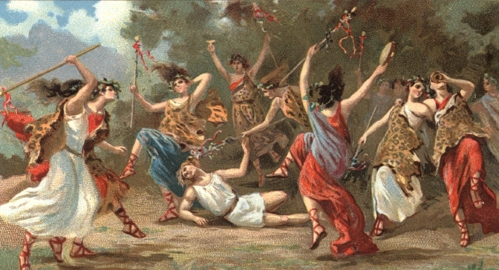
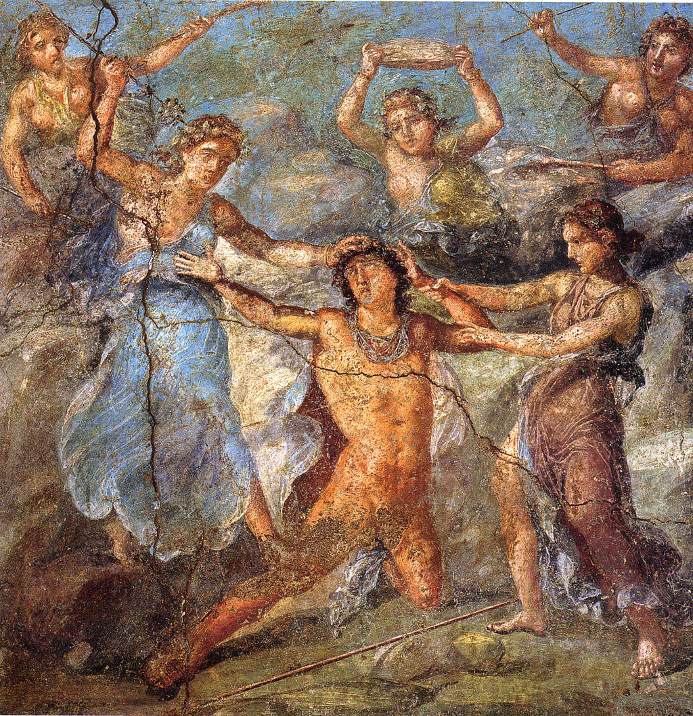
5th episode: 2nd Messenger (Page 82 Gibbons)
Pair with earlier Messenger speech, after short intro dialogue with chorus leader
[remember chorus of maenads aren’t the same as those on the mountain/you’re not meant to ask!]
Sets scene: clarity and detail in evoking miraculous; violent response by maenads to male intrusion on peaceful activity
Stranger disappears and is replaced by an invisible agent recognised by messenger and maenad as a god
Details suggest animal sacrifice and mystic initiation; this is a hunt so reverses normal control/order of sacrifice w/ violent chaos
Violence is described (possibly slightly mimed) by messenger, but not fully enacted

Slide 27
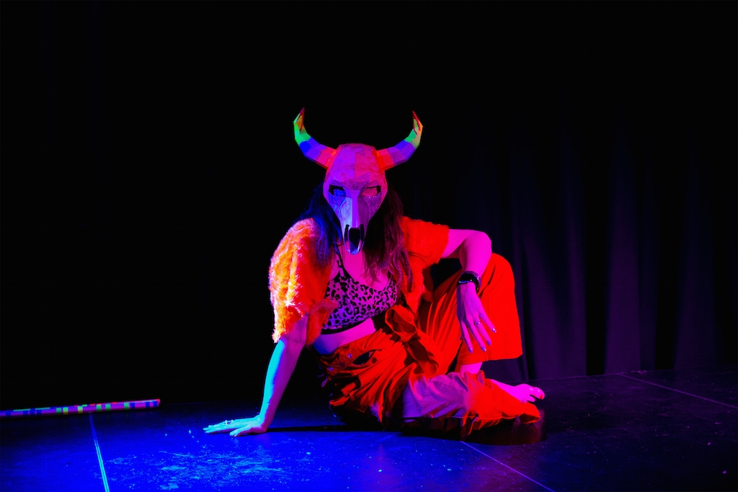
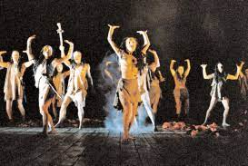
^{5th} stasimon: chorus (p. 87 Gibbons)
Lines 1153-1164
Short song at the climax of the action
Chorus celebrate the triumph of Dionysus

Slide 28
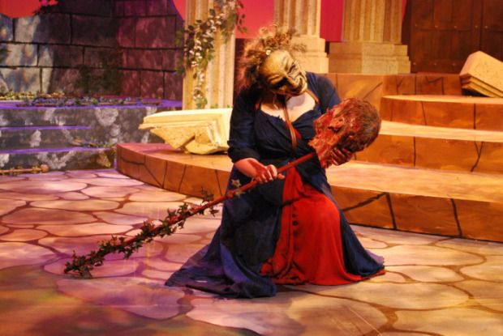
Exodus: chorus, Agave, Cadmus, Dionysus
Page 87-99 Gibbons
Lines 1165-1392
Arrival of Agave; dialogue w/ chorus
Arrival of Cadmus w/ P’s body &
Cadmus restores Agave to sanity/ helps her see what she has done
Funerary praise of Pentheus by Cadmus & lamentation by Agave (lost)
Appearance (beginning lost) of Dionysus as deus ex machina
Dodds: “the whole is evidently designed to produce a repulsion of sympathy from the god who is so terribly avenged to the human victims of his vengeance…”? Or agree with need to honour the god…?

Slide 29
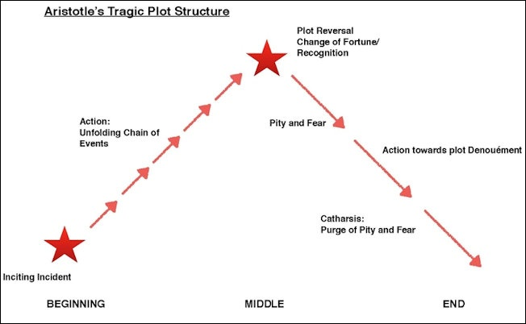
Recapping last week. Aristotle’s Poetics: key terms and concepts
Mythos (plot) is the ordered sequence of events that makes up the action.
For Aristotle, plot is the most important aspect of tragedy:
‘Tragedy is not an imitation of persons, but of actions and of life. [...] the plot is the source and (as it were) the soul of tragedy; character is second.’ (Aristotle 1996: 11–12)
For Aristotle, a plot should:
be ‘complete’; famously, it should have ‘a beginning, a middle and an end’ (Aristotle 1996: 13) in an ordered structure & self-contained sequence
have ‘magnitude’: i.e. enough content, but not too much for us to hold in our heads
minimal requirement = change in protagonist’s fortune
Other Aristotelian terms:
Ethos (‘character’): the kind of person the agent is
Dianoia (‘reasoning’ – sometimes translated as ‘thought’, or in 17th-century France as ‘sentiments’): how the agent interprets and reacts to situations, the attitudes s/he expresses, and the arguments s/he uses to express them
Peripeteia (‘reversal’): a change in situation that overturns expectations. Must be astonishing, yet integrated into a coherent plot, ‘out of necessity or in accordance with probability’ (Aristotle 1996: 18)
Anagnorisis (‘recognition’): a change from ignorance to knowledge, which affects a character’s good or bad fortune. This is often a literal matter of recognizing something, e.g. somebody’s true identity or parentage.
Hamartia (‘error’): a mistake made by the agent. (Not a psychological ‘flaw’, contrary to some interpretations and translations) This may be an error of fact, but may also be a bad or imprudent decision. Hamartia was also used in New Testament Greek to denote the Judaeo-Christian concept of ‘sin’: this probably influenced how the term was understood in the 16th and 17th centuries
Catharsis (‘purification’): a controversial term, most likely to mean purging excessive feelings of pity and fear, i.e. stimulating these feelings so that the audience gets them out of its collective system

Slide 30
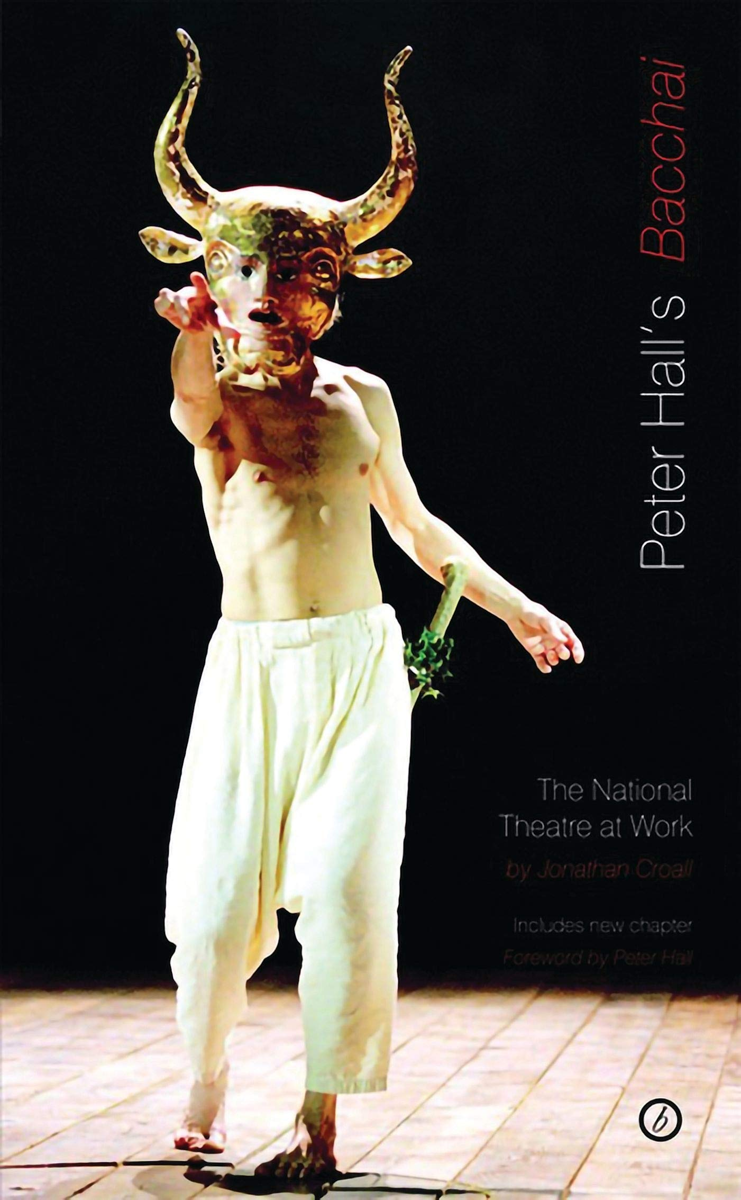
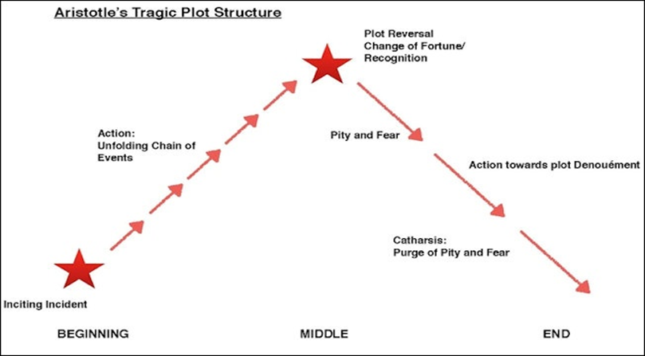
How well does Aristotle’s analysis apply to Bacchae?
Inciting action =
Chain of events =
Reversal of fortune =
Recognition =
Hamartia/ error =
Catharsis / “purging” =
Ethos: how do the agents affect the plot?
Dianoia/ reasoning: what are their reasons?

Slide 31
Character Analysis: Pentheus
How does Euripides characterise Pentheus?
Do you think he fits with Aristotle’s description of a tragic hero?
What his attitude to the ‘new religion/god’ -- and why?
Why does he want to spy on the maenads?
What is the significance of Dionysus persuading him into disguise in women’s clothing?
What are Pentheus’ public responsibilities/job role and how does this affect his choices?

Slide 32
Character Analysis: Maenads
How are the two kinds of maenads characterised?
Is there any difference in how they are represented (esp onstage)?
Where are the two groups from?
How does each group react to events /other characters?
What are Pentheus' criticisms of their worship?
Why does he find them and Dionysus so threatening?
How do the maenads and the chorus relate?

Slide 33
Character Analysis: Cadmus and Tiresias
What do you make of Cadmus and Teiresius?
What is their role in the play?
What reasons do they give for their worship of Dionysus?
How does Pentheus react to them?
What happens to Cadmus at the end of the play (how punished)?
Why are Cadmus and Agave punished?
Does Agave need her own slide of questions here…? What’s your opinion?

Slide 34
Character Analysis: Dionysus
What sort of god is Dionysus?
How is he depicted? What are his attributes? How does he look?
Why has he arrived in/ returned to Thebes?
Why do you think he is obsessed with/compelled to prove his own divinity/power?
Why is it appropriate that he is the god of theatre (i.e. are there any connections between wine, madness, ecstasy, sex, dismemberment, and theatre)?
Do you think Euripides sees Dionysus/religion/gods positively or negatively?

Slide 35
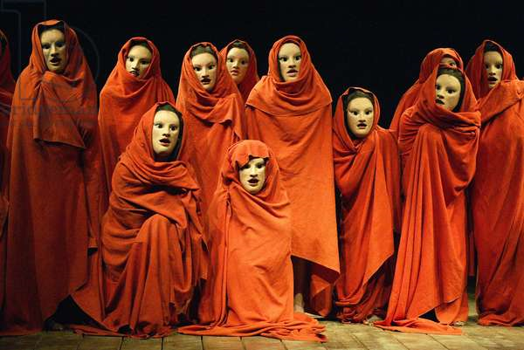
Has Bacchae changed your concept of ancient Athens/theatre/tragedy…? Next week…
Themes and Character interactions in more details
Quotes about Bacchae and Tragedy and how/whether they apply
Afterlives/reception history of Bacchae, incl religion syncretism
Themes include:
Gods: nature, power; relationship with humans, worship
Human authority/pragmatics vs religious belief/faith
Identity; self-knowledge
Disguise / recognition
Madness / inspiration
Agency / coercion
Family ties
Concepts of civilisation / communities

Slide 36
Finally… do these quotes resonate differently in light of studying Bacchae?
γνῶθι σ(ε)αυτόν (“know thyself”) μηδὲν ἄγαν (“nothing in excess”)
maxims inscribed on the
temple of Apollo (& Dionysus)
at Delphi
I will add a few short specific reading extracts to QMPlus; otherwise explore the reading list and (re)read the play ready for discussion

