Slide 1
Respiratory System II: Ventilation

Slide 2
Learning objective
“Students should demonstrate an understanding of how ventilation (respiration) takes place and some of the basic terminology associated with respiration. Students should demonstrate an understanding of basic lung function tests and the difference between restrictive and obstructive lung conditions.”

Slide 3
Lesson aims
After this lecture, you should be able to:
Describe how inspiration and expiration takes place
Understand basic terminology associated with respiration
Understand basic lung function tests
Understand the difference between obstructive and restrictive patterns of lung conditions

Slide 4
Ventilation
Inspiration – breathing in
Expiration – breathing out
Controlled by movements of the diaphragm, internal and external intercostal muscles and ribcage
Respiratory rate – take a minute to count your breaths per minute
Look up the “normal” range for respiratory rate
What does “normal range” mean and how is it determined?

Slide 5
Inspiration
To breathe in – external intercostal muscles and diaphragm muscles contract. Energy is needed.
The ribcage moves upwards and outwards, the diaphragm flattens
This causes the volume of the thorax to increase which in turn leads to the lung pressure to decrease so air flows in
What gas law in physics/chemistry is this?

Slide 6
Expiration
External intercostal muscles and diaphragm muscles relax
Ribcage moves downwards and inwards, diaphragm moves upwards and becomes curved again
Volume in thorax is decreased which leads to an increase in pressure
Air is forced out of lungs
This is a passive process - it does not require energy
Expiration can be forced – e.g. when exercising hard. Internal intercostal muscles contract which pulls ribcage down and in.

Slide 7
Respiratory terminology
Lung function tests – group of tests that measure breathing and how well the lungs are functioning
Spirometry – measures airflow
Tidal volume – volume of air in each “normal” breath, usually around 0.4 litres
Vital capacity – the maximum volume of air that can be breathed in or out (deep breath in and deep breath out)
Breathing rate (or respiratory rate) the number of breaths taken per minute
Residual air – air left in lung which cannot be breathed out – why is this?
Oxygen consumption or oxygen uptake – the rate at which an organism uses up oxygen (litres oxygen used/min)
Click here for a glossary of respiratory terms

Slide 8
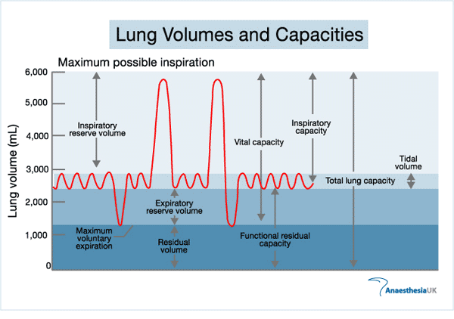

Slide 9
Spirometer
Machine that determines tidal volume, vital capacity, breathing rate and oxygen uptake
Oxygen-filled chamber with a lid that goes up and down
You breathe through a tube connected to the oxygen chamber
As you breathe in and out, the lid of the chamber goes up and down.
The movements are recorded by a pen attached to the lid, this produces a spirometer trace
Soda lime in the breathing tube absorbs carbon dioxide
The volume of gas in the chamber will decrease over time as the air breathed out contains carbon dioxide that is absorbed by the soda lime and the oxygen in the chamber is used up.

Slide 10
Online breath test
Click here for the British Lung Foundation lung test
In a test, the patient could be asked to blow out air from the lungs in a relaxed way. This is called the slow vital capacity or VC.
The forced expiratory volume is how much a patient can blow out in one second or FEV₁. With healthy lungs and airways, this is normally most of the air from the lungs in one second.
The forced vital capacity or FVC is how much air can be blown out in one complete breath after taking in a deep breath. This can then be compared to how much air was expelled in one second to give the percentage of air blown out.
In someone with healthy airways, at least 70% of the total air they breathe out would be expelled in one second.

Slide 11
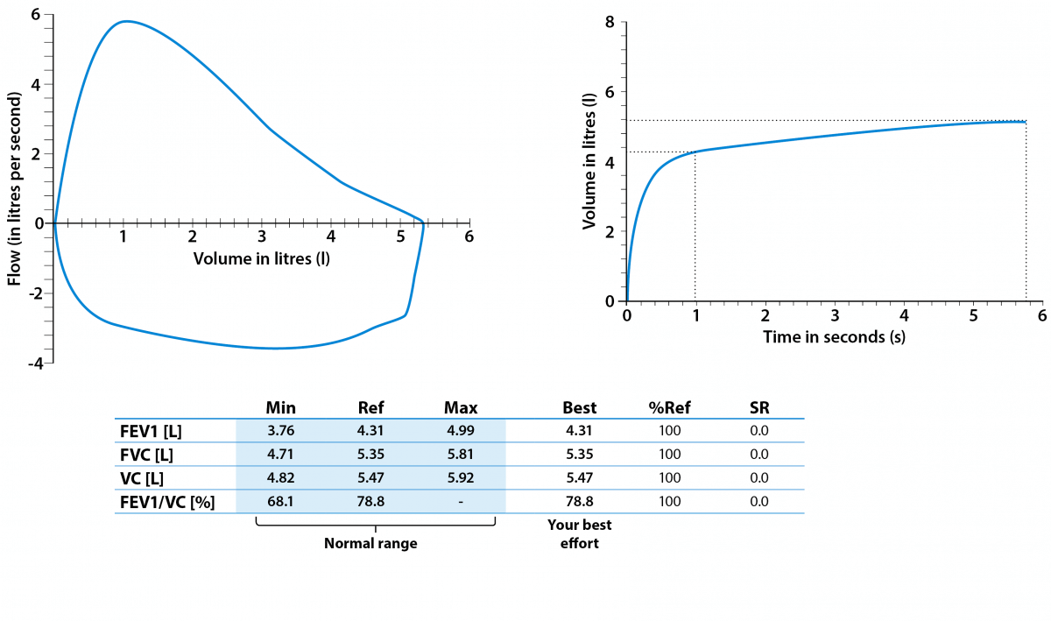
An example of a (normal) spirometry result for a hospital spirometer

Slide 12
Obstructive versus restrictive patterns
An obstructive pattern can be seen in lung conditions that narrow the airways, such as COPD and asthma.
This means that the air flows out of the lungs more slowly than it should (low FEV₁) with less than 70% of the total amount in the first second.
With a restrictive pattern, the total amount of air breathed in is reduced but the speed it is breathed out stays the same. In this situation, both the FEV₁ and FVC will be lower than predicted, but the ratio between the two will not be reduced.
This is caused by various conditions that affect the tissue of the lungs or affect the capacity of the lungs to expand and hold a normal amount of air, such as pulmonary fibrosis (what is this?)
This pattern can also be seen in people who are significantly overweight, have an abnormal curvature of the spine or weak breathing muscles.

Slide 13
Normal vs Obstructive
Normal pattern
Obstructive pattern

Slide 14
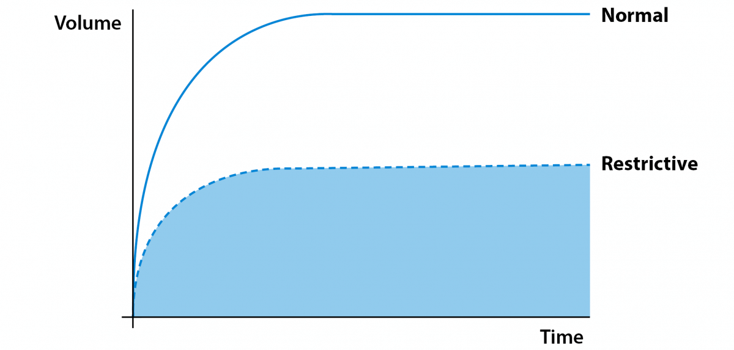
Normal vs Restrictive patterns
Normal pattern
Restrictive pattern

Slide 15
Question time
What is meant by tidal volume and vital capacity?
Describe the changes that take place in the human thorax during inspiration and expiration?
Use your phones for the following challenge question - what is surfactant and why is it needed?

Slide 16
Lesson aims
After this lecture, you should be able to:
Describe how inspiration and expiration takes place
Understand basic terminology associated with respiration
Understand basic lung function tests
Understand the difference between obstructive and restrictive patterns of lung conditions

