Slide 1
Putting theory and practice together: Interdisciplinary research
James Esson
j.esson@qmul.ac.uk

Slide 2
Learning objectives
Foster critical reflection on the politics of interdisciplinary research
Explore ethical considerations in research involving North-South/South-North partnerships

Slide 3
Session outline
The politics of interdisciplinary research
Defining
Solving ’Wicked Problems’
Challenges and tensions
Reflections on interdisciplinary working
RURBAN Africa

Slide 4
The politics of interdisciplinary research

Slide 5
What does interdisciplinary research mean to you?

Slide 6
Why does this matter? (general)
Complex problem solving
Innovation and creativity
Career opportunities
Ethical and responsible

Slide 7
Why does this matter? (personal)
Previous studies?
Current programme?
Next steps

Slide 8
Defining interdisciplinary research

Slide 9
Key element – a coming together
‘‘Ideas, data and information, methods, tools, concepts, and/or theories from two or more disciplines are synthesized, connected, or blended’’ [to generate new insights on an issue]

Slide 10
3 overarching disciplines*
Natural Sciences
Humanities
Social Sciences

Slide 11
What makes a discipline, a discipline?

Slide 12
Disciplines
Claim a body of knowledge about certain subjects
Possess a recognised core of ‘canonical knowledge’
Have methods of creating knowledge
Have their own community of experts i.e. community of practice
Train future experts in their disciplines

Slide 13
What about geography?
Geography is the world discipline, and the world is both natural and human.
Geography has sought to find order in both, and to study the relationship between the two
(Bonnett 2017: 30)
Bonnett, A. (2008). What is geography? Sage. New York and London

Slide 14
What about geography?
Radically interdisciplinary and with the spatial turn in the humanities and social sciences has become an exporter of ideas and faculty to other disciplines.
RGS-IBG ‘ What is geography?’ Available here

Slide 15
Key approaches to interdisciplinary research
Generalist-
Instrumental
Integrationist-Transformative

Slide 16
Generalist-Instrumental
“Any form of dialog or interaction between two or more disciplines” while minimizing, obscuring, or rejecting altogether the role of integration’’

Slide 17
Integrationist-Transformative
“Integrationists believe (unsurprisingly) that integration should be the goal of interdisciplinary work because integration addresses the challenge of complexity’’

Slide 18
Bowl of fruit (multi) or Smoothie (inter)
This Photo by Unknown Author is licensed under CC BY

Slide 19
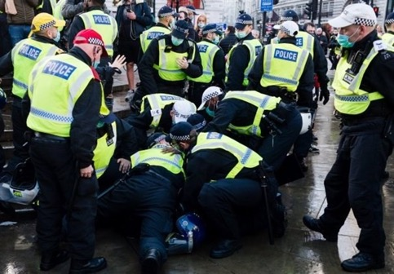
Inter refers to contested spaces
Most interdisciplinary study examines contested terrain—problems, issues, or questions that are the focus of several disciplines.
This Photo by Unknown Author is licensed under CC BY
This Photo by Unknown Author is licensed under CC BY

Slide 20
Inter refers to the results of integration
The result of integration should be the creation of something altogether new, distinctive, apart from, and beyond the limits of any discipline i.e. a significant advancement in knowledge
This Photo by Unknown Author is licensed under CC BY-NC-ND
This Photo by Unknown Author is licensed under CC BY-NC-ND

Slide 21
Solving ‘Wicked Problems’

Slide 23
Key features
Wicked Problems
Complexity and uncertainty
Continuous change
No clear solution
Multiple stakeholders

Slide 24
UK research landscape

Slide 25
UK research landscape
“We recognise that many of the most pressing research challenges are interdisciplinary in nature, both within the social sciences and between the social sciences and other areas of research.”
“UKRI is committed to supporting an enhanced culture of interdisciplinary and multidisciplinary research in the UK.
“We already fund a great deal of interdisciplinary research, which draws together insights and approaches from one or more research disciplines.”

Slide 26
Challenges and tensions

Slide 27
Disciplinary politics - the butt of jokes
Geography is often the butt of jokes in England. A school friend of mine who was about to start a degree in pure mathematics described my chosen degree as the ‘science of common sense’
(Cresswell 2013: 1)
Cresswell, T. (2013). Geographic thought: a critical introduction. John Wiley & Sons. Chichester.

Slide 28
Challenges
Power dynamics
Disciplinary Boundaries
Recognition and attribution
Impact and legitimacy
Influenced by Petts, J., Owens, S., & Bulkeley, H. (2008). Crossing boundaries: Interdisciplinarity in the context of urban environments. Geoforum, 39(2), 593-601.

Slide 29
Insert Global South-Global North dynamics
Whose Geography?
Situated knowledges
Knowledge and disciplines
Decolonising knowledge

Slide 30
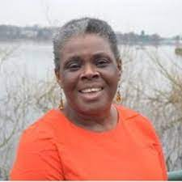
Insert Global South-Global North dynamics
https://www.ukri.org/what-we-do/browse-our-areas-of-investment-and-support/global-challenges-research-fund/

Slide 31
Challenges
Power dynamics
Resources and funding
Impact and legitimacy
Epistemic differences

Slide 32
Reflections on interdisciplinary working (across the GS-GN)

Slide 33
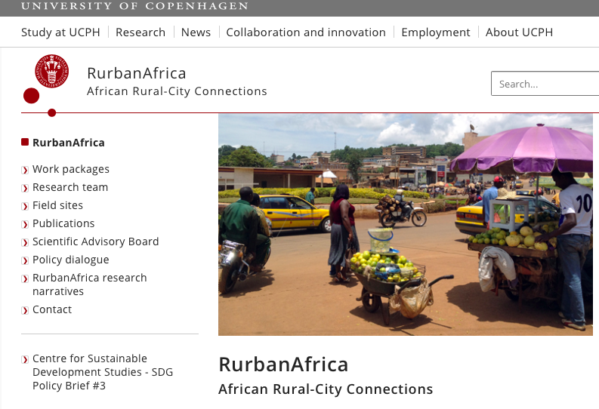
https://rurbanafrica.ku.dk

Slide 34
RurbanAfrica
Cameroon, Denmark (lead), France, Ghana, the Netherlands, Rwanda, Tanzania & the UK

Slide 35
Work Packages
Agricultural Transformation
Rural livelihoods
City Dynamics
Access to Services
Management
Dissemination and Policy

Slide 36
City Dynamics and Access to Services
City Dynamics
The aim of this work package is to provide a comprehensive understanding of city dynamics through an analysis of urban growth rates and mobility pattern.
Access to Services
This work package aims to investigate variations in the relationship between poverty and access to services in different types of urban low-income areas.

Slide 37
Countries and cities
Ghana
Accra
Sekondi-Takoradi
Cameroon
Douala
Bafoussam
Rwanda
Kigali
Musanze (Ruhengeri)
Tanzania
Dar es Salaam
Arusha

Slide 39
This Photo by Unknown Author is licensed under CC BY-ND

Slide 40
Epistemological limits

Slide 41
Learning from and with the GS

Slide 42
‘’We examine the thoughts, actions, and experiences of male youth in Ghana using Guru's popular song “Boys abrƐ [Boys are tired].”
https://www.youtube.com/watch?v=YdMAn91wYWU

Slide 43
Retaliatory patriarchy
Entitlement
Resentment
Obliviousness

Slide 44
Masculinities – learning from and with GS?
This Photo by Unknown Author is licensed under CC BY-SA
This Photo by Unknown Author is licensed under CC BY-SA

Slide 45
Summary

Slide 46
Generalists and Integrationists
Solving ‘Wicked Problems’
Disciplinary politics
Inserting Global South-Global North Dynamics
Reflections – opportunities and challenges

