Slide 1
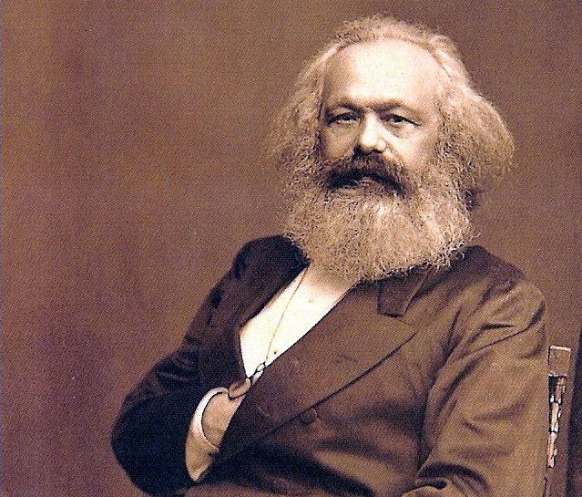
Marxism and Geography
Dr Sam Halvorsen

Slide 2
What is Marxism

Slide 3
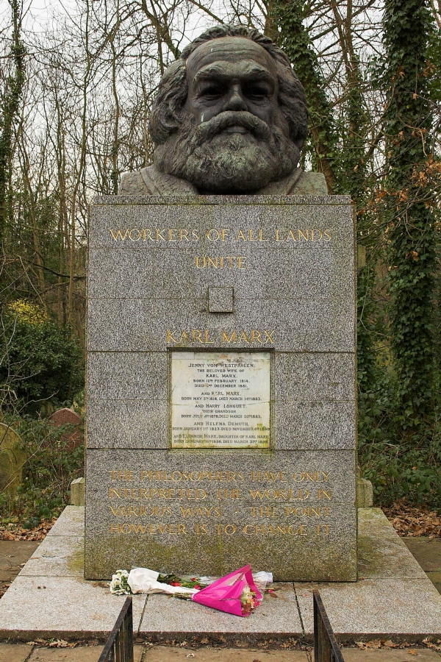
Why Marx today?
Global financial crisis 2008
Influential geographers (Harvey et al)
Many Marxisms: urban studies; feminist; global south; the state..
And…the second contradiction of capitalism: the environment

Slide 4
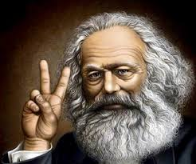
Who was Marx?
Rich body of work developed by Karl Marx (1818-1883)
Karl Marx, born in Trier, Germany, 1818
Lived in Paris where he witnessed uprisings of 1848. Stayed in London from 1849 until death in 1883
Bankrolled by Engels, he also wrote articles to get money.
Has had huge impact in both ideas and practice worldwide
Much debate about how to interpret his work, and a vast amount of Marxist literature
Early work: philosophical/humanist (ideology, alienation)
Late work: political-economy, “scientific”, Capital 3 Vols
Communist Manifesto as a good introduction to his writings

Slide 5
Ideas for Action
Marx’s commitment to social change and emancipation: “The philosophers have only tried to interpret the world in various ways; the point is to change it.” Marx, Theses on Feuerbach (1845)
He anticipates a communist society: “In place of the old bourgeois society with its classes and class antagonisms, we shall have an association, in which the free development of each is the condition for the free development of all.” Marx and Engels, Manifesto of the Communist Party (1848)
But not just about action – also shaped by context: “Men [and women] make their own history, but they do not make it as they please; they do not make it under self- selected circumstances, but under circumstances existing already, given and transmitted from the past.” Marx, The Eighteenth Brumaire of Louis Napoleon, 1852

Slide 6
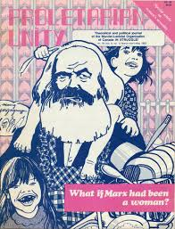
A pluralised tradition after his death
“There is not one Marxism but rather many Marxist tendencies, schools, trends and research projects. Marxism in France does not have the same orientation it has in Germany, Italy, the Soviet Union or China.” Henri Lefebvre, 1988, 75

Slide 7
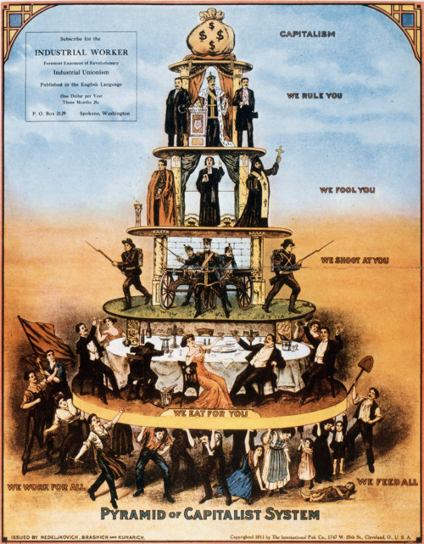
Some key ideas
Class and class struggle
“The history of all hithero existing society is the history of class struggle”.
Bourgeoisie (owners of the means of production and employers of wage labour) and proletarians (wage-laborers who have no means of production, just sell their labour power)
Antagonism is key

Slide 8
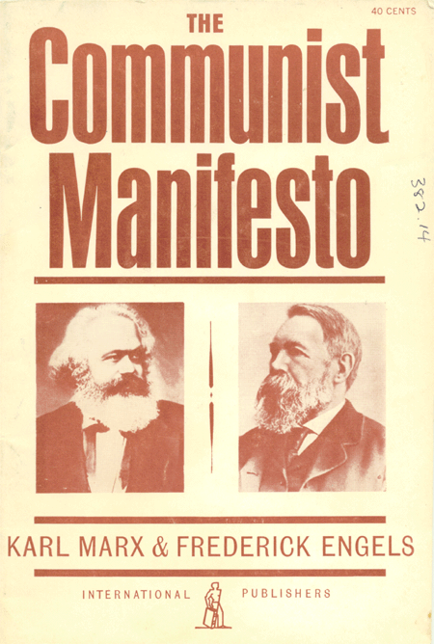
Including globalisation…
“The need of a constantly expanding market for its products chases the bourgeoisie over the whole surface of the global. It must nestle everywhere, settle everywhere, establish connections everywhere”

Slide 9
Capital and the labour process
Surplus value and exploitation
Understand the world to change it
Labour movements, communist parties, revolutions

Slide 10
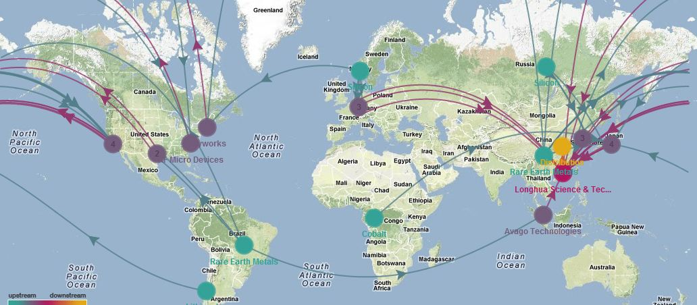
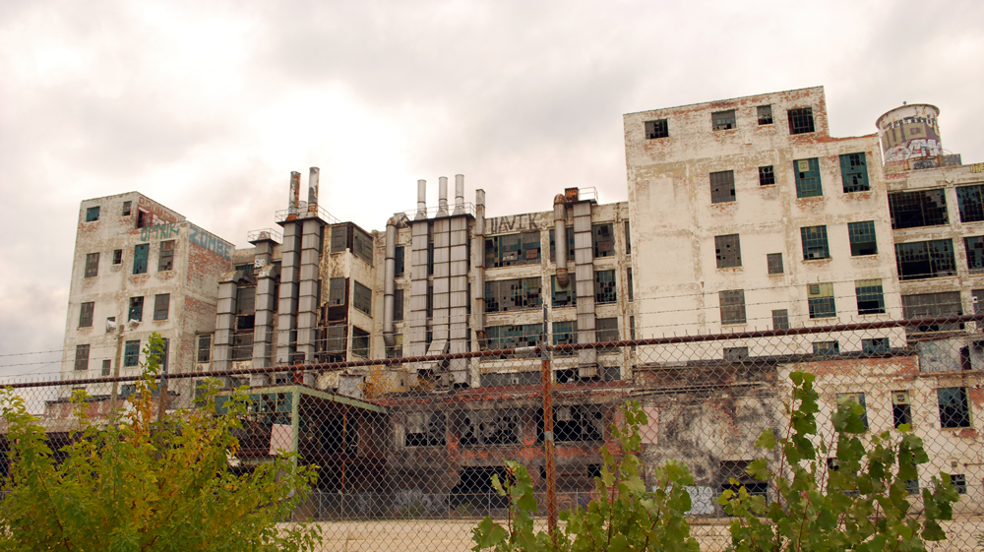
The Geographies of Capital
The production of surplus value takes place somewhere. It involves not only workers and capitalists, but factories and machines, transport and retail.
Geographers have explored questions such as the spatial division of labour (Doreen Massey), and the uneven geography of capital accumulation (Neil Smith).
The production of space – Henri Lefebvre

Slide 11
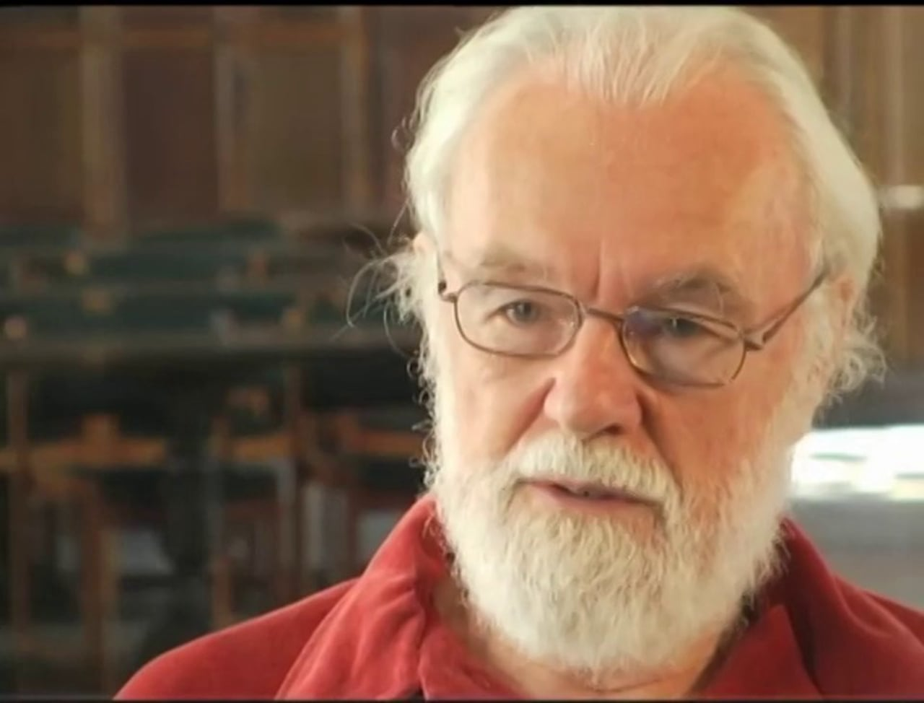
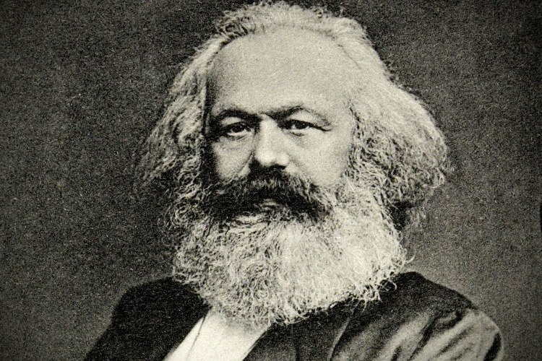
And this guy…

Slide 12
Marxism and Geography
We cannot understand Marxism without geography
Yet we also cannot understand geography without Marxism
BUT there are other ways of understanding the world too
Class and gender and race and sexuality and coloniality
Too structuralist: everything (superstructure) is determined by the economic base? Where is human agency in shaping the world?

Slide 13
Structure-agency

Slide 14
In small groups: What is Marxism? Is it relevant today? Could it help you do research?

Slide 15
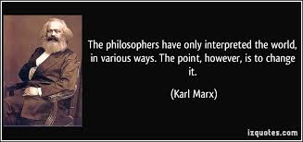
So…why bother? A personal story
What is the point in knowledge? Why do we learn and research?
Need tools to change the world

Slide 16
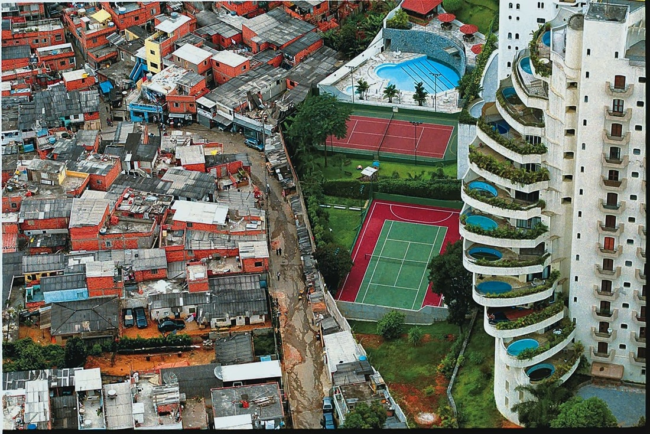
Relevance
Capitalist mode of production is hard to ignore.
Shapes our societies and lives in multiple ways with clear geographical implications

Slide 17
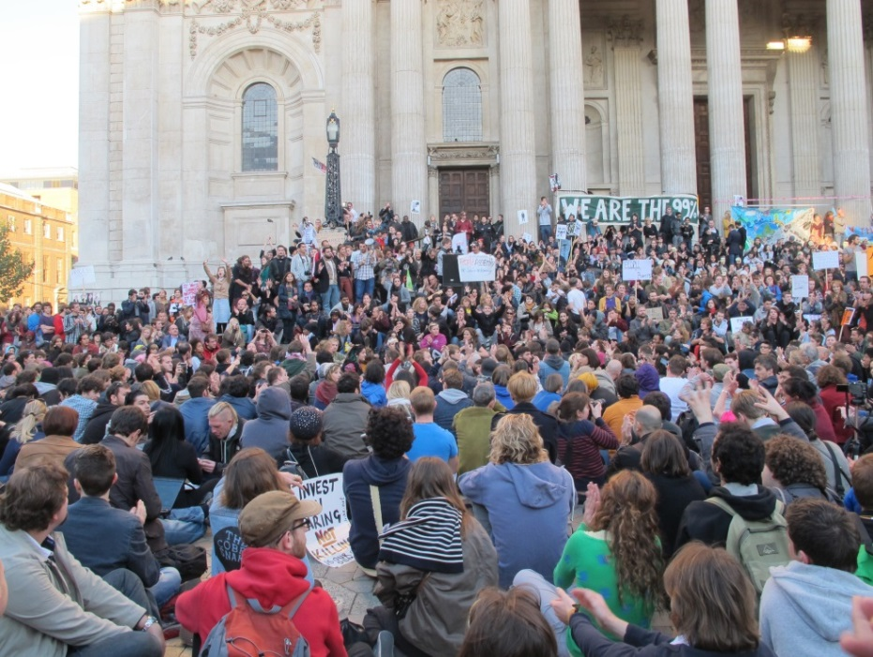
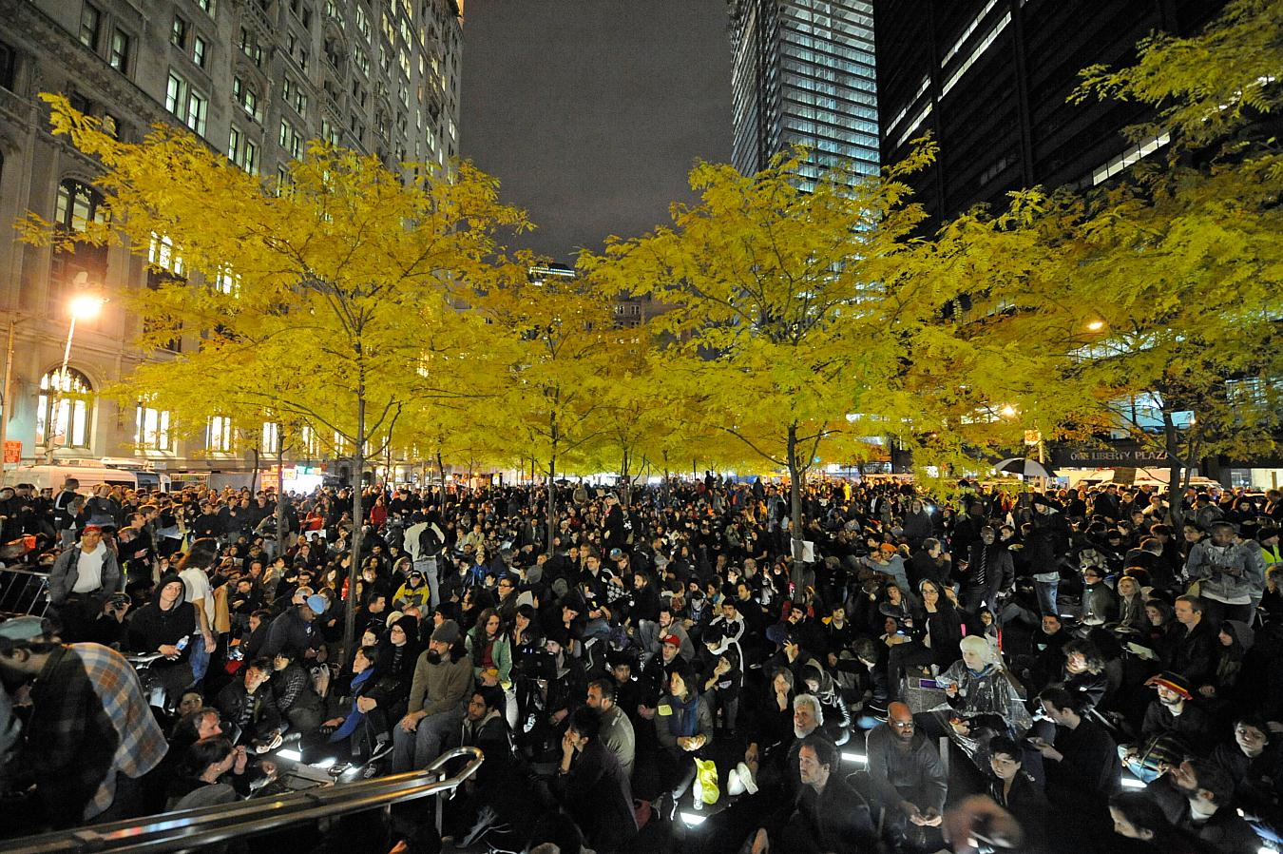
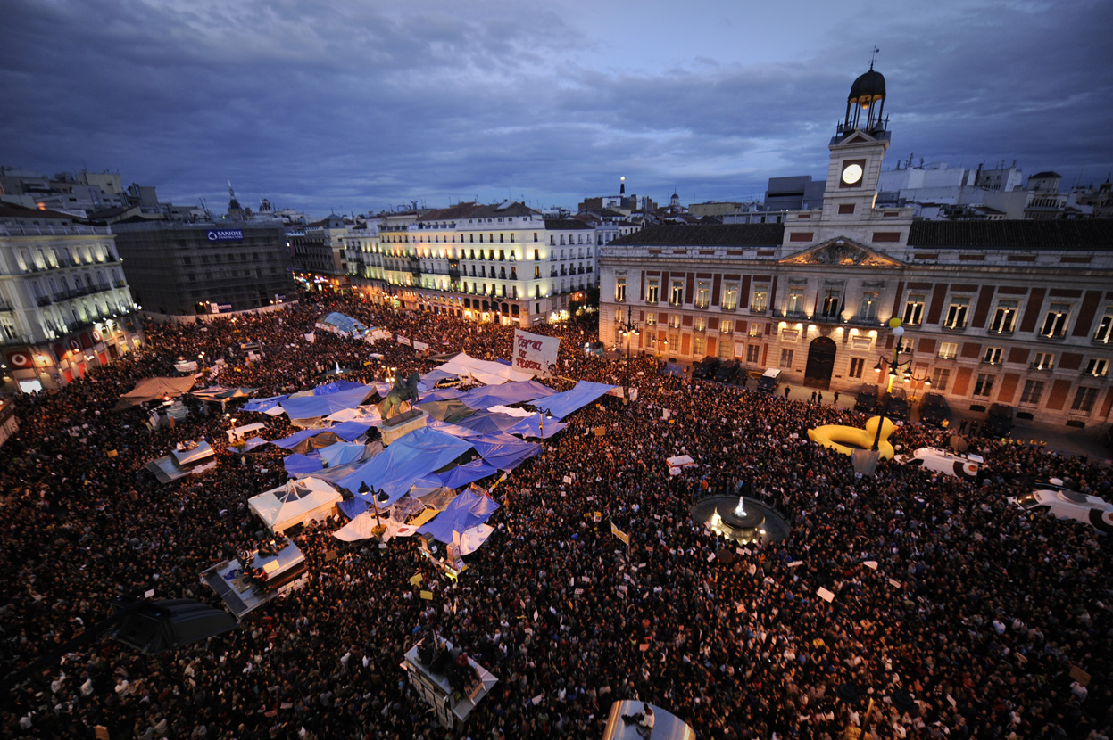
My research on urban activism
Marxism has helped me to make sense of urban struggles
Occupy! And the 99%
Production of space and Lefebvre
Dialectics and antagonism

Slide 18
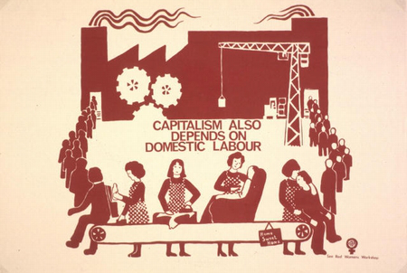
I have also questioned Marxism
How universal is it?
Can I use it to understand Latin America?
Is everything class?
Am I a Marxist???

Slide 20
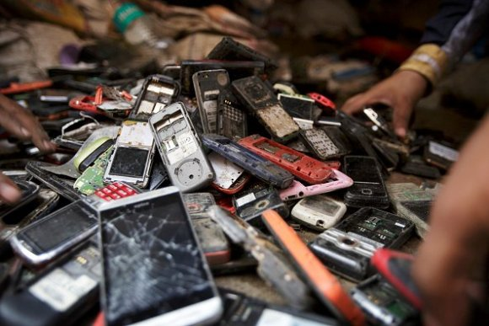
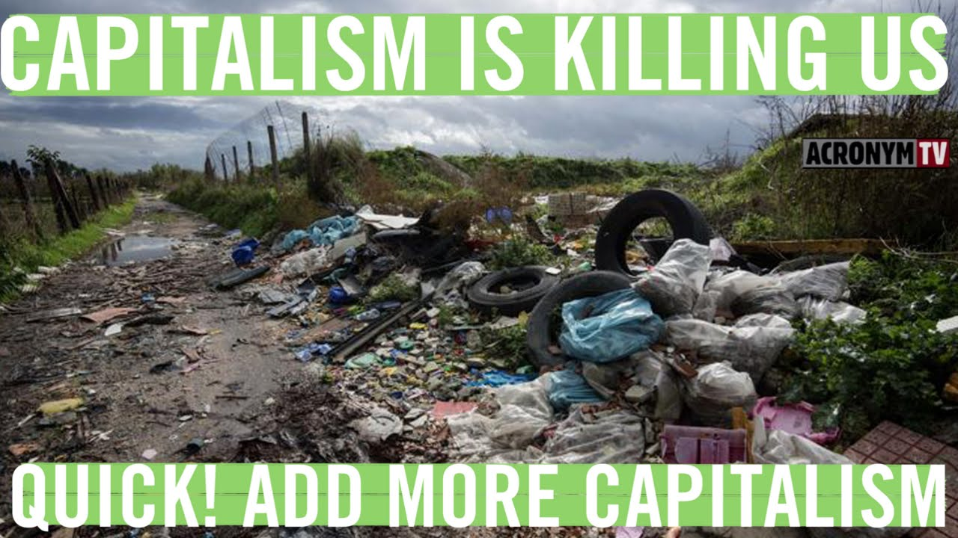
Example: The geographies of waste
Capitalism appears to be very wasteful
Waste intersects with class and is unevenly distributed
So what can a Marxists analysis bring?

Slide 21
Capitalism and Waste
https://www.tni.org/en/article/waste-and-capitalism
1. Capitalism wastes resources: surplus value requires constant growth: for ever! Goods cannot last
2. Capitalism wastes people: requires a reserve army of labour; happy to let people go
3. Capitalism wastes society: it pulls them apart and reduces social cohesion
4. Capitalism wastes money: consumerism and bail outs

Slide 22
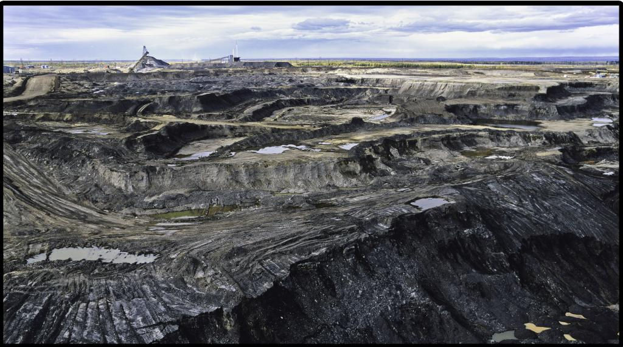
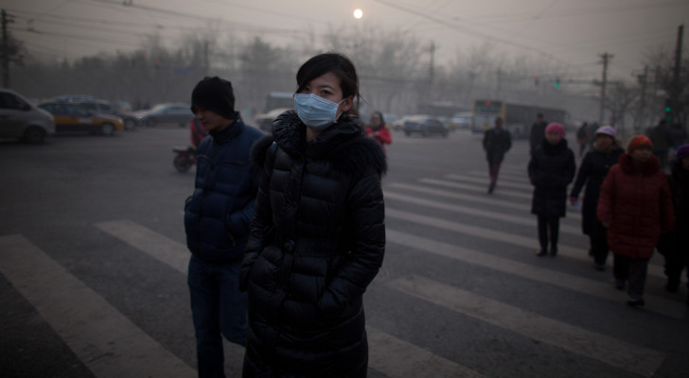
Capitalism wastes nature
The second contradiction of capitalism (James O’Connor)
Capital relies on endless growth – requires basic material conditions of production (water, energy, etc).
Yet the production process undermines these conditions
Harms the environment and people that live there

Slide 23
The production of nature
Capitalism has, for a long time, produced much of the “non-human” world – plants
Nature is thus dynamic and shifting
In capitalism nature and our relation within it also transforms
There is no limit for capitalism…or is there?

Slide 24
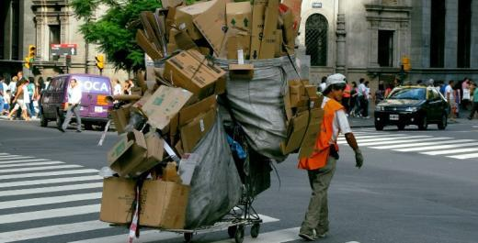
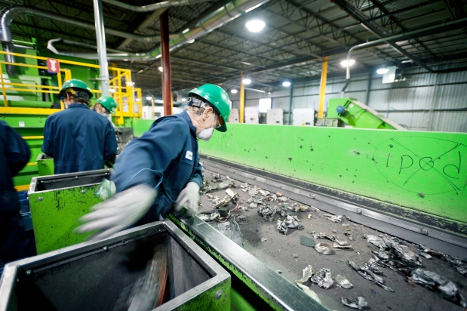
Waste forever
Waste can thus accumulate seemingly forever
Yet many see capitalism as providing solutions for waste: by commodifying it
So: is capitalism sustainable?
https://www.youtube.com/watch?v=VthS0PDbiP8

Slide 25
Conclusion
Marxisms and geographies
Class, value, production
Exploitation, antagonisms, social change, revolution
Tools for changing the world
But limited

