Slide 1
Masterclass 4 10th and 17th January 2025 DAT and TDM MAN and ADR Learning points
Patricia McGettigan
Clinical Pharmacologist
Head of MBBS CPT teaching

Slide 2
I had many Q re the new asthma guidance Here is a PSA update on new NICE / other guidance
'Whilst the PSA assessment board will not comment on the content of PSA question papers, they can confirm that all questions are reviewed prior to each use to ensure they align with contemporary practice and guidelines.
If guidance changes close to a sitting date, this is taken into account during the post-assessment review process, so that no candidates are disadvantaged by knowledge of recent changes in practice.'

Slide 3
DAT (Data Interpretation) Many DAT questions include aspects of TDM and / or MAN This is true of most of the Q that follow here It can be helpful in answering to think, ‘if this was a MAN situation in clinical life, what would I do’

Slide 4
Tips
Interactions Appendix 1 BNF – search ‘Appendix’
Useful tables, e.g. drugs causing long QT, serotonin synd, anti-muscarinic effects, … etc; Useful to know about; not exhaustive – see table caveats
For dose increases / decreases relating to low / high measures, e.g., abx level, blood glucose (TDM or MAN or DAT question)
Change dose in the region of 10% - 15% up or down from current (not 50%)
Palliative care: Avoid IV routes for analgesia, symptom relief
Use oral, topical, SC
Opioid dose conversions – READ the question
Can be as simple as a patient on prn Oramorph & good pain control needing to have a switch to a longer-acting prep: SO, add up the total oramorph for the day, divide in 2 for bd dosing, e.g. oramorph 200mg over 24h would be changed to MST Continus 100mg bd
Good Tables in BNF Palliative Care section for drug conversions; oral → topical, etc.

Slide 5
Tips
Anticoagulants – DOAC PWS questions:
Check your chosen DOAC has that indication – differing indications; Check dose v renal function
Care with medical v orthopaedic / surgical thromboprophylaxis
Pabrinex is not a PWS item as not available in the PSA platform’s drug list
But of course, it could show up in a best-of-5 MAN / other Q
Crossover - topics can appear in any section
e.g. ADR / interactions / COM / REV
Stuck on finding the right Treatment Guideline but you know a drug used, e.g., warfarin reversal with high INR/bleeding
‘Navigate to Section’ of the drug monograph may have a ‘Related Treatment Summaries’ section that will help guide you

Slide 6
Data Interpretation Item
ID
DAT001
This question item is worth 2 marks
You may use the BNF at any time
Case presentation
A 34-year-old woman is on twice daily gentamicin based on weight [60mg 12-hrly] for streptococcal infective endocarditis
After 4 doses:
Pre dose trough: 0.6 mg/L [<1}
Post dose peak: 6 mg/L [3-5]
DECISION OPTIONS
A | Gentamicin 60mg once daily |  | ☐
B | No change to therapy required |  | ☐
C | Gentamicin 75mg twice daily |  | ☐
D | Gentamicin 45mg twice daily |  | ☐
E | Stop gentamicin |  | ☐
Question
Select the most appropriate decision option with regard to the anti-biotic prescription based on these data.
(mark it with a tick)
Created by Department of Clinical Pharmacology, QMUL

Slide 7
Data Interpretation Item
ID
DAT001
This question item is worth 2 marks
You may use the BNF at any time
Case presentation
A 34-year-old woman is on twice daily gentamicin based on weight [60mg 12-hrly] for streptococcal infective endocarditis
After 4 doses:
Pre dose trough: 0.6 mg/L [<1}
Post dose peak: 6 mg/L [3-5]
DECISION OPTIONS
A | Gentamicin 60mg once daily |  | ☐
B | No change to therapy required |  | ☐
C | Gentamicin 75mg twice daily |  | ☐
D | Gentamicin 45mg twice daily |  | ✓
E | Stop gentamicin |  | ☐
Question
Select the most appropriate decision option with regard to the anti-biotic prescription based on these data.
(mark it with a tick)
Answer box
Option A | Justification
Would be appropriate if trough level is high
Option B | Justification
Peak is too high
Option C | Justification
This will increase peak levels
Option D | Justification
If peak levels, high, reduce by 25% and keep dosing interval same [Application of BNF info; % decrease not in BNF - clinical work; see MicroGuide Barts Health]
Option E | Justification
Not needed
Created by Department of Clinical Pharmacology, QMUL

Slide 8
Gentamicin – BNF
Gentamicin dose level (data) interpretation and next mx step
Common FY1 role
Major safety element
https://bnf.nice.org.uk/drug/gentamicin.html#monitoringRequirements
“For multiple daily dose regimens, blood samples should be taken approximately 1 hour after IM or IV administration (‘peak’ concentration) and also just before the next dose (‘trough’ concentration).”
“If the pre-dose (‘trough’) concentration is high, the interval between doses must be increased. If the post-dose (‘peak’) concentration is high, the dose must be decreased”
Note endocarditis levels lower than for other indications
Hartford Dosing Nomogram – once daily (Extended Interval) dosing
Useful Read: Banarjee et al. BMJ 2012; 345 doi: https://doi.org/10.1136/bmj.e6354

Slide 9
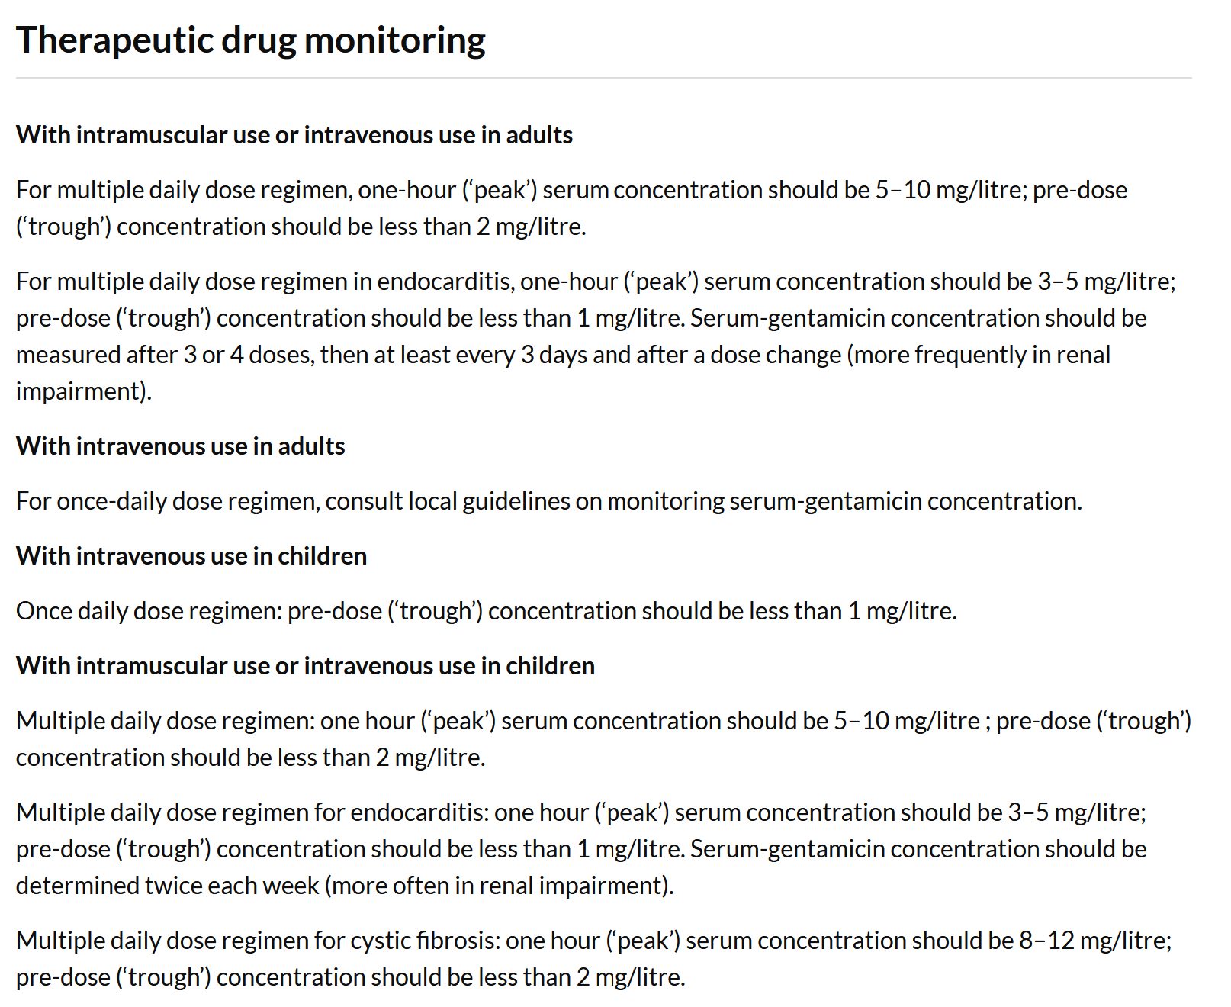
https://bnf.nice.org.uk/drug/gentamicin.html#directionsForAdministration
For Q on once daily dosing / levels, PSA will provide the Hartford nomogram if needed

Slide 10
Hartford nomogram – for extended interval dosing Designed for dose 7mg/Kg body weight Check level at 6-14h after first dose Plot on nomogram to guide timing interval for next dose Read: Banarjee et al. BMJ 2012; 345 doi: https://doi.org/10.1136/bmj.e6354
PSA Q – if Hartford/ other abx dosing nomogram is needed, it will be shown in the Q
Make sure to read all the text on the nomogram – for some abx, may direct you on dividing / timing doses

Slide 11
Vancomycin https://bnf.nice.org.uk/drug/vancomycin.html
Multiple indications – see BNF
For Adult systemic therapy: 15–20 mg/kg IV every 8–12 hours (max. per dose 2 g) adjusted according to plasma-concentration monitoring; consult product literature for further information…..
Unlike gentamicin, peak / trough levels not listed in BNF – so a PSA TDM / DAT Q will provide targets and dosing adjustment table for you to use
You do not have access to Micro Guide / dosing calculators
NB: C diff – oral dosing – local effect desired, not systemic
low GI absorption (unless GI inflammatory disorder – care)

Slide 12
Data Interpretation Item
ID
DAT021
Case presentation
A 62-year-old man attends the Emergency Department as he cannot stop the bleeding from a small shaving cut. There are no other symptoms or signs of bleeding. PMH. Mitral stenosis with atrial fibrillation. DH. Warfarin 3 mg orally daily (target INR 2.5)
Investigations
Hb 145 g/L (130-170), stable.
INR 7.9.
Continue warfarin at reduced dose of 2 mg orally daily
Stop warfarin, give Vitamin K 1 mg intravenously
Stop warfarin, give Vitamin K 1 mg orally
Stop warfarin, give Vitamin K 5 mg intravenously and dried prothrombin complex
Stop warfarin, start edoxaban 60 mg orally daily
Question
Select the most appropriate decision option with regard to his warfarin based on these data.
(mark it with a tick)

Slide 13
Data Interpretation Item
ID
DAT021
Case presentation
A 62-year-old man attends the Emergency Department as he cannot stop the bleeding from a small shaving cut. There are no other symptoms or signs of bleeding. PMH. Mitral stenosis with atrial fibrillation.
DH. Warfarin 3 mg orally daily (target INR 2.5)
Investigations
Hb 145 g/L (130-170), stable.
INR 7.9.
Continue warfarin at reduced dose of 2 mg orally daily
Stop warfarin, give Vitamin K 1 mg intravenously *
Stop warfarin, give Vitamin K 1 mg orally
Stop warfarin, give Vitamin K 5 mg intravenously and dried prothrombin complex
Stop warfarin, start edoxaban 60 mg orally daily
*Clinical practice note: Warfarin is re-commenced when INR =/<5
Question
Select the most appropriate decision option with regard to his warfarin based on these data.
(mark it with a tick)

Slide 14
Warfarin, high INR
Be familiar with BNF Treatment summaries → Oral anticoagulants
Know what you can find there
Contains generic advice on
Target INR
Duration of treatment with DVTs
Action with high INRs / bleeding
Peri-operative management
Finding the correct Treatment Summary for anything
If you know a drug used, then the drug monograph Navigate to Section box may be helpful – may have a Related Treatment Summaries heading

Slide 15
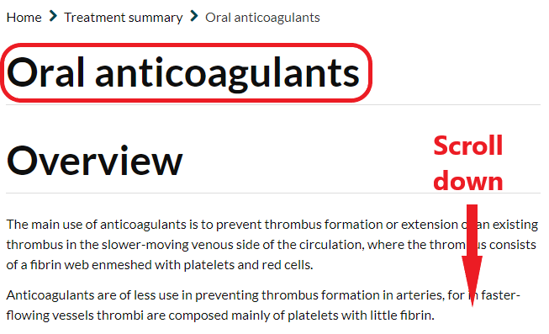
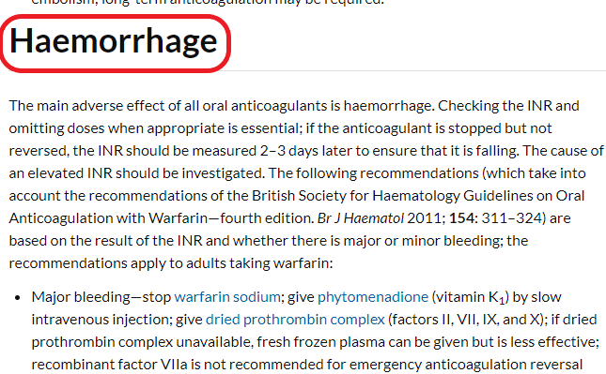

Slide 16
Warfarin reversal determined by INR and severity of bleeding
Bleeding | INR | Action
Major (limb or life-threatening) | Any | Stop warfarin Give phytomenadione (vitamin K1) 5 mg slow i.v. Give dried prothrombin complex 25–50 units/kg i.v. (If dried prothrombin complex unavailable, give FFP but less effective)
Minor | >8.0 | Stop warfarin Give phytomenadione (vitamin K₁) 1–3 mg slow i.v. (Repeat dose of phytomenadione if INR still too high after 24 hours) Restart warfarin when INR <5.0
 | 5.0 – 8.0 | Stop warfarin Give phytomenadione (vitamin K₁) 1–3 mg slow i.v. Restart warfarin when INR <5.0
Nil | >8.0 | Stop warfarin Give phytomenadione (vitamin K₁) 1–5 mg p.o. (Repeat dose of phytomenadione if INR still too high after 24 hours) Restart warfarin when INR <5.0
 | 5.0 – 8.0 | Withhold 1 or 2 doses of warfarin Reduce subsequent maintenance dose

Slide 17
Data Interpretation Item
ID
DAT026
Case presentation
A 28-year old woman is admitted with acute pyelonephritis. She is being treated with tobramycin 60mg intravenously 8-hrly, as indicated by microbiology sensitivities. PMH. Type I diabetes mellitus. DH. Insulin.
Serum tobramycin level:
Pre-dose 1.4 mg/L (target <2 mg/L)
Post-dose 11.3 mg/L (target <10 mg/L)
Renal function normal
Change to gentamicin 70 mg intravenously 8-hrly
Decrease dose to tobramycin 50 mg intravenously 8-hrly
Decrease frequency to tobramycin 60 mg intravenously 12-hrly
Increase dose to tobramycin 70 mg intravenously 8-hrly
Increase frequency to tobramycin 60 mg intravenously 6-hrly
No changes to tobramycin dose
Question
Select the most appropriate decision option with regard to antimicrobial doses based on these data.
(mark it with a tick)

Slide 18
Data Interpretation Item
ID
DAT026
Case presentation
A 28-year old woman is admitted with acute pyelonephritis. She is being treated with tobramycin 60mg intravenously 8-hrly, as indicated by microbiology sensitivities. PMH. Type I diabetes mellitus. DH. Insulin.
Serum tobramycin level:
Pre-dose 1.4 mg/L (target <2 mg/L)
Post-dose 11.3 mg/L (target <10 mg/L)
Renal function normal
Change to gentamicin 70 mg intravenously 8-hrly
Decrease dose to tobramycin 50 mg intravenously 8-hrly
Decrease frequency to tobramycin 60 mg intravenously 12-hrly
Increase dose to tobramycin 70 mg intravenously 8-hrly
Increase frequency to tobramycin 60 mg intravenously 6-hrly
No changes to tobramycin dose
Question
Select the most appropriate decision option with regard to antimicrobial doses based on these data.
(mark it with a tick)

Slide 19
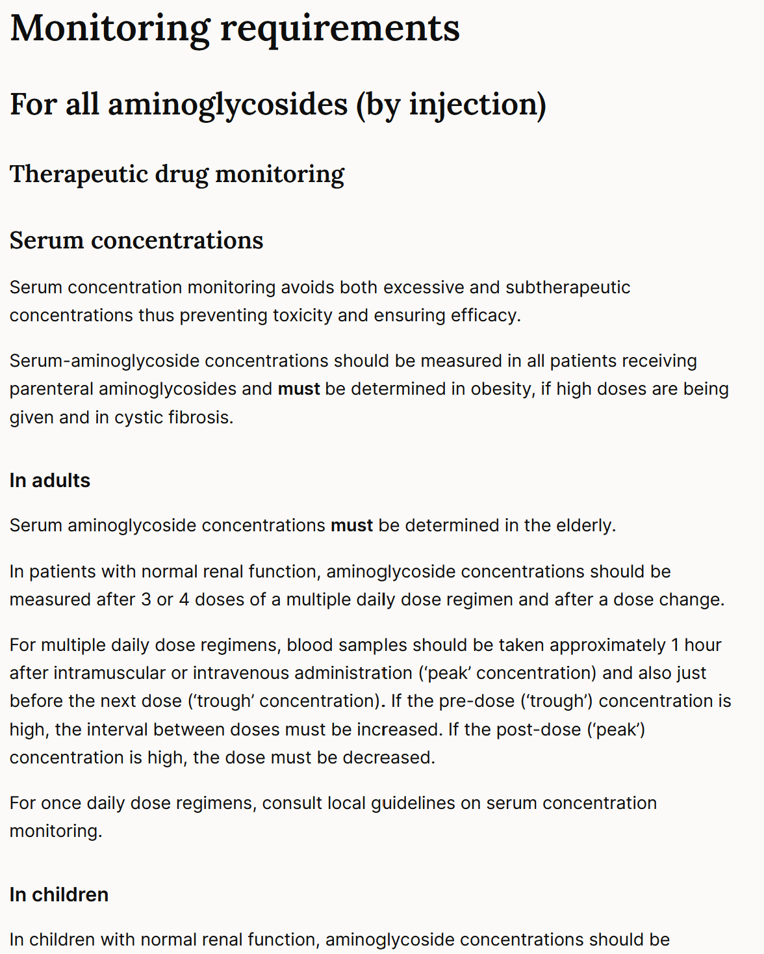
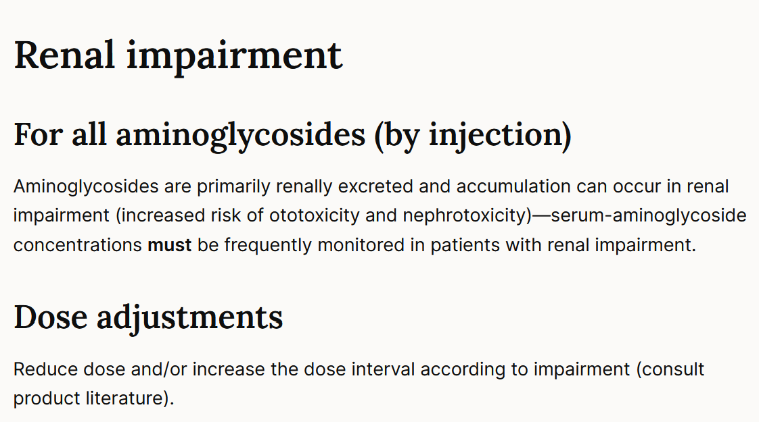
Antibiotics - therapeutic drug monitoring
For antibiotics that require TDM, BNF does not usually provide target levels
These will be in the PSA question
In “real-life” you should also consult local microbiology guidance

Slide 20
Antibiotics therapeutic drug monitoring
There is also guidance on whether to decrease/increase dose or increase interval in the BNF
Result | Action
Pre-dose (“trough”) high | Increase interval between doses (i.e. less frequent)
Post-dose (“peak”) high | Decrease dose

Slide 21
Paracetamol
Refer Tox section of BNF
Also, later toxicology Lecture by Dr Kapil will include

Slide 22
Some other Data Topics
Resp – COPD / asthma add-in or tx changes depending on respiratory function result provided or symptoms showing imperfect control
Anaemia therapy choice – check indices for microcytic v macro and/or folate and/or B12 results provided

Slide 23
TDM (Therapeutic Drug Monitoring) questions and associated learning points TDM and DAT questions may overlap depending on the drug or situation Some TDM questions will include data, as in clinical life

Slide 24
Drug Monitoring Item
ID
TDM000
This item is worth 2 marks
You may use the BNF at any time
Case presentation
PMH.
DH.
SH.
MONITORING OPTIONS
A
B
C
D
E
Question
Select the most appropriate monitoring option to assess the [beneficial/adverse] effects of this treatment.
(mark it with a tick)
Answer box
Option A | Justification
Option B | Justification
Option C | Justification
Option D | Justification
Option E | Justification

Slide 25
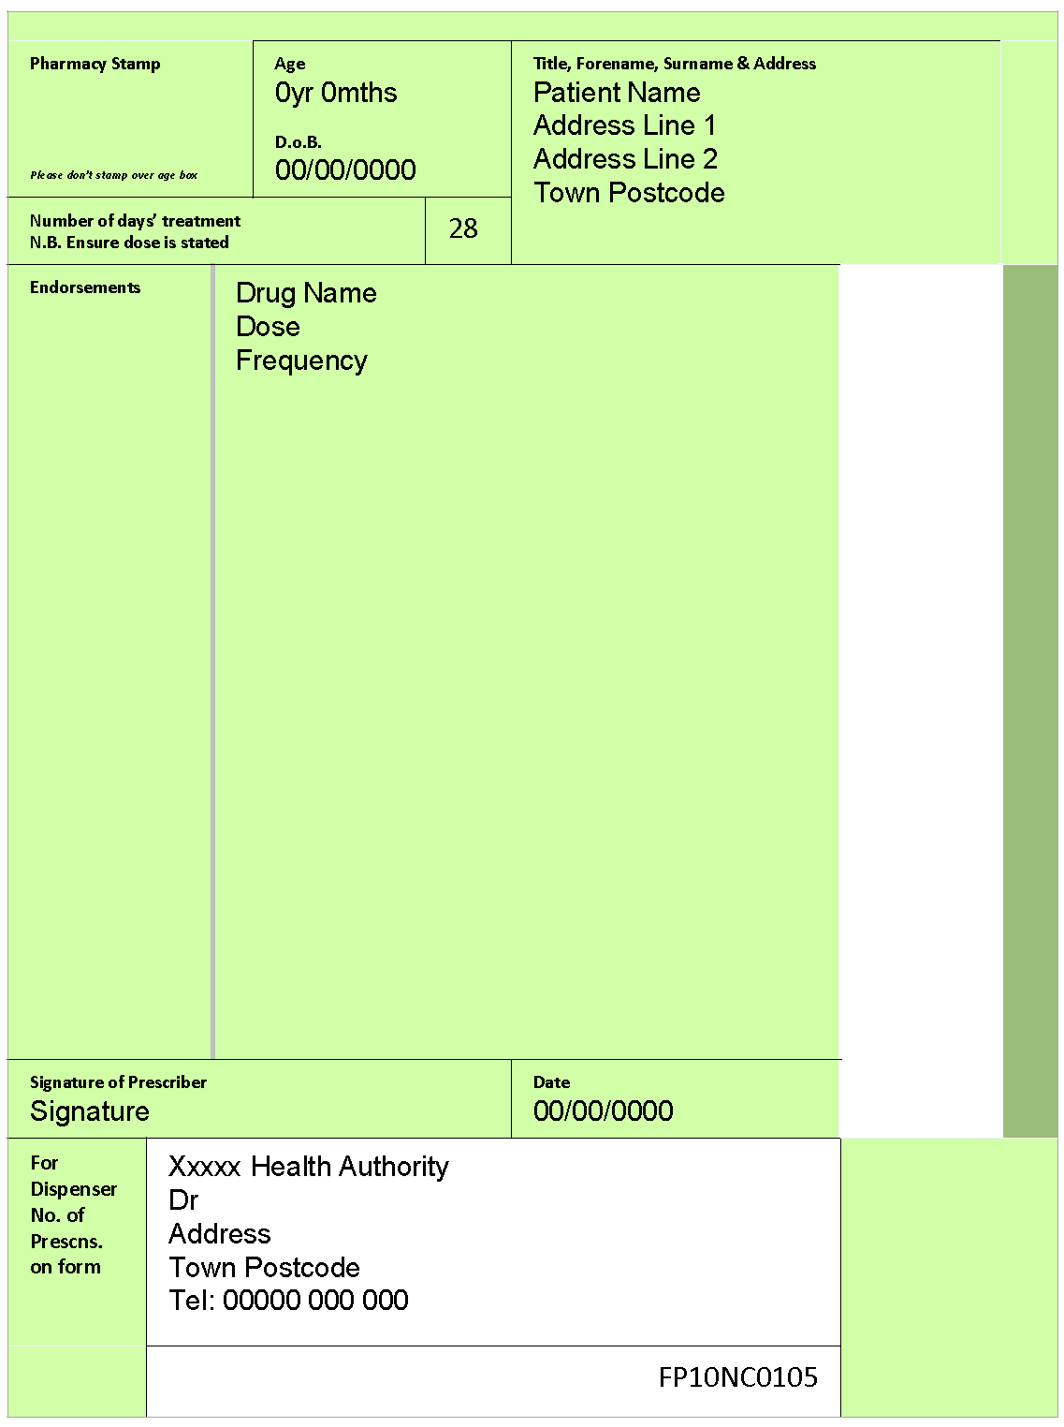
Prescribing Item
ID
Case presentation
A 9-year old boy is being reviewed for his asthma. He has been requiring regular salbutamol inhalers, around 4-5 times a week recently. Previously, he rarely needed to use the inhaler. PMH. Asthma.
His General Practitioner (GP) explains he needs to commence additional therapy to improve his asthma control
Drug name
Dose
Frequency
Duration
Prescribing request
Write a prescription for an appropriate drug to be added to his therapy
(Use the GP prescription form provided)

Slide 26
Prescribing Item
ID
Possible options
Budesonide 100 micrograms / inhalation inhaler; 1 inhalation twice daily
Budesonide 100 micrograms / inhalation inhaler; 1 inhalation twice daily
Beclomethasone 100 micrograms / inhalation inhaler; 1 inhalation twice daily
Beclomethasone 50 micrograms / inhalation MDI; 2 inhalations twice daily
Etc, etc
Duration: 28 / 30 days; one month. This will be a repeat prescription, but here, the child will be reviewed in 2-3 weeks to assess control, ideally before next prescription due.
(Note: multiple products are suitable – in the PSA, the dropdown menu is a big help – take care to choose the correct dose device
BTS/SIGN recommend to prescribe by brand (happens with e-prescribing anyway – product name/brand incl in the selection)
NB: For clinical practice, choose same brand on repeat prescription because the devices differ – MDI, DPI, breath actuated, soft mist)
Case presentation
A 9-year old boy is being reviewed for his asthma. He has been requiring regular salbutamol inhaler use, 4-5 times a week, recently. Previously, he rarely needed to use the inhaler. PMH. Asthma.
His General Practitioner (GP) explains he needs to commence additional therapy to improve his asthma control
Prescribing request
Write a prescription for an appropriate drug to be added to his therapy
(Use the GP prescription form provided)

Slide 27
Drug Monitoring Item
ID
TDM020
Blood glucose diary
Blood pressure
Full blood count
Haemoglobin A1c
Height and weight
Liver function tests
Serum cortisol
Urea and electrolytes
Case presentation
A 7-year old boy is being reviewed for his asthma. He has been requiring regular salbutamol inhalers, around 4-5 times a week. PMH. Asthma.
He is due to start on budesonide 100 micrograms, inhaled twice daily.
Question
Select the most appropriate monitoring option to assess the adverse effects of this treatment.
(mark it with a tick)

Slide 28
Drug Monitoring Item
ID
TDM020
Blood glucose diary
Blood pressure
Full blood count
Haemoglobin A1c
Height and weight
Liver function tests
Serum cortisol
Urea and electrolytes
Case presentation
A 7-year old boy is being reviewed for his asthma. He has been requiring regular salbutamol inhalers, around 4-5 times a week. PMH. Asthma.
He is due to start on budesonide 100 micrograms, inhaled twice daily.
Question
Select the most appropriate monitoring option to assess the adverse effects of this treatment.
(mark it with a tick)

Slide 29
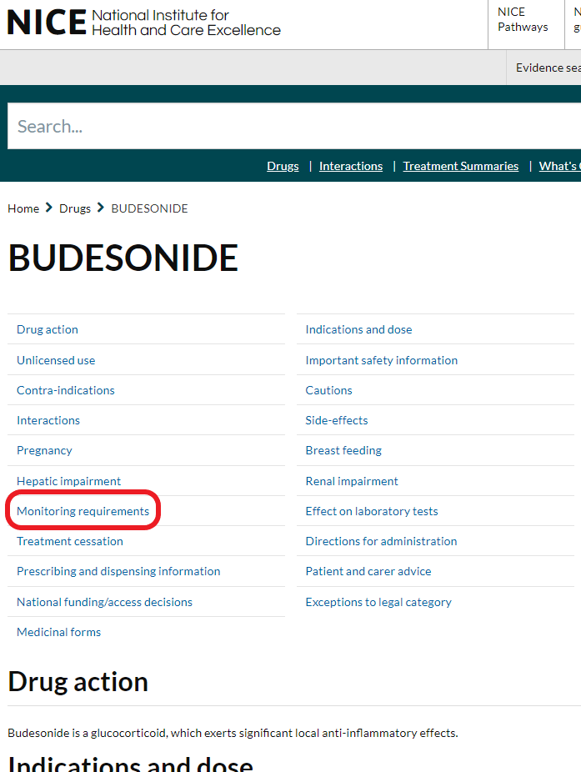
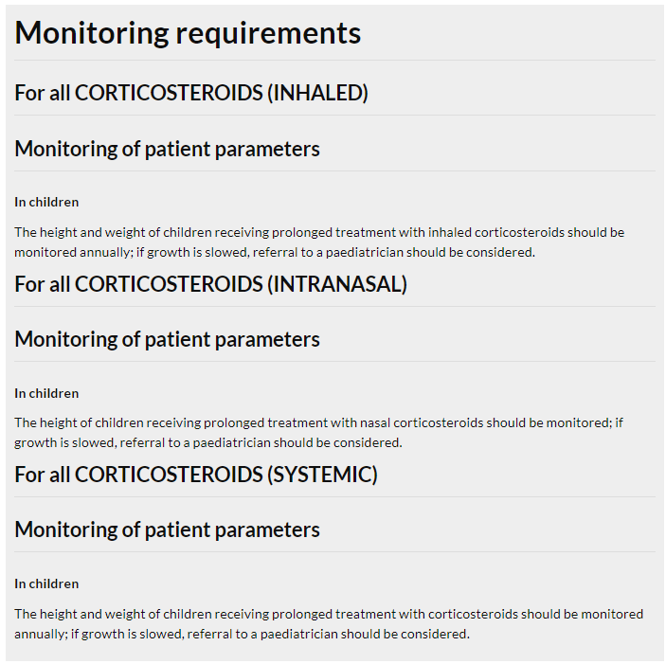
“Monitoring requirements” in BNF

Slide 30
Drug Monitoring Item
ID
TDM021
Exercise tolerance
Heart rate
Left ventricular ejection fraction
Postural blood pressure
PR interval
Case presentation
A 65-year old man is being reviewed about his angina which comes on when walking his dog or doing the shopping. He is currently using his GTN sublingual spray at least three times a week.
ECG – sinus rhythm 88/min, no ischaemic changes.
He is due further cardiac investigations.
In the meantime, he has been started on bisoprolol 2.5 mg orally daily.
Question
Select the most appropriate monitoring option to assess the beneficial effects of this treatment.
(mark it with a tick)

Slide 31
Drug Monitoring Item
ID
TDM021
Exercise tolerance
Heart rate
Left ventricular ejection fraction
Postural blood pressure
PR interval
Case presentation
A 65-year old man is being reviewed with regards to angina which comes on when walking his dog or doing the shopping. He is currently taking his GTN sublingual spray at least three times a week.
ECG – sinus rhythm 88/min, no ischaemic changes.
He is due further investigations.
In the meantime, he has been started on bisoprolol 2.5 mg orally daily.
Question
Select the most appropriate monitoring option to assess the beneficial effects of this treatment.
(mark it with a tick)

Slide 32
Drug Monitoring Item
ID
TDM021
Anti-factor Xa activity
Bleeding time
aPTT
INR
Platelet count
Case presentation
A 45-year old woman presents with sudden onset breathlessness & is found to have multiple small pulmonary emboli. She weighs 116Kg. PMHx. Previously well.
ECG – sinus rhythm, no ischaemic / strain changes. Sats 93% on air. BMI 42 Kg/m2
She has been started on enoxaparin 100mg sc twice daily.
Question
Select the most appropriate monitoring option to assess the need for dose adjustment of the enoxaparin.
(mark it with a tick)

Slide 33
Drug Monitoring Item
ID
TDM021
Anti-factor Xa activity
Bleeding time
aPTT
INR
Platelet count
Case presentation
A 45-year old woman presents with sudden onset breathlessness & is found to have multiple small pulmonary emboli. She weighs 116Kg. PMHx. Previously well.
ECG – sinus rhythm, no ischaemic / strain changes. Sats 93% on air. BMI 42 Kg/m2
She has been started on enoxaparin 100mg sc twice daily.
Question
Select the most appropriate monitoring option to assess the need for dose adjustment of enoxaparin.
(mark it with a tick)

Slide 34
Drug Monitoring Item
ID
TDM021
Alpha-1-fetoprotein levels
FBC
Stool frequency
Serum albumin
INR
Case presentation
A 22-year old man has had several recent flare-ups of his inflammatory bowel disease despite taking prednisolone 20mg/day.
He is commenced on Azathioprine 150mg po daily
Question
Select the most appropriate monitoring option to check for adverse effects of the new treatment in the next 1-2 weeks
(mark it with a tick)

Slide 35
Drug Monitoring Item
ID
TDM021
Alpha-1-fetoprotein levels
FBC
Stool frequency
Serum albumin
INR
Case presentation
A 22-year old man has had several recent flare-ups of his inflammatory bowel disease. He is taking prednisolone 20mg/day.
He is now commenced on Azathioprine 150mg po daily
Question
Select the most appropriate monitoring option to check for adverse effects of the new treatment in the next 1-2 weeks
(mark it with a tick)

Slide 36
Drug Monitoring Item
ID
TDM021
Alpha-1-fetoprotein levels
FBC
Stool frequency
Serum albumin
INR
Case presentation
A 22-year old man has had several recent flare-ups of his inflammatory bowel disease despite taking prednisolone 20mg/day.
He is commenced on Azathioprine 150mg po daily
Question
Select the most appropriate monitoring option to check for beneficial effects of the new treatment in the next 1-2 weeks
(mark it with a tick)

Slide 37
Drug Monitoring Item
ID
TDM021
Alpha-1-fetoprotein levels
FBC
Stool frequency
Serum albumin
INR
Case presentation
A 22-year old man has had several recent flare-ups of his inflammatory bowel disease despite taking prednisolone 20mg/day.
He is commenced on Azathioprine 150mg po daily
Question
Select the most appropriate monitoring option to check for adverse effects of the new treatment in the next 1-2 weeks
(mark it with a tick)

Slide 38
Drug Monitoring Item
ID
TDM022
Pre-bedtime capillary blood glucose
Pre-breakfast capillary blood glucose
Pre-evening meal capillary blood glucose
Pre-lunch capillary blood glucose
Pre-morning snack
Case presentation
A 24-year old man is having his diabetic control reviewed. He is currently asymptomatic. PMH. Type I diabetes. DH. Basal-bolus insulin.
He has concerns that his lunchtime dose is too high. His usual meals are breakfast, lunch and evening meal and he has a mid-morning snack
Question
Select the most appropriate monitoring option to assess the effects of lunchtime dose of insulin.
(mark it with a tick)

Slide 39
Drug Monitoring Item
ID
TDM022
Case presentation
A 24-year old man is having his diabetic control reviewed. He is currently asymptomatic. PMH. Type I diabetes. DH. Basal-bolus insulin.
He has concerns that his lunchtime dose is too high.
Pre-bedtime capillary blood glucose
Pre-breakfast capillary blood glucose
Pre-evening meal capillary blood glucose
Pre-lunch capillary blood glucose
Pre-morning snack
Question
Select the most appropriate monitoring option to assess the effects of lunchtime dose of insulin.
(mark it with a tick)

Slide 40
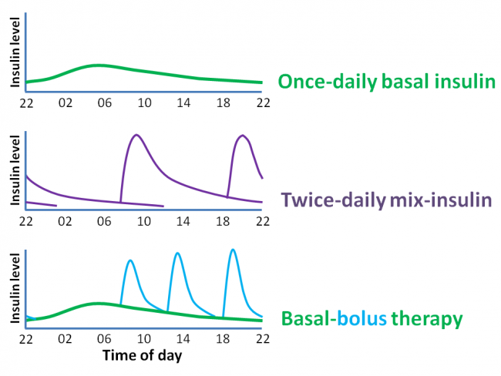
Bedtime
Post-prandial
Post-prandial
Post-prandial
Pre-prandial
Pre-prandial
Pre-prandial

Slide 41
Bedtime
Post-prandial
Post-prandial
Post-prandial
Pre-prandial
Pre-prandial
Pre-prandial
Blood glucose level | MAIN influence on the level
Pre-breakfast | Evening dose
Pre-lunch | Morning dose
Pre-evening meal | Morning dose
Bedtime | Evening dose

Slide 42
Bedtime
Post-prandial
Post-prandial
Post-prandial
Pre-prandial
Pre-prandial
Pre-prandial
Blood glucose level | MAIN influence on level
Pre-breakfast | Basal dose
Pre-lunch | (Breakfast and basal dose)
Pre-evening meal | (Lunch and basal dose)
Bedtime | (Evening meal and basal dose)

Slide 43
Data Interpretation Item
ID
DAT027
Case presentation
A 27-year-old woman attends the diabetes clinic for routine review. She reports no hypoglycaemic symptoms or episodes. PMH. Type 1 diabetes. DH. NovoMix® 30 (biphasic insulin aspart) 20 units SC at breakfast and 16 units SC with evening meal.
For the past 2 weeks, pre-prandial and bedtime capillary blood glucose monitoring shows:
08.00 h: 10-13 mmol/L
12.00 h: 6-11 mmol/L
18.00 h: 7-11 mmol/L
22.00 h: 11-14 mmol/L
Decrease the breakfast NovoMix® 30 dose to 16 units SC
Decrease the evening meal NovoMix® 30 dose to 12 units SC
Give Actrapid® insulin 6 units SC with the evening meal
Increase the breakfast NovoMix® 30 dose to 22 units SC
Increase the breakfast NovoMix® 30 dose to 30 units SC
Increase the calorific content of the lunchtime meal
Increase the evening meal NovoMix® 30 dose to 18 units SC
Increase the evening meal NovoMix® 30 dose to 24 units SC
No changes to insulin doses
Switch from NovoMix® 30 SC to insulin glargine 36 units SC nightly
Question
Select the most appropriate management option at this stage to improve glycaemic control. (mark it with a tick)

Slide 44
Data Interpretation Item
ID
DAT027
Case presentation
A 27-year-old woman attends the diabetes clinic for routine review. She does not report any hypoglycaemic symptoms or episodes. PMH. Type 1 diabetes. DH. NovoMix® 30 (biphasic insulin aspart) 20 units SC at breakfast and 16 units SC with evening meal.
For the past 2 weeks, pre-prandial and bedtime capillary blood glucose monitoring shows:
08.00 h: 7-10 mmol/L
12.00 h: 6-11 mmol/L
18.00 h: 7-11 mmol/L
22.00 h: 11-14 mmol/L
Decrease the breakfast NovoMix® 30 dose to 16 units SC
Decrease the evening meal NovoMix® 30 dose to 12 units SC
Give Actrapid® insulin 6 units SC with the evening meal
Increase the breakfast NovoMix® 30 dose to 22 units SC
Increase the breakfast NovoMix® 30 dose to 30 units SC
Increase the calorific content of the lunchtime meal
Increase the evening meal NovoMix® 30 dose to 18 units SC
Increase the evening meal NovoMix® 30 dose to 24 units SC
No changes to insulin doses
Switch from NovoMix® 30 SC to insulin glargine 36 units SC nightly
Question
Select the most appropriate management option at this stage to improve glycaemic control. (mark it with a tick)

Slide 45
Adjusting insulin – general principles
Which insulin to adjust depends on timing of hypo/hyperglycaemia
Typical target of 4-10 mmol/L
Ideally, in clinical practice, review pattern over 48 hours (might not always be possible)
Typically adjust by ~10% of dose (varies with experience), e.g.
Reducing from 24 units → new dose 22 units
Increasing from 16 units → new dose 18 units
Heed the patient – a most important option in real life

Slide 46
Adjusting insulin – general principles (do NOTs)
Do not prescribe stat doses of rapid-acting insulin to ‘correct’ hyperglycaemia
Can precipitate hypoglycaemia
Do not change the total daily dose of insulin into one night-time dose
Dangerous
Do not specify changes in calorific content of meals
Get help from experts – real life

Slide 47
Adjusting insulin – biphasic insulins
E.g. Humulin M3 or Novomix 30
Typically dosed at breakfast and evening meal
Abnormality? | When? | Plan to change dose before | How much?
High BM (e.g. persistently >10 mmol/L) | Before lunch / evening meal | Increase the breakfast dose | Typically increase by ~10%
 | Before bed / before breakfast | Increase the evening meal dose
Low BM (e.g. <4 mmol/L) (Treat hypoglycaemia first!) | Before lunch / evening meal | Reduce the breakfast dose | Typically reduce by ~10% (but may be more if dangerous hypos)
 | Before bed / before breakfast | Reduce the evening meal dose

Slide 48
Data Interpretation Item
ID
DAT028
Case presentation
A 27-year-old woman attends the diabetes clinic for routine review. PMH. Type 1 diabetes. DH. Lantus 10 units at bedtime, Actrapid 6 units at breakfast, 8 units at lunchtime, 8 units at evening meal
For the past 2 weeks, pre-prandial and bedtime capillary blood glucose monitoring shows:
08.00 h: 3-5 mmol/L
12.00 h: 6-9 mmol/L
18.00 h: 6-9 mmol/L
22.00 h: 6-8 mmol/L
Decrease bedtime Lantus to 8 units
Decrease breakfast Actrapid to 4 units
Decrease evening-meal Actrapid to 6 units
Decrease lunchtime Actrapid to 6 units
Increase bedtime Lantus to 12 units
Increase breakfast Actrapid to 8 units
Increase evening-meal Actrapid to 10 units
Increase lunchtime Actrapid to 10 units
Question
Select the most appropriate management option at this stage to improve glycaemic control. (mark it with a tick)

Slide 49
Data Interpretation Item
ID
DAT028
Case presentation
A 27-year-old woman attends the diabetes clinic for routine review. PMH. Type 1 diabetes. DH. Lantus 10 units at bedtime, Actrapid 6 units at breakfast, 8 units at lunchtime, 8 units at evening meal
For the past 2 weeks, pre-prandial and bedtime capillary blood glucose monitoring shows:
08.00 h: 3-5 mmol/L
12.00 h: 6-9 mmol/L
18.00 h: 6-9 mmol/L
22.00 h: 6-8 mmol/L
Decrease bedtime Lantus to 8 units
Decrease breakfast Actrapid to 4 units
Decrease evening-meal Actrapid to 6 units
Decrease lunchtime Actrapid to 6 units
Increase bedtime Lantus to 12 units
Increase breakfast Actrapid to 8 units
Increase evening-meal Actrapid to 10 units
Increase lunchtime Actrapid to 10 units
Question
Select the most appropriate management option at this stage to improve glycaemic control. (mark it with a tick)

Slide 50
Adjusting insulin – basal-bolus
Basal – e.g. Lantus, Levemir or insulin glargine; typically at night
Bolus – e.g. Actrapid or soluble / short-acting insulin; at each meal time
Abnormality? | When? | Plan to change dose before | How much?
High BM (e.g. persistently >10 mmol/L) | Before lunch | Increase the breakfast dose | Typically increase by ~10%
 | Before evening meal | Increase the lunch dose
 | Before bed | Increase the evening dose
 | Before breakfast | Increase basal dose (if no hypo elsewhere)
Low BM (e.g. <4 mmol/L) (Treat hypoglycaemia first!) | Before lunch | Reduce the breakfast dose | Typically reduce by ~10% (but may be more if dangerous hypos)
 | Before evening meal | Reduce the lunch dose
 | Before bed | Reduce the evening dose
 | Before breakfast | Reduce basal dose

Slide 51
Drug Monitoring Item
ID
TDM023
anti-Factor Xa activity
aPTT (activated partial thromboplastin time)
Clotting time
INR
Liver function tests
Monitor clinically
Platelets
Urea and electrolytes
Case presentation
A 68-year-old man is admitted with palpitations. His ECG shows atrial fibrillation with a fast ventricular rate (144 bpm). A beta-blocker is prescribed with good effect on ventricular rate.
After a discussion about anticoagulant choices, the agreed treatment is edoxaban 60 mg orally daily.
Question
Select the most appropriate monitoring option to assess the adverse effects of edoxaban.
(mark it with a tick)

Slide 52
Drug Monitoring Item
ID
TDM023
anti-Factor Xa activity
aPTT (activated partial thromboplastin time)
Clotting time
INR
Liver function tests
Monitor clinically
Platelets
Urea and electrolytes
Case presentation
A 68-year-old man is admitted with palpitations. His ECG shows atrial fibrillation with a fast ventricular rate (144 bpm). A beta-blocker is prescribed with good effect on ventricular rate.
After a discussion about anticoagulant choices, the agreed treatment is edoxaban 60 mg orally daily.
Question
Select the most appropriate monitoring option to assess the adverse effects of edoxaban.
(mark it with a tick)
As a COM Q
What would you tell the patient to monitor?

Slide 53
Drug Monitoring Item
ID
TDM024
anti-Factor Xa activity
aPTT (activated partial thromboplastin time)
Clotting time
INR
Liver function tests
Monitor clinically
Platelets
Urea and electrolytes
Case presentation
A 28-year-old woman is found to have a pulmonary embolus. She is 7 weeks pregnant. She weighs 80kg.
She is started on tinzaparin 14000 units subcutaneously daily.
Question
Select the most appropriate monitoring option to assess the anticoagulant effect of tinzaparin.
(mark it with a tick)

Slide 54
Drug Monitoring Item
ID
TDM024
anti-Factor Xa activity
aPTT (activated partial thromboplastin time)
Clotting time
INR
Liver function tests
Monitor clinically
Platelets
Urea and electrolytes
Case presentation
A 28-year-old woman is found to have a pulmonary embolus. She is 7 weeks pregnant. She weighs 80kg.
She is started on tinzaparin 14000 units subcutaneously daily.
Question
Select the most appropriate monitoring option to assess the anticoagulant effect of tinzaparin.
(mark it with a tick)

Slide 55
 | How? | When? | Other factors for dosing
Warfarin | INR | Regularly Also during dose changes, interacting medications, acute illnesses, surgery/procedures | Liver - Avoid in severe impairment (especially if PT/INR already prolonged – indicate liver synthetic failure) Renal - Caution in impairment. With severe renal impairment, monitor INR more frequently.
Low molecular weight heparin | anti-Factor Xa activity | Not routine May be necessary in patients at increased risk of bleeding / difficult dosing (e.g. in renal impairment; those who are underweight or overweight, pregnancy) monitor platelets (for heparin-induced thrombocytopenia) | Liver - Reduce dose or avoid in severe hepatic impairment Renal - Dose may need to be reduced in impairment (or use other anticoagulant) - eGFR / CrCl cut offs in BNF
Unfractionated heparin infusion | aPTT (activated partial thromboplastin time) | Regularly during infusion (hours – very short half-life, ~30min IV) | Liver - Reduce dose or avoid in severe impairment Renal - Dose may need to be reduced in impairment
Direct oral anticoagulant apixaban, rivaroxaban, edoxaban (dominant factor Xa inhibitors (v thrombin, lla)) dabigatran (dominant thrombin (lla) inhibitor (v Xa)) | Andexanat-alpha for apixaban, rivaroxaban reversal; Specialist supervision darucizumab for dabigatran reversal; Specialist supervision | Monitor clinically; Inhibit Xa and lla; Xa inhibition ~3 x potency of lla inhibition; Useful ref: https://www.ncbi.nlm.nih.gov/pmc/articles/PMC4715843/ | Liver - caution in mild-to-moderate impairment; avoid in severe impairment and in coagulopathy Renal - Dose may need to be reduced in impairment- clearance is mainly renal; eGFR /CrCl cut offs in BNF
Fondaparinux (activated factor X inhibitor) | None in clinical use (monitor clinically only) | Monitor clinically | Liver – Caution in severe hepatic impairment Renal - Dose may need to be reduced in impairment (or use other anticoagulant) - eGFR / CrCl cut offs in BNF

Slide 56
Topics show up in multiple Q categories
Topics that arise in DAT, TDM, COM, MAN
Insulin / Hypoglycaemics
Contraceptives
HRT
Sick day rules
Drug levels / signs of excess or insufficiency

Slide 57
Sick day rules - Type I diabetes mellitus
Never omit insulin (may need increased – local guidance usually provided)
Maintain adequate (sugar-free) fluid intake
Maintain regular carbohydrate intake – if unable to take solids, in liquid carbohydrate format
Consider anti-emetic if nauseated
Consider oral electrolyte replacement in diarrhoea
If prolonged inability to keep down fluids (e.g. >4hrs), then likely needs hospital admission
Increased blood glucose monitoring (e.g. 4hr-ly, and even more frequently if >moderate ketones)
Ketone testing 2-4 hrly
If persistently elevated, or elevated while low blood glucose – may need hospital admission
Diabetic specialist nurse should provide individualised plan

Slide 58
Sick day rules - Type II diabetes mellitus
Medications | Advice
Patients on oral medication only, not including sulphonylureas | Continue with medication as normal (except metformin if prolonged D/V) Encourage adequate fluid and diet intake Consider providing an oral electrolyte replacement
Patients taking sulphonylureas | Minimum of daily self-blood glucose monitoring Advice should be provided regarding the increased risk of hypoglycaemia and reinforce the importance of taking some form of regular carbohydrate Seek advice if blood glucose persistently elevated (e.g. > 17)
Gliptins (dipeptidylpeptidase-4 inhibitors) e.g., sitagliptin | Not associated with hypoglycaemia – newer agents – wise to d/w diabetic spp nurse / team
SGLT-2i (sodium glucose co-transporter-2 inhibitors) e.g. dapagliflozin | Careful - DKA risk – see BNF Safety Information / Warnings – Monitor ketones - wise to d/w diabetic spp nurse / team [SGLT-2i heart failure indication - Avoid in T1DM pt with heart failure; Care - CKD]
Patients taking insulin therapy | Never omit insulin (if regular prescription) Emphasis on the importance of regular carbohydrate intake Minimum twice-daily self-blood glucose monitoring Seek advice if blood glucose persistently elevated (e.g. > 17) Diabetic specialist nurse should provide individualised plan

Slide 59
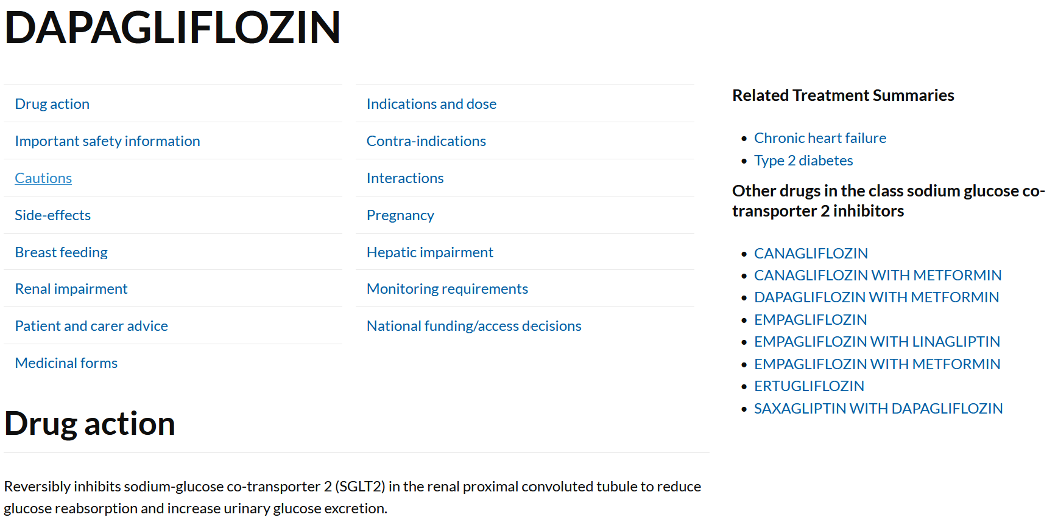
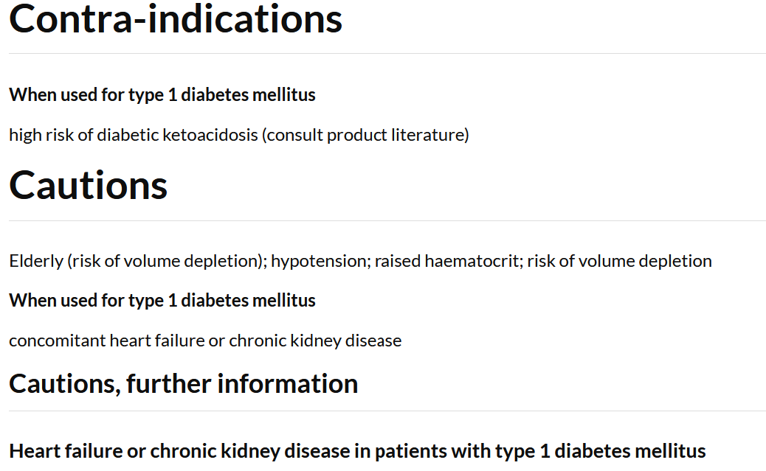
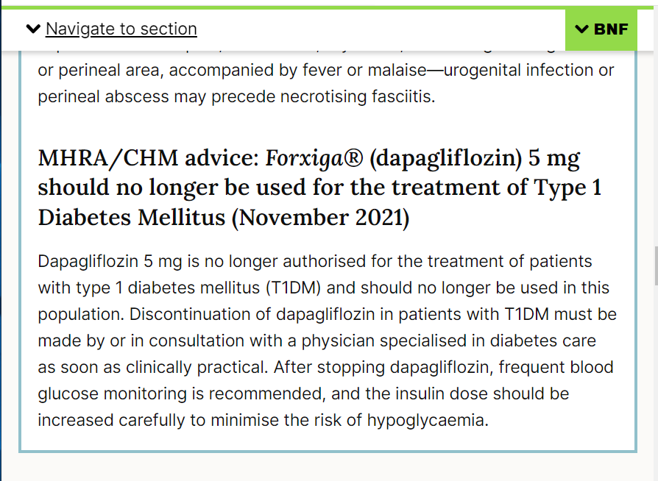
https://bnf.nice.org.uk/drug/dapagliflozin.html#indicationsAndDoses

Slide 60
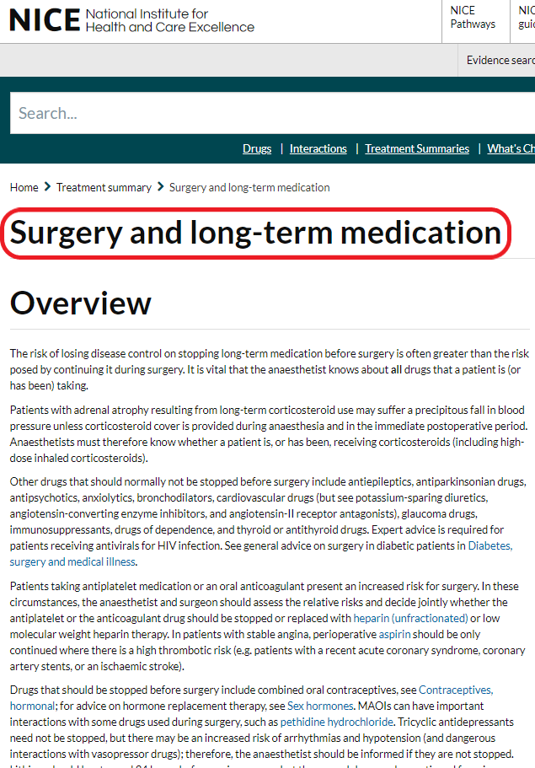
Peri-operative prescribing
Depends on:
Elective
Emergency
NBM
Common drugs involved:
Antiplatelets / anticoagulants
Diabetic medications
Oral
Insulin
Steroids
Anti-hypertensives
Oral contraception / HRT
https://bnf.nice.org.uk/treatment-summaries/surgery-and-long-term-medication/?ref=switch

Slide 61
Drug / Class | “Typical” advice
Steroids | Continue and may need to increase
Antiepileptics, antiparkinsonian, antipsychotics, anxiolytics, bronchodilators, glaucoma drugs, immunosuppressants, thyroid / antithyroid drugs | Continue
Some cardiovascular drugs | Continue – anti-hypertensives, HF meds (but see ACEi/ARB) – in real life, check with team / senior and leave clear instructions for nursing team giving morning drugs
Antiplatelet agents | Discontinue if benefits outweighs risk (e.g., continued only if recent MI, PCI, ischaemic CVA)
Anticoagulant | Discontinue if benefits outweighs risk (or may require bridging unfractionated heparin infusion)
ACEi / ARB / potassium-sparing diuretics | Typically (not always) withheld 24 hours before surgery
Oral anti-diabetic medications | Can be complex (know where to look in “Diabetes, surgery and medical illness” in BNF) Sulfonylureas omitted while in fasted state
Insulin | Complex (know where to look in “Diabetes, surgery and medical illness” in BNF)
Contraception | Can be complex (know where to look in “Contraceptives, hormonal” in BNF) Oestrogen-containing contraceptives likely need to discontinue with major or significant orthopedic surgery (Progestogen-only are suitable to continue)
HRT | Likely need to discontinue with major or significant orthopedic surgery

Slide 62
Data Interpretation Item
ID
DAT025
Case presentation
A 72-year-old woman has been admitted with confusion and a fever. Her urine dip was positive for nitrites and leucocytes. She has been treated with nitrofurantoin 100 mg orally 12hr-ly for the last day. PMH. Nil. DH. Nil. Anaphylaxis to penicillin. She weighs 68 kg.
After a day of antibiotic therapy, microbiological results from her urine sample are available.
She continues to take medications orally.
eGFR 54 mL/min
Urine MC&S results:
Escherichia Coli >100,000/ml
Amoxicillin R
Amoxicillin/clavulinic acid S
Ceftazolin S
Ceftriaxone S
Ciprofloxacin S
Doxycycline R
Ertapenem S
Gentamicin R
Nitrofurantoin R
Ofloxacin R
Piperacillin/tazobactam S
Tigecycline R
Trimethoprim R
Co-amoxiclav 625 mg orally 8hrly
Co-amoxiclav 1.2 g intravenously 8hrly
Ceftriaxone 1 g intravenously once daily
Ciprofloxacin 500 mg orally 12hrly
Ciprofloxacin 750 mg orally 12hrly
Doxycycline 200 mg orally daily
Gentamicin 70 mg intravenously 8hrly
Nitrofurantoin 100 mg orally 12hrly
Tazosin 4.5 g intravenously 8hrly
Tigecycline 100 mg intravenously 12hrly
Question
Select the most appropriate antibiotic based on these data.
(mark it with a tick)

Slide 63
Data Interpretation Item
ID
DAT025
Case presentation
A 72-year-old woman has been admitted with confusion and a fever. Her urine dip was positive for nitrites and leucocytes. She has been treated with nitrofurantoin 100 mg orally 12hr-ly for the last day. PMH. Nil. DH. Nil. Anaphylaxis to penicillin. She weighs 68 kg.
After a day of antibiotic therapy, microbiological results from her urine sample is available.
She continues to take medications orally.
eGFR 54 mL/min
Urine MC&S results:
Escherichia Coli >100,000/ml
Amoxicillin R
Amoxicillin/clavulinic acid S
Ceftazolin S
Ceftriaxone S
Ciprofloxacin S
Doxycycline R
Ertapenem S
Gentamicin R
Nitrofurantoin R
Ofloxacin R
Piperacillin/tazobactam S
Tigecycline R
Trimethoprim R
Co-amoxiclav 625 mg orally 8hrly
Co-amoxiclav 1.2 g intravenously 8hrly
Ceftriaxone 1 g intravenously once daily
Ciprofloxacin 500 mg orally 12hrly
Ciprofloxacin 750 mg orally 12hrly
Doxycycline 200 mg orally daily
Gentamicin 70 mg intravenously 8hrly
Nitrofurantoin 100 mg orally 12hrly
Tazosin 4.5 g intravenously 8hrly
Tigecycline 100 mg intravenously 12hrly
Question
Select the most appropriate antibiotic based on these data.
(mark it with a tick)

Slide 64
Antimicrobial choice based on MC&S
Factors
Which antibiotic is the organism sensitive to? | Look at microbiology reports (S = sensitive/susceptible, I = intermediate, R = resistant)
Is there an antibiotic allergy? | Remember cross-reactivity!
Choose oral vs intravenous | Is there indication for intravenous route (e.g. severe infection)? Can/will the patient take oral medications? Is there vomiting or severe confusion declining oral medications?
Renal (and liver) function | Does it change choice / dosing?
Check past medical history – any other contraindications | E.g. Quinolones with long QT, G6PD E.g. Nitrofurantoin with G6PD, folate deficient (or predisposition) E.g. Trimethoprim with folate deficiency (or predisposition) Also, for female, childbearing age, check ask/check re pregnant / breastfeeding

Slide 65
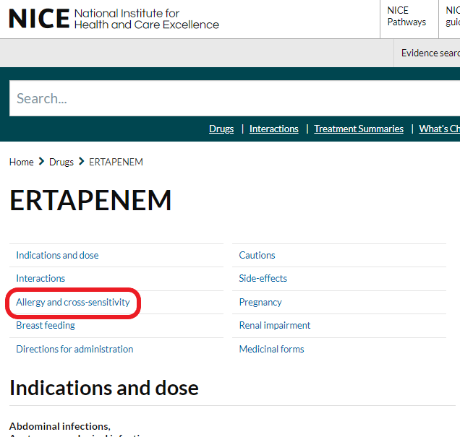
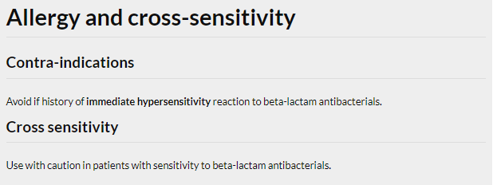
Cross-reactivity (worked example)

Slide 66
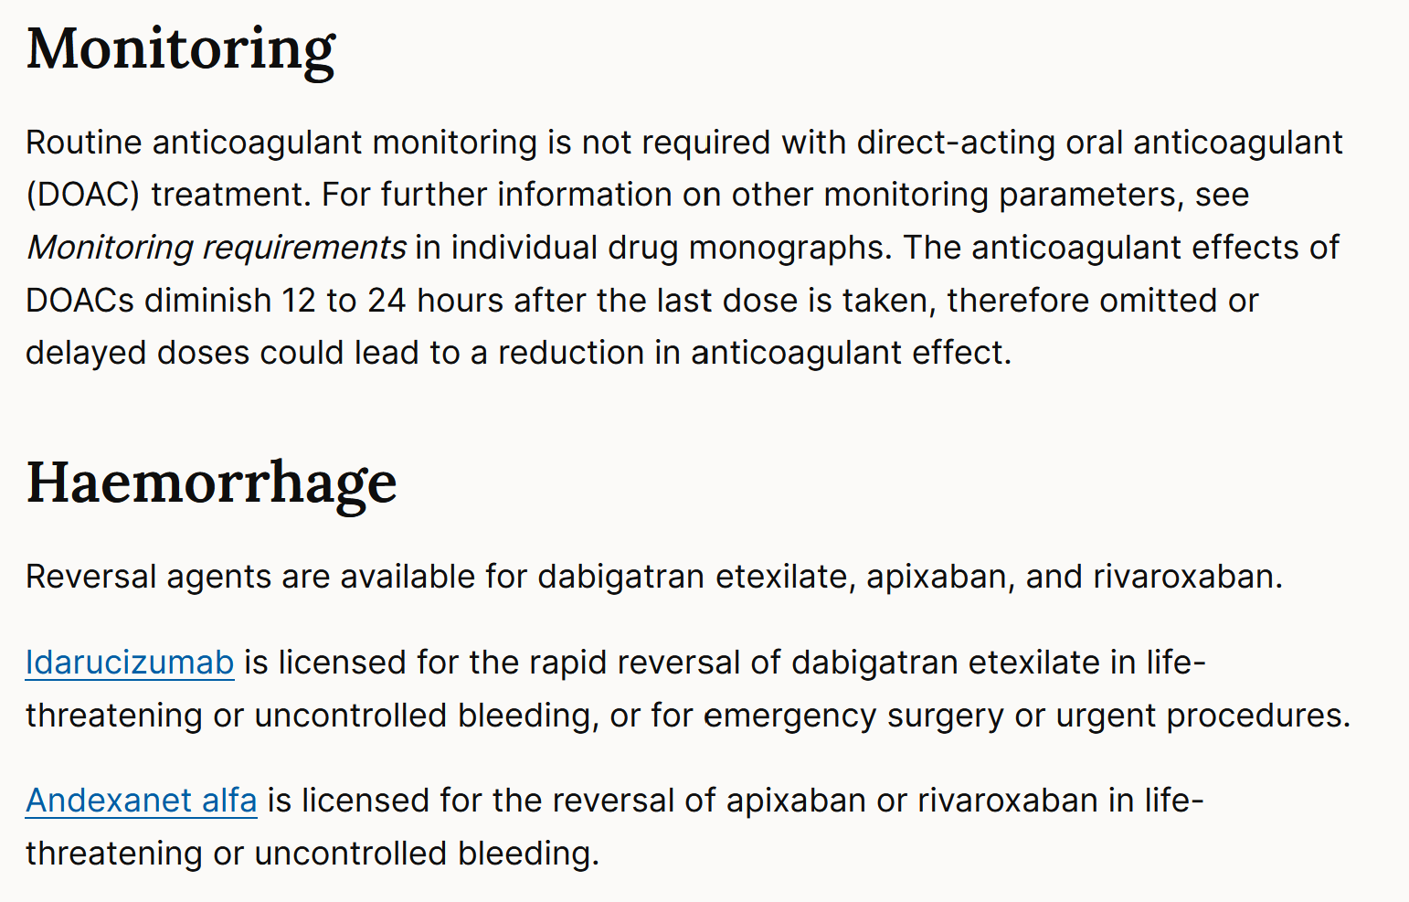
DOACs See some cases/& tips in Additional Materials at the end of this pc
https://bnf.nice.org.uk/treatment-summaries/oral-anticoagulants/#direct-acting-oral-anticoagulants
Unlike Vitamin K for warfarin reversal, DOAC reversal agents have limited indications. Prescribing is on specialist advice. They are also extremely expensive.
Check & compare the costs for the warfarin & DOAC reversal agents

Slide 67
DOACs – some tips
Pt with PE, stable, needing anti-coagulation
https://bnf.nice.org.uk/treatment-summary/venous-thromboembolism.html
Apixaban / rivaroxaban ok – have PE indication & NICE first line
But note high starting dose for a week or so; LMWH less good choice owing to NICE guidance (in BNF)
Read patient details & any results in these Q v carefully, e.g., renal function impaired enough to need lower doses
Renal impairment cut-offs vary by drug – apix (avoid if <15ml/min) is lower than dabigatran (avoid if <30ml/min) – Plus reduced daily doses may apply
Just check drug plus its indication – can be risky to recall!

Slide 68
Data Interpretation Item
ID
DAT022
Case presentation
A 65-year old man has been started on atorvastatin 20 mg orally nightly for cardiovascular primary prevention; his 10-year QRISK2 score is >10%. PMH. Hypertension, current smoker. DH. Atorvastatin 20 mg orally nightly, amlodipine 10 mg orally daily.
He is asymptomatic and returns for monitoring of his lipid levels 3 months after starting therapy.
Investigations
Pre-treatment:
Cholesterol 6.0 mmol/L (<5.2)
Non-HDL Cholesterol 4.0 mmol/L (<3.4)
HDL Cholesterol 1.1 mmol/L (>1.55)
3 months after starting:
Cholesterol 5.1 mmol/L (<5.2)
Non-HDL Cholesterol 3.0 mmol/L (<3.4)
HDL Cholesterol 1.2 mmol/L (>1.55)
Change to ezetimibe 10 mg orally nightly
Change to simvastatin 40 mg orally nightly
Decrease atorvastatin to 10 mg orally nightly
Increase atorvastatin to 40 mg orally nightly
No changes to medications, continue to monitor lipid profile
Question
Select the most appropriate decision option with regard to his atorvastatin based on these data.
(mark it with a tick)

Slide 69
Data Interpretation Item
ID
DAT022
Case presentation
A 65-year old man has been started on atorvastatin 20 mg orally nightly for primary prevention of cardiovascular disease as his 10-year QRISK2 score was more than 10%. PMH. Hypertension, current smoker. DH. Atorvastatin 20 mg orally nightly, amlodipine 10 mg orally daily.
He is asymptomatic, and returns for monitoring of his lipid levels 3 months after starting therapy.
Investigations
Pre-treatment:
Cholesterol 6.0 mmol/L (<5.2)
Non-HDL Cholesterol 4.0 mmol/L (<3.4)
HDL Cholesterol 1.1 mmol/L (>1.55)
3 months after starting:
Cholesterol 5.1 mmol/L (<5.2)
Non-HDL Cholesterol 3.0 mmol/L (<3.4)
HDL Cholesterol 1.2 mmol/L (>1.55)
Change to ezetimibe 10 mg orally nightly
Change to simvastatin 40 mg orally nightly
Decrease atorvastatin to 10 mg orally nightly
Increase atorvastatin to 40 mg orally nightly
No changes to medications, continue to monitor lipid profile
Question
Select the most appropriate decision option with regard to his atorvastatin based on these data.
(mark it with a tick)

Slide 70
Data Interpretation Item
ID
DAT023
Case presentation
A 65-year old man has been started on atorvastatin 20 mg orally nightly for cardiovascular primary prevention; his 10-year QRISK2 score is >10%. PMH. Hypertension, current smoker. DH. Atorvastatin 20 mg orally nightly, amlodipine 10 mg orally daily.
He is asymptomatic and returns for monitoring of creatine kinase 3 months after starting therapy. This was normal before starting treatment.
Investigations
Creatine kinase 750 U/L (24–195)
Change to simvastatin 40 mg orally nightly
Decrease atorvastatin to 10 mg orally nightly
Increase atorvastatin to 40 mg orally nightly
No changes to medications, continue to monitor creatinine kinase
Stop atorvastatin
Question
Select the most appropriate decision option with regard to his atorvastatin based on these data.
(mark it with a tick)

Slide 71
Data Interpretation Item
ID
DAT023
Case presentation
A 65-year old man has been started on atorvastatin 20 mg orally nightly for primary prevention of cardiovascular disease as his 10-year QRISK2 score was more than 10%. PMH. Hypertension, current smoker. DH. Atorvastatin 20 mg orally nightly, amlodipine 10 mg orally daily.
He is asymptomatic and returns for monitoring of creatine kinase 3 months after starting therapy. This was normal before starting treatment.
Investigations
Creatine kinase 750 U/L (24–195)
Change to simvastatin 40 mg orally nightly
Decrease atorvastatin to 10 mg orally nightly
Increase atorvastatin to 40 mg orally nightly
No changes to medications, continue to monitor creatinine kinase
Stop atorvastatin
Question
Select the most appropriate decision option with regard to his atorvastatin based on these data.
(mark it with a tick)

Slide 72
Statins monitoring summary
Measurement | Result | Action
Non-HDL, after 3 months (primary CVS prevention) [NOT IN BNF] | >40% reduction | Continue dose
 | ≤40% reduction | Consider increasing dose (and discuss / reinforce adherence / lifestyle / non-drug measures)
Secondary prevention | No target levels | Start high-intensity statin (e.g. atorvastatin 80mg on) and continue as tolerated
Creatine kinase [In BNF “Monitoring Requirements” for each statin] | Between 1x to 5x upper limit of normal | Continue statin, but regular CK monitoring Stop statin if muscle symptoms OR rising CK levels
 | ≥5x upper limit of normal | Stop statin
LFTs (Transaminase) [In BNF “Monitoring Requirements” for each statin] | Between 1x to 3x upper limit of normal | Continue the statin but recheck LFTs within 4–6 weeks to exclude further increases in transaminase levels. No extra monitoring is required if values are stable.
 | ≥3x upper limit of normal | Stop the statin and recheck LFTs within 4–6 weeks to ensure that values settle (consider re-introducing the statin cautiously at a later date), OR Reduce the statin dose (if the person is taking a high dose) and recheck LFTs within 4–6 weeks, OR Change to a statin in a lower intensity group (for example change to a medium-intensity statin if the person is taking a high-intensity statin) and recheck LFTs within 4–6 weeks. If transaminase levels continue to be three times the upper limit of normal or more, stop the statin and seek specialist advice (for example from a lipid clinic).

Slide 73
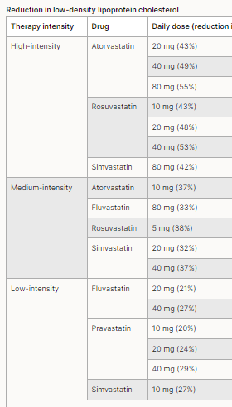
Familial hypercholesterolaemia (FH)
Target is LDL reduction >50% from baseline (<1.8 / <1.4 mmol/L)
(not non-HDL Cholesterol %) https://bnf.nice.org.uk/treatment-summaries/dyslipidaemias/
European Atherosclerosis Society Consensus Statement 2023 https://www.ncbi.nlm.nih.gov/pmc/articles/PMC10314327/
NICE CKS helpful
https://cks.nice.org.uk/topics/hypercholesterolaemia-familial/
High-intensity statins plus adjuncts (or alternatives if statins not tolerated), e.g.,
Ezetimebe, PCSK9-inhibitors
Bempedoic acid
Indication for heterozygous, not homozygous, FH – PSA question potential

Slide 74
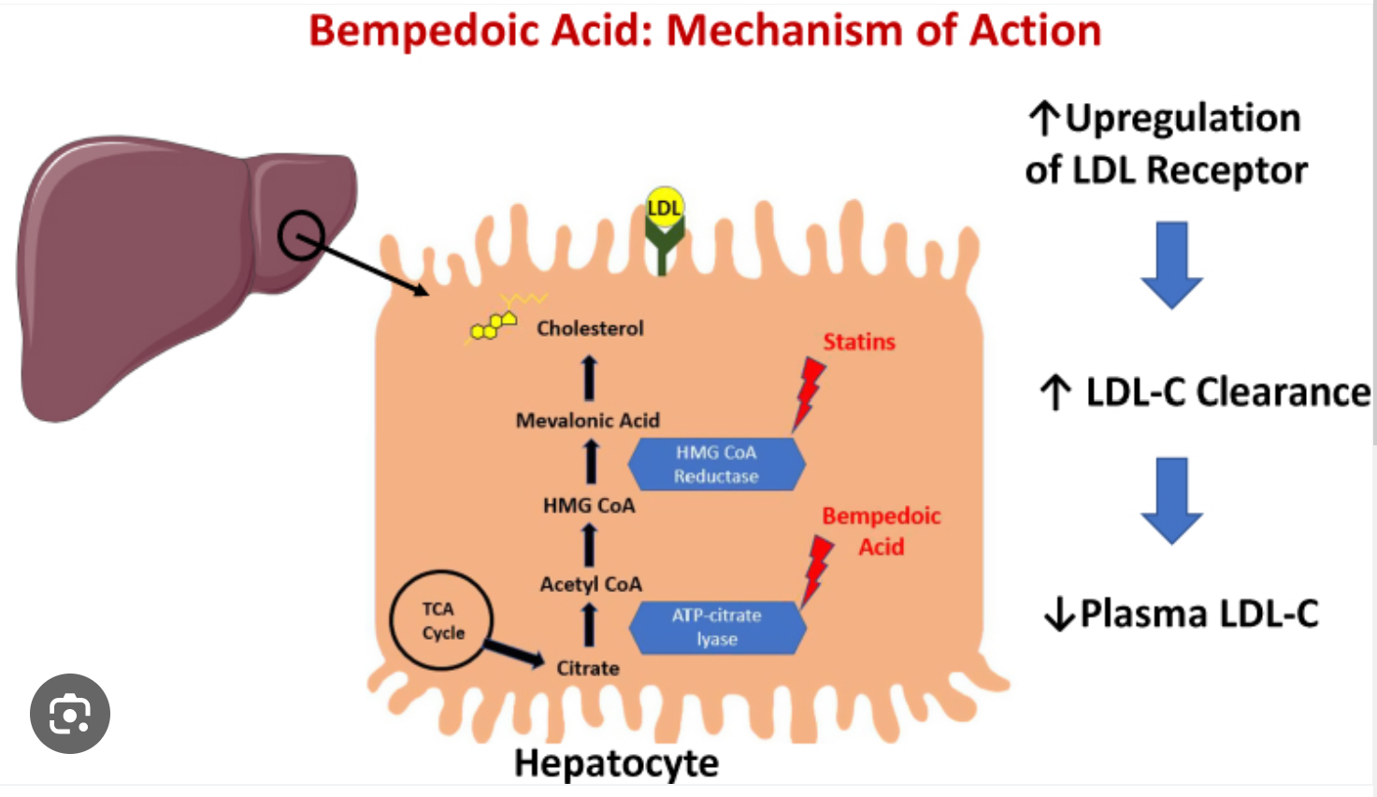
Bempedoic Acid – second line tx (Nilemdo)
ATP citrate lyase (ACL) inhibitor
Inhibits hepatic cholesterol synthesis upstream of HMG CoA reductase
Pro-drug, activated in liver, not in peripheral tissues (fewer systemic (muscle) side effects?)
ACL inhibition decreases intracellular cholesterol biosynthesis → upregulation of LDL receptors on hepatocytes → increased uptake of LDL particles → reduced circulating LDL-C levels
PSA question considerations: Adjunct therapy for hyperlipidaemia
Interactions with simvastatin, pravastatin (levels increase) but not atorvastatin https://bnf.nice.org.uk/drugs/bempedoic-acid/
https://www.dovepress.com/bempedoic-acid-for-heterozygous-familial-hypercholesterolemia-from-ben-peer-reviewed-fulltext-article-DDDT
https://www.ema.europa.eu/en/documents/product-information/nilemdo-epar-product-information_en.pdf

Slide 75
“Do nothing” / “observe”
Sometimes this is the right thing to do!
You just need to know the reasons behind it…

Slide 76
ADRs
Type A
Identification of common side effect of a common drug, e.g. metformin / B12 deficiency, antibiotic / C diff
Type B
Identification of culprit drug for a presentation, e.g. AKI, low platelets, COC failure
Type C
Identification of interactions,
e.g. SSRI and tramadol; clopidogrel & omeprazole
Type D
Decide on therapeutic response to an ADR, e.g. management of hypoglycaemia; acute renal impairment

Slide 77
Adverse Drug Reactions Item
ID
ADR301
This question item is worth 2 marks
You may use the BNF at any time
Case presentation
A 53-year-old woman with bronchiectasis and chronic obstructive pulmonary disease is being treated in hospital for an exacerbation of her usual wheeze and productive cough. Her regular medicines include oral theophylline that is continued in hospital.
Her concomitant in-patient prescriptions are listed (right). On Day 3 of admission, she suffers a first-ever seizure.
PRESCRIPTION OPTIONS
A | ciprofloxacin 500 mg orally 12-hrly |  | ☐
B | enoxaparin 40 mg subcutaneously daily |  | ☐
C | ipratropium 250micrograms nebulised 6-hrly |  | ☐
D | prednisolone 30mg orally daily |  | ☐
E | salbutamol 2.5 mg nebulised 6-hrly |  | ☐
Question
Of the prescriptions listed here, which is most likely to have contributed to the occurrence of a seizure in this patient.
(mark with a tick)

Slide 78
Adverse Drug Reactions Item
ID
ADR101
This item is worth 2 marks
You may use the BNF at any time
Case presentation
A 10-year-old girl is treated with ipratropium as part of treatment for an acute asthma attack.
ADVERSE EFFECT OPTIONS
A | bradycardia |  | ☐
B | hypersalivation |  | ☐
C | hypokalaemia |  | ☐
D | mydriasis |  | ☐
E | urinary frequency |  | ☐
Question
Select the adverse effect that is most likely to be caused by ipratropium.
(mark it with a tick)

Slide 79
Adverse Drug Reactions Item
ID
ADR301
This question item is worth 2 marks
You may use the BNF at any time
PRESCRIPTION OPTIONS
A | Acute renal injury |  | ☐
B | Diarrhoea |  | ☐
C | Hypoglycaemia |  | ☐
D | Osteonecrosis of the jaw |  | ☐
E | Vaginal candidiasis |  | ☐
Case presentation
A 64-year-old woman with heart failure is commenced on dapagliflozin..
Question
Of the adverse effects listed, which is most likely to be caused by dapagliflozin.
(mark with a tick)

Slide 80
Adverse Drug Reactions Item
ID
ADR301
This question item is worth 2 marks
You may use the BNF at any time
PRESCRIPTION OPTIONS
A | Acute renal injury |  | ☐
B | Anaphylactoid reaction |  | ☐
C | Hypoglycaemia |  | ☐
D | Jaundice |  | ☐
E | Serotonin syndrome |  | ☐
Case presentation
A 18-year old man is on a n-acetylcysteine (NAC) infusion following a paracetamol overdose.
Question
Of the adverse effects listed, which is most likely to be caused by dapagliflozin.
(mark with a tick)

Slide 81
Adverse Drug Reactions Item
ID
ADR101
This item is worth 2 marks
You may use the BNF at any time
Case presentation
A 10-year-old girl is treated with ipratropium as part of treatment for an acute asthma attack.
ADVERSE EFFECT OPTIONS
A | bradycardia |  | ☐
B | hypersalivation |  | ☐
C | hypokalaemia |  | ☐
D | mydriasis |  | ✓
E | urinary frequency |  | ☐
Question
Select the adverse effect that is most likely to be caused by ipratropium.
(mark it with a tick)
Answer box
Option A | Justification
Palpitations or tachycardia are more likely than bradycardia
Option B | Justification
Dry mouth not hypersalivation might arise but would be v unusual with inhaled anti-muscarinic
Option C | Justification
Hypokalaemia is a temporary effect of salbutamol
Option D | Justification
Ipratropium is a classical anti-muscarinic agent with consequent likely adverse effects being mydriasis; ileus; cough; dry mouth; acute angle-closure glaucoma; palpitation; tachycardia; urinary retention
Option E | Justification
Urine retention not frequency might arise but would be v unusual with inhaled anti-muscarinic

Slide 82
Adverse Drug Reactions Item
ID
ADR301
This question item is worth 2 marks
You may use the BNF at any time
Case presentation
A 73-year-old woman with bronchiectasis and chronic obstructive pulmonary disease is being treated in hospital for a severe exacerbation of her usual wheeze and productive cough. Her regular medicines include oral theophylline that is continued in hospital.
Her other in-patient prescriptions are listed (right). On Day 3 of admission, she suffers a first-ever seizure.
PRESCRIPTION OPTIONS
A | ciprofloxacin 500 mg orally 12-hrly |  | ✓
B | enoxaparin 40 mg subcutaneously daily |  | ☐
C | ipratropium 250micrograms nebulised 6-hrly |  | ☐
D | prednisolone 30mg orally daily |  | ☐
E | salbutamol 2.5 mg nebulised 6-hrly |  | ☐
Question
Of the prescriptions listed here, which is most likely to have contributed to the occurrence of a seizure in this patient.
(mark with a tick)

Slide 83
Adverse Drug Reactions Item
ID
ADR301
This question item is worth 2 marks
You may use the BNF at any time
PRESCRIPTION OPTIONS
A | Acute renal injury |  | ☐
B | Diarrhoea |  | ☐
C | Hypoglycaemia |  | ☐
D | Pancreatitis |  | ☐
E | Vaginal candidiasis |  | ✓
Case presentation
A 64-year-old woman with heart failure is commenced on dapagliflozin..
Question
Of the adverse effects listed, which is most likely to be caused by dapagliflozin.
(mark with a tick)

Slide 84
Adverse Drug Reactions Item
ID
ADR301
This question item is worth 2 marks
You may use the BNF at any time
PRESCRIPTION OPTIONS
A | Acute renal injury |  | ☐
B | Anaphylactoid reaction |  | ✓
C | Hypoglycaemia |  | ☐
D | Jaundice |  | ☐
E | Serotonin syndrome |  | ☐
Case presentation
A 18-year old man is on a n-acetylcysteine (NAC) infusion following a paracetamol overdose.
Question
Of the adverse effects listed, which is most likely to be caused by dapagliflozin.
(mark with a tick)
Note: in BNF, search for acetylcysteine, not n- acetylcysteine

Slide 85
Data interpretation – wise to know basics of managing: |  | Availability in the BNF
Paracetamol overdose | Know/find management for all different timepoints, and for staggered overdoses | [Treatment summaries → Poisoning, emergency treatment]
Warfarin and INR | Know/find what to do with high INR Need to know INR and severity of any bleeding | [Treatment summaries → Oral anticoagulant]
Other kinds of anticoagulation monitoring | Know what monitoring options for other anticoagulants | Not easily found in BNF
Antibiotic sensitivity / MC+S result | Know how to work through e.g. sensitivities, contraindications/allergies, severity, renal dysfunction with adjusted doses | Not in BNF
Antibiotic therapeutic drug monitoring | Know how to interpret peak / trough levels | In the “monitoring requirements” for some antibiotics (e.g. gentamicin)
Adjusting insulin doses | Know how to adjust insulin doses based on blood glucose diary | Not in BNF – clinical placement work. Be familiar with the five DM BNF Treatment summaries (DM, T1DM, T2DM, Complications, Pregnancy)
Lipid lowering Tx, esp statins and CK / LFTs / cholesterol | Know/find when to adjust/stop statins; Know indications for adjuncts: ezetimebe, PCSK9i, bempedoic ac, incl limits on some statin doses when used in combination | In the “monitoring requirements” for most statins [BUT NOT for cholesterol targets – that you will need to know]; Interactions sections are helpful
Oxygen therapy | Know the different co-morbidities with different oxygen therapy strategies Know the different targets for these comorbidities Know how to interpret arterial blood gases | Not very useful, should know clinically [Treatment summaries → Oxygen]
Converting opiates | Know how to calculate total daily opiate requirements Know how to find equivalent doses | Needs practice - straightforward [Treatment summaries → Prescribing in Palliative Care]
TFT monitoring | Know how to interpret and adjust medications | Not in BNF; know about sick euthyroid
Lithium levels | Know what to do if toxic, or if needing to change doses – review Y4 psychiatry teaching | Monitoring not explained in BNF (you need to know) Treating lithium toxicity in [Treatment summaries → Poisoning, emergency treatment]
Adjusting dose for renal dysfunction | Be able to recognise when patient has renal dysfunction Be familiar with how to find dosing adjustments (if required) | Be familiar with how to change doses based on “Renal Impairment” information with each drug

