Slide 1
Welcome to Year 5 2024 - 2025 Clinical Pharmacology, Prescribing and Therapeutics (CPT)
Patricia McGettigan BSc (Pharm) MD FRCPI FRACP SFHEA FBPhS
Clinical Pharmacologist
Head of QMUL MBBS CPT Teaching

Slide 2
Today
Evolving landscape of prescribing competence requirements for new doctors
Your QMUL MBBS CPT work & experience to date
CPT Year 5 activities for the year ahead
Resources
Our QMUL CPT team along with me for MBBS 2024-2025
Barts Health Pharmacy Teaching Team: Lead, Shammi Khatun
Dr Ajay Gupta – Pharmacist-led prescribing sessions
Dr Vikas Kapil – Safe Prescribing Exams
Clinical Pharmacology specialist trainees
Plus
Guest lecturers and facilitators

Slide 3
Clinical pharmacology, prescribing & therapeutics, skills Why are they so necessary for new doctors?
Prescribing Errors are common
They damage patients, doctors, healthcare quality and public trust
FY1 and FY2 doctors write most hospital prescriptions
FY1 doctors write 40% of hospital prescriptions
FY2 doctors, 28%
Consultants: 3%
Ref. GMC UK EQUIP Study 2009 www.gmc-uk.org
Notes:
There were 1225 admissions related to an ADR, giving a prevalence of 6.5%, with the ADR directly leading to the admission in 80% of cases. The median bed stay was eight days, accounting for 4% of the hospital bed capacity. The projected annual cost of such admissions to the NHS is £466m (€706m, $847m). The overall fatality was 0.15%. Most reactions were either definitely or possibly avoidable. Drugs most commonly implicated in causing these admissions included low dose aspirin, diuretics, warfarin, and non-steroidal anti-inflammatory drugs other than aspirin, the most common reaction being gastrointestinal bleeding

Slide 4
Prescribing is risky
EQUIP 2009: Errors in 8%-11% of prescriptions
Annually in the UK, billions of prescriptions
So, an error rate of 8% - 11% = An awful lot of errors
Even though much prescribing is done safely
2020 data: 237 million errors /year in England
Many (72%) prescribing errors are minor
But 25% (~60 million) lead to ‘moderate’ harm
And 2% (~5 million) → potential serious harm, including death
https://www.bmj.com/company/newsroom/237-million-medication-errors-made-every-year-in-england/
Hospital discharge is especially risky – FY1 & FY2 doctors write the discharges
Serious errors → patient harm, distress; doctor distress
Your aim: Be a safe, effective prescriber on Day 1 of FY1

Slide 5
Medical Schools & GMC Response to EQUIP The Prescribing Safety Assessment (PSA) A high stakes assessment
QMUL MBBS graduation requirement
National examination
Summative v formative at MBBS graduation level
A requirement for full GMC registration at the end of FY1
Administered by BPS and MSC - external to School
Dacre Review of the PSA – published August 2023
Considered the role of the PSA as the Medical Licensing Assessment is introduced – Is the PSA ‘needed’?
https://prescribingsafetyassessment.ac.uk/#

Slide 6
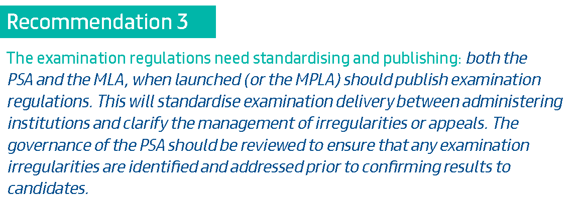
Dacre PSA Review Recommendations

Slide 7
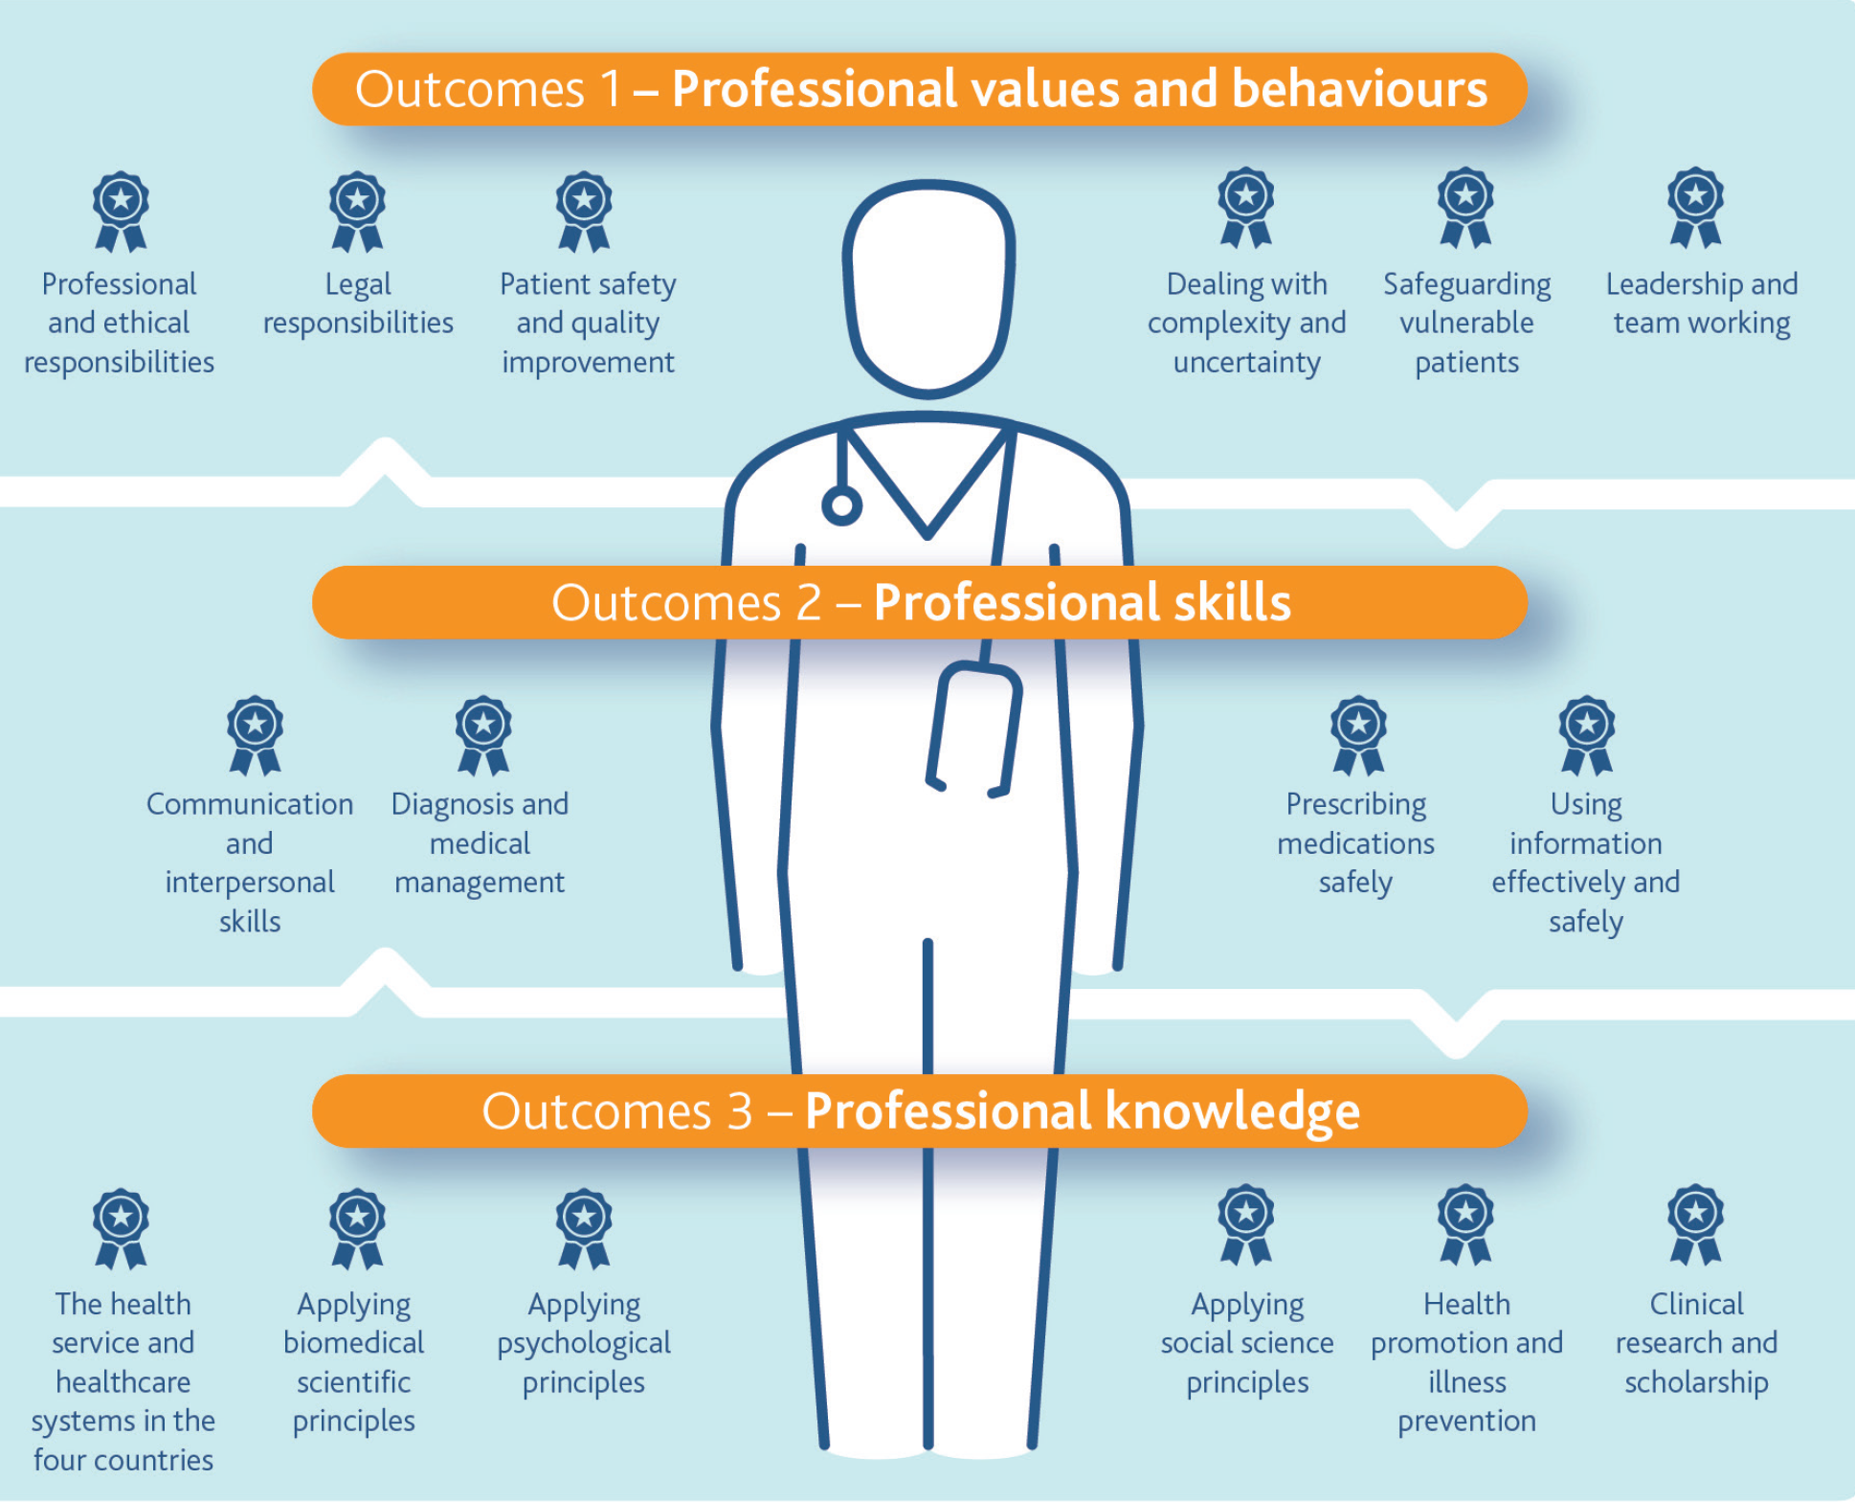
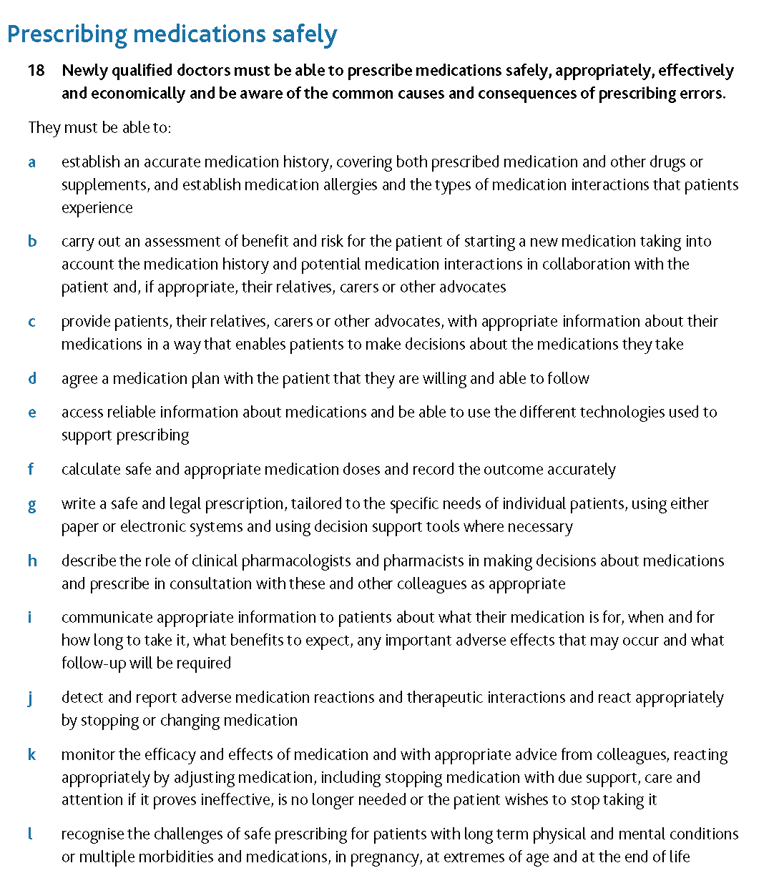
GMC: Outcomes for Graduates 2018 = Over-arching guidance for MBBS CPT 15 outcomes relate to prescribing – the CPT curriculum Safely, appropriately, effectively, economically

Slide 8
MBBS Year 5 specific objectives Refer: Syllabus document on our QM+ CPT site
To consolidate your CPT learnings of MBBS Years 3 and 4
To understand the electronic and paper prescribing systems used in community and hospital placements and their roles/ integration in the patient health and care journey
To learn how to
Communicate important / priority medicines information to patient / carer / professional colleagues, within community and hospital settings, and bi-directionally across community-hospital boundaries (includes discharge letters)
Work with inter-professional colleagues in the health arena of therapeutics and understand systems aspects of CPT
[GMC / PSA ]
Conduct medication reviews
Do drug dose calculations
Interpret data / tests in the context of medication needs / therapeutic adjustment
Monitor drug / therapeutic effects
Plan therapeutic drug management for common conditions
Recognise and manage drug overdose / self-harm with medicines
Recognise and manage prescribing errors, potential adverse drug effects, drug interactions
Write safe accurate appropriate prescriptions for hospital and community patients

Slide 9
MBBS Clinical Years 3-5 are a spiral of learning towards Finals & FY1
Over-arching guidance for CPT MBBS work
GMC CPT Outcomes for Graduates = Our curriculum
15 Outcomes - Complexities clear – inform your spiral of learning – they are perfected in the clinical care environment
CPT
Knowledge-driven, Evidence-driven, Practical and Applied
Working with patients and healthcare professionals – the multi-disciplinary interprofessional team
Working with uncertainty often; benefit-harm balance; patient views as well as ‘clinical’ evidence
Your clinical exposure is core in your CPT learning
Varied – but common principles and themes recur
You broaden and deepen your knowledge
Throughout your MBBS clinical years
And forever after in your clinical practice
You learn about navigating medicine’s many uncertainties and evolving evidence bases, e.g. HFrEF and HFpEF
Primary focus in MBBS and the PSA is on common disorders & therapies, rather than uncommon / rare
GMC CPT
Prescribing safely, appropriately, effectively, economically
Right drug (if any)
Right reason
Right patient
Right amount
Right duration

Slide 10
Year 4 CPT
Focus: Specialty CPT exposure
Specialty placements integrate commonly used therapies, their use, patient care
Placement portfolio activities include medication review & prescribing
Joint CPT-Paeds practice
CRS / GP patient record systems use
Coursework activities
SCRIPT - themes aligning with specialty placement areas
CPT QM+ resources /materials, guidance, PSA question recordings
PSA Mock Examination
November 2024
External via MSC using PSA platform
Major bonus is experience of the PSA platform
Indicator for your CPT / PSA trajectory
Prescribing Safety Assessment

Slide 11
Year 5 – PSA and Finals → FY1
Hospital and GP Assistantships are your primary opportunities – CPT in action
Throughout Y5, you must use hospital CRS & GP systems (EMIS / other)
Understand how clinical care is organised, delivered, recorded
Omit = huge gap in your understanding and knowledge of care & its delivery
Core Message: The PSA rewards clinical practice and exposure
1. Activities commencing in August
Lectures:
CPT Year-map; High-risk patients; Pharmacogenomics
Safe Prescribing Exam (SPE) 1*
Feedback
Coursework
Clinical Case Medication Reviews: 1 per placement (supervisor-discussed & signed) *
Use CRS / GP system for the information you need; Use the Review template provided on QM+ CPT area
Pharmacist-led practical prescribing*
During hospital placements Sep-Jan
4 Sessions - hospital admin team for schedules
2. Activities: September – January
PSA Friday Masterclasses *
Run September - January
4 Masterclasses, each repeated once
Masterclass Q/A/Tips available on QM+ for revision
November Lectures
Multiple topics
SPE 2* and feedback
3. Activities: January - March
SPE 3* and feedback
PSA online Practice Papers
PSA 30th January
MBBS Finals in March integrate CPT in paper, clinical & OSCE elements
Core Drug list is available in the Y5 QM+ CPT area
CPT e-Portfolio (Pebble Pad) Activities*

Slide 12
CPT activities during Year 5
Year 5 activities consolidate the CPT knowledge you have developed throughout Year 3 and Year 4
Placement clinical activities – hospital and GP (later slides)
Placements = your major site of learning – out in the clinical action
Access & review drug charts / records of the hospital and GP patients you see
Ensure your Hospital ID card is activated for EPR access
Undertake drug choice discussion and medication review with every team, supervisor, pharmacists, nursing teams CPT - a cross-cutting MBBS theme
Include therapeutics (treatment) in your hospital Case Based Discussion (CBD) activities and GP Clinical Evaluation Exercises (mini-CEX) for your e-portfolio
Aspects of CPT will also feature in your GP Patient Case & Reflections on Professional Practice
Practice prescribing using resources on QM+

Slide 13
CPT activities during Year 5
Safe Prescribing Exams (Lead: Dr Vikas Kapil)
Formative, in PSA question format
Dates: August, December, January; Dates via Year 5 MBBS admin team
Required Coursework: Two SPEs must be completed; Pebblepad
Low scores, third SPE to help address knowledge gaps
Dr Kapil does a review session after each SPE
Pharmacist-led prescribing workshops (Lead: Dr Ajay Gupta)
Focus on some high risk areas
Required Coursework; 4 workshops / Topics; Pebblepad
Drug Calculations; Safe Prescribing; Drug Interactions; Controlled Drugs
During hospital placements – Dates via placement admin teams
Clinical Case Medication Reviews (lead: Prof Patricia McGettigan)
Holistic focus on a patient’s medicines in context of the presentation
We discuss your examples / Q at PSA Masterclass 1 – worked example
Required Coursework; 1 per placement (supervisor-discussed & signed); Pebblepad
PSA Masterclasses (lead: Prof Patricia McGettigan)
4 Masterclasses, each repeated once; Schedule on Y5 QM+ CPT Area
Voluntary Coursework; Practice PSA questions; Pebblepad
PSA topic groups, BNF practice, Q / A and discussion, Tips
Materials posted on QM+ afterwards for self-directed study & revision
In-person (first session of each Masterclass) and on-line for the repeat

Slide 14
CPT activities during Year 5
Prescribing is risky
Certain populations are ‘more risky’ than others
Small margins for error owing to multiple factors
e.g., lower organ reserve: very ill, very young, older, organ impairment, co-morbidities, pregnant, transplant
And commonly, (multiple) concomitant medicines
Today
Dr Abubaker El-Tayeb and I will discuss prescribing for high risk populations in our lectures
Dr Emma Magavern will discuss Pharmacogenomics, including FY1 aspects, in her lecture

Slide 15
Recording your CPT activities - Pebblepad e-portfolio

Slide 16
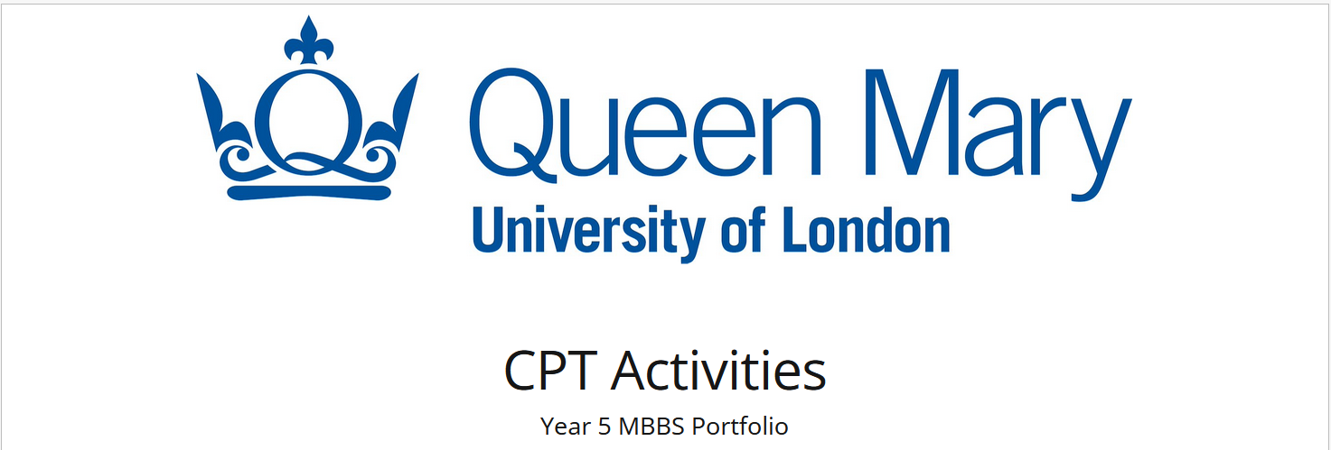
Pebble Pad
You enter Scores for:
Safe Prescribing Exams
You enter Participation dates for:
PSA Masterclasses
You upload information for:
Clinical Case Medication Review. A Template to Guide you is available on the Year 5 QM+ CPT area
You upload information for:
Pharmacist-led Prescribing Sessions. Materials, including student Drug Chart, are available on the Year 5 QM+ CPT area
Instructions for completing each activity are on Pebble Pad

Slide 17
QMUL SPEs (Safe Prescribing Exams)
Year 5 requirement: Sit at least two exams
September; December; January – Assessments Team alert you / details
If missed or have an unsatisfactory score in September + December, must sit again in January
Students who wish to sit SPE3 in January to improve score, should contact the Assessments Team
CPT course work requirement, e-portfolio record - attendance and your score
Inform Tom Schindler of any extenuating circumstances
SPE Scores will help your tutors provide support if required
Also identify some gap areas for your focus during placement work
Friday SPE: on line, Rogo, 30 Q with BNF as reference
I have prepared slide sets of information and example questions for you
Available on QM+, CPT site, ‘SPE Outline and Example Q’ area https://qmplus.qmul.ac.uk/course/view.php?id=2594

Slide 18
Where & how to practice prescribing and hone your skills 1
Every patient, every day
Assistantship model is great! Hands-on clinical team working - your opportunity to gain invaluable practical experience & good skills
Write practice prescriptions during your placements
GP & hospital (Portfolio evidence)
QM+ CPT area has practice prescription forms – all of us must be able to prescribe on paper
NEVER fill in any patient identifier details
With hospital ward nursing staff
Ask and then go on medication rounds – enlightening to do this
With your pharmacist
Hospital: Ask and then go on rounds with the pharmacist – medication reconciliation & review; If you can, go to pharmacy to see d/c dispensing (TTOs)
GP: Join the practice pharmacist doing reviews +/- MDTs with GPs
With your clinical team
Help prepare discharge letters & TTOs for your patients in hospital – must always be checked by the responsible doctor
Discuss / review with team, supervisors
Practice Prescriptions for ‘difficult’ drugs
Fluids, warfarin/DOACs, antibiotics, insulin, opiates
Write these up as practice prescriptions – your personal learning portfolio
Undertake drug dose calculations and then, write up the prescription
OSCE 2024: A similar station was a big problem for students – Straightforward - But Practice!

Slide 19
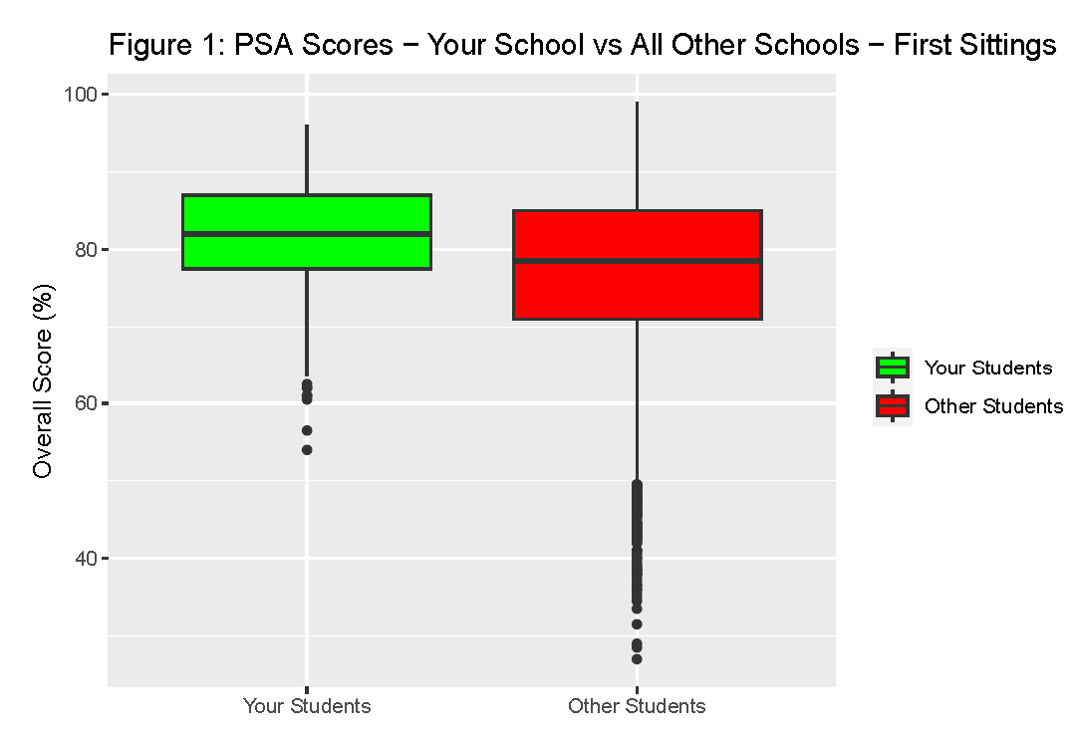
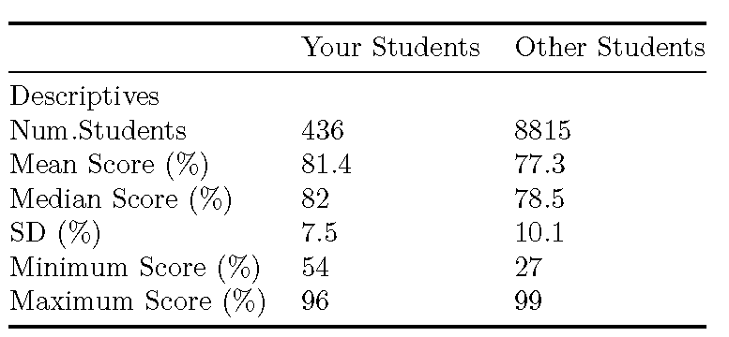
QMUL students had a fantastic 2024 PSA 436 students: 433 (99.3)% passed at first-sit All passed second-sit
PSA Pass Score, 2024
59% - 61% depending on the paper
Every PSA question is standard set individually

Slide 20
CPT Resources
QMUL Resources
Keep an eye on our MBBS Year 5 QM+ CPT site – regular additions
Site is updating currently
QMUL QM+ Refresh project
External Resources (Links on QM+ CPT Page)
PSA information & practice materials
https://prescribingsafetyassessment.ac.uk/
SCRIPT modules – detailed, valuable resource
https://qmul3.safeprescriber.org/login?redirect=/profile
PK / PD revision - Excellent short recordings
http://www.pharmacologyeducation.org/clinical-pharmacology/introduction-clinical-pharmacology
BNF
BNF (NICE) - https://bnf.nice.org.uk/
BNF (Medicines Complete) - https://www.medicinescomplete.com/#/browse/bnf
Your hospital intranet & GP resources
Medicines formularies, policies, guidance
Public Health England
Antibiotic Resources https://www.gov.uk/government/collections/european-antibiotic-awareness-day-resources
https://wchh.onlinelibrary.wiley.com/doi/10.1002/psb.2141

Slide 21
PRIZES
BLSMD Liddle Prize (SPE and PSA scores)
BPS prize for highest score in PSA
Thank you for listening
Questions?

Slide 22
Pharmacist-led prescribing teaching
Sessions
Drug Dose Calculations
Safe Prescribing
Drug Interactions and Management
Controlled Drugs and High Risk Drugs
Pebble Pad coursework activity Your placement hospital administration team will advise of dates
QMUL Lead is Dr Ajay Gupta ajay.gupta@qmul.ac.uk

Slide 23
Both PSA and FY1 reward clinical experience and practice of prescribing and related activities

Slide 24
Resources on QM+ CPT area
Materials build throughout the year so keep an eye on site
QMUL Core Drugs List
Concentrates on important therapeutic areas where FY1 doctors are regularly required to prescribe
Not an exhaustive list, but highlights important topics, medicines
Use it in conjunction with BNF - individual drug detail and treatment summaries
PSA Practice Materials – added as we do the Masterclasses
Questions for own / group practice plus Answer notes
All PSA Question categories
The side panel on our CPT page has links to multiple good resources for your work through the year

Slide 25
Reading List - Library
Kumar and Clark – Clinical Medicine
Excellent CPT section + clinical areas
Instant Clinical Pharmacology - Evan Begg
Prescribing Scenarios at a glance (+ workbook) – Baker et al
The Top 100 Drugs: Clinical Pharmacology and Practical Prescribing – Hitchings et al
Pass the PSA – Brown et al
BMJ journal – Therapeutics articles
Prescriber – PSA articles
https://wchh.onlinelibrary.wiley.com/journal/19312253
BPS e-learning FREE resources (lots cost)
Scroll down the Page to the section with free resources https://portal.bpsassessment.com/
By A Barts Colleague, Rageshri Dhairyawan, Unheard: The Medical Practice of Silencing – is good reading on doctors’ hearing/listening in relation to prescribing for some situations, e.g., pain

