Slide 1
BS Chong BDS, MSc., PhD, LDS, FDS, MFGDP, MRD, FHEA
Specialist in Endodontics
Professor & Honorary Consultant in Restorative Dentistry
Institute of Dentistry
www.qmul.ac.uk/dentistry

Slide 2
MSc in Endodontic Practice
2020-21
Institute of Dentistry
www.qmul.ac.uk/dentistry

Slide 3
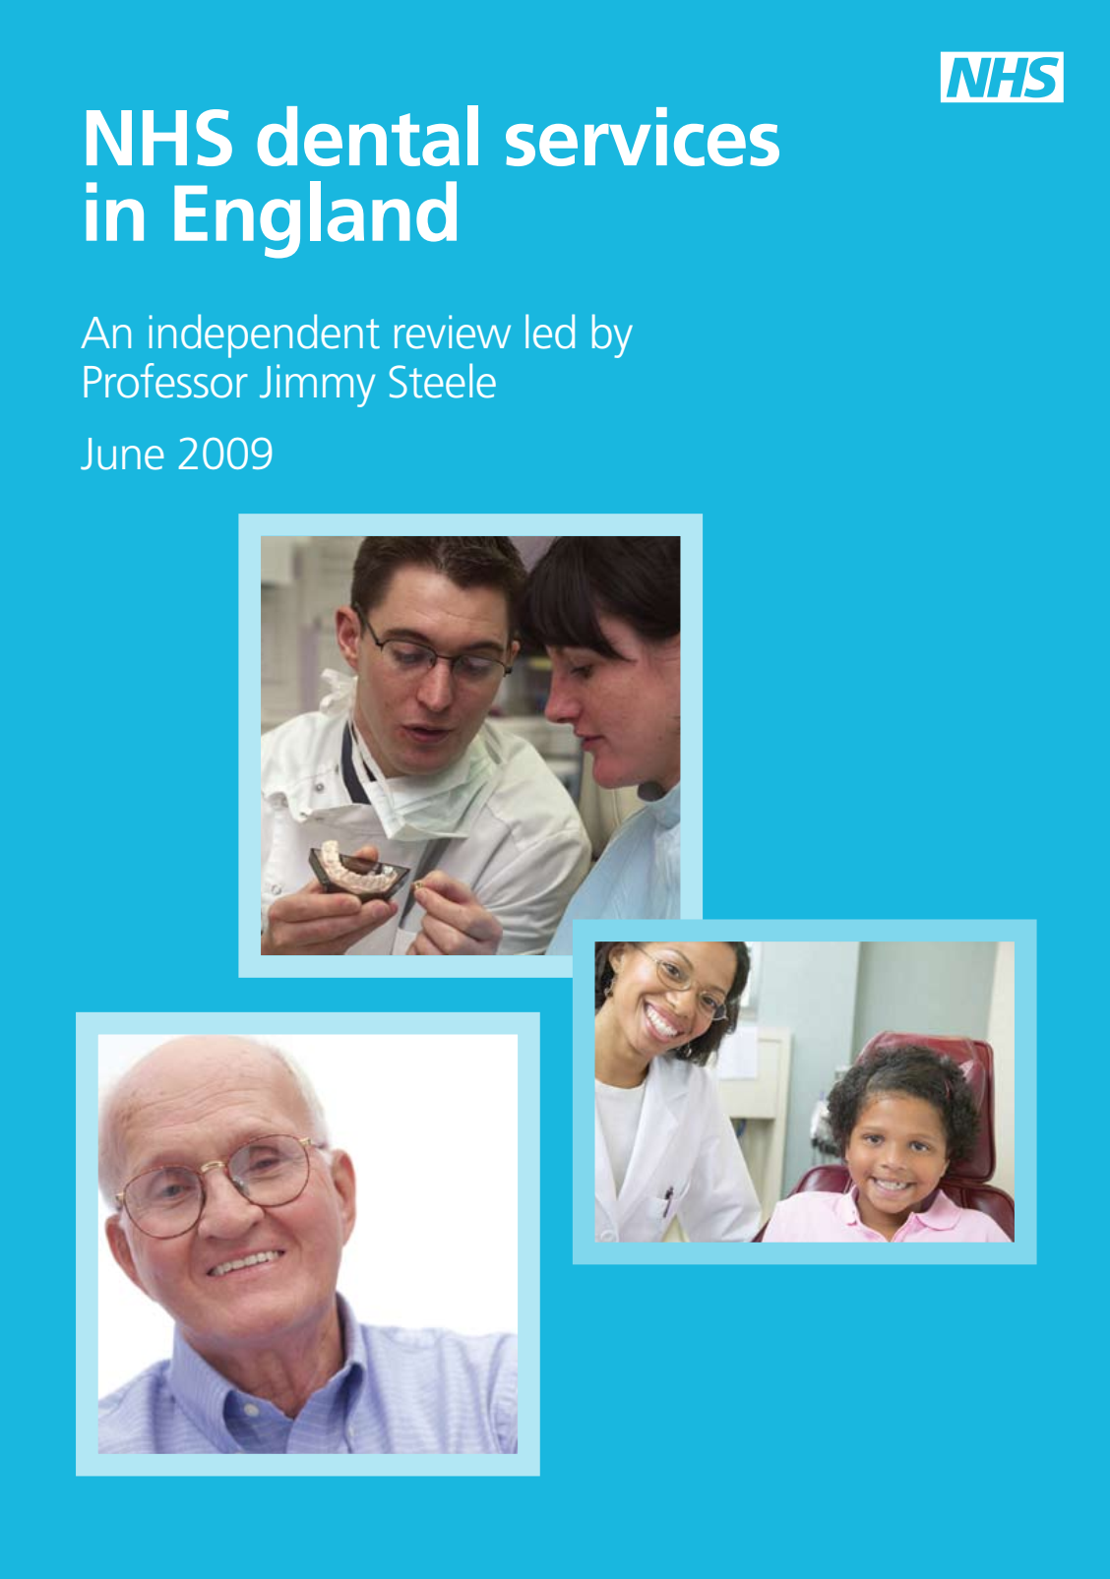
Challenges

Slide 4
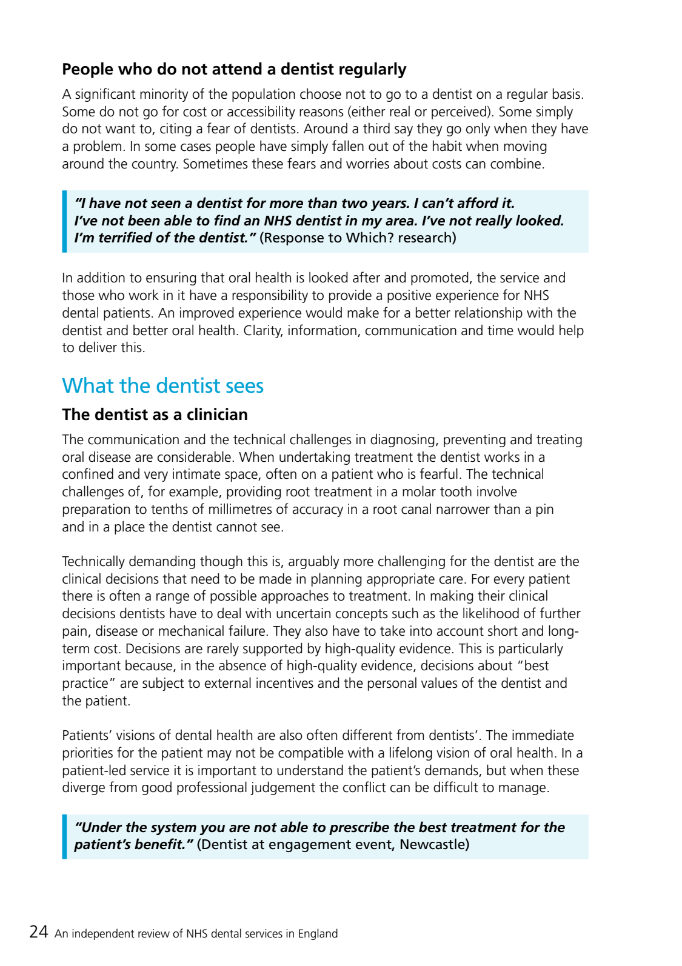
‘The technical challenges of, for example, providing root treatment in a molar tooth involve preparation to tenths of millimetres of accuracy in a root canal narrower than a pin and in a place the dentist cannot see.’
Jimmy Steele

Slide 5
Programme overview
Part-time course specifically geared towards GDPs, to improve endodontic knowledge & skill
Didactic – Seminars (Year 1 & 2)
Practical – Skills Lab (Year 1)
Clinical – Supervised Treatment (Year 2)
Research – Literature Review + Research Project (Year 3)
Institute of Dentistry
www.qmul.ac.uk/dentistry

Slide 6
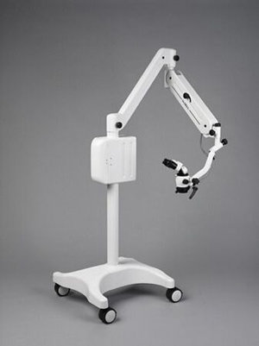
What to expect? – Year 1

Slide 7
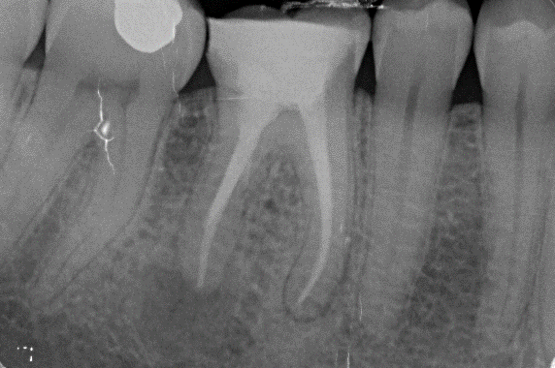
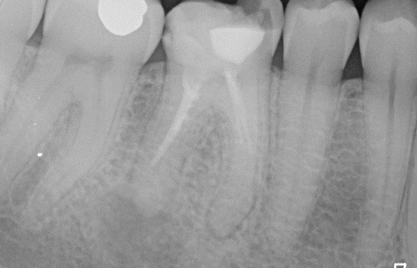
What to expect? – Year 2

Slide 8
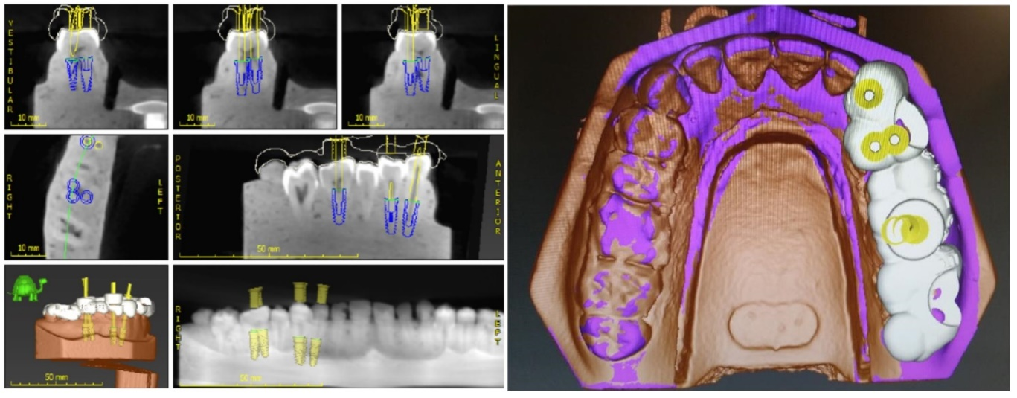
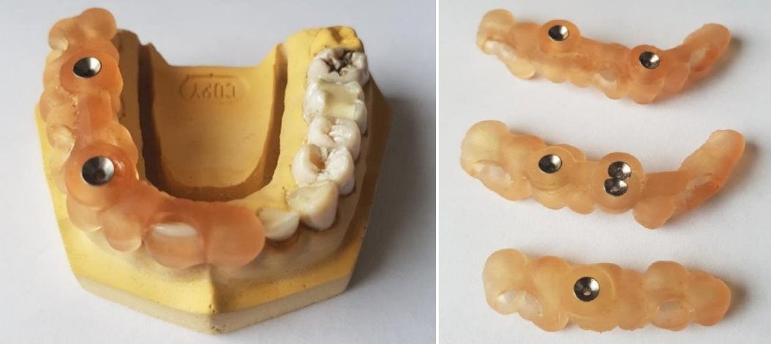
What to expect? – Year 3

Slide 9
Publications - Examples

Slide 10
Thank You
Institute of Dentistry
www.qmul.ac.uk/dentistry

