Slide 1
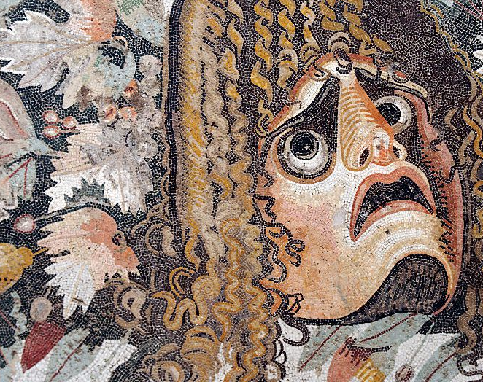
COM507 European Tragedy Comparative Essay Workshop

Slide 2
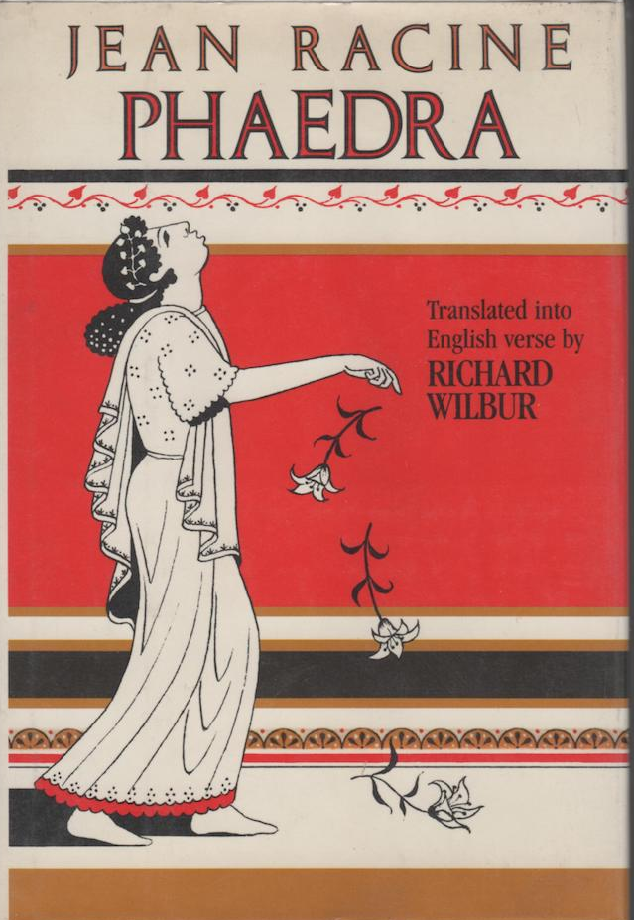
Session structure
Coursework practicalities
Initial exploration of essay questions
Discussion of quotes gathered by students (preparation task)
Glossing key themes from assignment questions
Comparative ideas from Phaedra and Endgame (Richard)
–(break)–
Module evaluation?
Recap of Aristotle’s Poetics (Rachel)
Comparative ideas from Bacchae and Blood Wedding (Rachel)
Questions/troubleshooting

Slide 3
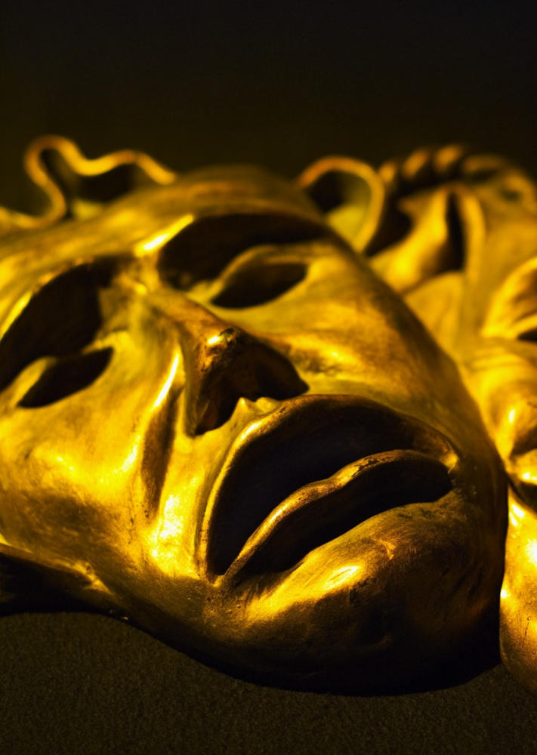
Coursework practicalities
Write a comparative essay on at least two of the plays studied for the module (given the word count, it would be ambitious to tackle three!)
The word limit is 2000 words (+/- 10%). There is no space for unfocused discussion! Structure matters more than usual!

Slide 4
General advice
Read the question very carefully, identify its key terms, and make sure that you are answering the question that has been set.
Plan your essay and argument, incl. use of secondary sources.
Set out a clear argument in the introduction. Summarise argument to test. Avoid plot summary.
Back up your claims with short quotation from primary and secondary sources. Analyse quotations and justify their use.
Avoid overly general statements (‘women in ancient times thought this...’, or ‘This engages the audience’s emotions’ ).
Acknowledge the specific historical and aesthetic context in which each play was produced (e.g. fifth-century Greece, seventeenth-century France, twentieth-century Spain or France).
Do not forget that you are analysing plays, not novels. Discuss spectators, not readers. Refer to dramatic structure, dramatic devices, stage directions, performance history, etc where appropriate.
Pay attention to referencing and presentation. Include a bibliography.

Slide 5
The questions
Pick one of the following questions:
1. Discuss the role of any one of the following in relation to at least two of the plays studied for this module: time; gender; recognition; fate.
2. To what extent are the gods, or God, indispensable to an understanding of the tragic action in any two of the plays studied for this module?
3. Discuss the relationship between tragedy and social status in at least two of the plays studied for this module.
4. ‘‘Through the estrangement and the decomposition of the tragic protagonist we are brought face to face with the fragility of our identity, and the fragility of the languages through which we make sense of that identity.’ (Hammond) Discuss this quotation with reference to at least two of the plays studied for this module.
5. Discuss the treatment of ‘endings’ in at least two of the plays studied for this module.

Slide 6
Student preparation task
In advance of this session, you were required to find a quote or key idea from secondary criticism that allowed for a comparative perspective on two of the plays studied for the module.
Please write your quotation in the chat.
Discussion: what are the key ideas expressed by each quotation and which plays/questions would they be relevant for?

Slide 7
Student quotations:
'The space delineated by tragedy often carries a mythic freight and temporal complexity' (Hammond, 2009, p. 13)
„Running through tragedy is the problem of agency and of freewill, as tragedy asks, ‚Who is it that acts‘ and ‚Who is it that speaks‘?“ (Hammond)
“If characters have repressed desires, the gods are no longer essential to understanding events.” (Scodel, An Introduction to Greek Tragedy)

Slide 8
Initial perspectives for comparative analysis
NB these are only some ideas/questions! Please do not feel restrained by them ☺

Slide 9
Time
How does stage time relate to narrative time?
Why might unity of time magnify the tragic action?
What do people say about time in the plays studied?
How and why does time matter to the tragic protagonists of these plays?
For what reasons do they look to the past, present, or future?
To which other tragic themes does time relate? (e.g. fate, recognition, memory, guilty…)
How have treatments of time on the stage shifted during different eras of tragic drama? (e.g. Why might time be treated differently in Euripides and Beckett?)

Slide 10
Gender
How is gender presented on stage?
Do the plays reinforce or subvert conventional notions of gender and gender identities/roles? (be wary: conventional for whom? See secondary literature to avoid generalisations)
To what extent do questions of gender overlap with social and political concerns in the plays? (again, be wary of historical specificity)
How do questions of gender intersect with other key tragic themes? (e.g. fate)
NB questions of gender are often important when gender does not seem to play a central role!

Slide 11
Recognition
Why has recognition been seen to be so important to tragedy?
Do not disregard the fact that recognition is a key category in Aristotle’s discussion of tragedy in the Poetics (anagnorisis, also related to reversal, or peripeteia).
Whose recognition? The characters’ recognition? The audience’s recognition? How do these two sites of recognition (stage and audience) connect?
Relatedly, what is the relationship between recognition and catharsis?
Which other key themes might recognition connect to? (e.g. knowledge, understanding, time)

Slide 12
Fate
What is fate? And what role has tragedy played in shaping our understanding of it?
To what extent is the tragic action in your chosen plays dictated by fate?
If the tragic action is not governed by fate, what is it governed by?
How do conceptions of fate change (or remain constant) across the different historical and cultural periods covered by the module?
How does the category of fate intersect with other key tragic themes? (e.g. time, divinity, guilt and responsibility…)

Slide 13
gods/God
NB major contributions to literature on tragedy that have broached questions of belief/religion (Aristotle, Hegel, Kierkegaard, Goldmann, Steiner…)
Don’t forget, you can analyse not only the presence of gods/God but also their absence, as well as the absence of faith/belief in afterlife etc.
Given the crossover with questions of society/politics, especially important to take account of the contexts in which plays appear and their historical specificity (e.g. religion very important in the context in which Racine is writing)
Connection of gods/God to other key themes? (Fate, recognition, gender etc.)

Slide 14
Social status
What social spheres do the plays represent?
‘[The tragic protagonist] is one of those people who are held in great esteem and enjoy great good fortune, like Oedipus, Thyestes, and distinguished men from that kind of family.’ (Aristotle, Poetics, p. 21)
Why has tragedy often focused on nobility/royalty? Is this the case in the plays you are analysing?
How do tragedians treat those of lower social status (e.g. servants)?
If your tragedy does not deal with the ‘great and good’, how does this change things?
How does the representation of social status in tragedy intersect with political and social questions?

Slide 15
Fragility of language and identity
Look carefully at what Hammond is saying and read the relevant sections from The Strangeness of Tragedy.
The advantage here is you have a secondary framework to begin with.
NB he also has a chapter on Phaedra and says, interestingly, that he is not going to extend his analysis to the ‘estranged domesticities of […] Beckett’ (p. 12). There is nothing to stop you doing so!
Why does language matter to the characters of the plays that you have chosen to analyse? How does identity take shape in and through language? Why might this identity be marked by fragility?

Slide 16
Endings
How do your plays end? But also, how do they begin? What happens in the middle?
That is, dramatic structure (c.f. Aristotle) would be one way to approach this question.
What other important themes does the notion of ‘endings’ evoke? (e.g. time, mortality and death, fate…)
How might conceptions of endings relate to notions of catharsis?
NB Poole has a chapter on endings in Tragedy: A Very Short Introduction. This might be a good place to start!

Slide 17
Phaedra: comparative perspectives
Don’t ignore Racine’s preface! Racine theorizes his own tragedy in dialogue with contemporary aesthetic theory. Key ideas about social status, dramatic composition, gods/Gods, fate and agency, ancients and the moderns etc.
Phaedra has, in Racine’s presentation of things, ‘all the qualities which Aristotle requires in a tragic hero, and which are capable of exciting pity and terror.’ (Preface, Phaedra, p. 76)
A great play for thinking through the three unities as well as notions of bienséance and vraisemblance (see lecture slides and critical literature); in this sense, broader question about the ‘rules’ of tragedy.
The seventeenth century very much in dialogue with classical tragedy (e.g. Euripides); however, lots of ways of linking the play to modernity (e.g. identity, language)

Slide 18
Endgame: comparative perspectives
Questions of genre very important: not labelled a tragedy: i.e. you will have to justify your decision to read it as such (see lectures)
The preface to the recommended edition is short but very useful.
This play appeared in a completely different cultural context and moment to Bacchae and Phaedra — leaving aside Lorca for the moment. It is crucial that you recognise this historical and cultural specificity in your comparative analyses.
Nonetheless, there are abundant lines of comparison between the plays (themes, dramatic structure, parody and inversion)
‘By its refusals, Endgame brings the oldest and most venerated literary mode of the Western tradition — dramatic tragedy — into a belated and bewildered modernity’ (Preface, Endgame, p. xv)

Slide 19
Questions?
After the break
Module evaluation?
Recap slides on Aristotle’s Poetics, Bacchae and Blood Wedding

