Slide 1
THE cell cycle and mitosis

Slide 2
Learning objective
“Students should demonstrate an understanding of the sequence of events in the cell cycle and mitosis”

Slide 3
Lecture aims
After this lecture you should be able to:
Describe the sequence of events in the cell cycle and mitosis
Explain the different checkpoints and why they exist
Describe what happens at each stage of mitosis

Slide 4
Cell cycle
Process of cell growth and cell division
All body cells in multicellular organisms use this to grow and divide
Start – cell having been produced by cell division
End – cell divides to produce two identical daughter cells

Slide 5
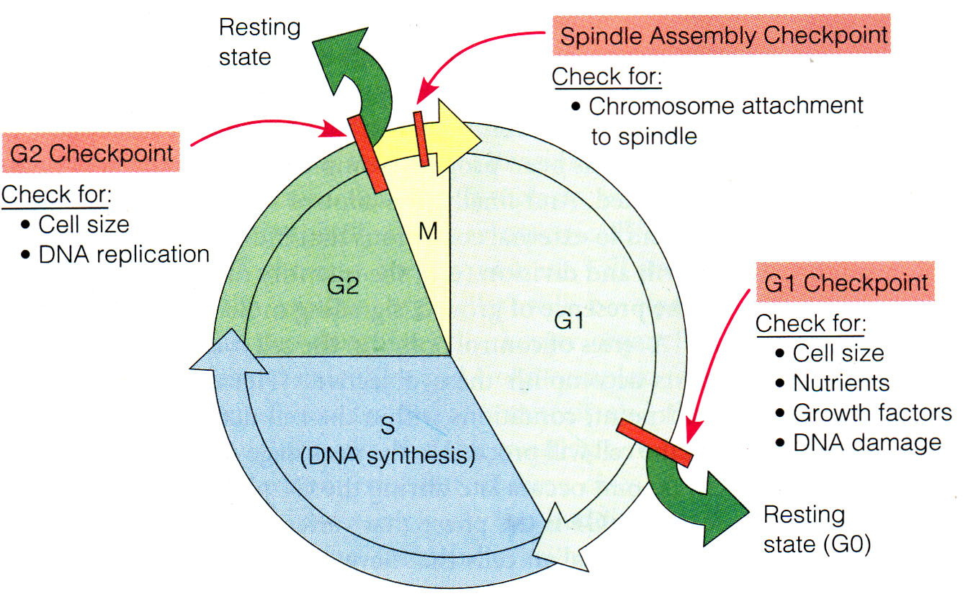
Cell cycle
Have cell growth and DNA replication
This is called INTERPHASE
Cell division = M phase and involves mitosis where nucleus divides and cytokinesis where cytoplasm divides

Slide 6
Cell cycle
Interphase – three separate growth stages
G1(gap/growth 1), S (synthesis) and G2 (gap/ growth 2)
Cell cycle regulated by checkpoints – why?

Slide 7
checkpoints
G1 checkpoint- checks that all chemicals needed to help cell to divide have been made and checks for damage to DNA before S phase– why?
G2 checkpoint – checks DNA replicated correctly – why?
Metaphase checkpoint – cells checks all chromosomes have attached correctly to spindle before mitosis continues

Slide 8
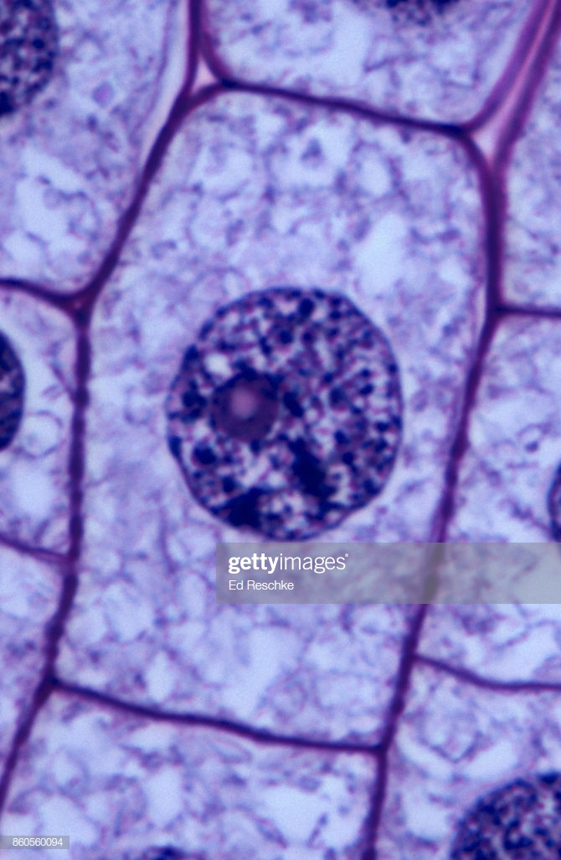
interphase
“Business as usual” – normal functions going on but cell is preparing to divide
DNA is unraveled but also replicated
Cell organelles replicated including centrioles
ATP increases – why?

Slide 10
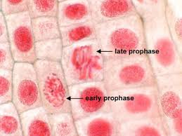
Prophase
Chromosomes get short and fat – condense
Can be viewed as two chubby strands stuck together at the centromere
Chromosomes now called chromatids (sister chromatids)
Centrioles move to opposite end of cell and produce network of fibres called the spindle
Nuclear envelope breaks down

Slide 11
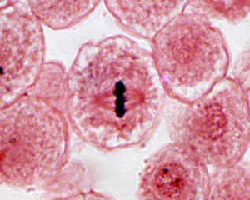
Metaphase
Chromosomes (sister chromatids joined by centromere) line up on equator of spindle and attach to spindle by the centromere, specifically the kinetochore
Metaphase checkpoint makes sure all chromosomes are attached before mitosis continues– why?

Slide 12
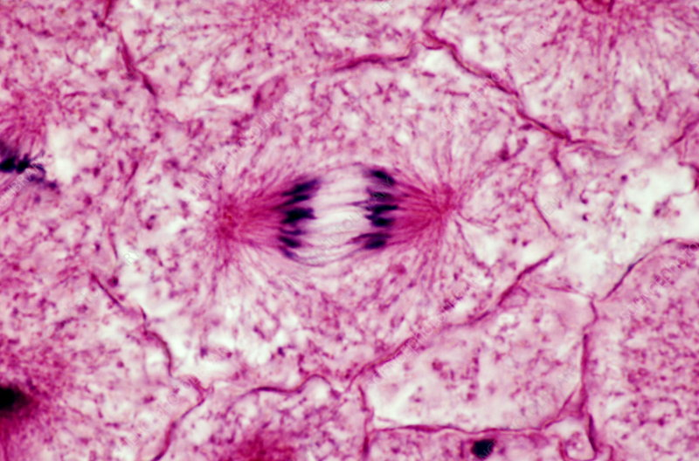
anaphase
Centromeres split
Sister chromatids are now separated from each other
Spindle contracts, pulling chromatids to opposite ends of cell by the centromere

Slide 13
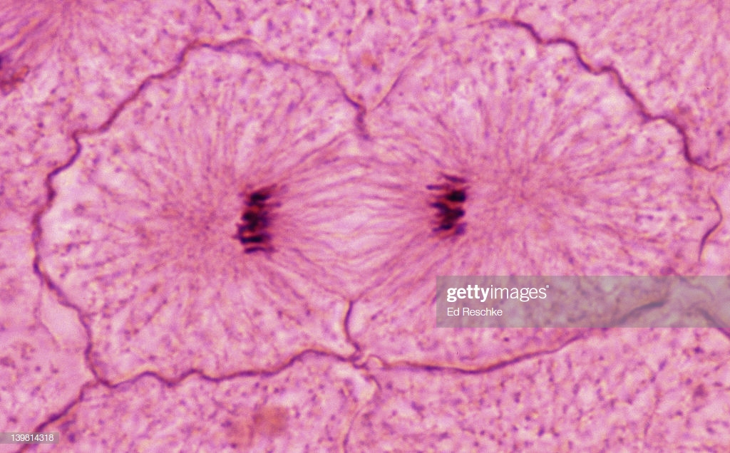
telophase
Chromatids reach opposite poles of cell on the spindle
Start to uncoil and get long and skinny again
Called chromosomes again
Nuclear envelope starts to form again around the chromosomes

Slide 14
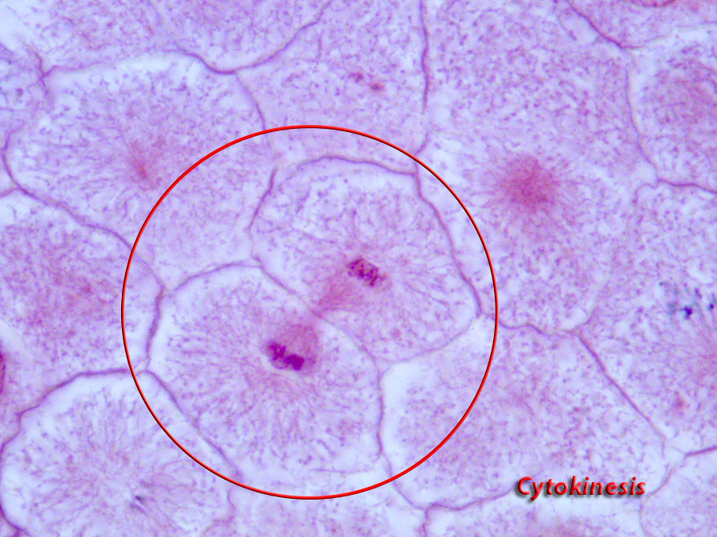
cytokinesis
Cytoplasm divides
Get cleavage furrow in animal cells and cell membrane forms
Cells are now separate and identical
Cytokinesis starts in anaphase and ends in telophase

Slide 15
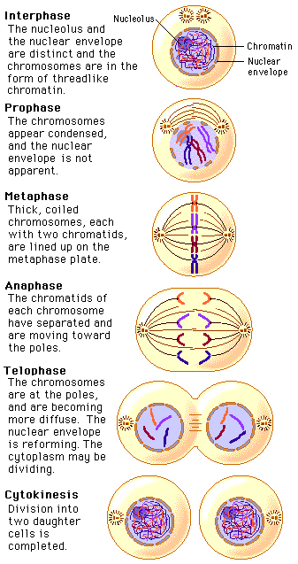
Mitosis summary and video
https://www.youtube.com/watch?v=ofjyw7ARP1c
Note that there is an additional phase called prometaphase
centromere is the region of the chromosome that holds two sister chromatids together, kinetochore is the disc-shaped protein complex of the chromosome that allows spindle fibres to attach during the cell division.

Slide 16
Play time
Use the wool to make two chromosomes (one bigger than other, use different wool colours)
Use paper clips or “pinch” chromatids together to make centromeres
Demonstrate the stages in mitosis

Slide 17
Lecture aims
After this lecture you should be able to:
Describe the sequence of events in the cell cycle and mitosis
Explain the different checkpoints and why they exist
Describe what happens at each stage of mitosis

Slide 18
Question time
What happens during interphase?
Why are there checkpoints and what happens in them?
What are the four stages of mitosis?
Use your phones to find two cell types that undergo regular cell division and two cell types that do not routinely undergo cell division

