Slide 1
‘I Wish I Had Known’
By: Imad, Khalid and Shahryar

Slide 2
Role of Year 4 in the MBBS Curriculum
Similar to Year 3, except the content is focused around the various medical and surgical specialties (organized as modules), including:
Brain and Behaviour
Neurology and Neurosurgery
Ophthalmology
Psychiatry
Ears, Nose and Throat (ENT)
Chronic Conditions and Community Care
Dermatology
Geriatrics
Rheumatology
Orthopedics
Sexual Health
Human Development
Obstetrics and Gynaecology (OBGYN)
Paediatrics

Slide 3
Role of Year 4 in the MBBS Curriculum
Various specialties have a difference in weighting
Generally speaking, weighting correlates with the length of time per placement:
Human Development (OBGYN + Paediatrics) – 10 weeks
Psychiatry – 6 weeks
Neurology and Neurosurgery – 3 weeks
Geriatrics – 3 weeks
Everything else
Ophthalmology – 1 week
ENT – no placement, integrated into GP + separate teaching
Dermatology – no placement, integrated into GP + separate teaching
Rheumatology – 1 week
Orthopedics – 1 week
Sexual Health – no placement, 1 teaching week
This is a guide, learn everything
Some modules, although have a short placement/no placement, show up frequently in exams, e.g. rheumatology, dermatology and sexual health

Slide 4
Study Tips
There is a lot of content, arguably more than year 3
Some of the content may be harder to grasp than 3rd year (it is more niche)
Start studying now and space out your learning
Can coordinate studying with each placement

Slide 5
Study Tips
Learn the content first, prior to testing
Flashcards are great to learn content and practice active recall + spaced repetition, e.g. Anki
PassMed is great to test knowledge, although it lacks considerably in certain specialties, particularly:
Neurology – some guidelines (e.g. epilepsy and seizure disorders) not up to date
Psychiatry – some major diagnoses barely covered (e.g. anxiety disorders, child and adolescent conditions, mental health act + capacity, obsessive-compulsive and related disorders, substance abuse, etc.)
Sexual health – HIV not covered extensively
Dermatology – barely any images
Public Health – few questions
‘PassMed textbook’ – adequate for a high-yield review, but probably not sufficient to fully understand diseases and their presentation, diagnosis and management
Capsule (free access from University) – great for dermatology and MSK
University lectures – average, useful to guide studying and as high-yield summaries
Study how you like, but please learn the content!

Slide 6
Study Tips – Recommended Textbooks
Textbooks are great to learn content, if you have access to them
Although old fashioned, textbooks provide a comprehensive review of diseases, written by specialists most of the time
Medical student friendly textbooks are best, don’t go for specialist textbooks
Some textbooks are available in the library on campus or through the QMUL online library
See following slides for recommended textbooks in own time

Slide 7
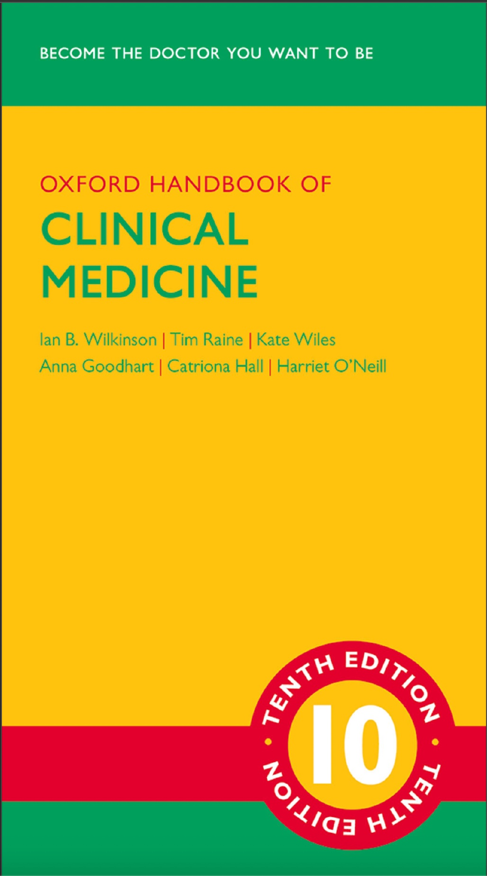
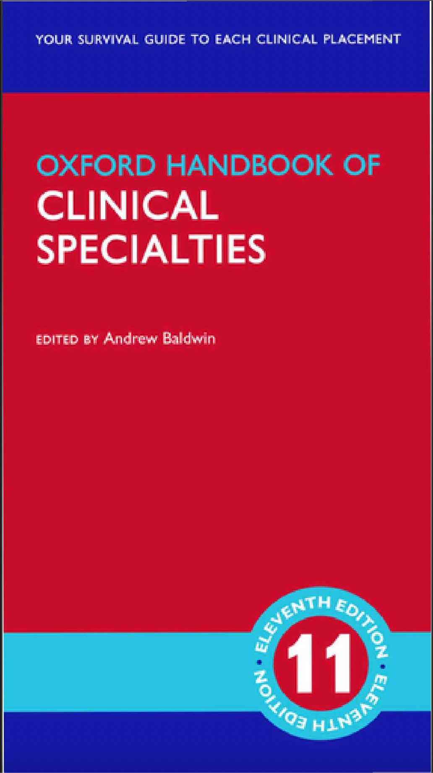
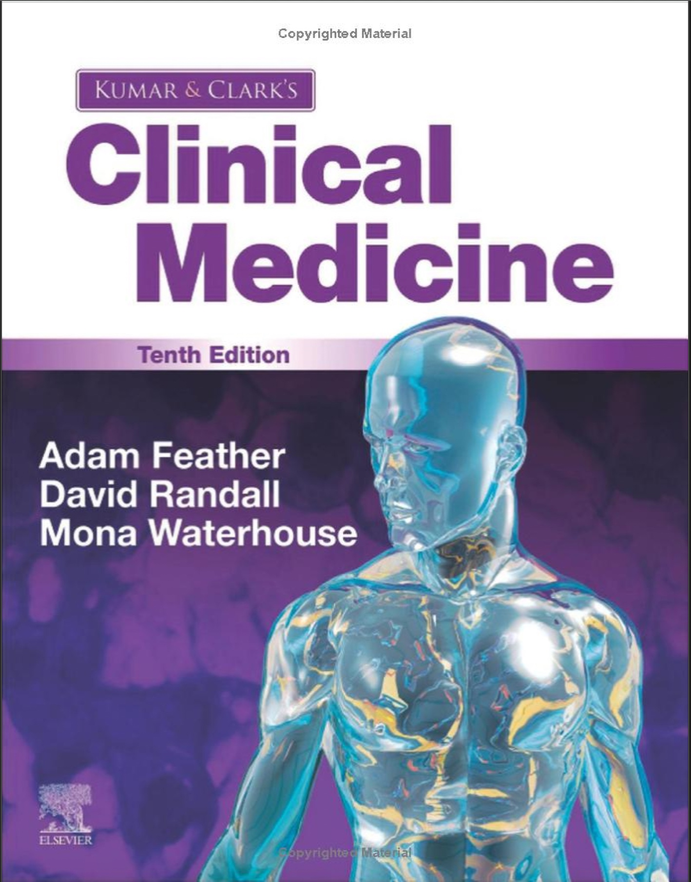
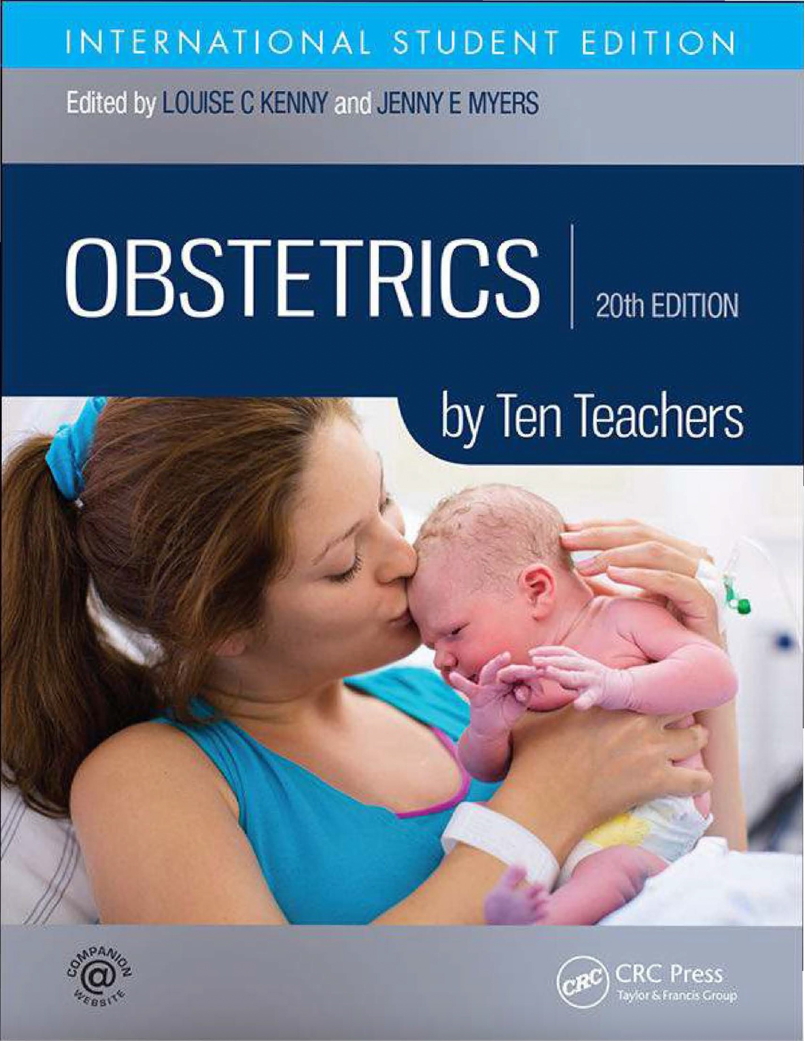
Study Tips – Recommended Textbooks
Rheumatology, Neurology and Sexual Health
OBGYN, Paediatrics, Ophthalmology, ENT, Dermatology, Orthopedics and Psychiatry
Rheumatology, Neurology, Sexual Health, Dermatology, ENT, Ophthalmology
Obstetrics

Slide 8
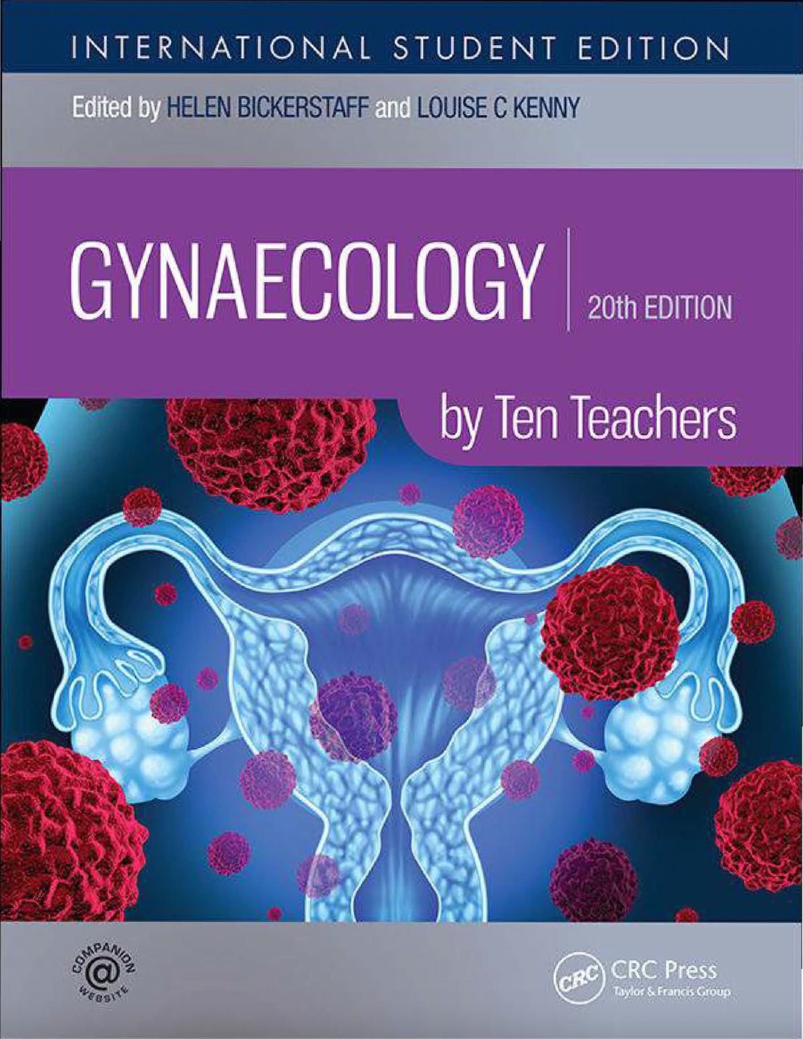
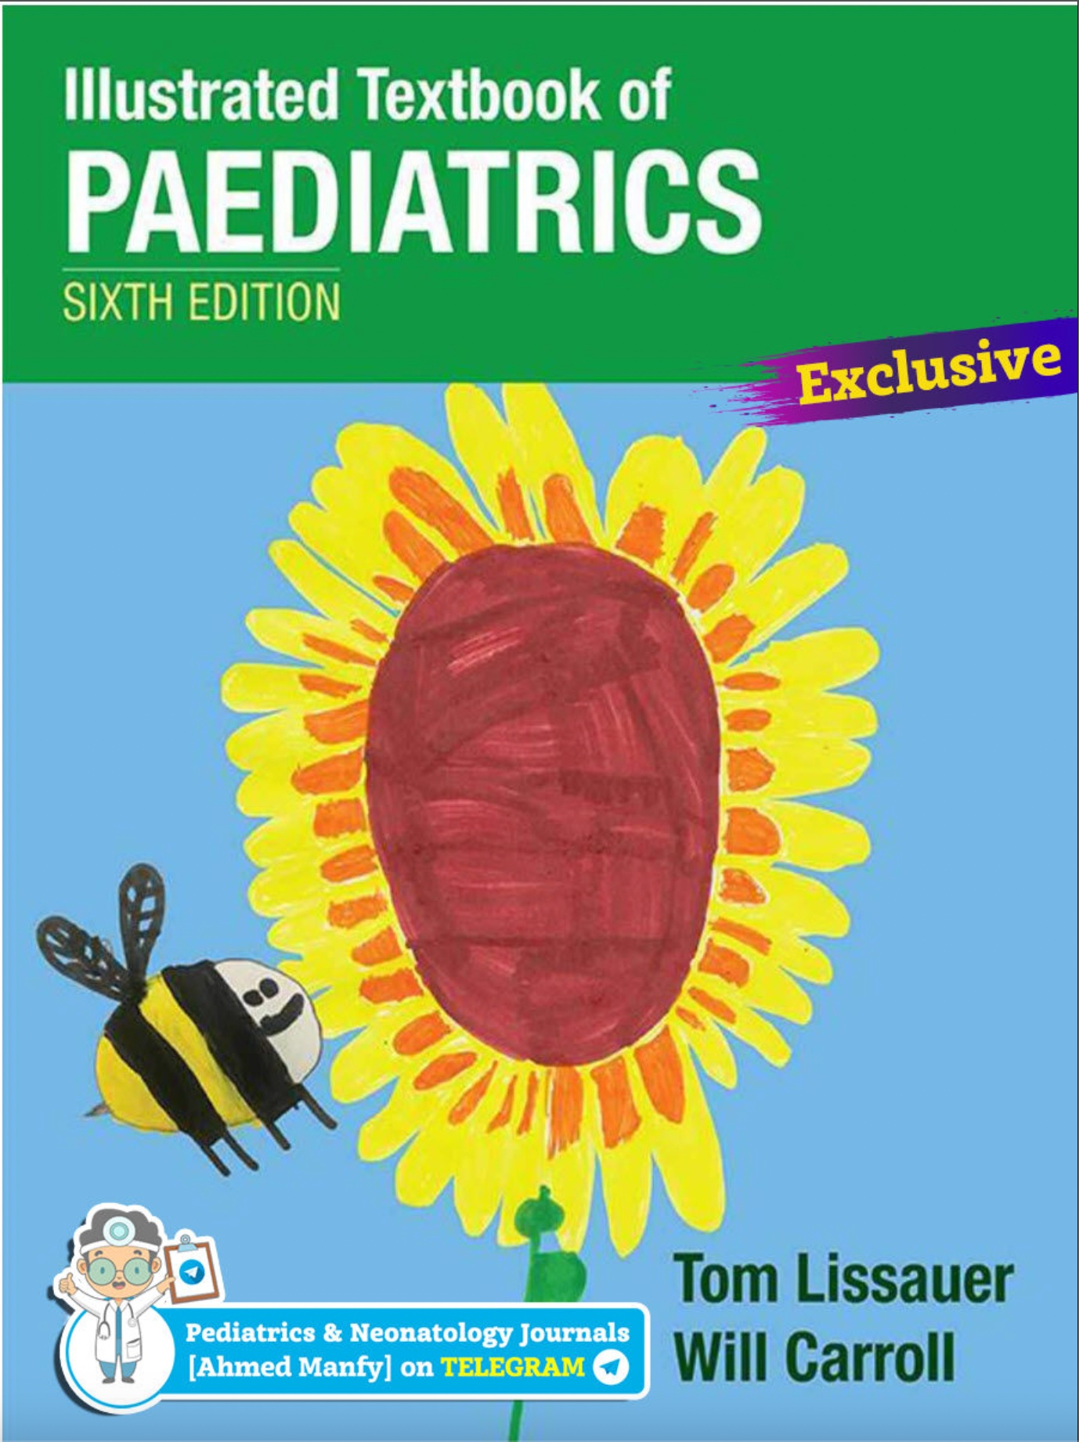
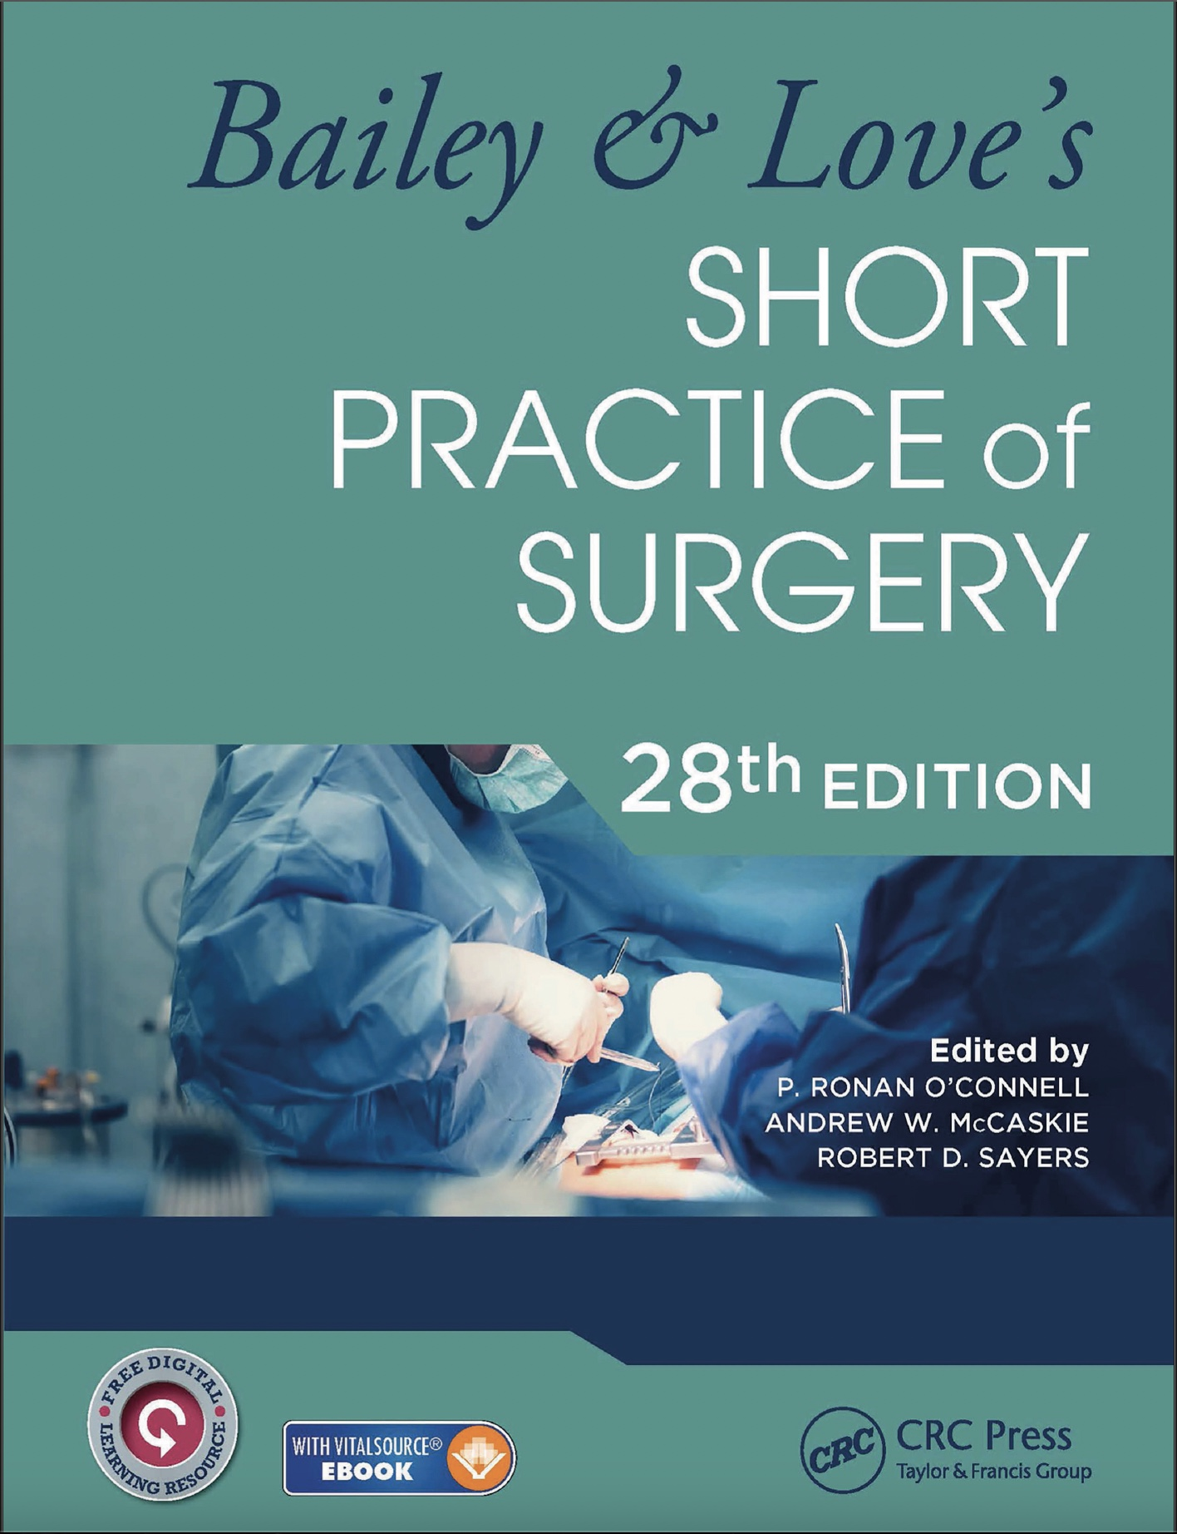
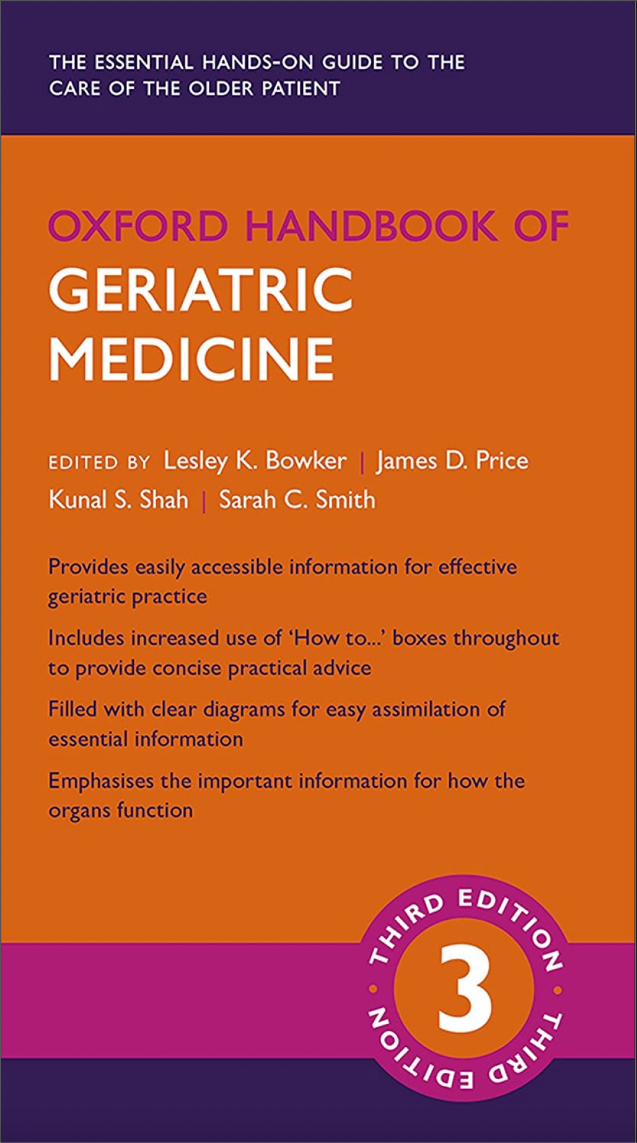
Study Tips – Recommended Textbooks
Gynaecology
Paediatrics
Orthopedics
Geriatrics

Slide 9
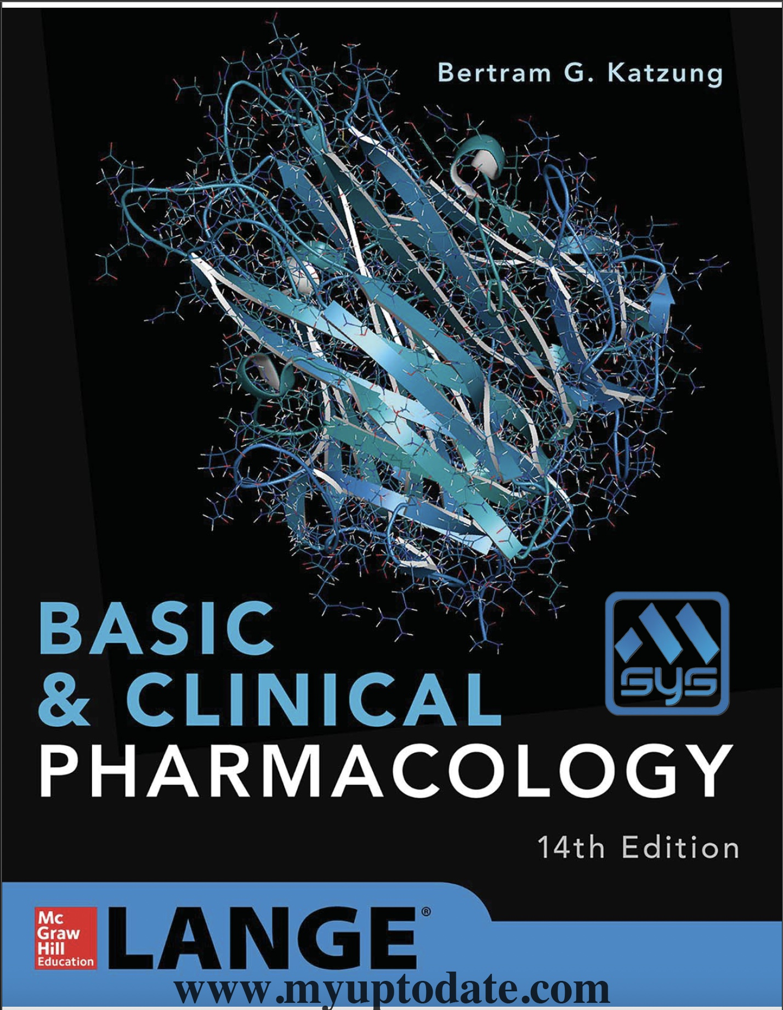
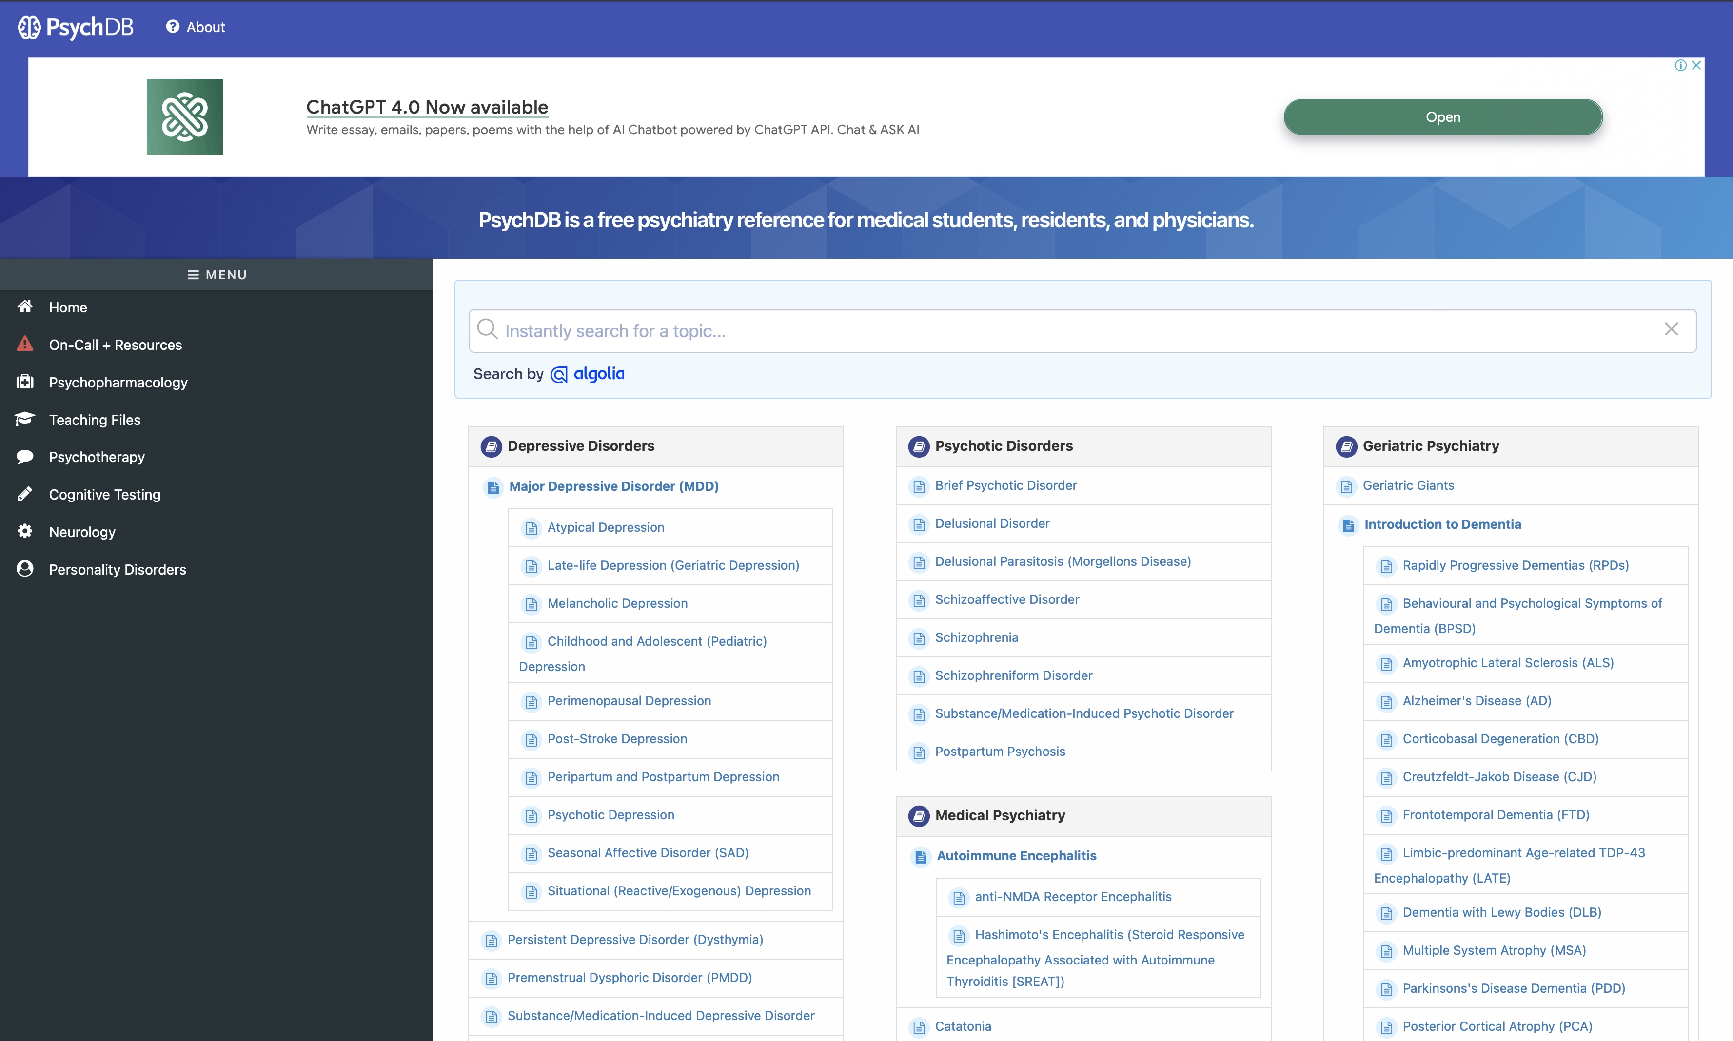
Study Tips – Recommended Textbooks
Pharmacology Reference
Psychiatry – PsychDB (website)
*Guidelines are Canadian, links to NICE Guidelines at the bottom of each page

Slide 10
Specific Study Tips
Neurology and Neurosurgery:
First principles are key – neuroanatomy, neurophysiology, tracts, pharmacology
No need to learn them in-depth for the exam, however, a basic understanding of first principles helps to learn disease
Ophthalmology
Similar to neurology and neurosurgery
An understanding of first principles helps to learn disease
Psychiatry
First principles from neurology and neurosurgery help
Pathophysiology of schizophrenia and depression help to learn management
No need to learn ICD/DSM criteria, except for some diseases, e.g. schizophrenia, depression, bipolar disorder and some anxiety disorders
ICD is used in the UK, DSM (used in the USA) is more practical and easier to follow
Understand the natural history/progression of psychiatric disease
Pharmacology – extremely important. Learn the drugs, their mechanism of action and side-effects. Very commonly tested on exams

Slide 11
Specific Study Tips
Dermatology
Basic physiology and anatomy help
Basic pathophysiology helps to understand management (which is sometimes obscure)
Learn the basic dermatological classification of diseases, e.g. macule, patch, vesicle, blister, bulla, pustule, papule, nodule, callus, plaque etc.
Photos
Dermatology is all about pattern recognition
PassMed barely has any images – better for management
Study images on your own time/in textbooks
Dermnet (website) has a massive categorized photo bank
Sometimes very hard to remember textbook clinical features of specific diseases word-by-word – think about learning images and describing them to yourself
Geriatrics
Mainly internal medicine (Year 3) principles
You will probably remember more than you think
‘New content’ centres around geriatric history, delirium, dementia, ethics, falls, palliative care and Parkinsonian disorders – focus on these

Slide 12
Specific Study Tips
Rheumatology
Deceivingly vast and commonly tested
Pattern of presentation is key, e.g. monoarthritis, oligoarthritis, polyarthritis
Ensure to cover
Association between different rheumatological and general diseases
Antibodies – consider making flashcards for them
Orthopedics
Basic anatomy helps
No need to learn complex anatomy – focus on the anatomy of specific injuries, e.g. in supracondylar fractures
Radiology of injuries is important
Management principles are important – specific management options less so, except for major injuries, e.g. hip fractures
Not only ‘broken bones’, make sure to cover MSK tumours and infections, as well as soft tissue injuries

Slide 13
Specific Study Tips
Sexual Health
Exam favorite
Clinical presentations, diagnosis and management generally straightforward
PassMed is great (except for HIV)
Sexual Health histories are key
OBGYN
Confusing on occasion and probably the hardest module to grasp, take your time to understand – all junior doctors need to have an appreciation of woman’s health
Never really black and white – large amount of lateral thinking required, so clinical placement is key
Antenatal care is an exam favorite, has a tie-in with public health
Learn key presentations, e.g. bleeding during pregnancy

Slide 14
Specific Study Tips
Paediatrics
Not just internal medicine for kids
Children have their own set of unique presentations, pathologies and management
Massive module – take your time
Ensure to cover common pathologies for all body systems
Cover key presentations within specific age ranges, e.g. trouble breathing after birth
Do not forget neonatology – it is a huge part of pediatrics
Placement is phenomenal – engage fully

Slide 15
Clinical Placement
Longer placements:
O&G
Paeds
Psych
GP & Derm
Geriatrics
Shorter Placements:
Neuro/Stroke
Sexual Health
MSK
Ophthalmology
Ask other students about tutors and sign-offs
Ideally, get sign-offs completed at the start of placement
Some tutors prefer a mass sign-off on the last day
Ask questions!
Engage in theatre sessions
Be more proactive in general

Slide 16
SSC4/Dissertation
8000-word project on specialty + topic of choice
Only SSC for Year 4
Can either be:
Large literature review (easier)
Original study
General timeline
Choose titles
Single title assigned by University
Meet with tutor and formulate plan
Work on project
Regular check-ins with tutor
Submission in May/June (check SSC handbook)
Potentially publishable, depending on personal choice, tutor, quality of work and journal options

Slide 17
SSC4/Dissertation
Great opportunity to explore specialties of interest
Extremely beneficial in developing basic research skills and becoming acquainted with the research themes of specific specialties
Extremely long and time-consuming project – best to choose a topic that aligns with personal interests
Most students choose to perform a literature review
Locate high quality studies, especially if your topic is in a research heavy field – Google searches, Google Scholar and PubMed are all great and have overlap
Finding adequate literature is sometimes tricky, especially if you have never performed research. If having trouble:
Speak with your tutor – most are at minimum a BST and thus will have some research knowledge
Speak with colleagues
Read the bibliography of a few published papers, this will lead you to other studies and have a snowball effect

Slide 18
SSC4/Dissertation
Have a basic understanding of your topic, do not dive headfirst unless you are extremely familiar with the topic/specialty
If you have a large topic, write succinctly, words add up – think about the true relevance of your words to the overall project
Start early – do not leave this to the last moment if you want to score well and really learn from the project
Start referencing early – EndNote is great as it stores all references and they can be inserted with an MS Word extension in your final project. All QMUL students have free access. Avoid referencing webpages and textbooks
Engage regularly with your tutor – believe it or not, there are marks for this
Read and refer to the SSC handbook – everything you need to know from deadlines to structuring the project and grading can be found in there
Public health is a required section in all projects – do not skip this, you will lose marks. It does not take much effort; most is reading and statistics

Slide 19
Exam Tips
Paper B and C may be split into different modules like your 3rd year exams (refer to the 2024-2025 Exams and Assessments Handbook)
100 questions each
120 minutes (excluding extra time candidates)
Paper D (OSCEs)
12 stations across 3 days
10 minutes per station (excluding extra time candidates)
1 minute reading time included in the 10 minutes
A 5-minute warning will be given
Final minute warning will be given

Slide 20
Exam Tips – Paper B and C
Not many tips that you haven't already heard or know of
Question style similar to your 3rd year exams
Very ambiguous answers (almost always between 2 choices)
Preparing for the exams
The preparation for B and C is the same
As mentioned earlier, there's a lot of content to cover, therefore, cramming is not going to work. Start early and pace yourself.
Tackle the more difficult and high yield topics first before heading to the easier and lesser yield topics
Group discussions and study sessions are useful
Attend revision lectures, alternatively, view the review sessions on the London or Malta page of QMplus (depending on where they've been uploaded)
Try not to overexert yourself a night before the exam, this time is meant for rest and maybe some light revision (to each their own though)

Slide 21
Exam Tips – Paper B and C
During the exams
Remember to stay calm, if you don't know an answer or are unsure of it, flag it and move on to the next, to save time
Don't second guess yourself!
Time management is key
There is a lecture on QMplus on how to approach answering SBA's (under the Exams and Assessments section, if you can't find it, check the archive of the previous year i.e., 2023-2024)

Slide 22
Exam Tips – Paper D (OSCEs)
More clinically oriented, approach the stations with the mindset of a junior doctor rather than a medical student
Differentials, Diagnosis +/- Management; the station scenarios will dictate which of these you have to do
Preparing for the OSCEs
Practice throughout the year (By far the most important tip)
You won't have enough time to cram OSCE practice during or just prior to exam season
This includes practicing with friends or colleagues as well as practicing on the wards
There will be many communication skills-based stations, so focus on practicing them
Structure your history-taking, counseling and other comm skills stations
Practice all your examinations (yes, including the examinations pertaining to 3rd year modules)
Also practice your procedural skills
Resources to use: Geeky medics, versus arthritis (for joint exams), QuesMed OSCE section, OSCEstop The OSCE Revision Guide and OSCE cases with Mark Schemes (pictures on the next slide)

Slide 23
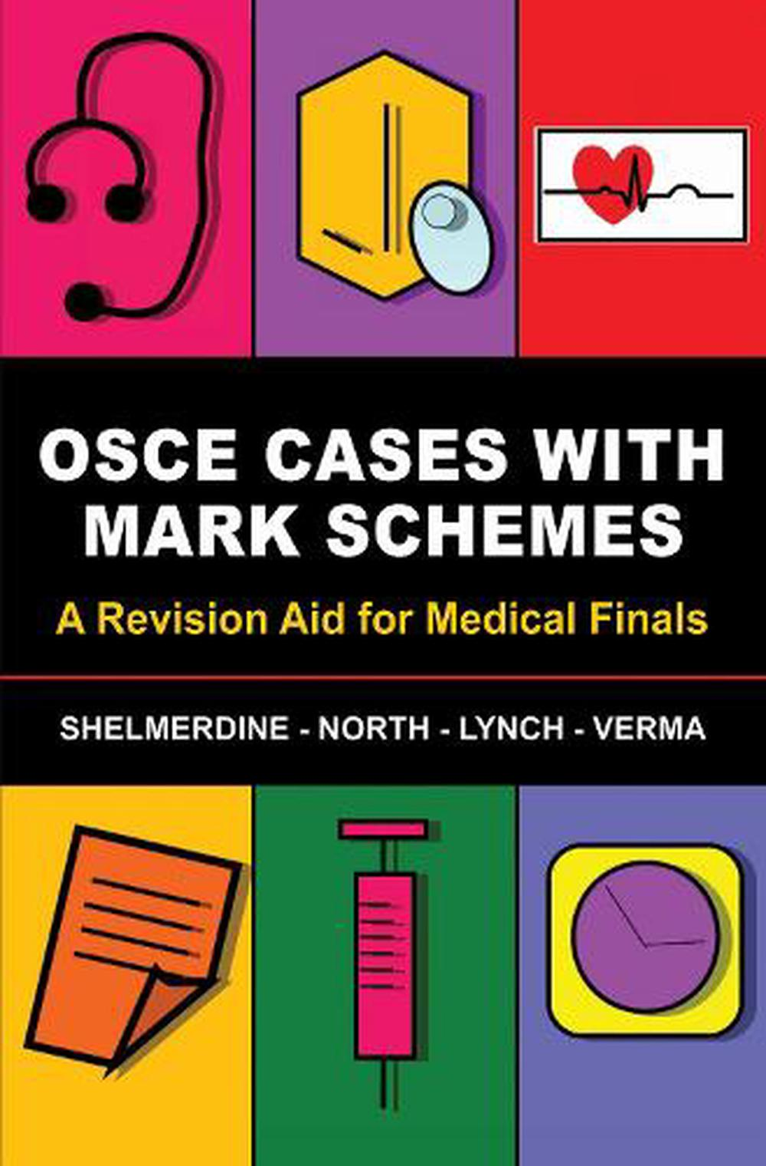
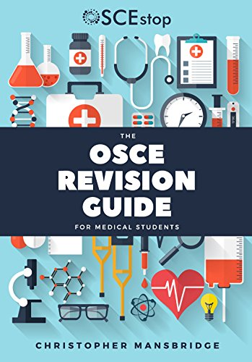

Slide 24
Exam Tips – Paper D (OSCEs)
During the OSCEs
Remain calm, take a deep breath and use the one minute of reading time to note down all the relevant information pertaining to the station
Remember WINDEC and ICE
Time management
Focus on what the scenario/station asks you to do
Cover all the red flags early on during the OSCE station (for example: ruling out red flag signs in a paediatric history)
Think laterally, not very straight forward stations
For certain history taking stations/counselling stations there is a lot of information being received/given to the simulated patient, so time yourself well
Look for the BNF tablet if you're needed to prescribe (usually on the table)
Refer back to the instructions in the room if you get stuck (usually on the table)
If you have any questions regarding exam tips, don't hesitate to ask your colleagues from the year(s) above

Slide 25
SCRIPT and Mock PSA
SCRIPT
Try finishing the SCRIPT modules as early as possible
Helps consolidate knowledge relating to clinical pharmacology
Provides useful information about navigating the BNF
Mock PSA
Good practice for the PSA
Opportunity to practice navigating the BNF, either directly or via MedicinesComplete

Slide 26
Lifestyle
Year 4 is a relatively stressful year and can be challenging, both physically and mentally, with burnout being a common problem, so:
Prioritize your health and well-being, make sure you're taking enough breaks and getting enough rest
Eat well (a fairly simple yet important piece of advice)
Reach out to your colleagues, friends, and/or family
SAPS
Stick to studying techniques that you're used to and work for you
Last but not least, 4th year is the last full year (with 5th year being only 6-7 months and a hectic schedule), so make the most of it, enjoy the year, and make memories with your friends
There are a lot of exciting things to encounter this year!

Slide 27
Any Questions?

Slide 28
Thank you and all the best!

