Slide 1
Green
Environmental
Eco
Carbon
}
Gentrification

Slide 2
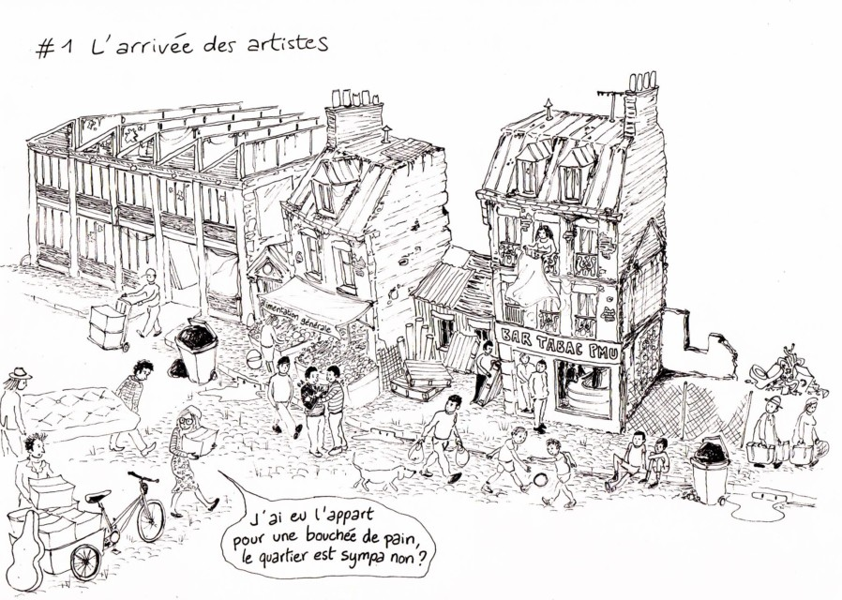
What is gentrification?
Notes:
Replacement of working class households by a “gentry”, affluent middle-class households

Slide 3
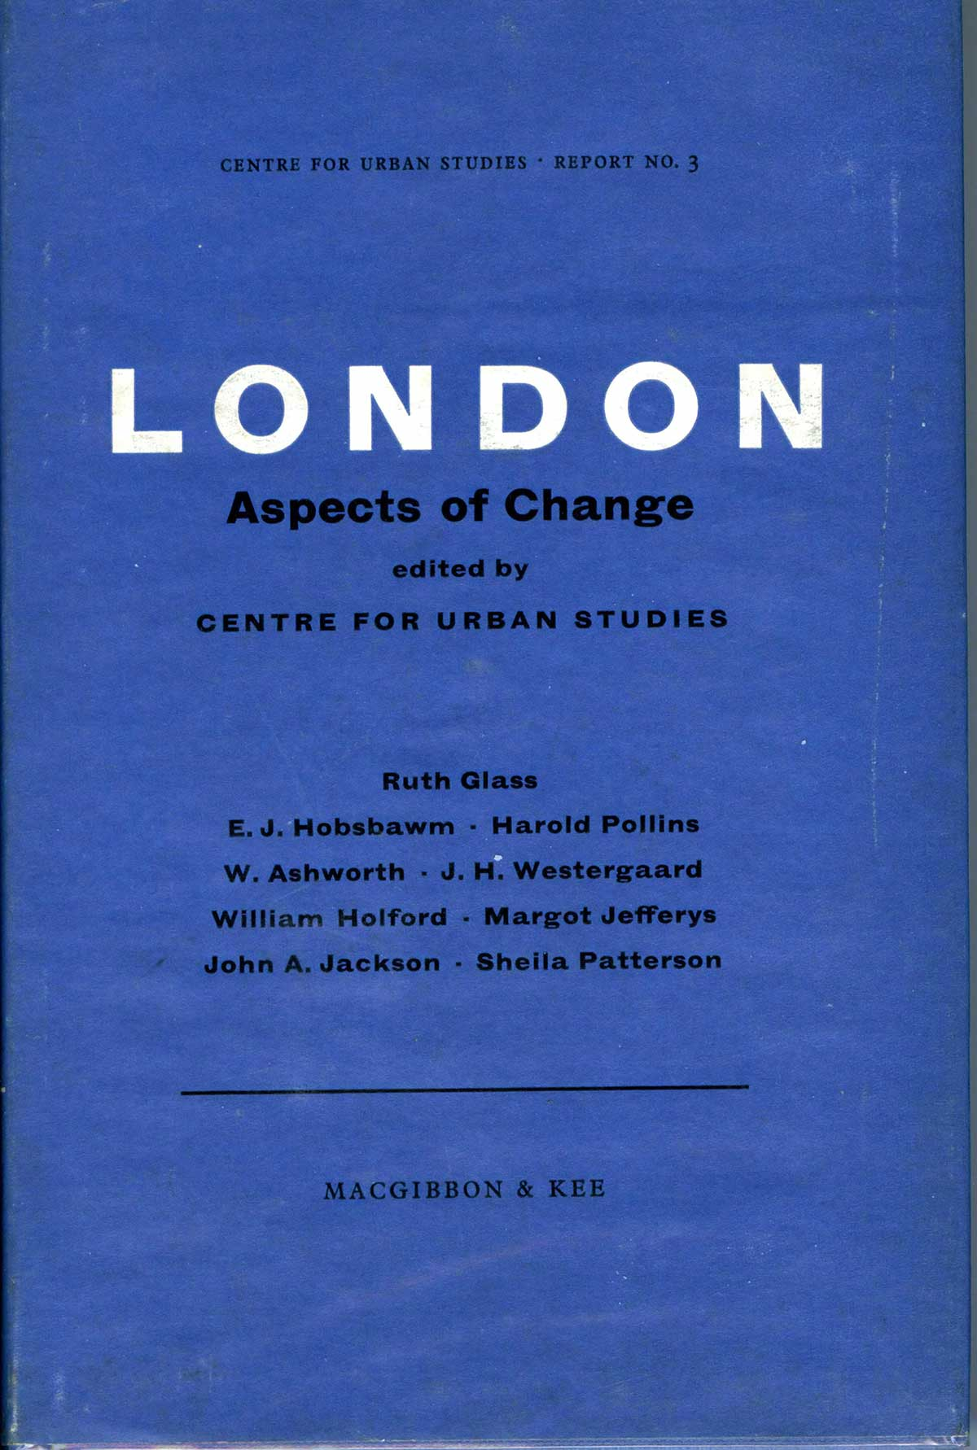
Ruth Glass (1964)
Neil Smith (1996)

Slide 4
Marxist geographers
Neil Smith (1996)

Slide 5
French/francophone Marxists
Henri Lefebvre (1968)
Manuel Castells (1972)

Slide 6
Why use gentrification concept?
Offers dynamic vision of the social division of space
Shows importance of urban space in class/social relations
Reproduction of class domination outside workplace
Resistance by dominated classes

Slide 7
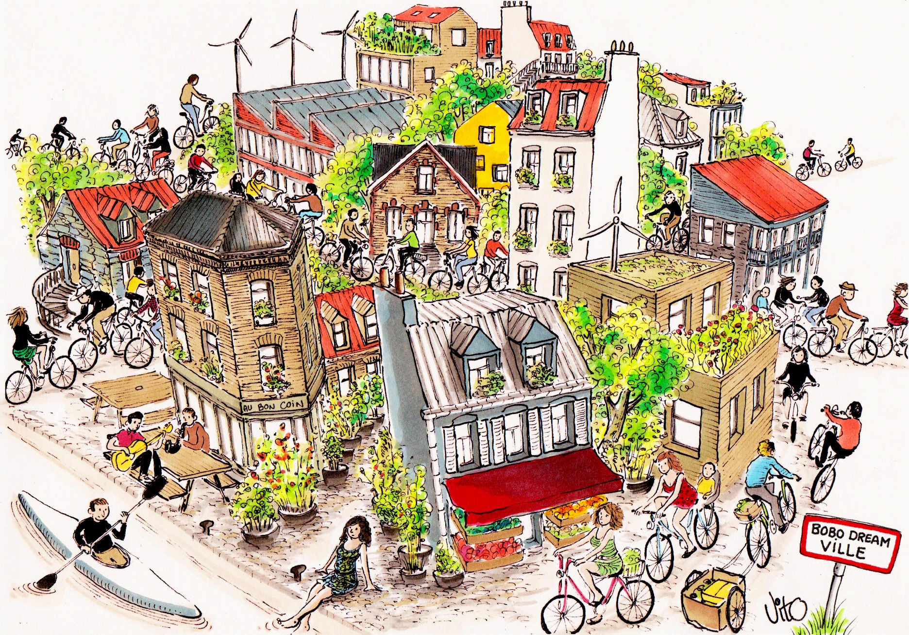
What is green/carbon/environmental gentrification?

Slide 8
Definitions / Environmental gentrification
“The premiums placed on neighbourhood amenities – such as walkability, public transport and the proximity of parks, farmers’ markets and ‘greenways’ such as hiking trails and bike paths – by residents who can afford to pursue them raise the cost of living.” (Wachsmuth, Aldana Cohen & Angelo, 2016: 392)
“Environmental gentrification describes the convergence of urban redevelopment, ecologically-minded initiatives and environmental justice activism in an era of advanced capitalism.” (Checker, 2011:212)
“Operating under the seemingly a-political rubric of sustainability, environmental gentrification builds on the material and discursive successes of the urban environmental justice movement and appropriates them to serve high-end redevelopment that displaces low income residents.” (Checker, 2011:212)

Slide 9
Definitions / Green gentrification
“a subset of urban gentrification. The process of green gentrification is started by greening initiatives that create or restore environmental amenities. Environmental amenities draw in wealthier groups of residents and push out lower-income residents, thus creating gentrification.” (Gould & Lewis, 2017:23)

Slide 10
Definitions / Carbon gentrification
“Middle- and upper-income residents’ preference for neighborhoods that offer the opportunity to walk, bike and ride transit in a mixed-use, dense urban environment, as a means to lower their carbon footprint, which are often, but not always, centrally located in urban areas, leading to a rise in housing prices for those areas.” (Rice, Long, Aldana Cohen & Jurjevich, 2019:6)
“The idea that by biking to work, walking to dinner and living in a dense urban environment, urban residents can ‘do their part’ in the fight against climate change, may also mean that these actions are driving up housing values in neighborhoods perceived as being low-carbon.” (Rice, Long, Aldana Cohen & Jurjevich, 2019:6).

Slide 11
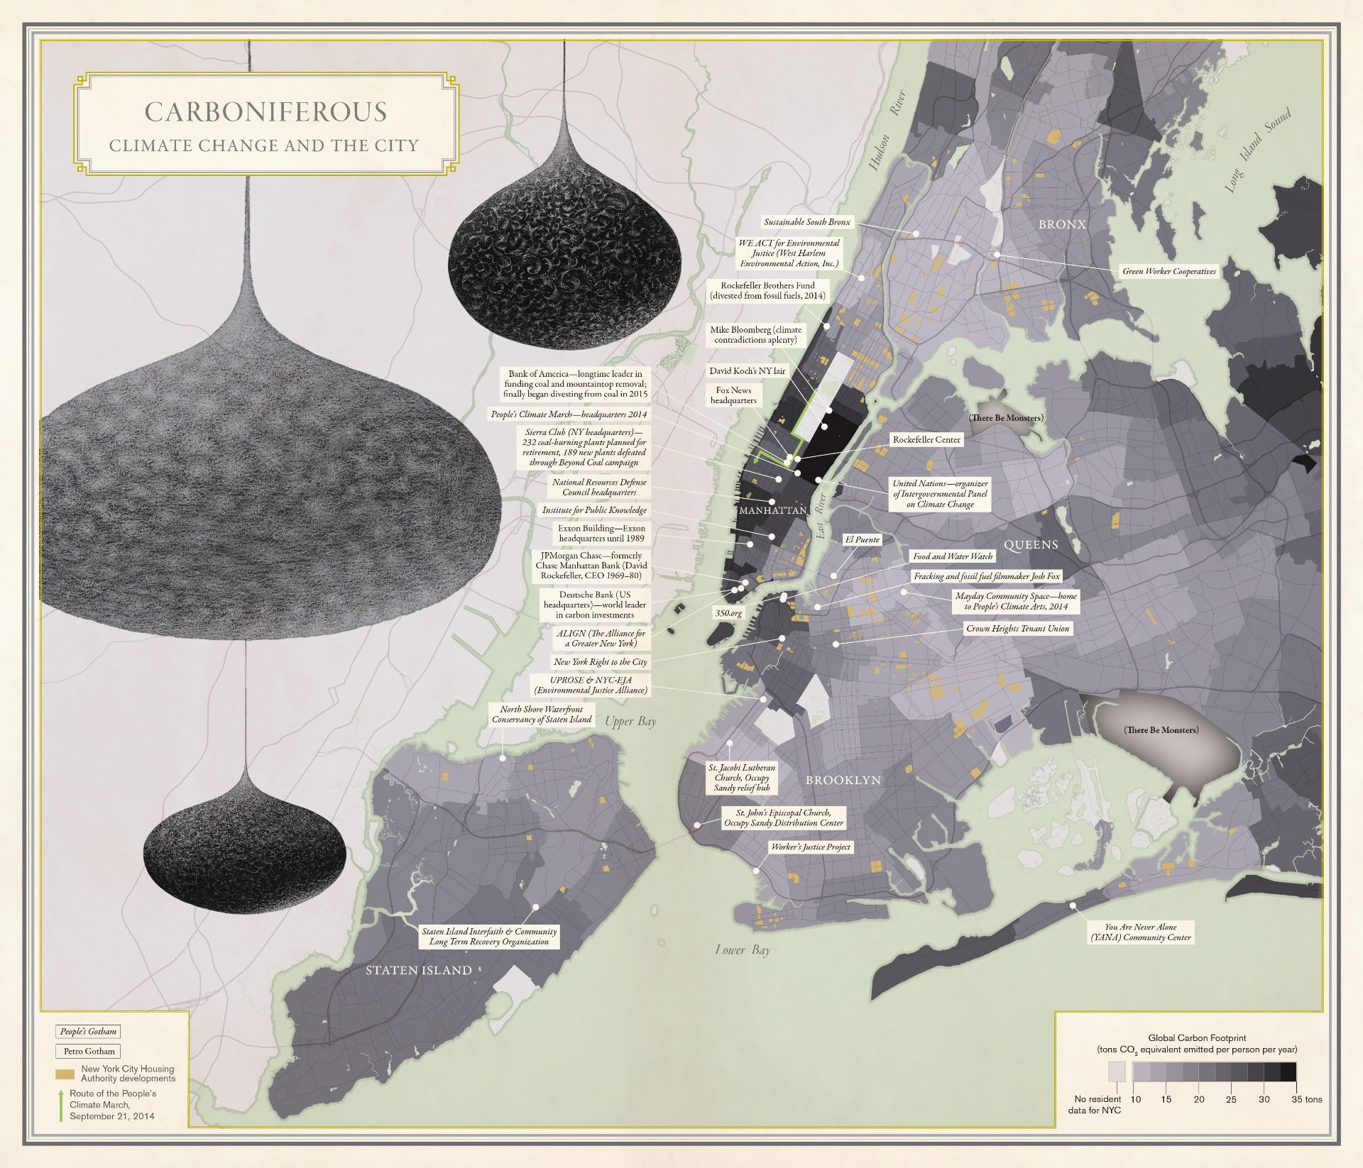
Aldana-Cohen 2016 (Image credit: University of California Press)

Slide 12
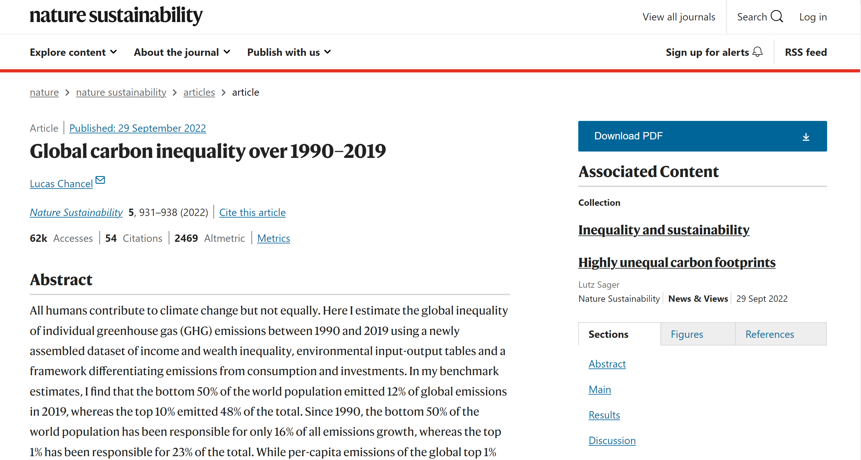

Slide 13
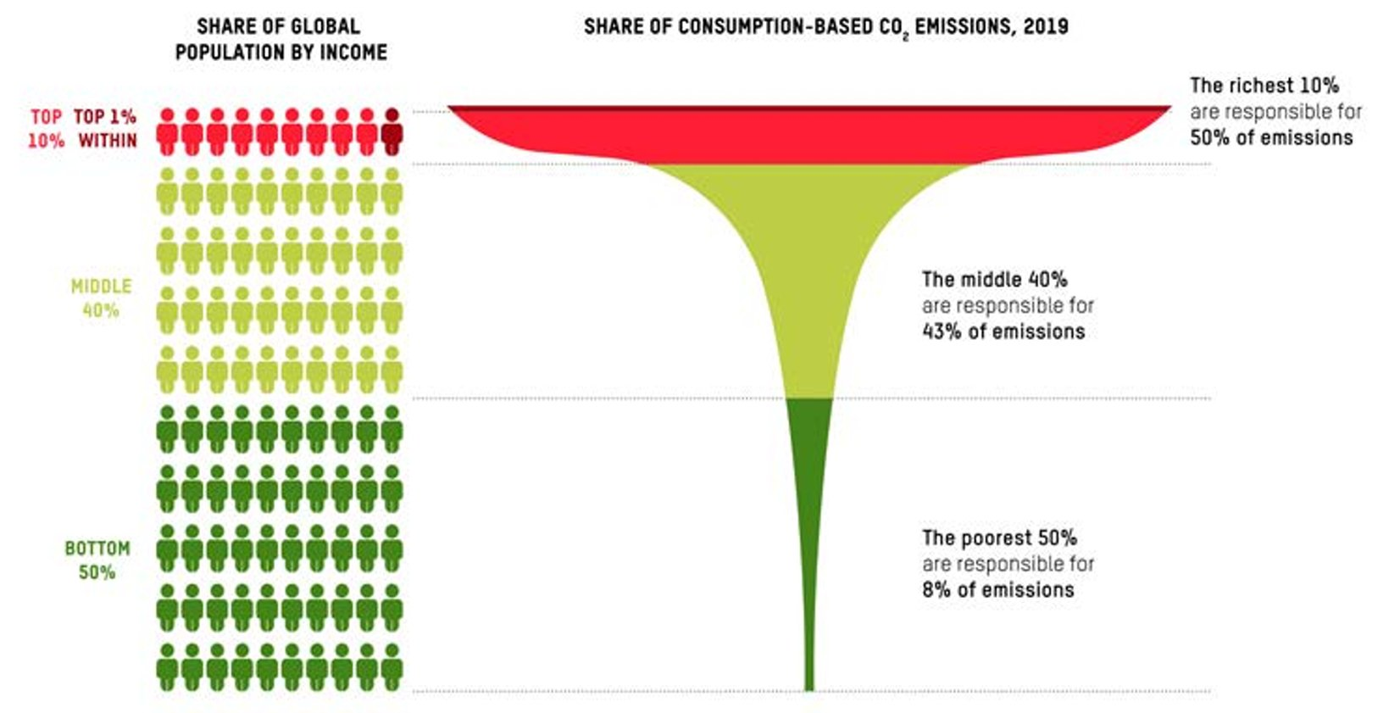
Source: https://oxfamilibrary.openrepository.com/bitstream/handle/10546/621052/mb-confronting-carbon-inequality-210920-en.pdf?sequence=1&isAllowed=y

Slide 14
Differences between carbon gentrification & green gentrification? (1)
Linked to urban development policies oriented around decarbonisation: carbon-centred policy mechanisms in city planning (reduction targets, climate action plans…)
Carbon politics touches almost all aspects of urban design and urban living (not just specific greening projects or redevelopments in city – parks, gardens, brownfield remediation).
Growing popularity of walkable, bikeable, mixed-use communities, with higher levels of density: linked with climate-friendly urban lifestyles.

Slide 15
Differences between carbon gentrification & green gentrification? (2)
“While specific greening efforts might produce displacement at a proximate scale, there is the potential for gentrification associated with low-carbon development to cause gentrification at a much broader level within and across the city.” (Rice et al., 2019:5)
City-level dimension of carbon gentrification

Slide 16
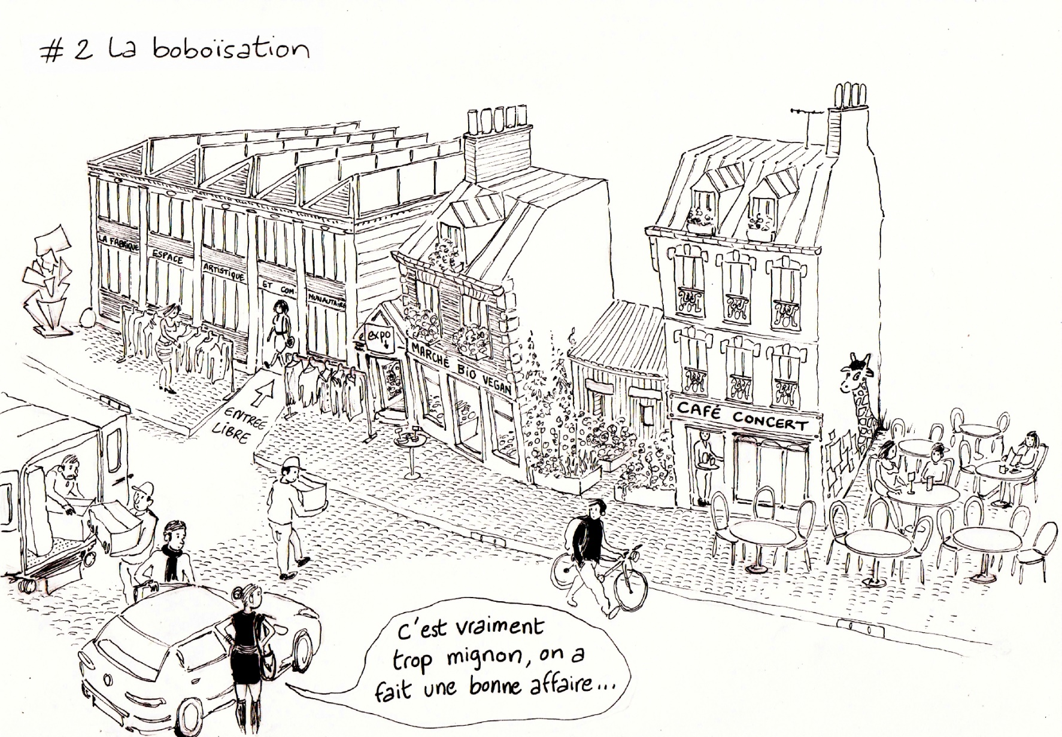
Gentrification & green gentrification of Paris

Slide 17
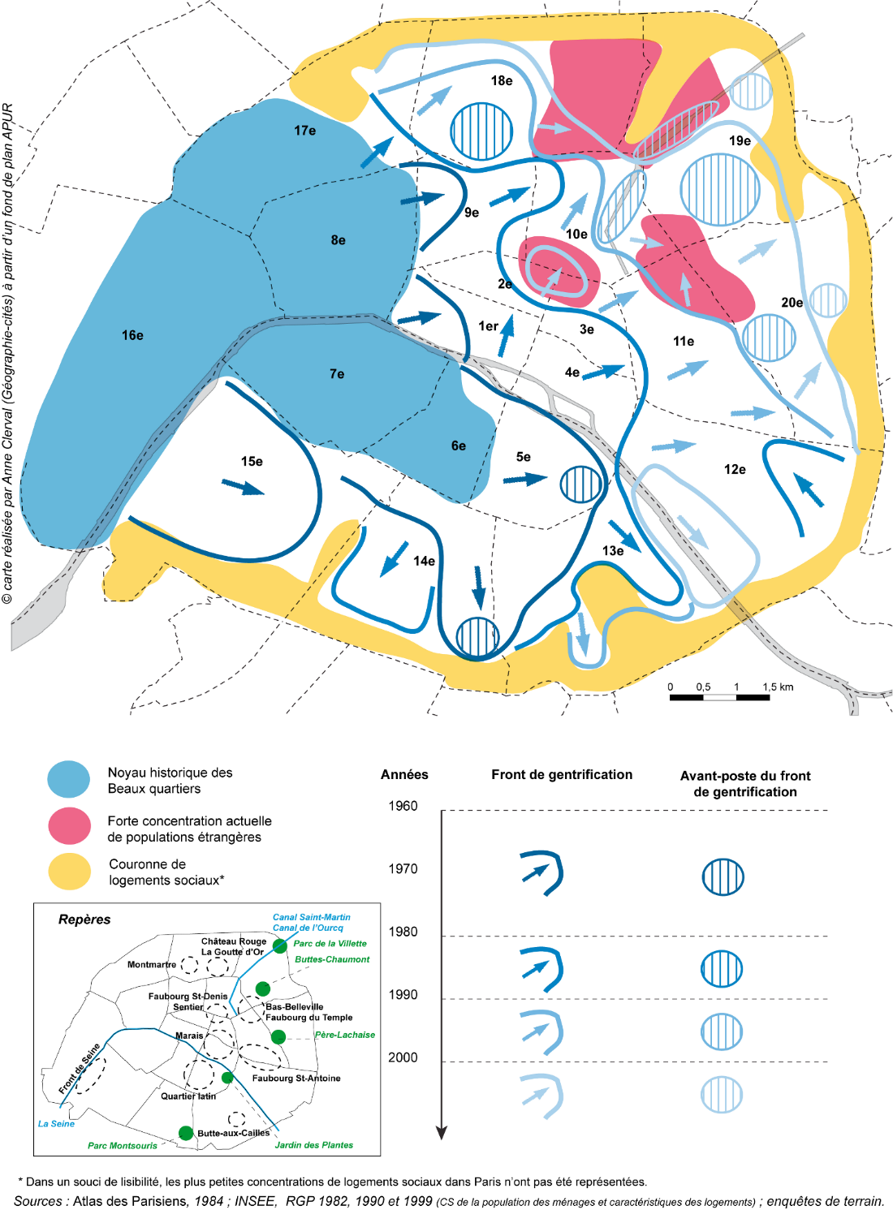

Slide 18
« Petite bourgeoisie intellectuelle »
« Petite bourgeoisie nouvelle »
Jean-Pierre Garnier (2010)
Pierre Bourdieu (1979)

Slide 19
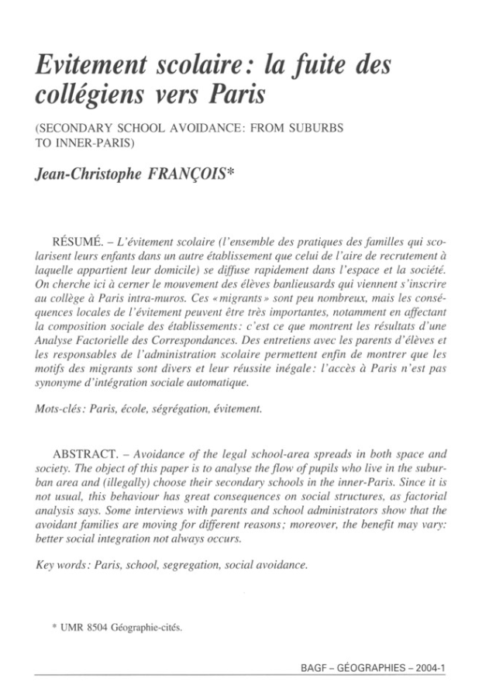

Slide 21
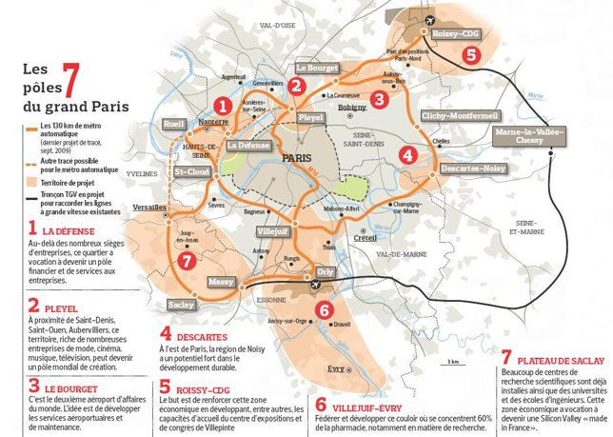

Slide 23
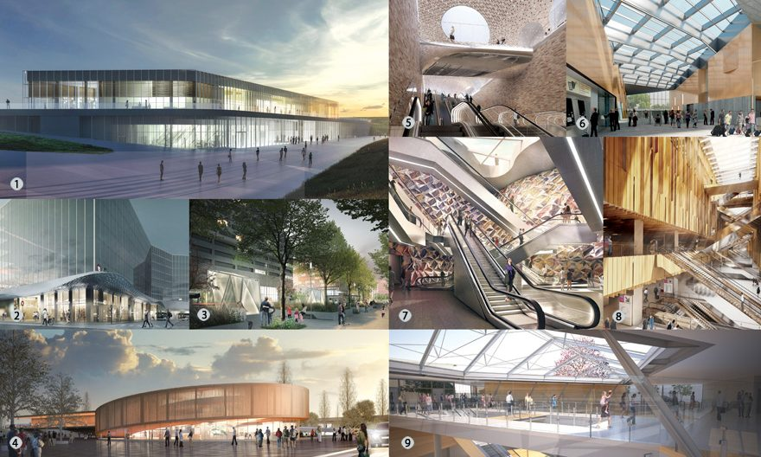

Slide 24
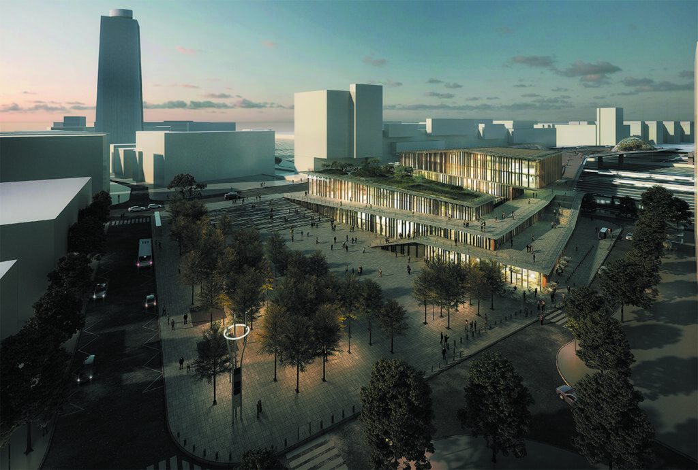

Slide 25
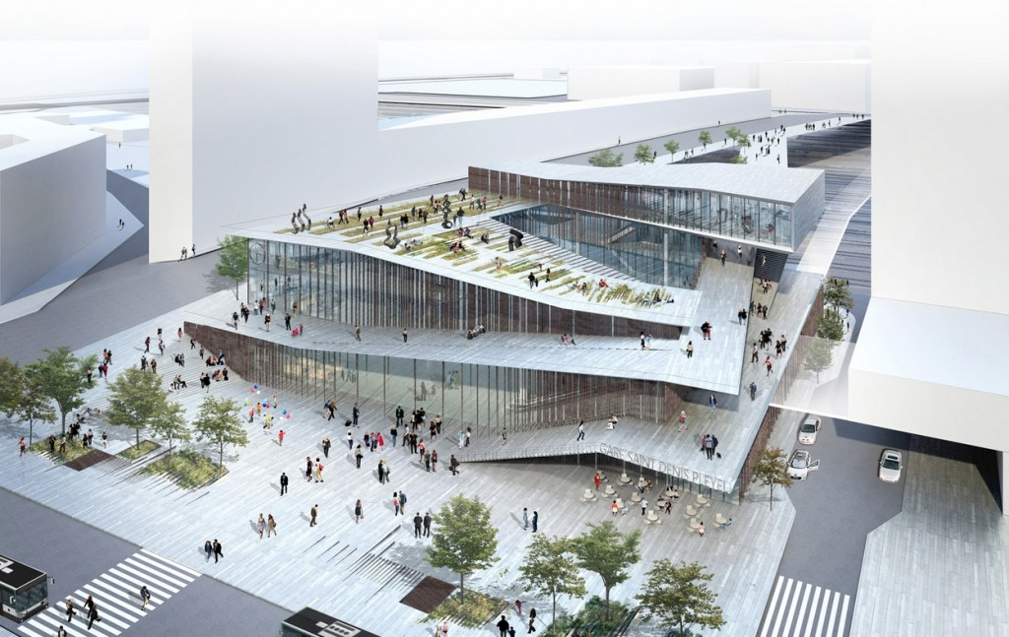

Slide 27
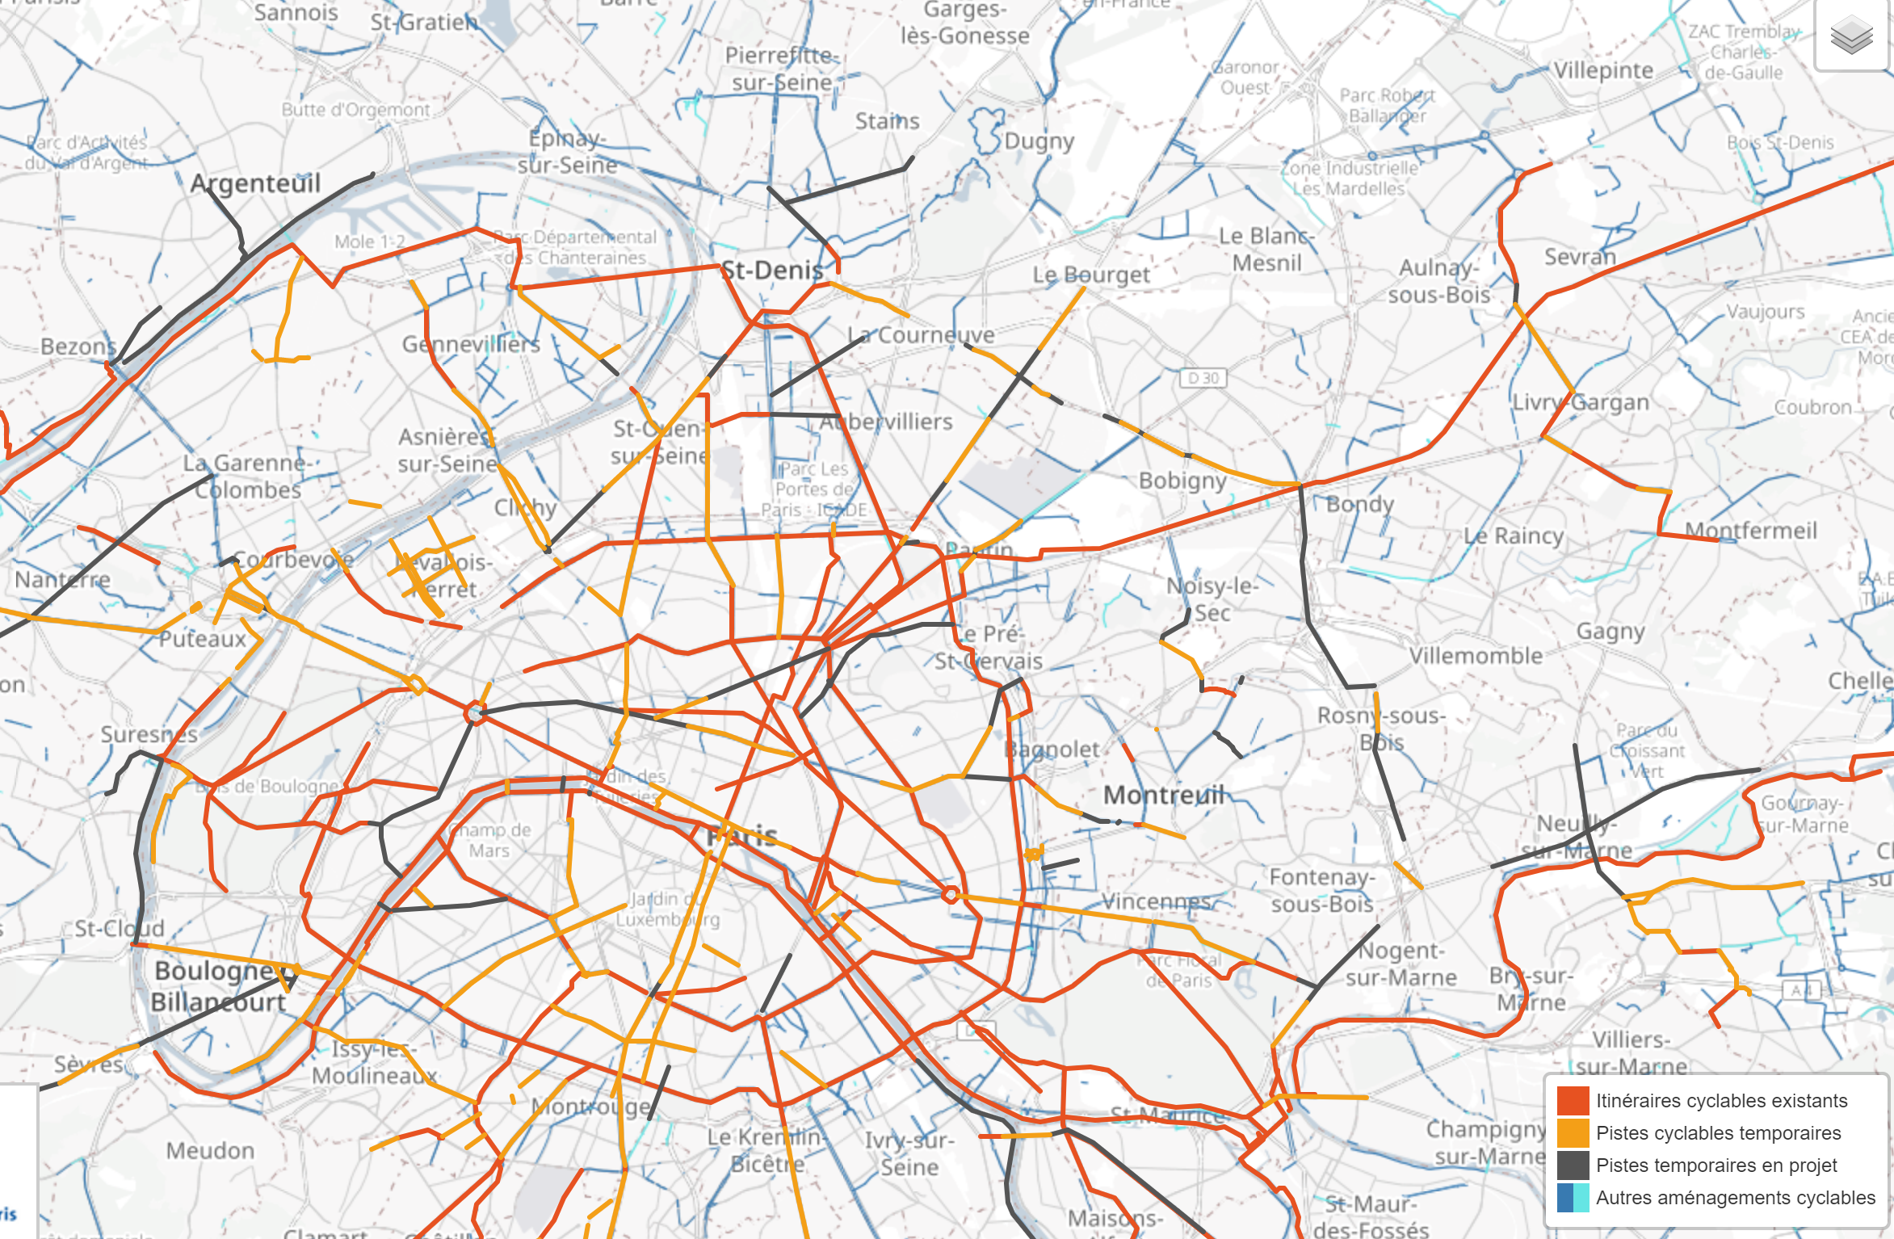

Slide 28
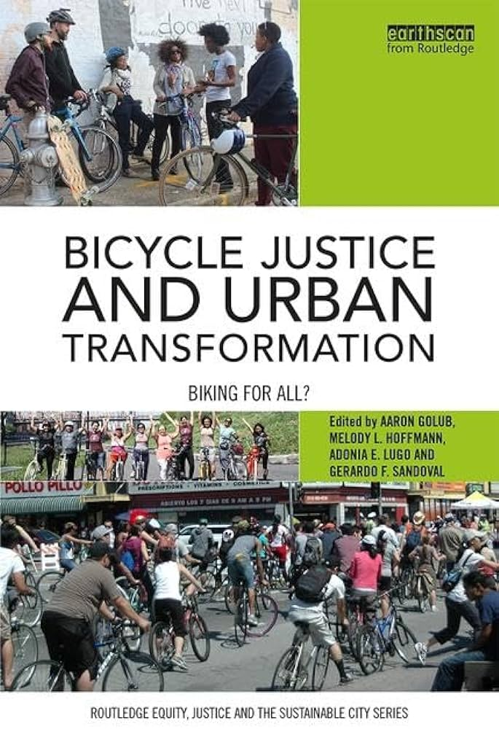
Bicycle justice
Overall trend: increase in people using bicycle
Factors explaining growth:
Improvements in cycling infrastructure
Recognition of health benefits
Cultural turn toward reduced environmental impact and petroleum dependence
Significant demographic and economic shifts which challenge traditional patterns of car ownership and licensure especially among younger age groups
"A new profile of urban cycling has emerged, one associated with the middle-class whiteness that was once more at home in suburbs and SUVs, but is now venturing, mostly by choice, back into the city riding buses, trains, and bicycles” (Golub, Hoffmann, Lugo and Sandoval, 2016).

Slide 29
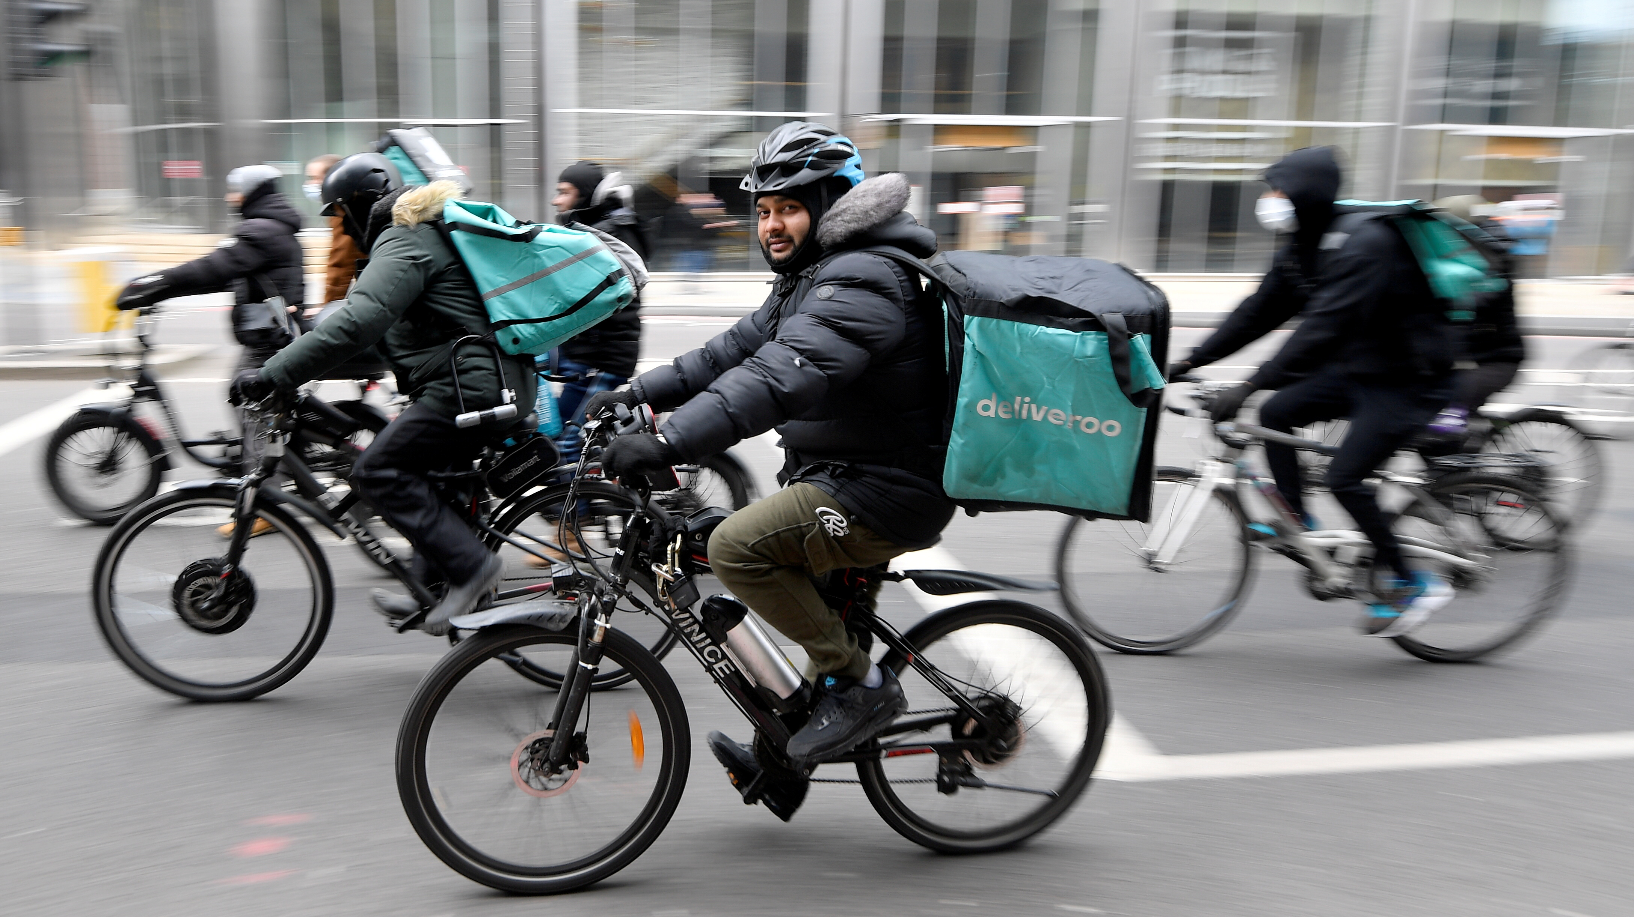
Bicycle justice
In US: Latinos and African American represent greatest share of bicycle commuters.
“There are thus striking contrasts between the widely touted cycling renaissance as a signifier of being hip and the bicycle’s more realistic utilitarian character as a low-cost transport mode for a broader range of rides and needs” (Golub, Hoffmann, Lugo and Sandoval, 2016).
Gap between image and reality

Slide 30
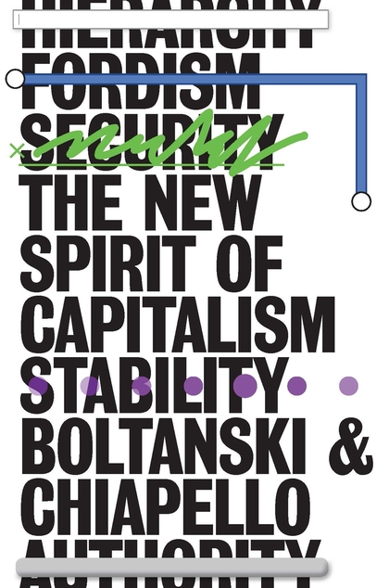
Boltanski and Chiapello (1999)

Slide 31
David Harvey (2012)

