Slide 1
Issues and debates in contemporary French politics
ULC140
Dr. Edouard Morena, edouard.morena@ulip.lon.ac.uk

Slide 2
Course assessments
Essay 1 (1200 words) – 30 %
Oral presentation (15 min) – 20 %
Essay 2 (1500 words) – 50%

Slide 3
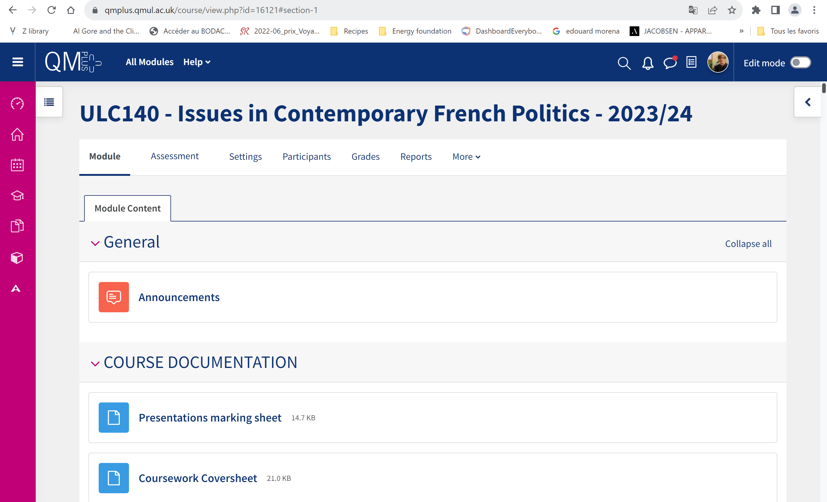

Slide 4
Other resources
Course readers
QMUL Library (ebooks, ejournals…)
ULIP library
Persée, CAIRN…
Academic seminars/conferences: https://ancmsp.com/mailing-list/
French and English-language newspapers: Le Monde, International Herald Tribune, Médiapart, The Guardian…

Slide 6
Aims of the course
Introduce you to some key debates in contemporary French society.
Look at the extent to which these debates are shaped by the Republican model.
Today, we will focus on the idea of « French exceptionalism » (as way of introducing these debates).

Slide 7
What do you think we mean by "French exceptionalism"?
ⓘ Start presenting to display the poll results on this slide.

Slide 8
What do we mean by ‘French Exceptionalism’? (1)
The claim that in politics and public policy, but also culture, France is different from everywhere else.
Politically: “the notion of the French exception has its roots in a distinctive republican model, attaching central importance to the prestige of the State, the primacy of politics and the active propagation, at home and worldwide, of certain values that are perceived, rightly or wrongly, to be enlightened and progressive” (Chafer & Godin, 2010: 9).
Socioeconomically: France’s prioritization of social welfare and solidarity. Linked with nation’s putative position against globalization and “the ravages of liberalisation à l’anglo-saxonne” (Chafer & Godin, 2010: 4)

Slide 9
What do we mean by ‘French Exceptionalism’? (2)
France has long seen itself as the repository of values inherited from the Enlightenment and the French Revolution
‘Civilizing mission’
De Gaulle’s ‘certain idea of France’: France ‘is only really herself when she is at the forefront of nations’ (1954)

Slide 10
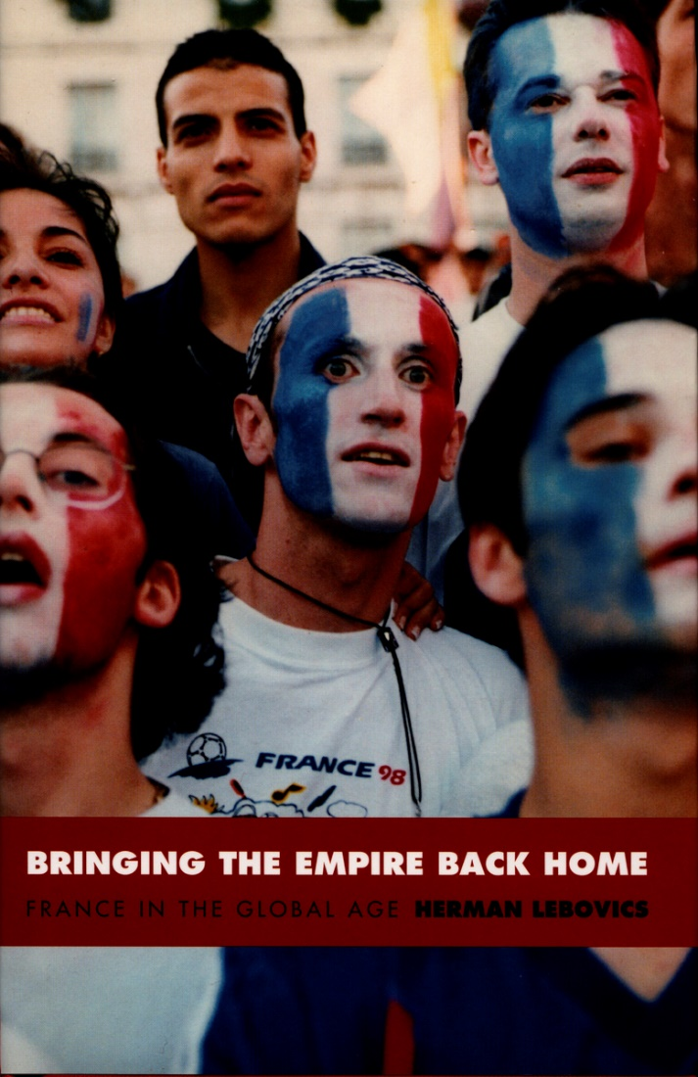
What do we mean by ‘French Exceptionalism’? (3)
French State:
In its Jacobin, dirigiste, republican or protectionist guise
State fashions the nation and national culture.
Education, culture…

Slide 11
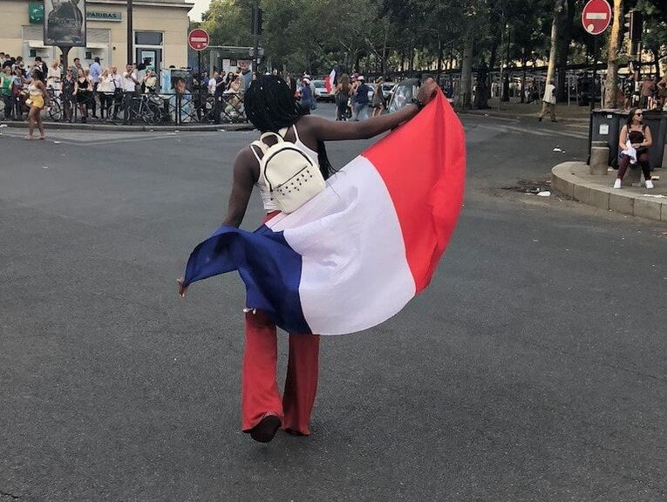
What do we mean by ‘French Exceptionalism’? (4)
Republican model of integration
Concept of laïcité (secularism)
French Republic as colour-blind, gender-blind…
Or blind to racism and other forms of discrimination?
No intermediary between the individual citizen and the nation-state.

Slide 12
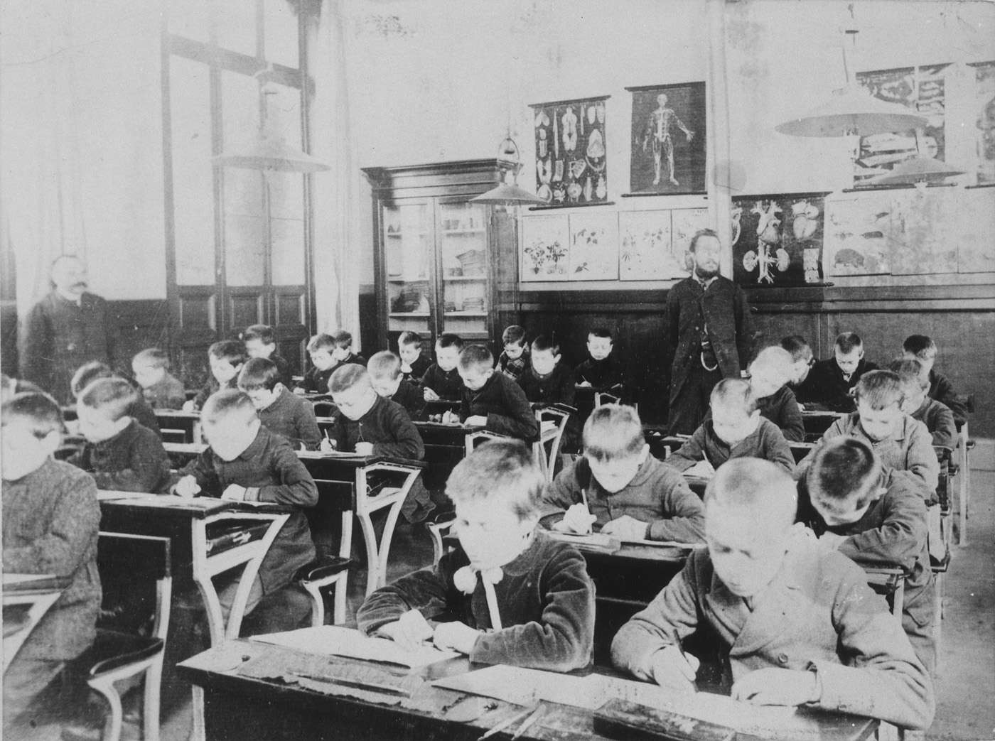

Slide 13
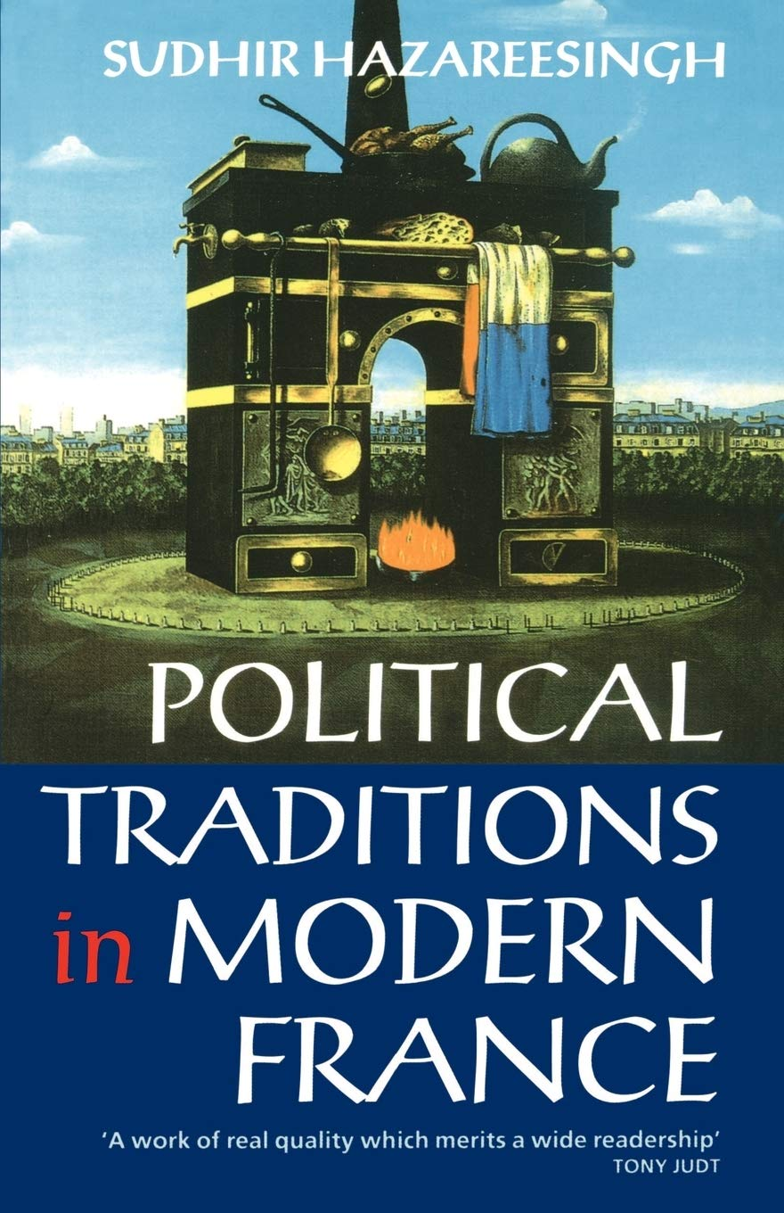
What do we mean by ‘French Exceptionalism’? (5)
Predilection for conflict, revolt and revolution
Revolutionism (Hazareesingh, 1994)
De Gaulle Bayeux speech (1946): “notre vieille propension gaulloise aux divisions et aux querelles” and “Il est nécessaire que nos institutions démocratiques nouvelles, compensent, par elles-mêmes, les effets de notre perpetuelle effervescence politique.”
Marx in 1843: France was “the nerve-centre of European history, sending out electric shocks at intervals which galvanized the whole world”

Slide 14
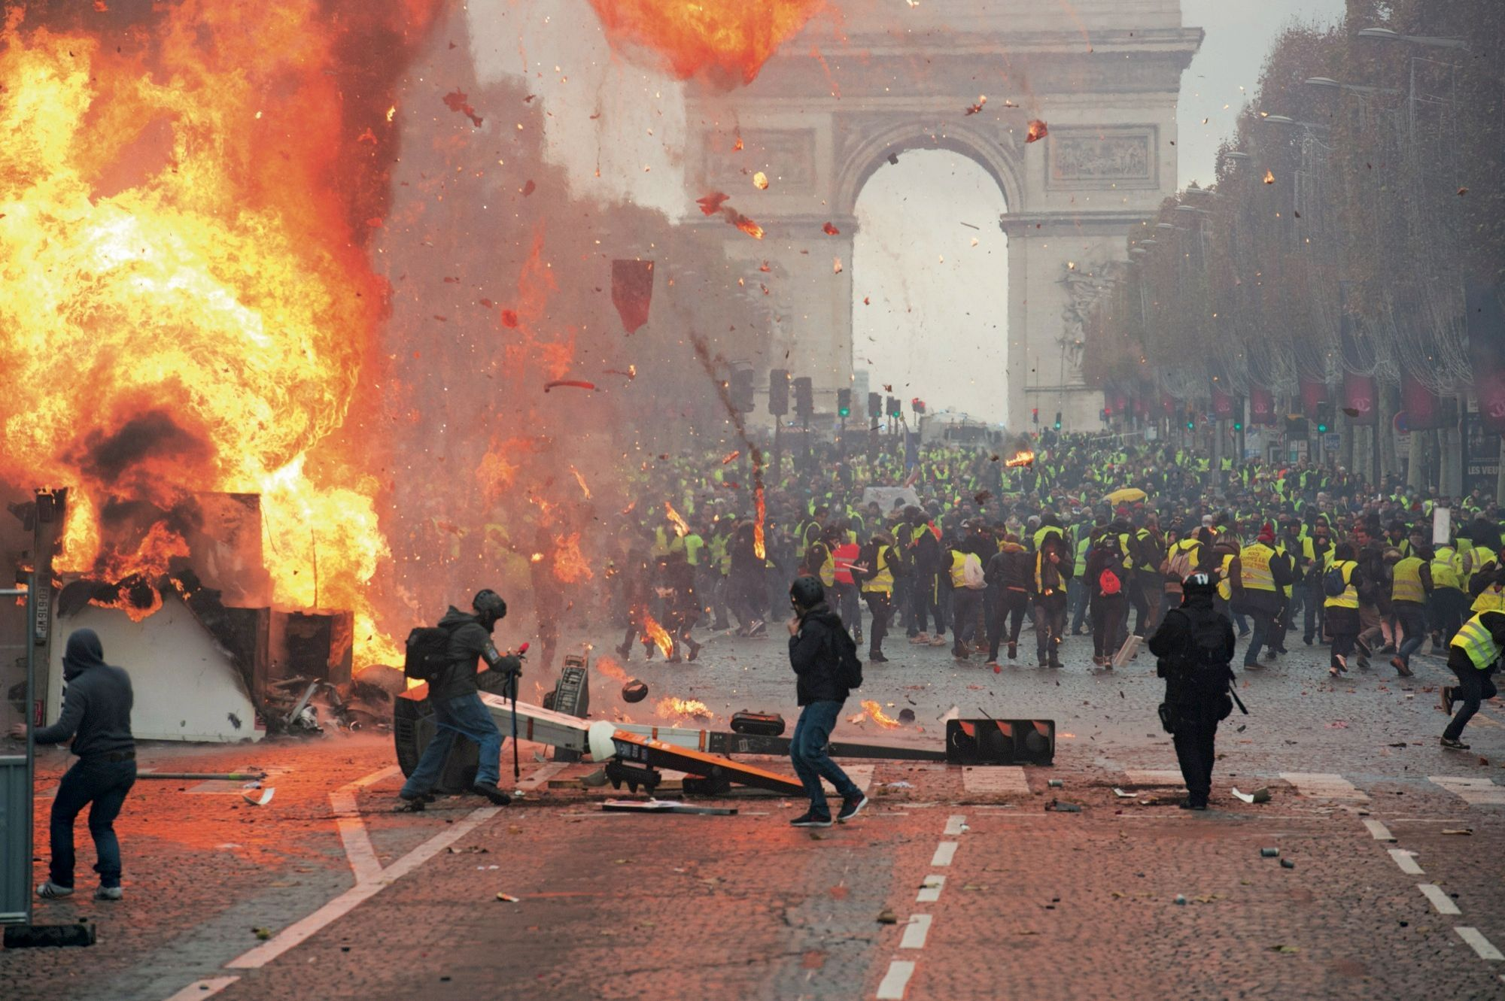

Slide 15
The end of French exceptionalism? (1)
Context of 1980s
Neoliberal moment
Crisis of Marxism
Fall of USSR
Mitterrand experiment
Dwindling importance of political activism
Economic crisis & rise of far right…
Only from moment that a debate emerged on the ‘end of exceptionalism’ that the issue of exceptionalism became widespread

Slide 16
The end of exceptionalism? (2)
‘We are all agreed: we are at a turning-point… an era is coming to an end… What we are living through is quite simply the end of French exceptionality’ (Furet et al 1988:11).
Desire to theorise and formalize depoliticisation.
Resurgence of debate on the nation.

Slide 17
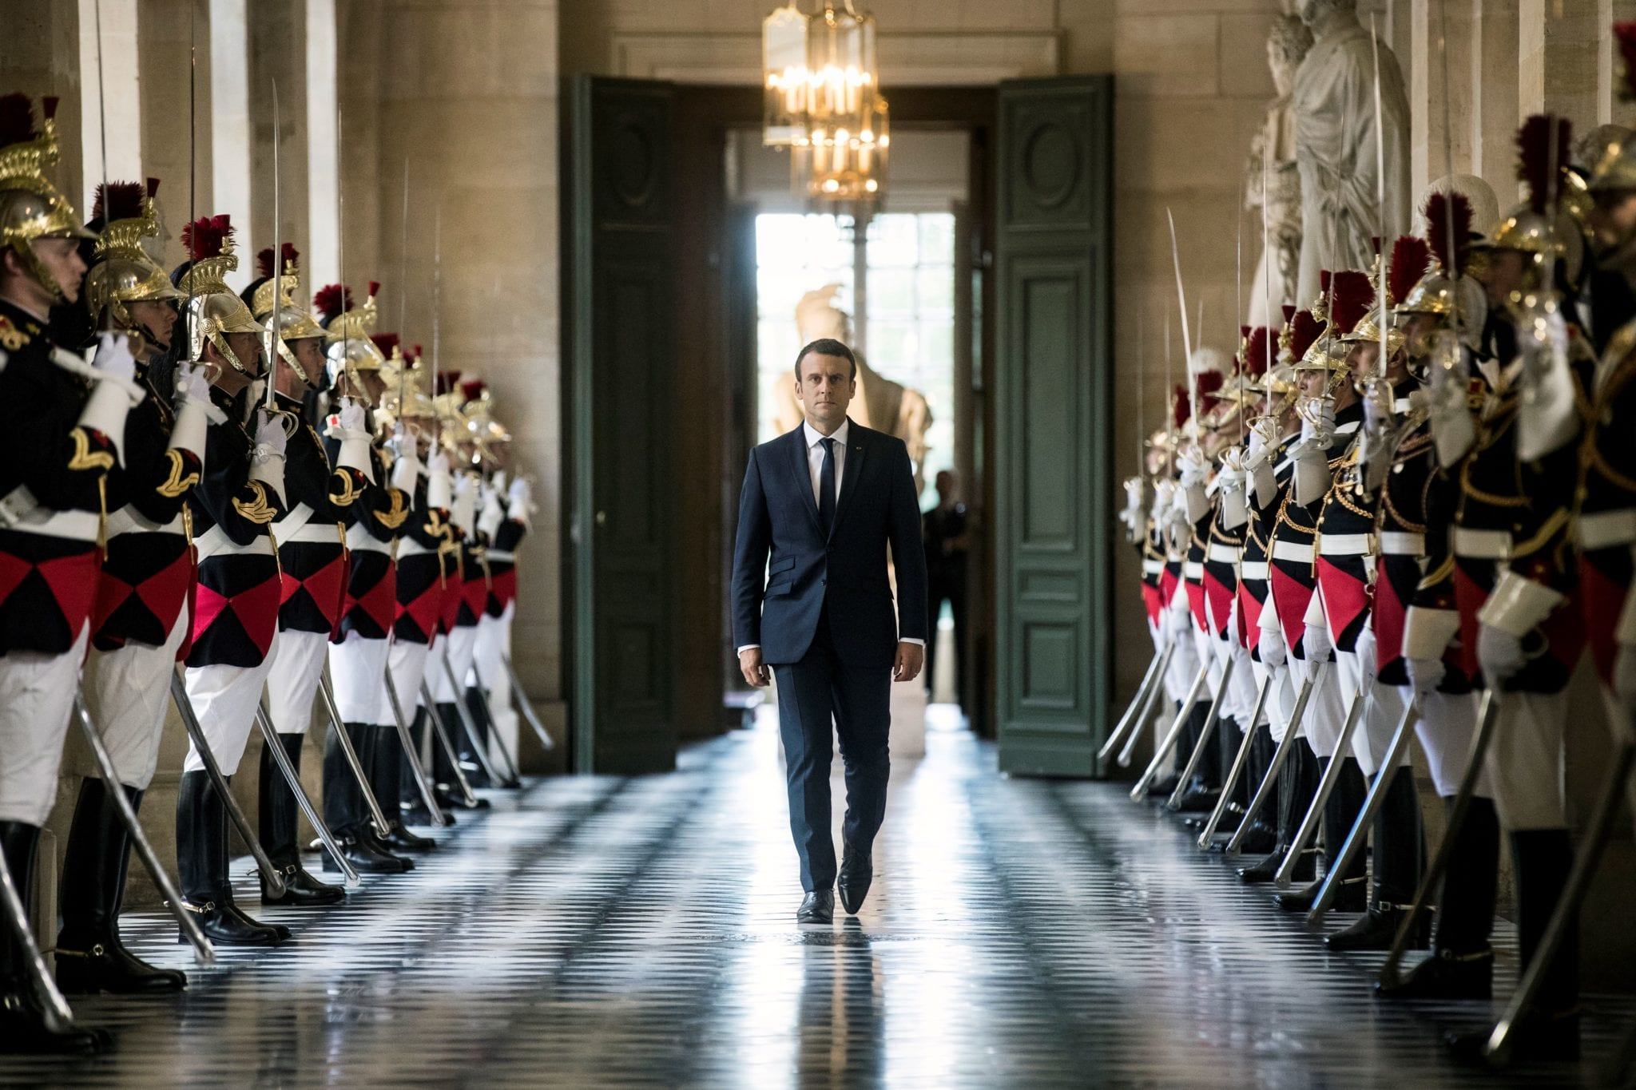
Reactions to the end of exceptionalism (1)
Emergence of 2 camps:
Those who reject/criticize French exception & those who defend it.
Division particularly visible in debate on globalisation (1990s)
Reappropriation by the right: idea of a French model
Connected to debates on identity and a reactionary politics.
Response to perceived threats in the intellectual (critical race theory, postcolonial studies…) & political fields…

Slide 18
« Postcolonial melancholia »
“In this French version of “postcolonial melancholia,” the state joins forces with certain public intellectuals and members of the French academy to mount counterattacks designed to undermine the legitimacy of artistic productions and critical research (especially critical race theory and before that postcolonial studies). These reactionaries not only strategically foster ‘a stark provincialism of the knowledge produced and disseminated in the Hexagon,’ as [Achille] Mbembe has noted, but foment a discourse of political emergency and cultural crisis, painting a chimera of the French nation infiltrated by individuals imputed to be terrorists, wayward Americanophiles, ‘Islamo-gauchistes’ (Islamoleftists), or some other phantasmagorical moniker (87).”
Christy Pichichero, ‘“Is God Still French?”: Racecraft, States of Exception, and the Creation of l'Exception Française’, PMLA, 137(1), pp.125-135.

