Slide 1
Musculoskeletal system
Dr Nyree Myatt
ccfs

Slide 2
Learning objective
“Students should demonstrate an understanding of the three different types of muscle tissue, their roles and locations in the body. Should be describe how muscle contraction takes place and the role of the neuromuscular junction.”

Slide 3
Lesson aims
By the end of the lesson, students will be able to:
1. describe the role and location of the three different types of muscle tissue
2. describe the sequence of events in muscle contraction, together with the role of calcium ions and ATP
3. Describe the role of the neuromuscular junction

Slide 4
Muscle tissue
Tissues are groups of cells that are adapted or specialised to work together
Muscle tissue - composed of bundles of long cells called muscle fibres
Three basic types of muscle tissue:
Skeletal (also known as striated [“striped”]or voluntary) – this is for movement you control
Smooth (also known as involuntary or unstriated) – this is found in wall of hollow organs (gut, bladder, uterus), blood vessels, iris, respiratory system
Cardiac – found in the heart

Slide 5
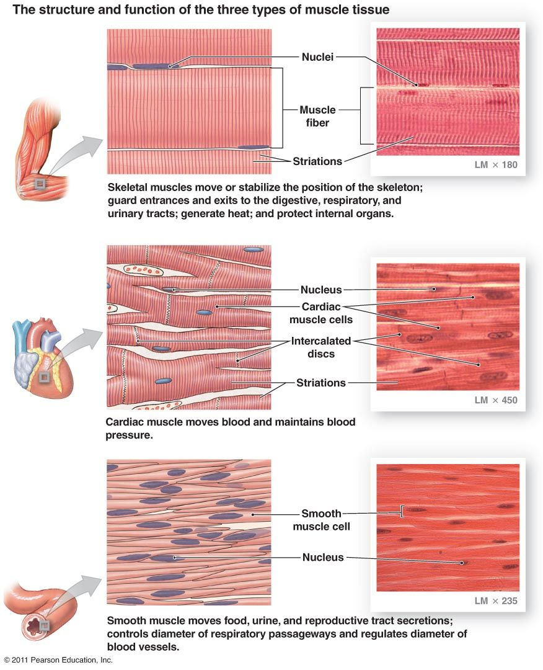

Slide 6
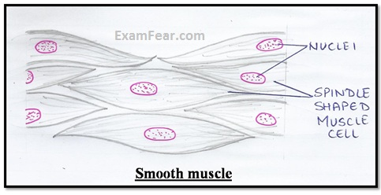
Involuntary or smooth muscle
Contracts without you thinking about it
Smooth appearance
Each muscle fibre has one nucleus, centrally placed
Muscle fibres vary in length (10 - 600µm), spindle-shaped (fat in the middle and gets thinner towards each end)
Muscle fibres contract slowly and do not get tired easily
Contain actin and myosin contractile filaments

Slide 7
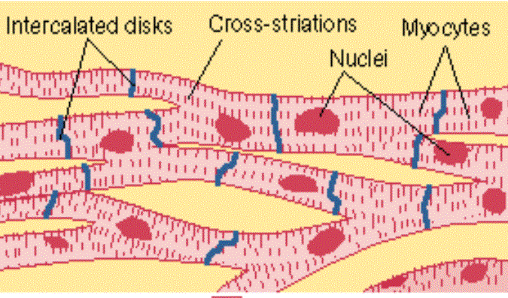
Cardiac muscle
Will contract on its own – myogenic
Found in walls of heart
Striated (but not as obvious as skeletal muscle); involuntary; about 100µm in length
Branching, cylindrical muscle fibres (cardiomyocytes), connected to each other by intercalated discs
Intercalated discs have low electrical resistance which makes it easier for nerve impulses to pass between muscle cells.
Being branched helps the nerve impulses to spread quickly around the heart
Contracts rhythmically, doesn’t get easily tired

Slide 8
Skeletal muscle
Skeletal muscle - made up of long muscle fibres (large bundle of long cells)
Muscle fibre cells are surrounded by a membrane called the sarcolemma
Cytoplasm in the muscle fibre cells is known as sarcoplasm
T tubules are areas of the sarcolemma which are folded across the muscle fibre and enter the sarcoplasm

Slide 9
Skeletal muscle
Within the muscle fibre is a network of membranes called the sarcoplasmic reticulum
The sarcoplasmic reticulum stores and releases calcium ions
Calcium ions are essential for muscle contraction
Muscle fibres have loads of mitochondria – why?
Muscle fibres are described as multinucleate – why?
Muscle fibres are composed of long, cylindrical organelles called myofibrils - contraction

Slide 10
Quick questions
What is the cell membrane called surrounding a muscle fibre?
What is the muscle fibre cytoplasm called?
What are T tubules?
What is the role of the sarcoplasmic reticulum?
Why do muscle cells have so many mitochondria?
What does multinucleate mean?

Slide 11
Myofibrils, actin and myosin
Myofibrils contain thick and thin myofilaments
Thick myofilaments are myosin
Thin myofilaments are actin
Using a microscope, the myofibrils look like they are made up of dark and light stripy bands

Slide 12
Myofibrils, actin and myosin
Dark bands are made of thick myosin filaments – A-bands
Light bands contain thin actin filaments called I-bands
Functional unit of myofibril is the sarcomere
The Z-line is found at the end of each sarcomere
The M-line is found in the middle of the myosin filaments
The H-zone surrounds the M-line and contains only myosin

Slide 13
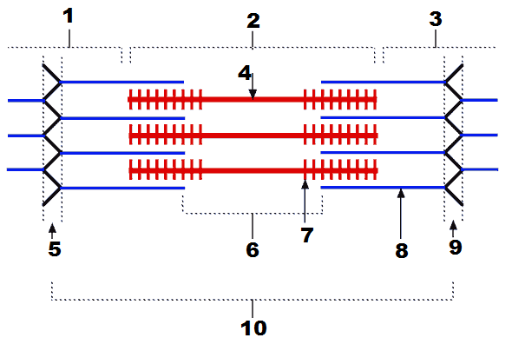
Label 1 -10 on the diagram

Slide 14
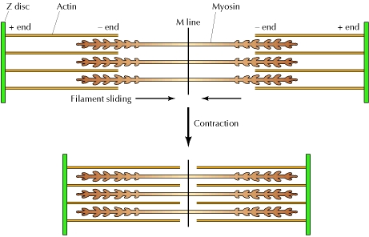
Muscle contraction – sliding filament theory
Actin and myosin filaments don’t “shrink” during contraction – they slide over each other so each sarcomere shortens in length
When lots of sarcomeres shorten, the muscle contracts
Within the sarcomere:
The A band stays the same length
The I band shortens
The H zone shortens

Slide 15
Actin-myosin binding site
Actin has binding sites for myosin – actin-myosin binding sites
The binding sites are hidden by the troponin-tropomyosin complex
In the relaxed state, the actin-myosin binding site is covered by tropomyosin which is held there by troponin

Slide 16
Actin-myosin binding site
When a nerve impulse reaches the muscle, it triggers the release of calcium ions (more detail on next slide)
Calcium ions bind to troponin which moves the troponin-tropomyosin complex away exposing the myosin binding site

Slide 17
Muscle contractions are stimulated by a nerve impulse (action potential)
A motor neurone is stimulated by a nerve impulse
The sarcolemma is depolarised
The depolarisation spreads down the T-tubules to the sarcoplasmic reticulum
The sarcoplasmic reticulum releases its store of calcium ions into the sarcoplasm
Calcium ions bind to troponin causing a shape change which pulls tropomyosin away from the myosin binding site
The myosin head can bind to the actin filament
and forms an actin-myosin cross bridge

Slide 18
Muscle contraction
Once myosin is bound to actin, it goes through a power stroke by moving its head and moves the actin filament towards the M line
ADP was attached to the myosin head but it is released after the power stroke
New ATP binds to the myosin which causes unbinding of the myosin and actin
ATP is hydrolysed by ATPase and this causes the myosin head to reposition itself ready to form a new cross bridge
Video

Slide 19
Rigor Mortis
In death, ATP production stops
Without ATP, myosin cannot detach from the actin
Myosin – actin cross-bridge cannot separate
Also, in death, cells start to breakdown and calcium is released
Calcium binds to the troponin-tropomyosin complex revealing the actin binding site to myosin
Muscles relax once enzymes start to break down the tissue

Slide 20
Recap
Summarise the previous three slides on the actin-myosin binding site and the sequence of events in a muscle contraction

Slide 21
Calcium ions and contraction
The muscle contraction cycle will continue while calcium ions are present and bound to troponin
Calcium ions are also needed to activate the ATPase
BUT – once the muscle stops receiving nerve impulses, calcium ions leave troponin and the myosin binding site is hidden again
Calcium ions are actively transported back to the sarcoplasmic reticulum (needs ATP)
No more cross bridges form so actin filaments return to the relaxed position and sarcomeres lengthen

Slide 22
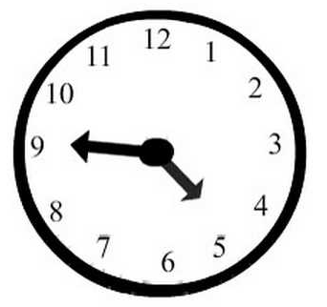
Question time
What are myofibrils composed of?
Which bands on the sarcomere shorten during contraction?
Which molecule blocks binding of the actin-myosin binding site in resting muscle?
Which bond is formed when a myosin head binds to actin?
What is rigor mortis? Why does a lack of ATP lead to muscles not relaxing after death?

Slide 23
Energy for muscle contraction
Muscle cells contain lots of mitochondria as they need lots of ATP
ATP is produced in three main ways:
Aerobic respiration via oxidative phosphorylation in mitochondria. Oxygen is needed for this
Anaerobic respiration via glycolysis. End product is pyruvate which is converted to lactate by lactate fermentation. Lactate builds up quickly and causes muscle fatigue.
ATP-creatine phosphate system (ATP-CP). ATP is made by adding a phosphate group from creatine phosphate to ADP (phosphorylation). Creatine phosphate is stored in cells so ATP can be generated quickly but it runs out quickly. ATP – CP system is anaerobic and alactic so oxygen not needed and no lactic acid build up.

Slide 24
Neuromuscular junction
The interface of the nervous system and muscle
The neuromuscular junction is the synapse between a motor neurone and a muscle cell
Neuromuscular junctions use acetylcholine as the transmitter
Acetylcholine binds to nicotinic cholinergic receptors

Slide 25
Neuromuscular junction
Once the nerve impulse has crossed the synaptic cleft, it triggers depolarisation in the post-synaptic muscle cell
Acetylcholinesterase breaks down acetyl choline so that the muscle cell is not repeatedly stimulated
Some drugs stop release of neurotransmitter or block acetyl choline receptors on muscle cell – what could the result be?

Slide 26
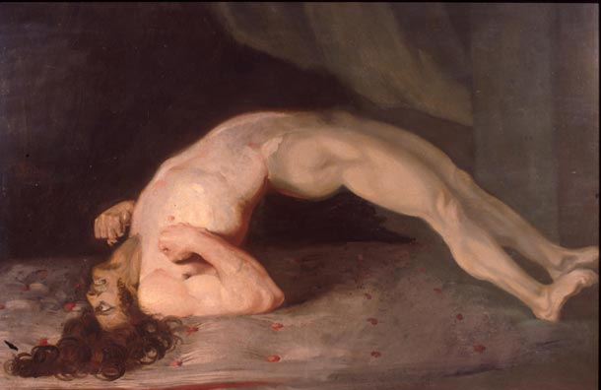
Muscle and neuromuscular junctions
What sort of drugs act on the neuromuscular junction?
What is tetanus?
What causes it?
What are the symptoms?
Opisthotonus in tetanus patient (Sir Charles Bell, 1809)

Slide 27
Questions
What are the three methods for ATP production?
What is the neuromuscular junction?
Which neurotransmitter is used at the neuromuscular junction?
How is it broken down?

Slide 28
Lesson aims
By the end of the lesson, students will be able to:
1. describe the role and location of the three different types of muscle tissue
2. describe the sequence of events in muscle contraction, together with the role of calcium ions and ATP
3. Describe the role of the neuromuscular junction

