Slide 1
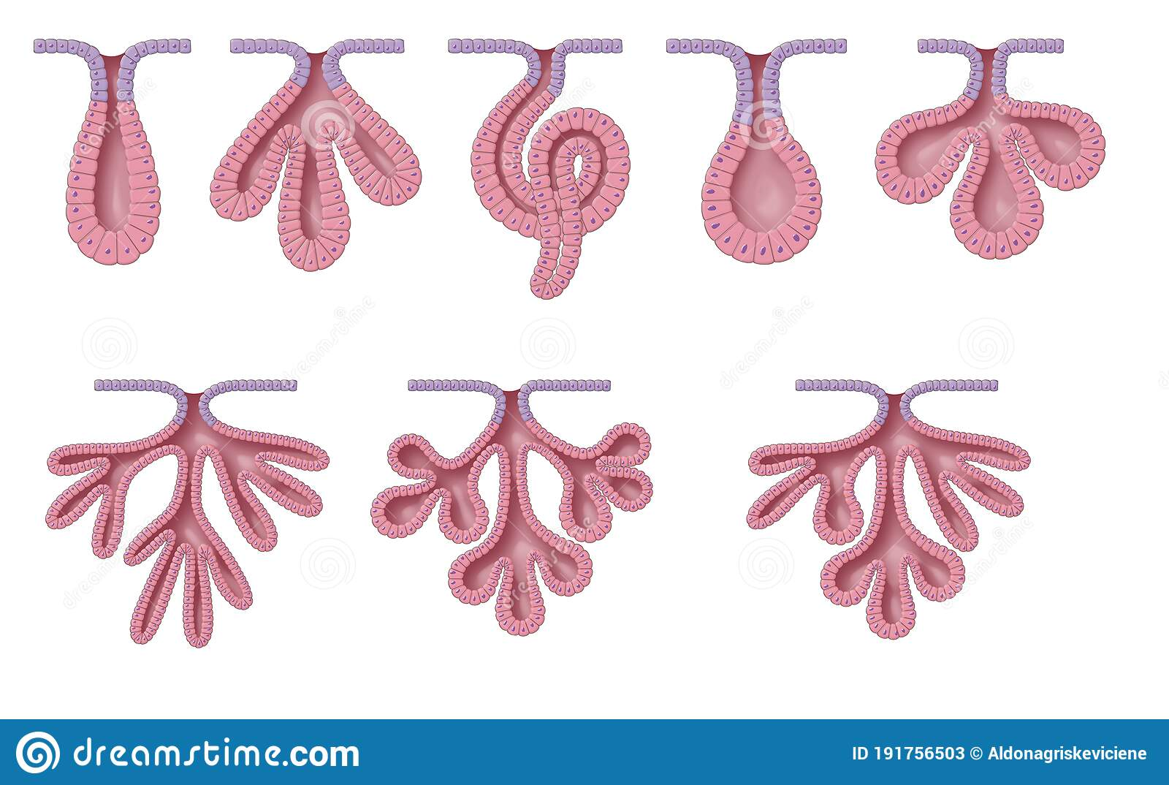
Exocrine glands

Slide 2
Learning objective
“Students should be able to explain the difference between endocrine and exocrine glands. Students should be able to classify the different types of exocrine gland based on structural differences and how secretions are released.”

Slide 3
Lesson outcomes
After this lecture, you should be able to:
1. Describe the difference between endocrine and exocrine glands
2. Describe the classification of exocrine glands in terms of structure and secretion types
3. Give examples of exocrine glands and their products

Slide 4
Glands
The function of glands is secretion
Glands can be a single cell or a collection of cells
The secretion can be released directly into blood (endocrine gland) or released into a duct (exocrine gland) that then drains into a hollow organ (e.g. small intestine) or onto a surface (e.g. skin)

Slide 5
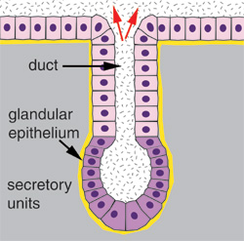
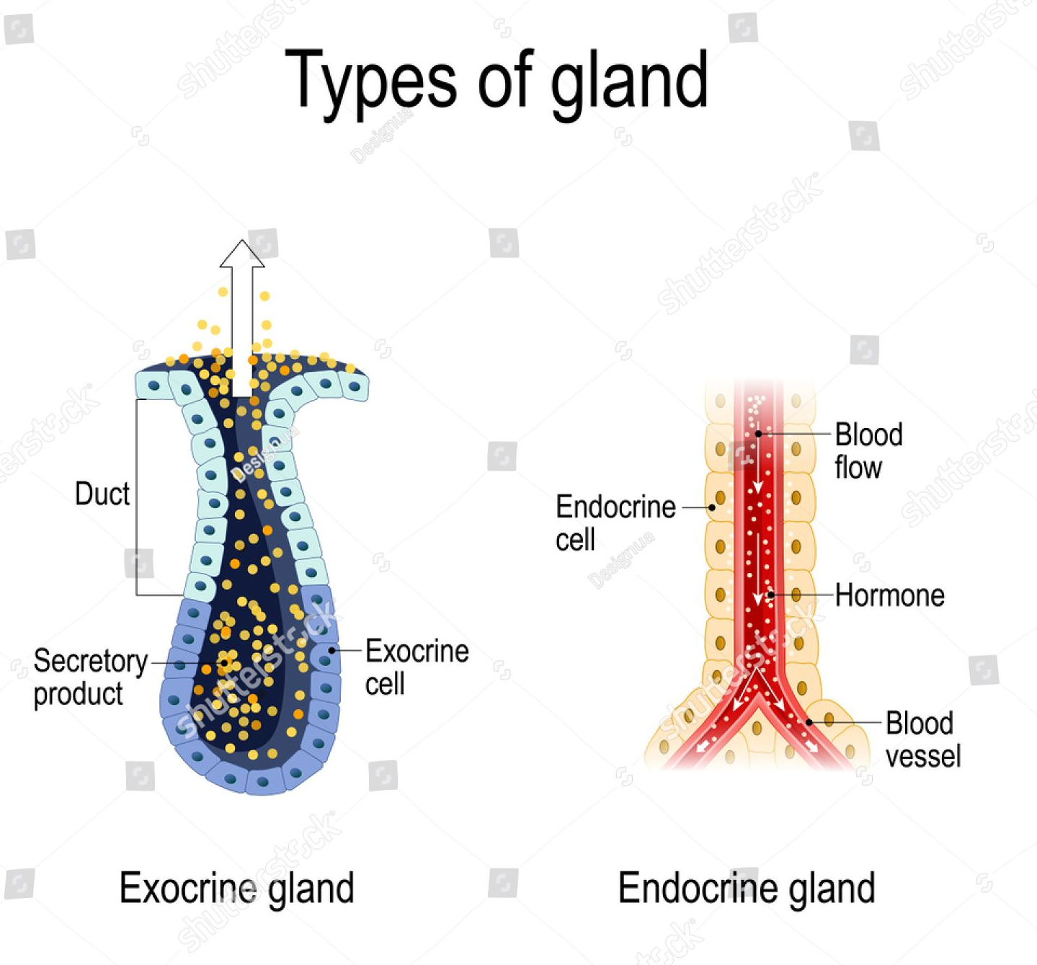
Exocrine gland

Slide 6
Classification of exocrine glands
Unicellular or multicellular
Unicellular – goblet cells – secrete mucus onto surface e.g. stomach, parts of respiratory tract
Multicellular glands have many cells and are categorised in two ways:
The are ducts branched or unbranched
The shape of the secretory part of the gland
Ducts that do not branch - simple glands
Ducts that branch - compound glands
If the secretory parts of the gland are duct-like, this is a tubular gland
If the secretory parts of the gland are rounded (like a berry), this is an acinar gland

Slide 7
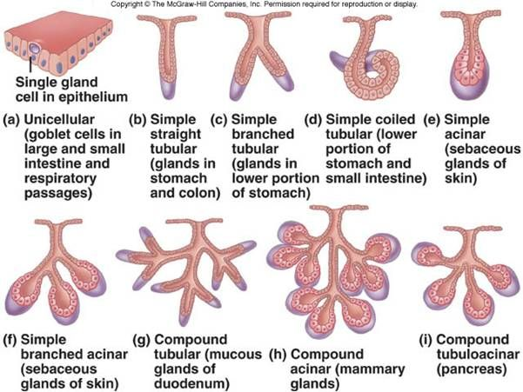

Slide 8
Functional classification
Merocrine gland
Based on how secretions are released
Merocrine glands make their product in the RER, package it at the Golgi and put it into secretory vesicles and secrete their product by exocytosis into a duct
Examples include salivary glands and pancreas

Slide 9
Functional classification
Apocrine gland
Apocrine glands have the secretory product stored on one side of the cell
This bit of the cell then pinches off and the secretion is released
The remaining cell then goes through the process again
Examples include mammary glands secreting milk

Slide 10
Functional classification
Holocrine gland
Holocrine cells fill up with secretory product and then the whole cell falls apart releasing the product
The cell is replaced by a new one
Examples include sebaceous glands in the skin

Slide 11
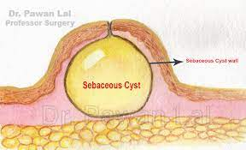
Exocrine gland products
Proteins
Enzymes
Mucus
Sebum (oil)
Look up sebaceous gland cyst and meibomium cyst (chalazion)

Slide 12
Question time
What is the difference between an exocrine and an endocrine gland?
How are exocrine glands classified?
Based on how secretions are released, what are the three types of exocrine gland?
Name an organ that is both an exocrine and endocrine gland.

Slide 13
Lesson outcomes
After this lecture, you should be able to:
1. Describe the difference between endocrine and exocrine glands
2. Describe the classification of exocrine glands in terms of structure and secretion types
3. Give examples of exocrine glands and their products

