Slide 1
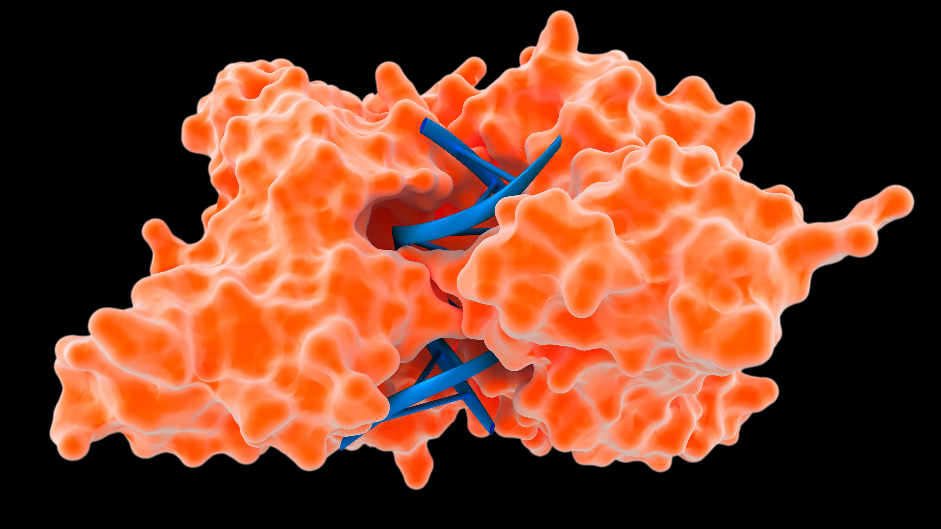
Enzymes
CCFS
Dr nyree myatt

Slide 2
Lesson aims
After this lecture you should be able to:
Describe what enzymes are, what activation energy is, describe the lock and key model and the induced fit model, and what the active site is
Describe the four factors that affect enzyme activity
Describe competitive and non-competitive inhibition
Understand how some medicines and poisons work by affecting enzymes

Slide 3
Biological catalysts – made of protein
Globular proteins (what is the other broad type of protein?)
Enzymes are biological catalysts – speed up chemical reactions without getting used up in the reaction
Catalyse metabolic reactions at cellular level and at whole organism level
Work in cells – intracellular – and work outside cells – extracellular
Intracellular – e.g. catalase to break down hydrogen peroxide
Extracellular – amylase and pepsin – in digestion
Find two more examples of intracellular and extracellular enzymes

Slide 4
Active site
Active site – specific shape
Where substrate binds to
Specific shape is determined by tertiary structure of protein
Substrate will only bind if it fits into the active site
Active site governs what substrates will fit
Usually only one substrate will fit unless there is something else which is very similar

Slide 5
Activation energy
Activation energy - energy needed by chemicals to get a reaction started – usually supplied as heat
Enzymes - reduce activation energy needed
With enzyme - reaction takes place at lower temperature than it could without an enzyme present

Slide 6
Activation energy
Once substrate binds to the active site, enzyme-substrate complex forms
The formation of the complex leads to the lowering of the activation energy
If two substrates are being joined by enzyme, attaching to enzyme brings them closer together to make bonding easier
If enzyme is catalysing a breakdown of a substrate, fitting the substrate into the active site can put a strain on the bonds in substrate leading to the breakdown of substrate more easily

Slide 7
Lock and key model

Slide 8
Lock and key model reimagined….
Lock and key model was not quite the full story
Evidence revealed that enzyme-substrate complex changed shape slightly to make a better fit
New theory is the “Induced Fit” model
Substrate has to be right shape to fit active site and make the active site change shape

Slide 10
Question time
What is an enzyme?
What is activation energy and how does an enzyme change it?
What type of protein structure governs the shape of the active site?
What are the differences between the lock and key model and the induced fit model?

Slide 11
Factors affecting enzyme activity
Temperature
pH
Enzyme concentration
Substrate concentration

Slide 12
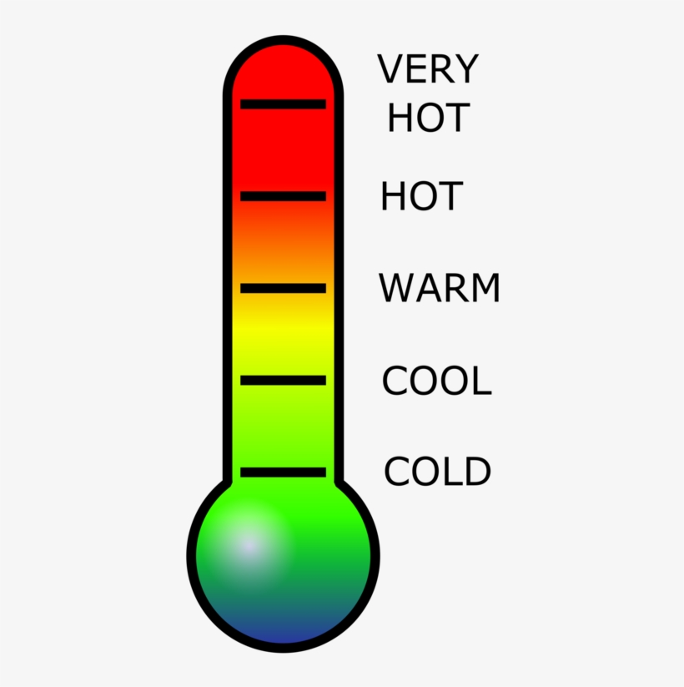
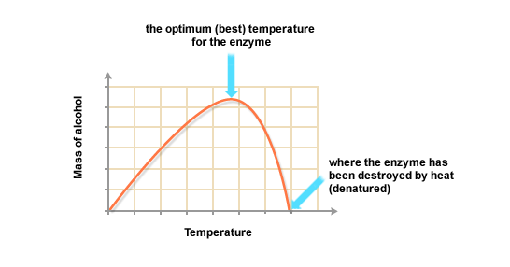
Temperature
Rate of enzyme controlled reaction increases as temperature increases
Increase in temperature increase in kinetic energy increase in movement of molecules increase in number of collisions between enzyme and substrate
BUT
If the temperature increases too much, there is too much vibration and bonds start to break
Active site loses its shape and enzyme is denatured
Food preservation – how?
Hypothermia and hyperthermia (fever)?

Slide 13
pH
All enzymes will function at an optimum pH value
In humans, optimum pH is around pH 7
However, pepsin has an optimum pH of around 2 – where in the body will this low pH be found?
pH above or below the optimum leads to production of H⁺ and OH⁻ ions which disrupt ionic bonds and hydrogen bonds and alters the tertiary structure of the enzyme - denatured.
Food preservation – how?

Slide 14
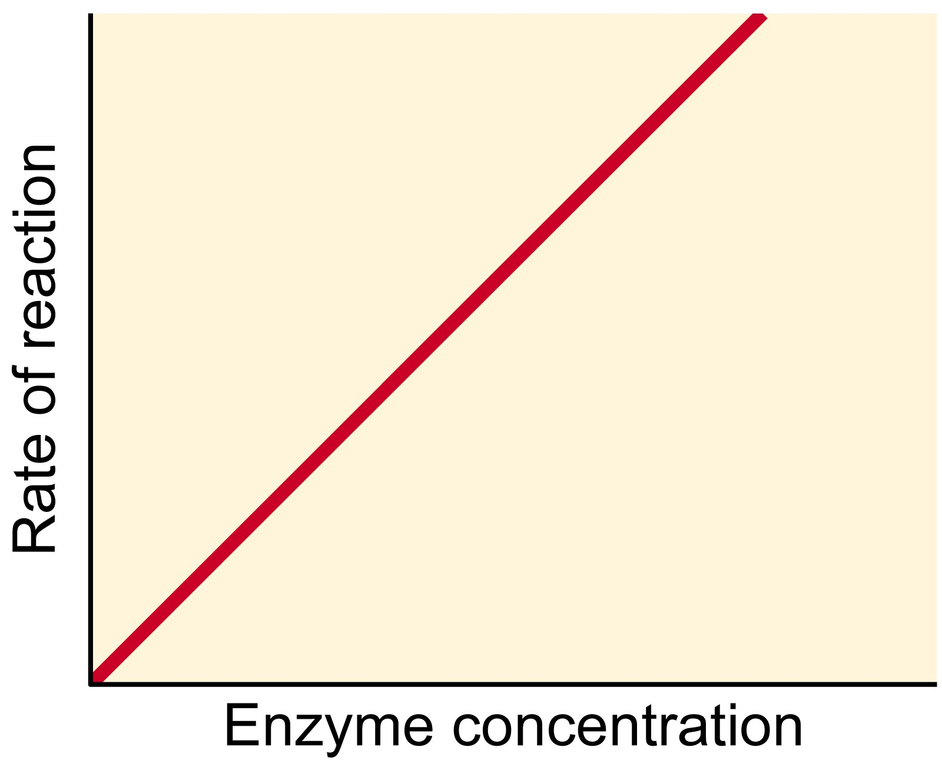
Enzyme concentration
Greater the number of enzyme molecules in a solution greater the chances of a collision with a substrate molecule more enzyme-substrate complexes forming and therefore a greater rate of reaction
If substrate amount is limited, rate of reaction is limited and increasing amounts of enzyme has no further effect

Slide 15
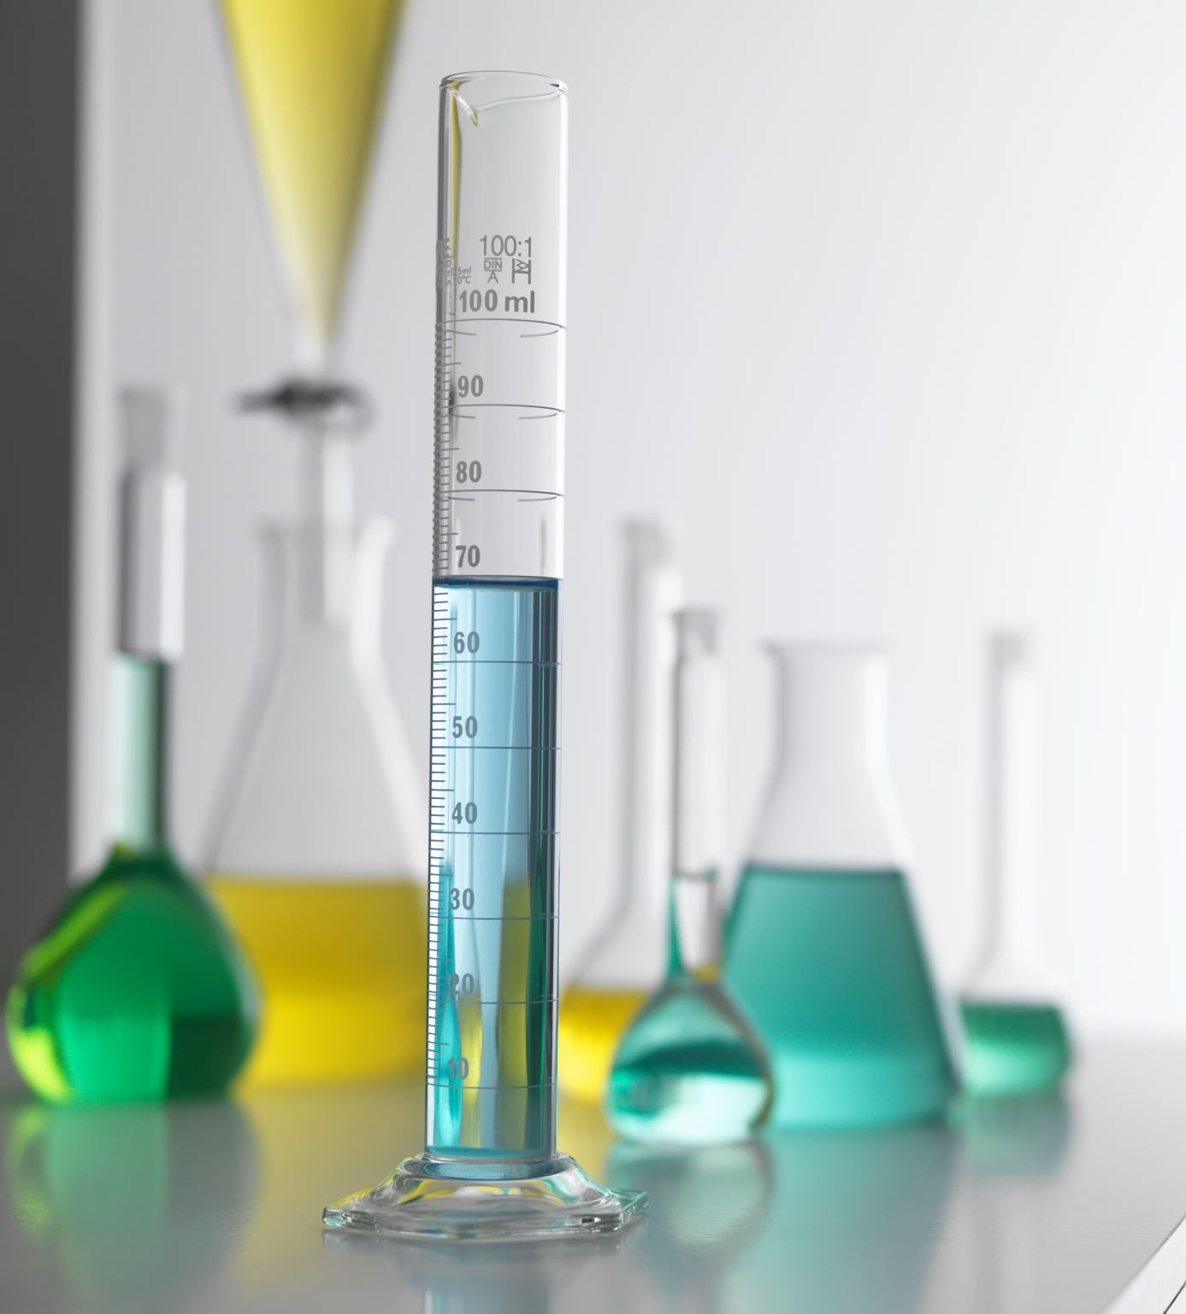
Substrate concentration
More substrate = faster the reaction
More substrate means there are likely to be more collisions between substrate molecules and enzyme molecules so active site more likely to be occupied
HOWEVER…..
Will reach saturation point when all active sites are occupied (full)
As substrate concentration decreases over time (as it is catalysed to become product), rate of reaction will decrease
Greatest rate of reaction will be at start of reaction (time is close to 0: initial rate of reaction)

Slide 16
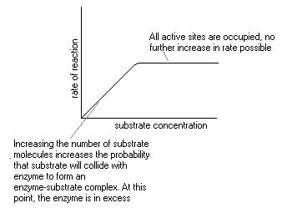

Slide 17
Small task…
Work in groups of 2 -3
Find as many different enzymes as you can

Slide 18
Cofactors and coenzymes
Sometimes enzymes need a non-protein cofactor to make them work = cofactor
Cofactors can be inorganic molecules or ions e.g. Cl⁻ or Mg²⁺
May help with binding of substrate to enzyme
Not used up or changed
Can stop the action of an enzyme by adding chemicals that “mop up” the ions

Slide 19
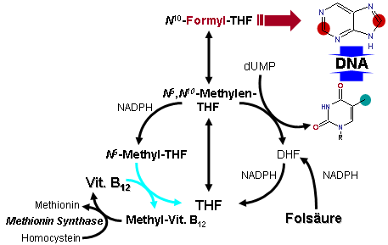
Cofactors and coenzymes
Some cofactors are organic molecules – coenzymes
Coenzymes do take part in reactions and do get changed
Act as carriers moving chemical groups between enzymes e.g. B vitamins

Slide 20
Cofactors and coenzymes
Cofactors that are tightly bound to the enzymes are called prosthetic groups
E.g. zinc ions – prosthetic group for carbonic anhydrase (produces carbonic acid from CO₂ and water in red blood cells), found as part of the active site
Cofactors and coenzymes – make enzymes work – essential
*Take 2 minutes to look up examples of cofactors and coenzymes*

Slide 21
Inhibition of enzyme activity
Inhibitors will stop enzymes from working – can temporary or permanent
Competitive inhibition – molecules “look like” the substrate and compete for binding to the active site
Once the competitive inhibitor is bound to the active site, the true substrate cannot bind so no products can be formed (rate of reaction is low)
If the concentration of true substrate is increased, it will outcompete the inhibitor and product can be formed (rate of reaction will increase)

Slide 22
Competitive inhibition

Slide 23
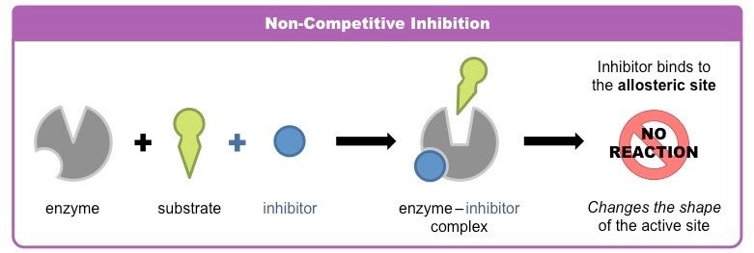
Non-competitive inhibition
Non-competitive inhibitors bind to the enzyme away from the active site
They bind to the enzyme’s allosteric site
They lead to a change in the shape of the active site and the substrate can no longer bind
Increasing the concentration of the substrate has no effect – it still can’t bind to the active site
The rate of reaction is badly affected

Slide 24
Inhibitors can be reversible or non-reversible
It all depends on the strength of the bond between the enzyme and the inhibitor
Strong, covalent bonds tend to lead to irreversible inhibition
Weak hydrogen bonds or weaker ionic bonds tend to lead to reversible inhibition
What are cofactors, coenzymes and prosthetic groups?
Find two examples of prosthetic groups
What is the difference between competitive and non-competitive inhibition?

Slide 25
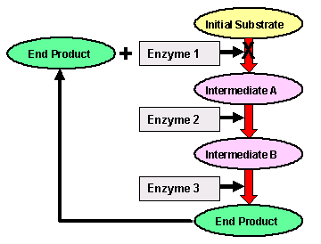
End point inhibition
Metabolic pathways are a series of reactions where the product of one reaction is the substrate in the next reaction. Different enzymes are used in the pathway
Sometimes, a product further down a pathway will inhibit an enzyme higher up the pathway.
Only when the product starts to run out is the inhibition overcome and the enzyme can work again (e.g. phosphofructokinase)

Slide 26
Medicines
Some medicines are enzyme inhibitors e.g some antiretroviral drugs like reverse transcriptase inhibitors. Stops HIV RNA being copied into viral DNA
Penicillin inhibits bacterial transpeptidase which is used to make proteins for the bacterial cell wall. Without transpeptidase, the bacterial wall is weakened and bursts
Some high blood pressure drugs inhibit enzymes involved with regulation of blood pressure e.g. ACE inhibitors (ramipril, perindopril, lisinopril)
Can you find any other examples of medicines which are enzyme inhibitors?

Slide 27
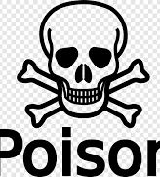
Poisons
Some poisons act by interfering with enzymes involved in metabolic reactions
Cyanide – irreversible inhibitor for cytochrome c oxidase. This enzyme is needed for cellular respiration - without it, cells cannot produce ATP and die
Arsenic inhibits pyruvate dehydrogenase – the enzyme is needed for cell respiration

Slide 28
Lesson aims
At this point, you should be able to:
Describe what enzymes are, what activation energy is, describe the lock and key model and the induced fit model, and what the active site is
Describe the four factors that affect enzyme activity
Describe competitive and non-competitive inhibition
Understand how some medicines and poisons work by affecting enzymes

