Slide 1
The Immune System

Slide 2
Learning objectives
“Students should demonstrate an understanding of how the body defends itself from pathogens, including how physical and chemical barriers are the first line of defence, followed by the innate immune system and the adaptive immune system. Students should understand that there is an orchestrated approach to immunity involving different specialised cell types and proteins. Students should understand the principle of vaccination and how antibiotics work.”

Slide 3
Lesson aims
By the end of the lesson, students will be able to:
1. describe the first line of defence against pathogens
2. describe the difference between the innate and adaptive immune response
3. describe the specialised immune cell types involved and some proteins
4. outline vaccination, why it is needed and what vaccinations are administered in the UK
5. outline how antibiotics work and what resistance is

Slide 4
Defence against pathogens
To cause illness, pathogens need to gain entry
However, we have a different layers (or mechanisms) of protection, firstly to prevent entry and secondly to prevent pathogens taking hold if they do gain entry
These are non-specific – that is, the same mechanisms are used against a range of pathogens
Skin – the first barrier against infection
Physical barrier – skin cells present a continuous surface and the outermost layers of skin cells are dead and flake off, taking bacteria with them (but what happens if we get scratched?)

Slide 5
Skin and mucous membranes
As well as being a physical barrier, skin also acts as a chemical barrier
Skin produces chemicals that are antimicrobial and lower the pH which slows down pathogen growth
Examples include sweat, sebum, ear wax (there are two types – who knew?!), lysozyme, anti-microbial peptides
Skin also has its own skin flora (commensal bacteria and fungi) – non-pathogenic bacteria which do not usually cause us harm and stop other bacteria from growing
Mucous membranes – protect body openings (e.g. mouth, nostrils, ear, genitals, anus)
Mucus – sticky, traps microbes and contains antimicrobial enzymes

Slide 6
Blood clotting
Blood clots stop loss of blood and stop microbes entering wounds
Clots are made from fibrin fibres and platelets
Look up disseminated intravascular coagulation (DIC)

Slide 7
Inflammation
Five signs of inflammation (heat, redness, swelling, tenderness, pain)
Triggered by tissue injury
Injured tissue releases chemicals leading to increased permeability (leakiness) of blood vessels
Leakiness leads to swelling

Slide 8
Inflammation
Increased permeability/leakiness leads to swelling (oedema) as more fluid and cells enter tissue
Vasodilation (widening) of blood vessels allows increased blood flow into area bringing in more white blood cells

Slide 9
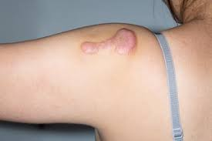
Wound repair
The initial reaction following a tissue injury is blood clotting – haemostasis
Inflammation takes place
This is followed by would repair and healing
Cells in the outer layer of skin (epidermis) divide and migrate to the edges of the wound
Contraction of tissue below the wound takes place to bring the sides of the wound together
Collagen fibres help to repair the wound but too much collagen results in a scar (or keloids – what are these?)

Slide 10
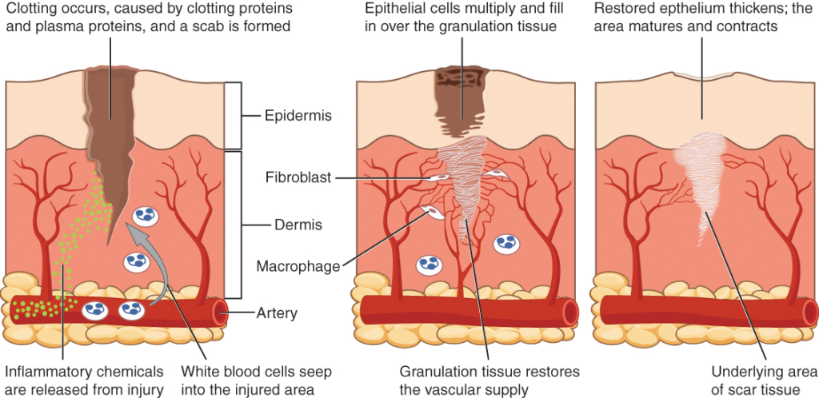

Slide 11
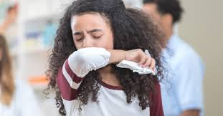
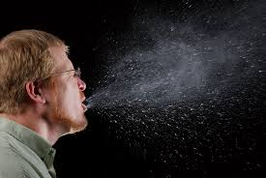
Expulsive reflexes
E.g. coughing or sneezing. Happen automatically
Both reflexes are stimulated by irritation and aim to eject the irritant (e.g. dust, dirt, microbes etc)

Slide 12
Recap time!
Recap the non-specific ways that we have to prevent entry of pathogens. Include in your recap the following:
The two ways that skin helps to defend against pathogens
The function of the mucous membranes

Slide 13
The Immune System
If a pathogen makes it past the different barriers and gains access to the body, a whole range of cells, proteins and processes awaits
The immune system includes both non-specific and specific responses
Non-specific responses means that the responses are broadly the same whatever the pathogen
Specific responses are tailored towards the actual pathogen and involve B and T white lymphocytes (cells).
Specific responses are aimed at the pathogen’s antigens as these are foreign to the body

Slide 14
Antigens are molecules (proteins or carbohydrates) found on cells

Slide 15
Four main stages in the immune response
1. Pathogens are engulfed by phagocytes – phagocytosis
Phagocytes are found in blood and tissues and help with non-specific responses – include neutrophils
2. Phagocytes activate T lymphocytes - T Helper cells, T Killer cells, T Regulatory cells
3. T lymphocytes activate B lymphocytes and B lymphocytes differentiate into Plasma cells
4. Plasma cells make antibodies that are specific for a particular antigen

Slide 16
Overview of phagocytosis
Pathogen enters the body
Phagocytes are attracted to the area of infection by chemicals such as cytokines
Chemotaxis – movement/attraction of cells
Phagocytes recognise antigens on the surface of the pathogen
Opsonins (“coating” proteins) and antibodies make recognition easier for phagocytes

Slide 17
Overview of phagocytosis
Opsonins can mask negative charges on the pathogen surface which makes it easier for negatively-charged phagocytes to get closer
Endocytosis – the cytoplasm of the phagocyte engulfs the pathogen, taking it inside the phagocyte

Slide 18
Overview of phagocytosis
Once inside the phagocyte, the pathogen is contained in a phagosome (phagocytic vacuole or vesicle)
Lysosomes fuse (join) with the phagocytic vacuole and empty out their toxic enzymes onto the pathogen, breaking it down

Slide 19
Antigen presentation
Once the pathogen has been broken down into smaller bits (antigens), they may be packaged with MHC II (major histocompatibility ) molecules and presented to T cells which activates them
Professional antigen-presenting cells include macrophages, B cells, dendritic cells

Slide 20
Recap time!
Summarise the previous slides on phagocytosis and antigen presentation
What are cytokines?
Find some examples of cytokines, cells that produce them and what actions they have

Slide 21
Break time

Slide 22
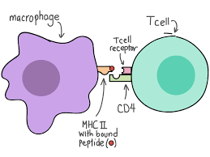
Phagocytes activate T cells
The surface of T cells is covered in receptors – T cell receptors
Each T cell has a different T cell receptor
Eg one T cell may be covered in T cell receptors
which recognise a bit of
measles virus (a measles antigen)
and those T cell receptors
will only ever recognise that measles antigen
Antigen presenting cells (APC) present antigens to T cell

Slide 23
Phagocytes activate T cells
If a T cell receptor recognises the presented antigen, it will bind to it
This activates the T cell
This is called clonal selection
The T cell then makes lots of copies of itself – clonal expansion

Slide 24
Different types of T cell
T helper cells – release cytokines that activate B lymphocytes and T cytotoxic cells
T cytotoxic cells – hunt down, bind and kill virus-infected cells
T regulatory cells – suppress immune responses from other white cells to stop immune cells attacking body cells by mistake

Slide 25
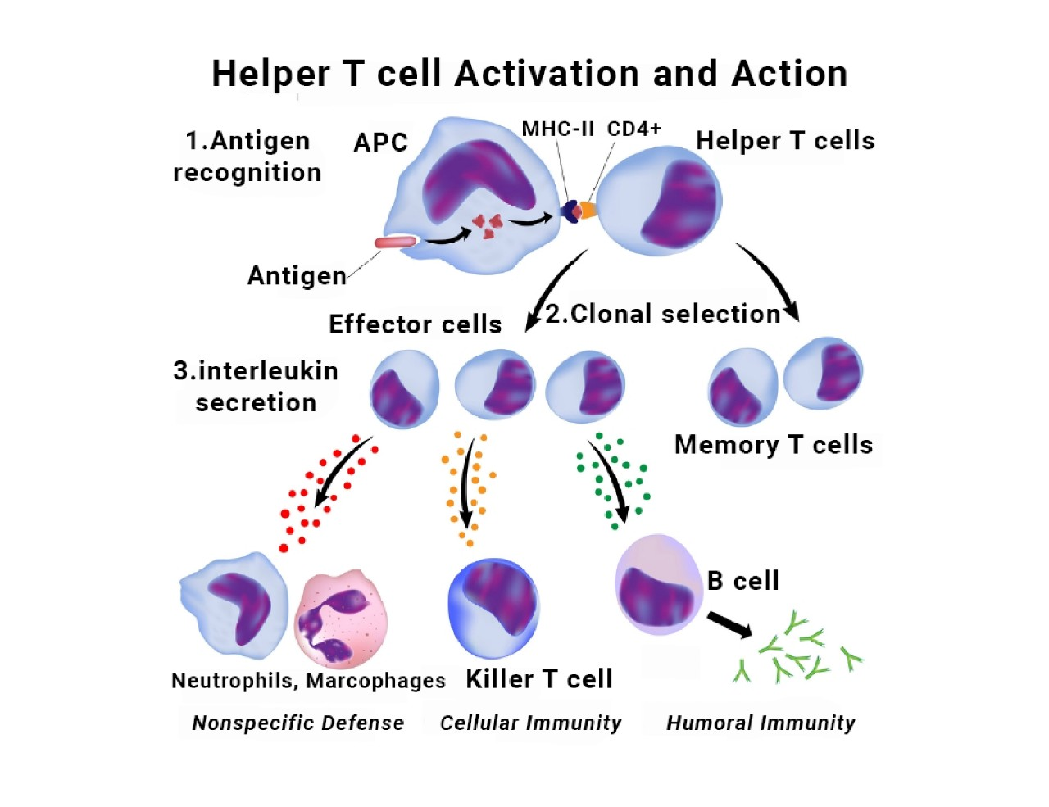
What do you think happens if T helper cells are removed?

Slide 26
T cells activate B cells
B cells are covered in antibodies
Antibodies are generally “Y” shaped proteins
Each B cell will make on antibody that recognises only one type of antigen

Slide 27
T cells activate B cells
If the antibody on the B cell meets the antigen it was destined to meet, it will bind to it
Binding to antigen, together with help from cytokines (e.g. imterleukins) released by T cells, activates the B cell – clonal selection
Activated B cells divide by mitosis into plasma cells and memory cells – clonal expansion

Slide 28
Plasma cells make antibodies for specific antigens
Plasma cells are clones of B cells
They secrete lots of antibodies into the blood which all recognise exactly the same antigen
Antibodies bind to antigen and form antibody-antigen complexes

Slide 29
Plasma cells make antibodies for specific antigens
Antibodies are glycoproteins
Made of four polypeptide chains -2 x light chains and 2 x heavy chains
Each chain has a variable and constant region

Slide 30
Plasma cells make antibodies for specific antigens
Variable regions form the antigen binding sites with a shape that is complementary to the antigen
Variable regions are different between antibodies

Slide 31
Plasma cells make antibodies for specific antigens
Hinge region makes the antibody flexible for binding
Constant regions can bind to receptors on other cells to cause further actions
Disulphide bridges hold the molecule together

Slide 32
Antibody actions
Agglutination – antibodies can clump pathogens together
Antibodies can bind to toxins and neutralise them (stop them being toxic )
Antibodies can stop pathogens entering our cells by binding to them
Antibodies can opsonise (“coat”) pathogens making it easier for phagocytosis or cell lysis

Slide 33
Recap time!
Summarise the previous slides.
Include in your summary:
what B cells and plasma cells are
the structure and functions of antibodies

Slide 34
The primary response to infection is slow
When we first encounter a pathogen in our body, an immune response is stimulated by the antigens on that pathogen
The primary response is slow to get started as B cells with the specific antibodies are scarce (there are not that many of them at first) - they are naive
While the B cell numbers take time to increase, we get the symptoms of the disease
Eventually we overcome the disease and there will now be memory B cell and T cells that are specific for that pathogen
Memory cells live for a long time and will recognise the pathogen quickly next time it invades us
We now have specific immunity

Slide 35
Secondary immune response
If the same pathogen enters us again, the secondary immune response is much faster
Specific memory B cells are activated and divide into plasma cells that secrete antibodies
Specific memory T cells are activated and divide
The pathogen is overwhelmed before any symptoms arise

Slide 36
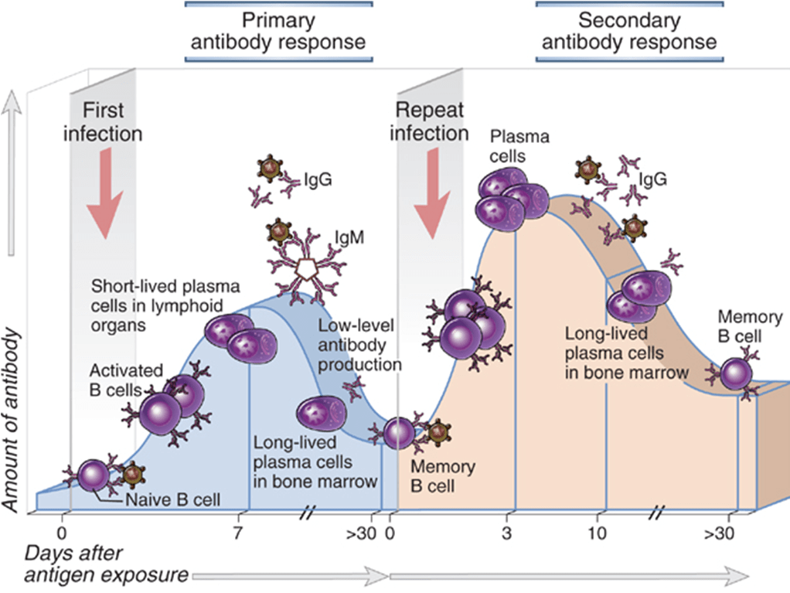
More detail on primary and secondary responses

Slide 37
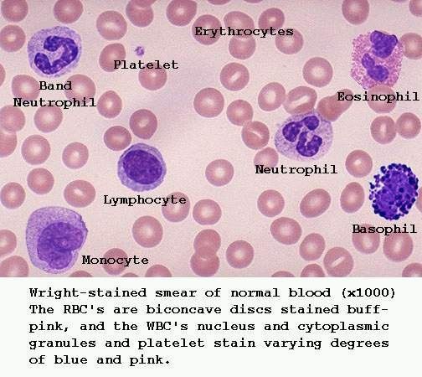
Neutrophils are the most numerous white blood cell. They have a lobed nucleus and grainy cytoplasm
Lymphocytes are a little smaller than neutrophils. The cytoplasm takes up most of the cell
Monocytes are large cells and have a large, kidney bean shaped nucleus
Basophils have a very granular cytoplasm containing heparin and histamine and are involved in allergic reactions
Eosinophils have a bi-lobed nucleus and are involved with defence against parasites and allergic reactions

Slide 38
Question time!
1. What are antigens?
2. What are the different types of T cell and what structure is found on the surface of T cell?
3. Explain why someone should only suffer Measles once despite being exposed to it again

Slide 39
Immunity and vaccination
Immunity – the ability to respond to an infection
Different types of immunity and different ways of developing it
Immunity can be active or passive
Active – you suffer the disease and develop memory T cell and B cells to it so you don’t get it again
Passive – you are “given” antibodies that were made elsewhere to help you in the short term but this does not last long term

Slide 40
Active immunity
Your immune system produces its own antibodies and T cell responses
Natural - you have suffered the disease (and survived)
Artificial – you have been vaccinated against a specific disease

Slide 41
Passive immunity
Immunity is “given” to you from elsewhere – you have not made the antibodies yourself
Natural – antibodies cross the placenta and enter the foetus and also passed to the baby in breast milk, but they don’t last in the baby more than a few months
Artificial – you can be injected with antibodies from someone or something else to get immediate protection. E.g. antibodies to tetanus collected from blood, or antibodies to corona virus collected from people who have had the disease is being trialled in some hospitals in very sick patients

Slide 42
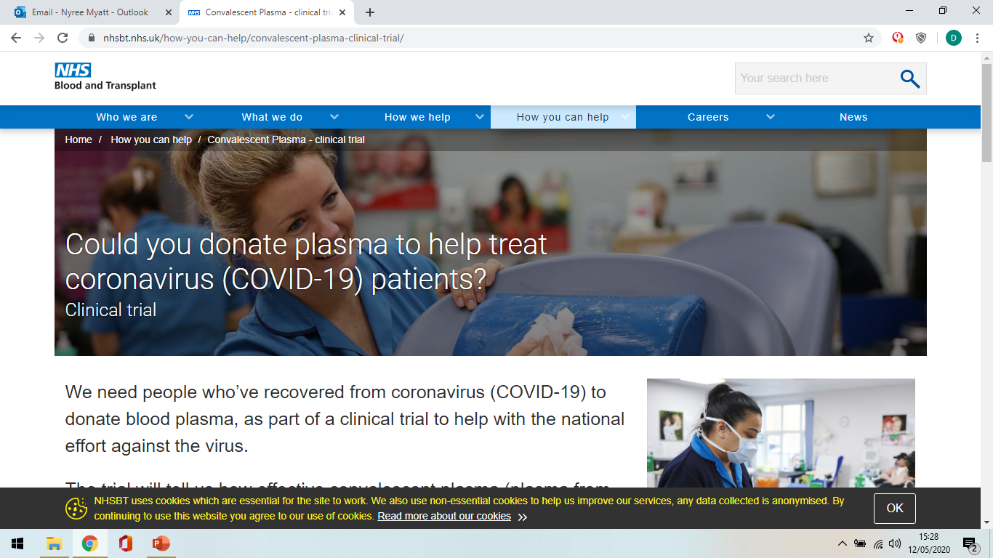

Slide 43
Autoimmune diseases - an abnormal immune response
Examples of Autoimmune Disorders
Rheumatoid arthritis.
Systemic lupus erythematosus (lupus).
Inflammatory bowel disease (IBD).
Multiple sclerosis (MS).
Type 1 diabetes mellitus.
Guillain-Barre syndrome.
Chronic inflammatory demyelinating polyneuropathy.
Psoriasis.
Autoimmune diseases are an immune response to parts of your own body
Self-antigens are viewed as foreign by the immune system
Chronic, cannot be cured but can be treated

Slide 44
Vaccination
Vaccination gets around the problem of waiting for your B cells and T cells to increase in number to deal with a pathogen
Vaccines can be made in different ways
They can involve dead pathogens, bits of pathogens, other bacteria that have similar antigens to the pathogen
The key to vaccination is to stimulate an immune response to pathogenic antigen without giving the person the disease so that if the person meets the pathogen they can mount a secondary response involving memory cells very quickly

Slide 45
Herd immunity
Herd immunity
When most people in a community have been vaccinated, it means that anyone who isn’t vaccinated is unlikely to get the disease.
This is herd immunity
But with fewer people being vaccinated, more outbreaks can happen

Slide 46
Question time!
Which vaccinations are routinely given in the UK?
How does this compare to other countries?

Slide 47
Antibiotics, antibiotic resistance and future medicines
The immune system is brilliant at fighting infections – much of the time
However, sometimes it needs help to overcome bacterial infections
Antibiotics are drugs that help by killing (bactericidal) or preventing growth (bacteriostatic) of bacteria
They work by exploiting differences in the bacteria (prokaryotic cells) compared to eukaryotic cells and therefore so not damage us (however, some people are allergic to some antibiotics)

Slide 48
Antibiotics
Penicillin was isolated from mouldy agar plates by Alexander Fleming in 1928 at St Mary’s Hospital Paddington
Further research was carried out by Florey and Chain in the 1930s and 1940s and was used to treat soldiers in WW2

Slide 49
Antibiotics
Find examples of different antibiotics
Give examples of what they might be used for
Find some examples of side effects of antibiotic use

Slide 50
Resistance to antibiotics
Because of genetic variations in bacteria, there is resistance to antibiotics
If someone is infected with a naturally resistant form, treating with antibiotics does not clear the bacteria
The resistant bacteria increase in number and can spread to other people (e.g. resistant gonorrhoea bacteria) – natural selection
Superbugs are resistant to nearly all antibiotics
People need to take antibiotics as prescribed and doctors should be careful with how they prescribe them

Slide 51
Antibiotic-resistant bacteria
Two important hospital-acquired bacteria include
meticillin (methicillin) resistant staphylococcus aureus (MRSA) which causes wound infection
Clostridium difficile (C.diff) – infects the digestive system.
Leads to diarrhoea, fever and cramps
Particularly relevant in hospitals as people may already have weaker immune systems and surgical wounds

Slide 52
Responsible use and prescribing
Don’t prescribe for minor infections or where viral infection is likely cause
Don’t prescribe to prevent infection unless elderly or weakened immune system
Take all antibiotics as prescribed

Slide 53
New medicines
A number of drugs are derived from chemicals found in nature (e.g. from plants, animals, microbes ; Chelsea Physic Garden in London has loads of examples of plants where drugs come from – and great cakes in their cafe!)
The search for new antibiotics is difficult as drug companies need to invest much time, money and effort
You can try Fold.it to look at how proteins fold and see which drugs might work in different scenarios

Slide 54
Personalised medicines
Research going on to see how someone’s genes can influence the drug therapy proposed to see if it will work or not
Synthetic biology – make artificial proteins, cells or microbes that have specific targets

Slide 55
Summary
Defence against pathogens starts with barriers e.g. skin, mucus membranes, blood clots, expulsive reflexes
Immune system – includes innate and specific responses, and memory
Involves cytokines, phagocytosis, antigen processing and presenting, T cells (helper, cytotoxic and regulatory), B cells and plasma cells, and antibodies
Primary response is slow, secondary response is faster – memory cells

Slide 56
Summary
Immunity can be passive or active, natural or artificial
Vaccination – lead to memory cells so have a fast secondary response
Antibiotics – fight bacterial infections but resistance is a big issue

Slide 57
Lesson aims
By the end of the lesson, students will be able to:
1. describe the first line of defence against pathogens
2. describe the difference between the innate and adaptive immune response
3. describe the specialised immune cell types involved and some proteins
4. outline vaccination, why it is needed and what vaccinations are administered in the UK
5. outline how antibiotics work and what resistance is

