Slide 1
Islam and Islamophobia in France

Slide 2
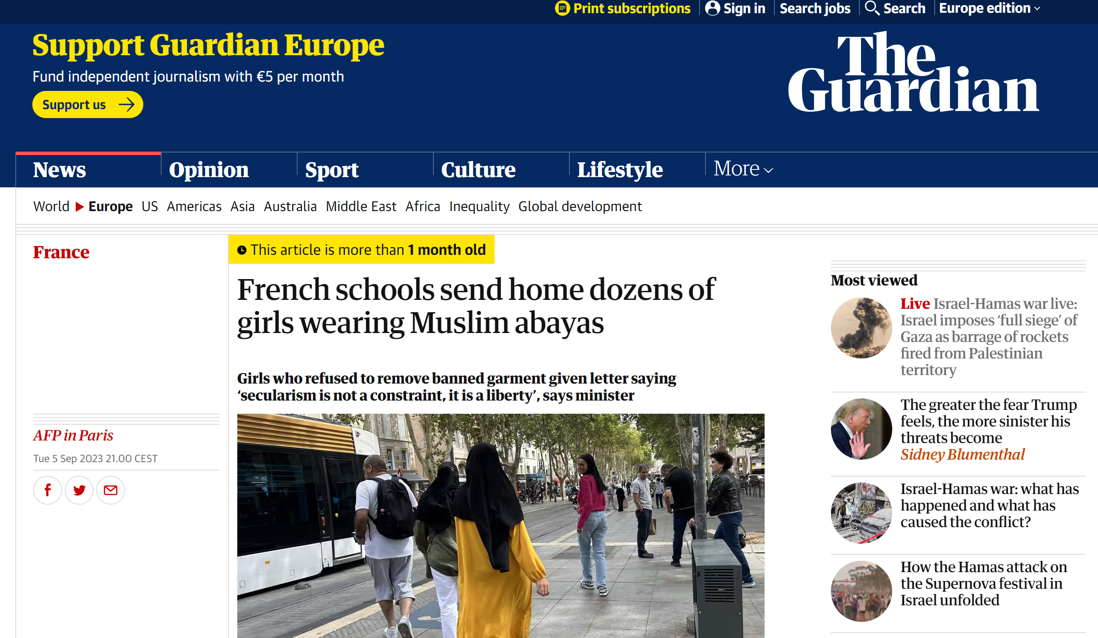

Slide 3
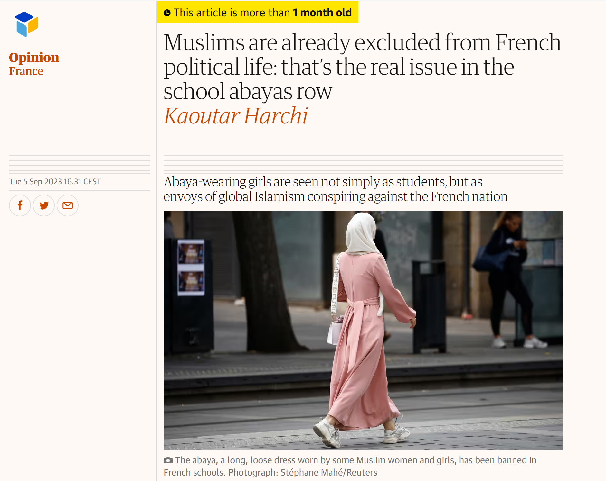

Slide 5
Aims of the class
How did we get here?
How are measures/policies targeted towards (female) Muslims justified?
Links to:
Broader issue of racism and its changing nature (linked to rise of FN)
Debates on identity and the republican model of integration

Slide 6
The Islam ‘problem’
Stigmatisation of French Muslims
Between 5 and 6 million people (largest in Europe)
Core argument: Communitarianism or voluntary segregation (‘guettoisation’, banlieues)
Result: stigmatisation along ethnic and racial lines of victims of social inequality.
‘Ethnicisation of social relations’ (Fassin, 2006)
Linked to this: Increasingly explicit assertions of superiority of ‘French’ values over religious beliefs and cultural practices of people from non-European backgrounds (Wolfreys, 2013)

Slide 7
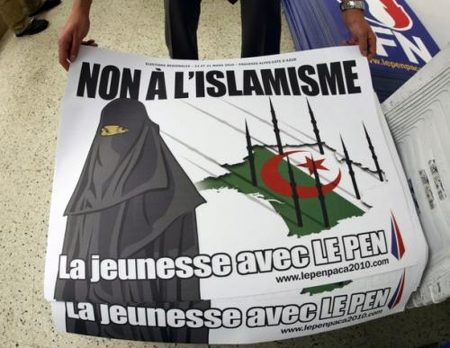
The ‘Islam problem’
‘For those belonging to minority ethnic groups, often born French in France yet still labelled second, third or fourth generation immigrants, integration is becoming a meaningless concept as the cultural practices of those who do not conform to French “norms” are stigmatised and the notion of “integration” is invested with colonial assumptions about France’s “civilising mission”, making it difficult to distinguish integration from assimilation.’ (Wolfreys, 2013)
Demands for conformity to ‘French way of life’ = couched in language of Republican universalism (Fysh & Wolfreys, 2003).

Slide 8
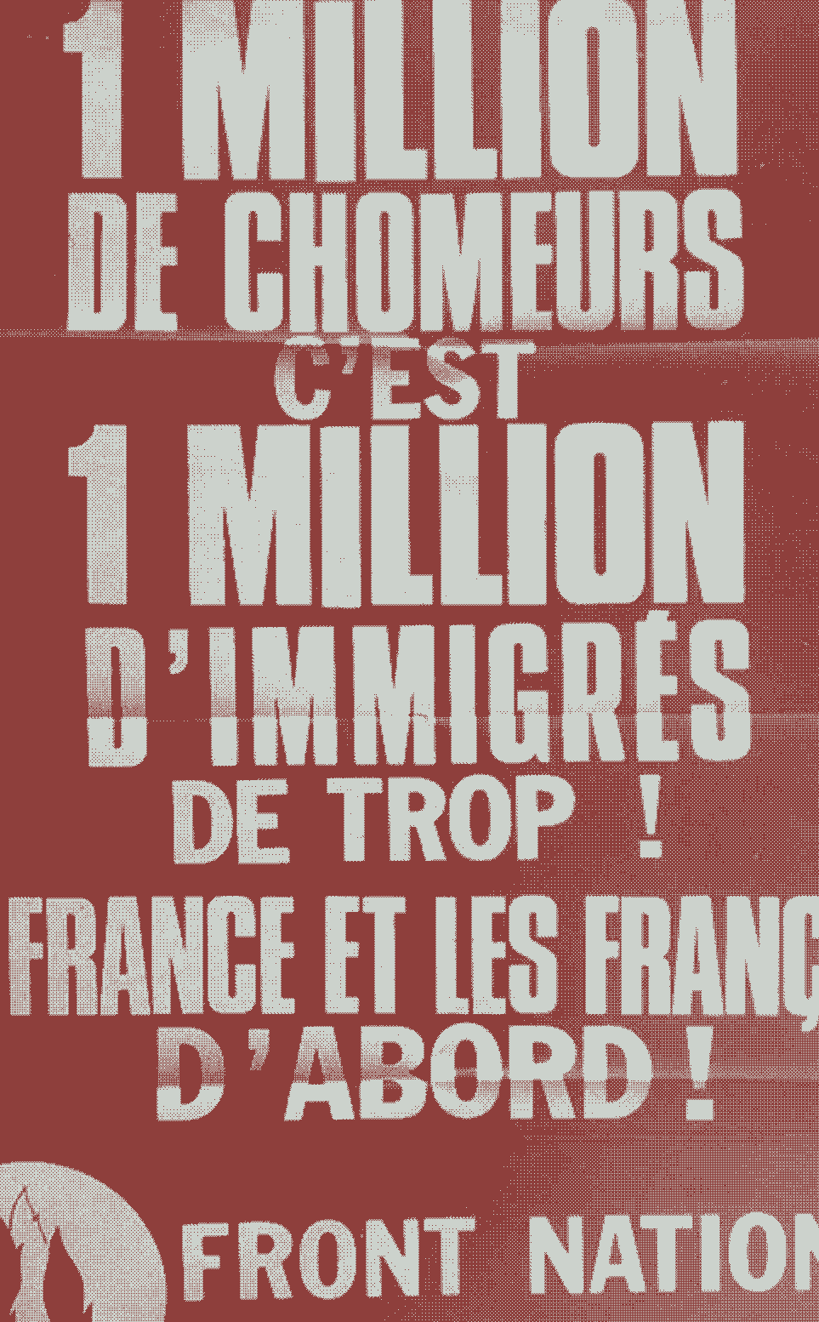
How did we get here?
Rise of the FN:
Rehabilitated racist ideas in contemporary France
Mainstreamed idea that France’s social and economic problems were linked to ‘problem’ of immigration
Exposed fault lines in Republican model of integration
Based on common identification with shared values (as opposed to ethno-culturalist notions of identity: shared culture and history)
2 approaches do not exclude each other
‘Republican tradition’ evoked as part of French culture, conflating political values with ethnic identity.

Slide 9
How did we get here?
Not just the FN.
Wider developments: entrenchment of a neoliberal outlook across mainstream parties.
Social conflict is ‘ethnicised’: those suffering discrimination are held responsible for their situation
Emphasis on personal responsibility of most impoverished for their situation
Global context: Islam = constructed as the global threat
Mainstreaming of FN’s ideas/discourse

Slide 10
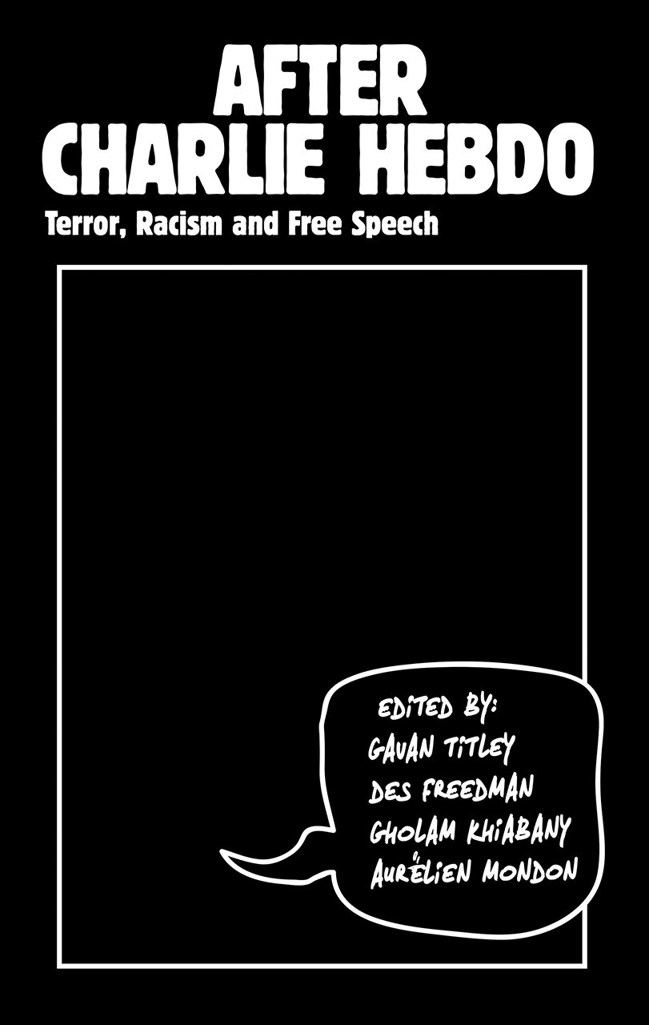
From illiberal to liberal Islamophobia
Mondon & Winter (2017)
Illiberal Islamophobia: ‘Anti-Muslim’ hate
‘Traditional’ racism
Exclusivist notions and concepts of race, ethnicity…
Liberal Islamophobia:
“Apparently rejects but in fact displaces and conceals traditional racism and overt prejudice by constructing a pseudo-progressive binary and narrative” (Mondon & Winter, 2017: 31).
Notion and image of Muslim or Islamic belief and culture as inherently opposed to core Western values (Progress, democracy, human rights, free speech, gender and sexual equality).
2017

Slide 11
From illiberal to liberal Islamophobia
“Although liberal Islamophobia claims to target religion and belief (Islam) on behalf of liberalism as opposed to people (Muslims) to claim its liberal credential and non-racist defence, it does retain the same target – Muslims – as its illiberal counterpart, often under the auspices of ‘culture’, and is part of a long legacy of anti-Muslim hate in France and wider Europe, dating to colonialism.” (Mondon & Winter, 2017: 32)
FN has strategically embraced liberal Islamophobia in defense of the Republic:
Becomes champion of hegemonic values seemingly abandoned by mainstream parties.
“The Republic is now understood as the nation in the traditional extreme right manner, and secularism as the weapon against the divisions caused by the nation’s new primary enemy: Islam” (Mondon & Winter, 2017: 37).

Slide 12
‘Cultural’ racism
Blurring of the divide possible through substitution of one ‘r’ word (race) by another ‘r’ word (religion)
‘Religiosity becomes a new criterion of social differentiation, thereby replacing race which operated for centuries as a marker for the hierarchy of civilizations. Anti-religious discourse becomes a fig leaf, used to conceal mechanisms of discrimination’ (Khemilat, 2019:184).

Slide 13
A ‘Colour-blind’ Republic
Fits into a broader reluctance in Republican circles to use the word ‘race’.
Sarah Mazouz: ‘Par une mystification dont les constructions nationales ont le secret, la République a en effet, dans la seconde moitié du XXème siècle, considéré que le racial c’était les autres, et en particulier les Etats-Unis. […] Dans ce contexte, on assiste du reste à une fétichisation du terme race. Le seul fait d’y recourir ou de le mentionner aurait le pouvoir de donner une vigueur nouvelle aux idéologies racistes’ (Mazouz, 2020: 22-23).

Slide 14
From illiberal to liberal Islamophobia
Framing of Islam as threat to Western values
Idea of a shared Western civilization (innately progressive)
Idea of a homogeneous and politically unified Muslim community (innately reactionary)
“Islam politique”
Western civilization is superior to others
Western civilization is under threat from minorities and certain intellectuals (‘Islamo-gauchistes’, ‘indigénistes’).
Us vs. Them
Good vs. Evil
Secularism (läicité) vs. Fundamentalism (Islamisme)

Slide 15
From illiberal to liberal Islamophobia
Muslim women are objectified and placed at the centre of these dichotomies.
‘The notions of immigration, Islam and the status of women are being linked as if there was an intrinsic causal relation between them, and all three of them being viewed under a negative prism: immigration only perceived as illegal and clandestine, Islam as the cause of tension between communities, and the status of Muslim women as backwards and oppressive.’ (Khemilat, 2019:184)

Slide 16
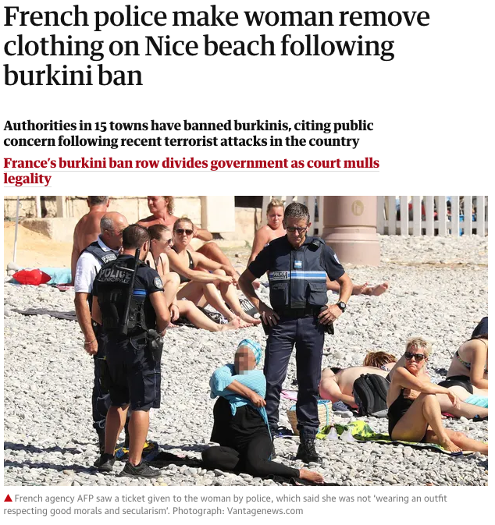
2016 Burkini ‘affair’
Source: The Guardian (26/08/16) https://www.theguardian.com/world/2016/aug/24/french-police-make-woman-remove-burkini-on-nice-beach

Slide 17
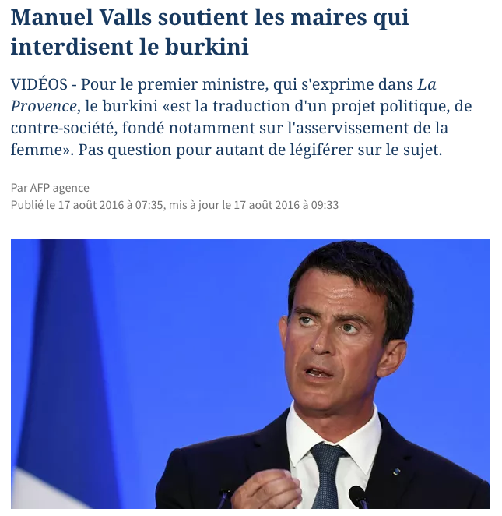
Source: Le Figaro (17/08/16) https://www.lefigaro.fr/politique/2016/08/17/01002-20160817ARTFIG00045-manuel-valls-soutient-les-maires-qui-interdisent-le-burkini.php

Slide 18
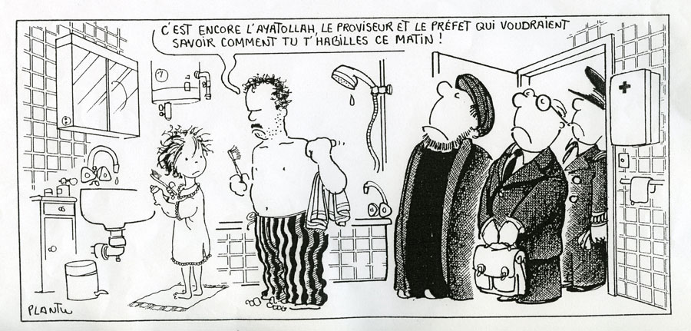
The 1989 Headscarf Affair
‘L’affaire du foulard eventually came to stand for all the dilemmas of French national identity in the age of globalization and multiculturalism: how to retain French traditions of laïcité, republican equality, and democratic citizenship in view of […] the pressures of multiculturalism generated through the presence of second- and third-generation immigrants from Muslim countries on French soil.’ (Seyla BENHABIB, 2002: 99-100)
Plantu (October 1989)

Slide 19
The 1989 Headscarf Affair
Backdrop: Bicentenary of Revolution
6 October 1989
3 Muslim girls are barred from entering a school in Creil because they are wearing a headscarf
Conseil d’Etat (highest administrative body): Wearing religious symbols in school ‘is not, in itself, incompatible with laïcité’, as long as it is not ostentatious
Numerous reactions (media, intellectuals)
Republic under threat from communitarianism, multiculturalism, particularisms…
E.G. Régis Debray (1989), Que Vive la République; Emmanuel Todd (1994), Le destin des immigrés

Slide 20
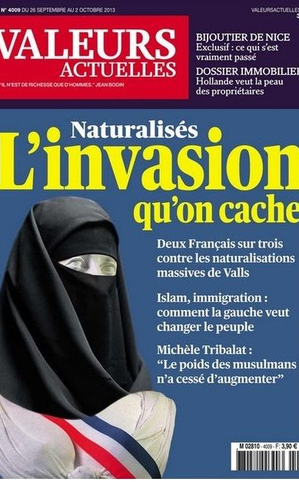
The 1989 Headscarf Affair
Republic under threat
Alain Finkielkraut: ‘Republican France’ vs. ‘Tribal France’
L’Express: ‘läique school under threat’
Political reactions: FN, but also mainstream left (Julien Dray of Socialist Party calls for a ‘Ministry of Integration’)
Rise of a neo-republican front against communitarianism.
1989 marked starting point: other ‘headscarf affairs’ (2003,...); laws (2004 law banning the wearing of conspicuous religious symbols in public schools…).

Slide 21
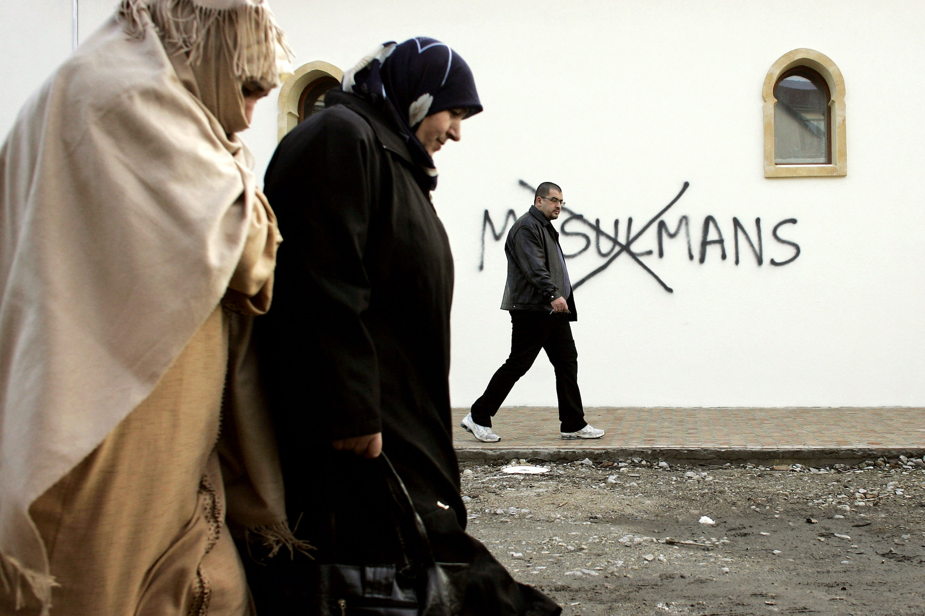
Concluding remarks
Issues at stake:
Laïcité: From ‘pacified secularism’ to ‘combative secularism’
Integration: ‘Right to difference’ or ‘right to indifference’
Refusal to integrate or refused integration?
Essentialism: West vs. the rest; Muslims as homogeneous bloc (idea of a single ‘Muslim identity’)
Mainstreaming of an ‘Islam problem’
Muslim women are objectified
Social and spacial marginalisation

