Slide 1
2. Survival Model concepts
Chris Sutton, October 2023

Slide 2
Topic outline
1
Basic assumptions and definitions
2
Force of mortality
3
4
Probability density function
5
Initial and Central rates of mortality
Expected future lifetime
6
Important formulae for _{t}q_{x} and _{t}p_{x}
7
Examples of simple survival models

Slide 3
Initial Definitions

Slide 4
T
The future lifetime of a person (a “life” in actuarial speak) is not known in advance.
We will assume for any given life it is a random variable
T = future lifetime of a new-born person, continuously distributed on the interval [0, ω]
where ω is the “limiting age” (often 100 or 120) which simplifies modelling
The distribution function of T is F(t) where F(t) = P[T ≤ t]
The “survival function” of T is S(t) where S(t) = P[T ≥ t] so S(t) = 1 – F(t)

Slide 5
T_{x}
In practice we are not only interested in following lives from birth. More generally we use random variables depending on age
T_{x} = the future lifetime after age x of a life who survives to age x
0 ≤ x ≤ ω
T₀ = T
The distribution and survival functions of T_{x} are
F_{x} (t) = P[T_{x} ≤ t]
S_{x} (t) = P[T_{x} ≥ t] = 1 – F_{x} (t)

Slide 6
p_{x} and q_{x}
Actuaries like to use different notation from other mathematicians!
_{t}q_{x} = F_{x} (t) called the “rate of mortality”
_{t}p_{x} = S_{x} (t) = 1 – _{t}q_{x}
When t=1 we drop the _{t}
₁q_{x} is written q_{x}

Slide 7
surviving for time s+t after age x
The probability of surviving for time s+t after age x, _{s+t}p_{x} , can be found by:
multiplying the probability of surviving for time s then surviving further time t
_{s+t}p_{x} = _{s}p_{x} . _{t}p_{x+s}
or
multiplying the probability of surviving for time t then surviving further time s
_{s+t}p_{x} = _{t}p_{x} . _{s}p_{x+t}

Slide 8

Demonstration of ${{}_{s+t}^{ }p}_{x}= {{}_{s}^{ }p}_{x}$ ${{}_{t}^{ }p}_{x+s}$
${{}_{t}^{ }p}_{x}=P\left[T_{x}>t\right]=P\left[T>x+t\right|T>x]$
${{}_{t}^{ }p}_{x}=\frac{P[T>x+t]}{P[T>x]}= \frac{{{}_{x+t}^{ }p}_{0}}{{{}_{x}^{ }p}_{0}}$
so similarly
${{}_{s+t}^{ }p}_{x}= \frac{{{}_{x+s+t}^{ }p}_{0}}{{{}_{x}^{ }p}_{0}}$

Slide 9

Demonstration continued
${{}_{s+t}^{ }p}_{x}= \frac{{{}_{x+s+t}^{ }p}_{0}}{{{}_{x}^{ }p}_{0}}$
if we multiply top and bottom by ${{}_{x+s}^{ }p}_{0}$ we get
${{}_{s+t}^{ }p}_{x}=\frac{{{}_{x+s}^{ }p}_{0}}{{{}_{x}^{ }p}_{0}} .\frac{{{}_{x+s+t}^{ }p}_{0}}{{{}_{x+s}^{ }p}_{0}}= {{}_{s}^{ }p}_{x}$ ${{}_{t}^{ }p}_{x+s}$

Slide 10
Force of mortality

Slide 11
µₓ
The “force of mortality” µ_{x} is an important variable in many survival models
another example of actuaries using different names. Most statisticians would call this the “hazard rate”
Questions may refer to either name
definition:
µ_{x} = lim 1 P[T≤x+h|T>x] µ_{x} = lim 1 P[T_{x}≤h]
^{h→0} h ^{h→0} h

Slide 12
How can we think of µₓ ?
µ_{x} = lim 1 P[T≤x+h|T>x] = lim 1 _{h}q_{x}
^{h→0} h ^{h→0} h
for very small h we can ignore the limit so
µ_{x} ≈ 1 _{h}q_{x} or _{h}q_{x} ≈ h µₓ
h
the probability at age x of death over a very short time h is approximately proportional to h with the force of mortality being the approximate constant of proportionality

Slide 13
probability density function

Slide 14
fₓ(t)
Re-cap of probability density function (pdf)
Fₓ(t) is the [cumulative] distribution function of Tₓ
fₓ(t) is the probability density function of Tₓ
fₓ(t) = d Fₓ(t) = d P[Tₓ ≤ t] = lim P[Tₓ ≤ t+h] - P[Tₓ ≤ t]
dt dt ^{h→0} h
pdf is the derivative
limit definition of a derivative

Slide 15
expressing fₓ(t) in terms of _{t}p_{x}
very important result in survival models
fₓ(t) = _{t}p_{x} µ_{x+t}
which can also be written
fₓ(t) = Sₓ(t) µ_{x+t}

Slide 16
Demonstration
See separate PDF “Demonstration 2” on module QM Plus section for this week

Slide 17
initial and central rates of mortality

Slide 18
mₓ
so far we have used qₓ as the rate of mortality
this is the probability a life at exact age x dies before reaching exact age x+1
more formally this is called the “initial rate of mortality”
in population studies and demography it is more common to use mₓ
this is the probability of dying between ages x and x+1 per person-year lived between ages x and x+1
it is called the “central rate of mortality”
mₓ = qₓ
₀∫¹ _{t}p_{x} dt

Slide 19
estimating mₓ
in population studies the central mortality rate mₓ is estimated using
“occurrence exposure rate” = number of deaths observed
total time alive and at risk for observed lives
this may also give us one way of estimating the force of mortality µₓ

Slide 20
Expected future lifetime

Slide 21
E[Tₓ]
Expected value of Tₓ
Actuaries call this “expected future lifetime” after age x and use notation eₓ
Demographers call this “expectation of life” at age x
In public policy, expectation of life is often used as a measure of living standards or healthcare quality
Recall that in general E[Y] = ∫y. f(y) dy and for us fₓ(t) = _{t}p_{x} µ_{x+t}
therefore
E[Tₓ] = eₓ = ₀∫^{ω-x} t. _{t}pₓ. µ_{x+t} dt
o
o

Slide 22
eₓ continued
o
We can think of this formula intuitively as
eₓ = ₀∫^{ω-x} t. _{t}pₓ. µ_{x+t} dt
o
force of mortality applies at age x+t
as time t passes
alive from age x for time t

Slide 23
E[Tₓ] continued
We will now show that
eₓ = ₀∫^{ω-x} _{t}pₓ dt
o

Slide 24
Demonstration
See separate PDF “Demonstration 3” on module QM Plus section for this week

Slide 25
eₓ
When we want to work in integer number of years we use the “curtate expectation of life” denoted eₓ
Introduce Kₓ = [Tₓ] the integer part of Tₓ (or Tₓ rounded down)
a discreet random variable
P[Kₓ = k] = P[k ≤ Tₓ ≤ k+1] = _{k} p_{x} q_{x+k}
then eₓ = E[Kₓ] and we will now show that
eₓ = ∑^{ω-x} _{k} p_{x}
k=1

Slide 26
Demonstration
See separate PDF “Demonstration 4” on module QM Plus section for this week

Slide 27
Variance of Tₓ
we can give the formulae for variances of Tₓ and Kₓ but they will not simplify in the way that E[Tₓ] and E[Kₓ] do
Var[Tₓ] = ₀∫^{ω-x} t². _{t}pₓ. µ_{x+t} dt - E[Tₓ]²
Var[Kₓ] = ∑^{ω-x} k² ._{k} p_{x .}q_{x+ k} - eₓ²

Slide 28
Important formulae for _{t}qₓ and _{t}pₓ
Calculus alert !

Slide 29
① _{t}q_{x}
_{t}qₓ = Fₓ(t)
now fₓ(t) = d Fₓ(t) from the definition of a pdf
dt
so
_{t}qₓ = Fₓ(t) = ₀∫^{t} fₓ(s) ds
and we also have from before that fₓ(s) = _{s}p_{x} µ_{x+s} giving us the first of our 2 “important formula”
_{t}qₓ = ₀∫^{t} _{s}p_{x} µ_{x+s} ds

Slide 30
② _{t}pₓ
our 2nd “important formula” is
_{t}p_{x} = exp - ₀∫^{t} µ_{x+s} ds
to derive this, we will begin by considering d _{s}pₓ
ds
…

Slide 31
Demonstration
See separate PDF “Demonstration 5” on module QM Plus section for this week

Slide 32
Examples of simple survival models

Slide 33
We introduce 4 models
Exponential model
Weibull model
Gompertz’ Law
Makeham’s Law

Slide 34
Exponential model
assumes force of mortality is a constant
i.e. µₓ = µ for all x
then using the “important formula” we developed for _{t}pₓ before
_{t}p_{x} = exp - ₀∫^{t} µ_{x+s} ds becomes _{t}p_{x} = exp - ₀∫^{t} µ ds
and as µ does not vary with s, the integration is µt, so
_{t}p_{x} = exp(- µt) and _{t}q_{x} = 1 - exp(- µt)

Slide 35
Weibull model
This is a 2 parameter model for the survival function Sₓ(t)
Weibull assumes the form Sₓ(t) = _{t}p_{x} = exp(-αt^{β})
so the exponential model is Weibull with β=1
This means the force of mortality is no longer a constant but varies with t

Slide 36
Demonstration
See separate PDF “Demonstration 6” on module QM Plus section for this week

Slide 37
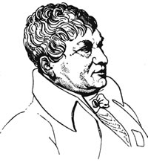
Gompertz’ Law
Benjamin Gompertz (1779-1865)
British mathematician and astronomer
denied a university education he was largely self-taught
appointed actuary of the newly formed Alliance Assurance Company in 1824
Gompertz law of mortality was published in 1825 after he worked on a new set of mortality tables for the Royal Society
‘On the Nature of the Function Expressive of the Law of Human Mortality, and on a New Mode of Determining the Value of Life Contingencies’, Philosophical Transactions of the Royal Society of London, vol.115 pp.513-85.
http://www-groups.dcs.st-and.ac.uk/history/Biographies/Gompertz.html

Slide 38
Gompertz’ Law
Gompertz assumes µₓ takes the form µₓ = Bc^{x} with parameters B and c
This continues to be a reasonable assumption at older ages
using the “important formula” _{t}p_{x} = exp - ₀∫^{t} µ_{x+s} ds
gives
_{t}p_{x} = exp -B
log c
c^{x}(c^{t}-1)

Slide 39
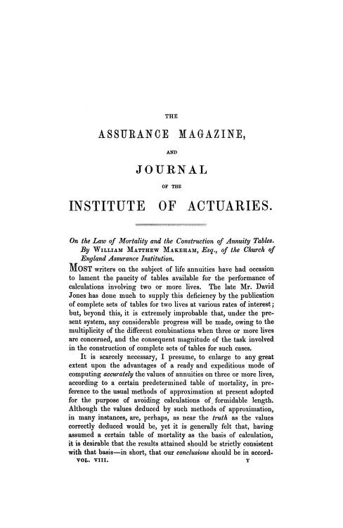
Makeham’s Law
William Makeham
published his development of Gompertz 45 years later in 1860
‘On the Law of Mortality and the Construction of Annuity Tables’, Assurance Magazine & Journal of the Institute of Actuaries, vol.8 pp.301-10
archive.org/details/jstor-41134925

Slide 40
Makeham’s Law
this allows for some deaths which are not dependent on age by adding an additional parameter to Gompertz
now µₓ takes the form µₓ = A + Bc^{x}
using the same “important formula” approach gives
_{t}p_{x} = exp(-A) . exp -B
log c
t
c^{x}(c^{t}-1)

Slide 41
Gompertz and Makeham
We will return to Gompertz and Makeham in the penultimate topic of the module – Graduation (likely to be in weeks 9 and 10)

