Slide 1
Thinking Geographically III: Geographical Traditions
Dr Sydney Calkin, s.calkin@qmul.ac.uk

Slide 2
Aims of the Seminar
Identify key features of several geographical traditions
Explore reasons for changes in geographical thinking
Identify suitable approaches for research subjects

Slide 3
Situating Research
“Embracing a particular way of knowing distinguishes a thesis or dissertation. It is what examiners and reviewers focus on as they try to place the work; the success or failure of a particular study often resides with its ability to contextualise itself in a larger corpus of knowledge...
Post-colonialism, humanism, econometrics and feminism are sets of methods and practices with their own assumptions, values and ways of proceeding. Each are legitimate geographic ways of knowing”
(Aitkin and Valentine 2006, 8)

Slide 4
Historical background I
Physical Geography approaches were dominant into the early 20th century
Human Geography approaches were shapes by environmental determinism
Environmental determinism: linked climatic conditions and other aspects of the physical environment to virtually everything, from culture, regional character, and political organization to the rise of civilization
Closely bound up with scientific racism to advance claims about ‘environmental’ reasons for European superiority

Slide 5
Historical background II
During the 19th century:
Geography as a scholarly discipline/ profession was closely tied to imperial conquest and colonization
University geography departments served to train teachers for the growing state school system and to be useful to the worlds of expanding commerce and imperialism
European geographers frequently associated their discipline with the perceived needs of empire; geography was claimed as an aid to statecraft

Slide 6
Quantitative Geography and Positivism:
The purpose of research is to explain how the world works
Data is collected about things that are known to exist and can be directly experienced
Data is collected through measurement and observation
Through repeated observations and testing, causal relationships can be established
Scientific knowledge must be falsifiable (contradictory evidence is a way of testing validify)
Positivism became synonymous with ‘good science’ during this time period

Slide 7
Quantitative Geography
Space as a surface on which measurable things are played out
Influenced by neo-classical economic models
Emphasized relationship between direction, distance and connection
Human activity can be reduced to movements, networks, nodes, hierarchies
This kind of geography positioned itself as ‘applied’ neutral expertise for environment management and planning

Slide 8
Critiques of quants/ positivism:
It imagines space as a featureless landscape
It imagines humans as aggregated flows without agency
It reduces complex phenomena too much
It cannot account for the processes that drive observed phenomena
It imagines scientific knowledge as having a ‘gaze from nowhere’

Slide 9
Derek Gregory (1978):
Theorizing is a social practice and cannot be divorced from its context
Human Geography is a social science that should draw on social theory
Theories are varied discourses that can be argued against and changed – they are not fixed or unified

Slide 10
Humanistic Geography
Key questions: What is the nature of the human world? What do human behaviours tell us about human life and experience?
Areas of interest: Human relations to nature, human geographical behaviours, human feelings and ideas in regard to place
Epistemology: Geographical activities and phenomena reveal the quality of human awareness, so we should study human behaviours, ideas, and beliefs about nature and place; emphasis places on human-centred interpretation of the world

Slide 11
New source material for geography: Art, Poetry, Literature, Novels
Humanistic geographers argue that literature provides evidence about the nature of place and human experience of it
For example: Tim Cresswell uses On the Road to write about the USA in the 1950s and the relationship between mobility, masculinity and ‘The American Dream’

Slide 12
Radical geography
Emerging partly from a critique of humanistic geography: that it is too focused on the small details of individual lives and cannot account for the broad context in which they live
Sought to make geography more relevant to the social world
Structuralists try to understand the structures in which humans live
Radical geographers wanted to make the discipline more political and more related to real life
Structuralists and radical geographers sometimes, but not always, overlap because of shared interests in class/ power structures

Slide 13
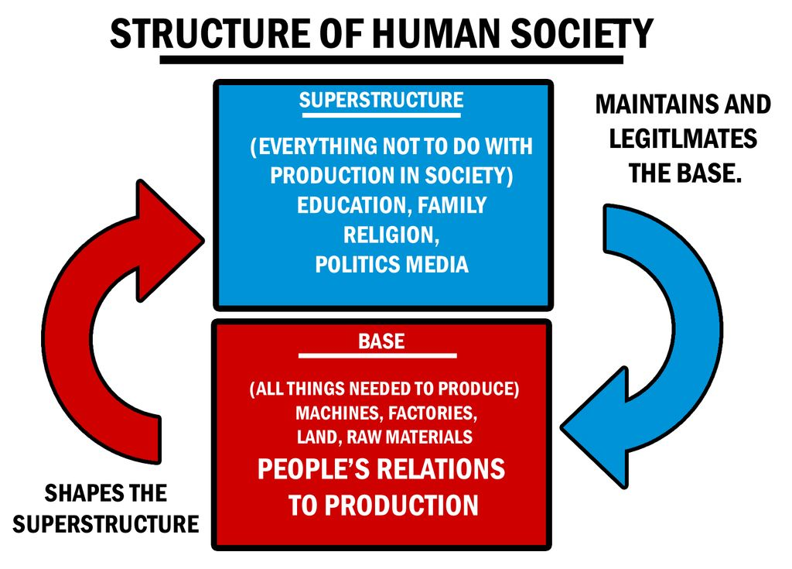
Many structuralists are influenced by Marxism
For Marx, the most important structures that shape our lives are capitalism and the class relations of capitalism
Marxist geographers are critical of ideas about ‘neutral’ spatial science, but also geographic traditions that do not focus on questions of power, space and capital

Slide 14
Marxist Geography
Marxist geographers: We should use geography to understand capitalism and to see how capital accumulation is spatialized
Key insights:
Space is not neutral, but socially produced, in relation to material events
Geographers should focus less on the agency of individual humans and look more at the material and political structures in which they live
Capital accumulation is spatial because it relies on destroying some spatial arrangements in order to create others
Geographers should identify AND CHANGE the processes that structure the lives of individual

Slide 15
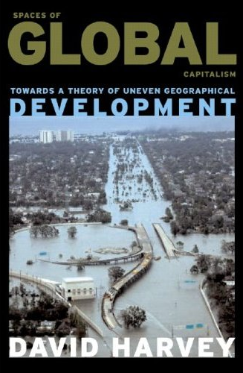
David Harvey:
Capitalism cannot survive without seeking a “spatial fix” by expanding and destroying/ building landscapes for capital
Globalization “is nothing more than yet another round in the capitalist production and reconstruction of space”
De-industrialization in one place is linked to industrialization in another, as capital moves across the uneven surface of the globe in search of profit
Capital moves to areas of cheap labour, for example by moving manufacturing sites to places with lower production costs in the global South

Slide 16
Feminist geography
Also has structuralist influences, but sees sex/gender system as the most important structure, not capital/ class
A few generations of feminist geography:
‘Mapping women’ and their lives which had been absent from geography
Studying women’s spaces and the gendered construction of space
Key insights: Construction of space is gendered
The discipline itself is masculinist and overlooks women/ women’s spaces/ women’s lives
For example: Geography traditionally reproduced gendered binaries that saw domestic space = female space = non-economic space

Slide 17
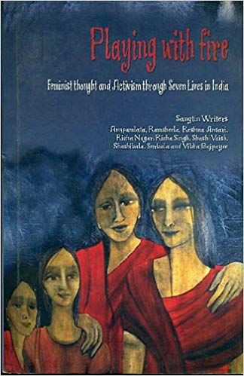
Feminist Methods
Key insights:
We must be reflexive about the power relations that constitute the research relationship
Scientific investigation can never stand apart from the subject it studies
Sought to theorize research as a collaborative and participatory practice designed to achieve the desired outcomes of participants
Research should be action oriented and connected to a project of social justice
2006. Sangtin Writers and Richa Nagar. Playing with Fire: Feminist Thought and Activism Through Seven Lives in India. Minneapolis: University of Minnesota Press.
Notes:
Richa Nagar -- the value of research should not be measured by how it accurately reflects or represents its subjects, but how it serves their political agency and contributes to their activism.
Playing with Fire is written in the collective voice of women employed by a large NGO as activists in their communities and is based on diaries, interviews, and conversations among them

Slide 18
Challenging binaries
‘Women’ is not a straightforward category of people with a single set of experiences and interests
Gender is always lived as one identity alongside race, class, sexuality, ability, etc.
Feminist geographers study how gender is lived in space, and how bodies/ borders/ spatial demarcations work to construct group identities
Browne explores “processes through which sexed bodies and spaces are (re)fixed, disempowering those who do not conform to the binary categories of man/woman, male/female” Browne, K. (2004).

Slide 19
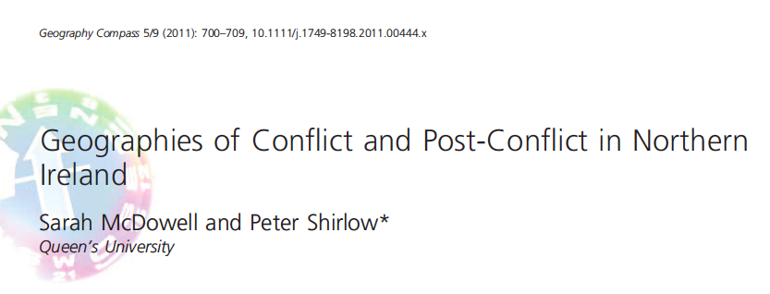
Seeing these traditions in practice/ in relation to each other:

Slide 20
Quants/ Mapping:
Research focused on quantifying violence and ethnic segregation in Belfast’s contemporary segregated urban landscape.
This work “provided an important framework for others examining the politicisation of space and ethnic division in other contexts, it did not go beyond quantifying and measuring conflict.. It did not attempt to explore the nature of cultural or political fragmentation nor did it try and gauge the attitudes between those who orchestrated or supported ethnic-sectarian enclaving and those who did not” (McDowell and Shirlow 702)

Slide 21
This work “explored divergent constructions of place through representation [and the] the social and geographical identity formations presented within literature” (McDowell and Shirlow704)
Stainer (2006) uses novels to critically interpret near-contemporary representations of place in two examples of Belfast fiction of the 1990s:
Cultural Turn:
Research focused on relationship between identity, place and belonging in Northern Ireland

Slide 22
Feminist geography:
Feminist critiques into spatial constructions of identity opened up a discussion about the gendered nature of the conflict.
“... Conflict did not fully undermine gendered divisions but instead reinforced the division between the foregrounded male ‘warrior’ and the backgrounded ‘obliging’ and ‘home-centred’ female” (704)

Slide 23
Participatory Geography/ Children’s Geography:
“Children and adults see the same sites through different eyes and that more child-centred methods are needed to capture and understand their views rather than seeing their behaviour through an adult lens” (Leonard 449)
“As existing users of city space, young people’s perspectives should be a necessary aspect of understanding how cities are perceived and encountered” (Leonard 449)
Participatory work: Protestant and Catholic teens design a tour of Belfast to highlight different spaces (shared and exclusionary)

Slide 24
Political Economy/ Structuralist Geography:
Situates sectarianism, ethno-national divides, spatial segregation, and post-conflict urban regeneration inside an economic critique:
The “conceptualization of a ‘normal’ society equates ‘neutral space’ to ‘capitalist’ space which is equally inscribed by markers of inclusion and exclusion and differently configured social groups but not by symbols of sectarianism” (Graham and Nash 217)
“... Space would become configured as ‘normal’ capitalist space with ‘acceptable’ axes of differentiation such as class, income and lifestyle and a neo-liberal accent on personal choice for those possessing the resources to exercise their choice” (Graham and Nash 217)

Slide 25
Articles cited in Northern Ireland section:
Boal, F. (1969). Territoriality on the Falls-Shankill divide. Irish Geography 6, pp. 30–50.
Graham, Brian, and Catherine Nash. "A shared future: territoriality, pluralism and public policy in Northern Ireland." Political geography 25, no. 3 (2006): 253-278.
Leonard, Madeleine. "The teenage gaze: Teens and tourism in Belfast." Childhood 26, no. 4 (2019): 448-461.
McDowell, Sarah, and Peter Shirlow. "Geographies of Conflict and Post‐Conflict in Northern Ireland." Geography Compass 5, no. 9 (2011): 700-709.
Stainer, J. (2006). Localism, significance, imagination: de-stabilising sectarian identities in two fictionalised accounts of the troubles. Social and Cultural Geography 7 (1), pp. 103–126.

Slide 26
Key questions

Slide 27
What are the key points of debate/ disagreement over geographical research that shape the different traditions we discuss in this session?
2. How do these geographical research traditions differ on their understanding of the purpose of research, the position of the researcher, and the production of knowledge?
3. Which of the research traditions discussed here is most familiar to you from your previous study? Which tradition is most influential in your research design for the MA dissertation?

