Slide 1
‘Sexual minorities’ (Minorités sexuelles) and the Republic
From the PaCS to the ‘marriage for all’

Slide 2
Introduction
Law of the 17 May 2013: Authorizes same-sex marriage
Nicknamed: “Mariage pour tous” (Marriage for all)
Electoral promise of François Hollande during the 2012 Presidential campaign

Slide 3
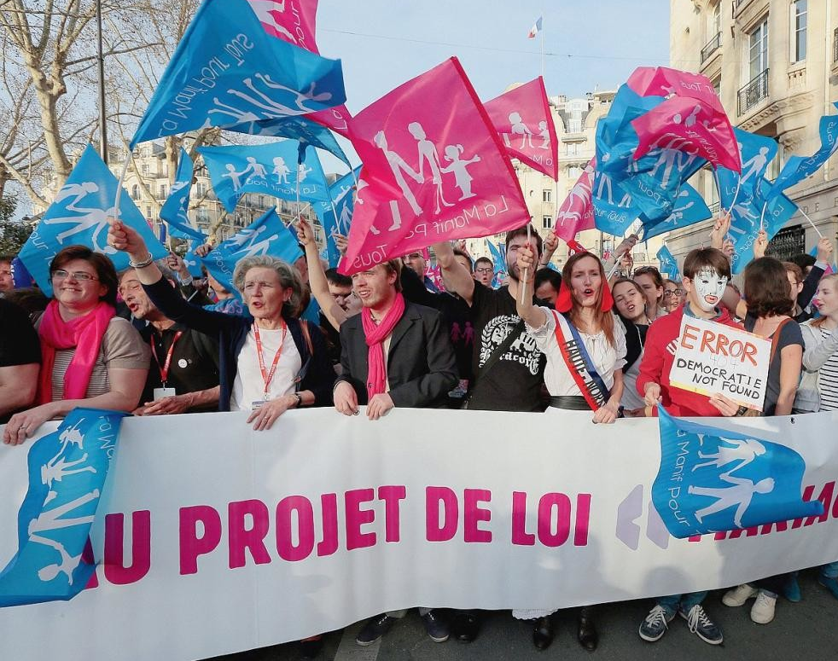
Introduction
Important debates surrounded the law
Opponents:
Majority of right-wing party members (UMP, FN/RN)
Manif pour Tous
Printemps Français
Defenders of the “traditional family”
Links to Catholic and “traditionalist" circles

Slide 4
Introduction
Supporters:
LGBTQ+ platforms and associations
Human rights groups
Most left-wing parties, Greens, and a few representatives from the liberal/progressive right.

Slide 5
Introduction
Fits into a broader debate on French republicanism and how it adapts to evolutions in French society
Like other debates (parité, Islam, race...), supporters and opponents of same sex marriage mobilized French Republican tradition.
Citoyen as abstract individual who enters into direct relationship with the State not mediated through any aspects of sub-State level identity (Johnston, 2008)
Preculding possibility of discrimination on basis of distinguishing feature such as sexuality.
2013 Law is outcome of a long process
Linked to recognition of homosexual rights
A first key moment: civil partnership (Pact Civil de Solidarité, 1999)

Slide 6
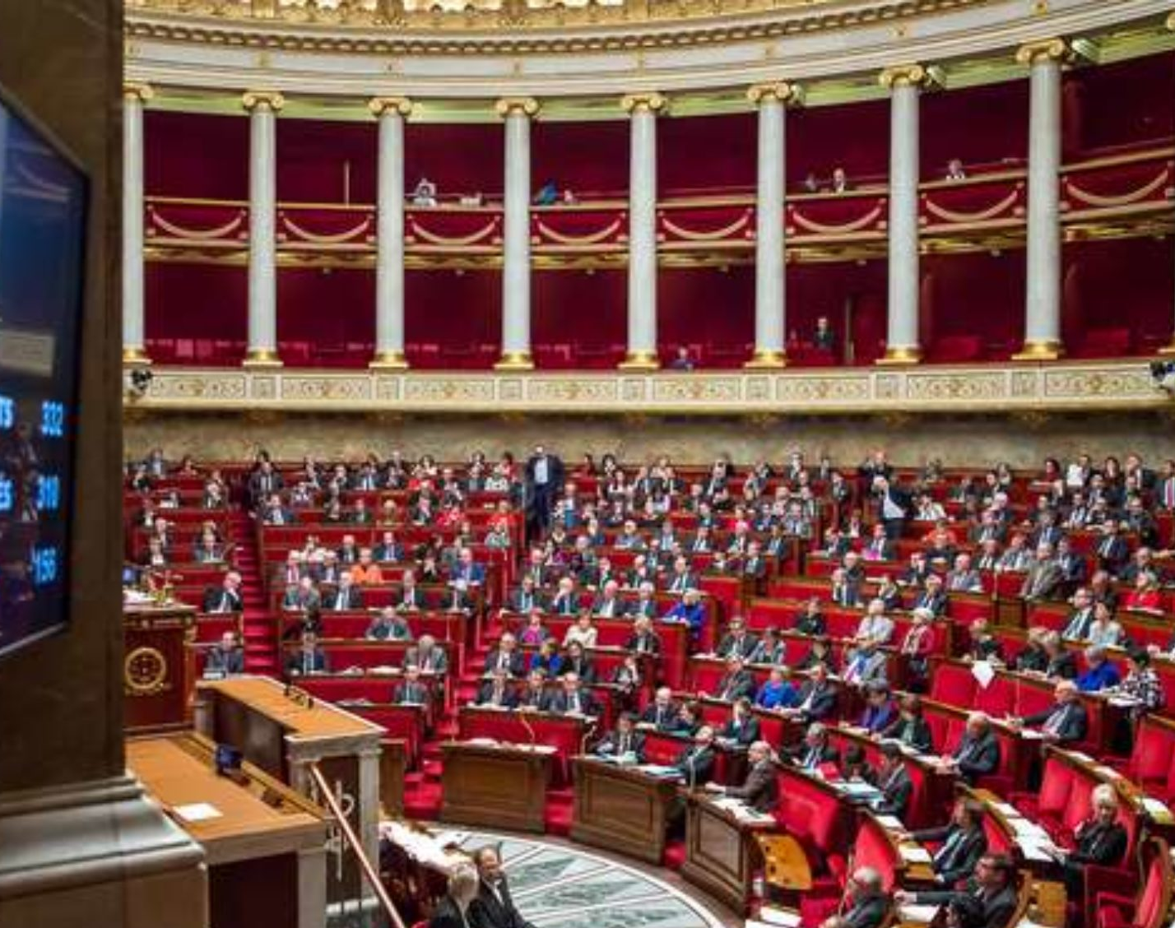
The Pacte Civil de Solidarité (PaCS)
1999: Parliament adopts law instituting PaCS
In political space, gay and lesbian rights = traditionally left-wing issue
1981: Socialists come to power
Abolished sole form of legal discrimination against homosexuality
Passed 1985 law against discrimination that included sexual orientation in its definition.
Socialists had then reached their goals: homosexual individuals were to be left alone
Sexuality = private affair (// right to indifference, not to difference)

Slide 7
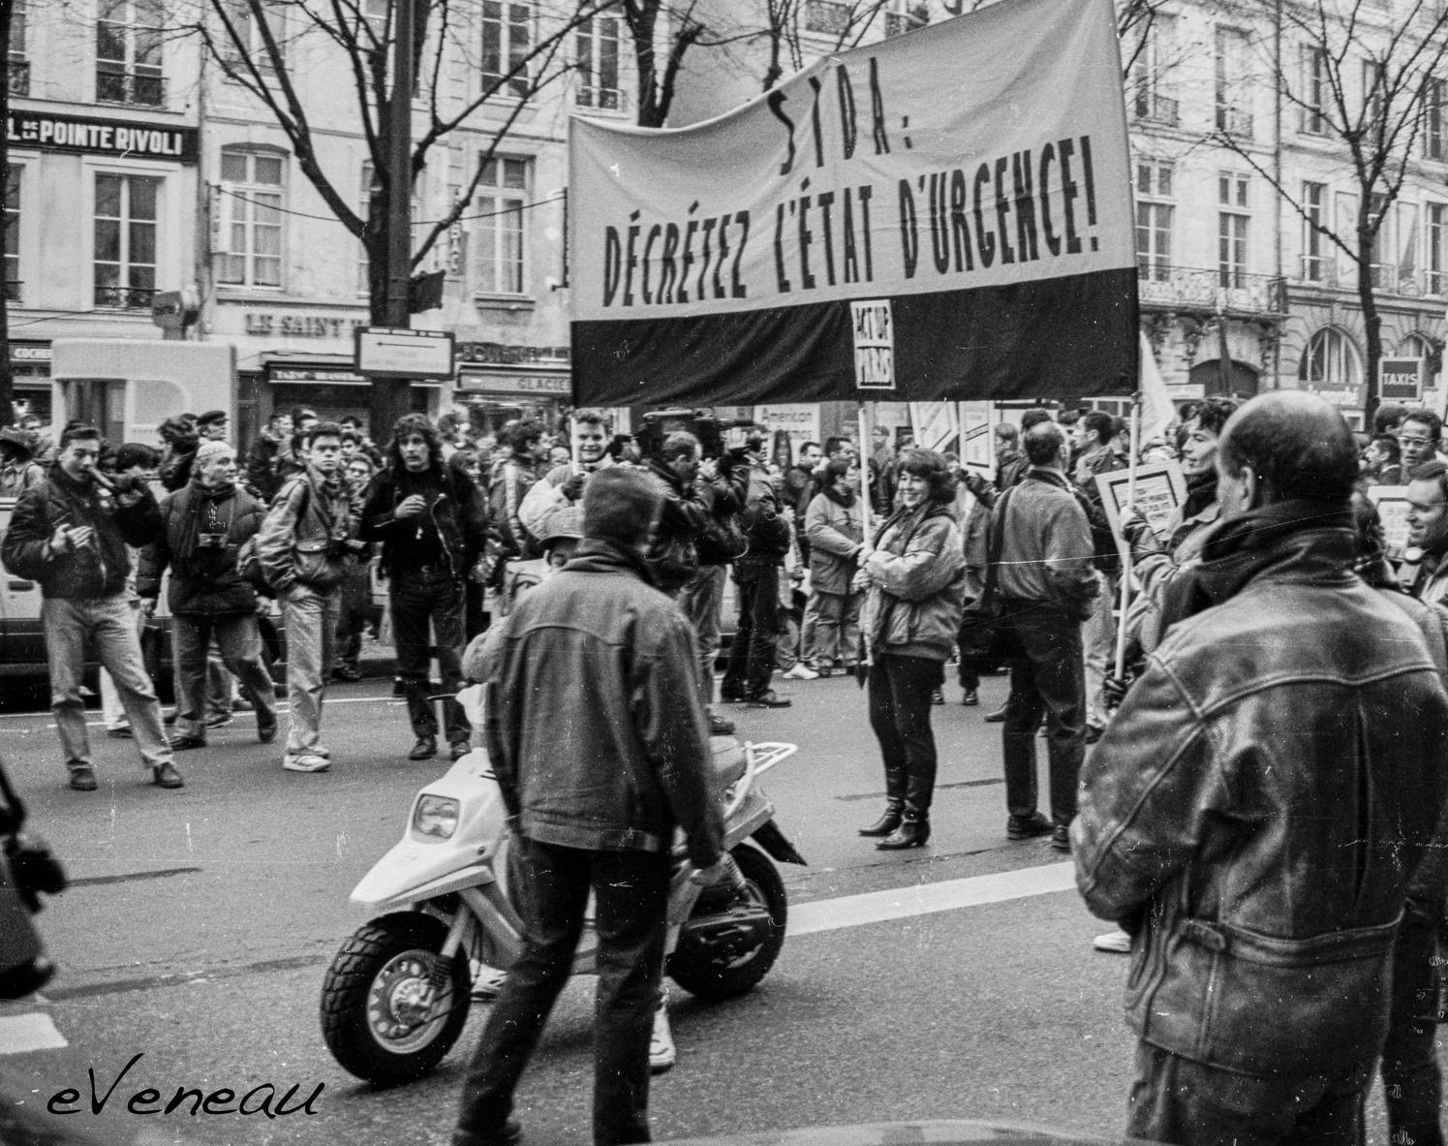
The Pacte Civil de Solidarité (PaCS)
“What the 1980s revealed, however, was that discrimination was not simply a matter of individuals" (Fassin, 2001)
Rise of HIV (human immunodeficiency virus) and AIDS (acquired immunodeficiency syndrome)-related deaths
Became clear that there was discrimination against same-sex couples.
Same-sex couples lacked access to health insurance, tax exemptions, and inheritance rights, and even the right to jointly own or rent property.
1980s: "Années SIDA" (approximately 30,000 deaths between 1983 and 1995) and rise of gay and lesbian movement (through associations like Act-Up, AIDES...)
Homosexual couples: no legal recognition
Until 1990s: demands for legal recognition of same-sex couples are relatively marginal in public debate

Slide 8
The Pacte Civil de Solidarité (PaCS)
Mobilisations:
1989: Association Gays pour la Libeté calls for equal rights for homosexual couples
1990: Civil partnership project presented at the Socialist Party Congress
1992-1995: Campaign for a Contrat d'Union Civil et Social
1997: Electoral victory of Socialists (Gauche Plurielle) in legislative elections.
Platform included legal recognition of same-sex couples.

Slide 9
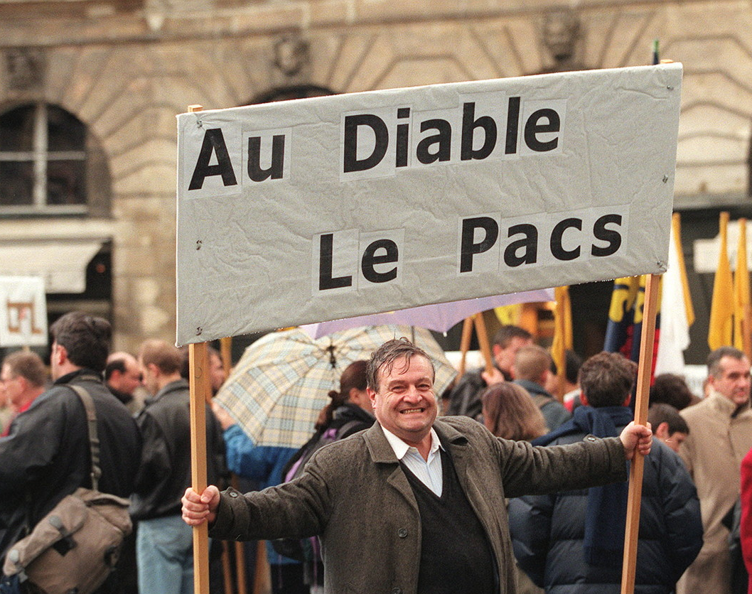
The Pacte Civil de Solidarité (PaCS)
PaCS status = open to same-sex and opposite-sex couples
This point remained in all versions proposed under different names throughout the 1990s
Offers a halfway solution between:
Concubinage (informal domestic relationship) and mariage
Law guarantees social rights for the new pacsés
Access to health insurance, tax exemptions, and even inheritance
“But these are limited rights (access to citizenship is notably not included) and, moreover, are granted with obvious reluctance (delays are imposed before the rights take effect, under the suspicion of fraud)” (Fassin, 2001:218).

Slide 10
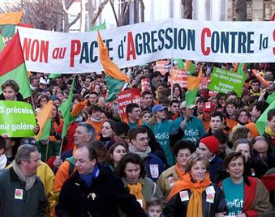
Tense debate
Deep divisions within political arena
Left vs. Right
On Right: Catholic and family associations
Rally in January 1999
Christine Boutin
65-hour speech
Defines homosexuality as a form of exclusion: “Qu'est ce que l'homosexualité sinon l'impossibilité à atteindre l'autre dans sa différence sexuelle?”

Slide 11
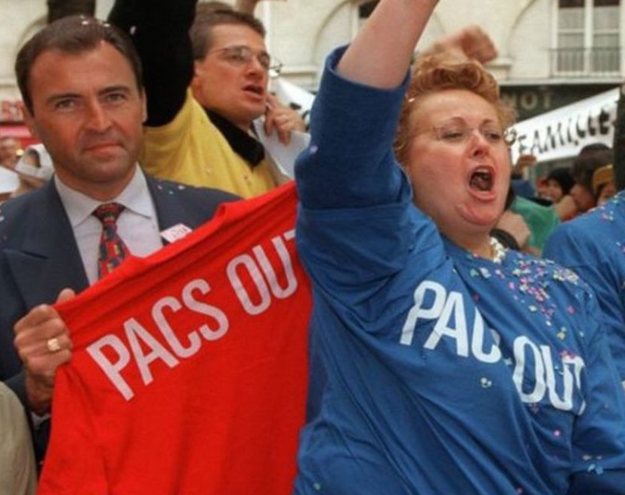
Critiques
Arguments put forward by opponents
PaCS has negative impact on marriage
Opens the door to same-sex marriage (which will be the case in 2013)
Medically-assisted procreation and surrogate motherhood
Critiques from within gay and lesbian communities:
Inequalities are maintained
Not sufficient

Slide 12
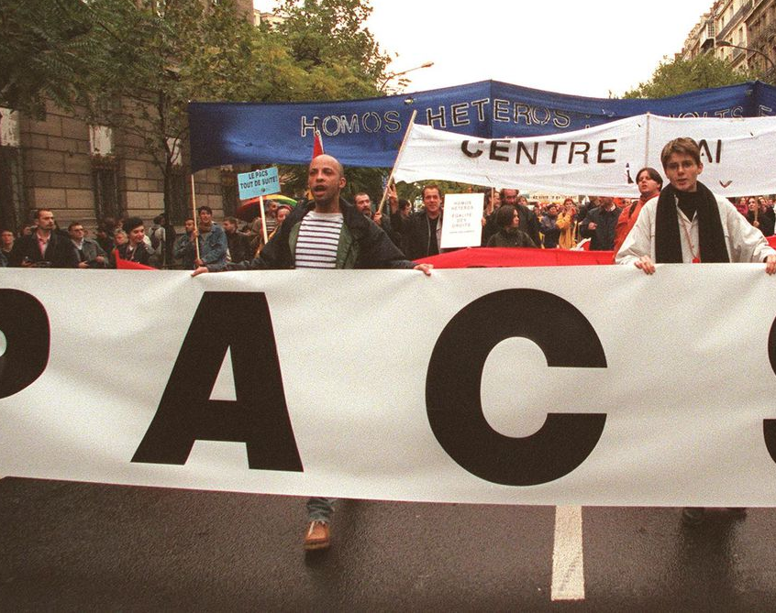
The PaCS and the Republic
Struggle between competing understandings of French Republicanism
Risk of “communautarianism” / “separatism”
Against the “communautarian temptation” (Frédéric Martel, 1996:398)
“La logique communautaire mène quasi nécessairement à la logique identitaire” (Martel, 1996:403)

Slide 13
The PaCS and the Republic
Major source of tension: potential impact of PaCS on family structures, filiation/kinship and citizenship (Johnston, 2008:89)
Recognized legal status of the relationship between family members. Creates rights and obligations. Father and mother.
Particular focus on the issue of "filiation“:
Evolution of family structures
Shift from individuals to couples.
No longer "right to indifference" or "tolerance" BUT "right to difference" / "recognition"
Fassin: “The problem, which was accurately perceived by conservatives, was that once engaged in such a logic, there was no reason not to continue.” (Fassin, 2001:225)
Why not proceed beyond couples to families?
Why stop at domestic partnerships without including reproductive rights?

Slide 14
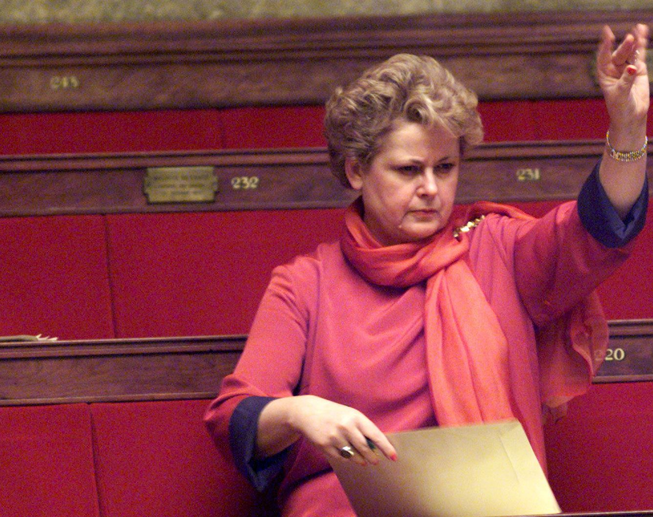
The PaCS and the Republic
Notion of “filiation” (filiation, kinship) was central to opposition to PaCS (and later to same sex marriage).
Irène Théry (1999):
“Filiation without sexual difference would […] undermine a symbolic order that is the very condition of our ability to think and live in society.”
Gélard report to the Commission des Lois (1999):
“Dangers que représente ce statut pour le mariage et l'union libre ainsi que des risques qu'il comporte en matière de filiation du fait qu'il s'adresse indifféremment à des couples qui ont vocation à procréer et à d’autres qui ne le peuvent pas.”
“La famille doit rester le lieu de la ‘différence symbolique’ des sexes.”

Slide 15
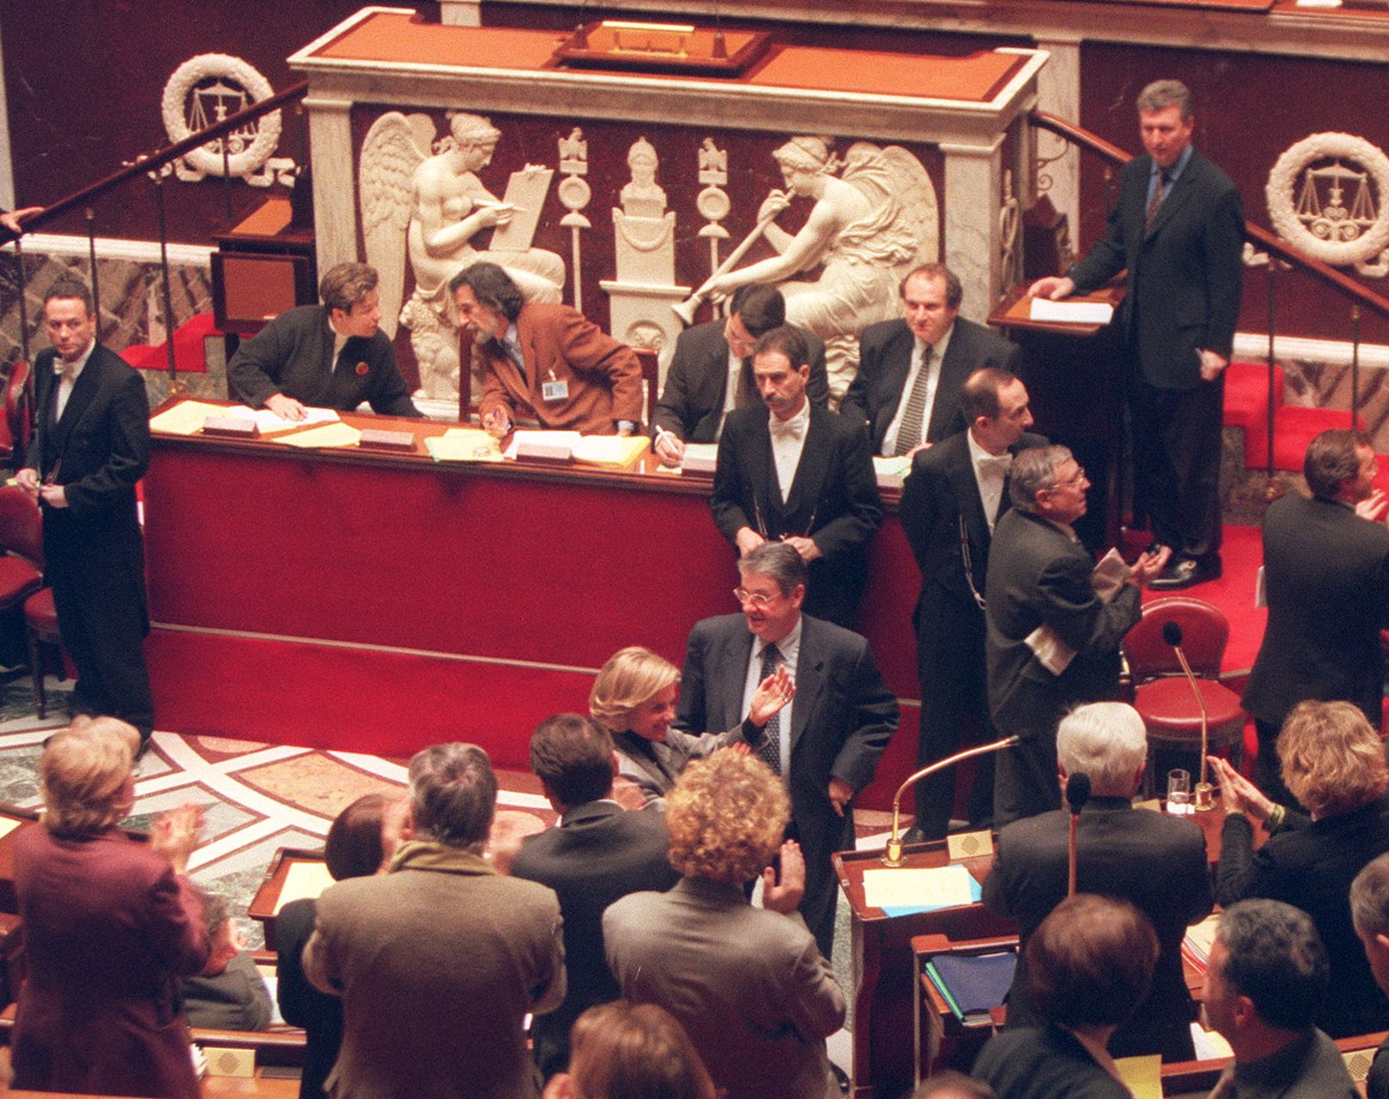
The PaCS and the Republic
What do they mean by “différence symbolique” and “symbolic order”?
Filiation/kinship structures human psyche (symbolic link between parent and child) and at same time culture itself.
“The argument was that if sexual difference is defined within culture by the observation of nature, then it is the key, not only to (biological) reproduction, but also to (symbolic) filiation.” (Fassin, 2001:226)
Argument provided intellectual legitimacy to the defense of a “symbolic” (that is social) order: “Our” kinship system had a universal reality - (French) ‘universality’ was thus reclaimed through a play on words.

Slide 16
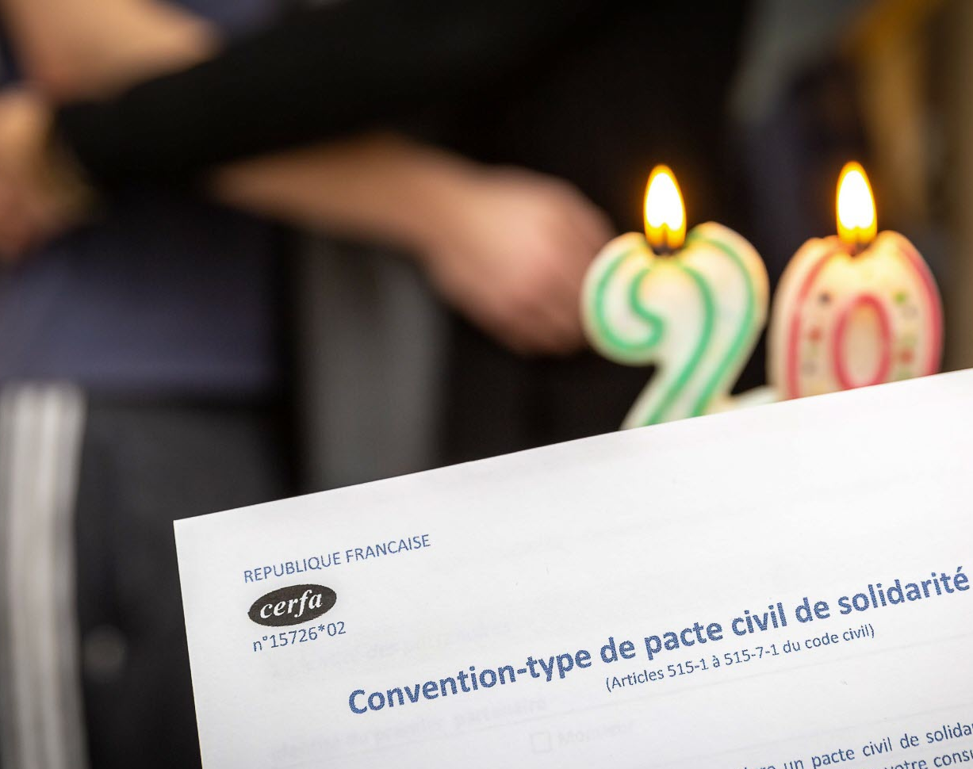
A heteronormative Republic?
Right to difference as long as it does not affect the social and moral fabric of French society.
Cultural and symbolic hegemony of heterosexuality (social norm)
Idea of a “sexually biased” Republic.
Sexual difference is “a fundamental (they say 'anthropological') reference that is pre-political insofar as it structures society: as a consequence, it should not be trifled with politically.” (Fassin, 2001: 229)

Slide 17
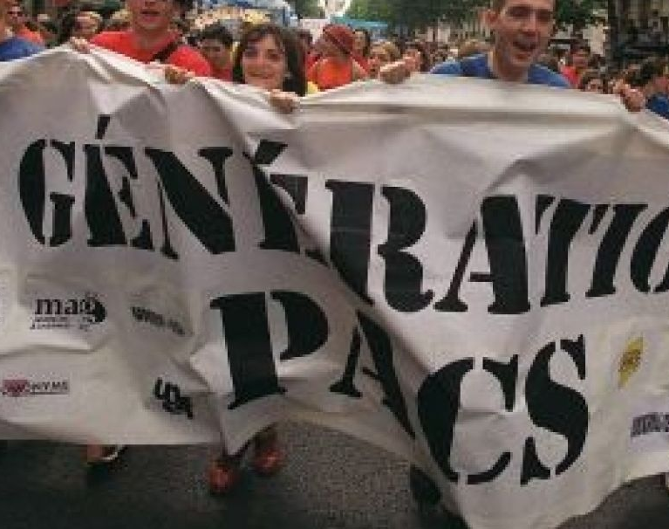
A heteronormative Republic?
PaCS debate “[highlights] discrepancies between republicanism in its 'inherited' form, and a renewed, renegotiated form that would be more appropriate as an expression of the values of contemporary France.” (Johnston, 2008:93)
Feeds into the debate on relevance of founding ideology in a social, political and cultural climate very different to that of 1789
Need for a renegotiation of Republicanism in order for ideology to remain of relevance to citizens today.

